Slide 1

LGAD technologies R&D towards the ETL*
2019 Activities Summary & 2020 Strategy and goals
FPA2017 coordination meeting
IMB-CNM, Jan 20th 2020
I. Vila
Instituto de Física de Cantabria (CSIC-UC)
^{(*)} Not covered here activities on MTD performance (TDR et al.)

Slide 2
Outline
Summary 2019
Outlook 2020: review of ETL milestones and strategy definition.

Slide 3
RD on LGAD in 2019 at a glance
Main focus on the radiation tolerance of the AIDA-2020 v1 run and preparing for future i-LGAD projects (RD50 and AIDAnova)
The measurements are completed, the analysis is ongoing.
Presented at Vienna Conference of Instrumentation (NIMA), Trento Workshop and RD50 workshops.
Presented at the ETL sensor working meeting (need to improve)
Consolidated collaboration with SSD – CERN group.

Slide 4
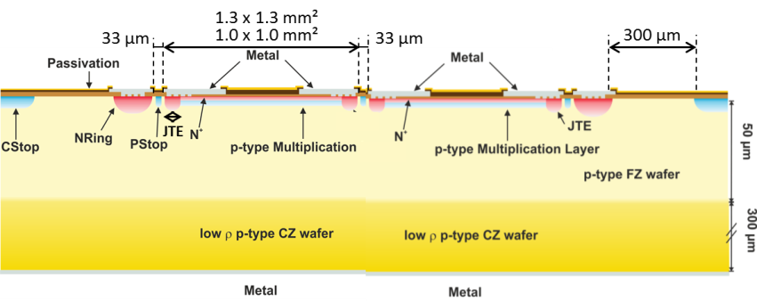
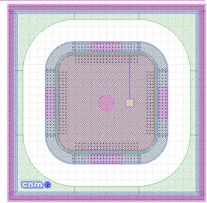
The context: high-reverse current on the AIDA2020 production
(run# 11748)
W # | GAIN | THICKNESS (um) | TEMPORARY METAL
1 | NONE | 35 + 300 | YES
2 | LOW | 35 + 300 | YES
3 | LOW | 35 + 300 | NO
4 | MEDIUM | 35 + 300 | YES
5 | MEDIUM | 35 + 300 | NO
6 | HIGH | 35 + 300 | YES
7 | HIGH | 35 + 300 | NO
8 | LOW | 50 + 300 | YES
9 | LOW | 50 + 300 | NO
10 | MEDIUM | 50 + 300 | YES
11 | MEDIUM | 50 + 300 | NO
12 | MEDIUM-HIGH | 50 + 300 | YES
13 | HIGH | 50 + 300 | YES
14 | HIGH | 50 + 300 | NO
Total area: 2.6x2.6 mm2
Active active area 1.3x1.3 mm2
DEVICE ID (w11) | FLUENCE (neq/cm2)
DB11 | 6.00E+13
DB12 | 1.00E+14
DB13 | 1.00E+14
DB14 | 3.00E+14
DB15 | 3.00E+14
DB16 | 1.00E+15
DB17 | 6.00E+13
DB18 | 1.00E+15
DB19 | 3.00E+15
DB20 | 3.00E+15
DEVICE ID (W5) | FLUENCE (neq/cm2)
DB10 | 6.00E+13
DB11 | 6.00E+13
DB12 | 1.00E+14
DB13 | 1.00E+14
DB14 | 3.00E+14
DB15 | 3.00E+14
DB16 | 1.00E+15
DB17 | 1.00E+15
DB19 | 3.00E+15
DB20 | 3.00E+15

Slide 5
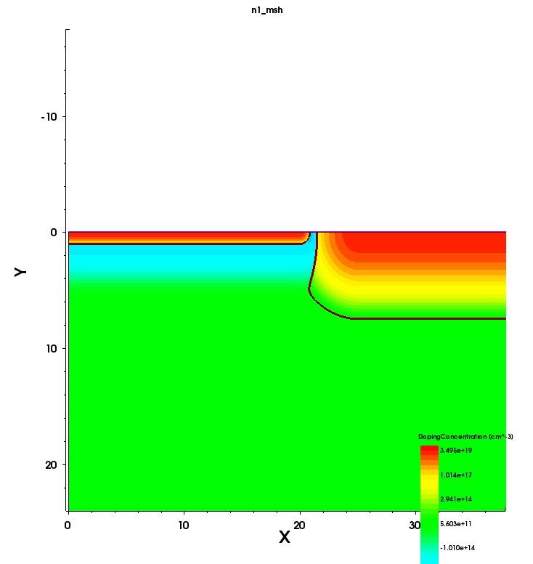
The context: high-reverse current on the AIDA2020 production
(run# 11748) (2)
N+ diffusion
JTE
Multiplication layer
TCAD Simulations explain the high current assuming that the N+ diffusion does not reach the JTE diffusion and a gap exists between them. Thermographic studies confirmed this assumption.
We have corrected the design of the mask in order to make the overlap between N+ and JTE larger. Now, N+ is diffused until the end of the JTE to assure its continuity along the periphery

Slide 6
Characterization main results

Slide 7
Characterization main results

Slide 8
Characterization main results

Slide 9
Characterization main results

Slide 10
Characterization main results

Slide 11
Characterization main results

Slide 12
Characterization main results

Slide 13
Characterization main results

Slide 14
Characterization main results

Slide 15
2020 activities approach
Close AIDA-2020 v1 Timing resolution and pop-corn noise analysis to be completed and published
Focus on AIDA-2020 v2 samples.
Increase participation on ETL LGAD R&D (alignment with ETL milestones, see next slides).
Increase cooperation with CERN and integrate CNA on LGAD R&D.

Slide 16
ETL 2020 milestones

Slide 17
ETL 2020 Milestones

Slide 18
ETL 2020 Milestones

Slide 19
ETL Reorganization
  ETL Meetings
    Time changed to 16:30-18:00 on Mondays to avoid a standing conflict with the Upgrade Steering Group meetings.
      We will try to finish by 18:00, with only rare overflows.
      Meetings have evolved from early sensor focussed R&D to be all encompassing over the past year.
      ETL plans to structure the meetings with an even/odd week focus to accommodate broadening scope:
        Odd weeks: Sensors and modules Organized by Artur and Nicolo
        Even weeks: Front end and system testing Organized by Ted, Chris and Marco.
  Module Workshop
    Workshop dates set for Feb. 10-11 in Torino. Thanks to Nicolo for hosting!
    At least one representative from each institution that plans to participate in module-related activities should attend.
    A major goal coming out of this workshop is to converge on a prioritized list of deliverables for this year and the timeline andresources needed.
  Pending Items
    Service Hybrid Project Definition Team status
    Identification of engineer for power supply requirements

Slide 20
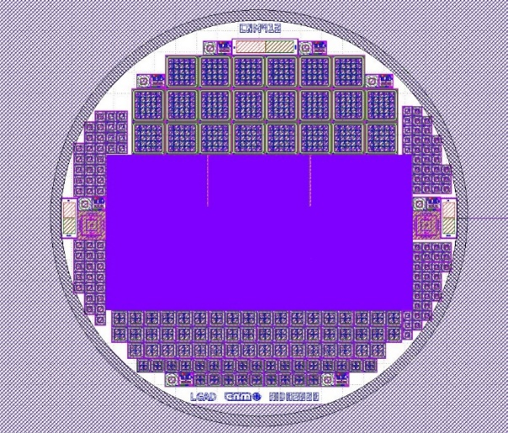
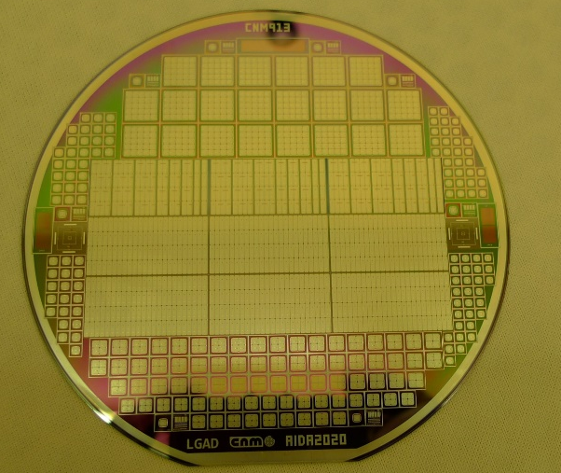
AIDA 2020 v2 (run # 12916)
Four wafers with the same dose/energy parameters.
New AIDA2020 run. Repetition of the previous run due to high leakage current.
IV/CV measurements on wafer (preliminary). Only pads were measured.
One wafer already diced the rest to be processed for temporary metal deposition to allow the QA of large diode matrices.
Wafer | Thickness (µm) | Dose (at/cm²) | Energy (keV)
1-4 | 50 | Medium | Low

Slide 21
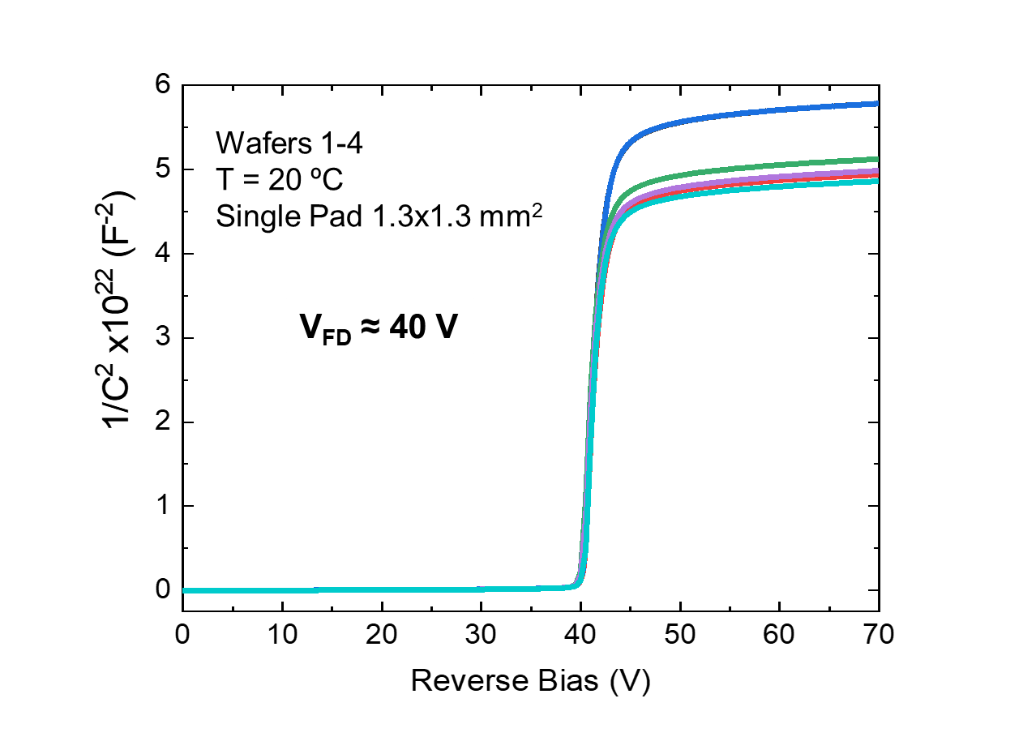
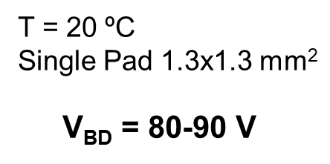
AIDA-2020 v2
(run # 12916) – Electrical characterization
Increasing the overlap between the JTE and the main diffusion n++ dramatically reduced the reverse current while preserving the multiplication.

Slide 22
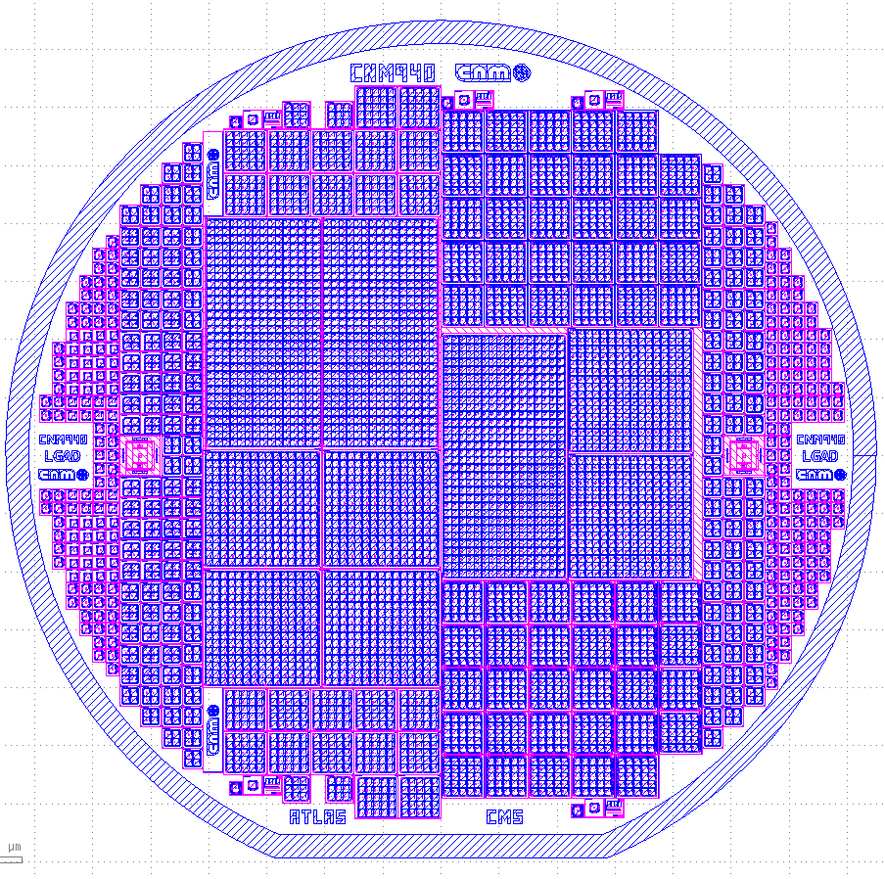
6’’ Thin LGAD 4 ATLAS/CMS (50 µm thick Epi-Wafers)
Common Run ATLAS/CMS. CNM940 v20190925
  150 mm wafers
  New run using 6”, 50+300 µm thick, Epi-Wafers
  Layout proposed by ATLAS-HGTD and CMS-ETL
  Timing detectors with Pad and Matrix designs
  Change standard Slim Edge to 500 µm (called SE5)
  3 Inter-Pad Gaps: 37, 47, 57 µm (corresponding to JTE 5, 10, 15 µm), called IP37, IP47, IP57
  Same positions of large probe pads for common probe card between HPK+CNM
  35-50 µm thick Si-Si wafers were purchased in January 2018 but the wafers haven't arrived by now (IceMosTech)
  1x CMS_1.3x1.3_16x32_IP57
  2x CMS_1.3x1.3_16x16_IP57
  28x CMS_1.3x1.3_5x5xN_IP57
  15x CMS_1.3x1.3_5x5_IP57
  9x CMS_1.3x1.3_5x5_IP47
  3x CMS_1.3x1.3_5x5_IP37
  1x PiN_1.3x1.3_5x5_IP57/47/37
  32x CMS_1.3x1.3_2x2_IP57/47
  5x PiN_1.3x1.3_2x2_IP57/47
  48x CMS_1.3x1.3_1x1_IP57/IP47
  16x PiN_1.3x1.3_1x1_IP57/47
Notes:
2. You can see a mask description of the 6-inch thin LGAD for ATLAS/CMS common run, in slide number 2. This run will be fabricated using 50+300 micron thick, epitaxial wafers. The mask design is based on the layout proposal by ATLAS-HGTD and CMS-ETL communities, and it includes several timing detectors with pad and array designs.
Taking into account the results of the above processes, we reduce to 500 micron the standard slim edge width. We consider also 57, 47 and 37 micron for the inter-pad distance, changing to 15, 10 and 5 micron the JTE width, maintaining the cell pitch value constant for all structures. All large probe pads will be compatible with the common HPK/CNM probe card.
35 and 50 micron thick, silicon on silicon wafers, were purchased in January 2018, but the wafers haven’t arrived by now from IceMos.

Slide 23
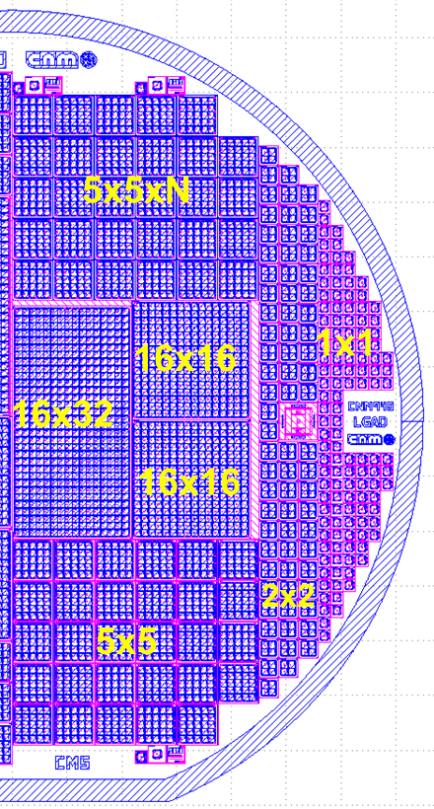
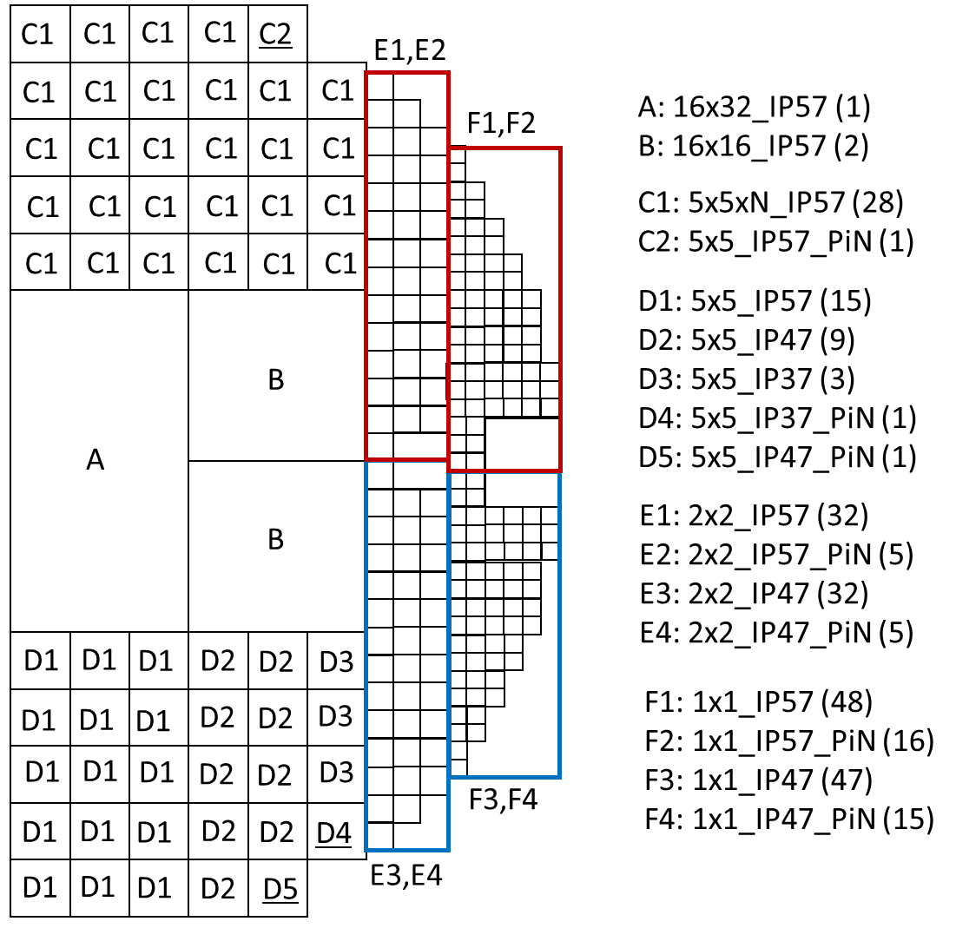
6’’ Thin LGAD 4 ATLAS/CMS (50 µm thick Epi-Wafers)
Common Run ATLAS/CMS. CNM940 v20190925
Inter-pad gaps: IP57/47/37 = 57, 47, 37 µm (Silicon between adjacent Multiplication areas)
Slim-edges: SE5 = 500 µm (Guard Ring to Dicing Path distance)
16x32 Module with 500 µm gap in the bump pad mask to be able to use 2 ETROCs
C1. 5x5xN Modules with Passivation on the Dicing Path (They could be cut with different configurations)
31 LGAD+PiN Modules
3 5x5 PiN Modules
Notes:
4. In this sense, we use an inter-pad gap of 57 microns for the 16x32, 16x16 and 5x5xN modules, using 57, 47 and 37 microns in the 5x5 modules. For the 2x2 and 1x1 modules we use 57 and 47 microns gap. All structures have 500 microns width from the guard ring area to the dicing path …

Slide 24
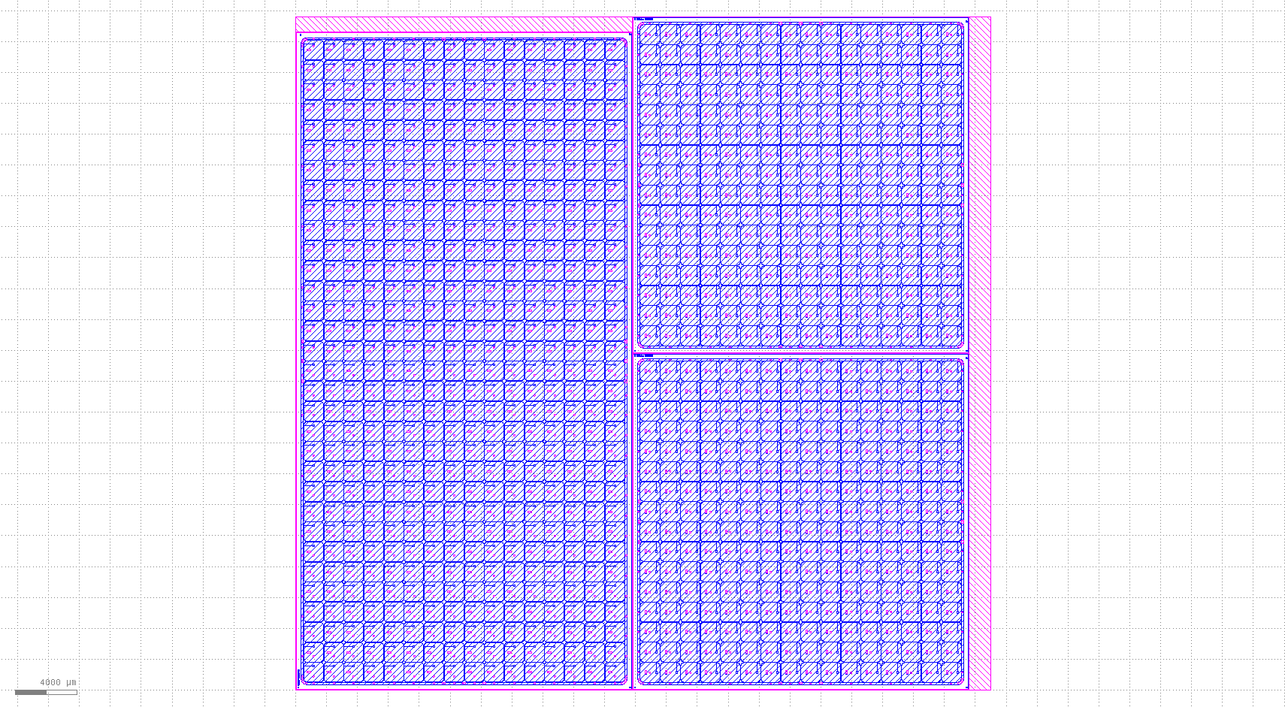
6’’ Thin LGAD 4 ATLAS/CMS (50 µm thick Epi-Wafers)
Common Run ATLAS/CMS. CNM940 v20190925. 16x32 + 16x16 Modules

Slide 25
6’’ Thin LGAD 4 ATLAS/CMS (50 µm thick Epi-Wafers)
Common Run ATLAS/CMS. CNM940 v20190925. 16x32 Module. 2x 16x16 500 µm

Slide 26
Summary
The design issue generating the high reverse current for the AIDA-2020 LGAD run located and fixed.
New manufacturing run fixing the issue just completed.
Electrical characterization of the fixed AIDA-2020 design successfully: reverse current back to nA/mm²
Please contact us if you want samples.
New ATLAS/CMS common run including the final TDR sensors layouts to start in December(turn around time of about five months).
Samples to be distributed among the interested groups.
Production cost covered by Spanish LGAD project, Atlas HGTD groups cover the cost of the wafers, can be mask cost covered by CMS groups? Around 12kCHF in total.
REPETITION OF
AIDA 2020 RUN
New common
ATLAS/CMS RUN

Slide 27
6’’ Thin LGAD 4 ATLAS/CMS (50 µm thick Epi-Wafers)
Common Run ATLAS/CMS. CNM940 v20190925
Inter-pad gaps: IP57/47/37 = 57, 47, 37 µm (Silicon between adjacent Multiplication areas)
Slim-edges: SE5 = 500 µm (Guard Ring to Dicing Path distance)
16x32 Module with 500 µm gap in the bump pad mask to be able to use 2 ETROCs
C1. 5x5xN Modules with Passivation on the Dicing Path (They could be cut with different configurations)
31 LGAD+PiN Modules
3 5x5 PiN Modules
LGAD+PiN
Notes:
5. In the 16x32 module passivation layer, we include 500 microns gap in the middle area in order to be able the use of two 16x16 pixels ETROCs to read it (in a similar way than ATLAS uses in their 15x30 modules).
In the top area of the half wafer we include 5x5xN modules with passivation on the dicing path, to cut them with different configurations maintaining the electrical isolation in the cutting area.
We include a column with 31 LGAD+PiN pairs, also.
You can see a summary of the integrated structures in the table located on the right-hand side of the slide.

Slide 28
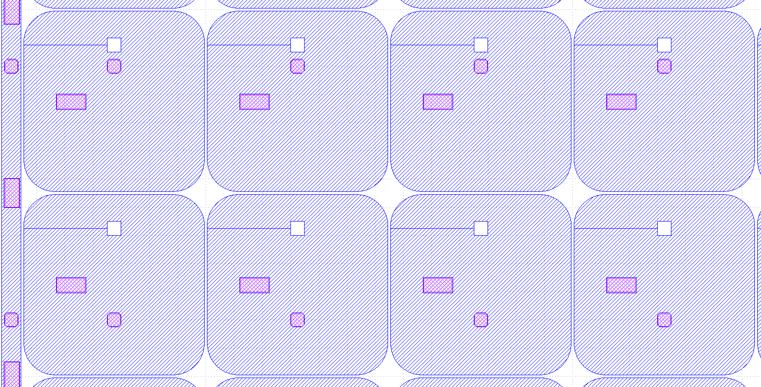
6’’ Thin LGAD 4 ATLAS/CMS (50 µm thick Epi-Wafers)
Common Run ATLAS/CMS. CNM940 v20190925. 16x32 Module. 2x 16x16 500 µm

Slide 29
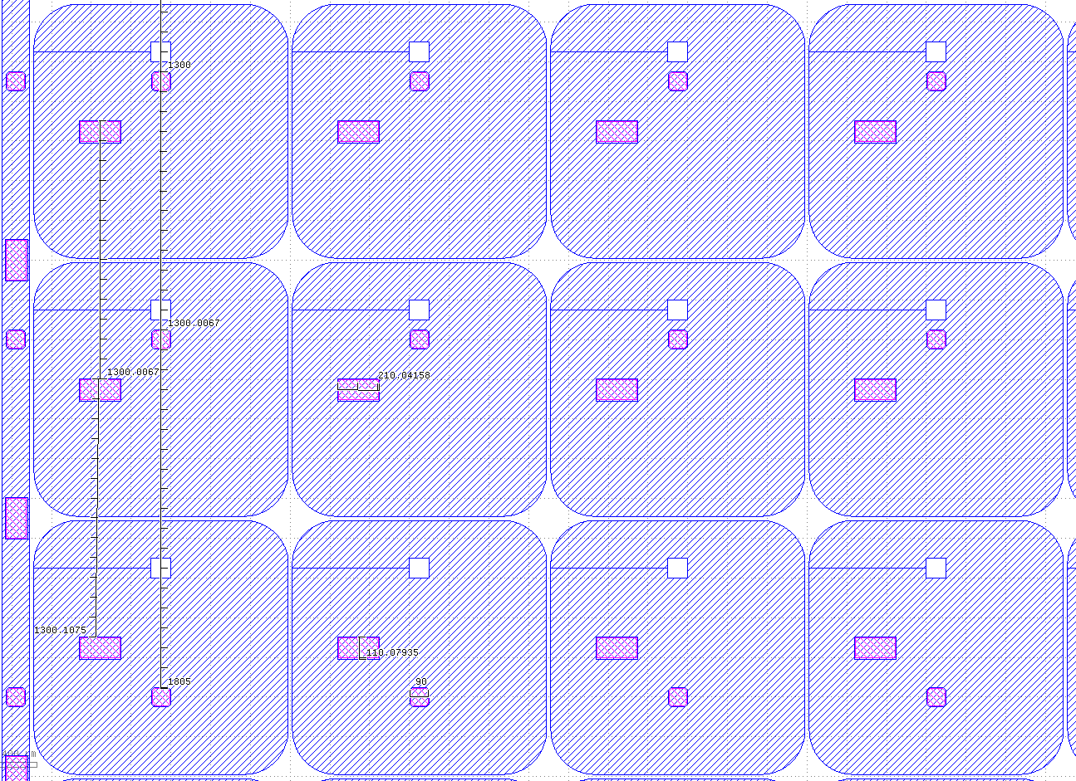
6’’ Thin LGAD 4 ATLAS/CMS (50 µm thick Epi-Wafers)
Common Run ATLAS/CMS. CNM940 v20190925. 16x32 Module. 2x 16x16 500 µm
1300 um
1300 um
210 um
1800 um
1300 um
110 um
90 um

Slide 30
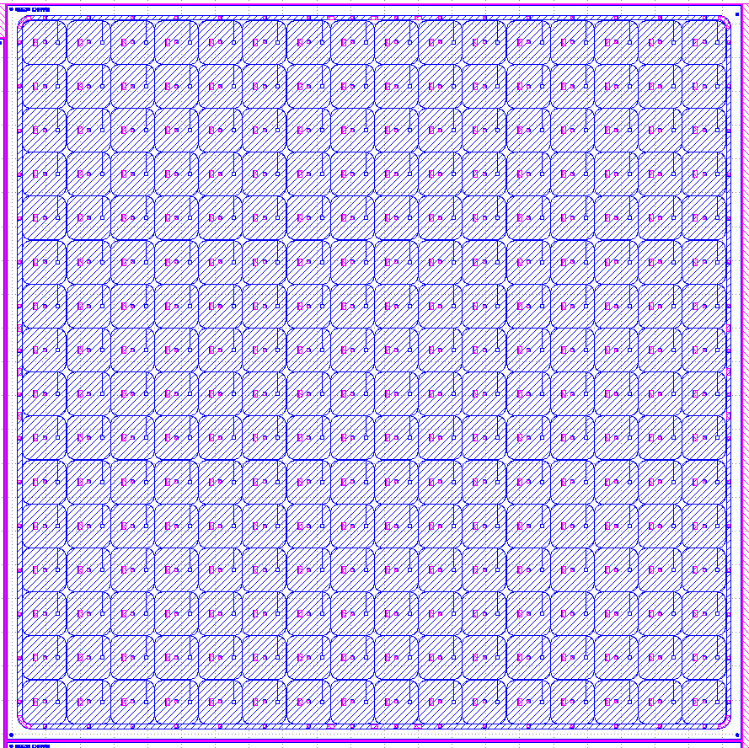
6’’ Thin LGAD 4 ATLAS/CMS (50 µm thick Epi-Wafers)
Common Run ATLAS/CMS. CNM940 v20190925. 16x16 Module

Slide 31
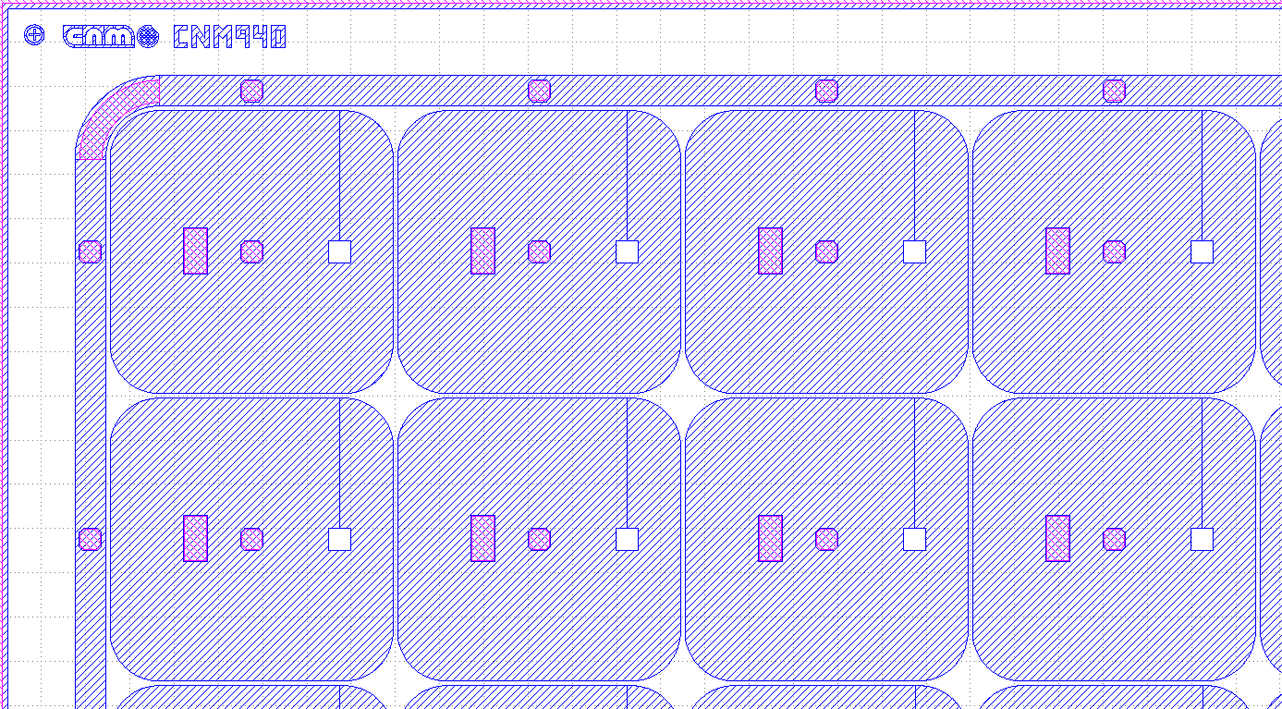
6’’ Thin LGAD 4 ATLAS/CMS (50 µm thick Epi-Wafers)
Common Run ATLAS/CMS. CNM940 v20190925. 16x16 Module
1300 um
210 um
110 um
1300 um
90 um

