Slide 1
Measurement of the Coulomb Sum Rule and Suppression of the Longitudinal and Enhancement of the Transverse Quasielastic Cross section
From an analysis of all available electron scattering data on Carbon and Oxygen
A. Bodek¹ and M. E. Christy²
¹The University of Rochester, Rochester, NY, USA
Thomas Jefferson National Accelerator Facility, Newport News VA, USA
NuInt 2022 Seoul, Korea
24 Oct 2022, 21:00 Eastern Time 20m
The link is shown below.
https://indico.cern.ch/event/881216/videoconference/
passcode: 10242022
or direct link is
https://cern.zoom.us/j/63191264477?pwd=NTd0aTFjWmYvdnp1WmswQnArQVhSUT09
Notes:
I would like to thank the organizers for this opportunity, it is an honor to be here. And very relaxation to see and listen to the sea. This is a great location. I am the first show before you get to see main show, which is the concert/ I am looking forward to hear it. My wife and I are Opera fans.

Slide 2
This talk reports on analysis of all available H, D, Carbon and Oxygen electron scattering data (Analysis will be expanded to all nuclei)
We update the Bosted-Christy fit to all of the world’s electron scattering data on H, D and nuclear targets to include the lowest values of energy transfer ν and q² (for C12 we fit ~8000 cross section data and 250 measurements for O16).
We fit for: QE cross section (including Transverse Enhancement/MEC and longitudinal low q Quenching). Resonance and pion production, DIS, nuclear excitations, elastic scattering data. Since the cross sections span a large range of energies and scattering angles, we extract both the longitudinal RL and transverse RT contributions, and also get the Coulomb Sum Rule.
We parameterize both the Enhancement of the Transverse QE cross section and the Quenching of the Longitudinal QE cross section. We extract the most precise Coulomb Sum rule as a function of q and compare to theoretical calculations.
The fit can be used in lieu of data to benchmark Monte Carlo predictions (e.g. for e-H, e-D and e-¹²C and e-¹O cross sections, and to is being used compute radiative corrections for electron scattering experiments..

Slide 3
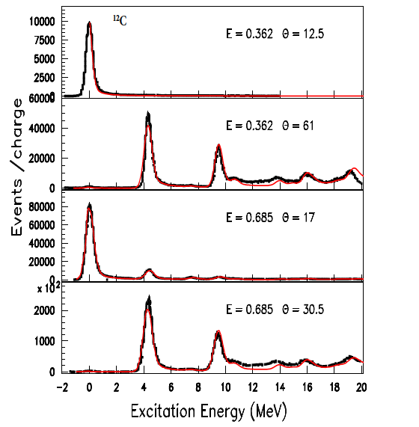

Nuclear excitations in Carbon
Note: Nuclear excitations are significant at low energy transfer ν and contribute up to 30% to the longitudinal Inelastic Coulomb Sum Rule (CSR)
¹²C
We parameterize form-factors for elastic scattering and for 17 longitudinal and transverse nuclear excitation (2< Excitation Energy<50 MeV) important since they contribution up to 30% to the Coulomb Sum Rule

Slide 4
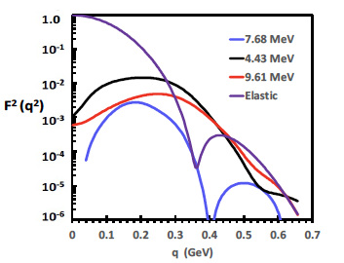
Examples: Squares of Elastic form factor and the form factors for the first 3 nuclear excitation (all are longitudinal)
¹²C
¹²C
¹²C
¹²C
We parameterize form-factors for elastic scattering and for 17 longitudinal and transverse nuclear excitation (2< Excitation Energy<50 MeV)

Slide 5
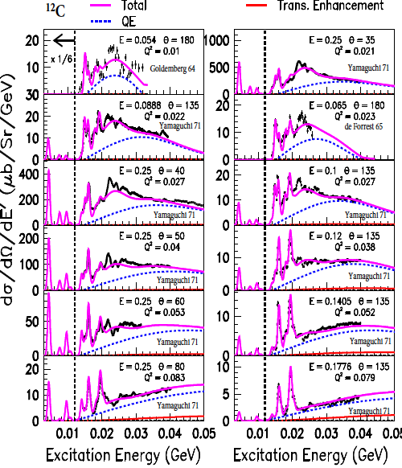
Electron scattering cross sections
Cross sections for excitations less than 10 MeV multiplied by (1/6)
Nuclear excitation region
Ex < 50 MeV
Comparison of our fit to representative e-C12 data for 0.01<q²< 0.08 GeV² .
Shown: Total including excitations : solid -------
Quasielastic (QE) contribution: dashed------
Transverse Enhancement at large angles accounts for Meson Exchange Currents and Enhancement of TTransverse QE response dashed------

Slide 6
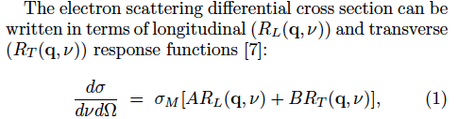
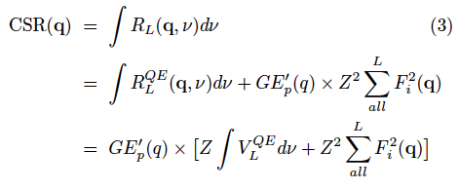

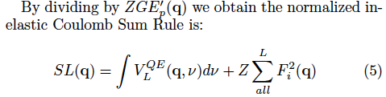
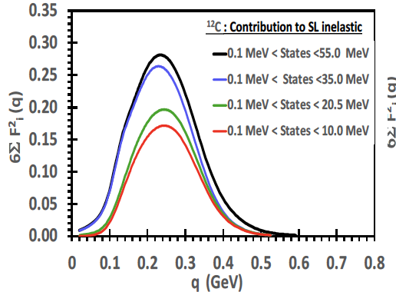
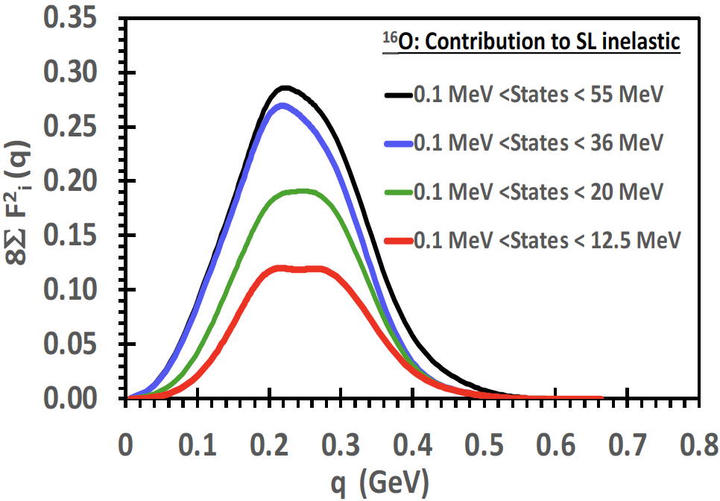
Coulomb Sum rule: Contribution of nuclear excitations
At very low q, SL_{inelastic} = 0
At high q expect SL_{inelastic} = 1
Nuclear excitations are significant at low energy transfer ν and contribute up to 30% to the longitudinal Inelastic Coulomb Sum Rule (CSR)

Slide 7
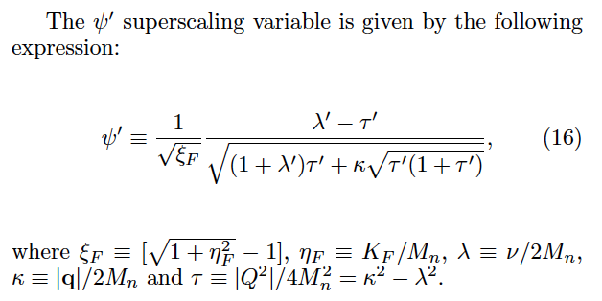
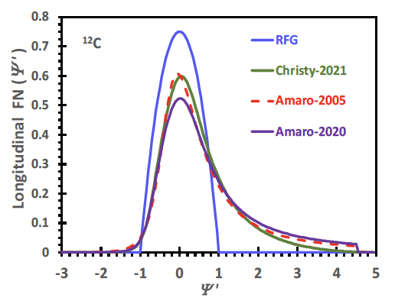
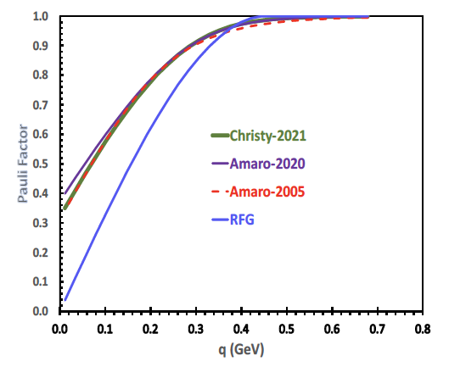
Modeling QE:
Use superscaling- Fit for the longitudinal scaling function parameters in the overall fit
We include Rosenfelder Pauli suppression
Pauli suppression Factor

Slide 8
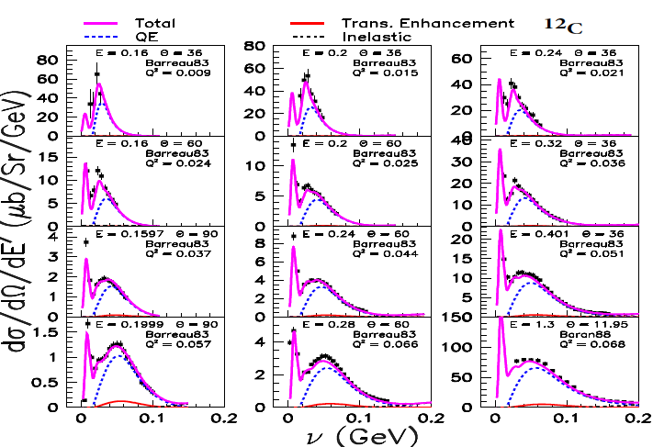
Quasielastic (QE) Region-I
Comparison of our fit to representative e-C12 data
For ν < 0.2 GeV and
0.01 <q²< 0.068 GeV² .
Shown: Total including excitations solid -------
Quasielastic (QE)
contribution dashed ------
Transverse Enhancement at large angles accounts for Meson Exchange Currents and Enhancement of Transverse QE response dashed------

Slide 9
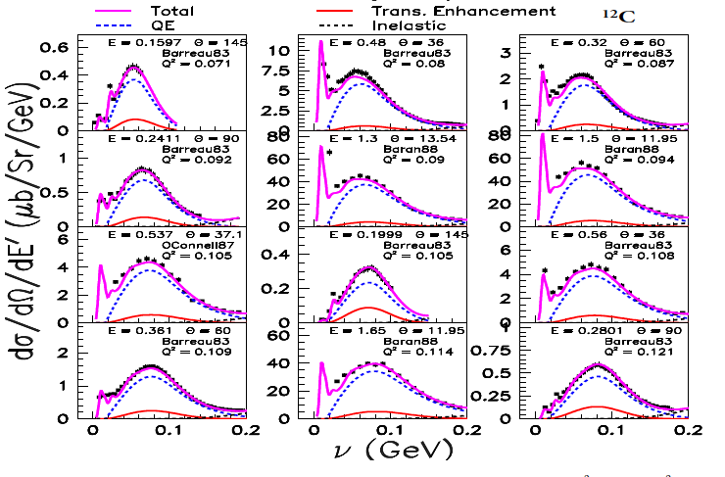
Quasielastic (QE) Region II
Comparison of our fit to representative e-C12 data for < 0.2 GeV and
0.071 <q²< 0.121 GeV² .
Shown: Total including excitations solid -------
Quasielastic (QE)
contribution dashed ------
Transverse Enhancement at large angles accounts for Meson Exchange Currents and Enhancement of Transverse QE reponse dashed------

Slide 10
¹²C
90⁰
60⁰
13.5⁰
60⁰
13.5⁰
145⁰
145⁰
15.5⁰
60⁰
The overall fit provides R_{L} and R_{T} at all values of q
Shown are large and small angle cross sections at the same q that provide the major contribution to the extraction of R_{L} and R_{T} at
q²=0.09, 0.15 and 0.35 GeV² (q=0.3, 0.38 and 0.57 GeV)

Slide 11
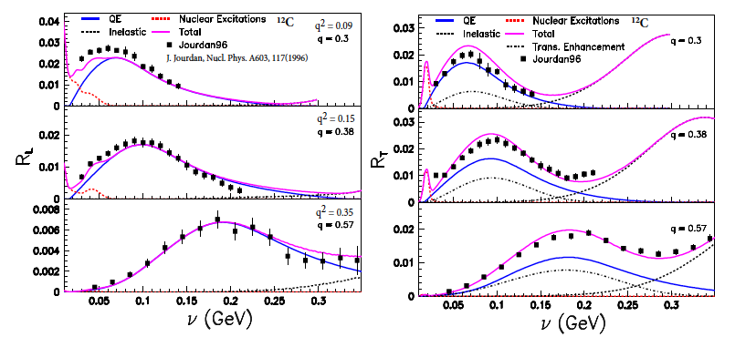
Comparison of our R_{L} and R_{T} from our universal fit to (~8000 cross sections) to previous extraction by Jourdan at q²=0.09, 0.15 and 0.35 GeV². (q=0.3, 0.38 and 0.57 GeV)
Our extraction is more reliable since we include all of the world’s data in the fit
At low q the contribution of the nuclear excitations important.
The superscaling fit function describes the QE distribution at higher ν.
Resonance region is modeled with Fermi Smeared H and D data.

Slide 12
Note
The 1p1h cross section is enhanced when 2 body currents are included in the calculations. This is the largest contribution to the Transverse Enhancement and increases the cross section in the region of the QE peak.
The 2 body currents also result in 2p2h final states. It increases the cross section between the QE peak and pion production threshold.

Slide 13
Pauli Suppression
Factor. We use the Rosenfelder method.
P₁= Pauli factor for the Christy 2021 QE superscaling model.
P₂ = Pauli factor for another QE model
(e.g. Amaro-2020)
¹²C
Pauli suppression Factor
ES₁ =The Extra Suppression (Quenching) of the longitudinal QE cross section (in addition to Pauli) extracted from our fit
ES₂ = Extra Suppression (Quenchig) for another QE model
ES₂= ES₁ (P₁/P₂)
Extra Suppression (Quenching) factor of the Longitudinal QE extracted from the fit

Slide 14
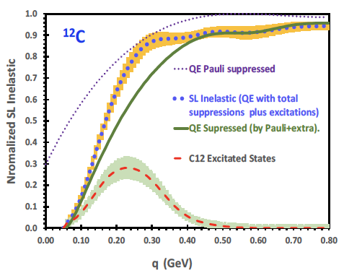
SL_{inelastic}(q)
Pauli
The different contribution from our fit to the extracted Inelastic Coulomb sum Rule: SL_{inelastic}(q)

Slide 15
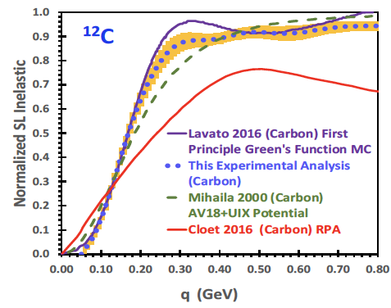
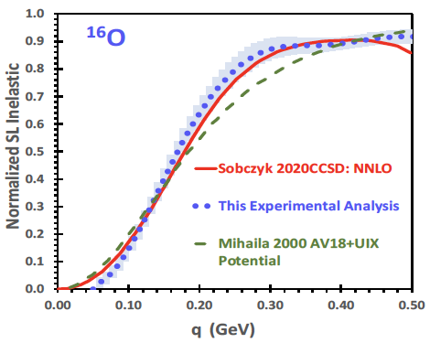
SL_{inelastic}(q)
Comparison to theory for
Coulomb sum Rule: SL_{inelastic}(q) ¹²C
1. Reasonable agreement with Lavato 2016 First Principle Green’s function MC.
2. Poor agreement with Mihaila 2010 Coupled Cluster AVI8-UIX potential
3. Poor agreement with Cloet 2016 (RPA)
Comparison to theory for
Coulomb sum Rule: SL_{inelastic}(q) ¹⁶O
1. Reasonable agreement with Sobczyk 2000 CCSD:NNLO
2, Poor agreement with Mihaila 2010 Coupled Cluster AVI8-UIX potential

Slide 16
Conclusions
We fit all existing e-H, e-D, e- ¹²C and e-¹⁶O data including elastic, nuclear excitations, Quasielastic, Resonance and Inelastic region.
Fit provides a benchmark to test electron and neutrino MC generators. (all parameters will be published).
The contributions of nuclear excitations is important at low q and should be added to electron and neutrino MC generators.
For the QE structure functions, we find that the QE Longitudinal cross section is Quenched by an Extra Suppression in addition to Pauli blocking and the Transverse cross section is Enhanced. We provide a parameterizations of the Longitudinal Quenching and Transverse Enhancement.
We extract the inelastic Coulomb sum rule and compare to theoretical calculations. Since all available e- ¹²C data is included in the fit, this is the best extraction of the Inelastic Coulomb Sum Rule from all the world’s data on ¹²C .

