Slide 1

Bunch by bunch tune shifts for HL-LHC
S. Antipov, E. Métral, N. Mounet, C. Zannini
Acknowledgments: S. Arsenyev, G. Iadarola, B. Salvant

Slide 2
Maximum tune shift along the train due to impedance
Machine | LHC - 2017 | LHC - 2017 | HL-LHC | HL-LHC | HE-LHC | HE-LHC
Cycle state | Injection | Flat-top | Injection | Flat-top | Injection | Flat-top
Energy, GeV | 450 | 6500 | 450 | 7000 | 1300 | 13500
Intensity, ppb | 1.05x10¹¹ | 1.05x10¹¹ | 2.3x10¹¹ | 2.3x10¹¹ | 2.2x10¹¹ | 2.2x10¹¹
Current full, A | 0.67 | 0.67 | 1.47 | 1.47 | 1.4 | 1.4
Imp, MΩ/m | 100 | 900 | 100 | 800 | 250 | 2000
Tune shift full | 8.8x10⁻⁴ | 5.5x10⁻⁴ | 1.9x10⁻³ | 1.0x10⁻³ | 1.6x10⁻³ | 1.2x10⁻³
L. Vos, EPAC 2000
Approximations:
Uniform bunch train of length τ
Resistive wall impedance Z ~ (j/ω)^{1/2}

Slide 3
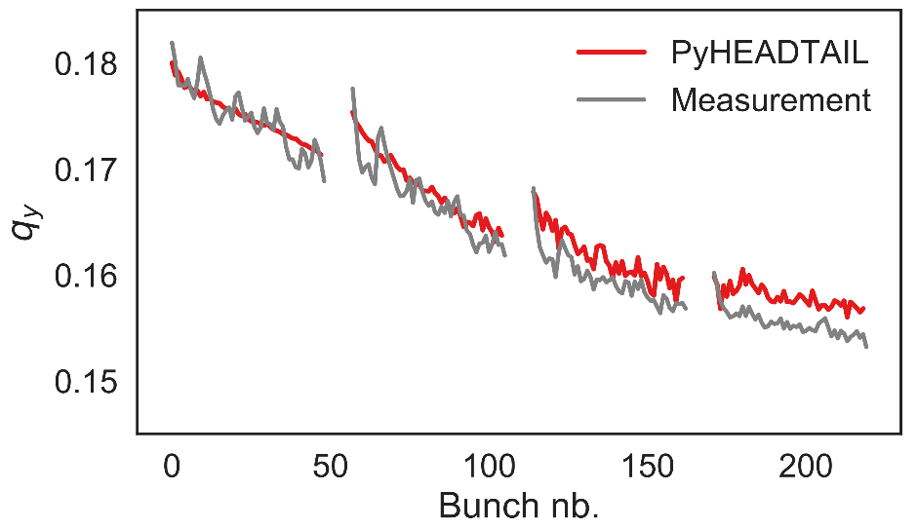
SPS bunch by bunch tune shift
Impedance model: wall
Courtesy of M. Schenk

Slide 4
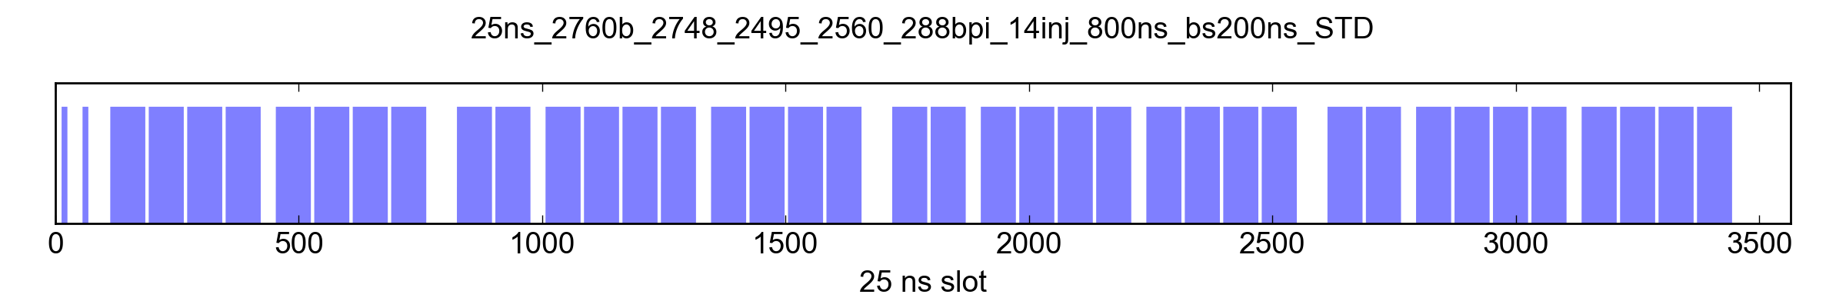
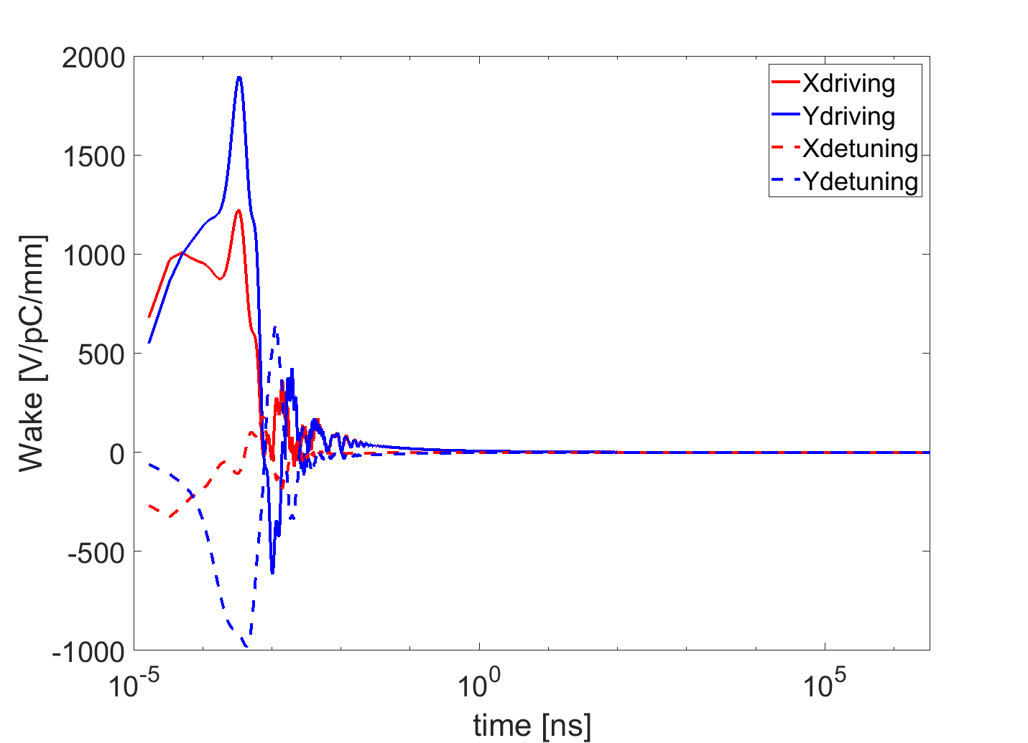
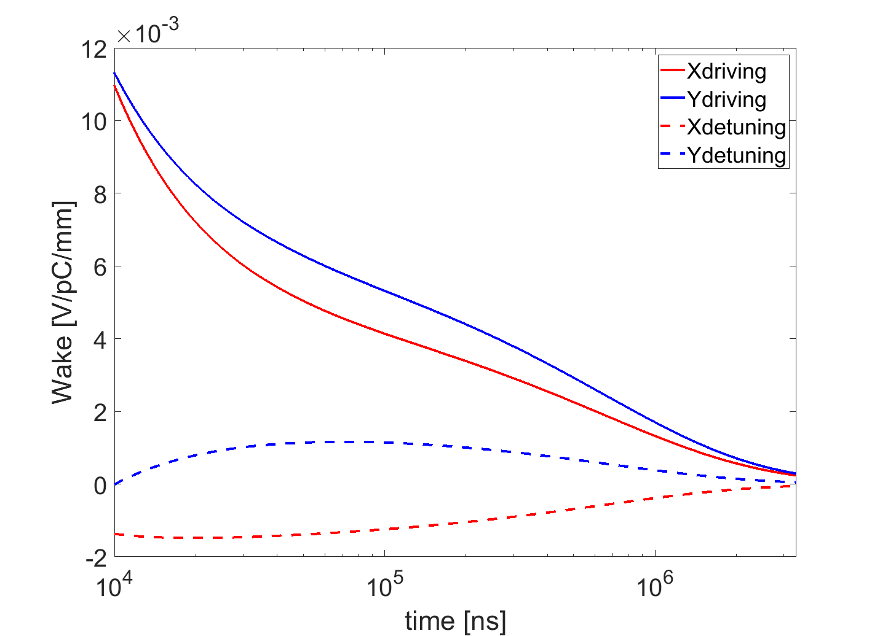
HL-LHC: PyHEADTAIL multi-bunch simulation
HL-LHC baseline scheme (assumed in TDR)
Flat top
N=2.3e11 ppb
Q’=15
σ= 0.08994
Qx=62.31
Qy=60.32
Resistive wall (collimators and all resistive elements) 2019 HL-LHC impedance model

Slide 5
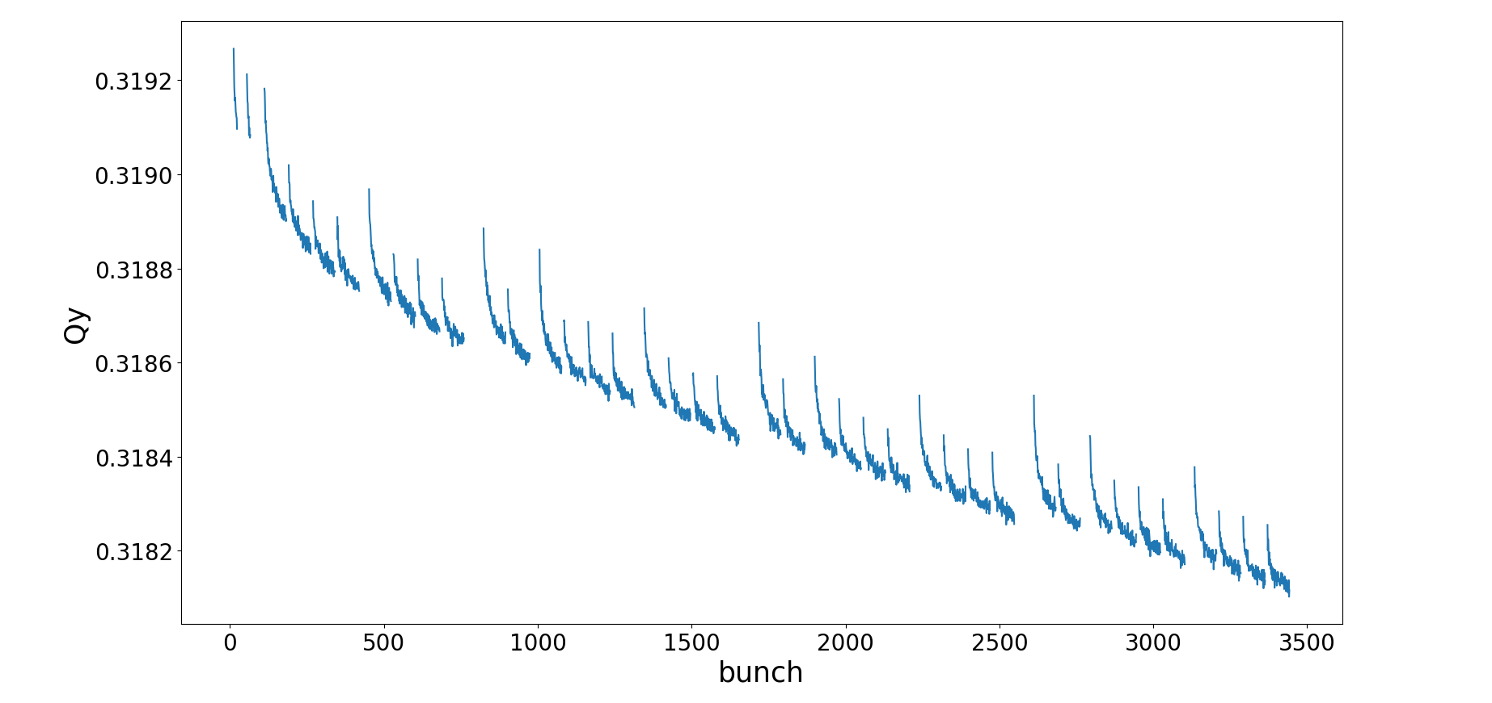
HL-LHC: PyHEADTAIL multi-bunch simulation
≈10⁻³

Slide 6
Summary
PyHEADTAIL multi-bunch simulations predict the maximum tune shift of the full train of bunches for HL-LHC beam at flat top to be in the order of 10⁻³
  In good agreement with the numbers obtained from L. Vos formula

Slide 7
Thank you for your attention

Slide 8
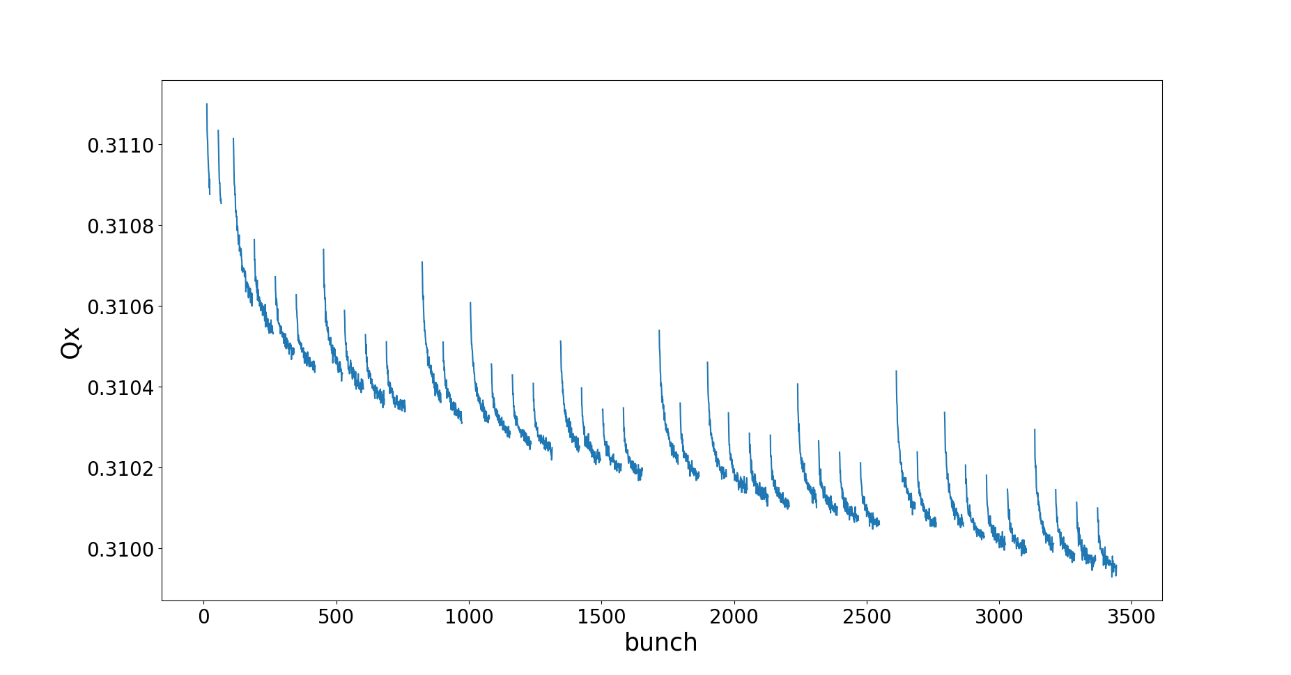
HL-LHC: PyHEADTAIL multi-bunch simulation

Slide 9
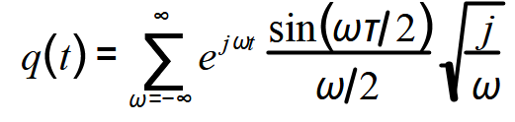
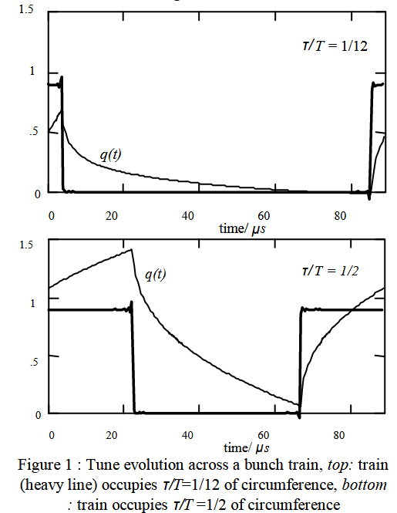
Laslett tune shift
L. Vos, EPAC 2000
Preceding bunches create a force that shifts the tune
Approximations:
  Uniform bunch train of length τ
  Resistive wall impedance Z ~ (j/ω)^{1/2}

Slide 10
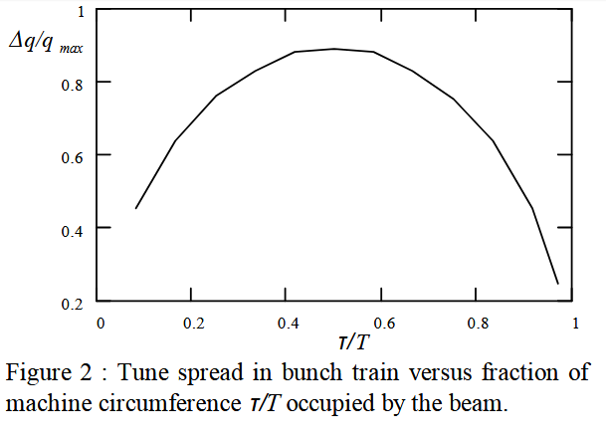
Laslett tune shift

Slide 11
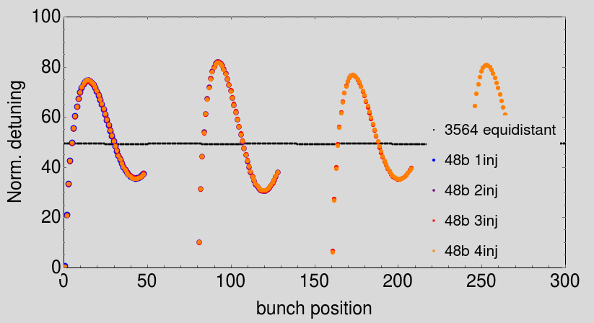
Tune variation along the bunch: NHT

