Slide 1
HL-LHC impedance model with considerations about MKI and triplet beam screens
N. Mounet, D. Amorim, S. Antipov, N. Biancacci, E. Carideo, O. Frasciello, E. Métral, B. Salvant, V. Vlachodimitopoulos, R. Wanzenberg, C. Zannini, M. Zobov.
Acknowledgements: M. Barnes, R. Bruce, F. Carra, R. de Maria, W. Deng, N. Kos, A. Mereghetti, M. M. Moh'D Al-Esseili.

Slide 2
Outline
Update of the HL-LHC impedance model.
Orientation of the longitudinal weld in the triplet beam screens and impact on impedance.
Impact of the new MKI and various equipment (deformable RF fingers, VAX, Y-chamber) close to the triplets.

Slide 3
HL-LHC impedance model
Changes w.r.t. the LHC that are included in the HL model:
  Collimator at almost full upgrade (jaws of 2 TCPs and all but 2 TCSs in IR7 replaced by Mo-graphite ones, Mo-coated for the TCSs); some TCTs in Cu-coated copper-diamond; tungsten TCLD absorber in IR7,
  Updated collimator tapers,
  Beta functions in the arcs and triplets (optics v1.4),
  TDIS (with graphite, Ti₆Al₄V and CuCr1Zr),
  New MKI-cool – 4 of them,
  New octogonal beam screens in triplets, with up-to-date dimensions, aC-coating, 75K copper, pumping holes and welds (rough estimate for the welds – to be updated by C. Zannini),
  Updated experimental chambers (ATLAS & CMS),
  Tapers and BPMs in the triplets region,
  Crab cavities,
  VAX, deformable RF- fingers and Y-chamber (triplet region).

Slide 4
HL-LHC impedance model
Modifications that are not (yet) in the model:
  VELO,
  experimental chambers ALICE and LHCb, possibly also CMS,
  updated longitudinal weld factor in the triplets beam screens,
  new instrumentation,
  possible aC-coating in some sectors,
  possible additional collimators in IR1 & 5, TCLD in IR2 (in parking for protons) and updated design of all tertiaries and TCLs, old CFC collimators that might stay in parking position,
  crab cavities HOMs as measured in real cavities,
  electron lens and crystal collimators (recently added to baseline),
  new roman pots,
  “SMOG3” in LHCb.

Slide 5
HL-LHC – Collimator settings
Collimator settings (𝜎 computed with 𝜀 = 2.5 𝜇m.rad) at top energy:
Collimators | Half-gap [#𝜎]
TCP/TCS/TCLA(D) IR7 | 6.7 / 9.1 / 12.7 (16.6)
TCP/TCS/TCLA IR3 | 17.7 / 21.3 / 23.7
TCDQ/TCS IR6 | 10.1
TCT IR1/5 | 10.4
TCL (IR1/5) Q4/Q5/Q6 | 14.2
TCT IR2/8 | 43.8 / 17.7
Note: injection protection collimators are always considered in parking position at top energy.

Slide 6
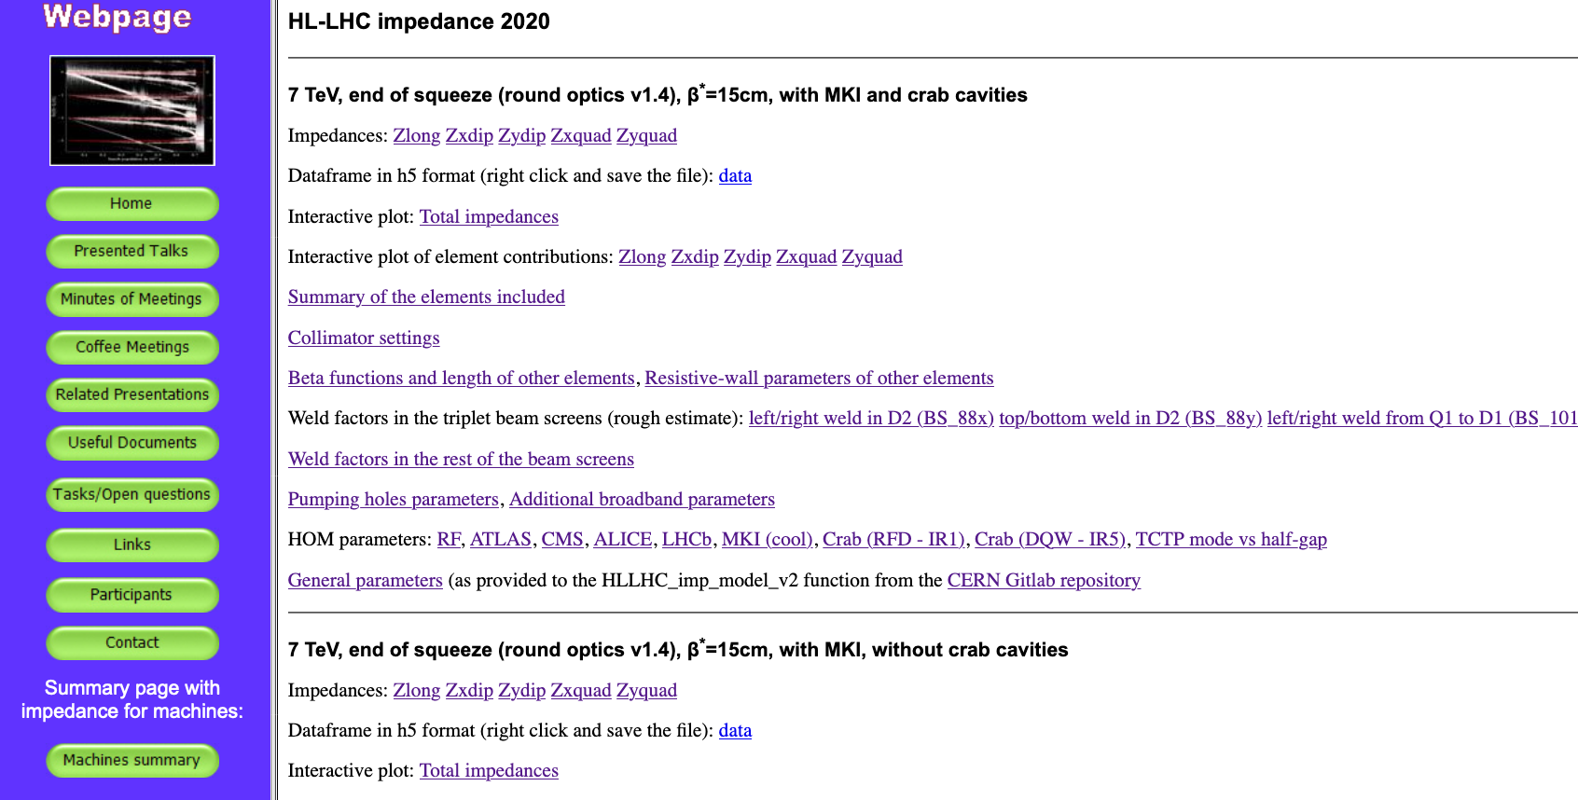
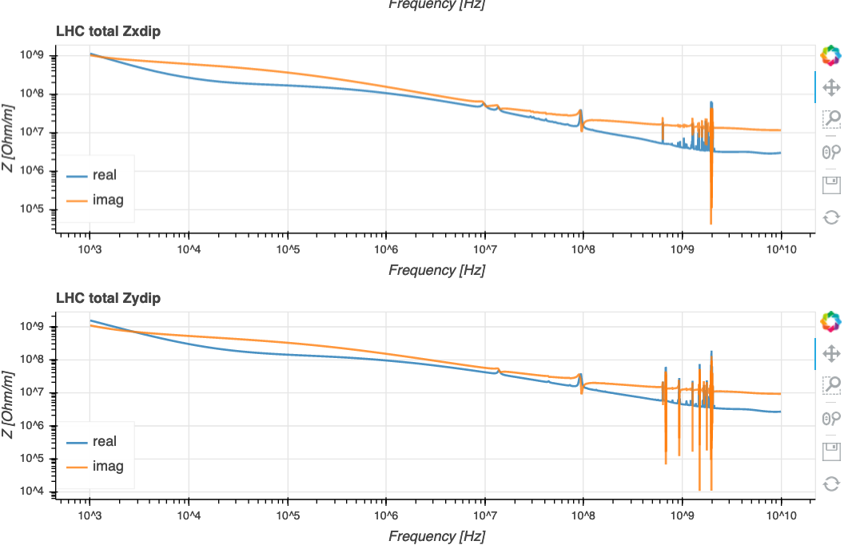
HL-LHC impedance model: web page
The model is on-line, at https://impedance.web.cern.ch/impedance/ (Machine Summary ⟶ HL-LHC 2020):
with interactive plots (thanks to N. Biancacci),
several variants (with and without crab cavities – more will come),
all parameters and settings are provided.

Slide 7
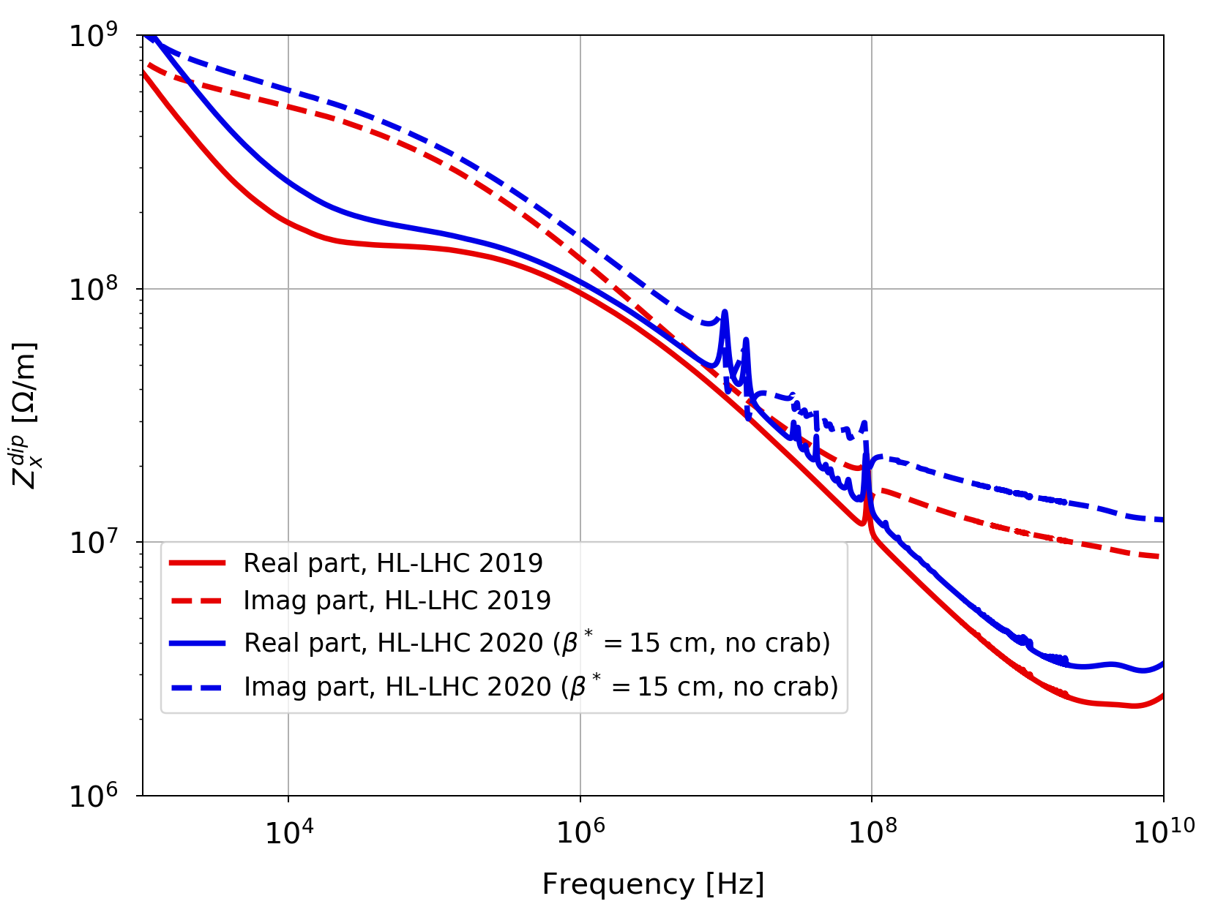
HL-LHC – old vs. updated impedance model
Frequency dependence of the impedance (dipolar horizontal):

Slide 8
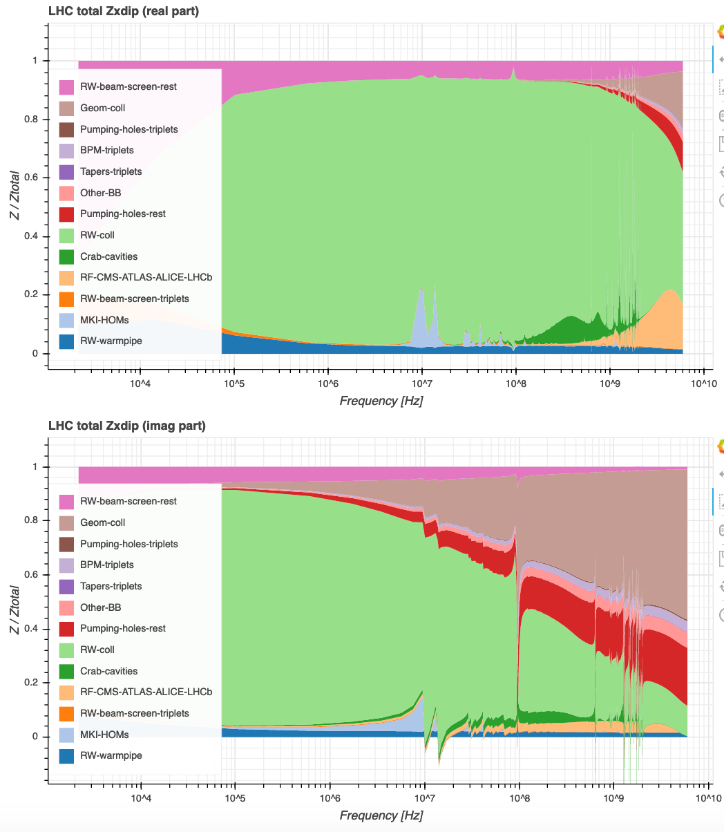
HL-LHC – Impedance contributions (round optics)
Frequency dependence of the various contributions to impedance (dipolar horizontal, real part, i.e. the main player for the growth rate):

Slide 9
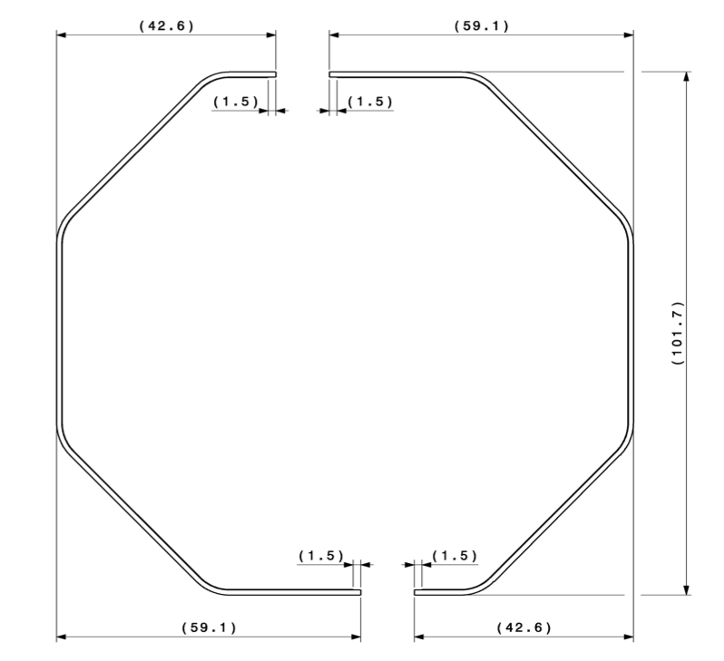
The weld in the triplet beam screen
The triplet zone is a sensitive region for transverse stability because of the magnitude of the beta functions when squeezed.
There are two orientation options for the beam screens: with the weld on the top/bottom facets, or on the left/right ones (note that the facets at 45° contain the pumping holes):
Q1 beam screen before assembly
From N. Kos

Slide 10
Weld in the beam screens – the question
The welds are in stainless steel, NOT copper-coated (but with aC coating), and up to 4mm-large.
→ this is seen by the beam and introduce a significant detrimental factor on the resistive-wall impedance (C. Zannini, 07/2013 & B. Salvant et al, 12/2015).
The plane on which the weld is located can matter, depending on the difference between x and y beta functions
→ an impedance optimization is in principle possible (question by N. Kos), by turning some beam screens by 90°.
→ But is it worth the effort?

Slide 11
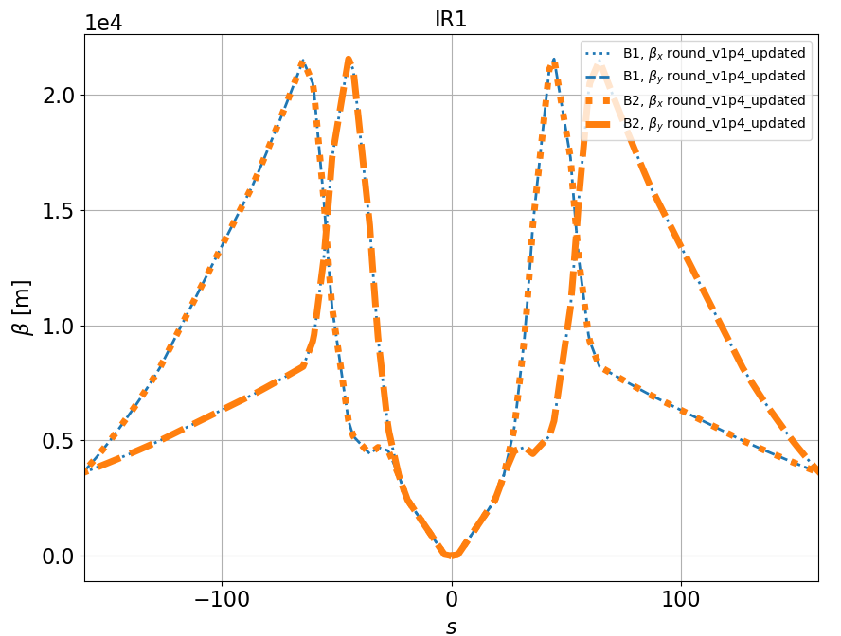
Optimizing the beam screen orientation - round
In principle we only have to look at the beta functions (optics v1.4).
BUT most beam screens contain the two beams (up to D1, i.e. ~80m from IP).
Only D2 beam screen (from ~140m to ~155m) is single-beam.
Round optics (IR1 and 5 are similar):
when e.g. 𝛽_{x}< 𝛽_{y} for B1, it is the opposite for B2
→ one cannot gain anything in total on the two-beam BS,
we could gain in D2 only, but the two beta functions are almost the same
→ very small impact.

Slide 12
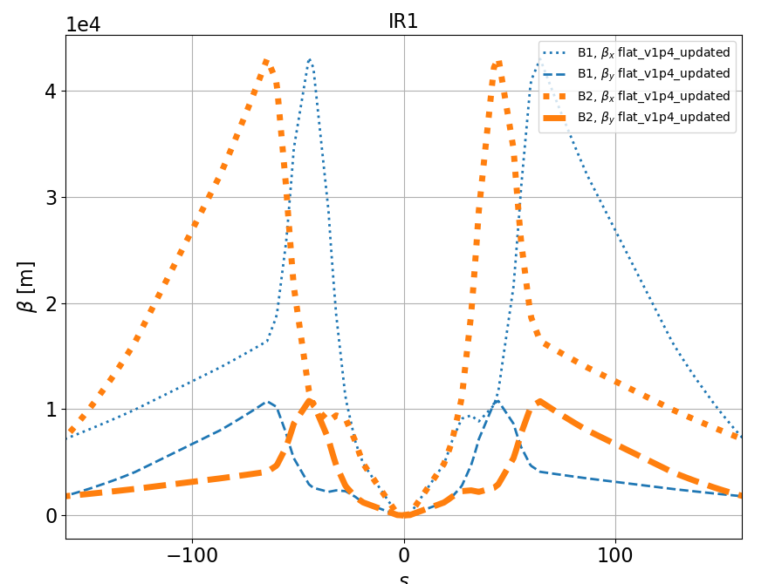
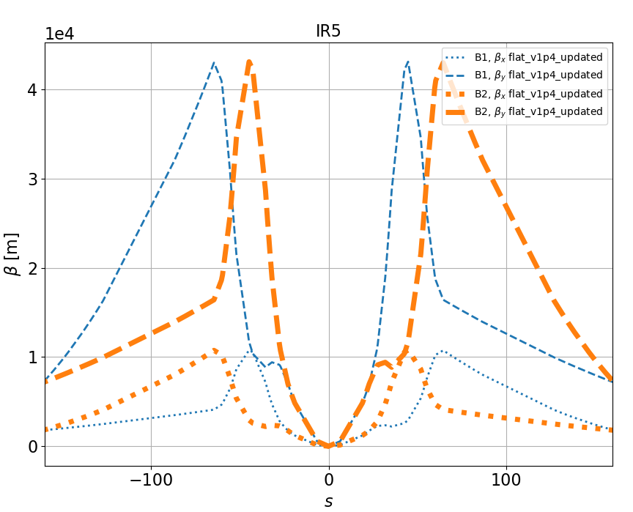
Optimizing the beam screen orientation - flat
For flat optics (v1.4) the situation is different: the same plane has a lower beta for both beams .
We can optimize if we choose the facets where to put the weld as:
  top/bottom for IR1
  left/right for IR5

Slide 13
Is it worth the effort?
Octupole thresholds with HL-LHC parameters (N_{b}=2.3e11 p+/bunch, emittances 2.1𝜇m.rad, with damper at 100 turns, Q’=15, Gaussian distribution), for flat optics:
  Resistive-wall from collimators only: 55A
  Resistive-wall from beam screens (including welds): < 0.01 A
→ The gain from the optimization of the weld orientation is not significant .
→ It’s better to keep the orientation of all beam screens at top/bottom (preferred option from the installation point of view – N. Kos).

Slide 14
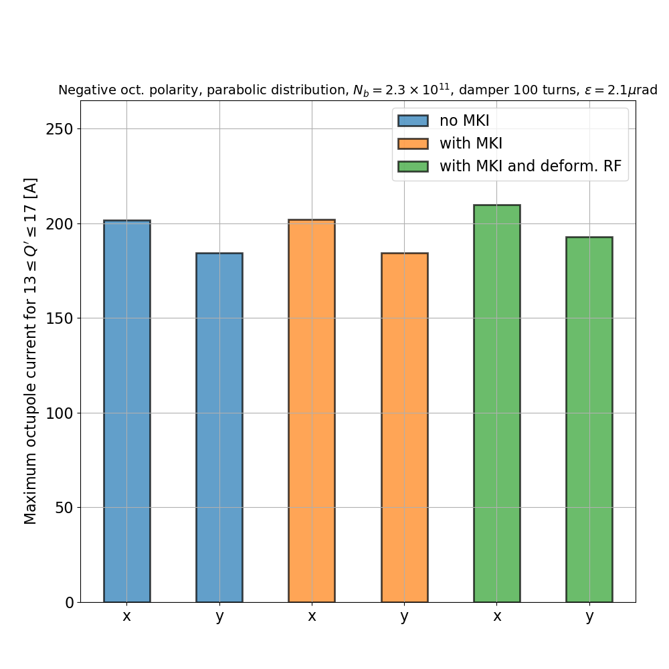
Impact of MKI & deformable RF fingers (+ VAX + Y-Chamber) on octupole threshold
We check the octupole thresholds for HL-LHC parameters (N_{b}=2.3e11 p+/b, 𝜀=2.1𝜇m.rad, damper 100 turns, Q’=15, distributions cut at 3.2𝜎, negative oct. polarity – positive is very similar), for round optics at 𝛽*=15cm:
MKI ”cool” HOMs values from V. Vlachodimitopoulos,
deform. RF / VAX / Y: broad-band impedance from B. Salvant.
⟶ Impact of MKI is negligible.
⟶ Impact of deformable RF fingers, Y-Chamber and VAX is visible but small (~4%).
⚠️ This is NOT an octupole current prediction for HL, but only a test of the impact of this equipment (we are not at the most critical point of the cycle).

Slide 15
Conclusions
The HL-LHC impedance model has been updated to take into account the latest developments, and is now available on the impedance web-page.
The triplet beam screens do not need to be oriented in a particular way to reduce the impedance from the longitudinal weld, as its impact is negligible.
The MKI does not have a significant impact on stability.
Deformable RF fingers (mainly) + VAX + Y-chamber (close to triplets) have an overall visible but small impact on stability (~4% for 15cm squeezed round optics).

Slide 16
Backup slides

Slide 17
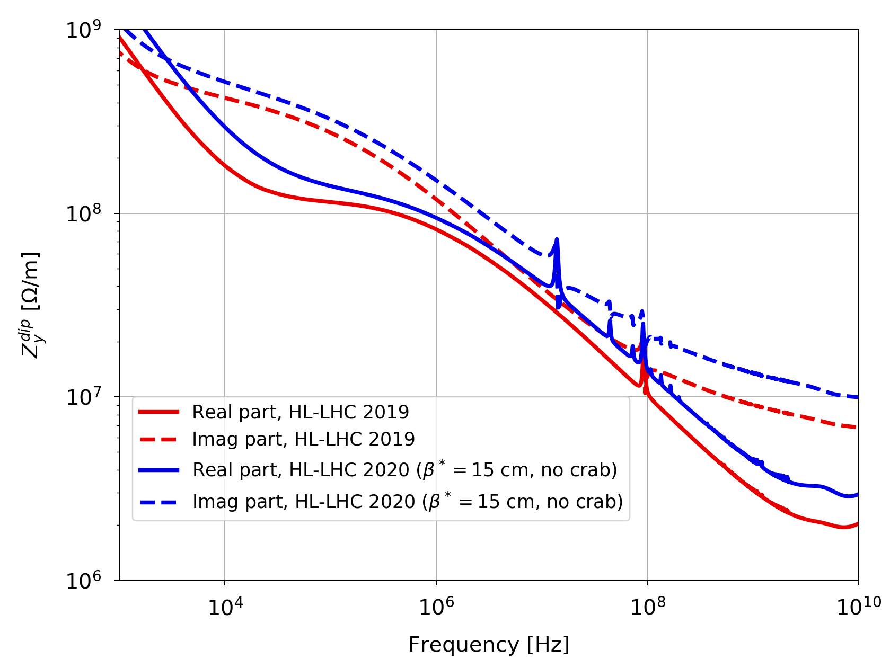
HL-LHC – Old vs. updated impedance model
Frequency dependence of the impedance (dipolar vertical):

Slide 18
HL-LHC – Impedance contributions (round optics)
Frequency dependence of the various contributions to impedance (dipolar horizontal, imaginary part, i.e. responsible for tune shift):

Slide 19
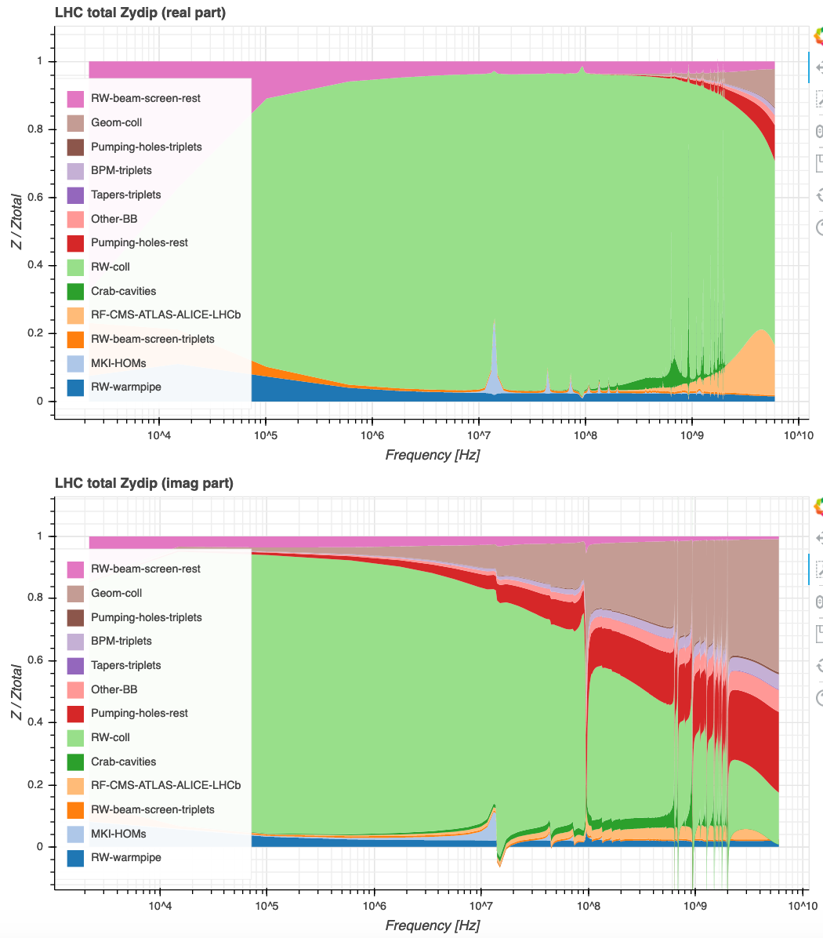
HL-LHC – Impedance contributions (round optics)
Frequency dependence of the various contributions to impedance (dipolar vertical, real part, i.e. main player for growth rate):

Slide 20
HL-LHC – Impedance contributions (round optics)
Frequency dependence of the various contributions to impedance (dipolar vertical, imaginary part, i.e. responsible for tune shift):

Slide 21
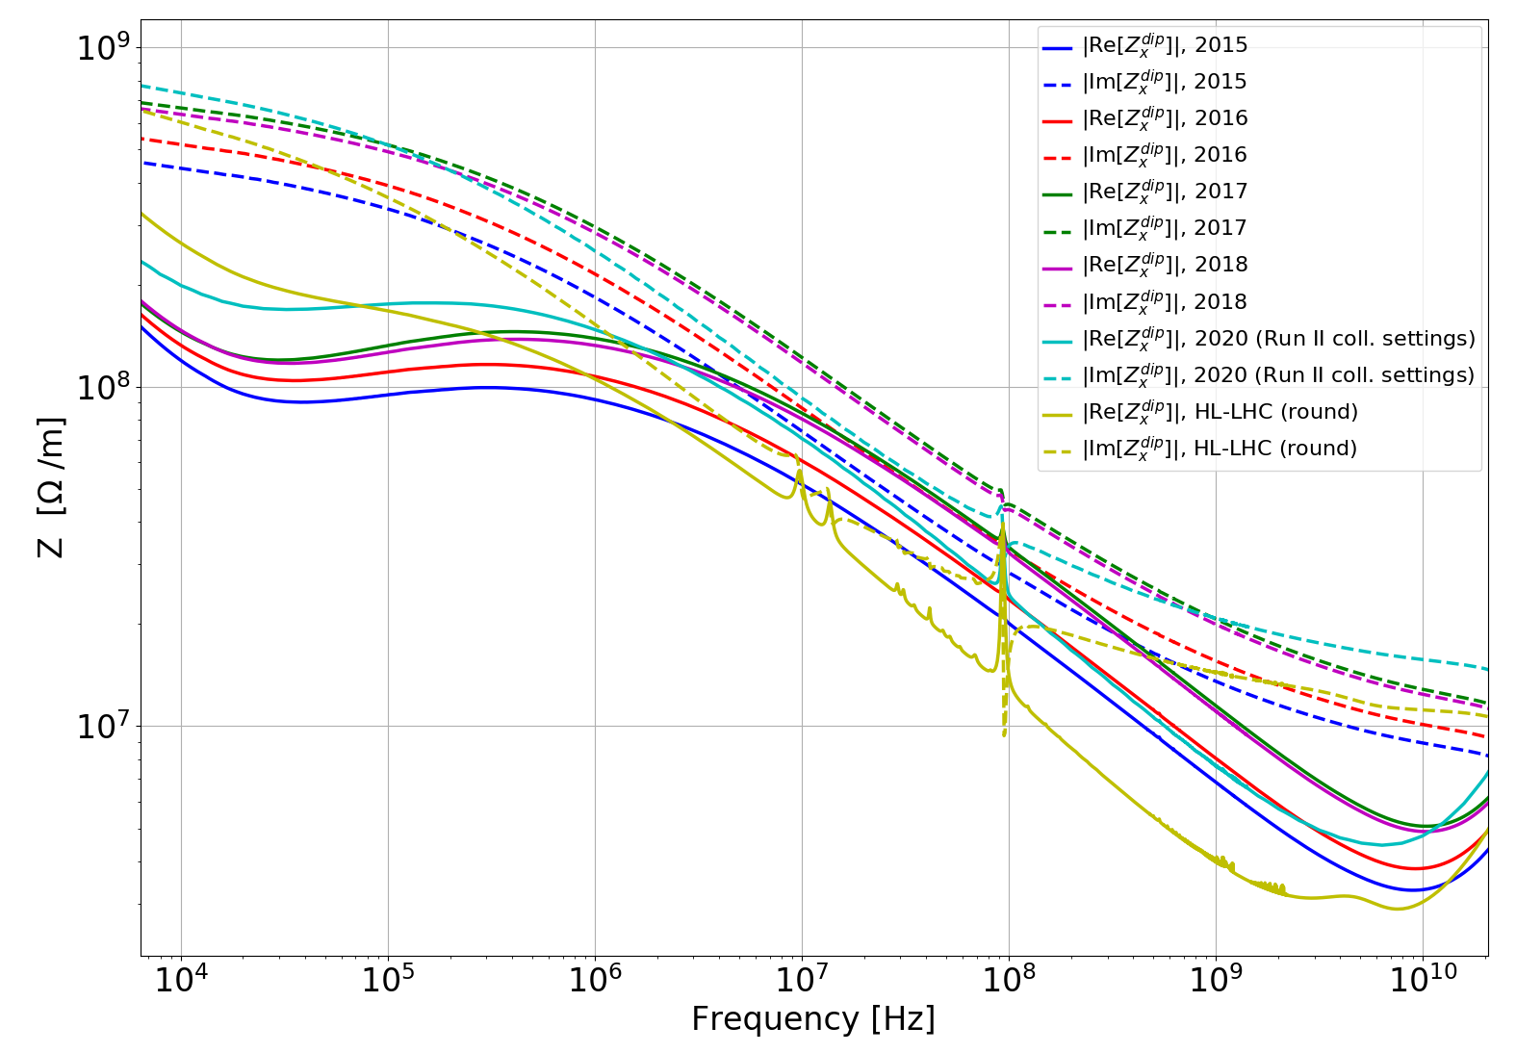
HL-LHC & LHC impedance models: a retrospective
Putting on the same plot all impedances currently on the web, for LHC & HL-LHC:
2020
2018
Dipolar horizontal
2017
2016
2015
HL-LHC (without crab)

Slide 22
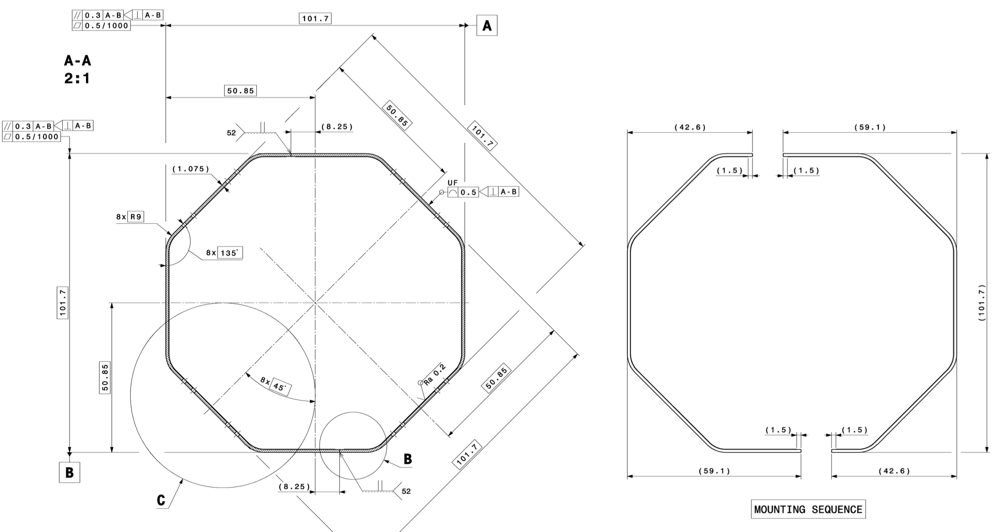
Octogonal beam screens in HL-LHC triplets (N. Kos)
Three different shapes, depending on the magnet cold bore aperture:
Q1 beam screen (“BS_101” in the impedance model, drawing LHCVSMSH0003)

Slide 23
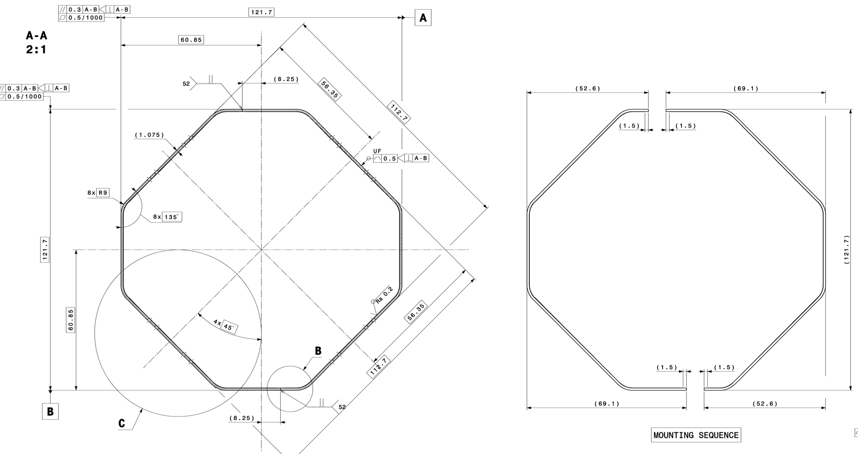
Octogonal beam screens in HL-LHC triplets (N. Kos)
Q2/Q3/CP/D1 beam screen (“BS_121” in the impedance model, drawing LHCVSMSL0001)

Slide 24
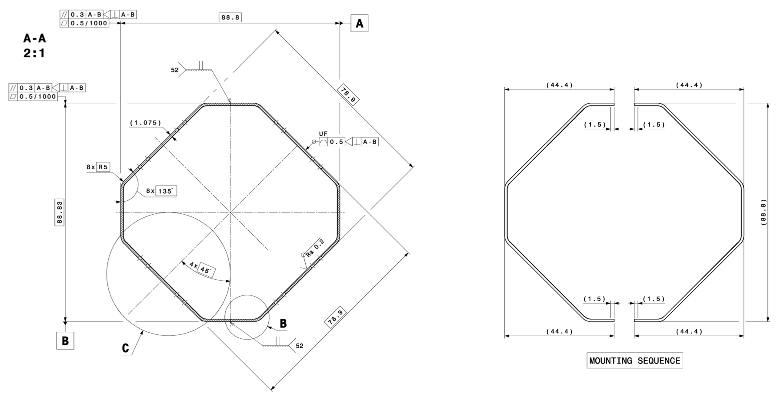
Octogonal beam screens in HL-LHC triplets (N. Kos)
D2 beam screen (“BS_88” in the impedance model, drawing LHCVSCS_0001) – single beam

