Slide 1
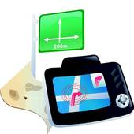
PVSS Navigator

Slide 2
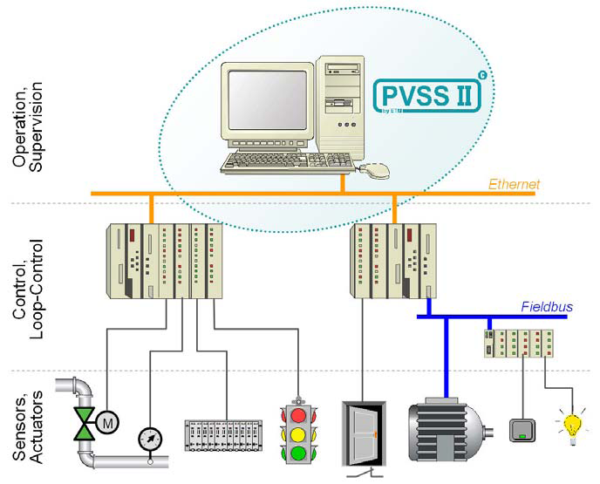
What is PVSS?
“Prozess Visualisierung und Steuerungs System“ (process visualization and control system)
SCADA (Supervisory Control and Data Acquistition)
Control and Visualization of process data

Slide 3
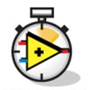

What is PVSS NOT for
NOT for realtime control
NOT for closed loop control
NOT for high bandwith data acquistition
HIGH SAMPLE RATE

Slide 4
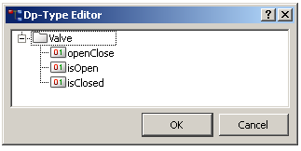
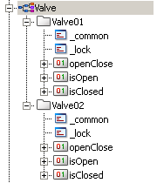
PVSS Data Point Concept
M
one input: openClose
two outputs: isOpen, isClosed
Create the Type:
Create instances:

Slide 5
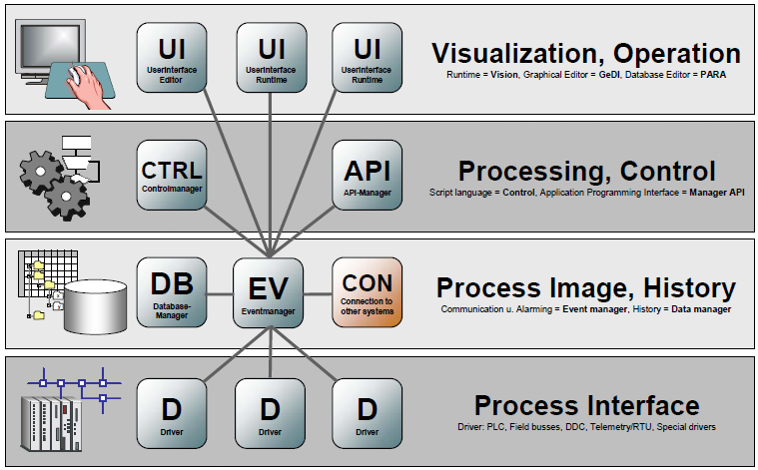
PVSS Manager Concept

Slide 6


Managing the Panels
Questions:
How to find a particular panel?
How to open a particular panel?
Who takes care of the screen configuration?
Who takes care of panel access rights?
Answer:
The Navigator

Slide 7

What is/does the Navigator
Single access point for all control panels
Holds all information about available panels
Let the user browse through the panels in a tree structured view
Handles the user login
Handles the permissions (users, roles, domains)
Takes care on the screen configuration (working place, number of screens, resolution)

Slide 8
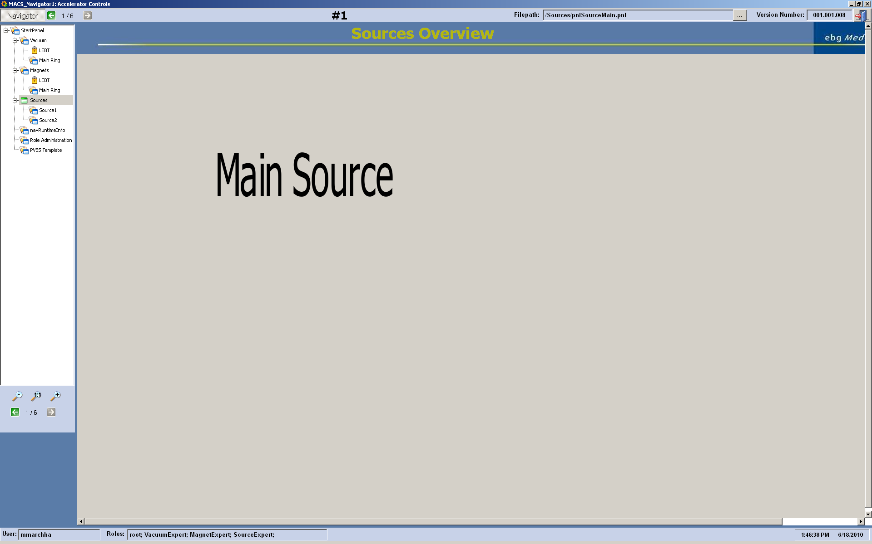
Navigator

Slide 9

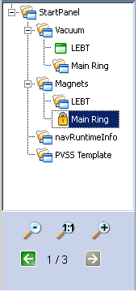
Tree Configuration
Each node has a assigned panel
Multible nodes can reffere to the same panel
Organizing the tree according to the current user permissions
Holds the panel information
(a panel may be opened at the same time only once)
All information about the tree and the panels is stored in a Data Point

Slide 10


Access Control
Includes Access Control Component of JCOP
Concept of Users, Roles and Domains
Domain permissions: read, write and execute
Required permission can be defined per panel and per element in the panel (e.g. button)
User login
Over the actual OS user

Slide 11

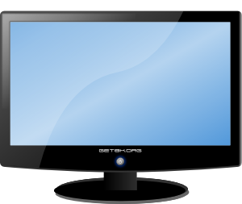
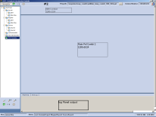
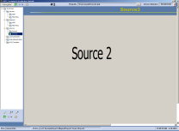
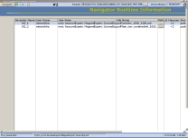
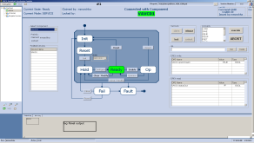
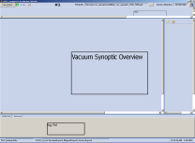
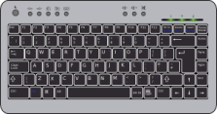
Screen Configuration
Definable per user and per working place(planned)
Each Screen has his own navigator panel
Working place 1
Working place 2
3 supported resolutions
  1280x1024
  1920x1200
  2560x1600

Slide 12
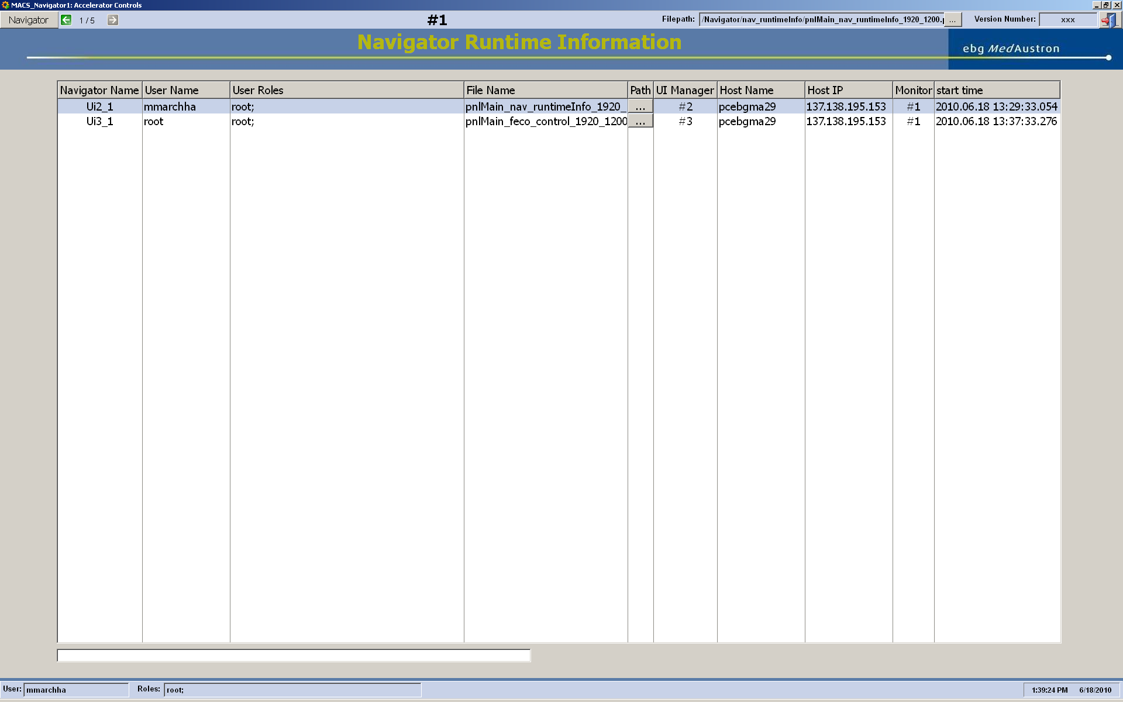
Example: Navigator Information

Slide 13
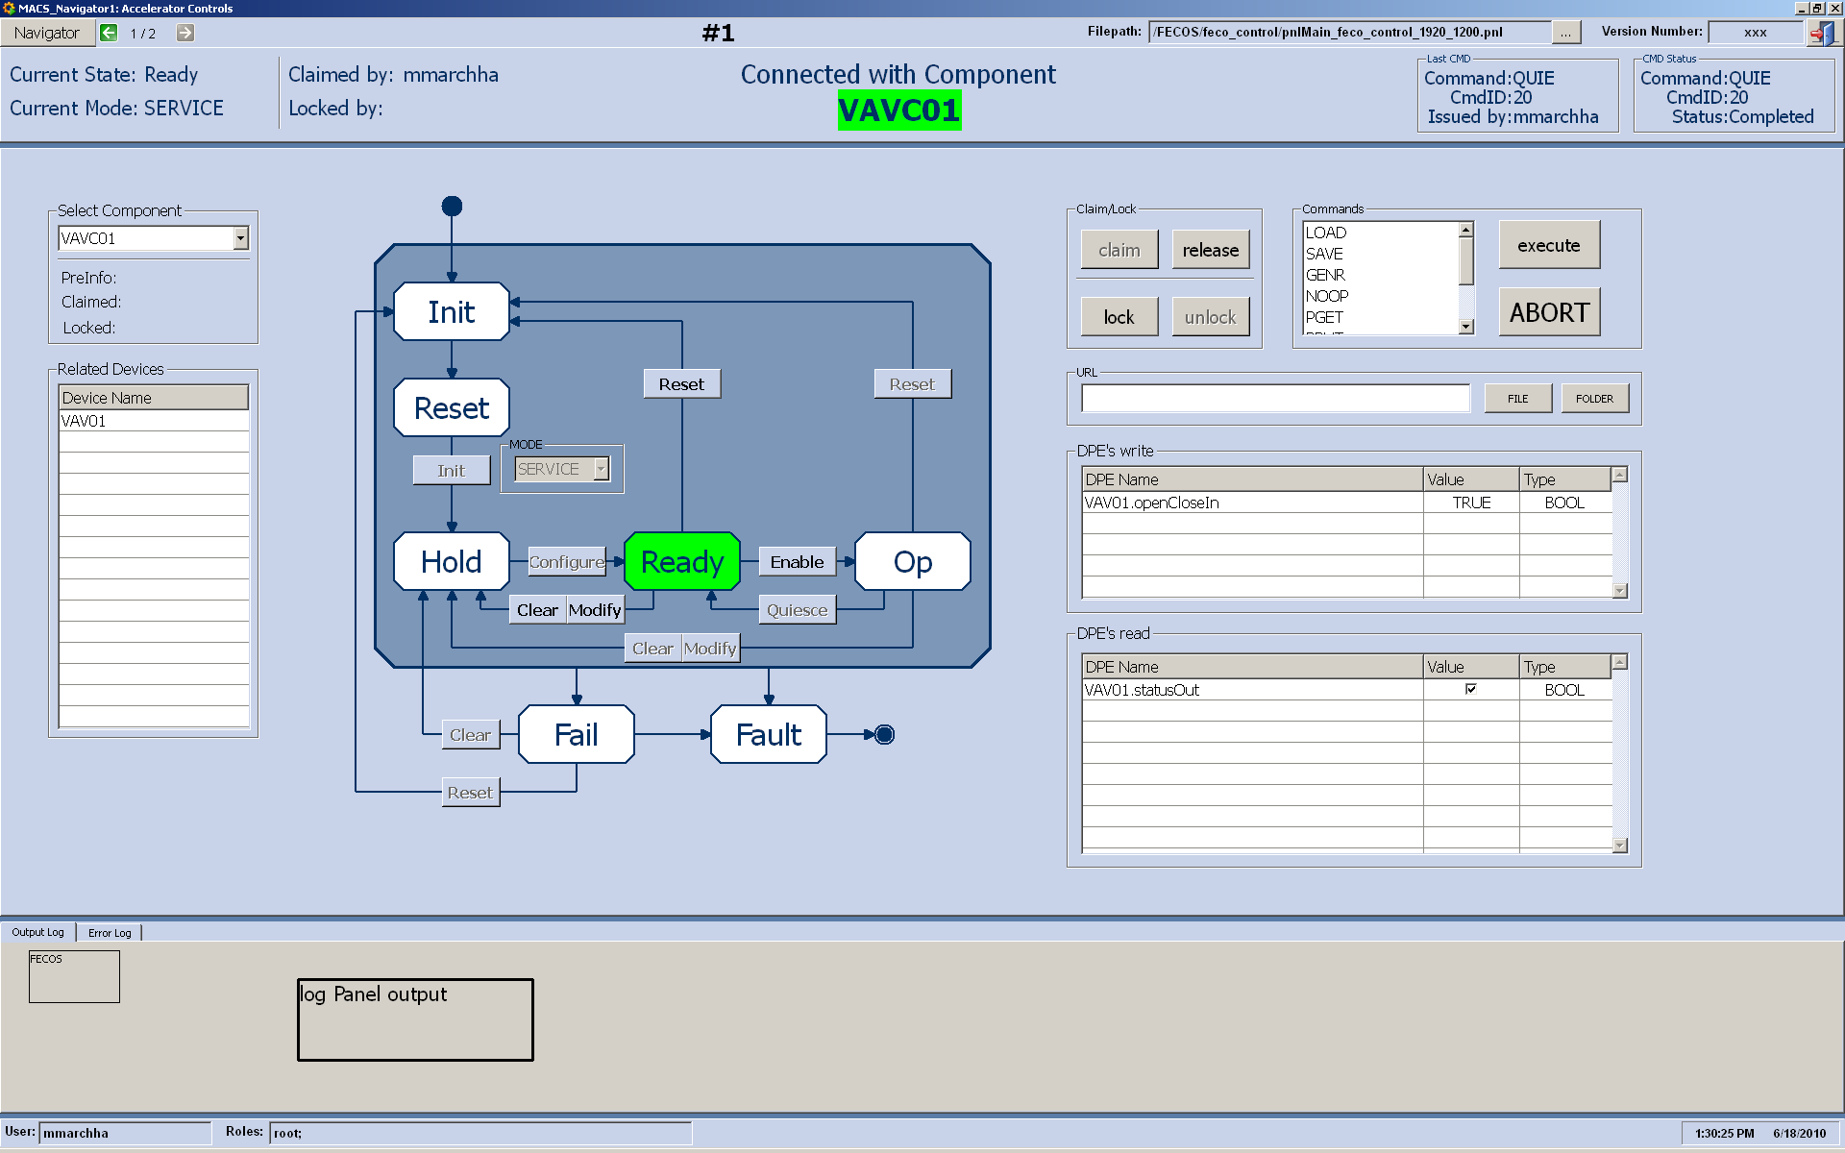
Example: FECOS panel

Slide 14
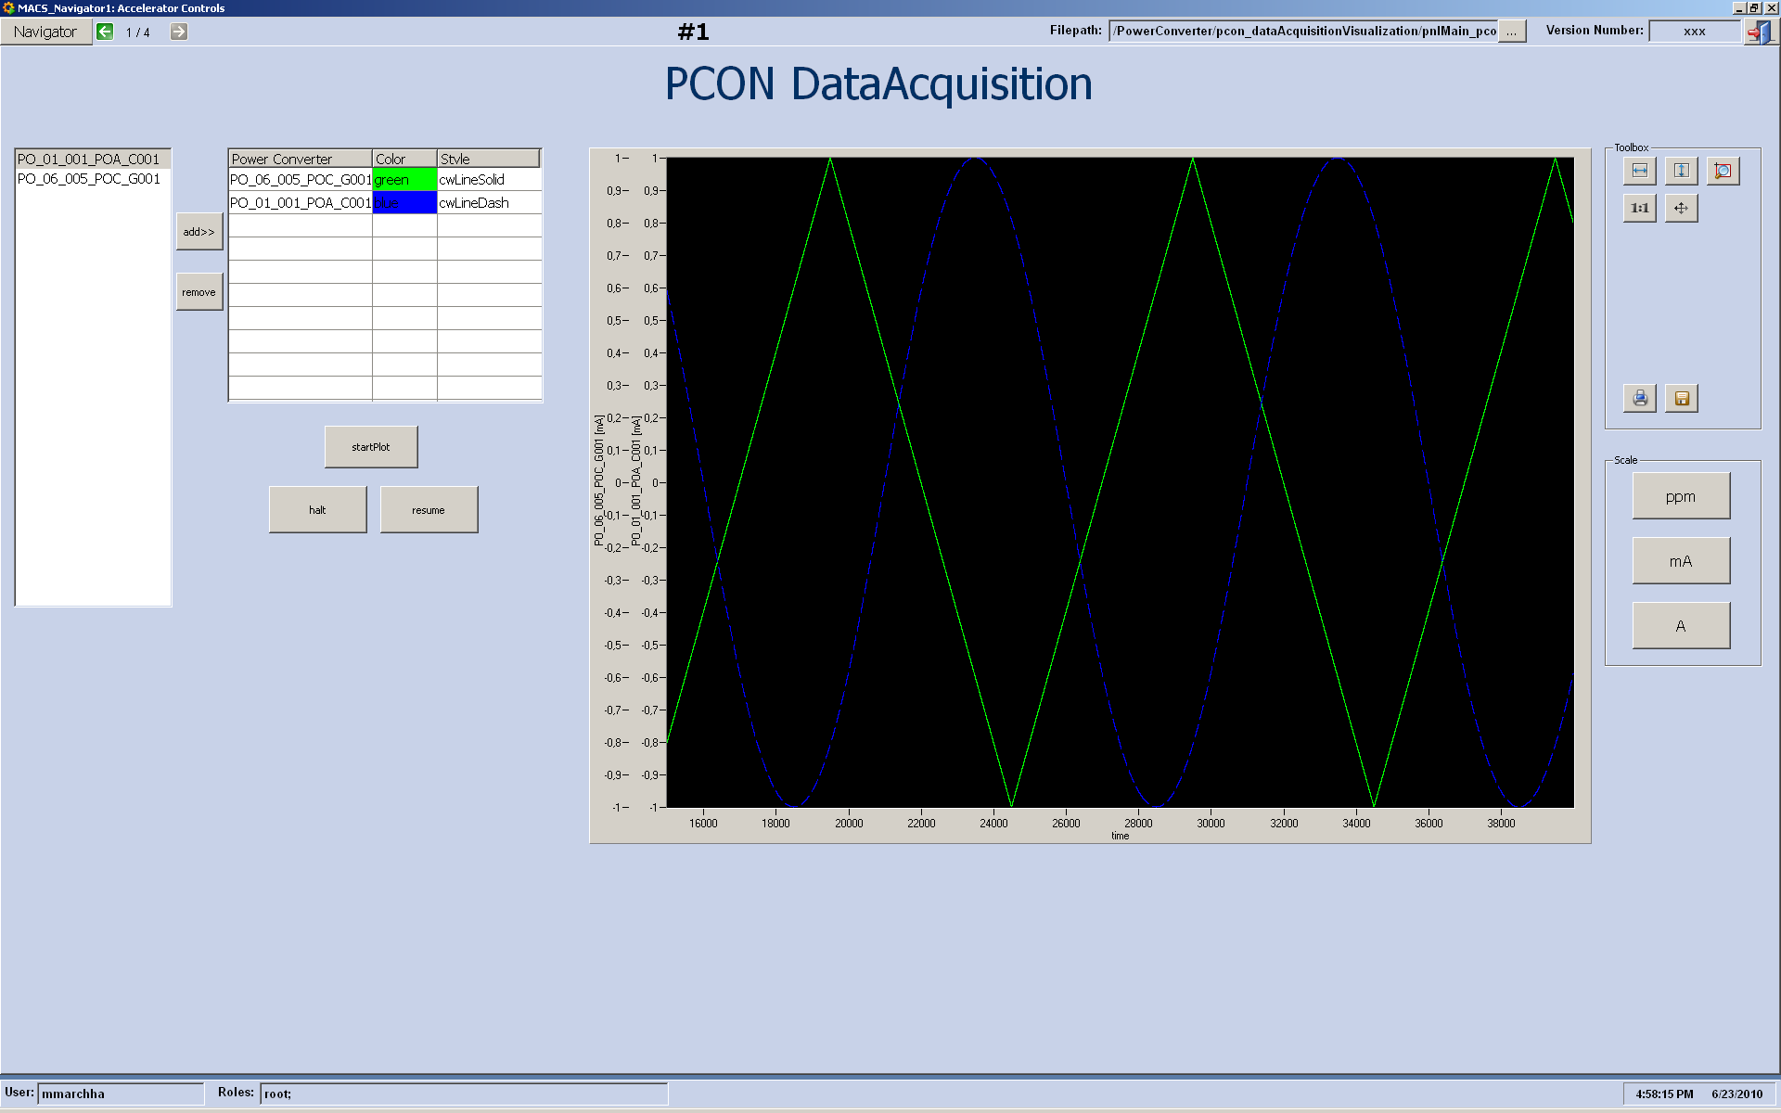

Example: PCON DataAcquisition

Slide 15
Outlook
Next Panels to develop:
  Power Converter Data Acquisition Panel (ongoing)
  ProShell Control Panel
Additional features:
  Screen configuration per working place
  Dynamic screen configuration

