Slide 1
Ion Beam Energy Verification
Requirements, Analysis and
Outlook on Design
Fabian Moser

Slide 2
Overview
Requirements for the particle energy distribution
Reasons for energy verification
Candidates for energy verification
Possible solutions
Strategy and Outlook

Slide 3
Requirements
Range measurement: 0.5 mm precision (ICRU)
Homogeneity: below 111% (CNAO)
For low-energy protons without ridge filter:
Energy accuracy: 0.1 MeV
Notes:
Explain what is ICRU?

Slide 4
Reasons for energy verification
Energy ⇨ Range verification:
Critical ingredient for dose distribution
Motivation
Lower safety requirements for accelerator
Relax complexity and cost of risk management
Recommended by ICRU (Report 78)

Slide 5
Candidates (selected)
Spectrometer
“B-train” (synchrotron as spectrometer)
“90° dipole field” (transfer line as spectrometer)
Time-of-flight
“Radio frequency” (TOF in the synchrotron)
Particle range
“Multi-layer Faraday cup”
Calorimetry
Depth-dose distribution
“Water phantom”
Non-destructive
measurement
Destructive
measurement

Slide 6
Possible solutions
Synchrotron ToF
Advantage: Few additional hardware
Drawback: Works only on bunched beam
Calorimetry
Advantage: “Ultimate” particle energy measurement
Drawback: Low radiation hardness
Depth-dose distribution
Advantage: “Like the doctors”
Drawback: Intensity dependent
Notes:
Biggest advantage and biggest drawback: there are potentially more (smaller ones)

Slide 7
Strategy
Synchrotron ToF
Transfer line Depth-dose
Performance expectations
Extraction influences
Reliability?
Conceptual design
Performance expectations
Feasibility
Build and Test
Conceptual design
Reliability?
?

Slide 8
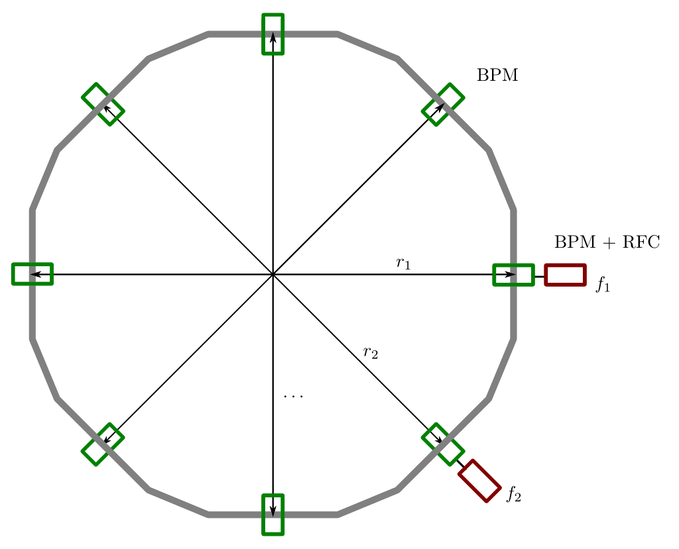
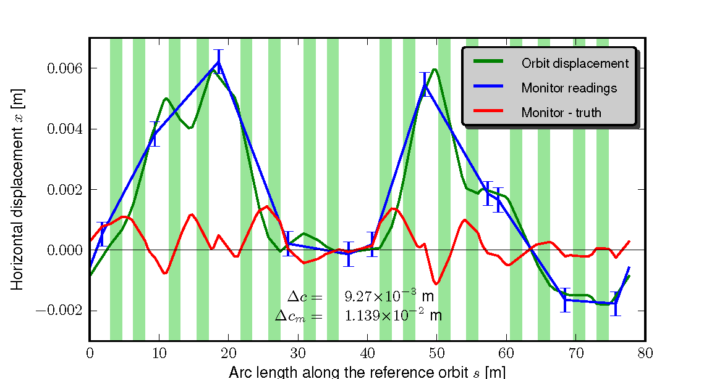
Time-of-Flight in the Synchrotron
Precision: O[ΔE] ≈10 keV

Slide 9
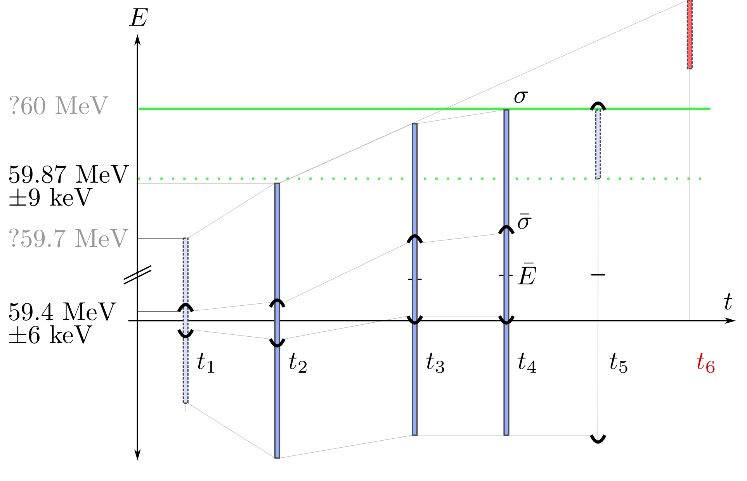
Extraction influences
e.g.
60.3 MeV !
RF phase jumps +
debunching
RF channeling
Measurement
Potential problem
Resonant extraction
Betatron core ramp

Slide 10
Outlook
Evaluation of extraction influences (ongoing)
Feedback on design
Approximation of reliability
Start with feasibility/design of depth-dose measurement

Slide 11
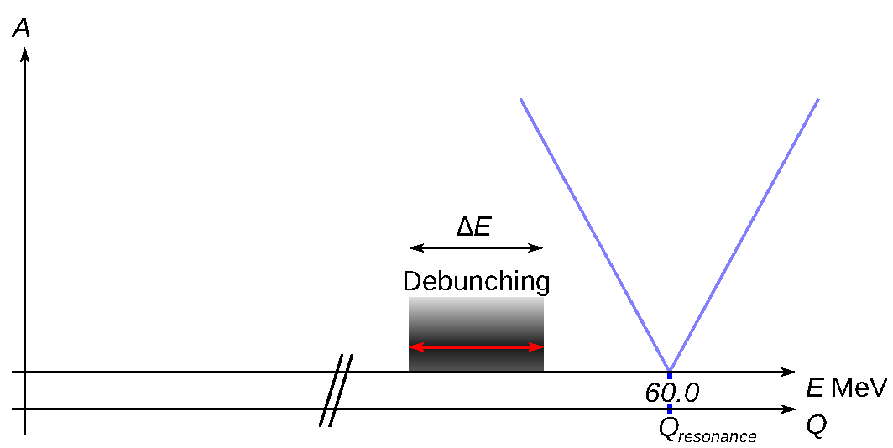
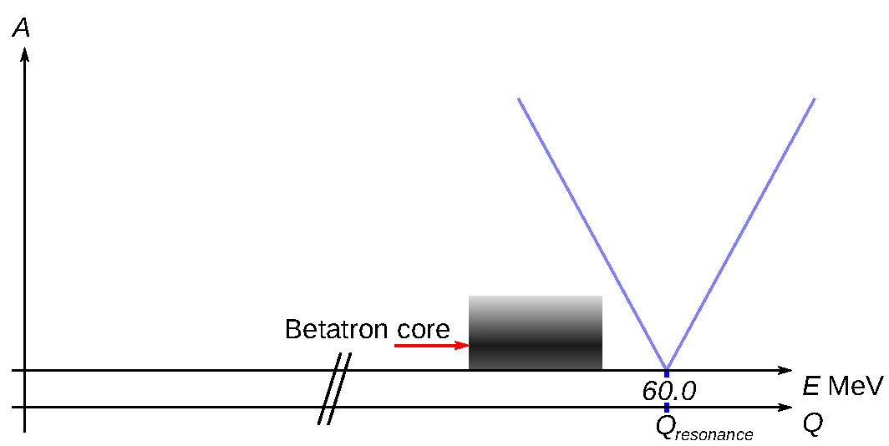
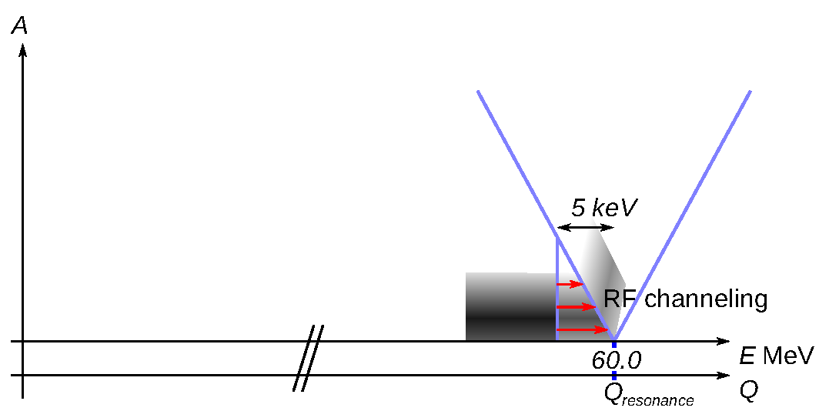
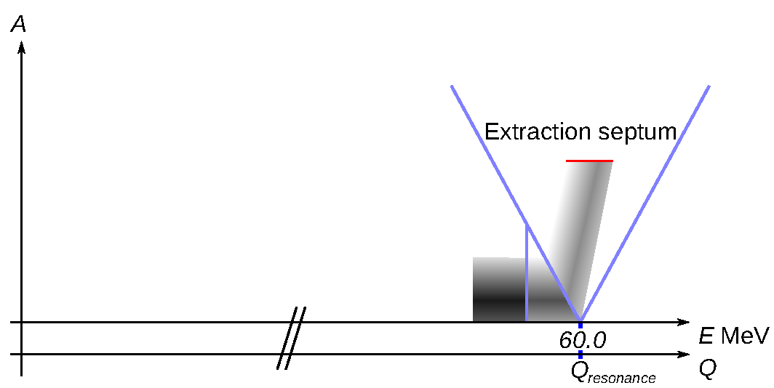
Backup: Steinbach diagrams
1
2
3
4

