Slide 1
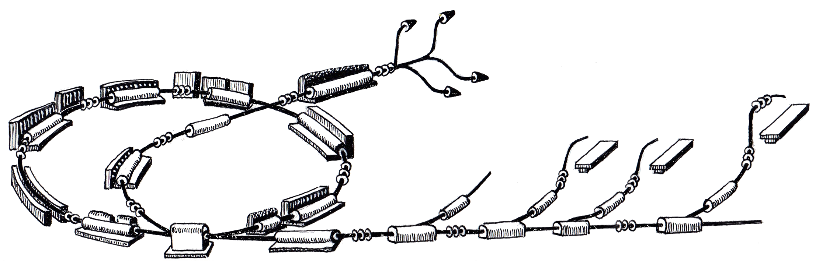
Work Package Controls
MACS Week June 2010
June 24th, 2010
Johannes Gutleber
R. Gutleber

Slide 2

Status Report

Slide 3
Contents
What has happened since Feb 5, 2010 (4 months)?
Where do we stand with respect to the planning?
What are our current activities?
Where are we heading for the next 6 months (Dec. 2010)?

Slide 4
Core Team Composition
Johannes Gutleber – WP leader
Roland Moser – Junior partner
Markus Marchhart – Automation technology engineer
Angela Brett – Software engineer
Cesar Torcato de Matos – Embedded systems engineer
Franz-Michael Coreth – IT coordinator (50%)
Michael Thonke – System administrator (since June)
Fabian Moser – doctoral student,
20% beam verification analyst

Slide 5
Procurement
Framework Agreement with Cosylab
  As of April 2010 team of up to 5 FTE for requirements, design, software and hardware developments
CNAO Repository Management System (RMS)
  As of June 18, source code, user documentation of software “AS IS”
  Software not in use yet
IBM Global Technology Services IT infrastructure architecture
  As of June 11, common project until mid December to elaborate the requirements and the architecture of the overall IT infrastructure.
  Output are “ready for tendering” documents
  Includes processes, procedures, organization, hardware and software

Slide 6
Framework Agreement
EU tendering procedure completed
  Framework Agreement with Cosylab in field of accelerator controls
Provision of software and hardware development services
  “Leasing” of skilled personnel that in close cooperation with WP controls core team creates the system
  Includes requirements re-scoping and design
  Work according to ISO 9001 QA process
Call-off-contract/Contract Work Order principle
  Payment of lump sum per CWO
  Work items and deliverables for time frames of about 6 months

Slide 7
First Experience
Alignment of development processes completed
Cosylab project team identified and assigned
Current work items
  Main Timing System (MTS)
  Power Converter Controller (PCC)
  Optical link from PCC to power converter
  Labview real-time framework (FECOS)
First CWO (4 months) completed
  Company works according to well-defined QA process
  Company helps in requirements finding (WHAT needs to be done)
  Company showed flexibility in adapting schedule

Slide 8



Status at Inception Phase Milestone
Defined work package scope
Agreement with other work packages on scope
Cost and schedule estimated
Project risk management process defined
Major risks identified and acknowledged by top management
Parameters from existing processes and designs identified
Project environment defined
Initial requirements defined
Project plan defined
Project plan aligned with top management
Development process defined and accepted
Medical device safety concept/scope completed

Slide 9
Achievements since Feb 2010
Architecture described (ES-100406-a-JGU)
Main Timing System (MTS) requirements settled
MTS technology chosen and design started
Power Converter Controller (PCC) requirements settled
PCC technology chosen and design started
Optical link evaluation between PCC and PCO performed
Labview-RT framework rapid prototyping started (FECOS)
Requirements collected for source, conventional and special magnets slow controls
Beam Interlock System requirements (initial)
IT infrastructure requirements and architecture started

Slide 10
Interfaces with Subsystems
Identification of controls contact for each WP
    Contact persons should act autonomously in requirements definition and report/consult their WP holders in case of technical/organizational doubts
  Progress made, but not all contacts yet defined/available
Requirements document with each work package
  Capture controls requirements
  Capture requirements on interface with SCS/ACS
  Capture safety requirements

Slide 11


Interfaces With Subsystems (1/3)
PCO (ES-091111-a-JGU, ES-091203-a-JGU, ES-091216-a-JGU)
  Perform slow-control
  Provide set points and set-point sequences to power converters
  Provide triggers to power converters
Magnets (ES-091021-a-MMA)
  Read out temperature and flow status
  Send control commands to magnet positioning system (septa)
Vacuum (ES-090916-a-MMA)
  Interface to vacuum local control system (LCS)
  LCS designed and implemented according to controls guidelines
Beam Interception Devices (action needed)
  Command devices
  Record device status

Slide 12

Interfaces With Subsystems (2/3)
Ion Sources (ES-091113-a-MMA in progress)
  Configure devices and command device parameters
  Change and record device status
RFQ, IH structure and RFC (TBD next)
  Configure RFC local control system
  Change and record LCS states
  Provide main timing system events and triggers
Beam Diagnostics and Instrumentation (TBD)
  Provide T4 programming framework and guidelines
  Configure T4 processing equipment
  Change and record T4 processing equipment states
  Provide main timing system events and triggers
  Provide Signal Acquisition and Distribution System (SADS)

Slide 13
Interfaces With Beam Delivery (3/3)
Beam positioning devices (WP BDS requires definition)
  Configure devices and record states
  Provide set points in real-time
Beam verification monitors (WP BDS requires definition)
  Acquire digital signals and transmit to BDCS
  Record operational conditions
Beam activation/de-activation devices (action needed)
  Configure devices and record states
  Provide triggers to activate/de-active beam

Slide 14

Interfaces With External Systems
Med. Software Systems (IS-090903-a-RTR, PM-090825-a-RTR)
  Interface to be elaborated in cooperation with MSS work package
  Mastership in clinical mode lies within PRVS
  PRVS controls patient positioning, gantry and MTE devices
Building Automation System (TBD IT coordinator)
  Request uniform Authentication & Authorization solution
  Receive and report status
Access Control/Safety Management System (TBD IT)
  Request uniform Authentication & Authorization solution
  Receive and report status
Beam Interlock System (ES-100107-a-MMA, in progress)
  Safety system that is orthogonal to operational functions
  Covered by work-package

Slide 15
Entering Elaboration Phase
Focus on requirements, architecture, design
Prototype implementation and technology evaluation
Prepare development setup

Slide 16

Preliminary Schedule
 | 2009 | 2010 | 2011 | 2012 | 2013 | 2014 | 2015
RMS
Proc. FW
Navigator
FECOS
CM
Environment
PCO
MTS
RFC
SRC
RFQ/IH
SADS
BID
BIS
MAG
VAC
BDCS
IT
Adaptation
Adaptation
Framework API
Framework
Procedures
Dev
Op. Panels
Dev
MACS Framework
Ready for WPs to work with
Survey
FED
PCC
PCC
MACS Transition Release
Ready for Commissioning
MACS Column
GUI-SCADA-Proc. FW-T4
Desi
gn
Production
Installation

Slide 17
Current Activities
Finalize Requirements (MTS, PCC, FED)
Main Timing System (MTS) design
Power Converter Controls (PCC) design
Front End Control Operating System (FECOS) design
  Framework for Labview real-time used for all developments
Integration of FECOS with PVSS via OPC and DIM
GUIs for FECOS and PCC
  Integration of PVSS with NI Measurement Studio
  Simulator components
Procedure framework (ProShell) design started
  Used to script control procedures for operation and machine development

Slide 18
Goals for December 2010
Complete architecture and implementing first components
Complete and MTS design and demo core functionality
Complete PCC design and demo core functionality
Make PCO FED ready for production
Elaborate ProShell design and API skeleton
Demonstrate use of RMS, database filler, PVSS filler
Have development infrastructure (HW, SW) operational
All goals are part of the MACS Column

Slide 19
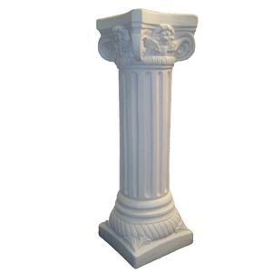
MACS Column
2010

Slide 20
MACS Column
Presentation tier (1)
Functional vertical cut through the control system architecture for
  confirming technology choices
  Refining the design
  Improving project cost/time estimate
  Providing users with a working infrastructure skeleton
To be replicated for each subsystem
Leads to a scalable system
  In terms of performance
  In terms of management
Processing tier (2)
Equipment tier (3)
Frontend tier (4)

Slide 21
Individual Columns
VAC
MAG
SRC
PCO
RF
BDI
BDS

Slide 22
Unified at Later Stage
Uniform Presentation Layer
Uniform SCADA layer and use of common services
VAC
MAG
SRC
PCO
RF
BDI
BDS

Slide 23









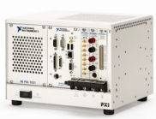


MACS Column Technologies
Windows, NI Measurement Studio
GUIs and PVSS Panel Navigator
SCADA and ProShell skeleton
Main Timing System demo
DIM
HTTP
Timing
Network
Control and Data Exchange
FECOS
Power Converter Controller
Optical link to transmit
setpoint sequences and acquire measurements from power converter FED
Power Converter
optical link for waveforms

Slide 24
Column Time Frame 2010
JAN
FEB
MAR
APR
MAY
JUN
JUL
AUG
SEP
OCT
NOV
DEC
Framework Agreement
PCO Interface
Power Converter Interface Recommendation
Identify requirements
PC Interface Def./Impl.
Production
MTS Definition
MTS development
Postponed
Postponed
PCC def.
PCC development
Tech. Eval.
PVSS/C#, environment, testing
Procedure Fw Definition
Skeleton Development
T4 framework def.
FECOS development
RMS not available
Repo Sw. Adoption
Repo Sw. Package 1
Beam Interlock System Specification and Development
1 SW engineer
1 engineer
Contractor
Column
Demo
WP JP

Slide 25
Summary and outlook

Slide 26
Summary
Requirements and design work has well progressed
Planning requires adaptation
  Work with contractor
    Requirements needed to be reduced and clarified (re-scoping)
    Followup of deliverables (geographical separation)
  Change in power converter control strategy
    Elaboration of multiple options and support in decision making process
  Inhouse software development
    New team members need time to adapt to project goals
    Taking responsibilities and autonomous work needs to be fostered

Slide 27
Outlook
MACS column remains on track (scope and deadline)
Delivery of production grade software in time of originally planned WP CO schedule
Team members should act more independent from now on
  Ensure that goals beyond 2010 are clear to everyone

