Slide 1
Publication Plan:
Gamma Rays from the Quiescent Sun
Nicholas Cannady

Slide 2
Reminder – what’s this all about?
Solar gamma rays
    Background
      SSG model
          IC halo
          Fermi 2011
          Tang et al.
        Paper plan
        Analysis targets
        Status
        Ongoing work
Seckel, Stanev, and Gaisser (SSG) predicted in 1991 a signal from the solar atmosphere due to cosmic-ray proton interactions
  Comprises neutrinos, hadrons (including antiparticles), and photons
  Photons predicted to be the most easily detectable signal, expected to be seen by EGRET but initially was not (Thompson et al. 1997)

Slide 3
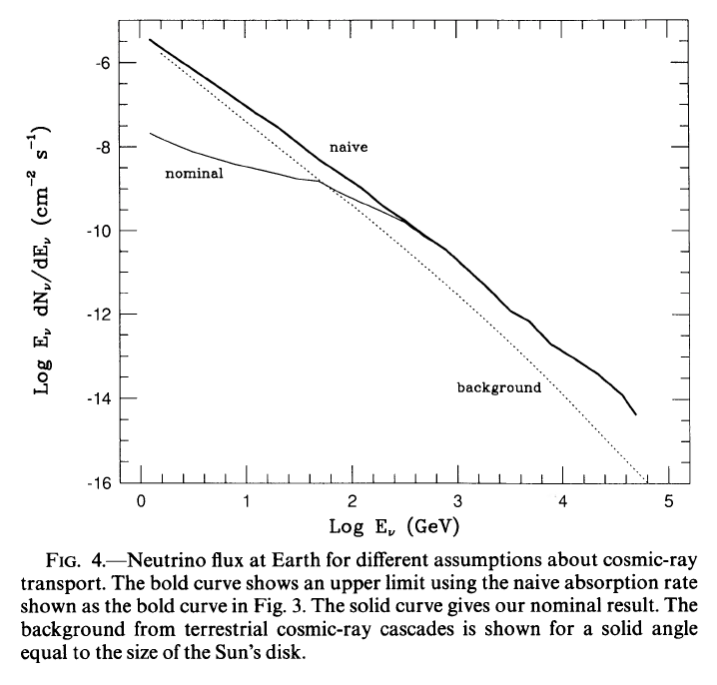
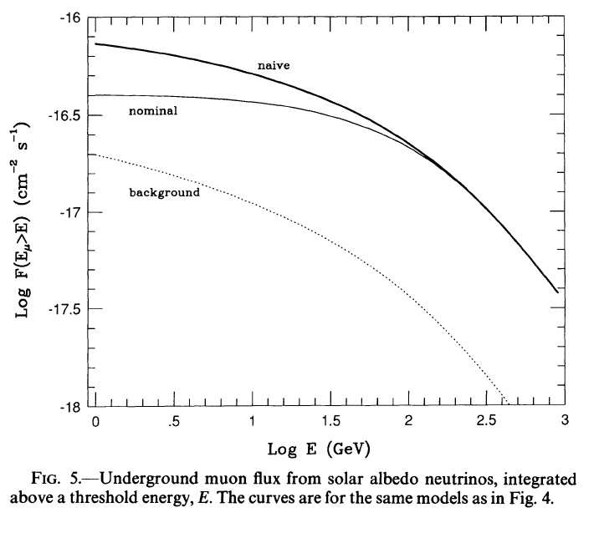
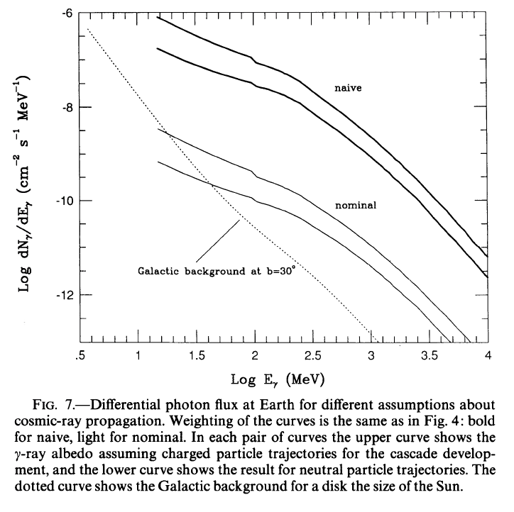
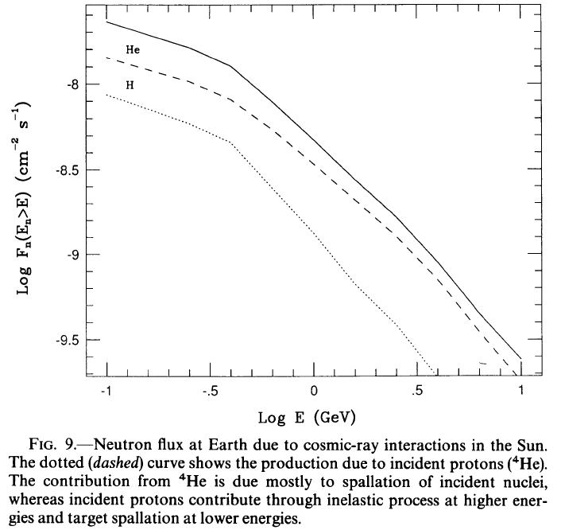
Seckel, Stanev, and Gaisser 1991
Solar gamma rays
    Background
      SSG model
          IC halo
          Fermi 2011
          Tang et al.
        Paper plan
        Analysis targets
        Status
        Ongoing work
ν
μ
ɣ
n

Slide 4
Reminder – what’s this all about?
Solar gamma rays
    Background
  SSG model
      IC halo
          Fermi 2011
          Tang et al.
        Paper plan
        Analysis targets
        Status
        Ongoing work
Seckel, Stanev, and Gaisser (SSG) predicted in 1991 a signal from the solar atmosphere due to cosmic-ray proton interactions
  Comprises neutrinos, hadrons (including antiparticles), and photons
  Photons predicted to be the most easily detectable signal, expected to be seen by EGRET but initially was not (Thompson et al. 1997)
Due to the intense photon field near the Sun, it is also expected that cosmic-ray electrons will create an inverse Compton (IC) halo
  Extended emission reaching far beyond the solar disk
  New analysis of full EGRET dataset found the IC halo and disk components to be significantly detected (Orlando and Strong, 2008)

Slide 5
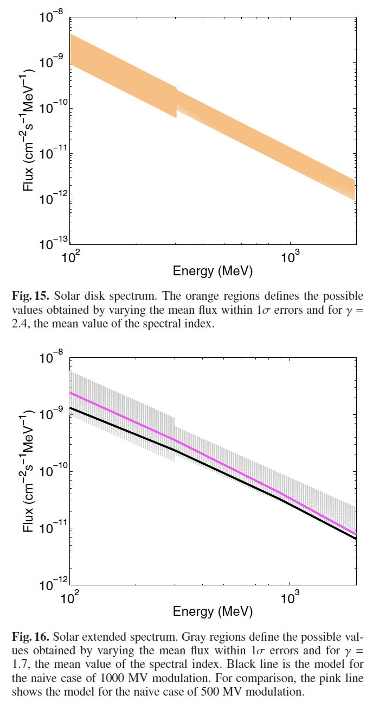
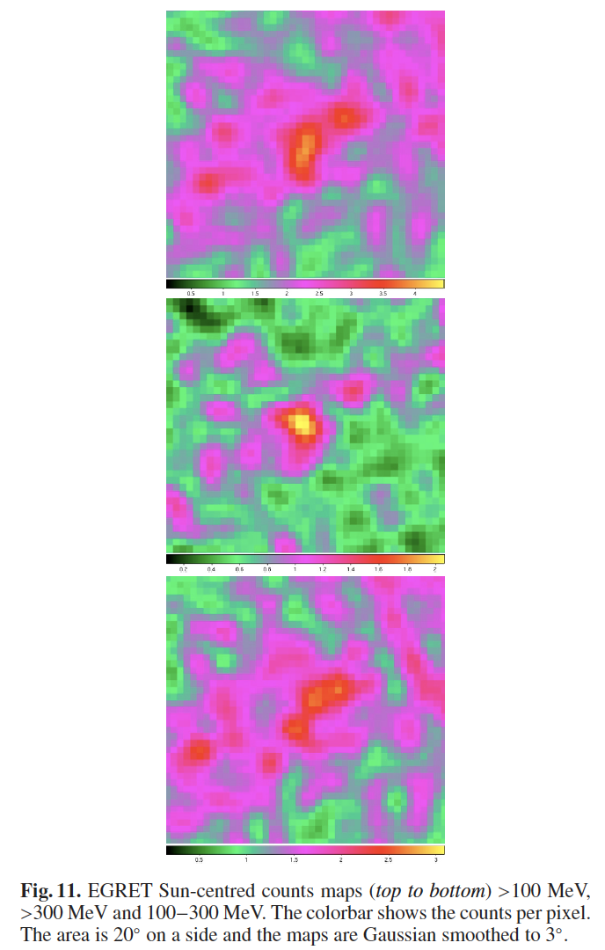
Orlando and Strong, 2008
Solar gamma rays
    Background
  SSG model
      IC halo
          Fermi 2011
          Tang et al.
        Paper plan
        Analysis targets
        Status
        Ongoing work

Slide 6
Reminder – what’s this all about?
Solar gamma rays
    Background
  SSG model
  IC halo
      Fermi 2011
          Tang et al.
        Paper plan
        Analysis targets
        Status
        Ongoing work
Seckel, Stanev, and Gaisser (SSG) predicted in 1991 a signal from the solar atmosphere due to cosmic-ray proton interactions
  Comprises neutrinos, hadrons (including antiparticles), and photons
  Photons predicted to be the most easily detectable signal, expected to be seen by EGRET but initially was not (Thompson et al. 1997)
Due to the intense photon field near the Sun, it is also expected that cosmic-ray electrons will create an inverse Compton (IC) halo
  Extended emission reaching far beyond the solar disk
  New analysis of full EGRET dataset found the IC halo and disk components to be significantly detected (Orlando and Strong, 2008)
Both the disk and halo components are significantly detected in the first two years of Fermi LAT observations (Abdo et al. 2011)
  Disk component higher than SSG “nominal” but below “naive” model, consistent with E⁻² spectrum up to 10 GeV
  Halo component roughly falls as θ⁻¹ and E⁻²

Slide 7
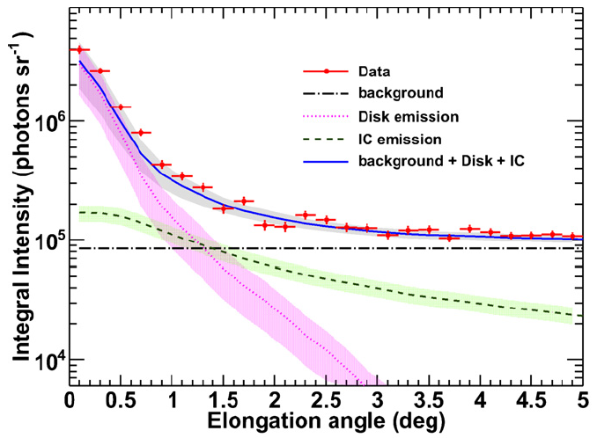
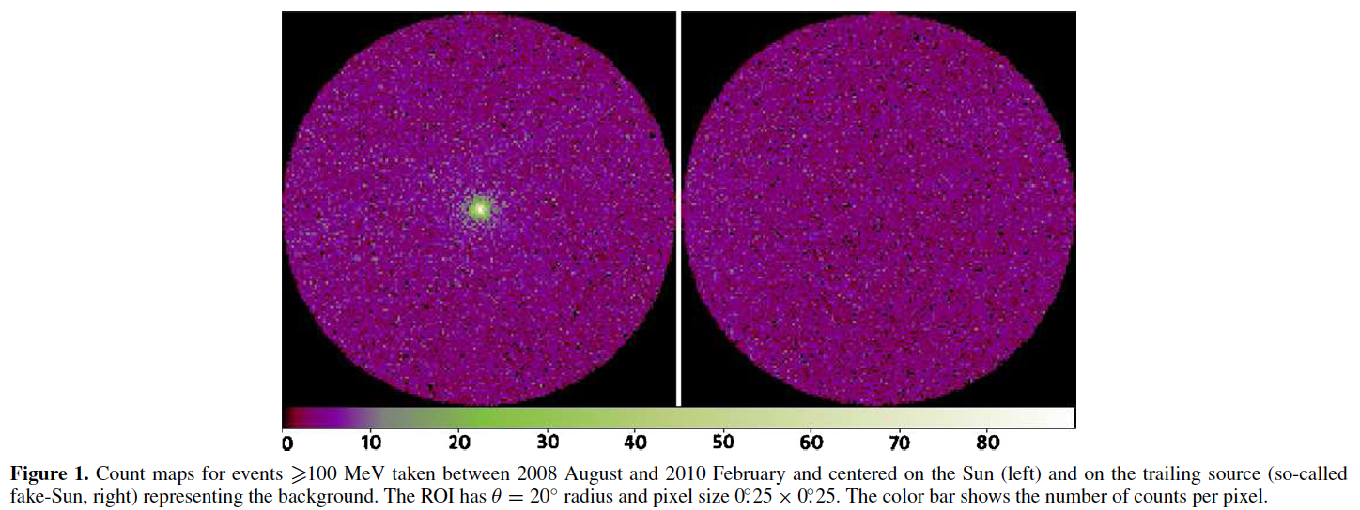
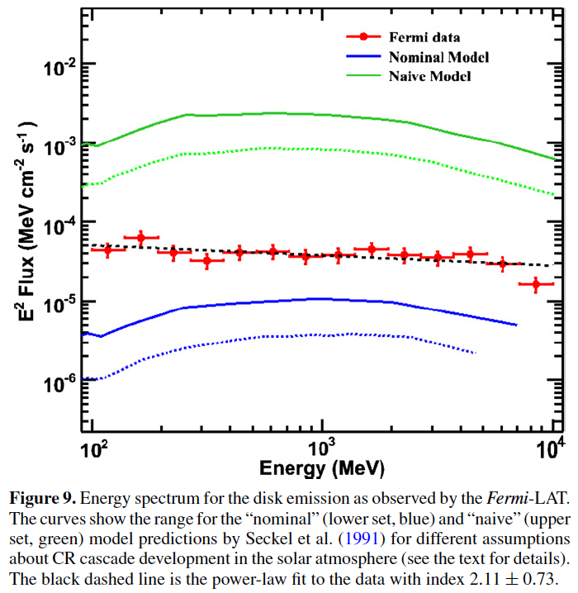
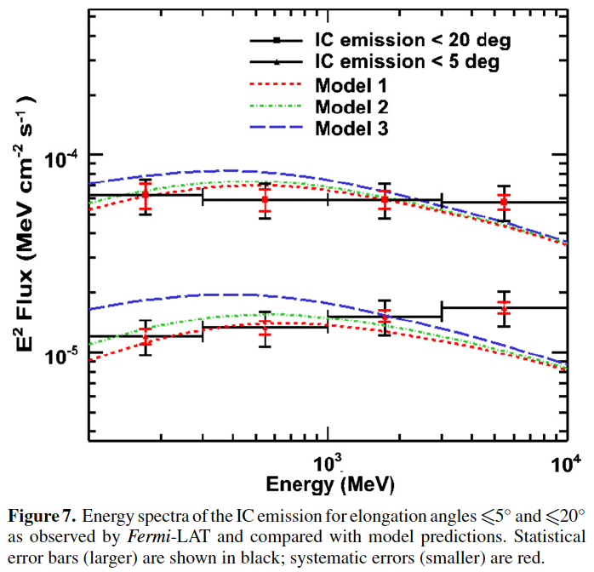
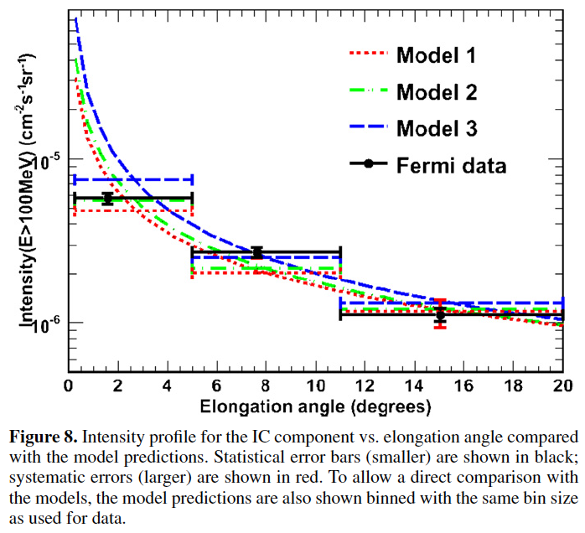
Tang et al. 2018 and Linden et al. 2018
Solar gamma rays
    Background
  SSG model
  IC halo
      Fermi 2011
          Tang et al.
        Paper plan
        Analysis targets
        Status
        Ongoing work

Slide 8
Reminder – what’s this all about?
Solar gamma rays
    Background
  SSG model
  IC halo
  Fermi 2011
      Tang et al.
        Paper plan
        Analysis targets
        Status
        Ongoing work
Seckel, Stanev, and Gaisser (SSG) predicted in 1991 a signal from the solar atmosphere due to cosmic-ray proton interactions
  Comprises neutrinos, hadrons (including antiparticles), and photons
  Photons predicted to be the most easily detectable signal, expected to be seen by EGRET but initially was not (Thompson et al. 1997)
Due to the intense photon field near the Sun, it is also expected that cosmic-ray electrons will create an inverse Compton (IC) halo
  Extended emission reaching far beyond the solar disk
  New analysis of full EGRET dataset found the IC halo and disk components to be significantly detected (Orlando and Strong, 2008)
Both the disk and halo components are significantly detected in the first two years of Fermi LAT observations (Abdo et al. 2011)
  Disk component higher than SSG “nominal” but below “naive” model, consistent with E⁻² spectrum up to 10 GeV
  Halo component roughly falls as θ⁻¹ and E⁻²
Analysis of 11 years of LAT data at OSU extended this to >100 GeV
  Hard spectrum continues to high energies with a dip from 30 – 50 GeV
  Anti-correlation of flux with solar cycle; >100 GeV only seen at solar min.
  Resolved disk shows changing emission region with solar cycle

Slide 9
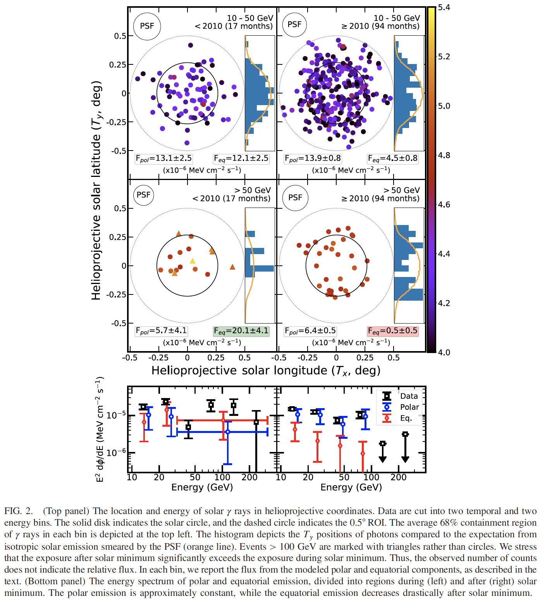
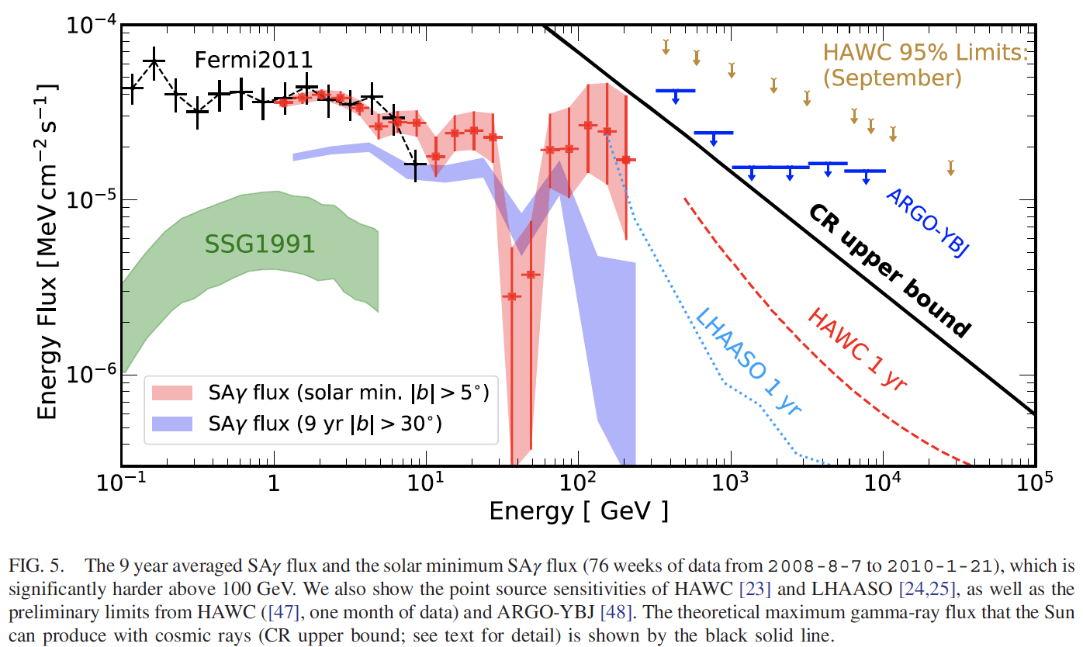
Reminder – what’s this all about?
Solar gamma rays
    Background
  SSG model
  IC halo
  Fermi 2011
      Tang et al.
        Paper plan
        Analysis targets
        Status
        Ongoing work

Slide 10
What can we contribute?
Solar gamma rays
Background
    Paper plan
        Analysis targets
        Status
        Ongoing work
Clear across multiple analyses and multiple instruments:
  There is emission from the disk of the quiescent Sun in excess of SSG
  There is an extended IC halo around the Sun
(Opinion): What’s probably true:
  The intensity of the disk emission is somehow affected by the solar cycle
  The disk emission extends beyond tens of GeV
What’s left:
  The morphology of the disk emission changes with solar cycle
  There is a dip in the disk emission spectrum for E ~ 30 – 50 GeV

Slide 11
What can we contribute?
Solar gamma rays
Background
    Paper plan
        Analysis targets
        Status
        Ongoing work
Clear across multiple analyses and multiple instruments:
  There is emission from the disk of the quiescent Sun in excess of SSG
    Easy to confirm - we definitely see this already!
  There is an extended IC halo around the Sun
    Will take as fact in likelihood analysis
(Opinion): What’s probably true:
  The intensity of the disk emission is somehow affected by the solar cycle
    Time dependence of CALET measurement
  The disk emission extends beyond tens of GeV
    Our exposure is not high enough beyond a few tens of GeV
What’s left:
  The morphology of the disk emission changes with solar cycle
    High-energy statistics not high enough to probe this
  There is a dip in the disk emission spectrum for E ~ 30 – 50 GeV
    We reach these energies (barely)

Slide 12
Intensity and hardness of spectrum
Solar gamma rays
Background
Paper plan
    Analysis targets
      Hard spectrum
          Flux variability
          No dip
        Status
        Ongoing work
A more specific itemization of what we would like to publish:
  A spectral fit along with our spectrum
  Power-law index consistency with Fermi2011 result
  Normalization in excess of SSG prediction

Slide 13
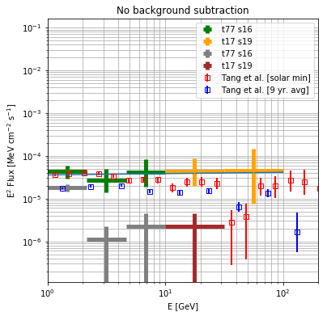
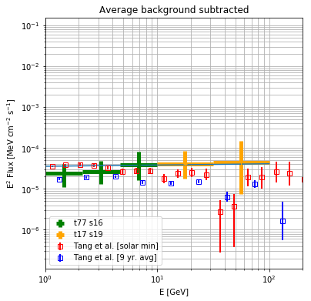
Intensity and hardness of spectrum
Solar gamma rays
Background
Paper plan
    Analysis targets
      Hard spectrum
          Flux variability
          No dip
        Status
        Ongoing work
A more specific itemization of what we would like to publish:
  A spectral fit along with our spectrum
  Power-law index consistency with Fermi2011 result
  Normalization in excess of SSG prediction

Slide 14
Variability of the CALET measurement
Solar gamma rays
Background
Paper plan
    Analysis targets
  Hard spectrum
      Flux variability
          No dip
        Status
        Ongoing work
A more specific itemization of what we would like to publish:
  A spectral fit along with our spectrum
  Power-law index consistency with Fermi2011 result
  Normalization in excess of SSG prediction
A measure of the variability present in the CALET data
  Do we detect a significant increase in the solar minimum period?
  If so, a quantitative statement about the significance

Slide 15
No dip present in the CALET measurement
Solar gamma rays
Background
Paper plan
    Analysis targets
  Hard spectrum
  Flux variability
      No dip
        Status
        Ongoing work
A more specific itemization of what we would like to publish:
  A spectral fit along with our spectrum
  Power-law index consistency with Fermi2011 result
  Normalization in excess of SSG prediction
A measure of the variability present in the CALET data
  Do we detect a significant increase in the solar minimum period?
  If so, a quantitative statement about the significance
A measure of the (in)consistency of the CALET measurement with the spectral dip present in the Tang et al. result
  In addition to trying the power-law fitting above, model a power law with a spectral dip
  Can we significantly reject a dip at any “severity?”

Slide 16
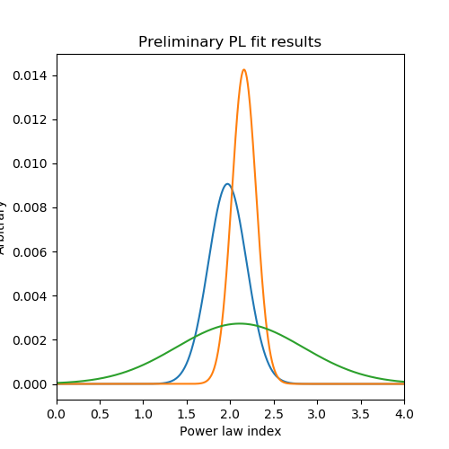
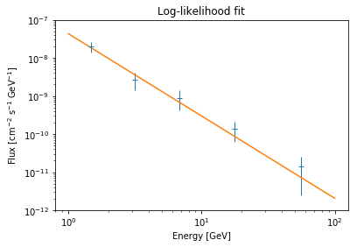
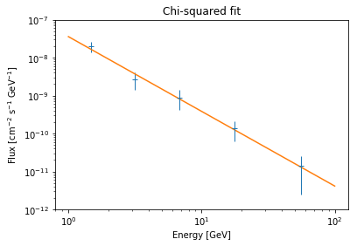
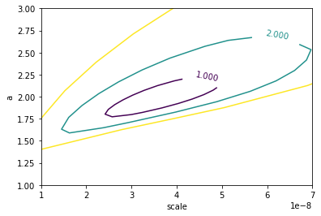
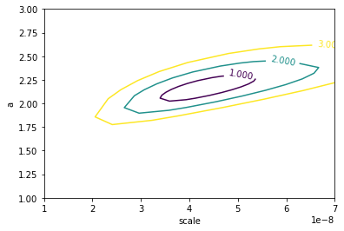
Fitting the measured spectrum
Solar gamma rays
Background
Paper plan
Analysis targets
    Status
      Spectral fit
          Background modeling
          Variability
        Ongoing work
Preliminary calculation of the flux was done and a power law was fit
  CAVEAT: currently no treatment of the IC flux is taken into account
Chi-squared fitting
(with Poisson errors)
  Scale: (3.6 ± 1.2) e-8
  Index: (1.97 ± 0.22)
Likelihood fitting
  Scale: (4.3 ± 1.1) e-8
  Index: (2.16 ± 0.14)
Fermi2011 results
  Index: (2.11 ± 0.73)
  (why is the error so large?)

Slide 17
Properly including ROI and background
Solar gamma rays
Background
Paper plan
Analysis targets
    Status
  Spectral fit
      Background modeling
          Variability
        Ongoing work
Current treatment of disk emission:
  Select window based on average angular resolution at energy for >95% containment of photons from the disk
Current treatment of backgrounds:
  Galactic plane: remove 10° window around plane region
  Point sources: remove 5° window around source list
  (Crab, Geminga, Vela, CTA 102, a few other AGN)
  Moon: remove 5° window around Moon position at each time
  IC halo: neglect

Slide 18
Properly including ROI and background
Solar gamma rays
Background
Paper plan
Analysis targets
    Status
  Spectral fit
      Background modeling
          Variability
        Ongoing work
Current treatment of disk emission:
  Select window based on average angular resolution at energy for >95% containment of photons from the disk
Current treatment of backgrounds:
  Galactic plane: remove 10° window around plane region
  Point sources: remove 5° window around source list
  (Crab, Geminga, Vela, CTA 102, a few other AGN)
  Moon: remove 5° window around Moon position at each time
  IC halo: neglect
Planned treatment of disk emission:
  Select events in region of interest of constant angular size
  Remove contribution from bright sources as above
  Include IC halo and disk component morphologically in likelihood
    Per Tang et al., IC angular extent as θ⁻¹, except 0 in disk region
    Normalization of IC halo left as nuisance parameter
    Assuming spectral shape according to θ < 5 result for Fermi2011?

Slide 19
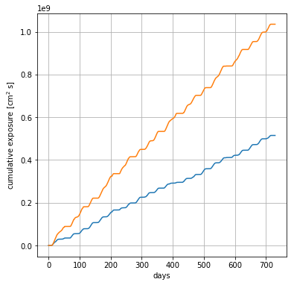
Testing the variability in the CALET dataset
Solar gamma rays
Background
Paper plan
Analysis targets
    Status
  Spectral fit
  Background modeling
      Variability
        Ongoing work
Some dependence on solar cycle is suggested in CALET data
Exposure accumulation is roughly linear
(somewhat low for 2019)
ISS structures in FOV can impact this result through exposure loss
2015 | 2 months | 2 | 0
2016 | 12 months | 6 | 0
2017 | 12 months | 11 | 2
2018 | 12 months | 13 | 2
2019 | 10 months | 7 | 0

Slide 20
Testing the variability in the CALET dataset
Solar gamma rays
Background
Paper plan
Analysis targets
    Status
  Spectral fit
  Background modeling
      Variability
        Ongoing work
Some dependence on solar cycle is suggested in CALET data
Exposure accumulation is roughly linear
(somewhat low for 2019)
ISS structures in FOV can impact this result through exposure loss
Finer time binning makes this seem not as clear...
2015/11 – 2016/02 | 4 | 0
2016/03 – 2016/06 | 0 | 0
2016/07 – 2016/10 | 4 | 0
2016/11 – 2017/02 | 3 | 0
2017/03 – 2017/06 | 3 | 2
2017/07 – 2017/10 | 3 | 0
2017/11 – 2018/02 | 3 | 0
2018/03 – 2018/06 | 4 | 1
2018/07 – 2018/10 | 4 | 1
2018/11 – 2019/02 | 3 | 0
2019/03 – 2019/06 | 1 | 0
2019/07 – 2019/10 | 6 | 0
2015 | 2 months | 2 | 0
2016 | 12 months | 6 | 0
2017 | 12 months | 11 | 2
2018 | 12 months | 13 | 2
2019 | 10 months | 7 | 0

Slide 21
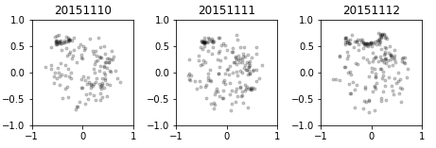
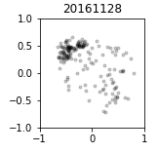
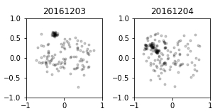
Revisiting the problem of ISS structures in FOV
Solar gamma rays
Background
Paper plan
Analysis targets
Status
    Ongoing work
      ISS structure treatment
          Increasing acceptance
Thanks to Asaoka-san, most ISS structure contamination is removed
Since the number of photons is so low for the solar analysis, must be very careful about removing as much as possible, especially if it affects the high-energy photons
  When checking daily maps, it is clear that there is some residual contamination in the photon dataset
  During Waseda visit, learned to make daily cuts to add to the database
  Recently completed removal of “urgent concern” regions
  Event and exposure files being generated now
  Next, the days that are flagged but maybe not ”urgent”

Slide 22
Expanding beyond CHD charge identification?
Solar gamma rays
Background
Paper plan
Analysis targets
Status
    Ongoing work
  ISS structure treatment
      Increasing acceptance
Increasing the exposure (esp. at high energies) is always nice, but for this analysis it requires expanding the acceptance

Slide 23
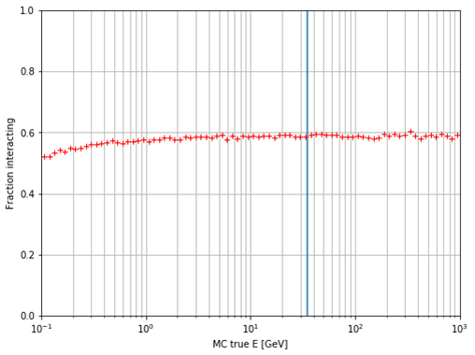
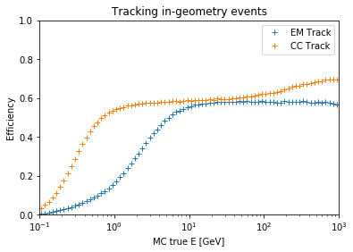
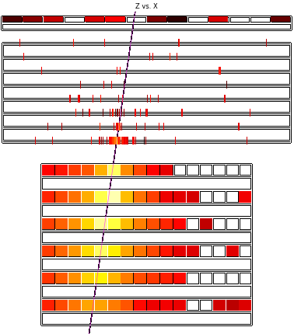
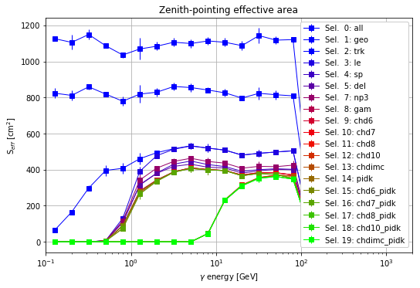
Why not just improve charge selection?
Solar gamma rays
Background
Paper plan
Analysis targets
Status
    Ongoing work
  ISS structure treatment
      Increasing acceptance
current selection
track passes:
CHD top
TASC top
first interaction:
below IMC 1 (Np < 8)
above IMC 6 (Np > 2)
Tracking efficiency converges to pair production efficiency
  we track photons with E > 1 GeV with ~100% efficiency
  no noticeable improvements possible in tracking
Charge cut only loses
<~ 10% of gamma events at intermediate energies
More statistics requires more open geometry

Slide 24
Expanding beyond CHD charge identification?
Solar gamma rays
Background
Paper plan
Analysis targets
Status
    Ongoing work
  ISS structure treatment
      Increasing acceptance
Increasing the exposure (esp. at high energies) is always nice, but for this analysis it requires expanding the acceptance
Can be investigated using the new photon and electron datasets generated at LSU HPC facilities (and the old proton dataset)
Started working with graduate student at Ritsumeikan University (Zenita-san) in regards to this selection

Slide 25
Summary
Solar gamma rays
Background
Paper plan
Analysis targets
Status
Ongoing work
We plan to publish the solar analysis in the coming months
Improved modeling of the source environment in the likelihood is being implemented and tested
ISS structure removal is being performed at a daily basis to remove remaining clear obstructions
Preliminary power-law fitting of the disk emission gives a result consistent with the Fermi 2011 result
The dip at 30 – 50 GeV remains undetected by CALET even with improved statistics
There is evidence of an increase of the flux during solar minimum, but 2019 is an outlier
Testing feasibility of opening acceptance to IMC-only charge selection

Slide 26
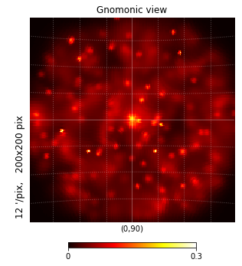
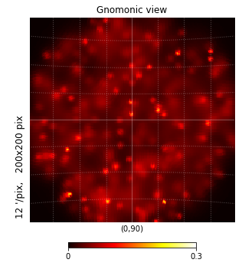
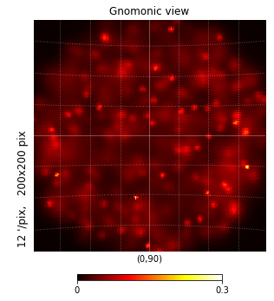
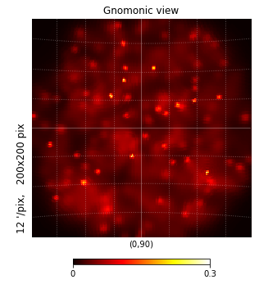
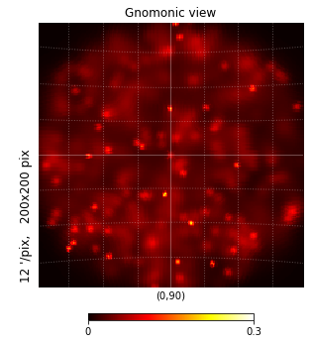
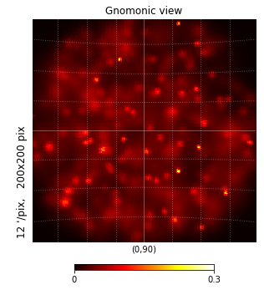
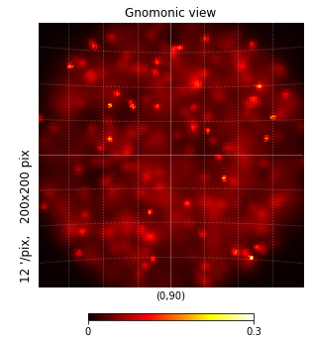
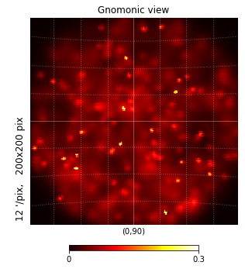
Real and fake Sun frames
Backup slides
Frame maps

Slide 27
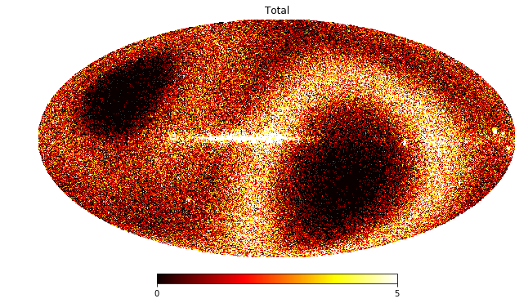
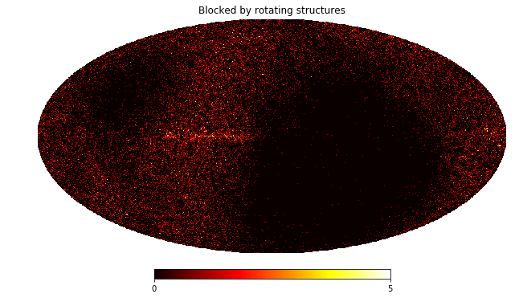
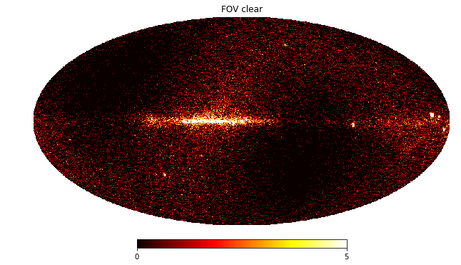
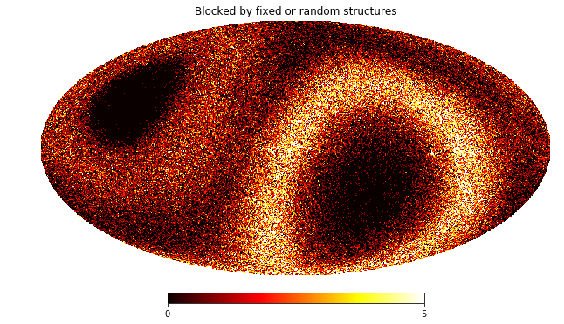
LE events removed by FOV cuts
Backup slides
Cut events

Slide 28
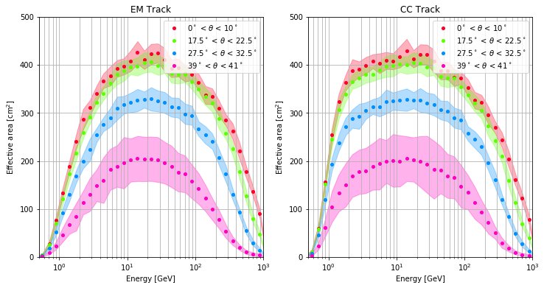
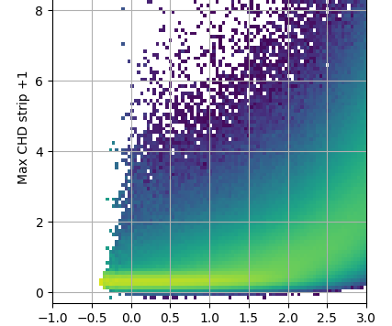
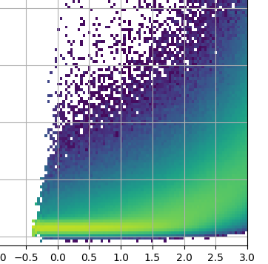
Backscatter effect on efficiency
Backup slides
Backscatter

