Slide 1

Gamma ray analysis and
GW follow-up observations
Masaki Mori, Yoichi Asaoka, Shoji Torii, Daisuke Zenita, Nick Cannady, Mike Cherry, Yuta Kawakubo
for the CALET collaboration
CALET TIM at CNR-IFAC, Florence, February 04-06-27, 2020

Slide 2
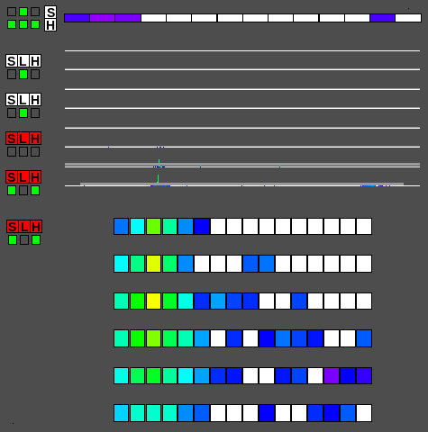
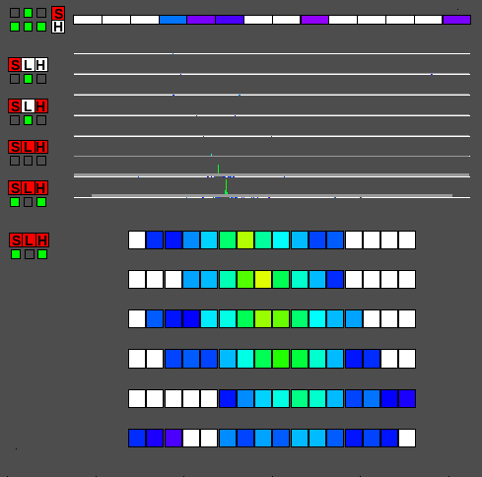
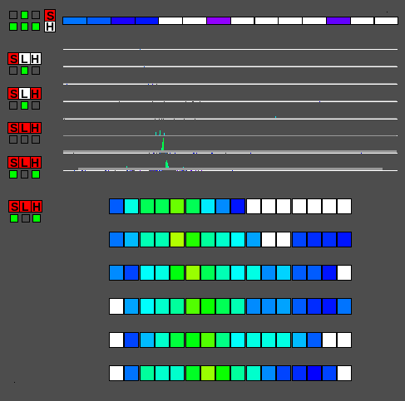
Gamma Ray Event Selection
Cannady et al., ApJS 238:5 (2018)
= Electron Selection Cut + Gamma-ray ID Cut w/ Lower Energy Extension
100 GeV Event Examples
gamma-ray
electron
proton
Charge Z=0
Charge Z=1
Electromagnetic Shower
Hadron Shower
well contained, constant shower development
larger spread

Slide 3
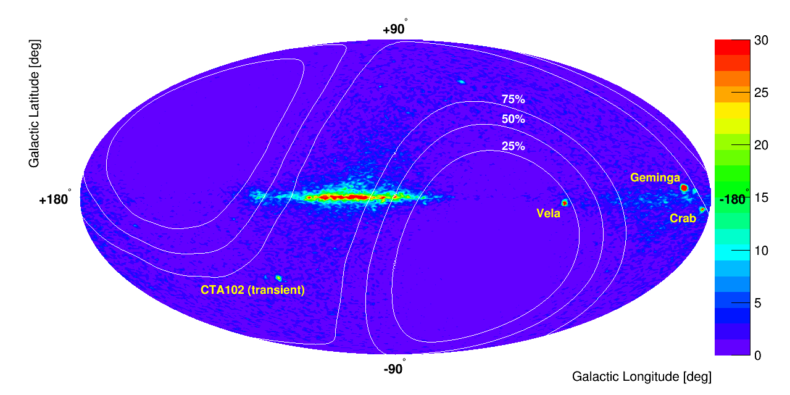
Gamma-ray skymap
Mori, Asaoka et al., ICRC2019
LE-γ mode, from 2015 November to 2018 May
(Contours show relative exposures)

Slide 4
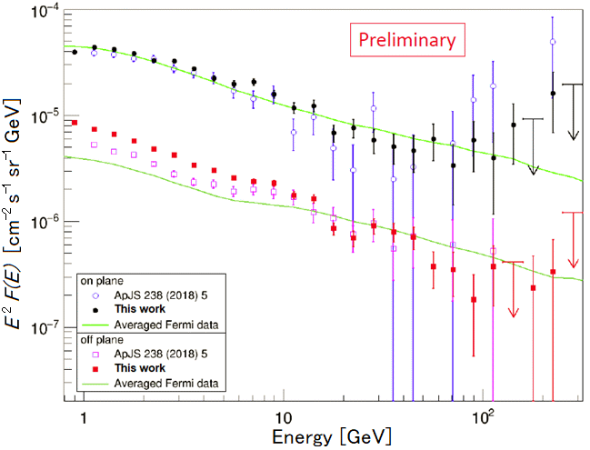
Gamma-ray spectra
Mori, Asaoka et al., ICRC2019+
LE-γ mode
from 2015 November to 2018 May
  “On-plane”: |l| < 80° & |b|< 8°, “Off-plane”: |b|> 8°

Slide 5
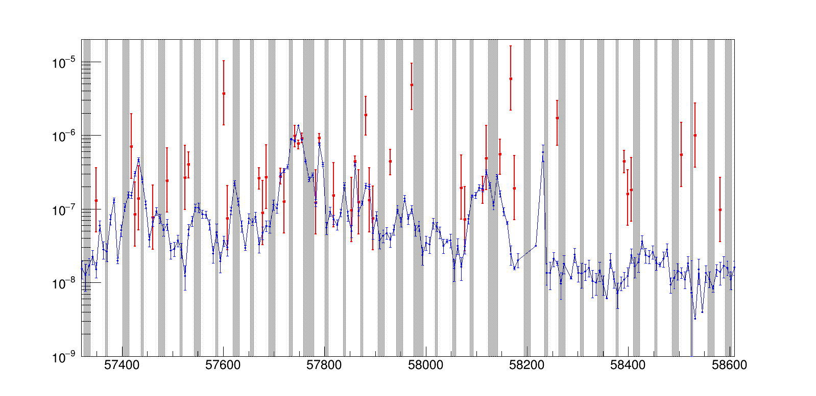
CTA 102 (AGN) light curve
By Zenita
LE trig (> 1 GeV)
Flux [cm⁻²s⁻¹]
(2016/1/13 2016/7/31 2017/2/16 2017/9/4 2018/3/23 2018/10/9 2019/4/27)
Modified Julian Day
Red: CALET signal, Hatched: CALET upper limit (<10⁻⁷cm⁻²s⁻¹)
Blue: Fermi-LAT

Slide 6
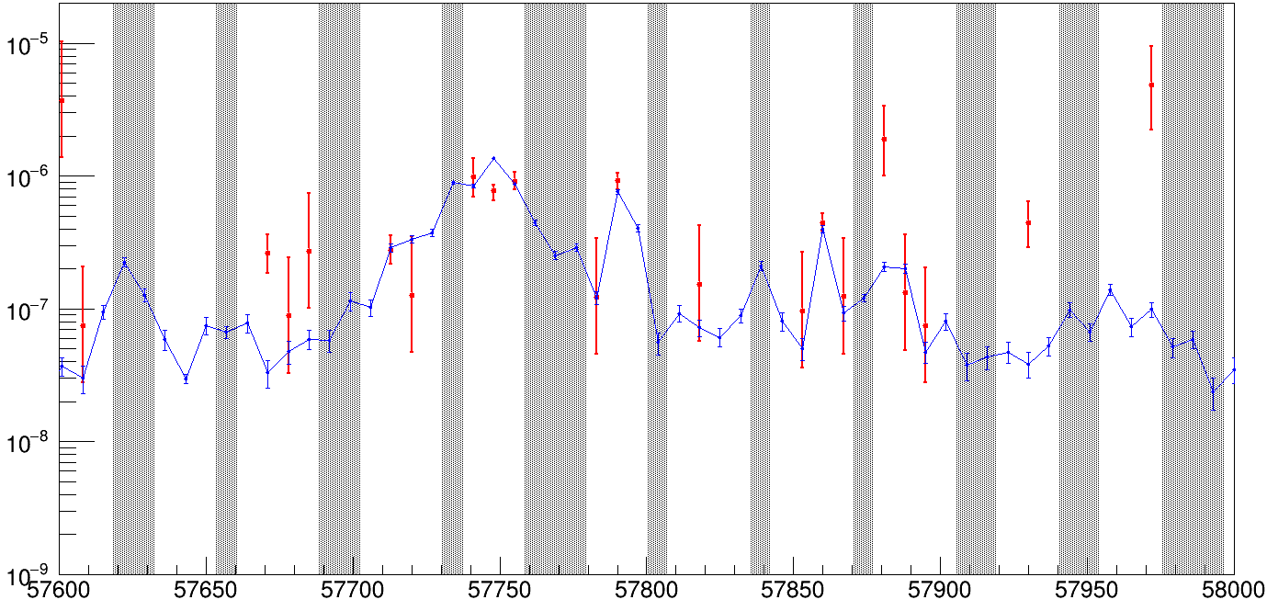
CTA 102 (AGN) light curve
By Zenita
[Flare period]
LE trig (> 1 GeV)
Flux [cm⁻²s⁻¹]
(2016/7/31 2016/11/4 2017/2/16 2017/5/27 2017/9/4)
Modified Julian Day
Red: CALET signal, Hatched: CALET upper limit (<10⁻⁷cm⁻²s⁻¹)
Blue: Fermi-LAT

Slide 7
Toward higher energies
- Gamma-ray line? -
No result yet…

Slide 8
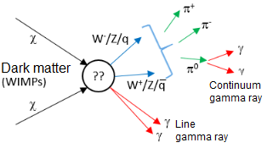
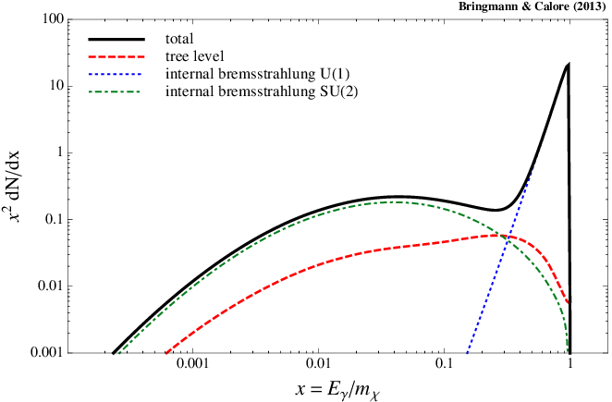
Gamma-ray lines from DM annihilation
Neutralino
Kaluza-Klein
Bringmann and Calor 2013
Tsuchida and Mori 2017
M = 800GeV
(loop suppressed – low branching ratio)

Slide 9
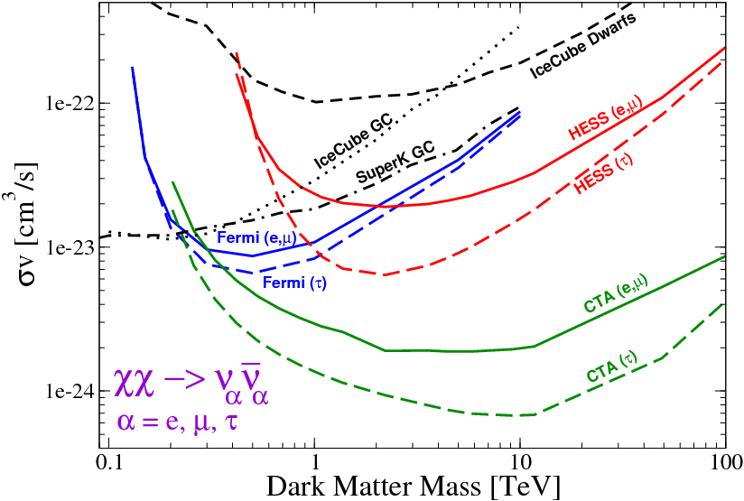
Limits by indirect searches
F. S. Queiroz, arXiv:1605.08788
Annihilation cross section
[proposed]

Slide 10
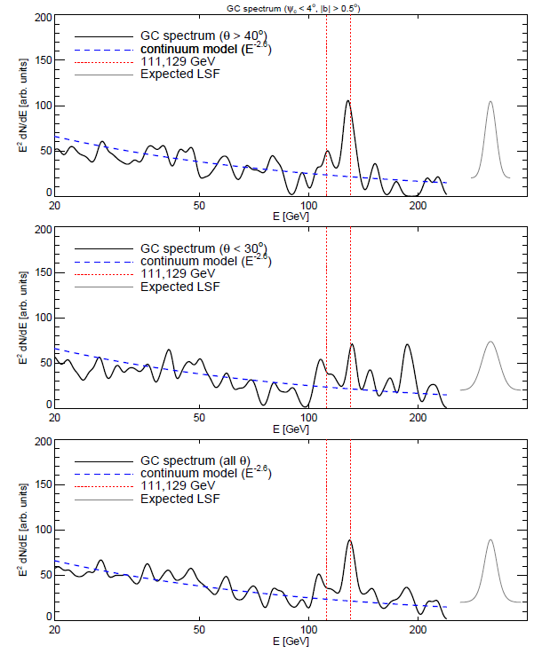
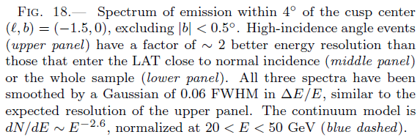
130 GeV line at the Galactic center?
Su & Finkbeiner, arXiv:1206.1616

Slide 11
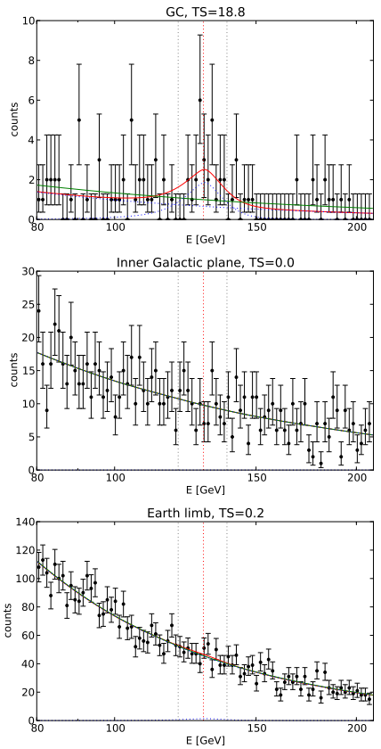
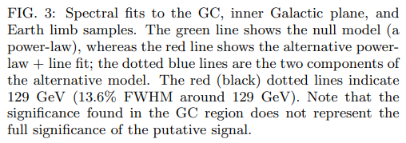
130 GeV line at the Galactic center?
Su, Finkbeiner & Weniger, JCAP 01(2013)209
TS=18.8 ↔ 4σ

Slide 12
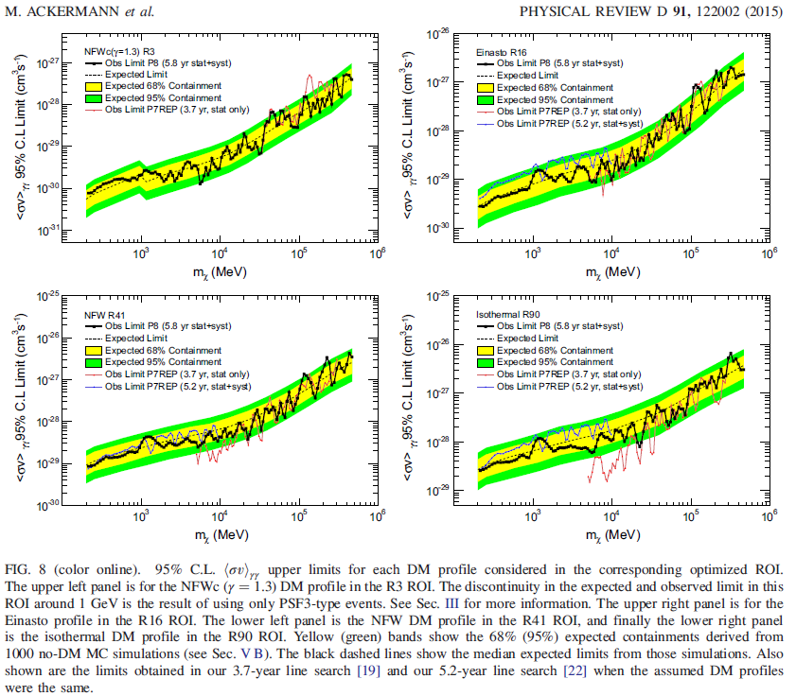
Fermi-LAT dark matter line analysis (update)

Slide 13
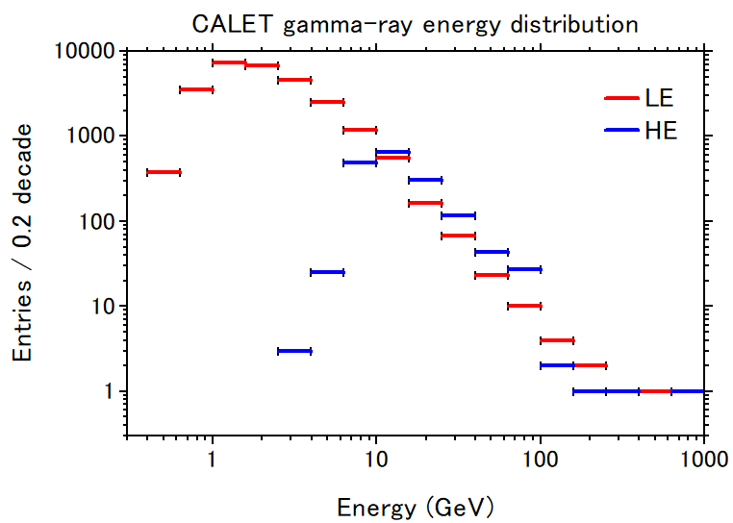
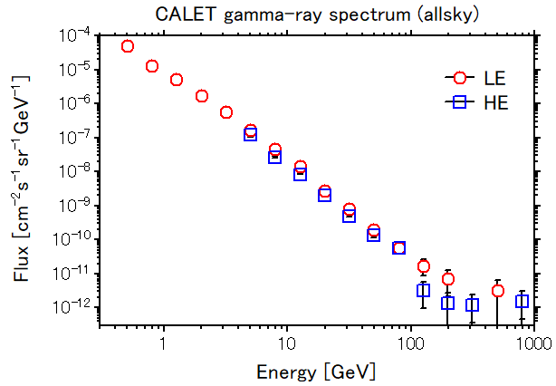
CALET gamma-ray spectrum

Slide 14
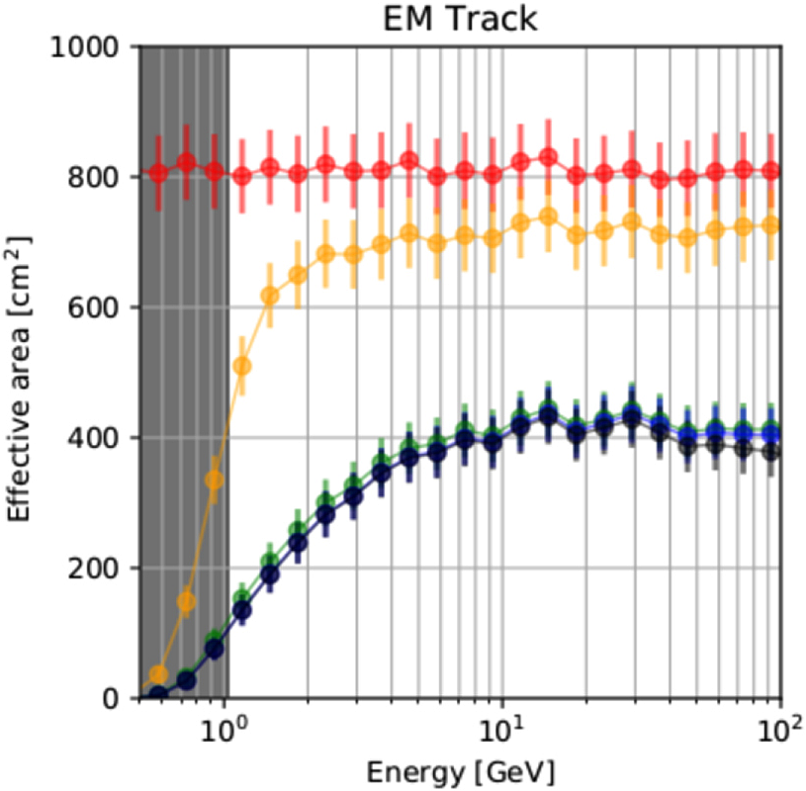
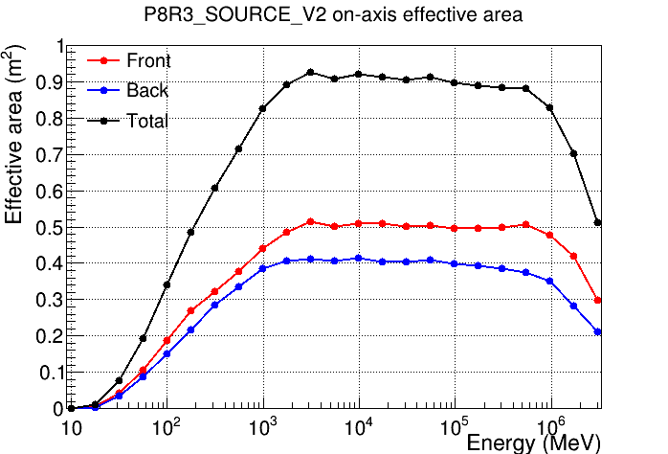
Effective area
CALET LE γ
(Cannady+, 2018)
Fermi LAT
https://www.slac.stanford.edu/exp/glast/groups/canda/lat_Performance.htm

Slide 15
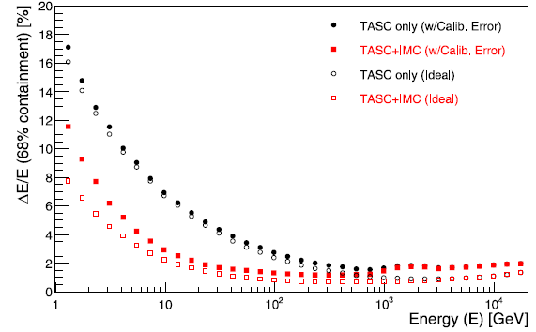
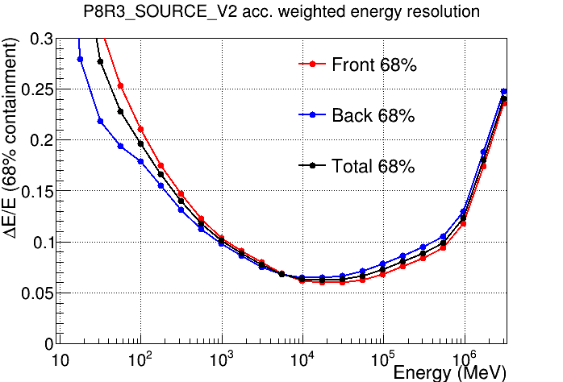
Energy resolution
CALET electron
(Asaoka+ 2017)
←2.5%@100 GeV
Fermi LAT
https://www.slac.stanford.edu/exp/glast/groups/canda/lat_Performance.htm
←7.5%@100 GeV

Slide 16
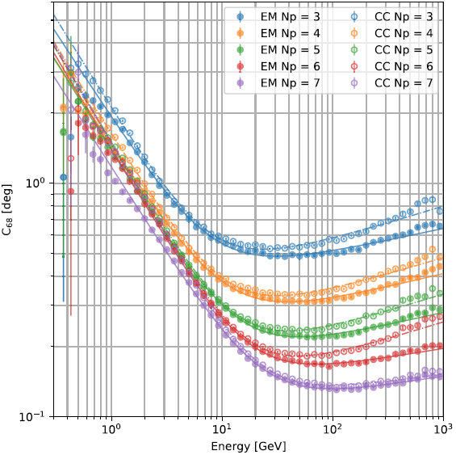
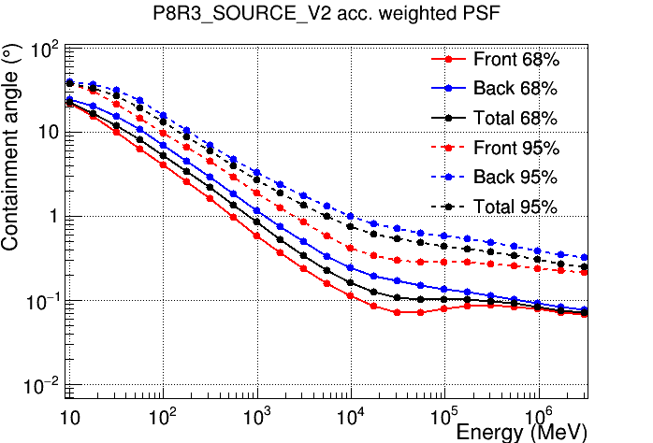
Angular resolution
100 GeV
C₆₈ [deg]
CALET LE γ
(Cannady+, 2018)
←0.6°@100 GeV
←0.13°@100 GeV
Fermi LAT
https://www.slac.stanford.edu/exp/glast/groups/canda/lat_Performance.htm
←0.1°@100 GeV

Slide 17
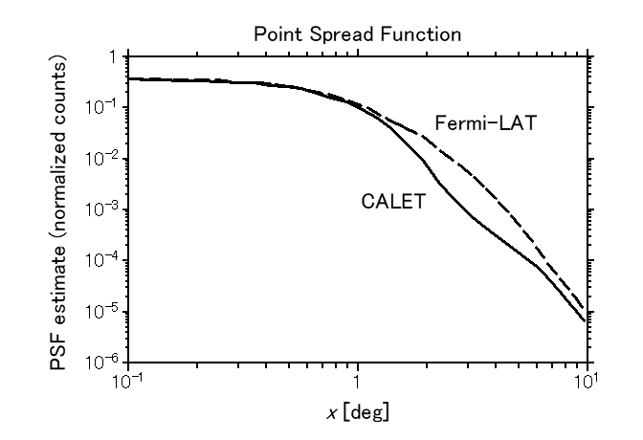
Point spread function: CALET vs LAT
(scaled)

Slide 18
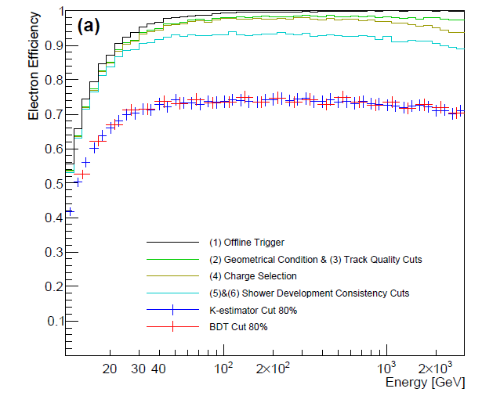
Effective area at high energies
Gamma ray, LE trig
100 GeV
Cannady+, 2018
Decreasing…
→ How to recover?
Electron, HE trig
Adriani+, 2019

Slide 19
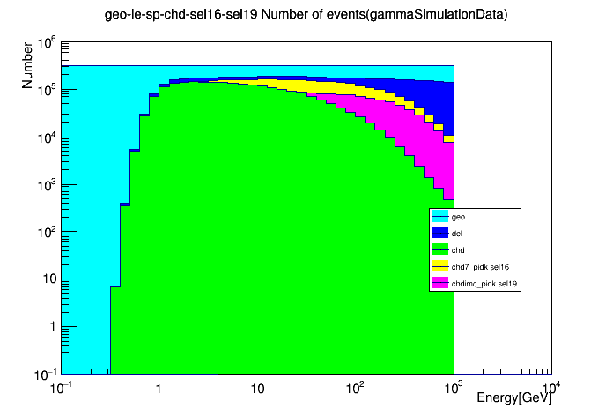
Efficiency in each step
By Zenita
100 GeV

Slide 20
GW counterpart search

Slide 21
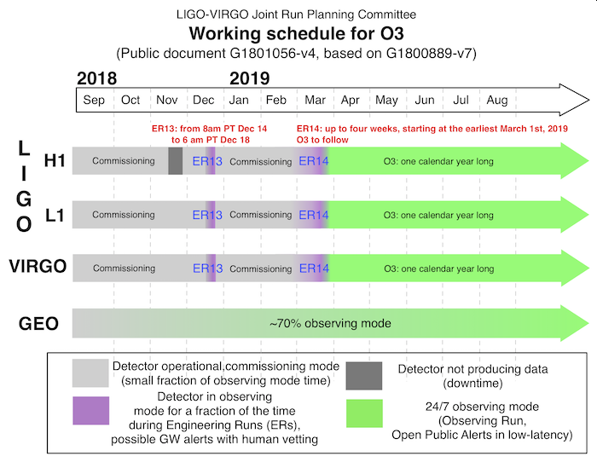
LIGO-VIRGO observation 3
April 30, 2020

Slide 22
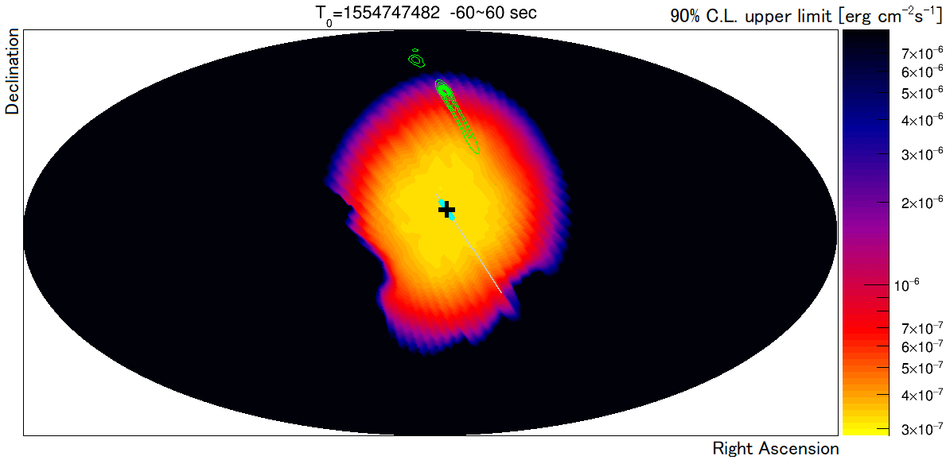
Energy flux limit map for S190408an
Mori, Asaoka et al., ICRC2019
10⁻⁶
90% C.L. upper limit on S190408an energy flux in the energy region 1–10 GeV and time window [T₀-60s, T₀+60 s] shown in the equatorial coordinates. The thick cyan line shows the locus of the FOV center of CAL, and the plus symbol is that at T₀. Also shown by green contours is the localization significance map of S190408an reported by LIGO/Virgo.

Slide 23
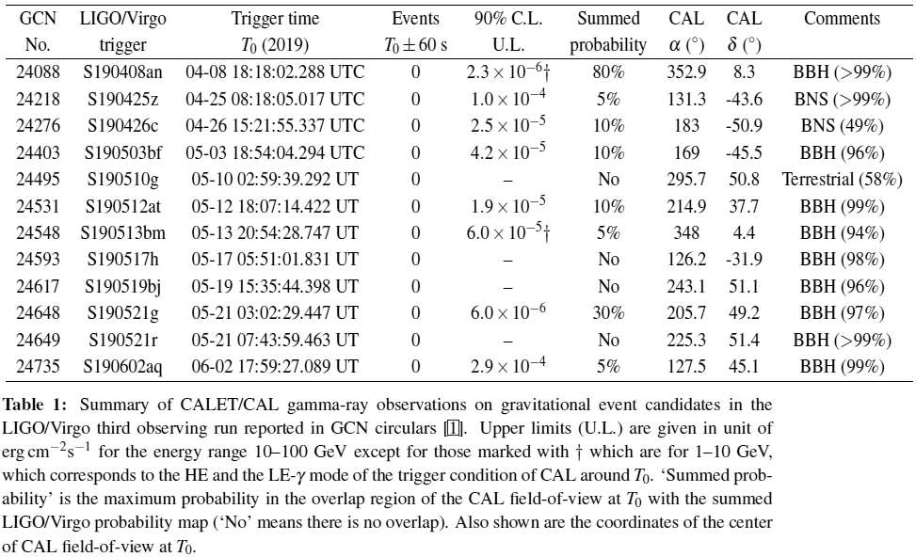
CAL limits on electromagnetic emission from gravitational wave events
Mori, Asaoka et al., ICRC2019
(LIGO/Virgo O3)
New!
†: LE-γ

Slide 24
GraceDB glossary
BBH - Binary black hole
BNS - Binary neutron star
NSBH - Neutron star black hole, a binary system composed of one neutron star and one black hole
Terrestrial - Classification for signals in gravitational-wave detectors that are of instrumental or environmental origin. Terrestrial signals are not astrophysical and not due to gravitational waves. Some examples of sources of terrestrial signals are statistical noise fluctuations, detector glitches, and ground motion.
MassGap - Compact binary systems with at least one compact object whose mass is in the hypothetical “mass gap” between neutron stars and black holes, defined here as 3-5 solar masses
Grace DB: https://gracedb.ligo.org/superevents/public/O3/

Slide 25
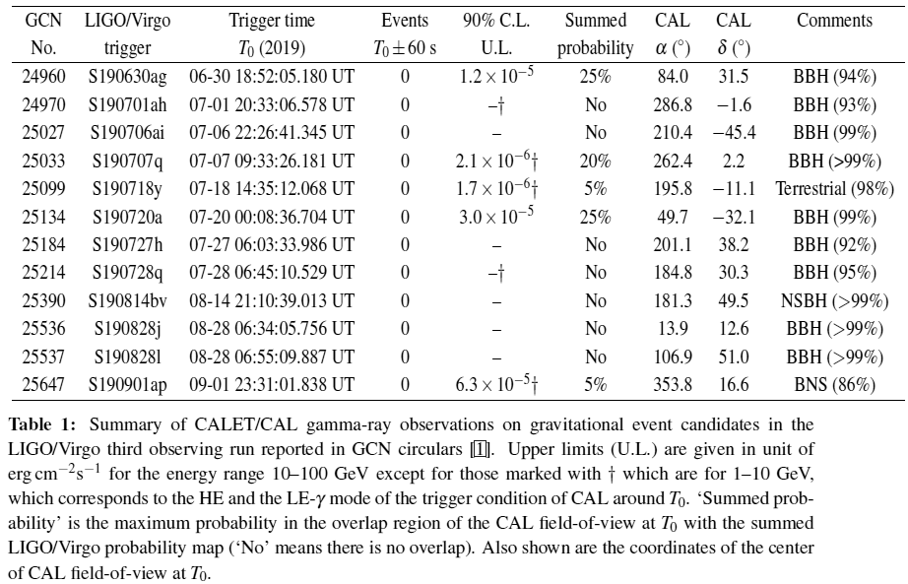
CAL limits on electromagnetic emission from gravitational wave events
Extended to 12-SEP-2019
(LIGO/Virgo O3)
†: LE-γ

Slide 26
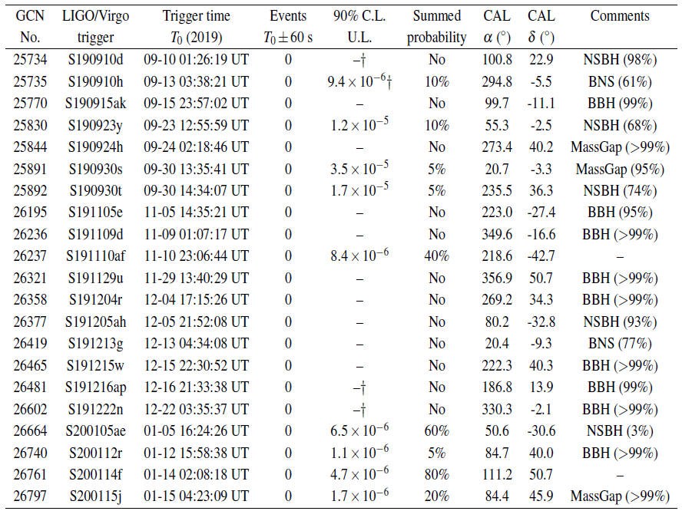
CAL limits on electromagnetic emission from gravitational wave events
Extended further to 27-JAN-2020
(LIGO/Virgo O3)
†: LE-γ

Slide 27
LIGO-VIRGO O3: Monthly variation
Grace DB: https://gracedb.ligo.org/superevents/public/O3/

Slide 28
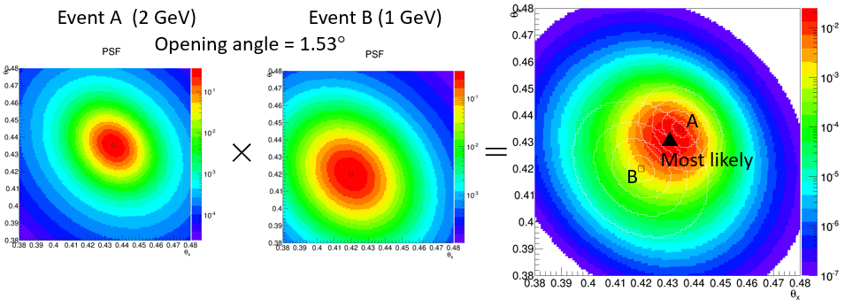
Searching transient events
Mori, ICRC2019
Gamma ray bursts, AGN flares, EM counterparts of GW, …
We define a ‘transient event’ as a gamma-ray pair coming from the same direction (within our angular resolution) in a 120-s time window.
Judging ‘pairs’ using PSF
See also poster PS3-243 (Cannady et al.) for GRB search by CALET/CAL

Slide 29
Transient gamma-ray monitor system
Mori, ICRC2019
Running since 2018/08/20 at WCOC
Parallel processing (60 threads) – 40 min for 1hr data
Receive 1hr data
Divide into threads
Thread01
Thread02
Thread03
Thread04
Thread05
Thread60
Produce high-level data
Produce high-level data
Produce high-level data
Produce high-level data
Produce high-level data
Produce high-level data
…
Select gamma ray candidates
Select gamma ray candidates
Select gamma ray candidates
Select gamma ray candidates
Select gamma ray candidates
Select gamma ray candidates
Classification of threads
HE
LE
CGBM T₀±60s
Same direction?
Same direction?
Same direction?

Slide 30
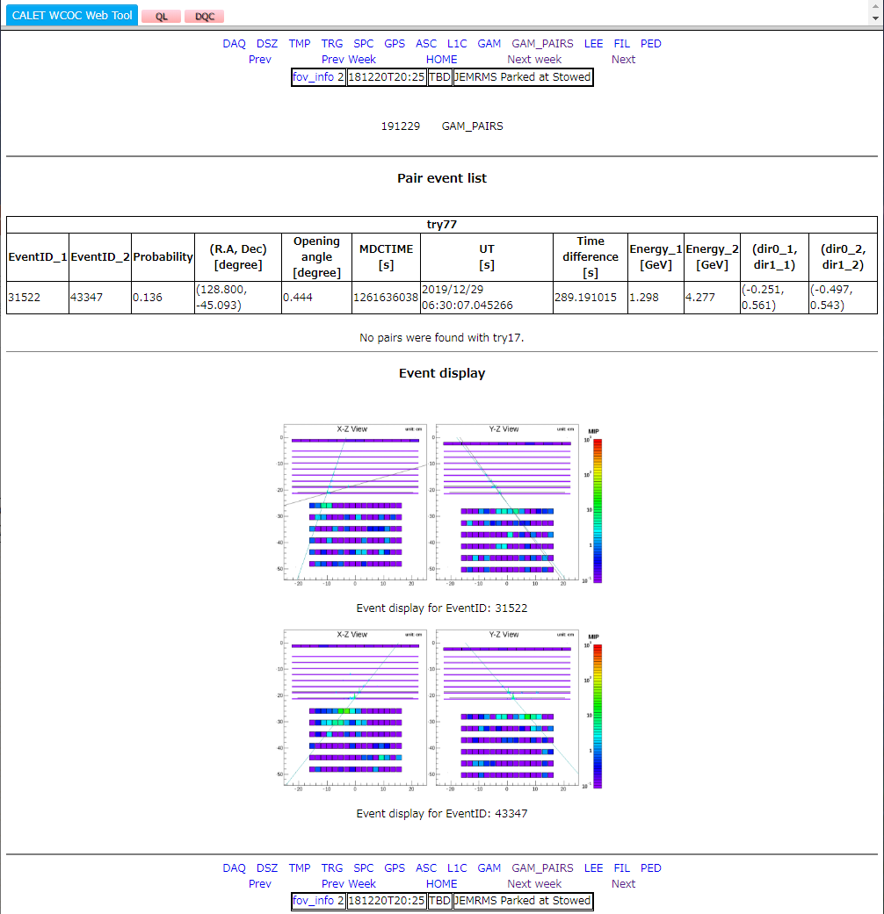
WCOC DQC “GAM_PAIRS”

Slide 31
Summary
Gamma ray analysis is on-going.
We have to recover efficiencies toward higher energies to have enough statistics. Some new idea is necessary.
Dark matter line signal search could be sensitive thanks to our good energy resolution.
GW counterpart search results are regularly reported in GCN circulars, but we have only upper limits up to now.
Automated search for gamma-ray pairs are working at WCOC.

Slide 32
Backups

Slide 33
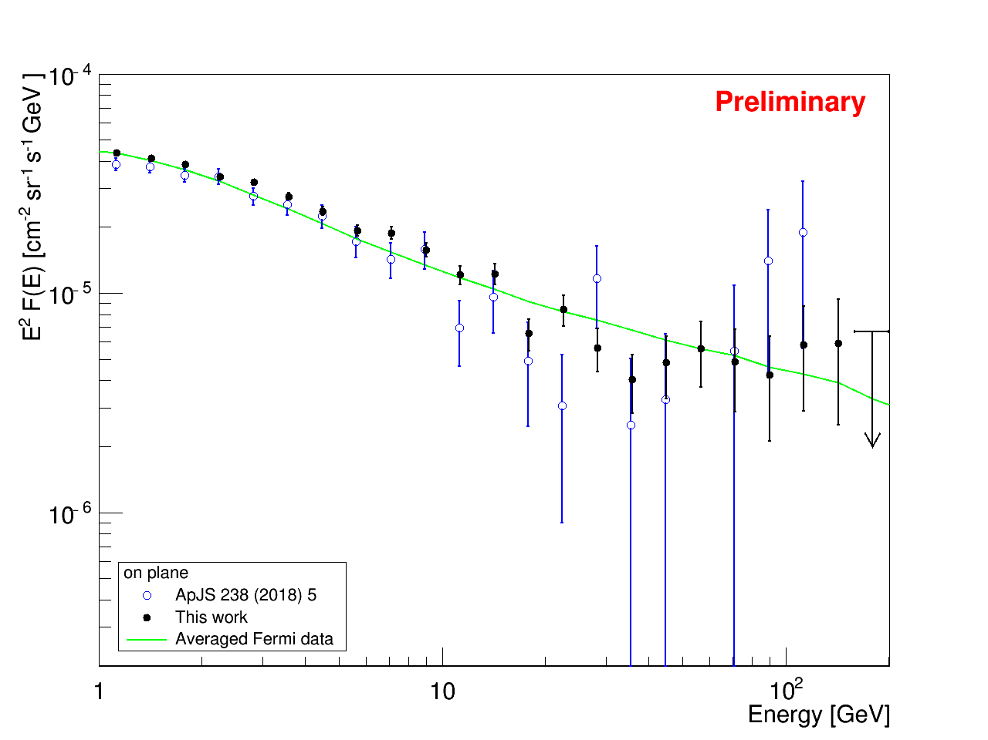
Gamma-ray spectra
Mori, Asaoka et al., ICRC2019
LE-γ mode
from 2015 November to 2018 May
  “On-plane”: |l| < 80° & |b|< 8°

Slide 34
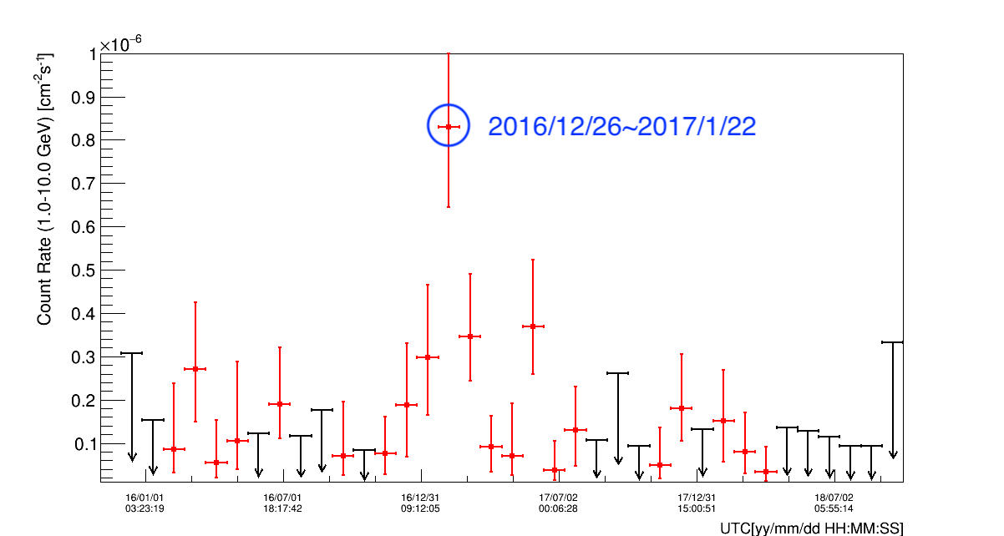
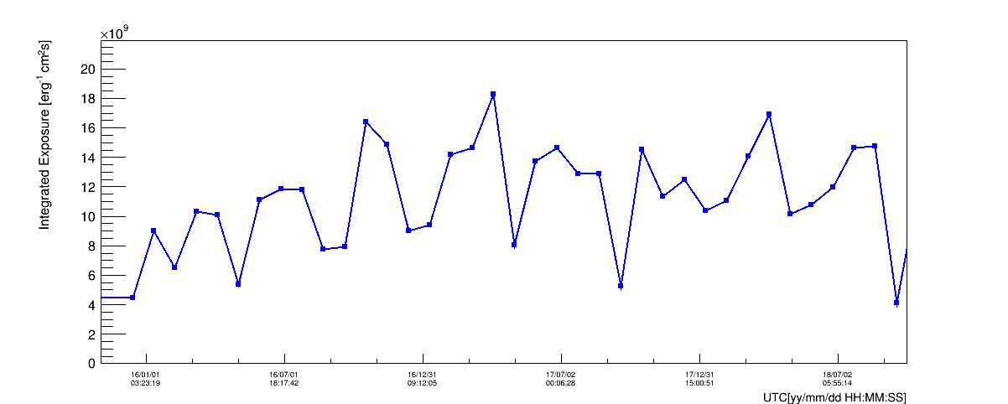
Monitoring count rates of AGNs
Search for flares of known AGNs
Use events within 68% containment angles from AGNs listed in 3FGL (Fermi-LAT 4-year catalog)
Calculate count rates based on 28-day exposures assuming E⁻² spectra
Exposures for CTA102 (2015/11-2018/09)
Count rates for CTA102 (2015/11-2018/09)

Slide 35
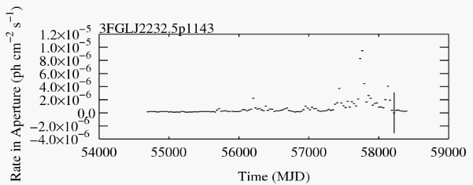
Monitoring count rates of AGNs
Search for flares of known AGNs
Use events within 68% containment angles from AGNs listed in 3FGL (Fermi-LAT 4-year catalog)
Calculate count rates based on 28-day exposures assuming E⁻² spectra
2017/01/12
Fermi-LAT count rates for CTA102
Count rates for CTA102 (2015/11-2018/09)

Slide 36
Summary for part B
Selection algorithm for transient gamma-ray events has been developed with FOV cut and direction consistency. It could identify point sources.
503 CGBM triggers are analyzed (T₀±60s) but no pairs were found.
Monitoring method for count rates of AGNs has been developed. It could identify CTA102 flare (2017/01).
Transient gamma-ray monitor system is running since 2018/08. It can detect transient events within 2hr from CGBM triggers by parallel processing.

Slide 37
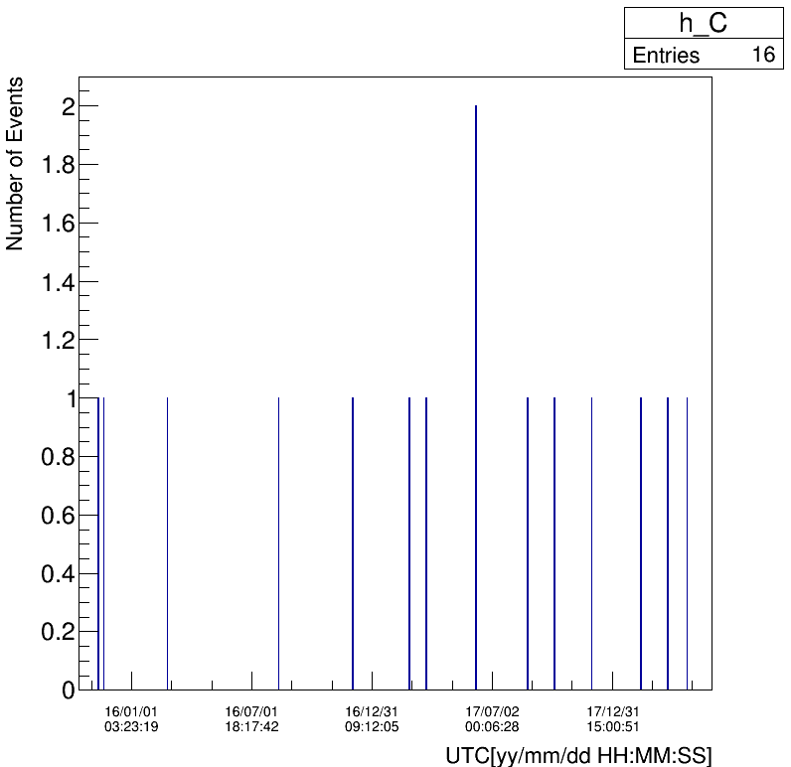
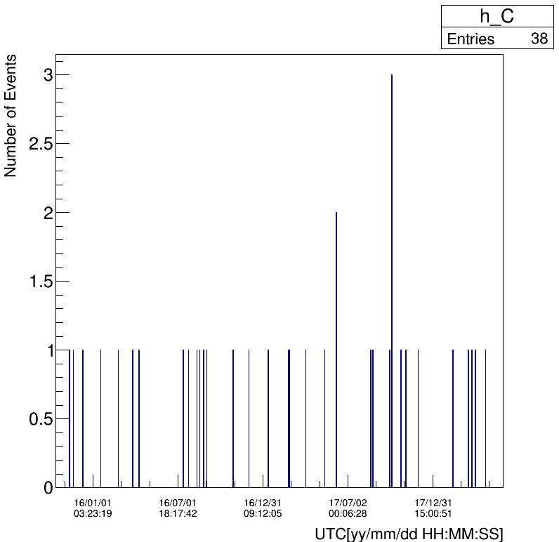
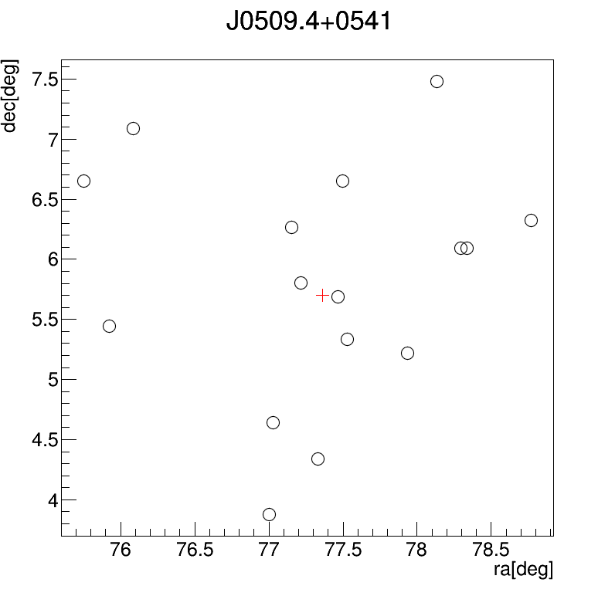
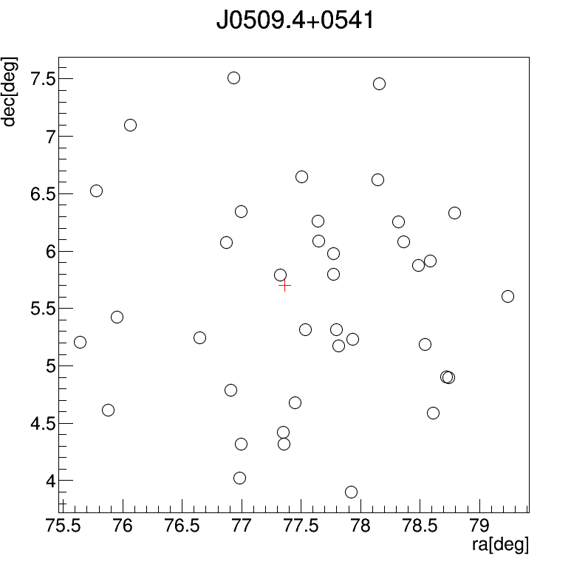
Analysis of TXS 0506+056/IceCube-170922A
2015/10/13-2018/05/31, LEγ run, FOV cut (fixed structure & robot arm)
EM track
CC track
Light curve
(1day/bin,
2months/tic)
17/09/22
17/09/22
Countmap
(within 2°)
+ : TXS 0506+056

Slide 38
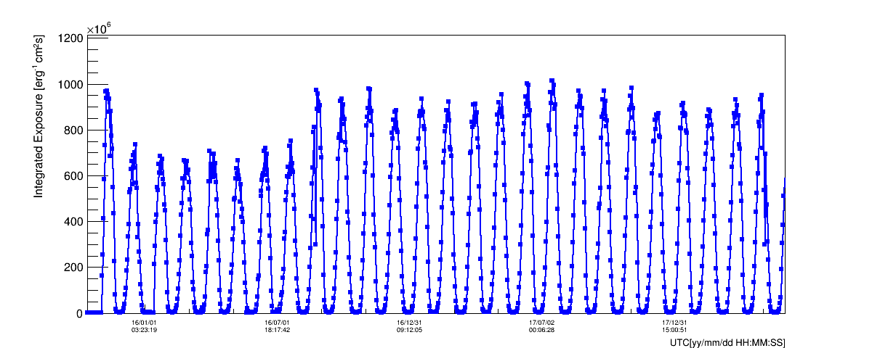
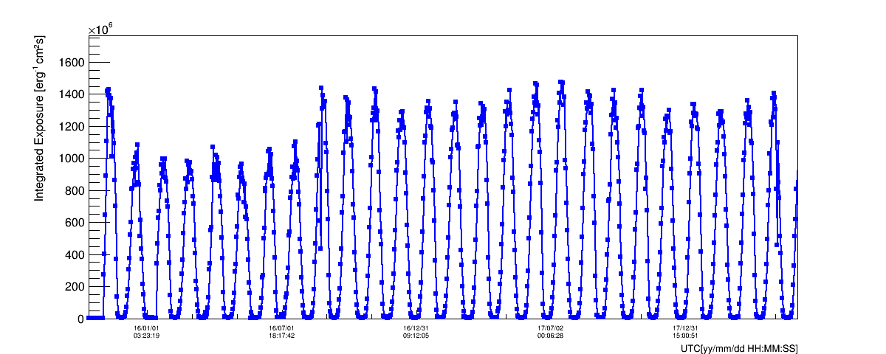
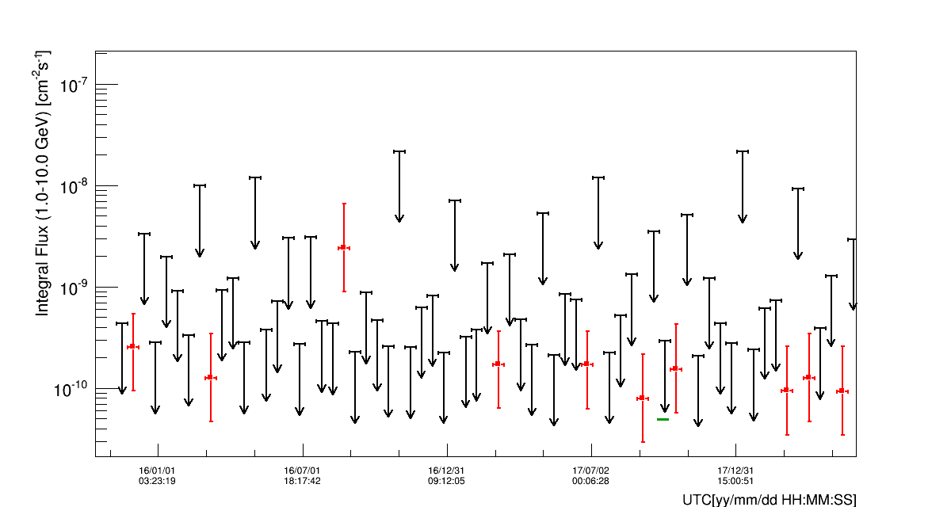
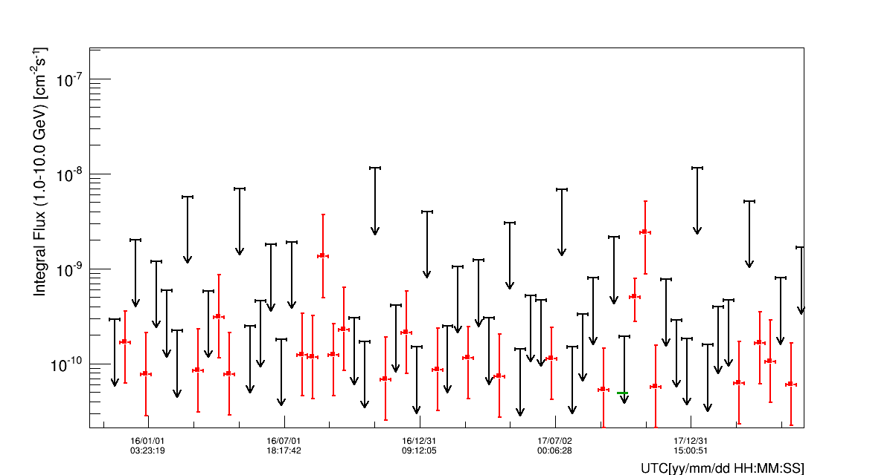
Analysis of TXS 0506+056/IceCube-170922A
EM track
CC track
Integrated Exposure
Integrated Flux

Slide 39
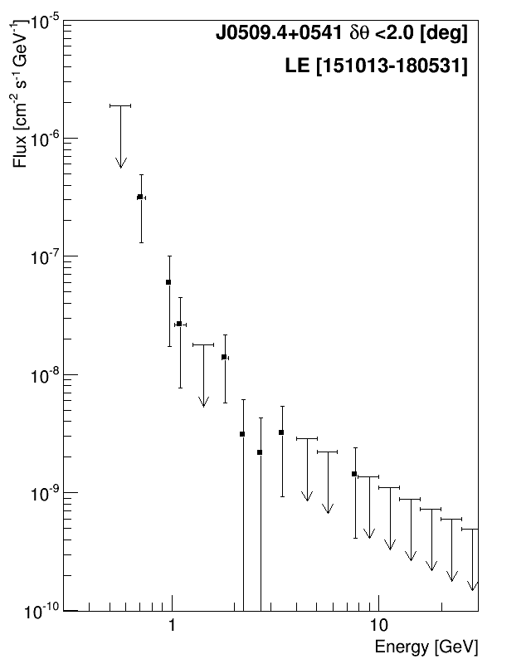
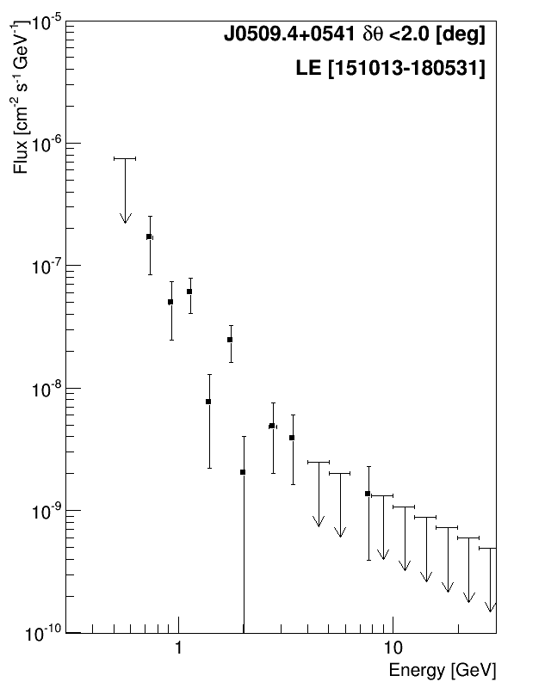
Analysis of TXS 0506+056/IceCube-170922A
EM track
CC track
Fermi-LAT flare
Fermi-LAT flare
Cf. Fermi-LAT: 3.6×10⁻⁷cm⁻²s⁻¹ (0.1-300 GeV, Sep.15-27 2017; Atel #10791)
→ dN/dE = 3.6×10⁻⁸ (E/GeV)⁻² cm⁻²s⁻¹GeV⁻¹

Slide 40
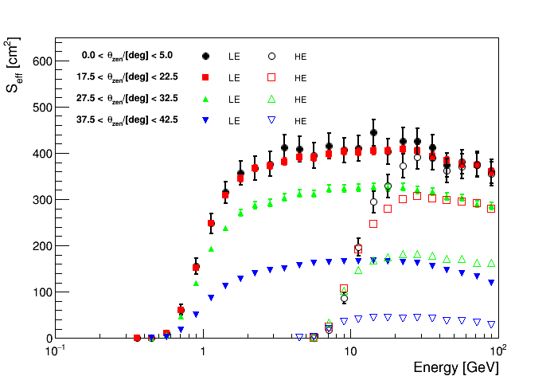
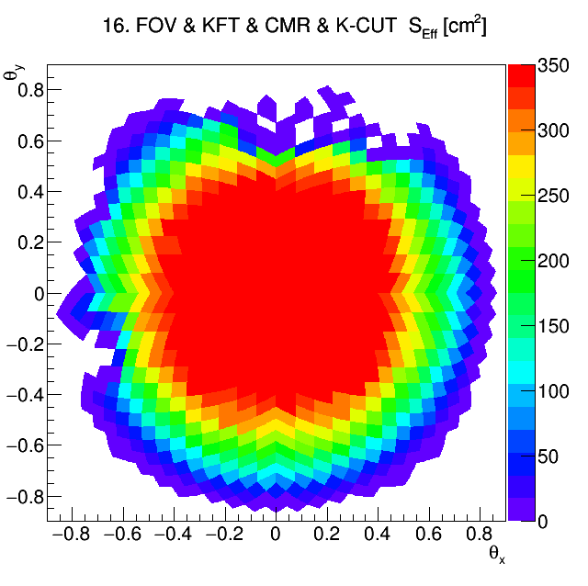
Effective Area and Sensitivity
Effective area is estimated as a function of incident angle (dx/dz, dy/dz) and energy.
Maximum effective area is achieved at around 5 GeV, but lower energy is more important for steep spectrum like E⁻².
LE-γ trigger: > 1 GeV
HE trigger: > 10 GeV
3-10GeV average
dy/dz
CC Track
dx/dz
Mostly axially symmetric except for FOV cut
Effective area as a function of energy. Four representing zenith angle ranges are shown.
→ Talk by Fujita (25pK202-10)

Slide 41

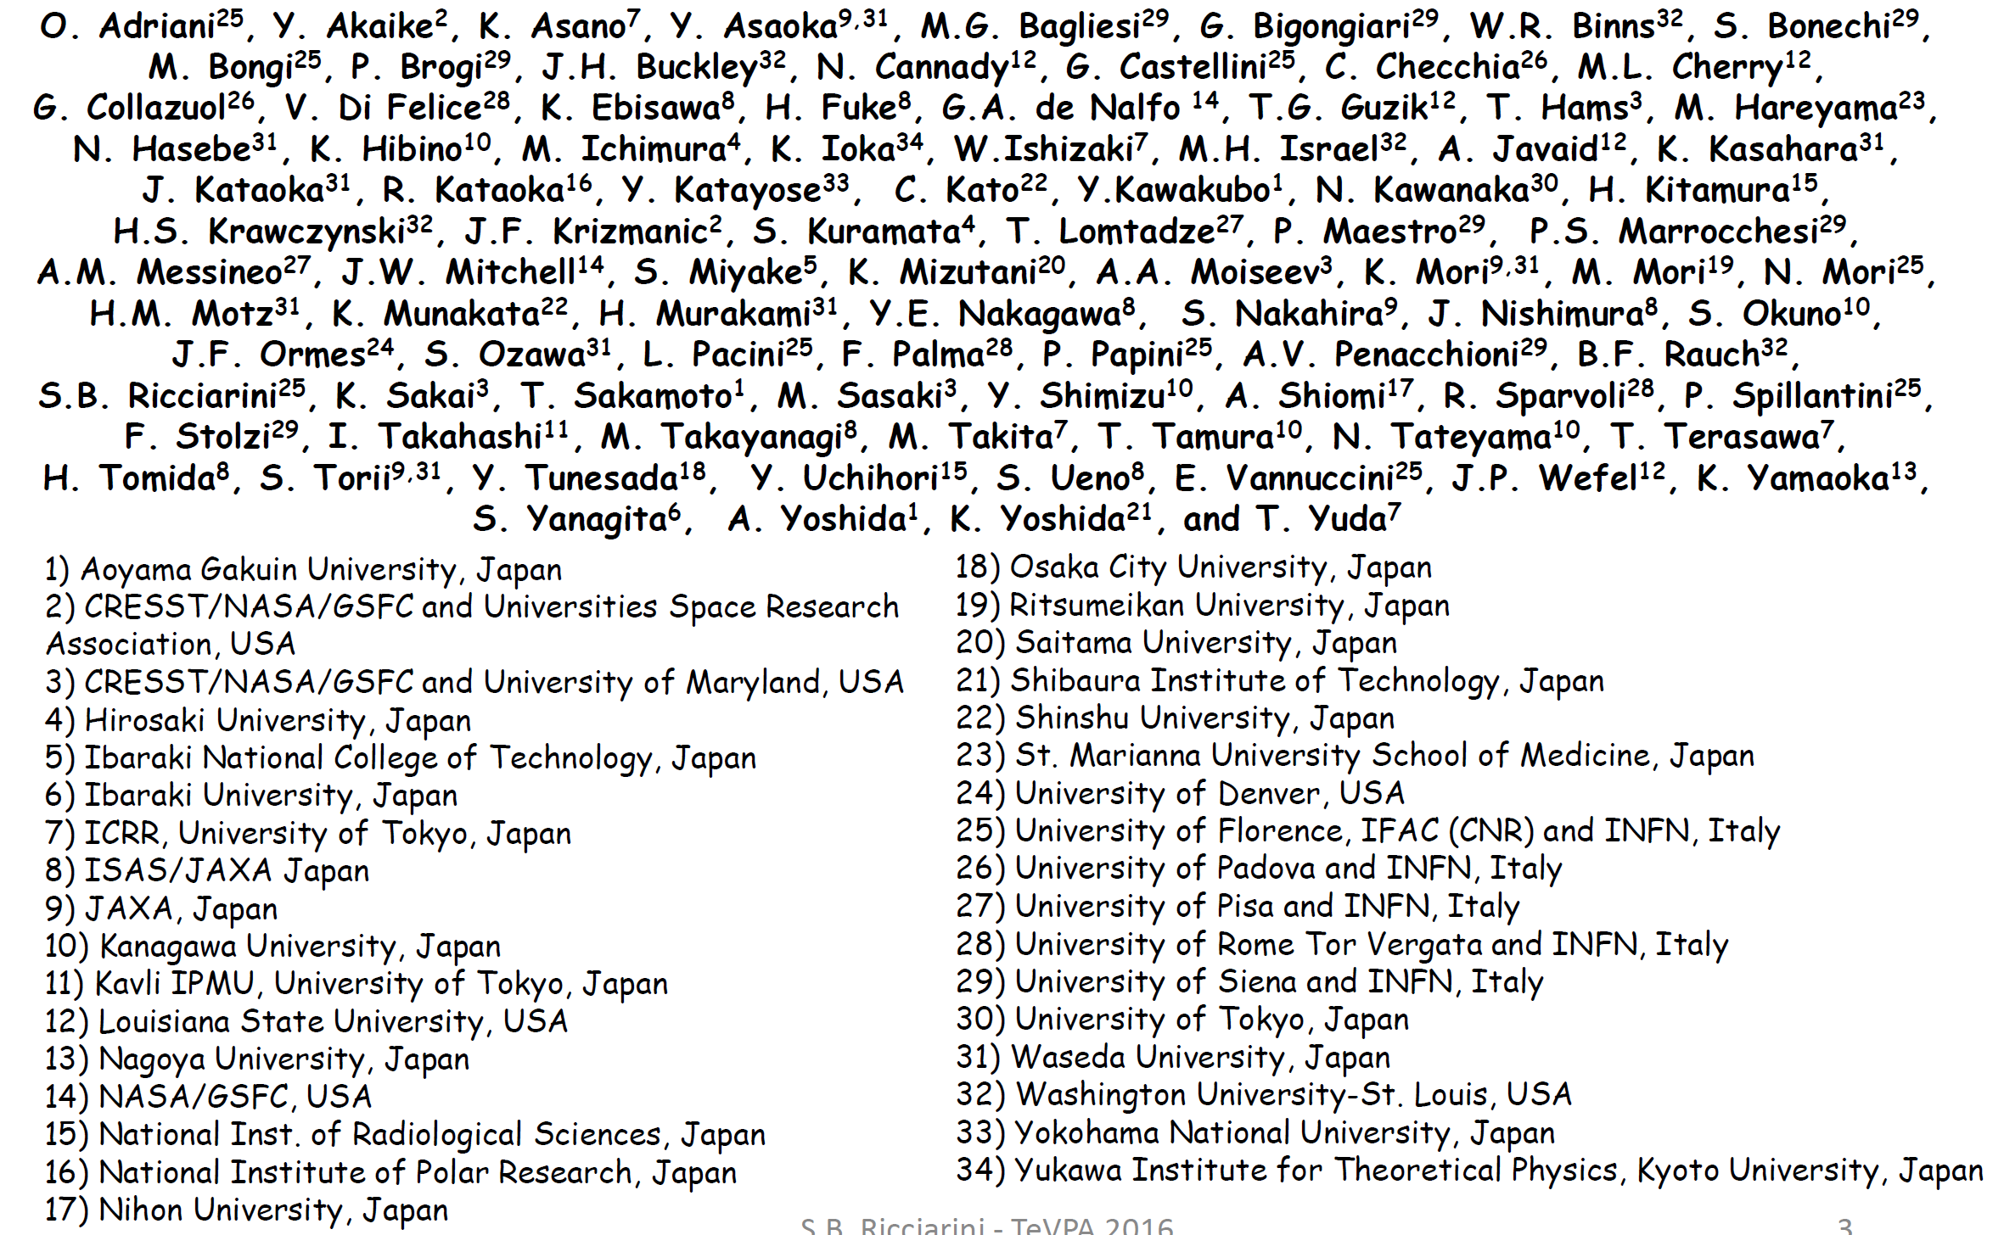
CALET Collaboration

Slide 42


CALET-CAL Detector
Fully active thick calorimeter (30X₀) optimized for electron spectrum measurements well into TeV region
448mm
Charge Detector
CHD
plastic scintillator hodoscope, absolute charge measurement
(including charge zero)
Imaging Calorimeter
IMC
SciFi + tungsten plate (3X0),
reconstruction of arrival direction and initial shower development
Total Absorption Calorimeter
TASC
PWO hodoscope (27X0),
energy measurements and particle identification
1TeV electron shower is fully contained in TASC

Slide 43

Gamma Ray Event Selection
= Electron Selection Cut + Gamma-ray ID Cut w/ Lower Energy Extension
1. Geometry Condition
  - CHD-Top to TASC
  1st layer (2cm margin)
2. Pre selection
  - Offline trigger
  - Shower concentration
  - Shower starting point
3. Track quality cut
  - Track hits >2
  - matching w/ TASC
4. Electromagnetic
shower selection
  - shower shape
5. Gamma-ray ID
  - CHD/IMC-veto
  (combination of
  loose cuts)
FOV cut
An example of gamma-ray event candidate in flight data
(reconstructed primary energy ~5GeV)

Slide 44
Gamma Ray Event Selection
= Electron Selection Cut + Gamma-ray ID Cut w/ Lower Energy Extension
1. Geometry Condition
  - CHD-Top to TASC
  1st layer (2cm margin)
2. Pre selection
  - Offline trigger
  - Shower concentration
  - Shower starting point
3. Track quality cut
  - Track hits >2
  - matching w/ TASC
4. Electromagnetic
shower selection
  - shower shape
5. Gamma-ray ID
  - CHD/IMC-veto
  (combination of
  loose cuts)
FOV cut
To maximize the field of view (FOV), the requirements on acceptance condition was loosened as much as possible compared to electron analysis. However, penetration of CHD paddle by shower axis is required to ensure charge zero selection.

Slide 45


Gamma Ray Event Selection
= Electron Selection Cut + Gamma-ray ID Cut w/ Lower Energy Extension
“K-cut”
1. Geometry Condition
  - CHD-Top to TASC
  1st layer (2cm margin)
2. Pre selection
  - Offline trigger
  - Shower concentration
  - Shower starting point
3. Track quality cut
  - Track hits >2
  - matching w/ TASC
4. Electromagnetic
shower selection
  - shower shape
5. Gamma-ray ID
  - CHD/IMC-veto
  (combination of
  loose cuts)
FOV cut
F_{E} : fractional energy deposit of TASC-Y6 relative to
total TASC deposit
R_{E} : Second moment of lateral energy deposit
distribution relative to shower axis [cm]
cut
O. Adriani et al., PRL 119, 181101 (2017) supplemental material

Slide 46


Gamma Ray Event Selection
= Electron Selection Cut + Gamma-ray ID Cut w/ Lower Energy Extension
1. Geometry Condition
  - CHD-Top to TASC
  1st layer (2cm margin)
2. Pre selection
  - Offline trigger
  - Shower concentration
  - Shower starting point
3. Track quality cut
  - Track hits >2
  - matching w/ TASC
4. Electromagnetic
shower selection
  - shower shape
5. Gamma-ray ID
  - CHD/IMC-veto
  (combination of
  loose cuts)
FOV cut
Electron
MC
Proton
MC
γ-ray
MC
⇒ reject charge 1 region

Slide 47

Gamma Ray Event Selection
= Electron Selection Cut + Gamma-ray ID Cut w/ Lower Energy Extension
It was found that secondary gamma-ray produced in ISS structures are dominant source of background
1. Geometry Condition
  - CHD-Top to TASC
  1st layer (2cm margin)
2. Pre selection
  - Offline trigger
  - Shower concentration
  - Shower starting point
3. Track quality cut
  - Track hits >2
  - matching w/ TASC
4. Electromagnetic
shower selection
  - shower shape
5. Gamma-ray ID
  CHD-veto
FOV cut
LE Trigger
60º
45º
Gamma-ray candidates
in CALET FOV
Fish-eye view of CALET FOV
By removing Black parts, it is possible to reject majority of such background. More sophisticated rejection method is under development.

Slide 48

EM Track vs CC Track: Effective area

Slide 49

EM Track vs CC Track : PSF

Slide 50
Point Source Spectra: Sensitivity Validation
CALET Preliminary
The observed point source spectra are well consistent with Fermi-LAT’s parameterizations. Therefore, it was found that current selection criteria has a validated sensitivity and can be used to set limit on GW counterpart flux.

Slide 51

Fermi LAT performance
https://www.slac.stanford.edu/exp/glast/groups/canda/lat_Performance.htm
Area
PSF
ΔE/E
ΔE/E

Slide 52



GRB analysis following a CGBM trigger: an example
GRB 180126A: triggered by CGBM at T₀=2018/1/26/ 2:16:38 UTC
→ No gamma ray candidates within T₀±60s
CALET zenith
Exposure during 120s
Upper limits on energy flux (0 event)
Upper limits are calculated assuming number of events N₀ corresponding to 90% C.L.
0 event → N₀ = 2.44
1 event → N₀ = 4.36
2 events, not a pair → N₀ = 4.38/0.68
Upper limits on energy flux (2 events, not a pair)

