Slide 1
Analysis for GW events and GRBs
Yuta Kawakubo
Louisiana State University
CALET TIM at CNR-IFAC
02/04/2020
Notes:
Hello everyone, I will talk about analysis for GW events and GRBs
OK

Slide 2
Outlines
Analysis systems for transient events
  The CAL pipelines for GW event & GRB
    Moving structure cut
    How to increase the region we consider
    Instrumental background
    PDF report
  The CGBM pipeline
    Signal search (SNR calculation)
    Summed probability in the CGBM FOV
    CGBM analysis web page
  The transient search system (DQC)
    GAM_PAIRS page
GW counterparts search in the O3
  Results
Terrestrial Gamma Flashes (TGFs)
Future works
  High energy afterglow search (GW and GRB)
  Future updates with the CGBM pipeline
Summary
Notes:
This is outline of my talk.
At firrst, I will talk about three analysis systems for transient events.
Next, I will talk about GW counterparts search in the O3.
Next, I will talk about future works.
At last, I will summarize my talk.
Ok

Slide 3
Analysis systems for transient events
For transient analysis, we have three analysis systems.
The CAL pipeline for GW events & GRBs
  To search for gamma-rays associating with GW events & GRBs
  To calculate gamma-ray flux upper limits
The CGBM pipeline
  To search for signals associating with GW events & GRBs
The transient search system
  To search for gamma-ray transients rapidly & automatically
The CAL pipelines and the transient search system were developed by graduate students in Waseda University and Asaoka-san. I have taken over their works.
Notes:
We have three analysis systetms for transient event analysis.
One of them is the CAL pipeline for GW events & GRBs
This pipeline is for the search for gamma-rays associating with GW events or GRBs.
Even if there is no gamma-rays, the pipeline calculate gamma-ray flux upper limits.
Next one is the CGBM pipeline.
This pipeline is for the search for signals associating with GW events & GRBs detected by other instruments.
The last one is the transient search system.
This system is for search the gamma-ray transients rapidly and automatically.
The CAL piplines and the transient search system were developed
by graduate students in Waseda University and Asaoka-san. I have taken over their works.
OK

Slide 4
The CAL pipelines for GW event & GRB
Input information
(Start python script)
GW: event name
GRBs: trigger time and position (R.A., Dec.)
Getting information from GCN
GW: the GW sky map, trigger time
GRB: Skip
Checking Run mode at the trigger time
HE or LEG
Search for gamma-ray events
EM track (HE) and CC track (LEG)
Making event displays
Using L2 viewer.
Calculate exposure & upper limits
Estimate background counts
Plotting upper limits map
with the GW skymap or GRB position
Making a pdf report
Red: manual
Blue: automatic
Notes:
I will explain about the CAL pipeline.
Since Asaoka-san or Mori-sensei explained the detail before, I will explain the overview of the pipeline.
This is analysis flow of the pipeline.
At first, we input information to start the pipeline.
For GW analysis, the information is event name like S190408an.
For GRB analysis, the information is trigger time and position of GRBs.
Next, the pipeline gets information from the GCN web page.
For GW analysis, the pipeline get the GW sky map and trigger time.
For GRB analysis, this step is skipped.
Next, the pipeline check the run mode at the trigger time.
Next, the pipeline seraches for gamma-rays.
Next, the pipeline makes event displays using L2 viewer for the pdf report.
Next, the pipeline calculate exposure & upper limits for any direction and estimate the background counts in the consider region.
Also, the pipeline make exposure & uppeer limits map with the GW skymap or GRB position.
At last, the pipeline summarize all information and figures to the pdf report.
OK

Slide 5
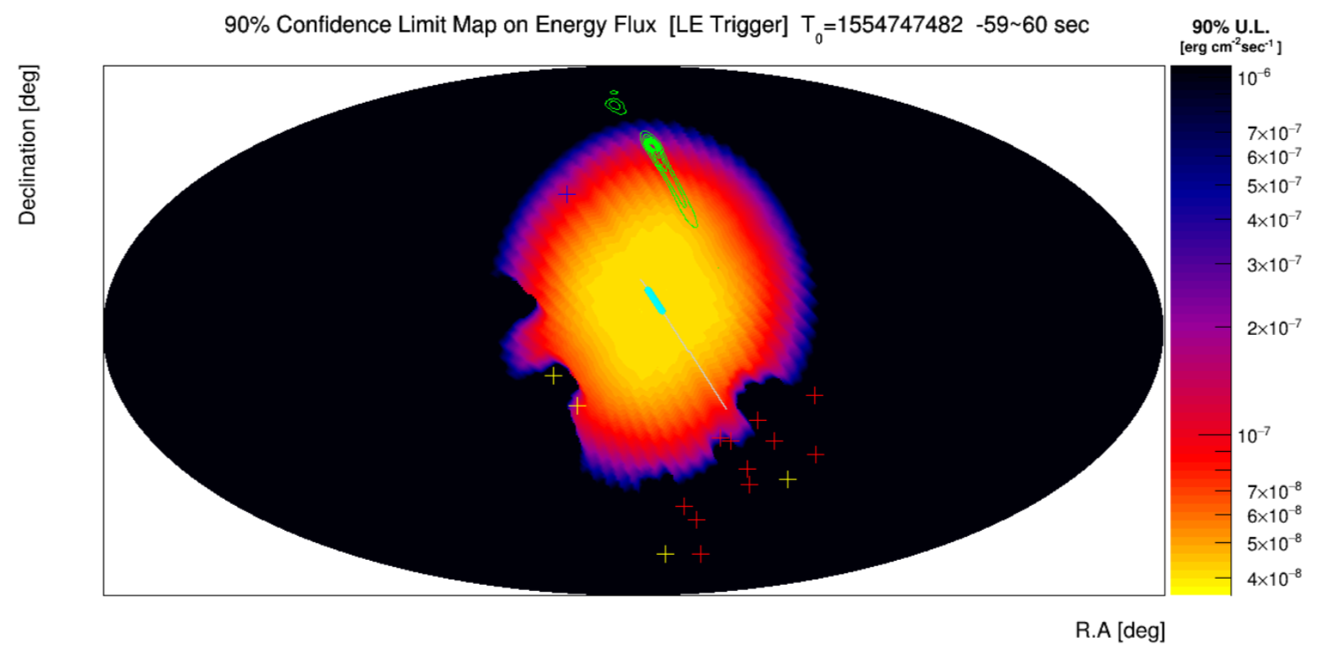
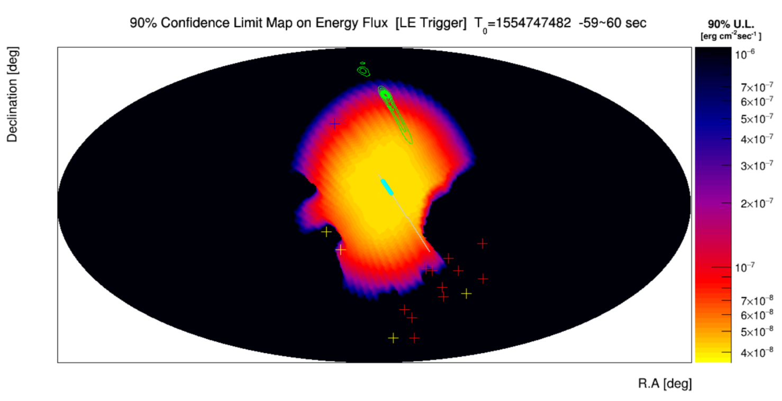
Moving structure cut
Moving structure cut has equipped with GW & GRB pipelines.
S190408an
Fixed structure cut
The fixed structure map was stored in the database.
The blocking by moving structures was calculated for every 30 seconds.
Robot arms and other obstruction due to the ISS activity is not included in the moving structure cut
The pdf report contains results with and without the moving structures cut.
Fixed structure cut + Moving structure cut
Notes:
Next I will talk about updates with the CAL pipeline.
We equipped moving structure cut with the CAL pipelines.
These plot shows upper limits map for S190408an.
For top panel, we used just the fixed structure cut.
For the bottom panels, we used the fixed structure cut and the moving structure cut.
We can see the difference around the lower right part in figures.
Robot arms and other obstruction due to the ISS activity is not included.
The pdf report contains results with and witthout the moving struture cut.
OK

Slide 6
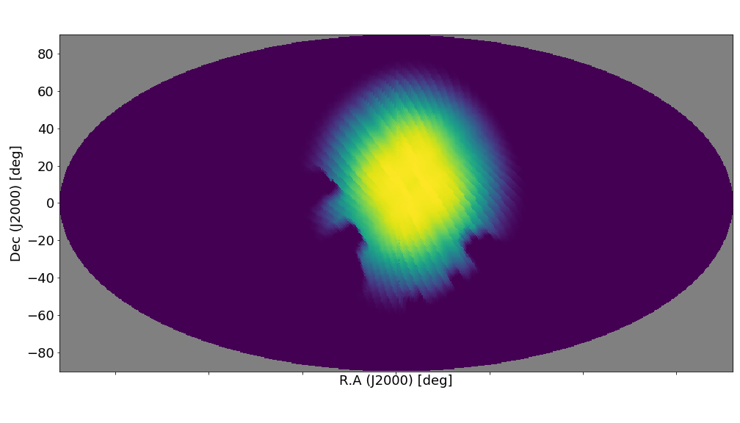
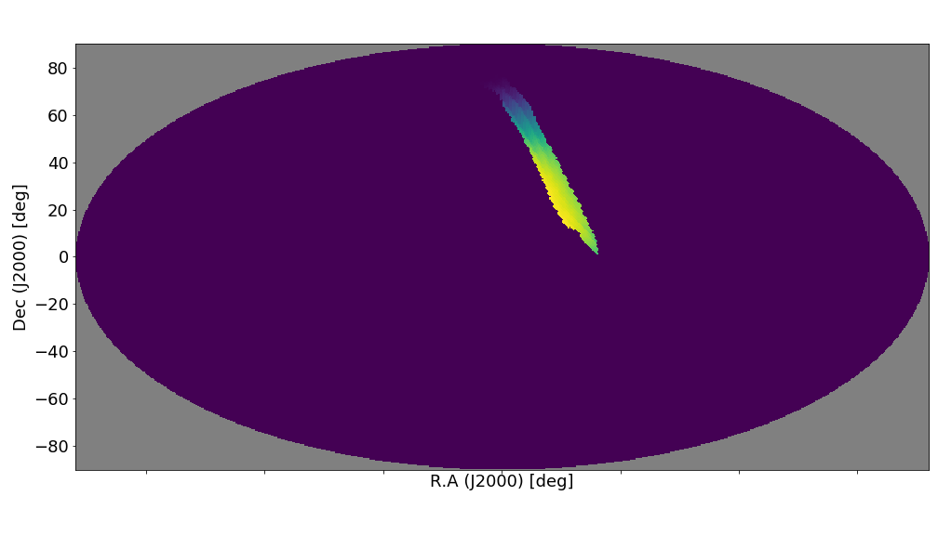
How to increase the region we consider
If we add pixels of HEALPix to the region we consider, expected background counts increase.
We don‘t want to add meaningless pixels to the consider region.
Exposure is zero.
Probability is quite low.
Cumulating the localization probability in descending order.
Checking the 99 % localization probability region.
We add pixels to the consider region in descending order of exposure from the 99 % localization probability region.
S190408an
-60 s ~ + 60s
Exposure
Exposure
for the 99 % localization probaility region
Notes:
If we add pixels of HEALPix to the region we consider, expected background counts increase.
We don‘t want to add meaningless pixels to the consider region.
Meaningless means exposure is zero or probaility is quite low.
To add pixels to the consider region efficiently, we performed following procedures.
At first, we cumulate the locaization probability in discending order. And, check the 99 % locaozation probability region.
Next, We add pixels to the consider region in descending order of exposure from the 99 % localization probability region.
The top panel shows CAL exposure for S190408an.
The bottom panels shows exposure for the 99 % localization probability region.
This enable us to reduce the region we consider and the background counts from meaningless pixels.
OK

Slide 7
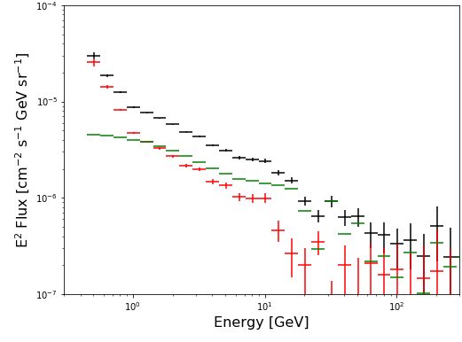
Instrumental background
Just the FOV cuts cannot remove the inclusion of secondary gamma-rays from the ISS structures.
We estimated instrumental BG counts using the difference between gamma-ray flux from the off galactic plane region observed by Fermi-LAT and CAL.
Provided by Zenita-san
CAL off plane (3.5 years)
LAT off plane (7 years)
CAL – LAT
Calculate difference of CAL flux and Fermi flux
Perform logarithmic, linear interpolation and integration over energy range (LE: 1 – 10 GeV, HE: 10 -100 GeV)
Notes:
We cannnot remove the inclusion of secondary gamma—rays from the ISS structures just using the FOV cuts.
Therefore, we estimated instrumental background counts using the difference between gamma-ray flux from the off galactic plane region observed by CAL and Fermi-LAT.
This plot shows the gamma-ray spectrum of off plane region.
Black is the CAL result. Green is the LAT result.
Red is difference between CAL flux and LAT flux.
Affter the subtraction, we perfomred logarithmic linear interporation and integration over energy range to estimate background counts.

Slide 8
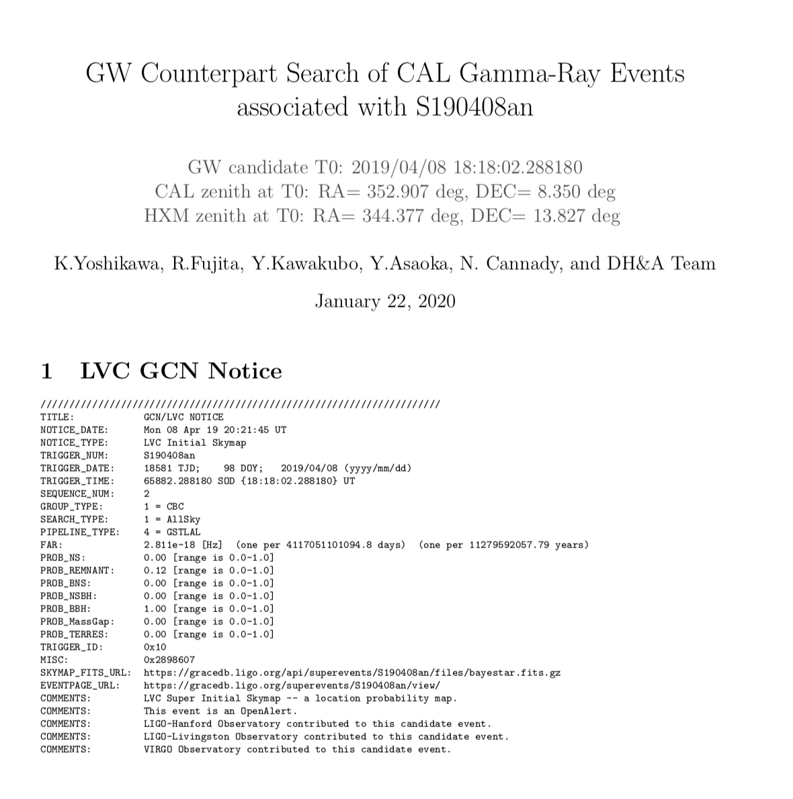
PDF report
Contents
Trigger time (T₀) & Zenith direction at T₀
GCN Notice
Run mode & observation range
Event lists
  Time, fileID, EventID, Energy, R.A & Dec., FOV information, Normalized probability, Survival probability
Event display
Exposure & Upper limit map
  LVC high probability region
  Gamm-ray candidate position
Exposure & summed probability vs. enclosed solid angle
Exposure & summed probability vs. enclosed solid angle
Exposure & Upper limits table
  Summed probability, enclosed probability, Exposure, Upper limits, Instrumental BG, Diffuse BG
I will also attach an example of the report to the TIM agenda.
I would appreiciate it if you check the report and give us your comments.
Notes:
I will introduce the pdf report.
This is top page of the PDF report. These are contents of the report.
The report inclueds, trigger time and Zenith direction at the trigger time.
And, GCN notice, and Run mode & observation range at the trigger time.
Also, Event lists, events display and Exposure and Upper limit maps are included.
I will attach the sample of the report to the TIM agenda. Please check it.
OK.

Slide 9
The CGBM pipeline
Input information
(Start shell script)
GW Trigger time, zenith direction at the trigger time
Making light curves
Using Time history data in CGBM L3 data
Calculate signal-to-noise ratio (SNR)
For 1680 conditions every 1/8s
Summarizing SNR results
Picking up high significance conditions and summarizing trigger due to the same event
Making FOV plot & Calculating the summed probability in the FOV
Checking overlaps between the CGBM FOV and the GW sky map
Creating an HTML file for the web page
For the summary web page, including plots and SNR calculation results.
Upload the HTML file and plots
to the web server in AGU
Aoyama Gakuin University (AGU)
Red: manual
Blue: automatic
Notes:
Next I will talk about the CGBM pipeline.
This is the analysis flow of the pipeline.
At first, we input information to start the shell script.
The information are trigger time, Zenitth direction at the trigger time.
Next the pipeline makes light curve using CGBM L3 data.
After that, the pipeline calculate signal-to-noise ratio to search signals.
Next, the pipeline summarize SNR calculation results. Picking up high significance conditions and summarizing trigger due to the same event.
Next, the pipeline makes the CGBM FOV maps and calculates summed probability in the CGBM FOV.
Next, the pipeline makes an HTML file for the webpage.
At last, we uplod the figures and the html file to the weeb server.

Slide 10

Signal-to-noise ratio calculation
Δt : Integration time for foreground
N_{tot}: total counts in Δt
Δt_{BG} = Integration time for background
N_{BG} : BG counts in Δt_{BG}
(1/8, 1/4, 1/2, 1, 4, 8 s)
(8, 16, 32, 64 s)
two-side
one-side (before)
one-side (after)
Δt_{BG1}
Δt
Δt_{BG2}
Δt_{BG}
Δt
Δt
Δt_{BG}
Δt_{BG} = Δt_{BG1} + Δt_{BG2}
We calculate signal-to-noise ratios (SNRs) using CGBM time history data (time resolution: 1/8 s).
We use “two-side” basically, but we use “one-side” when CGBM high voltages are turning on/off.
7 (Δt) x 4 (Δt_{BG}) x 10 (E band) x 2 (gain) x 3 (detector)
= 1680 conditions for each 1/8 s
We search for signals of which SNR exceeds 7.
  SNR = 7 is comparable with the onboard trigger system threshold.
  SNR ~ 7 is required for further analysis, at least.
  Excepting single-channel events which looks charged particles
Notes:
I will explain about Signal-to-noise ratio calculation.
We used this function for the calculation.
Since I talked about this at the last TIM, I will skip the detail.
I will mention just updated part.
We use two-side background basically, but we use one-side back ground when CGBM high voltages are turrning on/off.
We search for signals of which SNR exceeds 7.
This threshold is comparable with the onbord triggeer system threshold.
Also this significance is required for furtheer analysis at least.
We exclude single–channel events which looks charged particles.

Slide 11
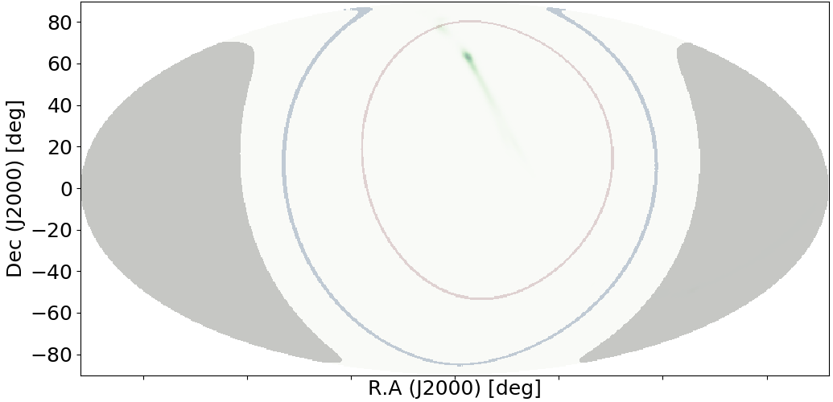
Summed probability in the CGBM FOV
S190408an
SGM FOV
HXM FOV
GW high probability region
The earth occulted region
Summed probability
SGM: 95.4 %
HXM: 91.1 %
The earth: 4.4 %
We calculate the summed GW probability in the CGBM
FOV assuming the HXM and SGM FOVs are 60 degrees and 90 degrees, respectively.
However, some part of the CGBM FOV is blocked by the ISS structures. We need to consider the ISS structures.
Notes:
I will talk about Summed probability calculation in the CGBM FOV.
This plot show the CGBM FOV and GW high probability region. Blue and purple are the SGM and HXM FOV, respctively.
Green is the GW high probability region. Gray is the earth occulted region.
We calculated the summed GW probability in the CGBM FOV assuming the HXM and SGM FOVs are 60 degrees and 90 degrees, respectively.
In the case of S190408an,
The summed probability in the SGM FOV is 95 % and that in the HXM FOV is 91 %.
However, some part of the CGBM FOV is blocked by the ISS structures. We need to the ISS structure as well as CAL analsysis .
OK

Slide 12
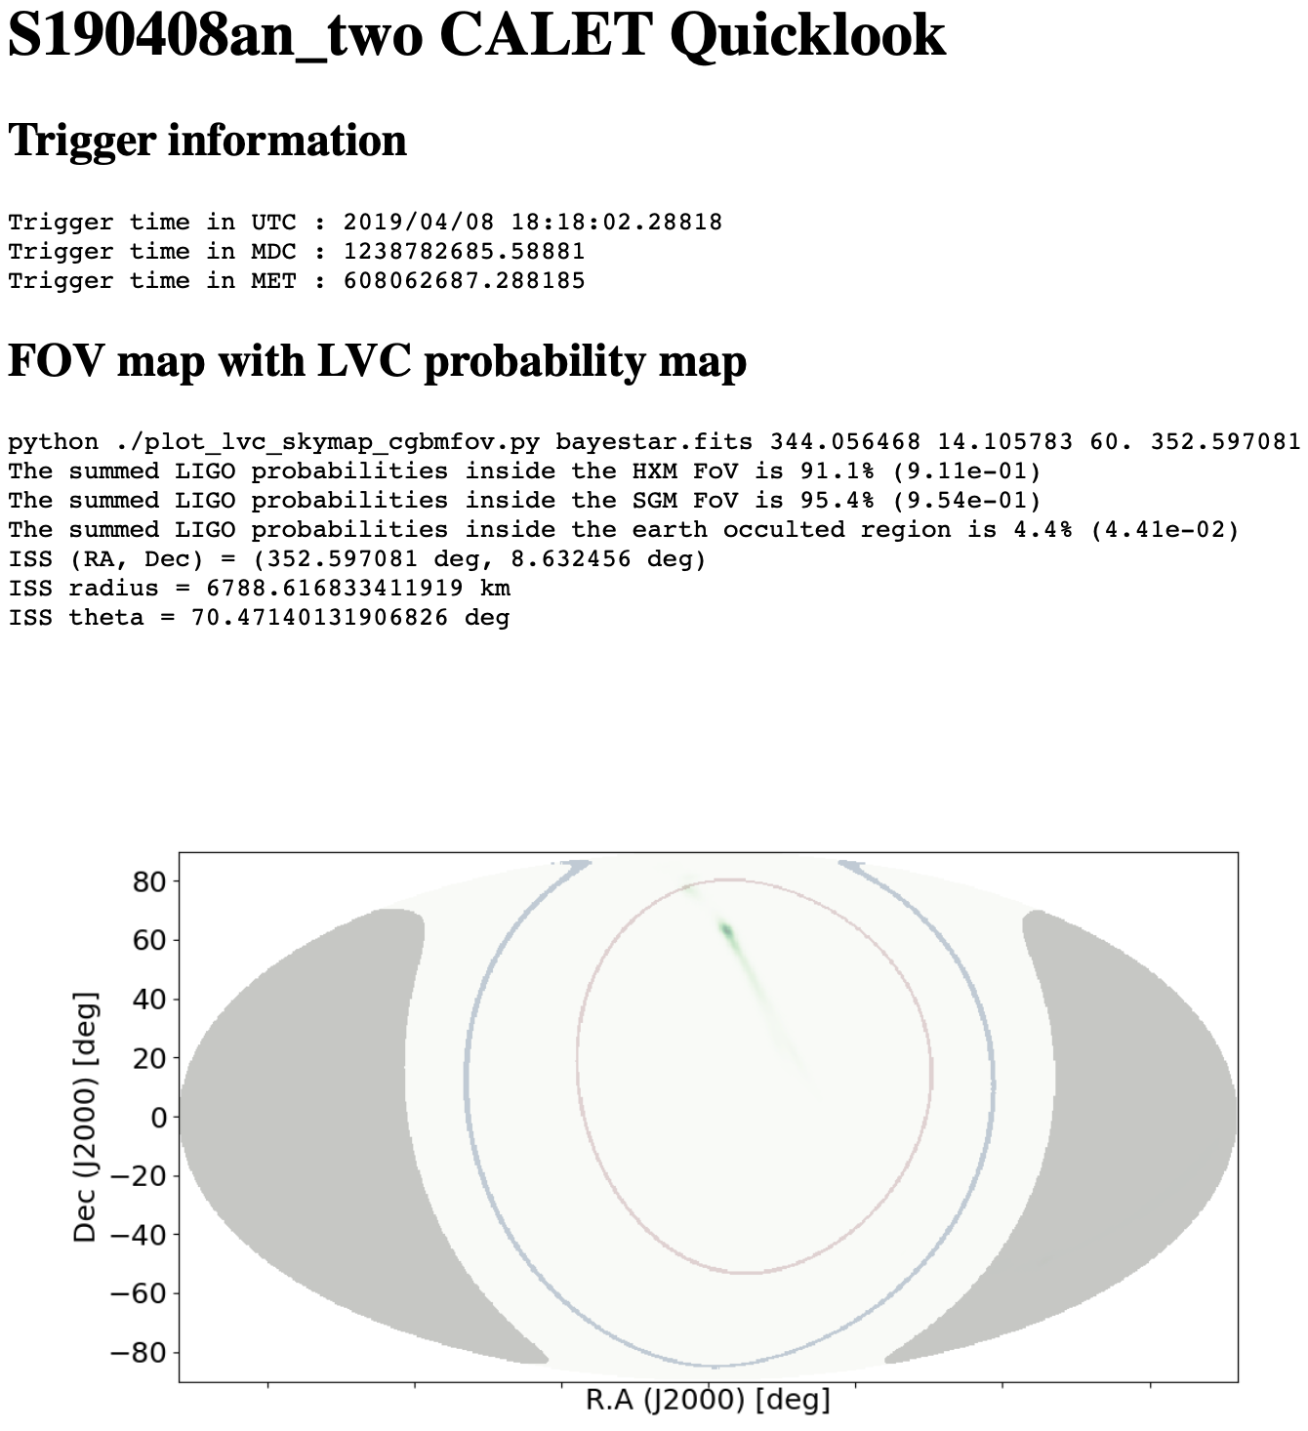
CGBM analysis web page
Contents
GW (GRB) Trigger time
Summed probability
LIGO & Virgo skymap plot
CGBM Light curves
  time binning = 1/8s, 1/4s, 1/2s, 1s, 2s, 4s, 8s
SNR vs time plots
  For all 1680 conditions.
SNR summary
  Highest SNR condition in the search interval
  Highest SNR condition at the trigger time
  Triggered (SNR > 7) time interval
http://yoshidalab.mydns.jp/CGBM/GW_ana_dev/
Notes:
I will introduce the CGBM analysis web page.
This is the top page of the CGBM analysis web page.
This page includes trigger time of GW or GRBs, summed probabilities and sky map plots.
Also, CGBM light curve plots and SNR calculation results.
OK

Slide 13
The transient search system
The transient search system is running automatically (crontab) in the analsysis machines in JAXA.
Find the duration of each run mode
& Checking CGBM trigger
For the gamma-ray pair search
Data conversion
from L1 to L1root to L2 to DST
Multithreading process
Exposure calculation & Gamma-ray selection
with EM track & CC track
Gamma-ray pair search
Please see Mori-sensei‘s presentation
Making GAM plots
& Making lists of gamma-ray pairs
For the GAM & GAM_PAIRS pages on the DQC
Making event display images
for gamma-ray pair events
Using L2 Viewer
rsync plots & lists to RAID
(For the DQC page)
Red: manual
Blue: automatic
Notes:
Next, I will explain about the transient search system.
The transient search system is runnning automatically in the analysis machines in JAXA.
Once the system started, the system finds the duration of each run mode and checks CGBM trigger for the gamma-ray pair search.
Next, L2 and DST data are created from L1 with multithreading process.
Next, exposure calculation and gamma-ray selection are performed.
After that, system searchs for gamma-ray pairs.
Next, system makes skymap plots for GAM page and a list of gamma-ray pairs for GAM_PAIRS page.
Also, the system creates event display images for pair gamma-rays.
At last, the system perform rsync plots & list to RAID for the DQC web page.

Slide 14
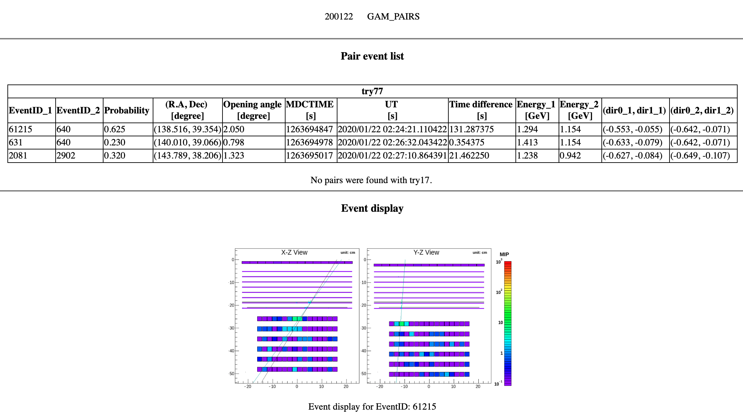
GAM_PAIRS page
GAM_PAIRS page was newly equipped on the DQC web page.
Pair search result is shown in the table, and event display for pair events are available.
Notes:
I will introduce the GAM_PAIRS page on the DQC web page.
This is an example of GAM_PAIRS page, This pase was newly equipped with the DQC web page.
The pair search result is shown in the table and event display for pair events are available.

Slide 15
GW counterparts search in the O3.
The LIGO & Virgo third observation run (the O3 run) started on April 1, 2019.
48 (+ Fermi GBM-190816) GW events have been reported in the O3.
CAL analysis (using the CAL pipeline)
Checking overlaps between the CAL FOV and the GW localization probability region
Seach for gamma-rays in -60 s ~ + 60 s (-1200s ~ + 1200s).
Even if there is no gamma-ray from the overlap region, we calculated 90% upper limits.
CGBM analysis (using the CGBM pipeline)
Checking whether CGBM high voltages were on or not
Checking overlaps between the CGBM FOV and the GW localization probability region.
Search for signal, of which SNR exceeds 7, in -60 s ~ + 60 s.
Notes:
Next, I will talk about GW counterparts search in the O3.
The LIGO & Virgo third observation run started on April 1, 2019.
48 GW events and 1 sub-threshold events have been reported in the O3.
We analyzed CALET data for GW events usign the CAL & CGBM pipelines.
For CAL analysis, we checked overlaps bettween the CAL FOV and the GW localization probability region.
And, we searched for gamma-rays in trigger time -60 s to trigger time + 60 s.
Even if there is no gamma-rays from the overlap region we calculate 90 % upper limits.
For CGBM analysis, we checked wether CGBM high voltages weere on or not.
Next, we checked overlaps between the CGBM FOV and the GW localization probability region.
After that, we searched for the signal of which SNR exceeds 7, in trigger time -60 s to trigger time + 60 s.

Slide 16
Results
CAL statistics
1 : HV off *
24 : Outside of the FOV
24 : No detection
CGBM statistics
17 : HV off
3 : Outside of the FOV
29 : No detection
* For safety during a special ISS activity
CALET has found no counterpart candidate so far.
We have reported our analysis for 46 events to GCN circular.
  Excepting S190412m, S190421ar, Fermi GBM-190816
I summarized analysis for GW events in the CGBM wiki page
  http://www.phys.aoyama.ac.jp/~yoshida/wiki/cgbm_int/index.php?Status%2FGW
Event ID | Time (UT) | CAL upper limit [erg cm⁻² s⁻¹ ] | CGBM status | GCN #
S200129m | 06:54:58.435104 | 5.7x10⁻⁵ (10 - 100 GeV) | HV off | 26941
S200128d | 02:20:11.903320 | 4.6x10⁻⁶ (10 - 100 GeV) | No detection | 26924
Notes:
This is a summary of CALET observation in the O3.
I’ll talk about CAL observation.
25 events were not observable by CAL due to the high voltage off and outside of the field of view.
24 events were observable. However, there is no gamma-rays from the GW overlap region.
Next, I’ll talk about CGBM observation.
20 events were not observable by CGBM due to the high voltage off and outside of the FOV.
29 events occurred in the CGBM FOV when the CGBM high voltages were on. However, there is no significant excess within trigger time +/- 60 s.
Therefore CALET has found no counterpart candidates so far.
We have reported our analysis for 46 events to GCN circular.
I summarized analysis for GW events in the CGBM wiki page.

Slide 17
Event ID | Time (UT) | CAL upper limit [erg cm⁻² s⁻¹ ] | CGBM status | GCN #
S200115j | 04:23:09.742047 | 1.7x10⁻⁶ (10 - 100 GeV) | HV off | 26797
S200114f | 02:08:18.239300 | 4.7x10⁻⁶ (10 - 100 GeV) | HV off | 26761
S200112r | 15:58:38.093931 | 1.1x10⁻⁶ (10 - 100 GeV) | No detection | 26740
S200105ae | 16:24:26.057208 | 6.4x10⁻⁶ (10 - 100 GeV) | No detection | 26664
S191222n | 03:35:37.119478 | Outside of the FOV | No detection | 26602
S191216ap | 21:33:38.472999 | Outside of the FOV | No detection | 26481
S191215w | 22:30:52.333152 | Outside of the FOV | No detection | 26465
S191213g | 04:34:08.142224 | Outside of the FOV | No detection | 26419
S191205ah | 21:52:08.568738 | Outside of the FOV | HV off | 26377
S191204r | 17:15:26.091822 | Outside of the FO | No detection | 26358
S191129u | 13:40:29.197372 | Outside of the FOV | No detection | 26321
S191109d | 01:07:17.220703 | Outside of the FOV | HV off | 26236
S191105e | 14:35:21.933105 | Outside of the FOV | HV off | 26195
S190930t | 14:34:07.685342 | 1.7x10⁻⁵ (10 - 100 GeV) | No detection | 25892
S190930s | 13:35:41.246810 | 3.5x10⁻⁵ (10 - 100 GeV) | No detection | 25891

Slide 18
Event ID | Time (UT) | CAL upper limit [erg cm⁻² s⁻¹ ] | CGBM status | GCN #
S190924h | 02:18:46.846654 | Outside of the FOV | HV off | 25844
S190923y | 12:55:59.645508 | 1.2x10⁻⁵ (10 - 100 GeV) | No detection | 25830
S190915ak | 23:57:02.690891 | Outside of the FOV | No detection | 25770
S190910h | 08:29:58.544448 | 9.4x10⁻⁶ (1 - 10 GeV) | No detection | 25735
S190910d | 01:26:19.242676 | Outside of the FOV | No detection | 25734
S190901ap | 23:31:01.837767 | 6.3x10⁻⁵ (1 - 10 GeV) | No detection | 25647
S190828l | 06:55:09.886557 | Outside of the FOV | No detection | 25537
S190828j | 06:34:05.756472 | Outside of the FOV | No detection | 25536
GBM-180816 | 21:22:13.027 | 2.1x10⁻⁶ (10 - 100 GeV) | No detection | No
S190814bv | 21:10:39.012957 | Outside of the FOV | HV off | 25390
S190728q | 06:45:10.529205 | Outside of the FOV | Outside of the FOV | 25214
S190727h | 06:03:33.985887 | Outside of the FOV | No detection | 25184
S190720a | 00:08:36.704102 | 3.0x10⁻⁵ (10 - 100 GeV) | HV off | 25134
S190718y | 14:35:12.067865 | 1.7x10⁻⁶ (1 - 10 GeV) | No detection | 25099
S190707q | 09:33:26.181226 | 2.1x10⁻⁶ (1-10 GeV) | No detection | 25033
S190706ai | 22:26:41.344727 | Outside of the FOV | HV off | 25027

Slide 19
Event ID | Time (UT) | CAL upper limit [erg cm⁻² s⁻¹ ] | CGBM status | GCN #
S190701ah | 20:33:06.577637 | Outside of the FOV | Outside of the FOV | 24970
S190630ag | 18:52:05.179550 | 1.2x10⁻⁵ (10-100 GeV) | HV off | 24960
S190602aq | 17:59:27.089355 | 2.9x10⁻⁴ (10-100 GeV) | No detection | 24735
S190521r | 07:43:59.463379 | Outside of the FOV | HV off | 24649
S190521g | 03:02:29.447266 | 6.0x10⁻⁶ (10-100 GeV) | HV off | 24648
S190519bj | 15:35:44.397949 | Outside of the FOV | No detection | 24617
S190517h | 05:51:01.830582 | Outside of the FOV | No detection | 24593
S190513bm | 20:54:28.747089 | 6.0x10⁻⁵ (1-10 GeV) | No detection | 24548
S190512at | 18:07:14.422363 | 1.9x10⁻⁵(10-100 GeV) | No detection | 24531
S190510g | 02:59:39.291636 | Outside of the FOV | No detection | 24495
S190503bf | 18:54:04.294490 | 4.2x10⁻⁵ (10-100 GeV) | HV off | 24403
S190426c | 15:21:55.336540 | 2.5x10⁻⁵ (10-100 GeV) | HV off | 24276
S190425z | 08:18:05.017147 | 1.0x10⁻⁴ (10-100 GeV) | HV off | 24218
S190421ar | 21:38:56.250977 | Outside the FOV | Outside the FOV | No
S190412m | 05:30:44.165622 | HV off | HV off | No
S190408an | 18:18:02.288180 | 2.3 x 10⁻⁶ (1-10 GeV) | No detection | 24088

Slide 20
Terrestrial Gamma-ray Flashes
TGFs (Terrestrial Gamma-ray Flashes) first detected by Burst and Transient Source Experiment (BATSE) on Compton Observatory (CGRO) 1991-2000
➔ The electric fields in ordinary lightning here on Earth accelerate particles to >30 MeV energies
Notes:
Next topic is Terrstrial Gamma-ray flashes (TGFs).
Terrestrial gamma-ray flashes (TGFs) were first detected by BATSE. The duration is typically less than millisecond. The electric fields in ordinary lightning on the earth accelerate particles to above 30 MeV.
Terrestrial gamma-ray flashes (TGFs) were first detected by BATSE and are now being observed by Fermi-GBM, ASIM (gamma ray detector on ISS), and GLM (optical detector on ISS). Typically less than a millisecond in duration, energies from a few hundred keV to 40 MeV.

Slide 21
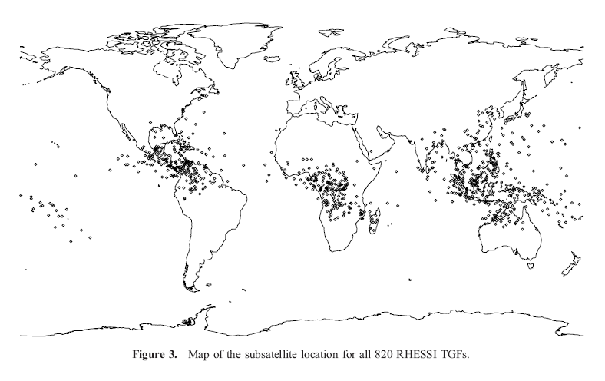
Hi Bkgnd - Low Sensitivity Region
SAA Region
High Background, Low Sensitivity Region
Map of RHESSI TGFs (820)
Notes:
TGFs are seen from space at low latitudes because that is where satellites are. Also, seen from ground in Louisiana.
Seen from space at low latitudes because that is where satellites are. Seen from ground in Louisiana.

Slide 22
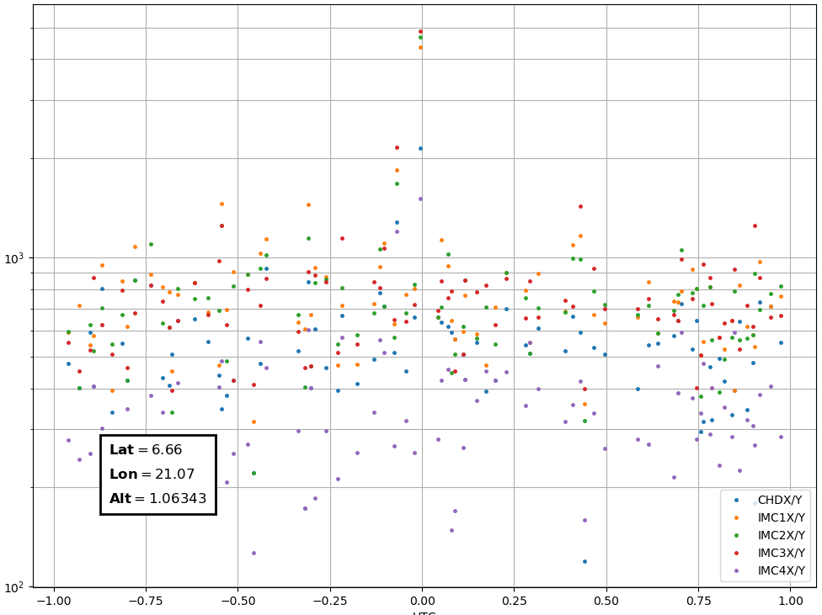
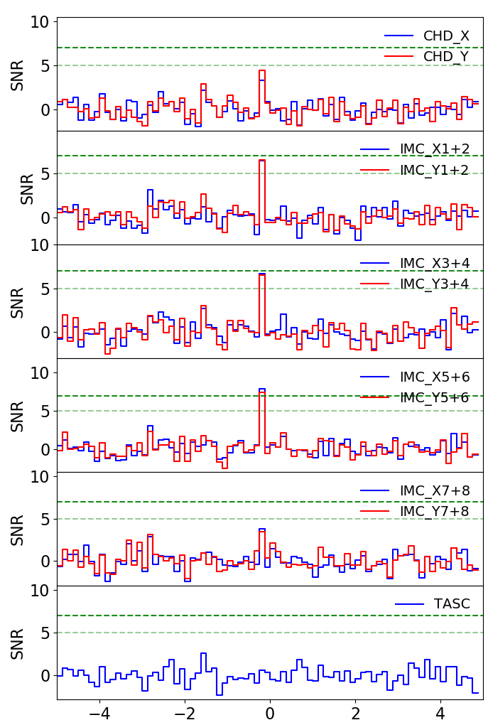
CHD & IMC signal due to TGF
A TGF detected by ASIM and Fermi-GBM at 2018-06-21 16:00:52 (Østgaard et al. 2019).
Information was provided by Prof. Mike Cherry and Samer Al Nussirat, who is Mike‘s postdoc.
Rate [counts / s]
CHD XY
IMC1+2 XY
IMC3+4 XY
IMC5+6 XY
IMC7+8 XY
Provided by
Anthony Ficklin
SNR vs. Time (1/8s binning)
Time [s] since 18/06/21 16:00:52.243 UTC
CHD & IMC detected a signal due to the TGF!
(There is no signal in CGBM data although.)
Time [s] since 18/06/21 16:00:52.243 UTC
Notes:
This plots shows count rate of CHD & IMC around the TGF that occurred on June 21st in 2018.
We can see the signal due to the TGF in CHD and IMC data.
Observing TGFs simultaneously with Fermi-GBM and ISS gives new information about beaming angle.
CALET was launched 2 years before ASIM, so we have much better statistics.
Observing TGFs simultaneously with GBM and ISS gives new information about beaming angle that is not available otherwise.
CALET was launched 2 years before ASIM, so we have much better statistics.

Slide 23
Future works
Analysis systems
  The CGBM pipeline
    Improvement with summed probability calculation
    Improvement with BG estimation method
    The upper limit calculation for any direction
  The transient search system
    Gamma-ray candidate list after the CGBM trigger (DQC)
    Reprocess for past data.
GRB analysis
  Systematic gamma-ray search for GRBs (including afterglow)
    Fermi-LAT -> other HE ground telescope -> Swift & Fermi-GBM -> others
Notes:
I will talk about future works.
We will continue to update the analysis systems.
For the CGBM pipeline, we will improve below. I will talk later about these.
For the transient search system, we will equip the gamma-ray candidate list after the CGBM trigger to the DQC web page.
Since the GAM_PAIRS page equiped recently, we need to reprocess for past data.
For GRB analsysis,
I plan to perform the systematic gamma-ray search for GRBs.
I prioritize GRBs detected by Fermi-LAT or other HE grond telescope.
Although some GRBs were anlalyzed by Nick, I will reanalize them for cross-check.
Also. we will extended time interval for the search considering highe energy after glow.

Slide 24
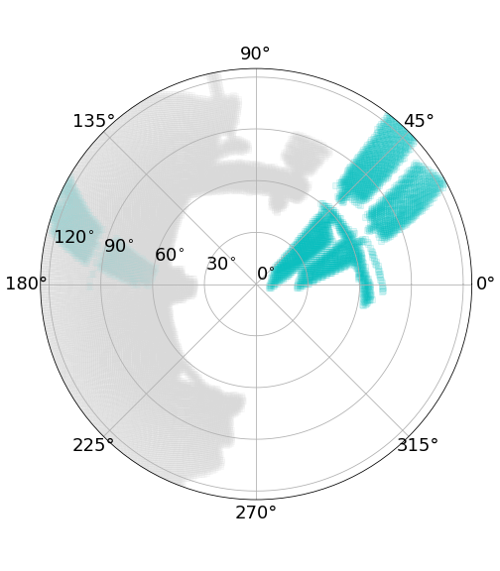
Future updates with the CGBM pipeline
Improvement with the summed probability calculation
Fixed
Moving
Currently, the summed probability in CGBM FOV is calculated, assuming no obstruction by the ISS structures.
We will improve the calculation to take into account the actual CGBM FOV.
Improvement with BG estimation method
  Currently, BG is estimated by the summation of counts before & after the region of interest.
  We plan to develop a database of background counts for any position (latitude & longitude).
The upper limit calculation for any direction
  Since GW high probability region is spread, the upper limit for one direction is not enough.
  We plan to develop tools to calculate the upper limit for any direction, which is like CAL analysis.
Notes:
I will explain about future updates with the CGBM pipelines.
There are three points we plan to update.
One of them is the summed probability calculation.
Currently, the summeed probability in CGBM FOV is calculated, assuming no obstruction by the ISS structtures.
We will improve the calculation to take into account the actual CGBM FOV like this.
Next one is BG estimation.
Currently, BG is estimated by the summation of counts before & after the region of intetrest.
This may cause over or under estimation of background levels.
We plan to develop a database of background counts for any position to estimate background.
The last one is upper limit calculation.
Since GW high probability region is spread, the upper limit for one direction is not enough.
We plan to equip a function making upper limits map like that of CAL to the CGBM pipeline.

Slide 25
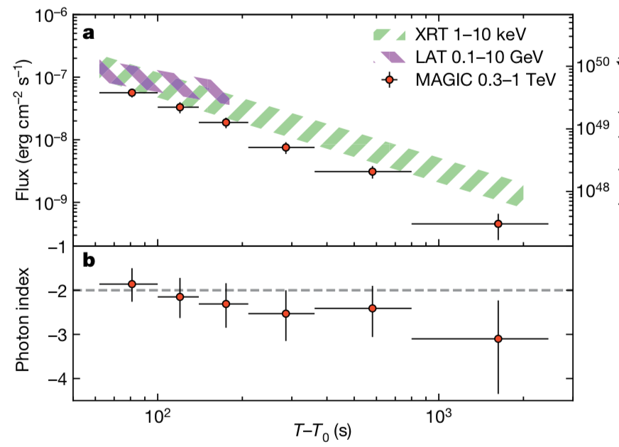
High energy afterglow
Acciari et al. 2019
GRB 190114C
MAGIC detected high energy gamma-rays (> 300 GeV) from GRB 190114C.
Although gamma-ray flux decrease with time, high energy emission continues after the prompt emission (GRB 940217, ~1.5h).
We need to care about high energy afterglow emission.
We should make sure our (instrumental & diffuse) background estimation is reasonable because exposure is large.
Notes:
I will metion about high energy afterglow of GRBs.
This plot shows light curve of GRB 190114C detected by MAGIC.
MAGIC detected high energy gamma-ray above 300 GeV from the 190114C.
And the high energy emission detected even ~1000 seconds after the trigger time of prompt emission.
Terefore, we need to take care about high energy after glow emossion in CALET analysis.
To do that, we should make sure our background estimation is reasonable because exposure is large.

Slide 26
Summary
We updated the GW & GRB pipelines and transient search system.
We searched for electromagnetic counterparts of 49 gravitational wave events in the O3.
  CAL and CGBM found no counterpart candidates.
CHD and IMC detected signal due to the TGF.
We will continue to update our pipelines and perform the systematic analysis for GRBs using the pipelines.
Notes:
I will summarize my talk.
We updated the GW & GRB pipelines and transient search system.
We searched for electromagnetic counterparts of 49 gravitational wave events in the O3.
However, no gamma-rays were found in CAL and CGBM data.
CHD and IMC detected signal due to the TGF.
We continue to update our pipelines and perform the systematic analysis for GRB using the pipelines.

Slide 27
Backup

Slide 28
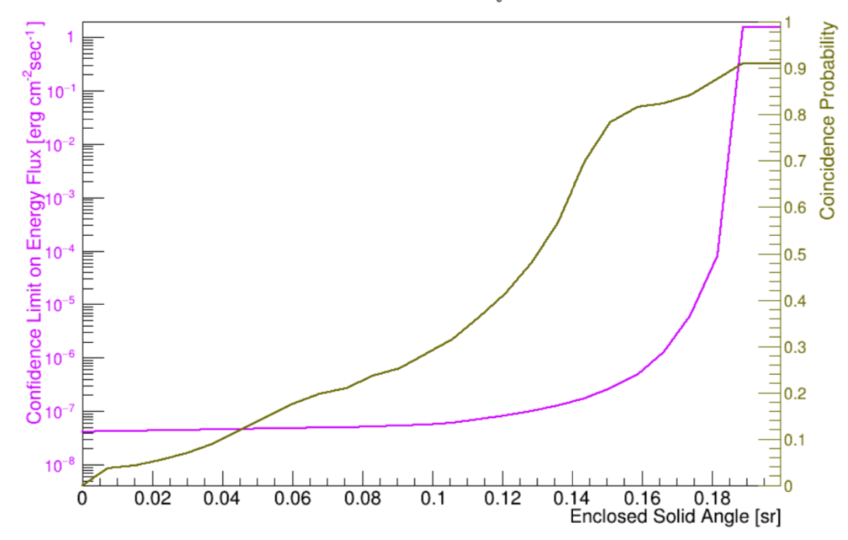
Upper limits vs. enclosed solid angle
Highest upper limit vs. Enclosed solid angle
& summed probability
If we increase enclosed solid angles in which we estimate the upper limit, background counts that come from the enclosed solid angles should increase.
We need to sort pixels of HEALPix when we calculate the summed probability in the enclosed solid angles to reduce expected background counts.
For S190408an
Sorting Healpix to descending order with probability in the pixel.
Calculating the cumulating probability with the descending order.
We set the threshold of probability, which corresponds to the 99% point of the cumulating probability.
For pixels of which probability above the threshold, we sort the HEALPix to descending order with exposure in the pixel
We add pixels to the enclosed solid angles according to the descending order, and we calculate the summed probability and the highest upper limits in the region.

Slide 29
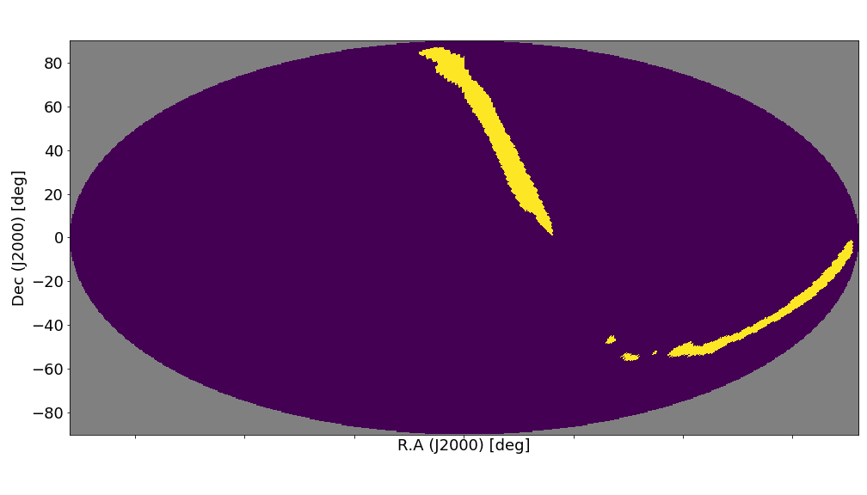
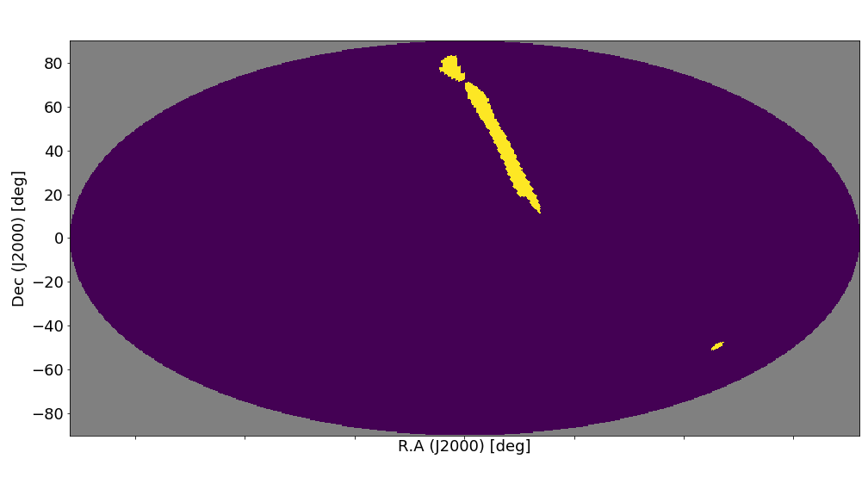
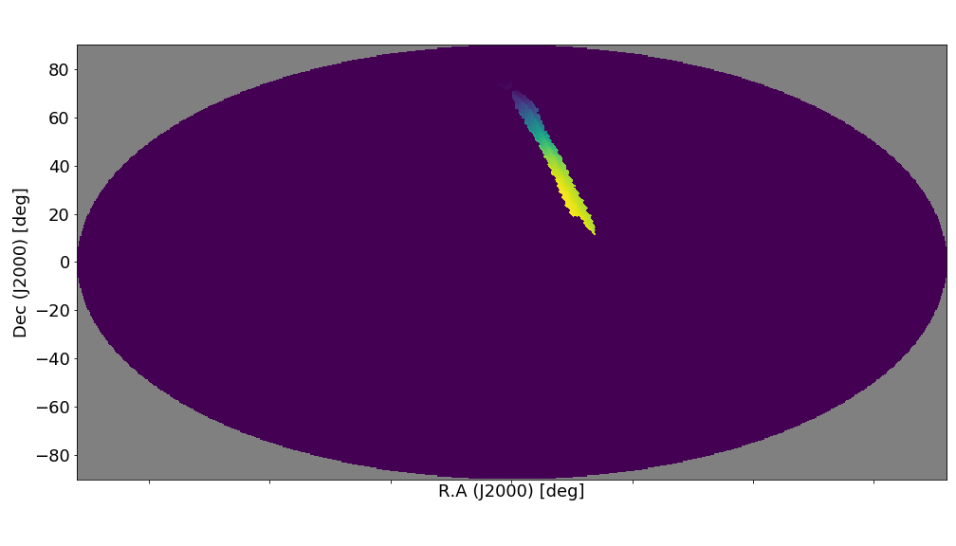
the cumulating probability <= 99%
Masked exposure (> 99%)
the cumulating probability <= 90%
Masked exposure (> 90%)

Slide 30
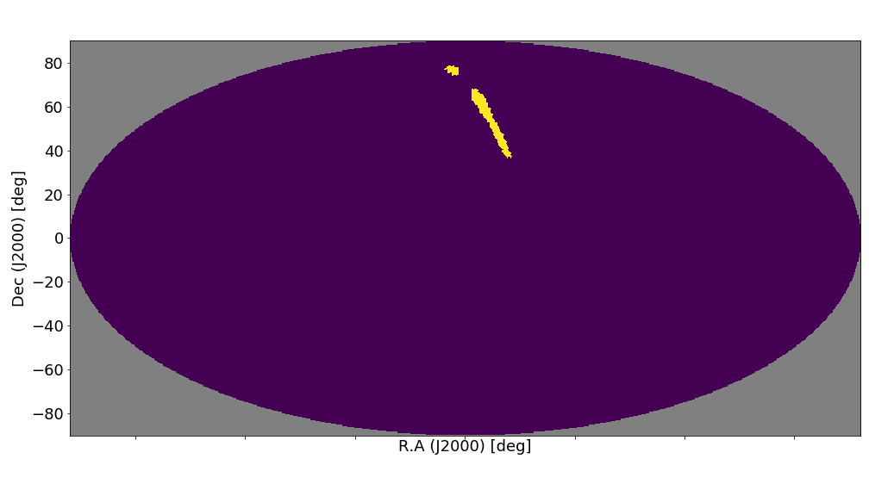
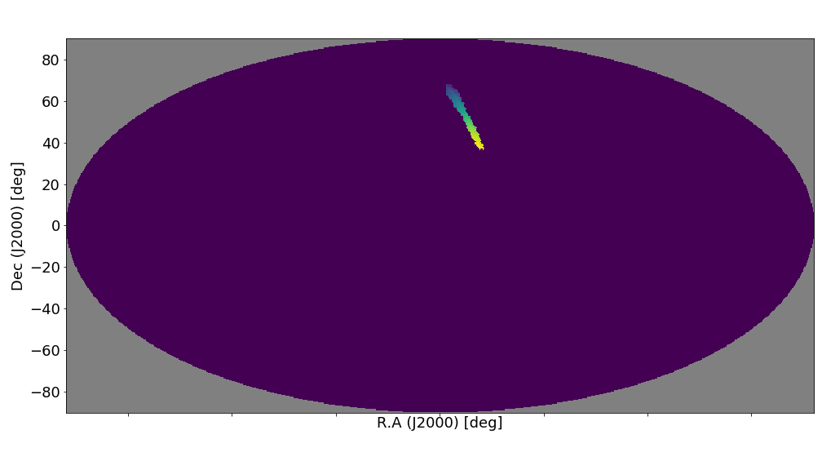
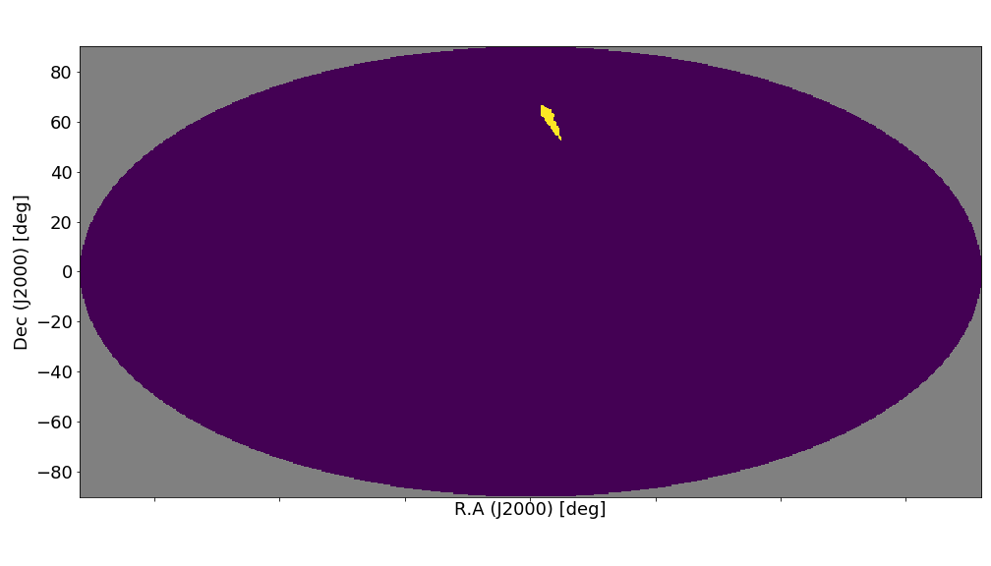
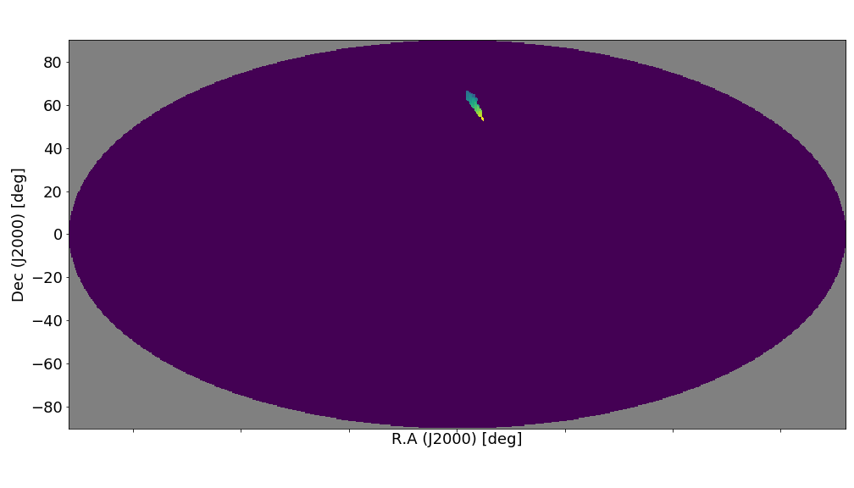
the cumulating probability <= 60%
Masked exposure (> 60%)
the cumulating probability <= 30%
Masked exposure (> 30%)

Slide 31



the cumulating probability <= 10%
Masked exposure (> 10%)
the cumulating probability <= 1%
Masked exposure (> 1%)

