Slide 1
CALET data archive at ISAS/JAXA's science archive DARTS
2020-02-05
Ken EBISAWA
Japan Aerospace Exploration Agency (JAXA)
Institute of Space and Astronautical Science (ISAS)
Center of Science satellite Operation and Data Archive (C-SODA)

Slide 2
Contents of the talk
Organization
JAXA projects and DARTS
CALET archive data flow
CALET data archive at DARTS
Future Plan

Slide 3
Contents of the talk
Organization
JAXA projects and DARTS
CALET archive data flow
CALET data archive at DARTS
Future Plan

Slide 4
1. Organization (JAXA, ISAS)
Universities
JAXA (~2000 FTE)
Tsukuba(TKSC)
The Manned Space program
(ISS, CALET, MAXI)
ISAS (~200 FTE)
~100 scientists (Professors, Associate professors,
Assistant professors)
Chofu
C-SODA
~100 engineers, admistrators
Tokyo

Slide 5
1. Organization (C-SODA)
C-SODA(~20 FTE, ~20 contractors)
Ground Station
Sa
Satellite operation
Sa
Data Processing/Archiving (~8 FTE, ~5 contractors)
http://darts.isas.jaxa.jp
SIRIUS
Reformatter
DARTS
users
L0
L1
L2/L3
C-SODA /DARTS provides infrastructure for data processing and /or archive
for JAXA’s science projects

Slide 6
Contents of the talk
Organization
JAXA projects and DARTS
CALET archive data flow
CALET data archive at DARTS
Future Plan

Slide 7
Data Processing and Archiving: example1
http://darts.isas.jaxa.jp
SIRIUS
Reformatter
DARTS
users
telemetry
processing
archive
Domestic project,
Data are released from and archived only at DARTS
Akatsuki (Venus Climate Orbiter) model

Slide 8
Data Processing and Archiving: example2
users
http://darts.isas.jaxa.jp
DARTS
SIRIUS
Reformatter
NASA
archive
telemetry
preprocessing
processing
archive
HEASARC
International projects
Data processed at ISAS and NASA
Data released from and archived both at DARTS and HEASARC
users
http://heasarc.gsfc.nasa.gov
ASCA/Suzaku/Hitomi /XRISM model

Slide 9
Data Processing and Archiving: example3
CALET data processing is made outside of JAXA
archive
http://darts.isas.jaxa.jp
Data processing outside of JAXA
Reformatter
DARTS
users
NO processing
Data are also archived at HEASARC according to JAXA-NASA LOA
HEASARC
http://heasarc.gsfc.nasa.gov
users
CALET model (instruments on ISS)

Slide 10
Contents of the talk
Organization
JAXA projects and DARTS
CALET archive data flow
CALET data archive at DARTS
Future Plan

Slide 11
From MOU between CALET and C-SODA
)
http://
darts.isas.jaxa.jp
not public
public archive
Some of the data mirrored to HEASARC
tool

Slide 12
Contents of the talk
Organization
JAXA projects and DARTS
CALET archive data flow
CALET data archive at DARTS
Future Plan

Slide 13
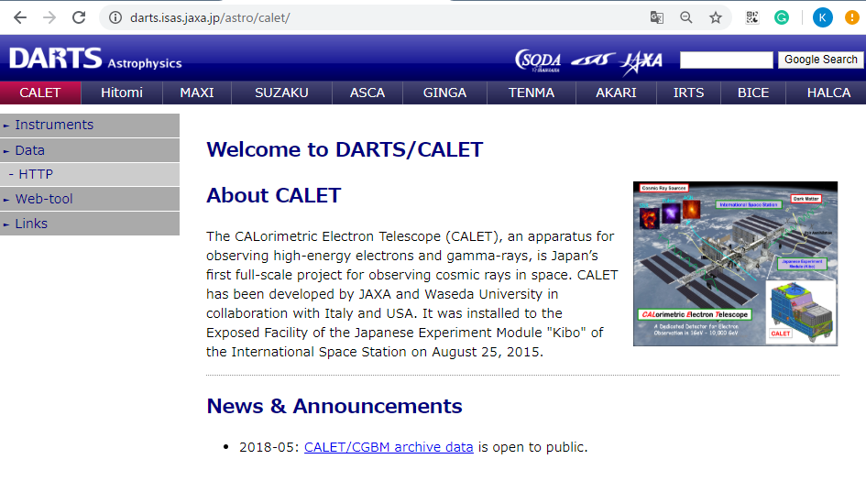
4. CALET Data archive at DARTS
Web page: http://darts.isas.jaxa.jp/astro/calet
Data download area : https://darts.isas.jaxa.jp/pub/calet/

Slide 14
Contents of the talk
Organization
JAXA projects and DARTS
CALET archive data flow
CALET data archive at DARTS
  CAL cosmic-ray Level 3 data
  CAL space weather Level 1.1 data
  CGBM Level 3 data
  CGBM web-tool
Future Plan

Slide 15
4.1 CAL cosmic ray Level 3 data
http://darts.isas.jaxa.jp/pub/calet/cal_pubdata
  README.txt
  CALET_all-electron_2017.dat
  CALET_all-electron_2018.dat
  CALET_all-electron-DAMPE-binning.dat
  CALET_all-proton_2019.dat
ASCII files of cosmic-ray energy spectra

Slide 16
4.2 CAL space weather Level 1.1 data
Real time processing at WCOC
ASCII file is daily sent from WCOC to C-SODA, converted to FITS format (HEASARC compliant)
Both ASCII and FITS files archived at DARTS
  http://darts.isas.jaxa.jp/pub/calet/cal-v1.1/CHD/level1.1/
FITS files mirrored to HEASARC

Slide 17
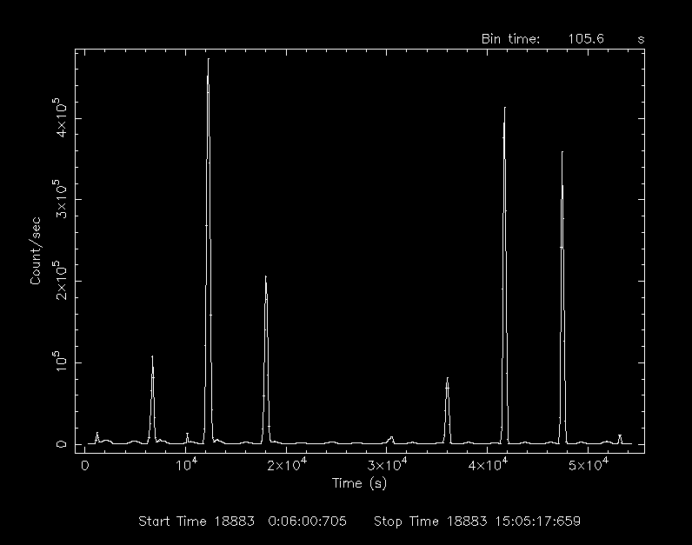
The latest FITS file http://darts.isas.jaxa.jp/pub/calet/cal-v1.1/CHD/level1.1/obs/2020/ccal_20200204_chd.lc.gz
Plot with ”lcurve” ftool
Comparison with other space-weather data
is readily possible
2020-02-04
Space –weather
Yesterday!

Slide 18
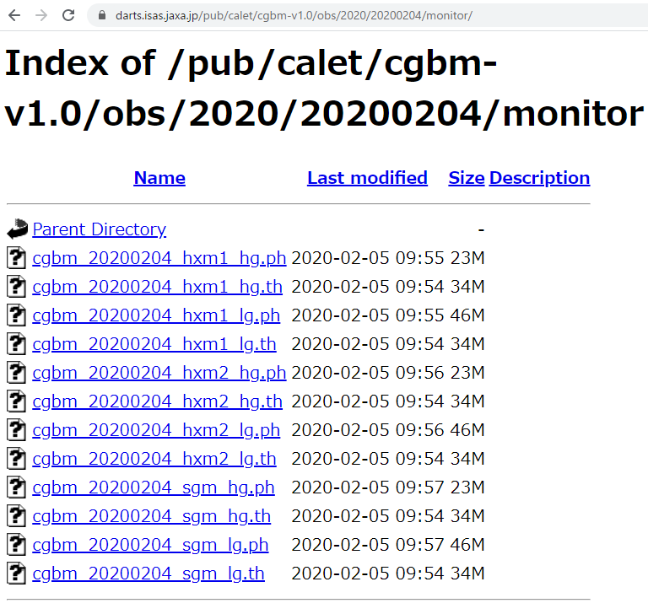
4.3 CGBM Level 3 data
Real time processing at AGU.
FITS files are daily sent to C-SODA
http://darts.isas.jaxa.jp/pub/calet/cgbm-v1.0/
  “Monitor” data (binned data) are released with FITS format
  Explanation by the CGBM team at
  http://cgbm.calet.jp/docs/archive
  The trigger data (event files) are not available in the current release.
New FITS format (including event files) will be employed
  Joint effort of AGU and HEASARC on-going
  All the data will be reprocessed for the new format
2020-02-04
CGBM data
Yesterday!

Slide 19
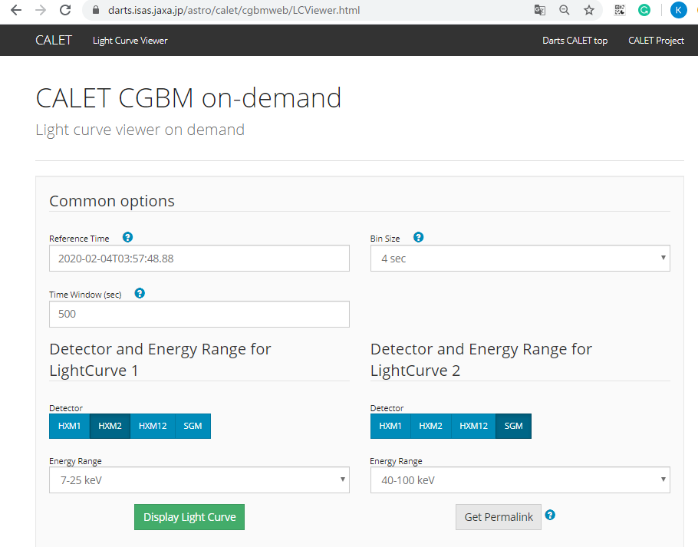
4.4 CGBM web-tool
https://darts.isas.jaxa.jp/astro/calet/cgbmweb/LCViewer.html
Specify time range, detector, and display CGBM light-curve

Slide 20
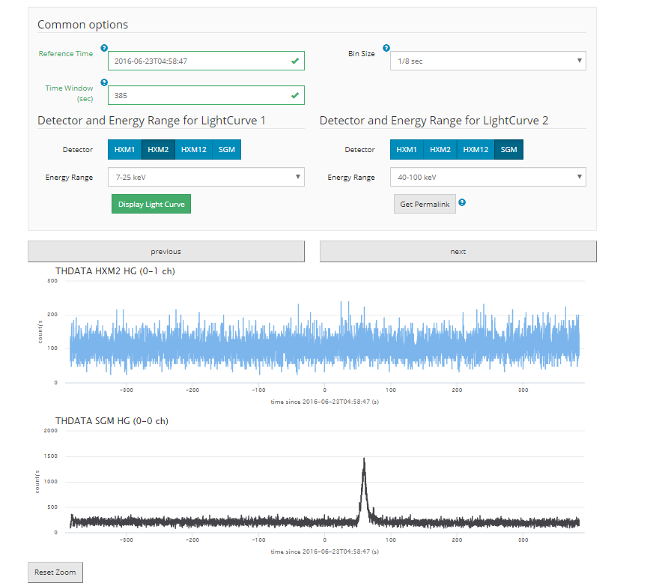
4.4 CGBM web-tool
https://darts.isas.jaxa.jp/astro/calet/cgbmweb/LCViewer.html
Specify time range, detector, and display CGBM light-curve
Change bin-size, time range, zoom

Slide 21
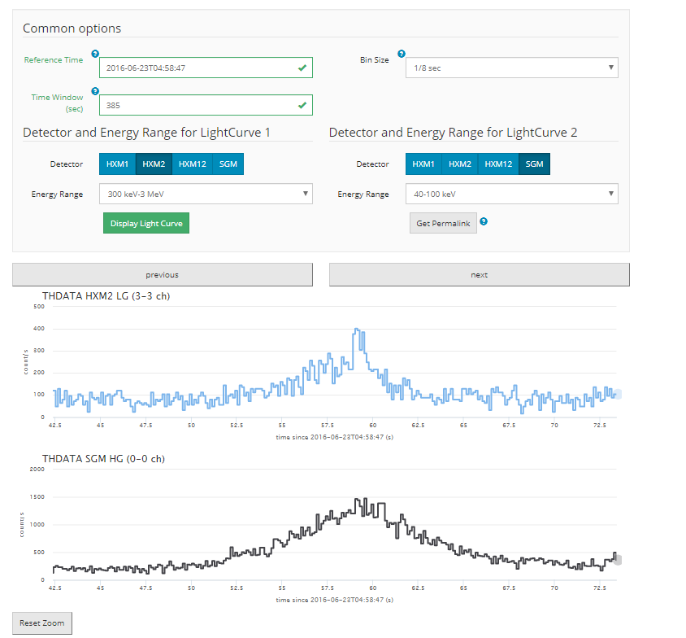
4.4 CGBM web-tool
https://darts.isas.jaxa.jp/astro/calet/cgbmweb/LCViewer.html
Specify time range, detector, and display CGBM light-curve
Change bin-size, time range, zoom

Slide 22
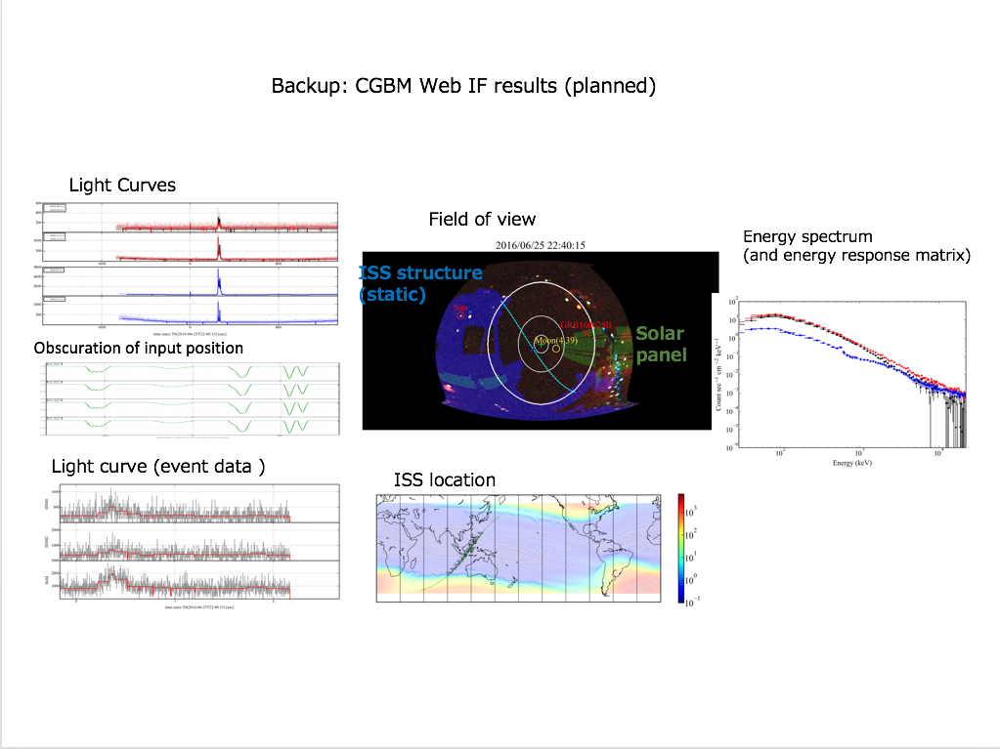
CGBM Web-tool advanced version
Web-tool advanced version being prepared
Field of view of CGBM and ISS location at the burst detection
Spectra, background extraction, response generation
Will be released after the new FITS format files are released

Slide 23
Contents of the talk
Organization
JAXA projects and DARTS
CALET archive data flow
CALET data archive at DARTS
Future Plan

Slide 24
Future plan
All the data currently archived at DARTS are permanent
CGBM Web-tool may not be operated permanently
It is expected that CGBM data analysis will be permanently possible with standard tools and database provided by HEASARC

