Slide 2
Signal selection for
beam phase detection
H. Damerau, N. Pittet
Meeting on PS LLRF developments
30/01/2020

Slide 3
Introduction
Double-harmonic receiver with pre-selection
Data concentrator/selector matrix
Phase detection as part of beam loops
Double harmonic
receiver
Data concentrator/
selector matrix
Phase detection as part of
beam loops
RF1 in
Double harmonic
receiver
Data concentrator/
selector matrix
RF2 in
…
…
RFn in

Slide 4
Beam synchronous double-harmonic receiver
Convert RF signals to baseband I/Q data
  Beam synchronous down-conversion
  Two harmonics simultaneously: previous/present and next
Configuration: VXS carrier (PSB), FMC-ADC (PSB), FMC-SFP (COTS)
In: 4 RF signals
Out: 2 data streams containing baseband information of 2 signals at
2 harmonics, or 4 signals
FMC
ADC
VXS Carrier
(PSB)
Data stream selection matrix
Internal functions:
HPL1/2, PLOFFSET1/2
FMC
SFP
RF in 1
Baseband I/Q,
h₁ and h₂, 2 signals
RF in 2
RF in 3
Baseband I/Q,
h₁ and h₂, 2 signals
RF in 4

Slide 5
Beam control – non-synchronous concentration
Data concentration of baseband I/Q data streams
  Reduce number of physical SFP connections
  Pack up to 4 baseband I/Q streams into single physical connection (SFP)
Configuration: VXS carrier (PSB), 2 × FMC-SFP (COTS)
Detailed synoptic on DFS (3 modules): link
Baseband I/Q,
4 streams
FMC
SFP
VXS Carrier
(PSB)
Data stream selection
Concentration of data streams
Internal functions:
HPL1/2
FMC
SFP
Baseband I/Q, up to 4 streams
Baseband I/Q, 4 streams
Baseband I/Q, 4 streams
Baseband I/Q, 4 streams
Baseband I/Q, 4 streams
Baseband I/Q, 4 streams
Baseband I/Q, 4 streams

Slide 6
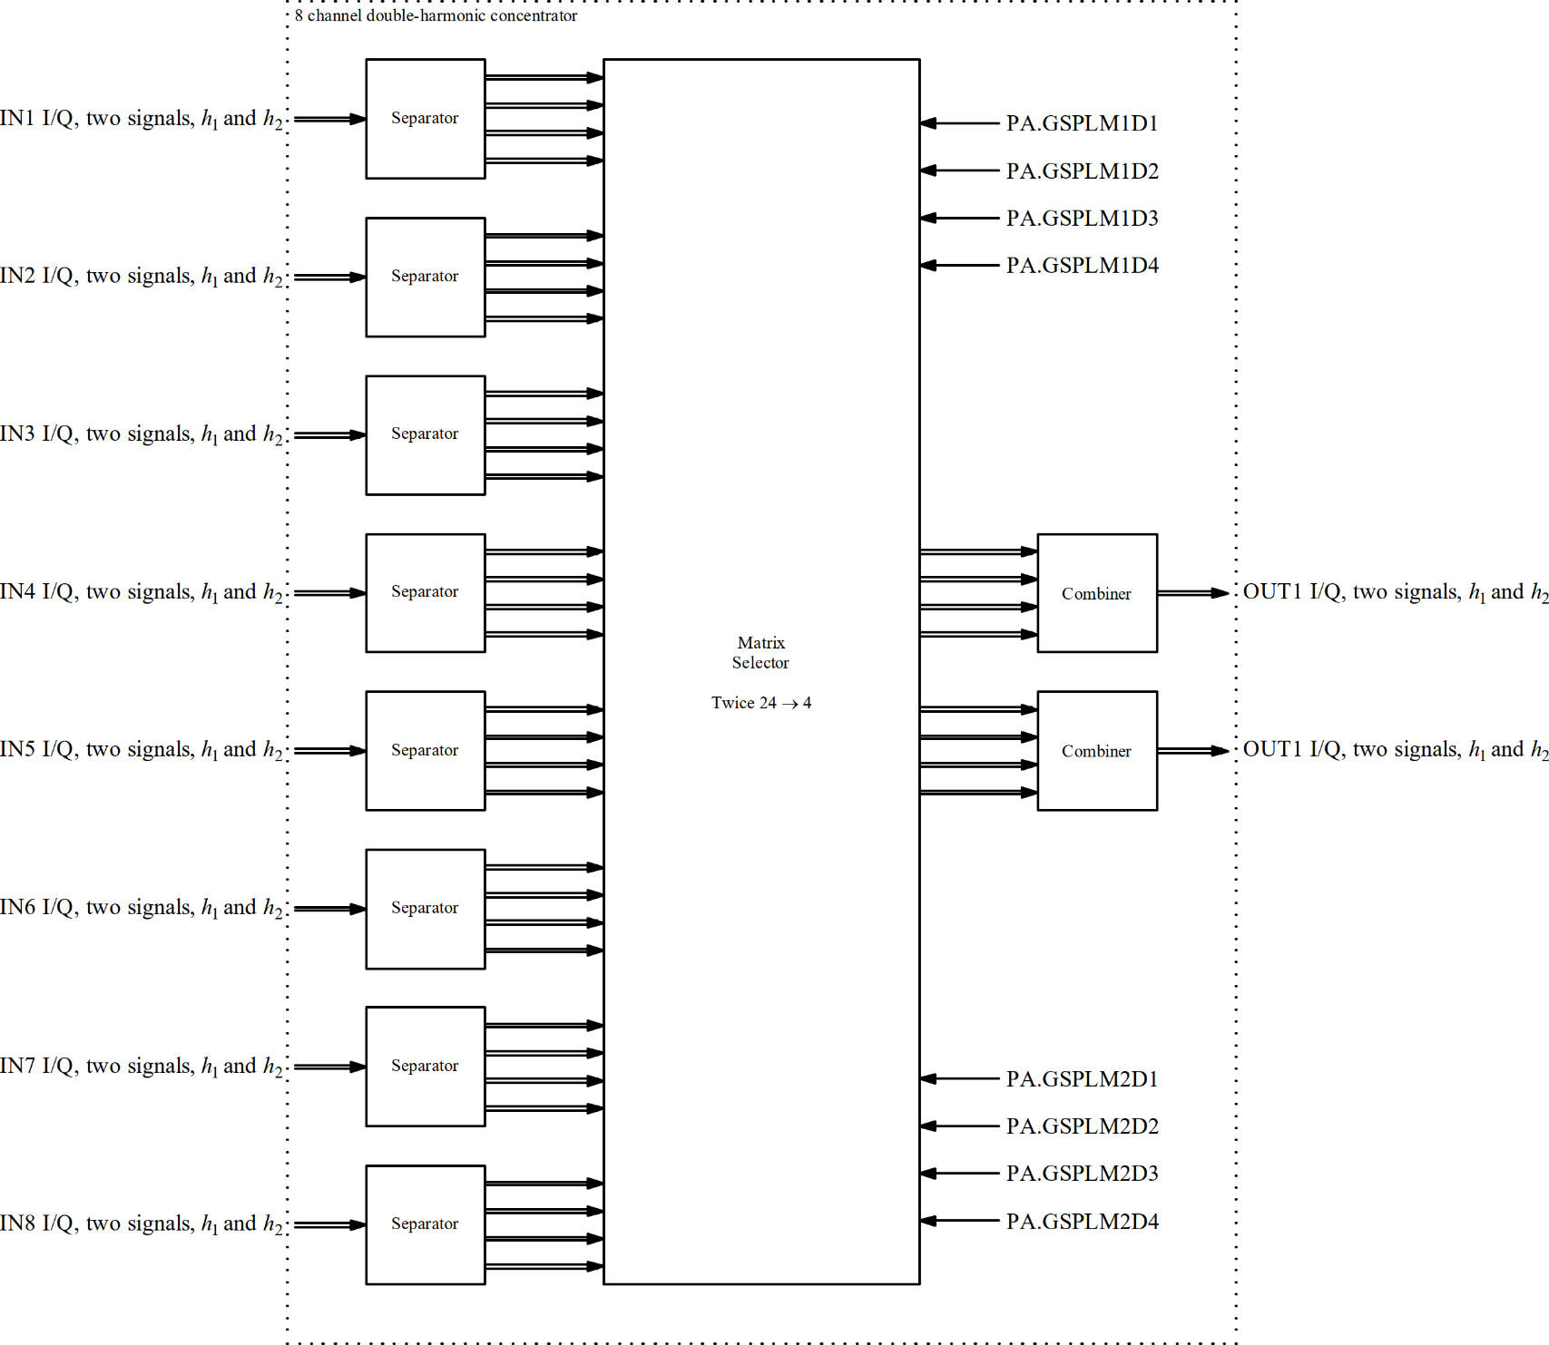
Beam control – non-synchronous concentration
Matrix selection
functions
256 MBit/s
256 MBit/s
Matrix selection
functions

Slide 7
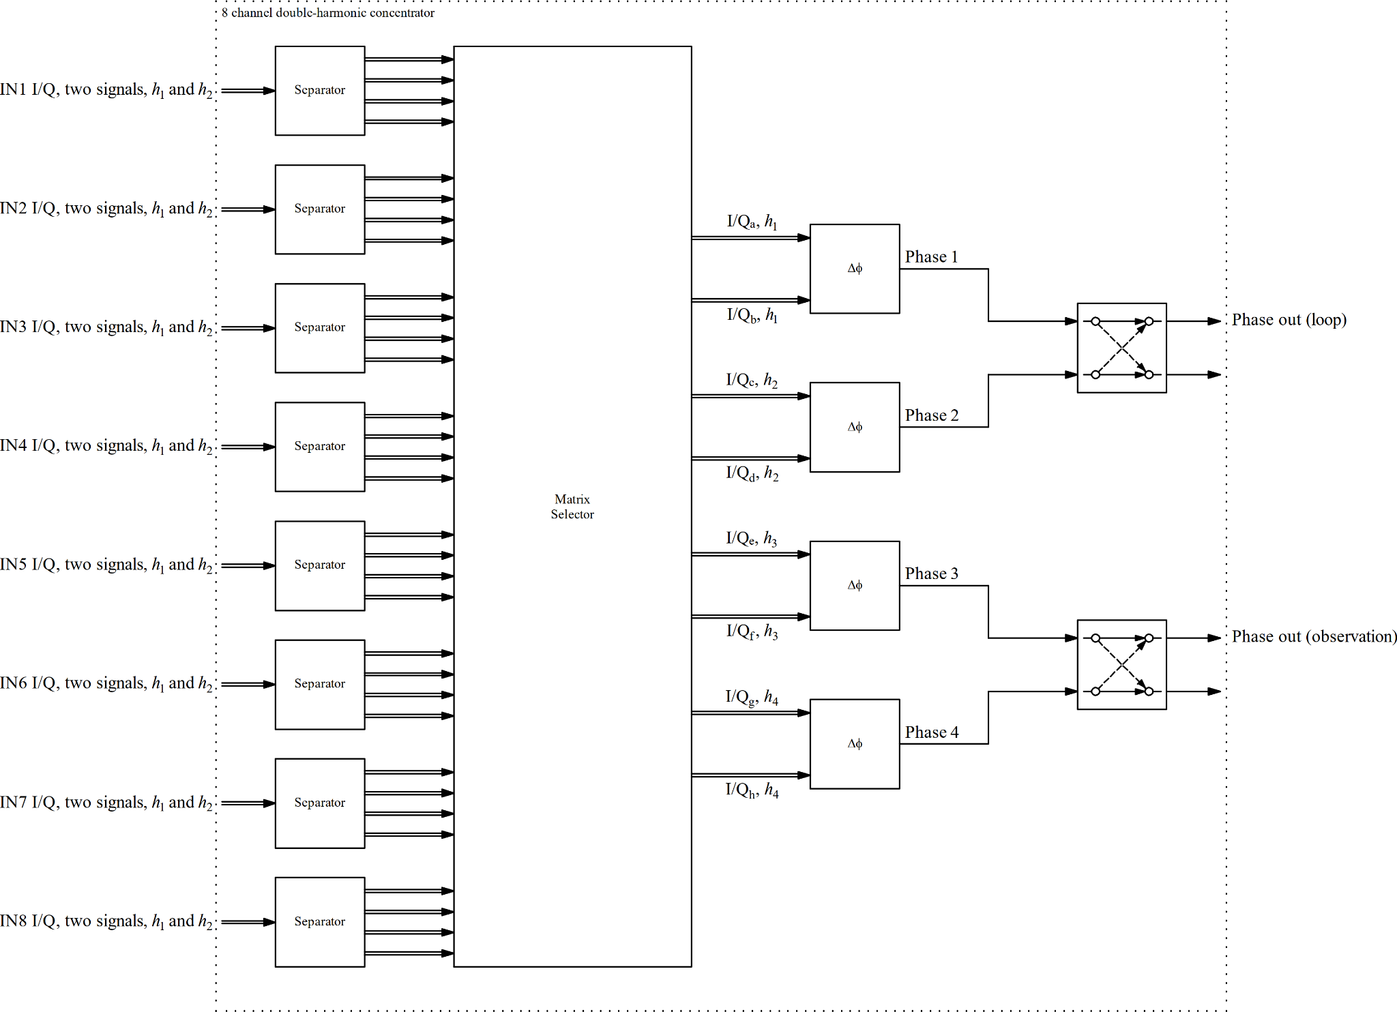
Beam control – non-synchronous concentration
Controlled by function per column

Slide 8
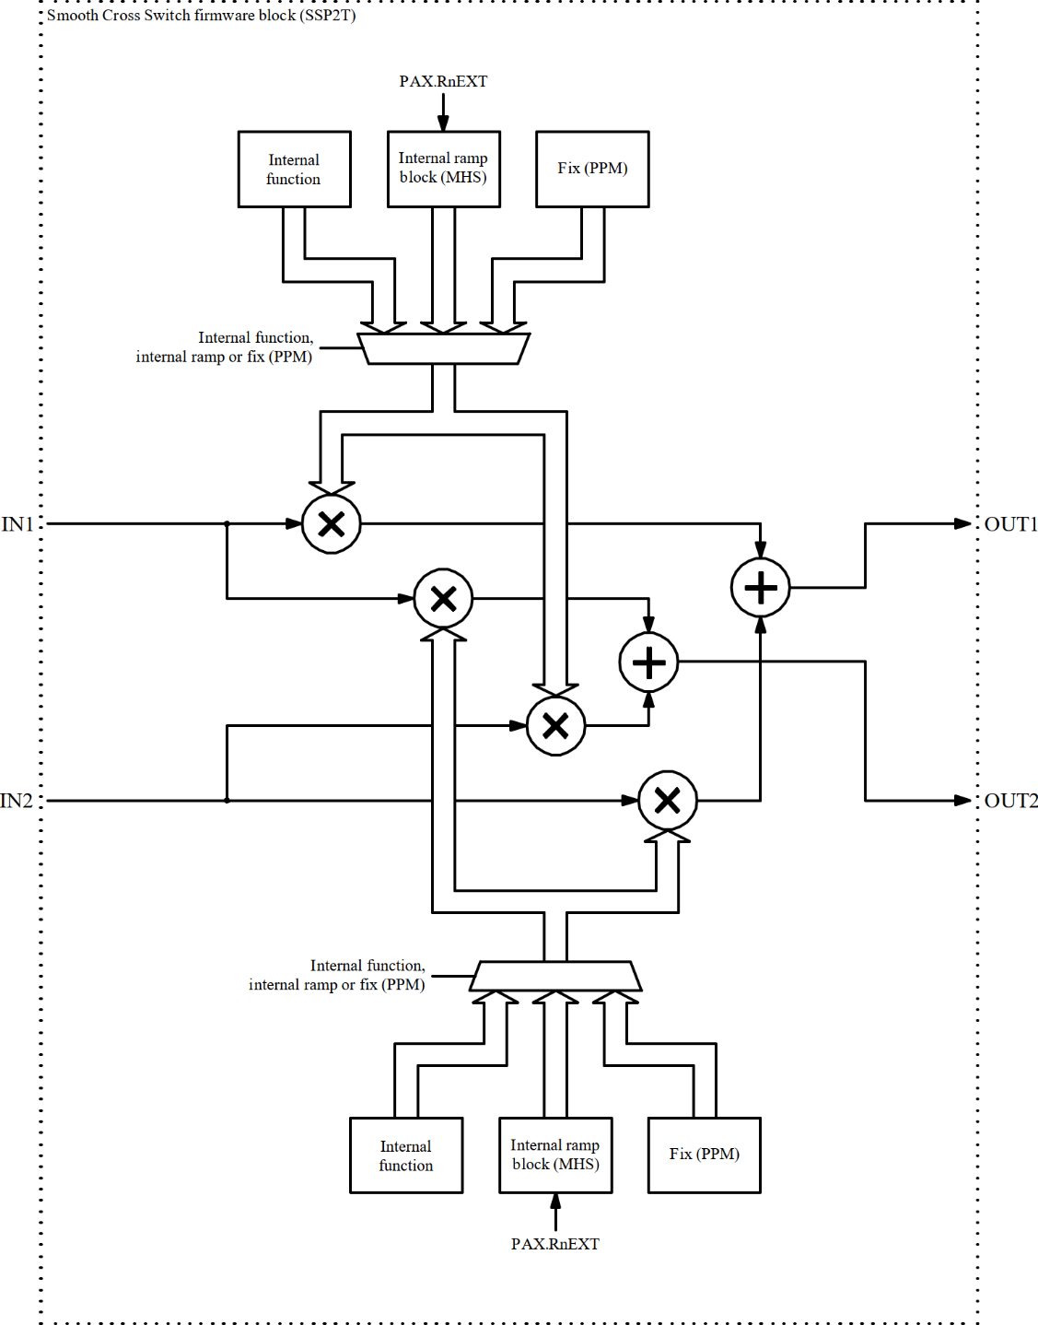
Smooth cross switch (SCSP2T)
2 × IN, 2 × OUT
Control through
  Register (PPM)
  Internal ramp block
    Slow and fast switching
  Internal function
Control configuration static
per cycle
Potential issues
  No fast timing triggered switching with internal function
Option for full flexibility
  Two switches in series

Slide 9
Summary and outlook
Multi-input, multi-harmonic beam phase detection
Main firmware blocks
  Double-harmonic receiver (DHRX)
  Dynamic matrix, set by functions (IQFM)
  Smooth cross switch (SCSP2T)
  Data separator and combiner for Gigabit links
Next steps
Finalize layout and overview diagram
Integrate ejection synchronization loops
Define function and timing devices
Define firmware framework

