Slide 1

CMS RPC
R134a RECUPERATION
R. Guida, A. D’Auria, G. Rigoletti, M. Corbetta

Slide 2
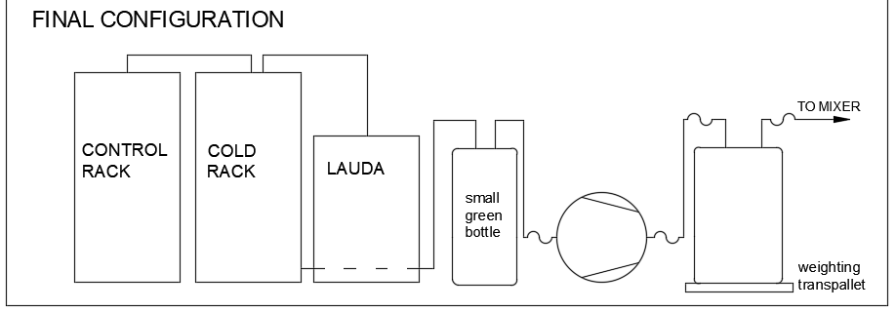
Configuration
TO GC
Compressor
Festo
Volume
CMS RPC - R134a RECUPERATION

Slide 3
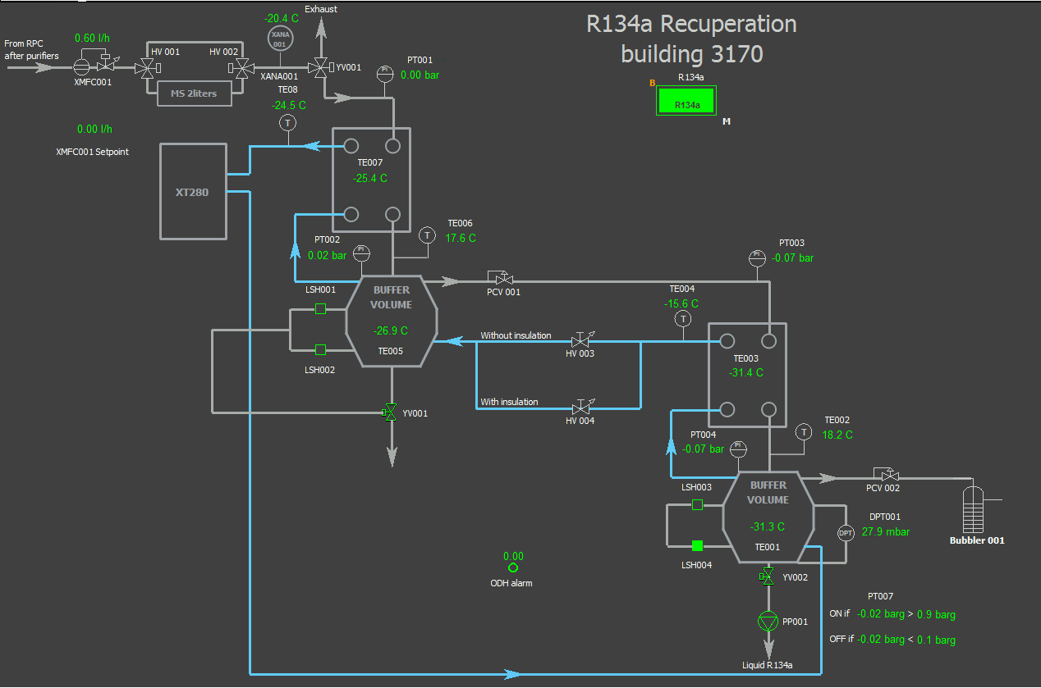
START OF THE SYSTEM
First, we started Lauda and cooled everything down
Buffer 1 (for iC4H10) to ~ -25°C
Buffer 2 (for R134a) to ~ -35°C
Started flowing ~300ln/h
Checked for leaks in the rack -> ok
Checked bubbler -> ok
CMS RPC - R134a RECUPERATION

Slide 4
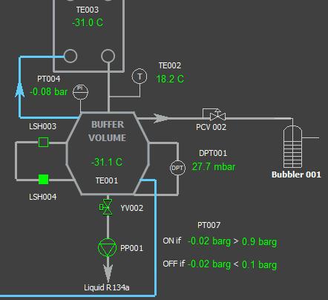
LOGIC
Gas mixture arrives from XMFC001
It goes to first buffer where isobutane liquifies (-15°C liquefaction point)
It arrives to second buffer where R134a liquifies
When the buffer is full the level LSH003 switches on -> YV002 opens and compressor starts
When buffer is emptied (i.e. LSH004 switches off) YV002 closes.
Liquid R134a in festo buffer thermalizes and become gas -> pressure in the festo increase
When PT007 > 0.9bar compressor starts until it returns to 0.1 bar
CMS RPC - R134a RECUPERATION

Slide 5
INPUT MIXTURE - AFTER PURIFIER
Purifier1 and Purifier2 in operation
At the beginning, H2O concentration ok (100 ppm)
after some hours of operation it started raising again (>200 ppm)
Purifier1 operation time was set to a longer time (since Oct 2019)
and it was not going to regeneration at the correct moment
Input mixture for recovery has to be dry (H2O<100 ppm)
Humidity value on recovery rack = -75 °C, Humidity on analysis = - 40 °C
CMS RPC - R134a RECUPERATION

Slide 6
GC ANALYSIS
New connection made from the output of the recuperated
gas bottle to the analysis rack
Pressure regulator on bottle (1.2 bar) + before analysis input (1 bar)
Line connected to analysis chain stream 147 (free/calibration bottles)
Analysis started (100 mbar at input) > still residual of ExhToDist mixture
keep doing analysis during recuperation
O2 concentration from 3% down to 0.3%, keep decreasing
CMS RPC - R134a RECUPERATION

Slide 7
Results
Few numbers/results for reference:
We did ~15 complete cycles
For each cycle:
  Pressure in the cold R134a buffer increase 15mbar/h with 300ln/h -> maximum efficiency
  It takes ~1:40 h to fill the volume from LSH004 to LSH003
  About 500-550 ln of R134a are recuperated
  It takes ~10 minutes to empty the buffer from LSH003 to LHS004
  It takes ~15 subcycles (about 1:30h) of the compressor to remove R134a from festo buffer
  The pressure in the green tank increases by ~1-1.2 bar (volume of 400l)
From GC we observed still some iC4H10 and SF6 -> to understand -> we regulated the pressure on the first bufer
CMS RPC - R134a RECUPERATION

Slide 8
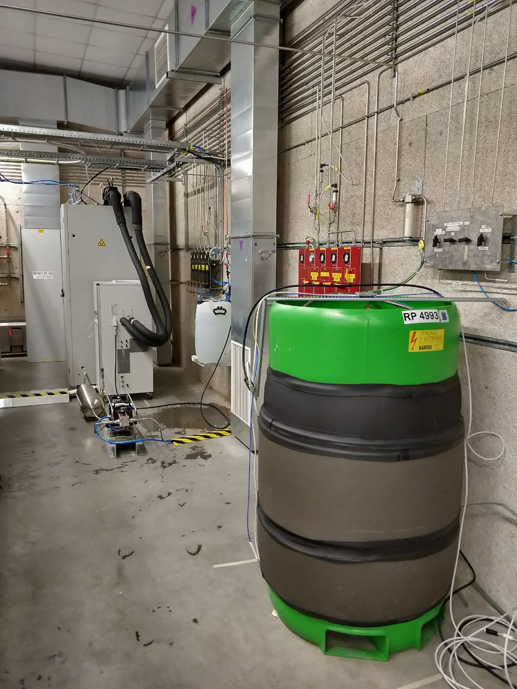
DONE
Install bypass line from the exit of green tank to the input of recovery -> clean up the gas inside
CMS RPC - R134a RECUPERATION

