Slide 1



CMS-RPC
Regulation Valve
Test Summary
Sabino Zagaria
EP-DT-FS
21/01/2020

Slide 2
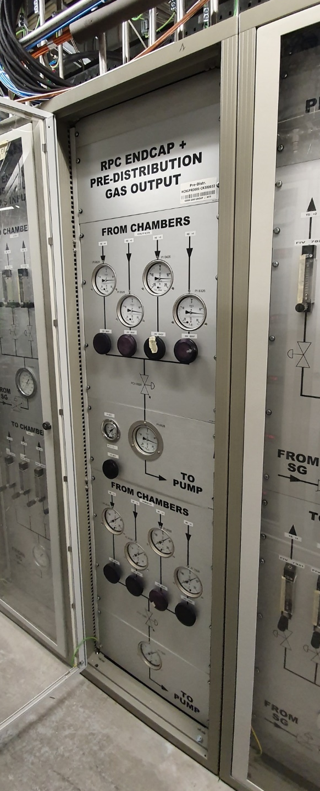
CMS-RPC Regulation valves
Manual valves in Pre-Distribution Output
Equalize pressure between different detector zones
Detector pressure regulation is done basing on sensors at rack level
→ Weight of hydrostatic column is not taken into account
→ Particularly critical during filling and emptying phase

Slide 3
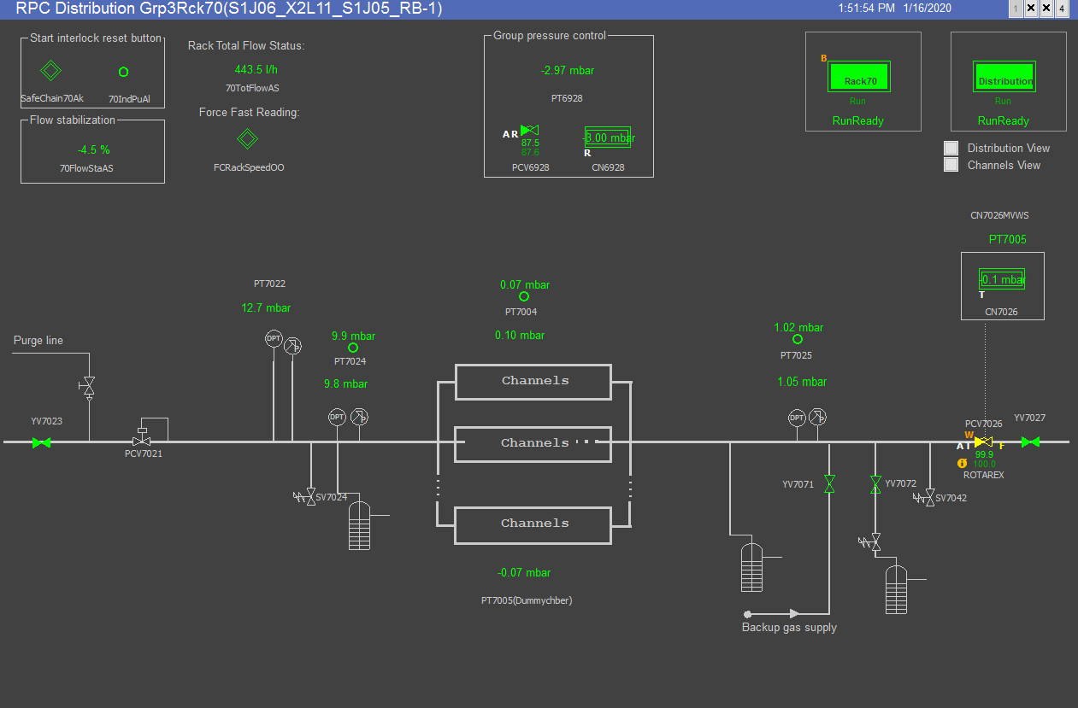
New regulation valves
Replacement of manual valves for better and automated regulation
→ LAB Characterization
→ Test in USC

Slide 4
Valves List
 | VALVE | TYPE/description | FEEDBACK | COST [CHF]
1 | ROTAREX | MANUAL | NO | 100
2 | ROTAREX WITH GULEX MOTOR | ACTUATED MANUAL | YES | 1400
3 | ASCO DN4 | SOLENOID | YES* | 440
4 | ASCO DN15 | SOLENOID | YES* | 320
5 | ASCO DN20 | SOLENOID | YES* | 315
6 | BURKERT 8mm | SOLENOID | NO | 420
7 | BURKERT 9.5mm | SOLENOID | NO | 340
8 | BURKERT 12 | SOLENOID | NO | 780
10 | BURKERT 12S | SOLENOID | NO | 500
11 | RESOLUTIONAIR | PINCH VALVE *(control: PWM+DIGITAL BINARY) | NO | 1300
12 | BRONKHORST F004 | SOLENOID *(control 70-190 mA) | YES | 1460
13 | FESTO | ELECTROPNEUMATIC Pinch valve | NO | 710
14 | FESTO | ELECTROPNEUMATIC Boisseau sphérique asservie par un contrôleur | NO | 620
15 | ECONEX | ELECTRO ACTUATED | NO | 500
16 | VON ROHR | ELECTROPNEUMATIC | YES | 3300
In the market do not exist valves with our requirements
Mostly classic control signal: 4-20mA
Many of them designed for higher pressure applications → difficult regulation in low pressure ranges
Silicon free
Aging test passed

Slide 5
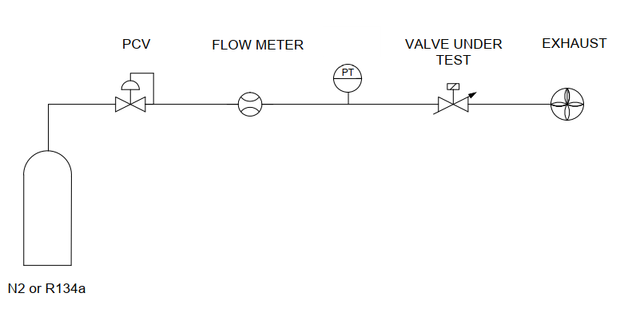
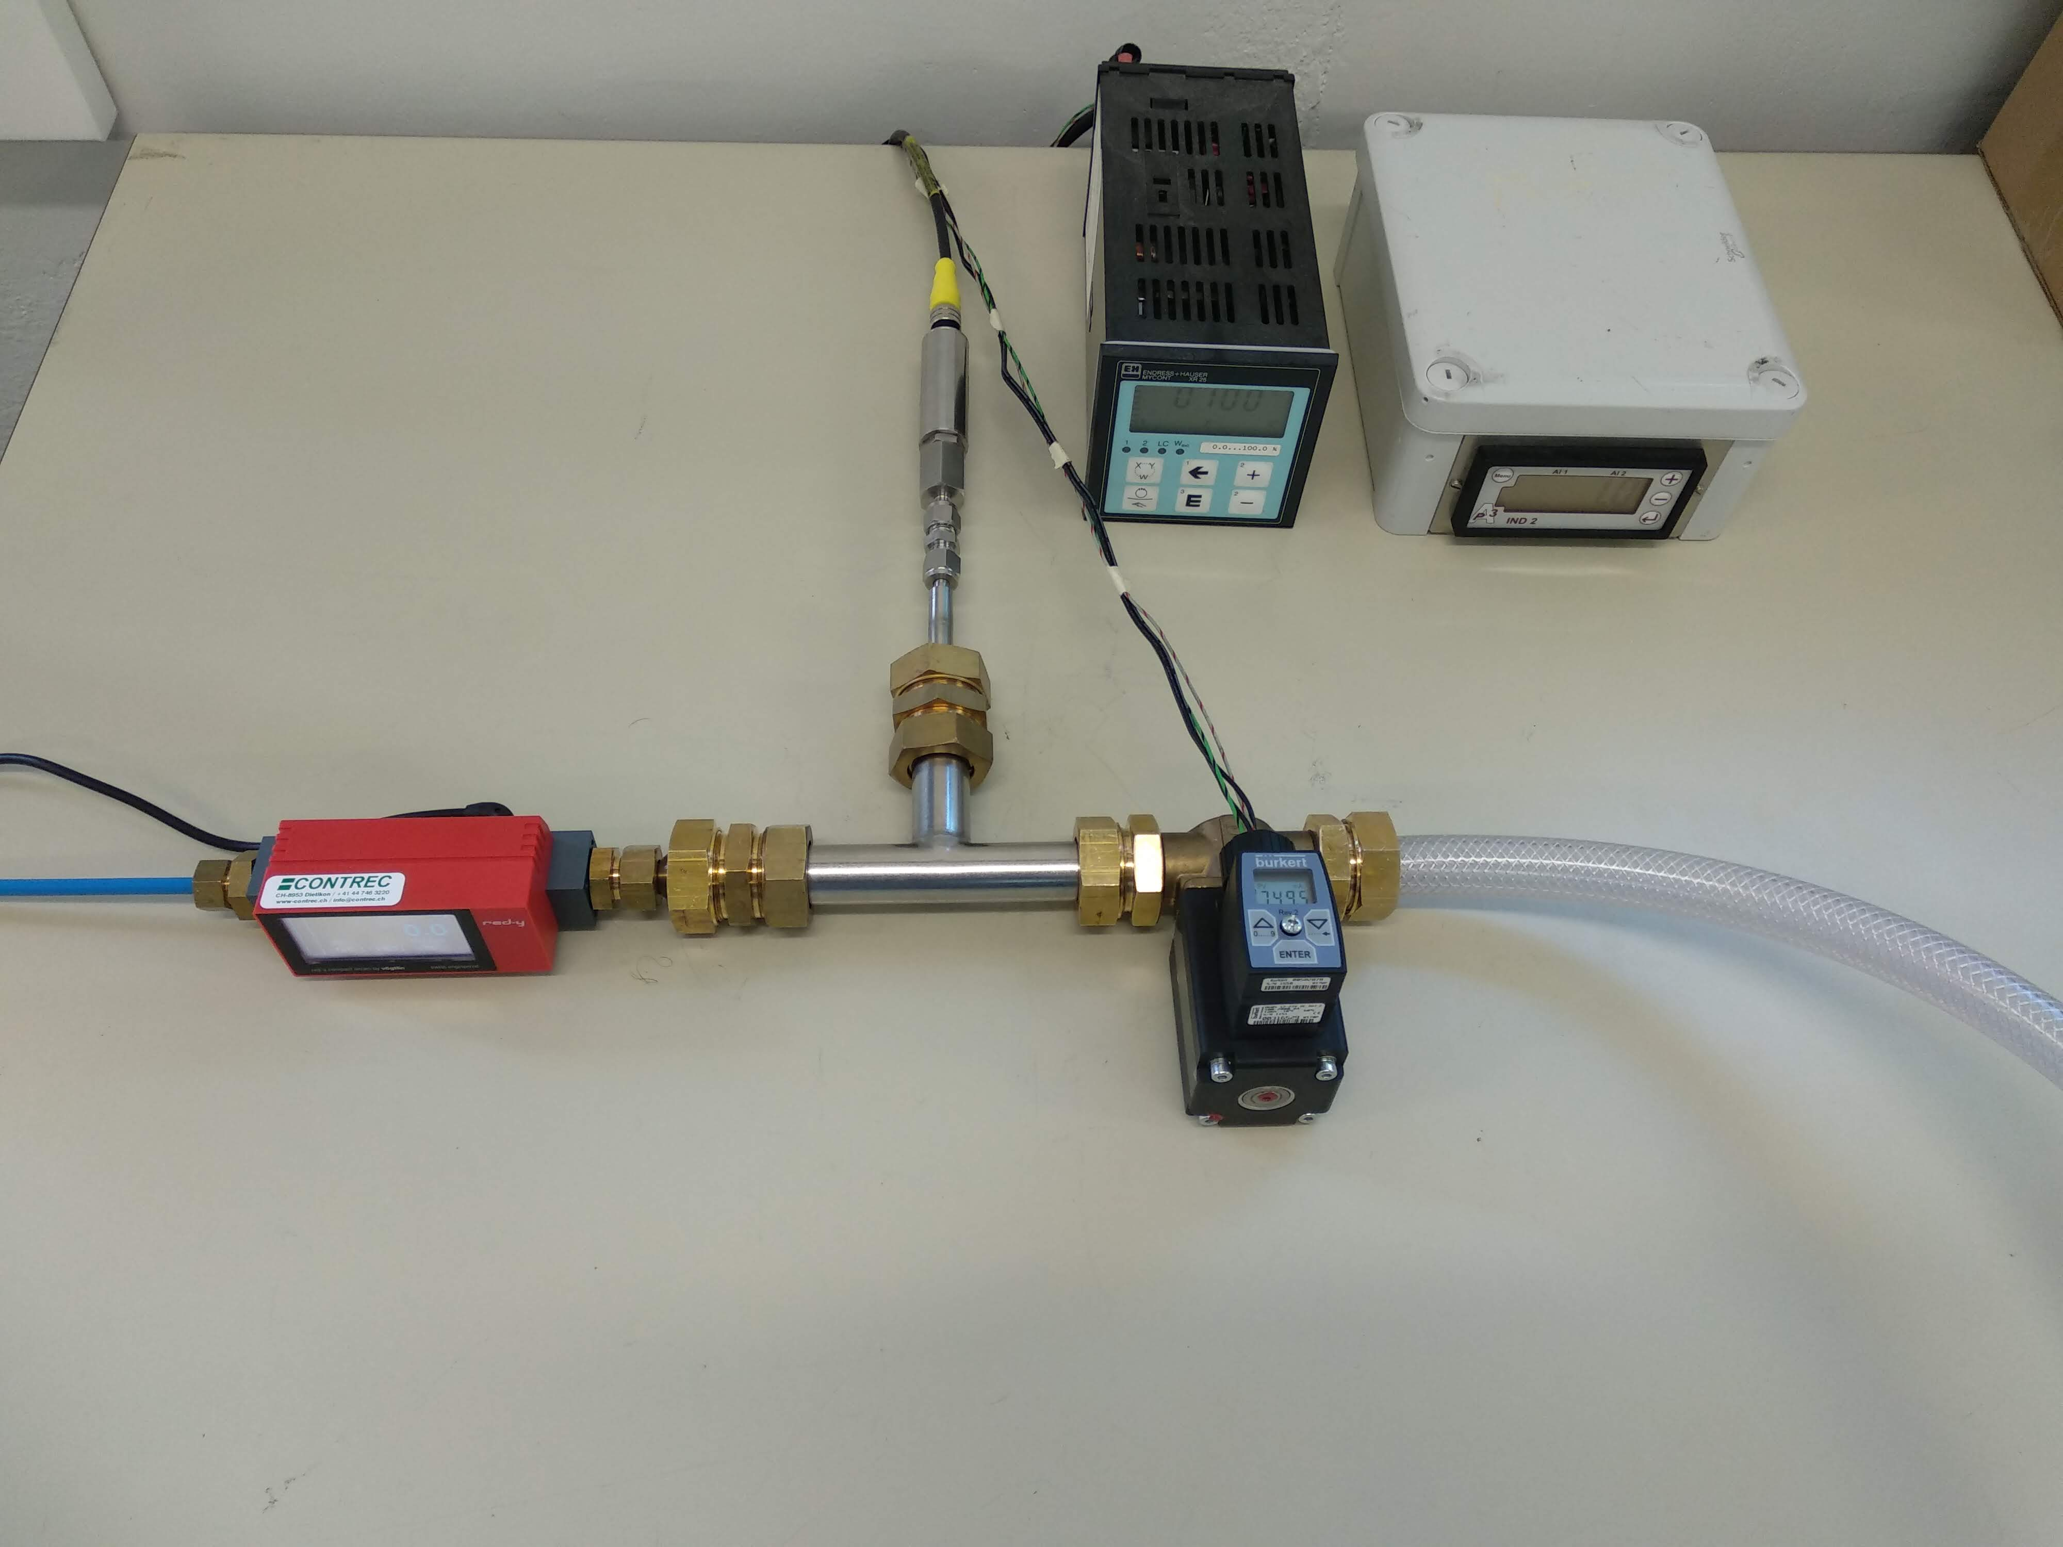
LAB Test Setup
Flowmeter
Pressure sensor
Tested Valve
Pressure reading
Controller
5
4
2
1
3

Slide 6
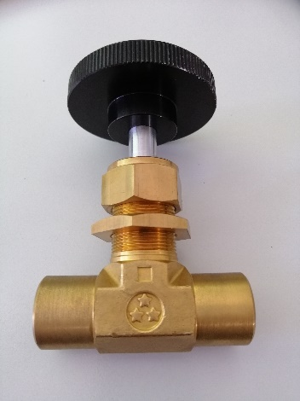
Manual Valve
Currently installed
Used as reference

Slide 7
Notes:
Aggiungi valvole mancanti

Slide 8
Installed valves

Slide 9
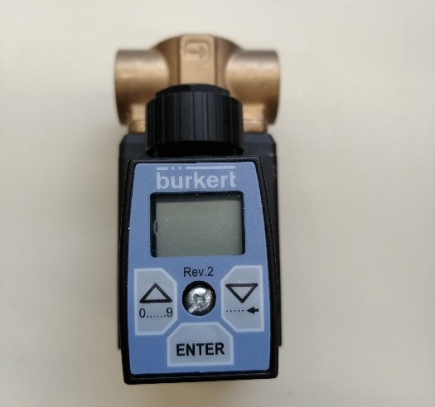
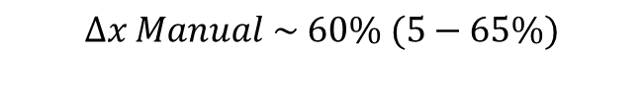
Comparison Burkert VS Manual
$$∆x Manual \sim 60\% (5−65\%)$$

Slide 10
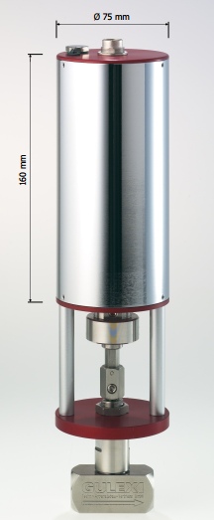
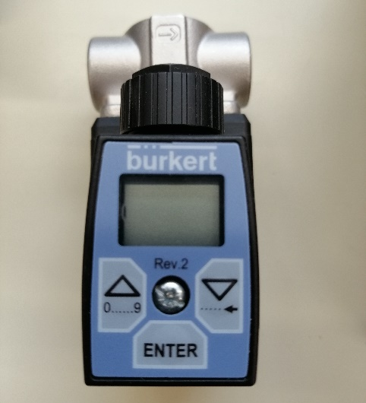
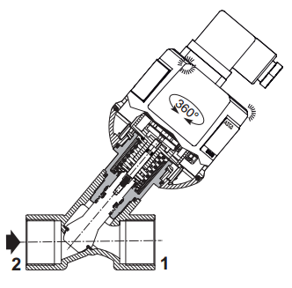
What’s installed in USC
Burkert 8mm
Burkert 9.5mm
ASCO DN20
ROTAREX MANUAL VALVE WITH GULEX ELECTRIC MOTOR
1
2
3
VALVE | WHERE | TYPE | FEEDBACK | COST [CHF]
BURKERT 8mm | BARREL 74 (RB-2 top) | SOLENOID | no | 420
BURKERT 9.5mm | BARREL 69 (RB-2 bottom)
 |  |  |  | 340
ROTAREX WITH GULEX MOTOR | BARREL 70 (RB-1 bottom) | ACTUATED | yes | 1400
ASCO DN20 | ENDCAP 83 | SOLENOID | yes | 315
4

Slide 11
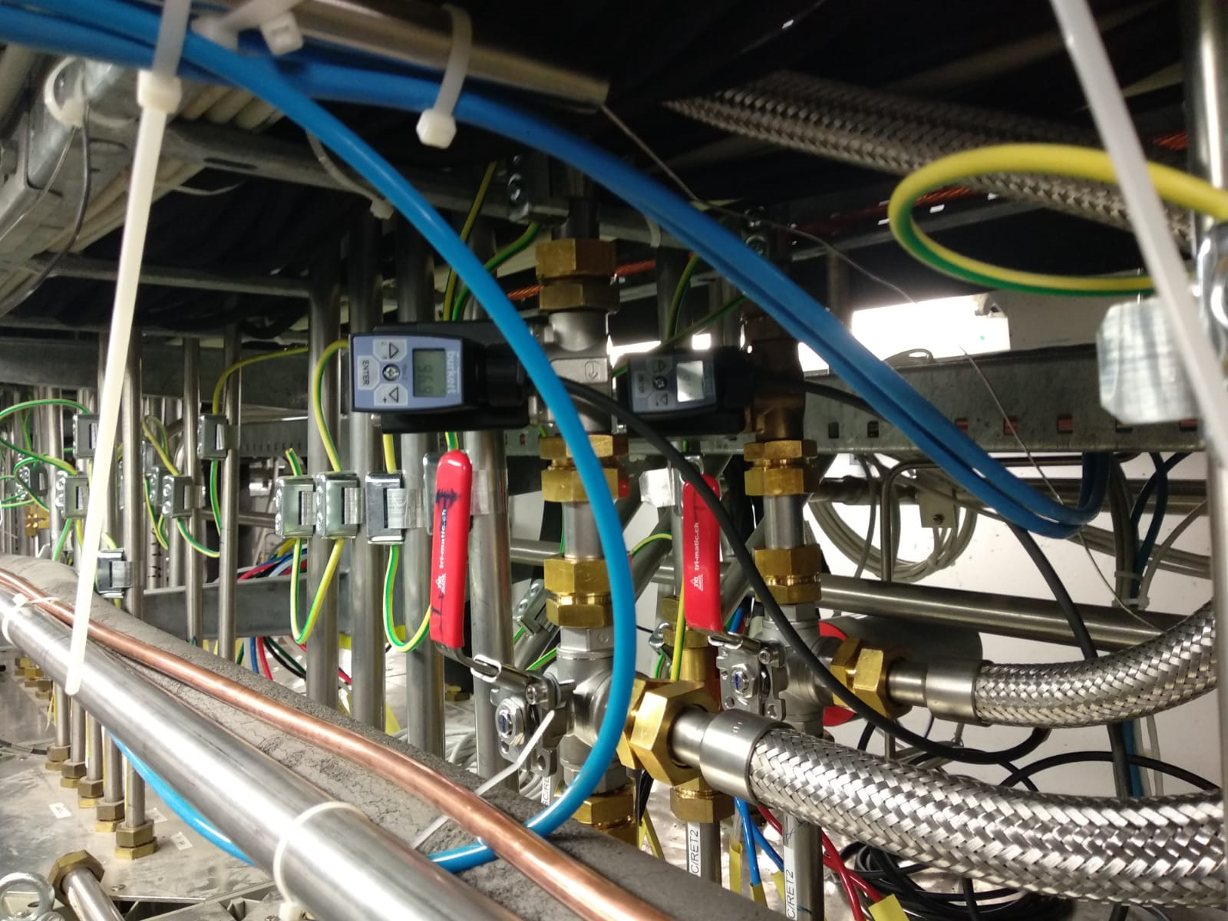
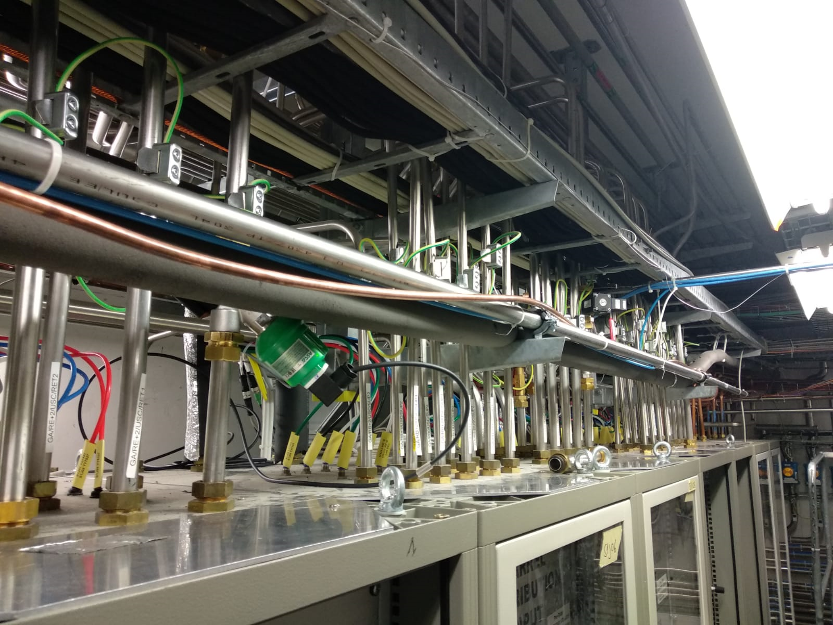
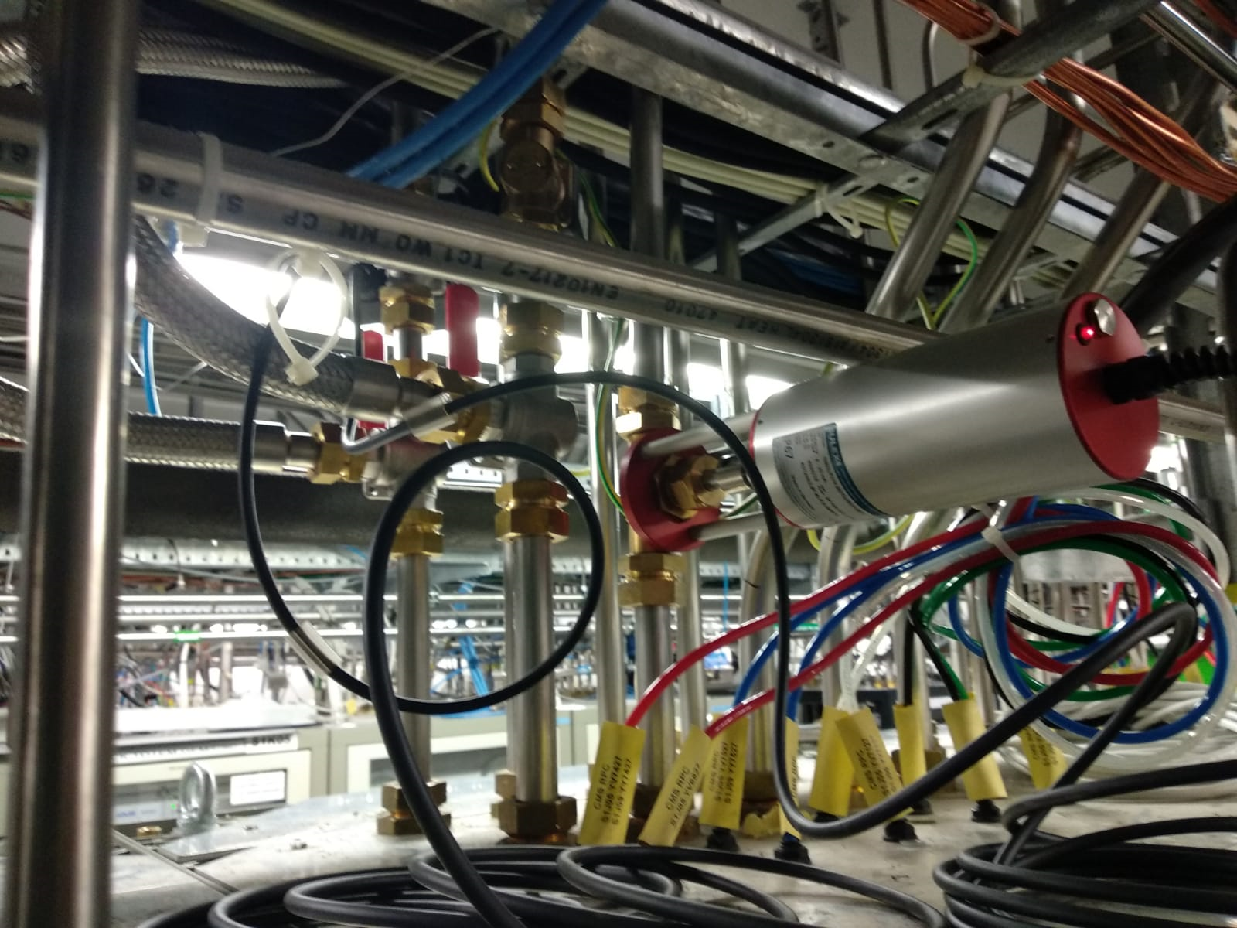
Installation in USC
1&2
Rack 69 & 74
3
4
Rack 83
Rack 70

Slide 12

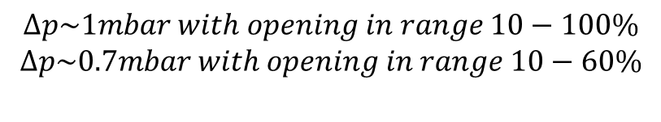
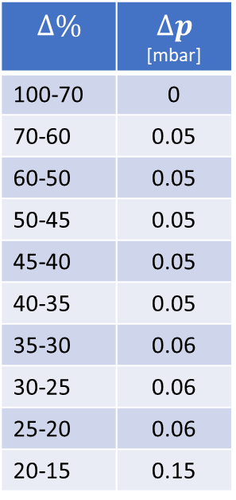
First tests on the real systems
$$Flow \sim 407 l/h$$
$$∆\%$$ | $$∆p$$ [mbar]
100-70 | 0
70-60 | 0.05
60-50 | 0.05
50-45 | 0.05
45-40 | 0.05
40-35 | 0.05
35-30 | 0.06
30-25 | 0.06
25-20 | 0.06
20-15 | 0.15
$$∆p\sim 1mbar with opening in range 10−100\%$$
$$∆p\sim 0.7mbar with opening in range 10−60\%$$
Notes:
Limited at 15%

Slide 13

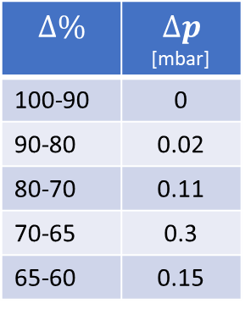
First tests on the real systems
$$Flow \sim 530 l/h$$
$$∆\%$$ | $$∆p$$ [mbar]
100-90 | 0
90-80 | 0.02
80-70 | 0.11
70-65 | 0.3
65-60 | 0.15
$$∆p\sim 0,5 mbar with opening in range 60−100\%$$
Notes:
Limited at 50%

Slide 14

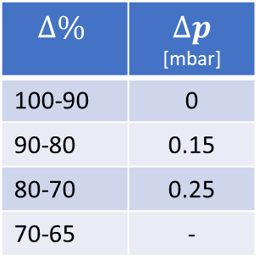
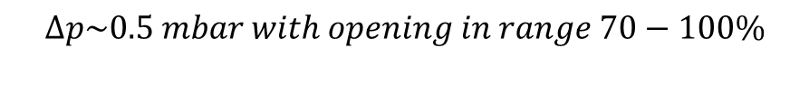
First tests on the real systems
$$Flow \sim 480 l/h$$
$$∆\%$$ | $∆p$ [mbar]
100-90 | 0
90-80 | 0.15
80-70 | 0.25
70-65 | -
$$∆p\sim 0.5 mbar with opening in range 70−100\%$$
Notes:
Limited at 53%

Slide 15
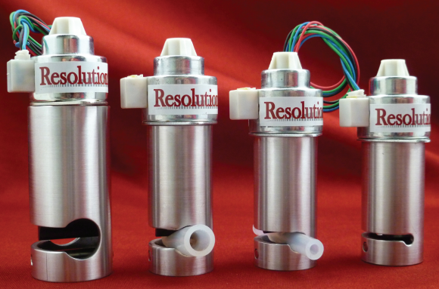
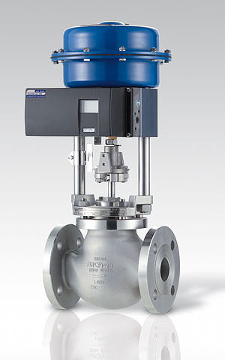
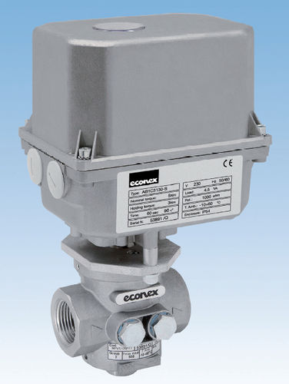
Next steps
1
Other tests in USC
Auto regulation on dummy chambers
Different pressure and flow conditions
Regulation with manual valves completely open
Other valves still under discussion/test
1. Resolution air pinch valve
Von Rohr
Econex
2
3

