Slide 1

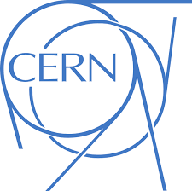
Collaboration between
PAEC and MEDICIS at CERN
CERN MEDICIS BOARD Meeting
Feb 20, 2020

Slide 2
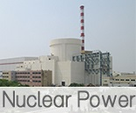
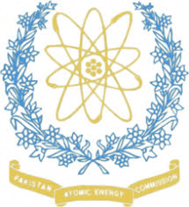


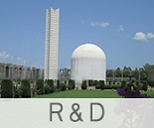
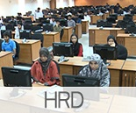
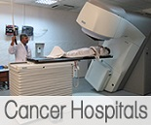
PAKISTAN ATOMIC ENERGY COMMISSION
(PAEC)
Nuclear Power Generation
Engineering
Agricultural and Biotechnology
Research and Development
Human Resource Development
Cancer Hospitals (Nuclear Medicine & Radiotherapy Institutes)

Slide 3
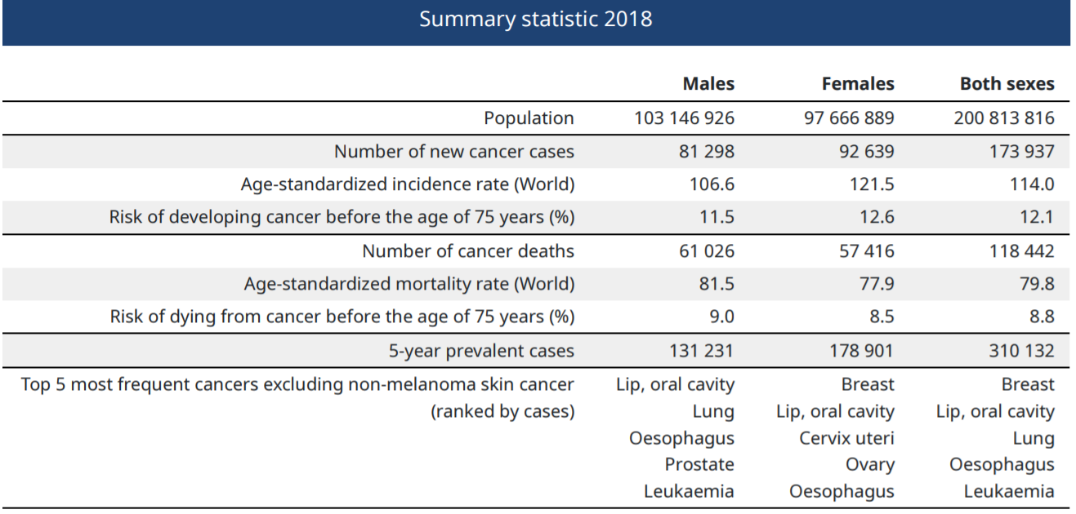
Pakistan & Cancer Statistics
Total Population 220 million
Estimated New Cancer cases/yr >173K
People dying from cancer /yr: >118K
Data from IARC GlobalCan (2018)

Slide 4
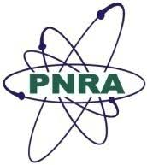
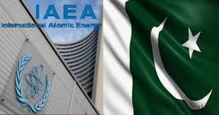

Pakistan and Nuclear Medicine
In Pakistan, nuclear medicine services are delivered under the Pakistan Nuclear Regulatory Authority (PNRA)
Guided by the principles laid down by the International Atomic Energy Agency (IAEA)

Slide 5
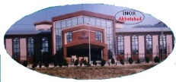
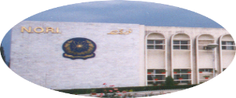
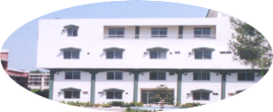
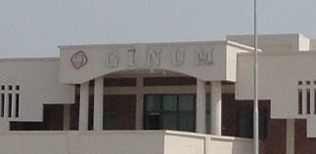
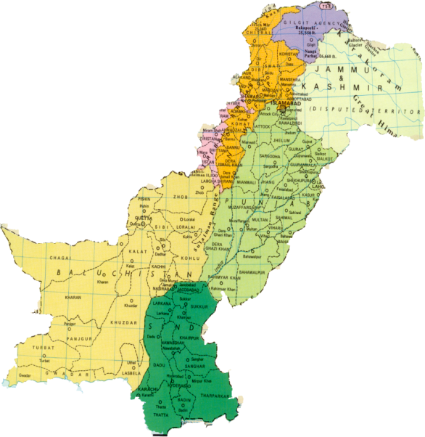
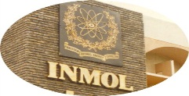
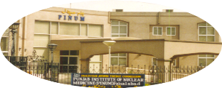
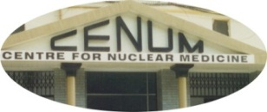
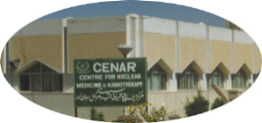

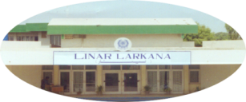

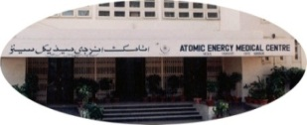

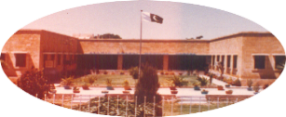
Nuclear Medicine Institutes / Departments in Pakistan
51 Nuclear Medicine Setups
Current Situation
INOR
Abbottabad
NORI
Islamabad
GINUM
Gujranwala
PAEC*
19 (NM & RT)
SINOR
IRNUM
Peshawar
INMOL
Lahore
BINOR
PINUM
Faisalabad
Public/private sector
28
DINAR
CENUM
Lahore
CENAR
Quetta
MINAR
Multan
Armed Force Institutes
04
LINAR
Larkana
BINO
Bhawalpur
NORIN
AEMC
Karachi
NIMRA
Jamshoro
KIRAN
Karachi
Notes:
Pakistan Atomic Energy Commission (PAEC) is the largest single contributor with 18 centers spread across the length and breadth of the
country, including some remote cities. In

Slide 6
Nuclear Medicine--Human Resources
Nuclear Physicians | 134
Medical Physicists | >30
NM Technicians | >130
Radiopharmacists / Radiochemists | >10
Notes:
190 Pakistani NM physicians

Slide 7
NM Main Medical Equipment
  Gamma camera >100
  SPECT-CT 10
  PET-CT Scanner 07
  Cyclotron 05

Slide 8
Developing Theranostics and its Clinical Applications in Pakistan
Iodine-131 therapy for thyroid cancer and hyperthyroidism----widely available across Pakistan
Pakistan’s first theranostic laboratory----at INMOL hospital (PAEC), in Lahore with support from IAEA.
Another Centre for Theranostics---NORI, Islamabad

Slide 9
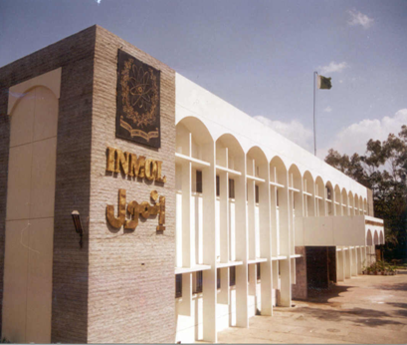
Institute of Nuclear Medicine & Oncology (INMOL), Lahore
The largest & the most equipped medical center
Clinical Work
  Nuclear Medicine – OPD & Indoor
  Oncology Services – OPD & Indoor
Post-graduate Training
Research & Development
Notes:
Among one of the 18 NM Centers of PAEC is

Slide 10
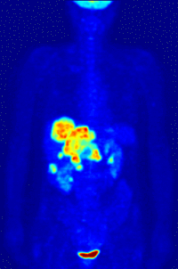
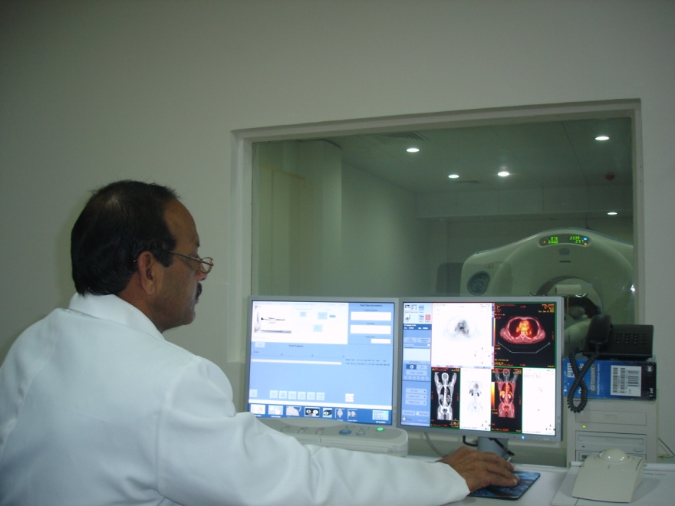
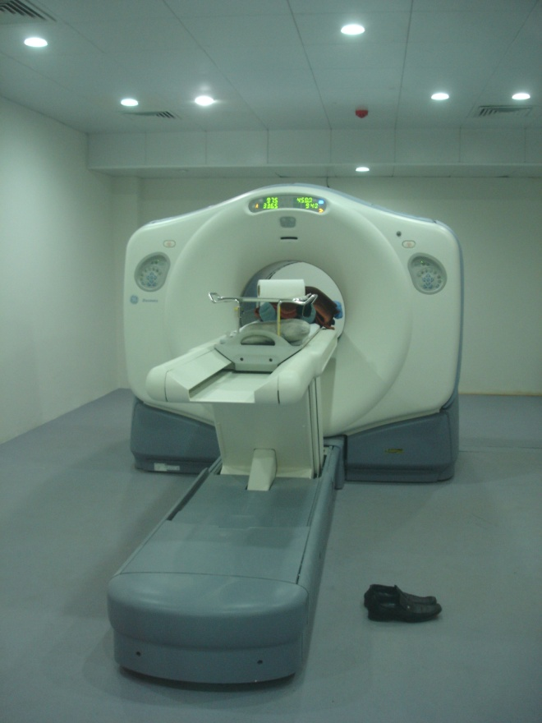
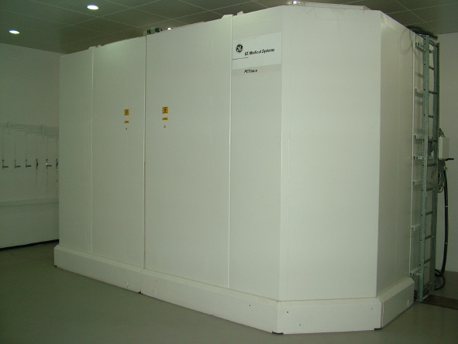
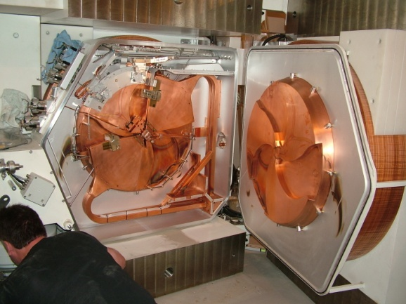
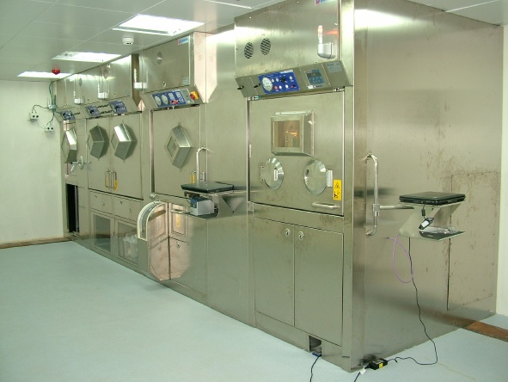
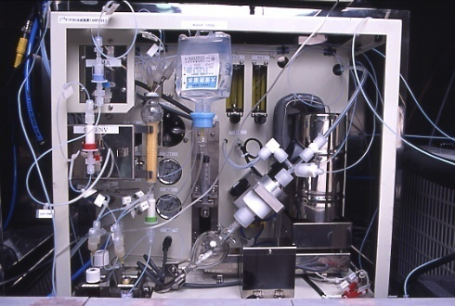
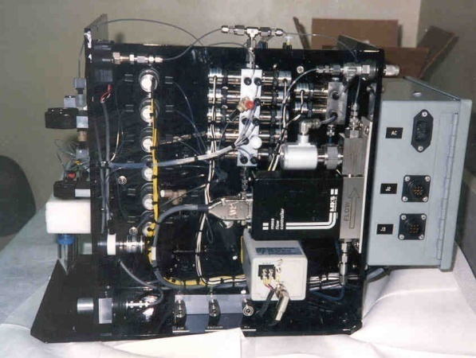
PET-CT & Cyclotron INMOL
PET scanner with 16 slice CT
F-18, C-11, O-15, N-13 and
GE PETrace 8
16.5 MeV
Self shielded
cyclotron
8.0 Ci EOB 18F
production

Slide 11
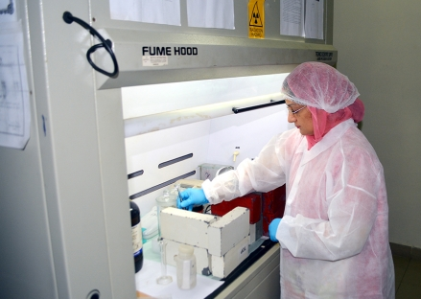
Facilities Available - Summary
Cyclotron
Access to Ga-68, Lu-177, Cu-64, Ac-225 and Y-90
PET Scanner and SPECT Cameras
CT Scanner and MRI
Two Analytical HPLC
Three Hot cells, Automated Dispensing
Gas Chromatography
Zeta Sizer, UV-Vis, FT-IR
Rotary Vaporator
Lyophilizer and Freeze Dryer
Dissolution Apparatus
Thermomixer, Vortex Mixer, pH meter, Balances, etc.

Slide 12
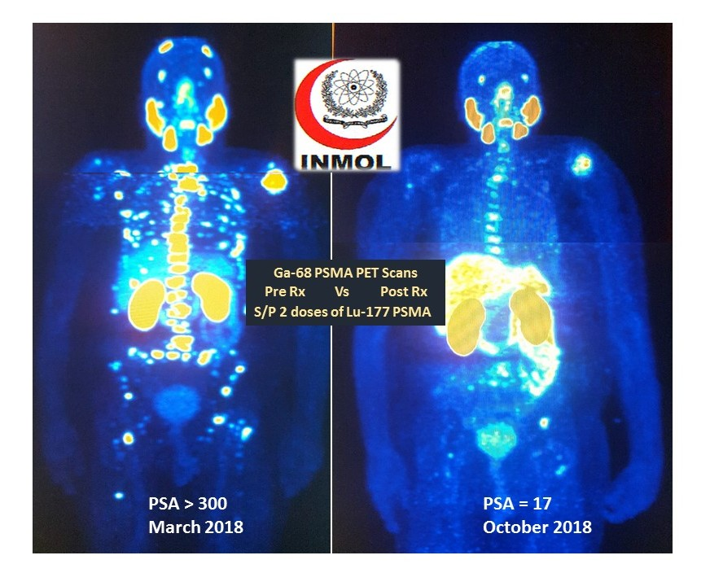
Theranostics at INMOL
I-131 therapy
Ga-68 PSMA and Lu-177 PSMA
Ga-68 Dota Tate and Lu-177Dota Tate
Ac-225 PSMA---3 patients

Slide 13
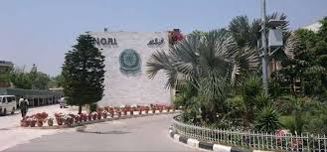
Nuclear Medicine Radiotherapy Institute (NORI), Islamabad
Nuclear Medicine, Oncology, Radiology, Medical Physics & Pathology Facilities
Nuclear Medicine Department
  3 Dual Head Gamma Cameras
    2 Dual Head
    1 SPECT CT
    Gamma probe
    DEXA Machine
In Pipeline:
    PET-CT, Cyclotron

Slide 14
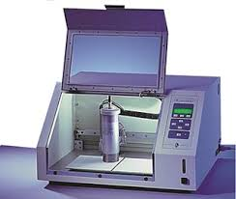
Radiopharmcy at NORI
Level 2b
Dose Calibrators
ITLC Scanner
Will be upgraded to 3c in1-2 year
  Cyclotron production of
    F-18
    G-68
    Synthesis of F-18 –Ga68 based RPs
  Full fledged PET QC Lab

Slide 15
Facilities at NM Department of NORI
Diagnostic Nuclear Medicine
Therapeutic Nuclear Medicine
  Conventional NM Procedures (> 10k procedures/year)
  Hybrid Imaging (SPECT-CT) (2000 /year)
  PET-CT (will be functional in 1-2 years)
I-131 Treatment for Thyroid Ca and Hyperthyroidism
  Bone pain Palliation
      P-32
      Lu-EDTMP
  I-131 MIBG therapy for Pheochromocytoma
  Peptide Receptor Therapy with Lu-177 Dotatate
  Lu-177 PSMA Therapy

Slide 16
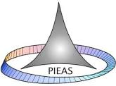
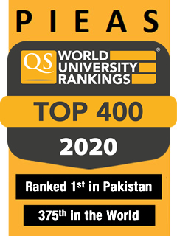
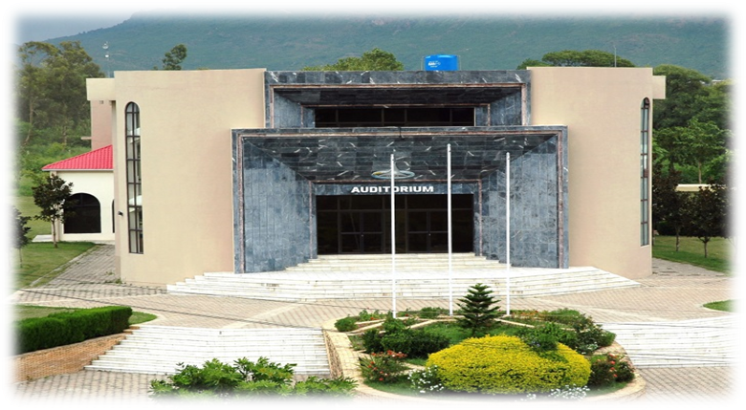
Pakistan Institute of Eng & Applied Sciences (PIEAS)---Human Resource
Multidimensional public sector university working under the umbrella of Pakistan Atomic Energy Commission (PAEC).
Highly qualified faculty matched with excellent infrastructure---- high quality education in the disciplines of engineering and applied sciences including nuclear science & technology
Academic Programmes in Radiation Medicine:
  M.Sc. Nuclear Medicine
  M.Sc. Radiation and Medical Oncology
  MS Medical Physics
  Ph.D Nuclear Medicine

Slide 17
Facility Available at PIEAS
Available
Complete Organic Synthesis Lab
Rotary Evaporator
Hot Lab
Radiation Safety Equipment
Gas Chromatography System
Gamma Camera (Orbiter)
Ready to Deliver
Purchase In progress
Radio-TLC System
Automatic Gamma Counter
Freezer Dryer
Centrifuge Machine
Radiopharmaceutical Clinical Gamma Camera
Laboratory
Radio-HPLC
Dual Head SPECT Gamma Camera

Slide 18
PIEAS—Future Plans
Synthesis of clinically important peptides, chelator, bioconjugate linkers for radiopharmaceutical synthesis
Protein based radiopharmaceutical synthesis
Monoclonal antibody base radiopharmaceuticals
Characterization and quality control of radiopharmaceuticals
Preclinical data including pharmacokinetics and imaging study
Clinical Studies
Sharing of data and information

Slide 19
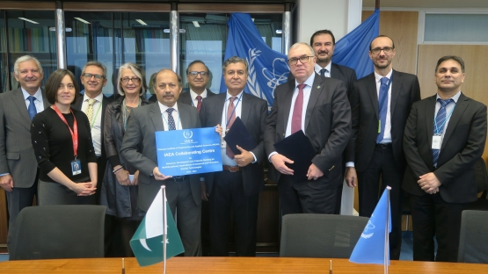
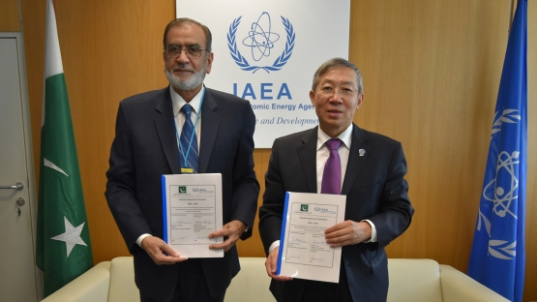
IAEA Projects
PAEC NM Physicians, Oncologists , Radiopharmacists, Medical Physicists are involved in:
    IAEA Technical Cooperation Projects on Radioistopes
    IAEA Coordinated Research Projects on Radioisotopes
    PIEAS is a New IAEA Collaborating Centre in Pakistan to assist in Applications of Nuclear Technologies.

Slide 20
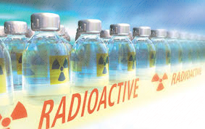
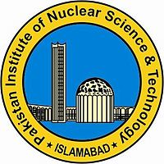
Radioisotopes & Radiopharmaceuticals in Pakistan
Isotope Production Division (IPD)
Pakistan Institute of Nuclear Science & Technology(PINSTECH), Islamabad
December 21, 1965

Slide 21
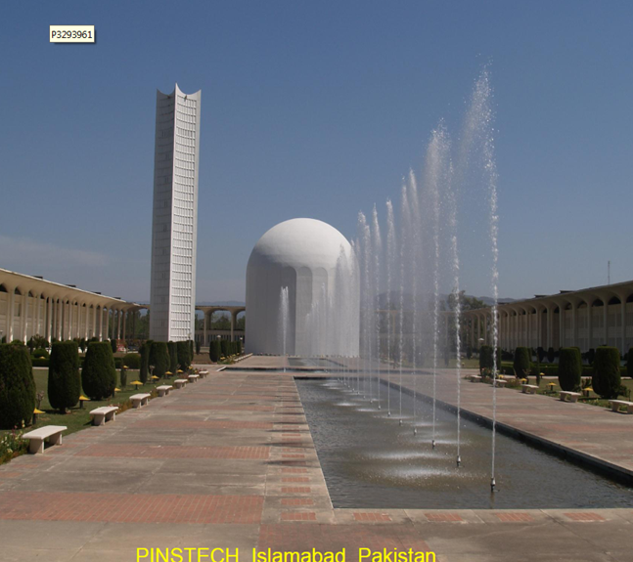
Pakistan Institute of Science & Technology (PINSTECH) (R&D Institute)
Pakistan Research Reactors (PARR-1 and PARR-2)
PARR-3 ---in 3 years time
Isotope Production
Isotope Application
Material Sciences and Development
Linear Accelerator Development
Nuclear Engineering
Health Physics and Environmental Monitoring
Radioactive Waste Management Facility
Central Analytical Facility

Slide 22
Isotope Production Division
Molybedenum-99 Production
Tc-99m Generator Production
I-131 Production
Freeze Dried Kits and Adenosine
P-32 Production

Slide 23
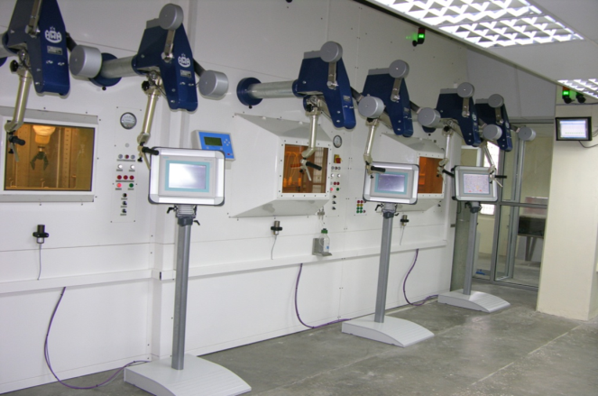
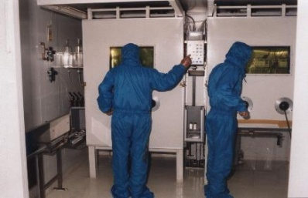
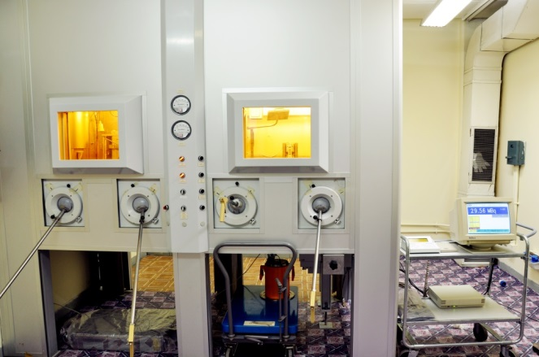
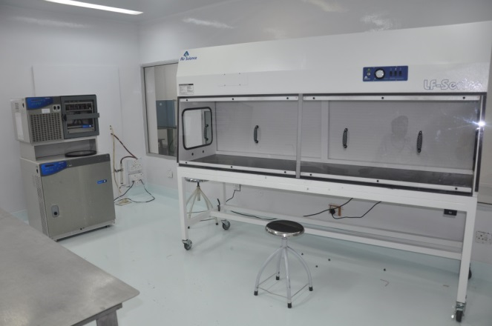
Isotope Production Division Facilities
Mo-99 Production Facility
TC-99m Generator Facility
Iodine-131 Facility
Clean Room Facility
Well Equipped Quality Control Lab

Slide 24
Facilities Available at PINSTECH
Pakistan Research Reactor (PARR-I) 10 MW, maximum thermal neutron flux ~ 1.5x10¹⁴ n.cm⁻².s⁻¹
Pakistan Research Reactor (PARR-II) 30 kW, maximum thermal neutron flux ~1x10¹²
Lead shielded hot cells (HWM Walischmiller/ITD Germany) for the production of indigenous fission ⁹⁹Mo
Loading Facility (IZOTOP Hungary) for the production ⁹⁹Mo /^{99m}Tc Generators
Lead shielded hot cells (HWM Walischmiller Germany) for the production of Sodium Iodide (¹³¹I ) solution

Slide 25
Facilities Available at PINSTECH
Contd..
Phosphorus-32 Production Cell (AECL, Canada, 10 Ci Capacity)
Fume Hoods (14)
Clean laboratory for the preparation of diagnostic freeze dried kits
Quality control laboratories equipped with multichannel analyzer, HPGe’s, HPLC, electrophoresis, 2 π scanner and paper chromatography, laminar flow cabinet etc.
Animal house for biological quality control

Slide 26
Contd..
Facilities Available at PINSTECH
Fume Hoods and Glove Boxes (for small scale production of different Radionuclides and R&D work)
Workshop for target preparation and sealed source fabrication
Laboratories for determination of radionuclidic, radiochemical and biological purity

Slide 27
Diagnostic Freeze Dried Kits Produced in IPD
DTPA (Diethylene Triamine penta Acetic acid)
MDP (Methylene Diphosphonic acid)
MIBI (Methoxy Isobutyl Isonitrile)
DMSA-III (Dimercapto Succinic acid)
HG, HEPTAGLUCONATE (Calcium Heptagluconate)
Phytate (Sodium Phytate)
MAG-3 (Mercapto Acetyl Tri-glycine)
DISIDA (2,6 Di-isopropyl Phenyl Carbamoyl Imino-diacetic acid)
PYROPHOSPHATE (Tetra Sodium Pyrophosphate)
DEXTRAN
Adenosine (9-β-D-Ribofuranosyladenine)

Slide 28
R&D in Isotope Production Division
Radiochemistry development and process parameter optimization for fission Mo-99 separation
I-131 separation for fission products
Xe isotopes separation and trapping system
Ruthenium carries development and optimization for Mo-99 purification

Slide 29
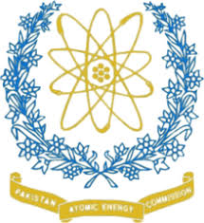
Proposed Collaboration between
PAEC and CERN (ISOLDE/MEDICIS)

Slide 30
Preamble
Proposed project will facilitate introducing new and novel medical radioisotopes in Pakistan
MEDICIS at CERN is a unique facility in the world which has the capability and capacity to produce wide range of radioisotope
Collaboration with MEDICIS will boost Pakistan capability to use new radioisotopes for improving cancer management

Slide 31
Project Significance
Rapid growth and research in the development of new theranostic radiopharmaceuticals for the management of cancer.
Pakistan with high cancer mortality and morbidity want to take advantage of the new theranostic radionuclides for the management of cancer patients.
Efforts are in progress to escalate the novel field applications in Pakistan in line with rest of the world.

Slide 32
Background
Pakistan & CERN
An associate member of CERN,
Has been participating actively in diversified experiments/projects at CERN.
PINSTECH
One Engineer - at MEDICIS for 1 yr
Established radiochemical purification setup
Another PINSTECH engineer may likely to start his assignment at MEDICIS
PAEC&ISOLDE-MEDICIS
2017- addendum for mutual cooperation

Slide 33
Objectives
Co-Production of novel radisotopes like Ac-225, Tb-155, Tb-161, Cu-64, Cu-67 etc. in collaboration with MEDICIS
Tb-161 can also be produced jointly at research reactor in Pakistan.
Labeling of radioisotopes with suitable chemical compound for:
Pre-Clinical Studies
Clinical Trials
Clinical Studies

Slide 34


Key Stakeholders
Pakistan Institute of Nuclear Science & Technology (PINSTECH)
Pakistan Institute of Engineering and Applied Sciences (PIEAS)
Nuclear Medical Centers
(INMOL, NORI)
MEDICIS
MEDICIS

Slide 35

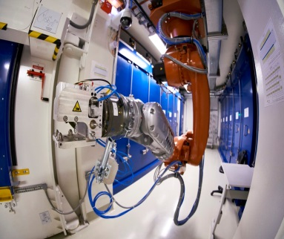
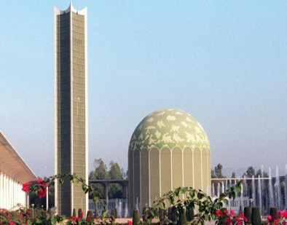
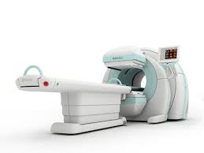
Proposed Project Strategy
Target Preparation & Qualification
Mass Separation
Chemical Processing / Purification
Quality Controls
MEDICIS
Chemical Processing / Purification
Quality Controls
Neutron Irradiation at PINSTECH (if required)
PINSTECH
Radiolabeling, & HPLC Identification
MEDICAL CENTRES & PIEAS
Pre-Clinical Trails
Clinical Trials
Clinical Studies

Slide 36
Execution Plan
An MoU will be signed between PAEC (PINSTECH) & MEDICIS to formally execute the project
PINSTECH team ---coordination, planning between PAEC and CERN (MEDICIS)
PINSTECH will draft the requirements of future isotopes for clinical tests and submit it to the MEDICIS board twice in a year.
PINSTECH will also collect the isotopes from CERN and will perform chemical purification.
PINSTECH

Slide 37
Execution Plan
Radiolabelling:
Ac-225---PSMA, Antibodies
Tb-161---PSMA, Abs, DOTATATE
Tb-155---PSMA, Abs, DOTATATE
Cu-64, Cu 69, PSMA, Abs
MEDICAL CENTRES & PIEAS
Pre-Clinical Trials (Biodistribution Studies)
TB-161, Tb-155 labeled compounds
Clinical Trials (Phase I & Phase II Clinical Trials)
TB-161, Tb-155 labeled compounds
Cu-64, Cu-67 labeled compounds
Clinical Studies
Ac-225 labeled compounds

Slide 38
Contribution to the Project
PAEC—In-kind contribution
  Chemical purification
  Secondement of Radiochemists to MEDICIS
  Expertise in clinical trials
MEDICIS, CERN
  Provision of Radioisotopes for pre clinical and clinical trails

Slide 39


