Slide 2
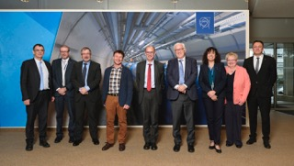

Physical mass separation to foster a new research era based on emerging medical isotopes
PRIS(MAS)-MAP :
PRoduction of hIgh purity iSotopes
by Mass separation for medical APplication

Slide 3
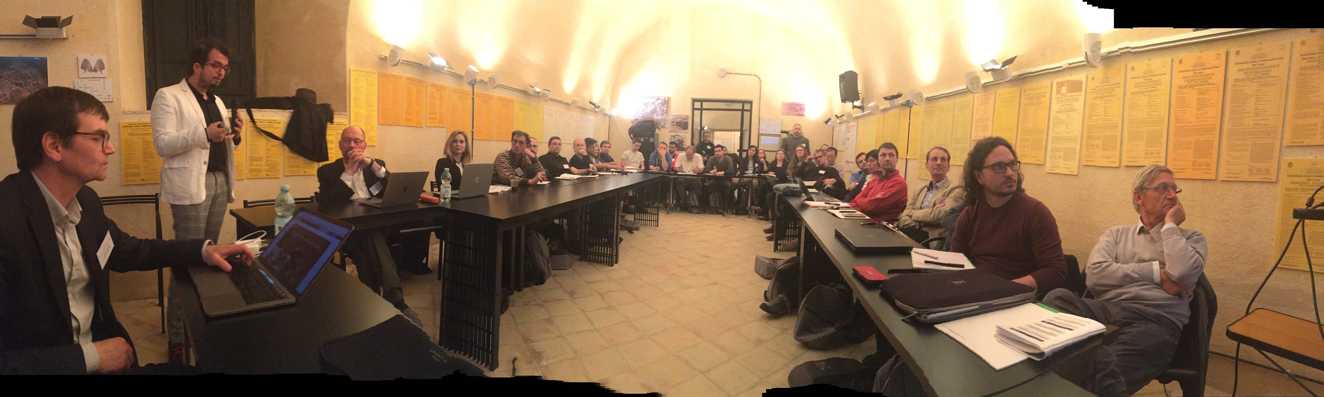
Integrate European Infrastructures for Starting Communities
New research community for nonconventional medical isotope production and research in radiopharmaceuticals and nuclear medicine
Overcome current fragmented landscape of infrastructures
1st Presentation : 3rd MEDICIS Board
Kick off in Erice May 2019
2nd meeting : Sept 2019

Slide 4
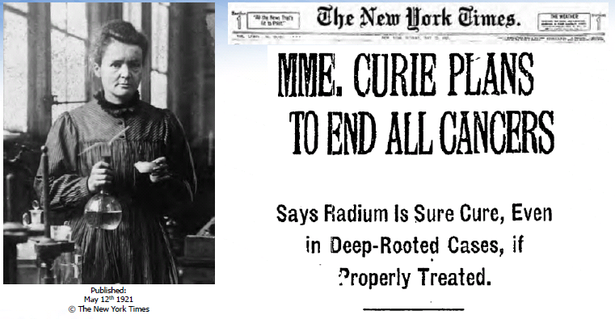
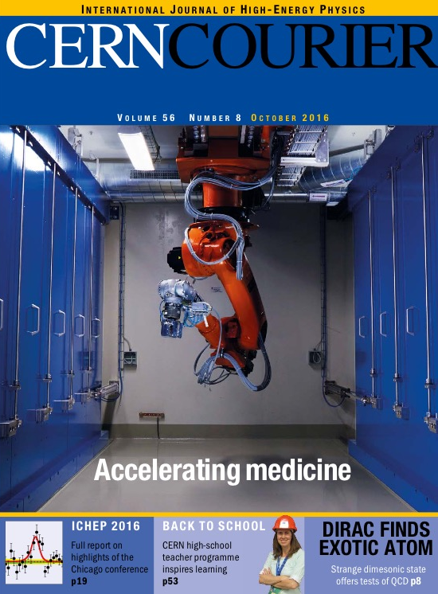
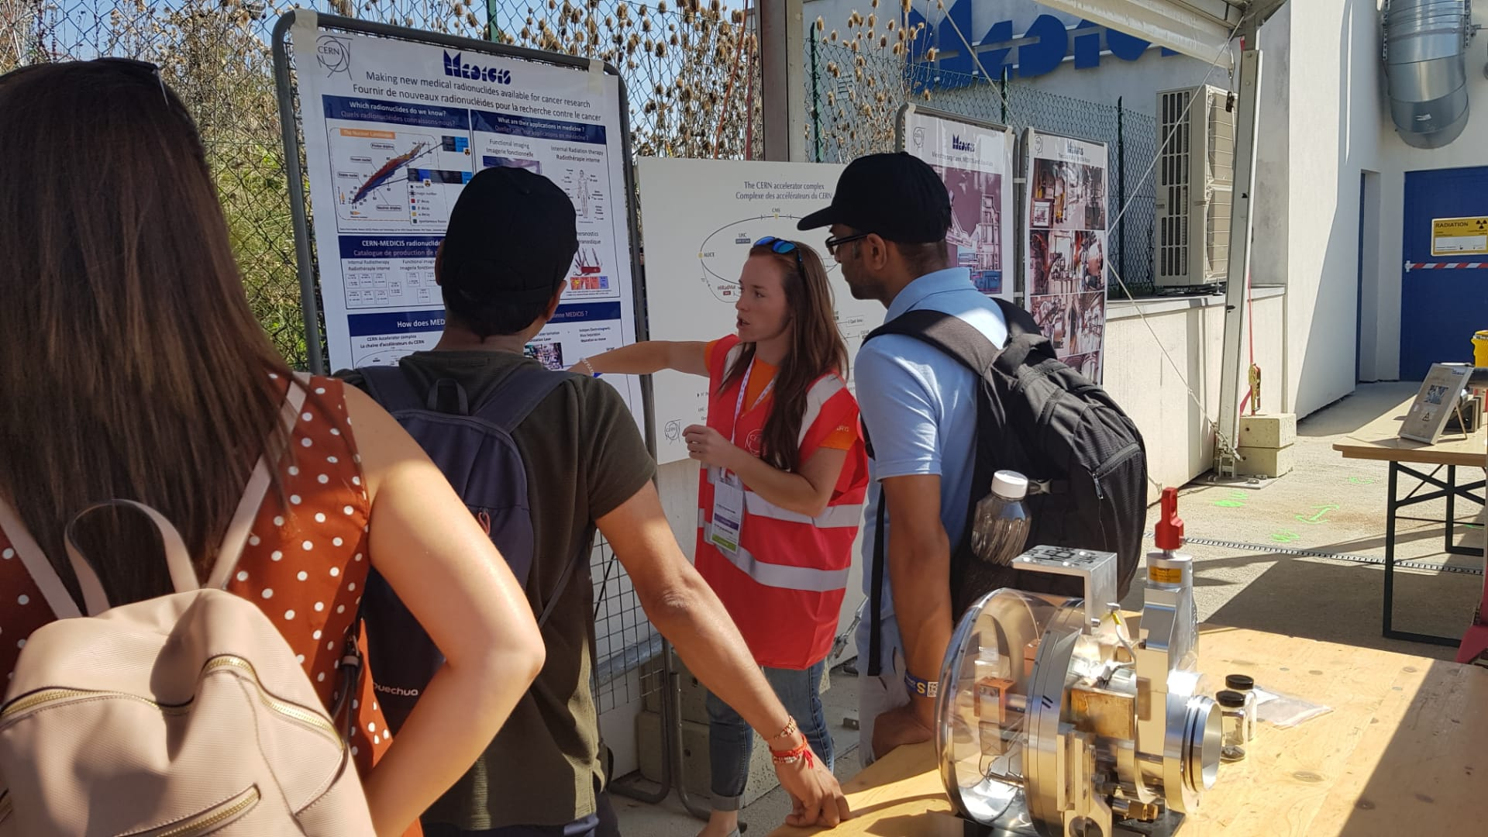
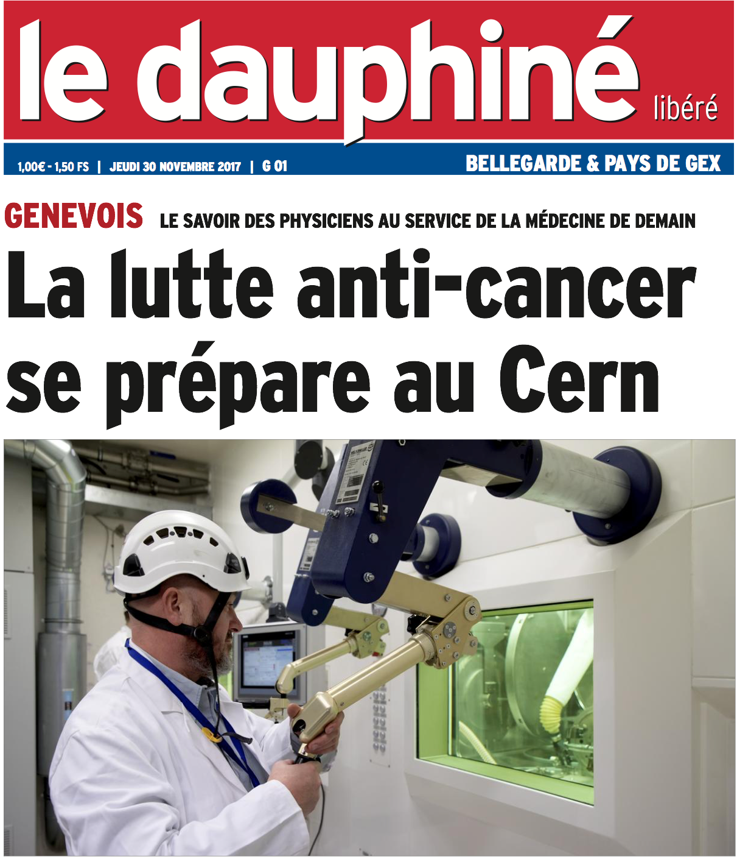
Medical Applications speak to everyone
€, $
Physics & Chemistry Nobel Prizes
Time
Economics, Innovators
Accelerator Labs Worldwide
(eg PSI, TRIUMF ),
You Today !
Helene Langevin-Joliot at MEDICIS,
professor in nuclear physics,
grand-daughter of Marie Curie
Finally Monsieur et Madame tout le monde

Slide 5

It is also a priority for the European Commission
Integrating Activities for Starting Communities ID: INFRAIA-02-2020
Type of action:
RIA Research and Innovation action
Deadline Model: single-stage (100 pages, budget 5 Mi Euros, 4 years)
Deadline: 17 March 2020 17:00:00 Brussels time
Specific Challenge:
European researchers need effective and convenient access to the best research infrastructures in order to conduct research for the advancement of knowledge and technology. The aim of this action is to bring together, integrate on European scale, and open up key national and regional research infrastructures to all European researchers, from both academia and industry, ensuring their optimal use and joint development.

Slide 6
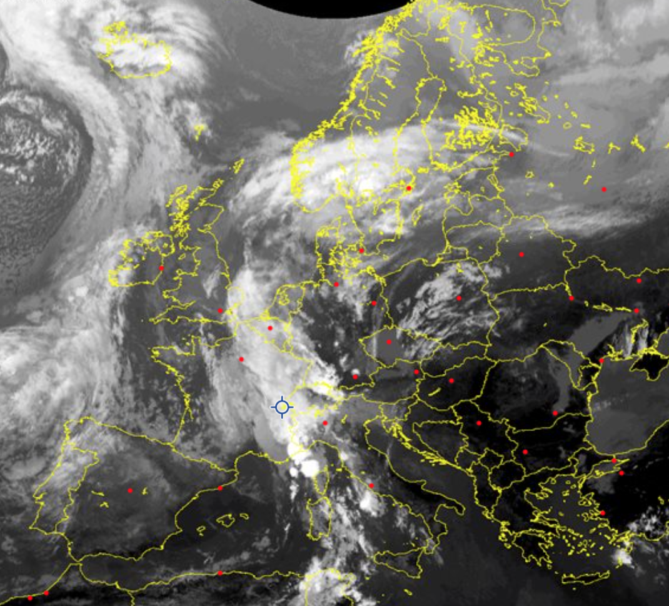
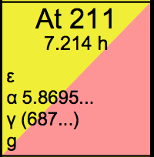
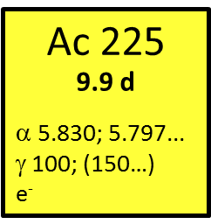
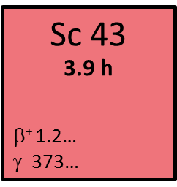
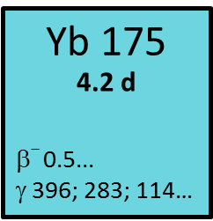
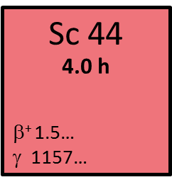
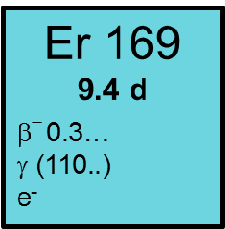
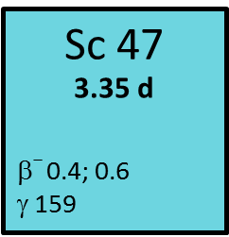


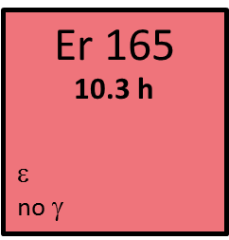


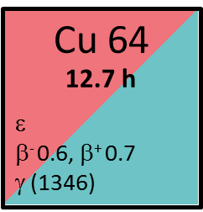











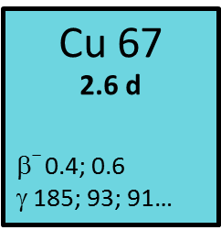

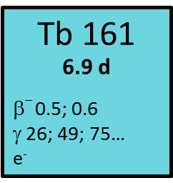


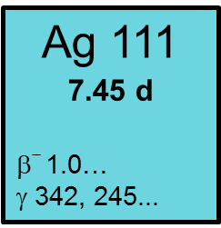
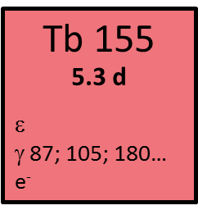
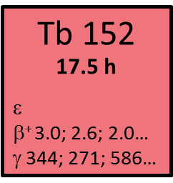
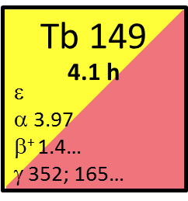
PRIS(MAS)-MAP :
PRoduction of hIgh purity iSotopes
by MAss Separation for Medical Application
Inspired from the NIDC
JRC
JRC

Slide 7
Consortium and foreseen management
No | Participant organisation name | Short name | Country | Organisation type
1. (Coordinator) | EUROPEAN ORGANIZATION FOR NUCLEAR RESEARCH | CERN | CH
2 | NPL MANAGEMENT LIMITED | NPL | UK
3 | PAUL SCHERRER INSTITUT | PSI | CH
4 | COMMISSARIAT A L ENERGIE ATOMIQUE ET AUX ENERGIES ALTERNATIVES | CEA | FR
5 | ASSOCIACAO DO INSTITUTO SUPERIOR TECNICO PARA A INVESTIGACAO E DESENVOLVIMENTO | IST-ID | PT
6 | DANMARKS TEKNISKE UNIVERSITET | DTU | DK
7 | CENTRE HOSPITALIER UNIVERSITAIRE VAUDOIS | CHUV | CH
8 | GRAND ACCELERATEUR NATIONAL D'IONS LOURDS | GANIL | FR
9 | STUDIECENTRUM VOOR KERNENERGIE / CENTRE D'ETUDE DE L'ENERGIE NUCLEAIRE | SCK-CEN | BE
10 | GROUPEMENT INTERET PUBLIC ARRONAX | ARRONAX | FR
11 | HAUTE ECOLE SPECIALISEE DE SUISSE OCCIDENTALE | HES-SO | CH
12 | EUROPEAN SPALLATION SOURCE ERIC | ESSS | SE
13 | KLINIKUM RECHTS DER ISAR DER TECHNISCHEN UNIVERSITAT MUNCHEN | TUM | DE
14 | KATHOLIEKE UNIVERSITEIT LEUVEN | KULeuven | BE
15 | EBG (Entwicklungs- und Betriebsgesellschaft) MedAustron GmbH | MedAustron | AT
16 | SCIPROM SARL | SCIPROM | CH
17 | MEDIZINISCHE UNIVERSITAT INNSBRUCK | MUI | AT
18 | INSTITUT MAX VON LAUE - PAUL LANGEVIN | ILL | FR
19 | JRC -JOINT RESEARCH CENTRE- EUROPEAN COMMISSION | JRC | BE
20 | NARODOWE CENTRUM BADAN JADROWYCH | POLATOM | PL
21 | GSI HELMHOLTZZENTRUM FUER SCHWERIONENFORSCHUNG GMBH | GSI | DE
22 | LATVIJAS UNIVERSITATE | LU | LV

Slide 8
List of Work Packages
13 Work Packages :
3 Transnational Activities (virtual platform,
Isotopes production, medical research )
CERN MEDICIS in TNA 2 isotopes + TNA 1 web
5 Network Activities + 4 Joint Research Activities
WP4/NA1 standardisation of use/access
WP5/NA2 industry engagement + stakeholders
WP6/NA3 education
WP7/NA 4 dissemination outreach
WP8/NA 5 : emerging infrastructures
WP9/JRA 1: transport shipping
WP10/JRA2 : target ion source mass separation
WP11/JRA 3 : nuclear data, dosimetry
WP12/JRA 4 : specific R&D chemistry/clinical with lanthanides
WP13 : management

Slide 9
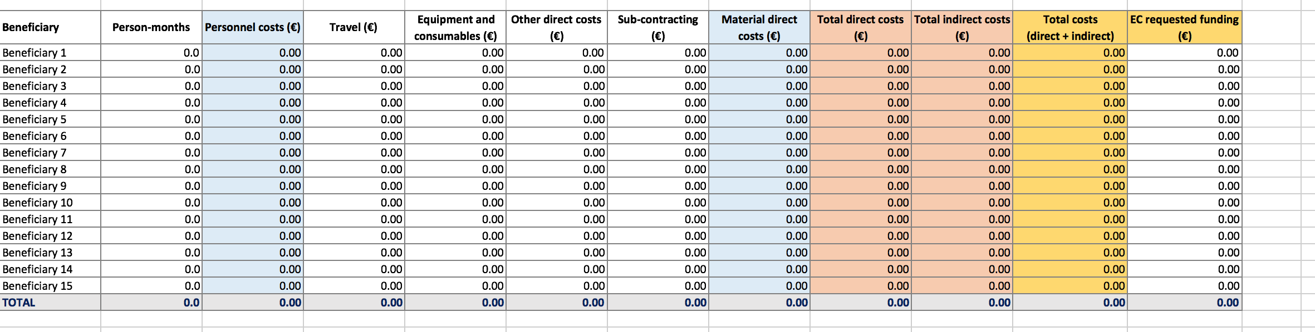
Budget

