Slide 1

Collaboration Board 02.2020 Technical readiness for Tb-155
MEDICIS Operator: Laura LAMBERT

Slide 2
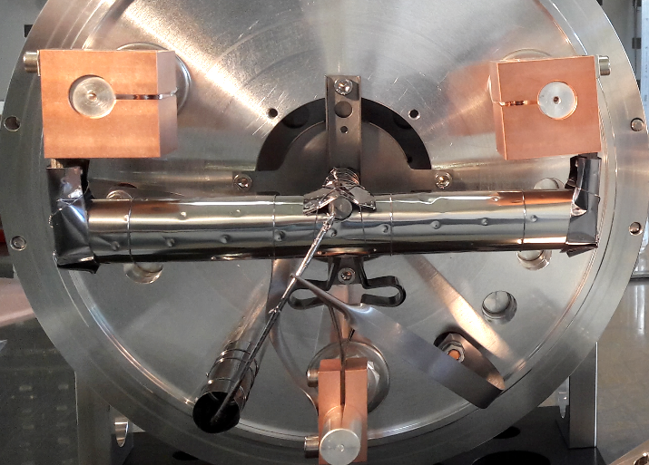
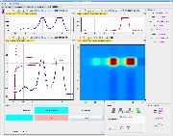
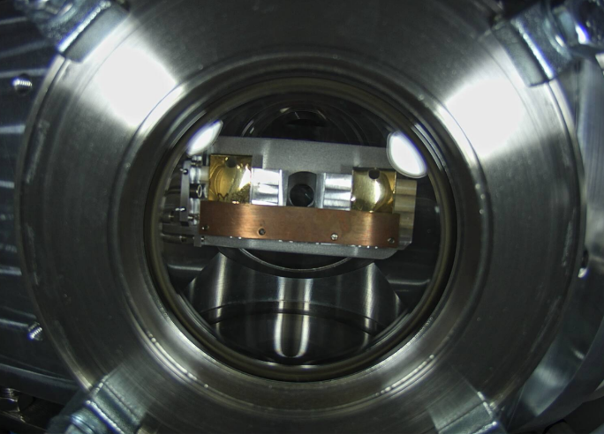
Collection procedure
Heating
Optimization
Separation
Implantation

Slide 3
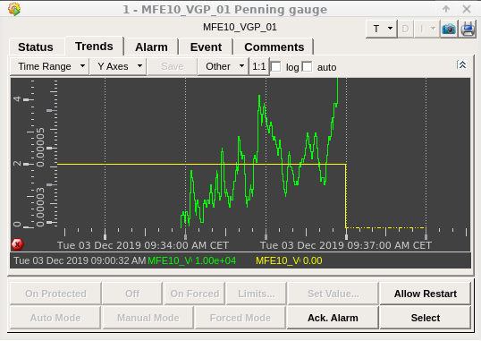
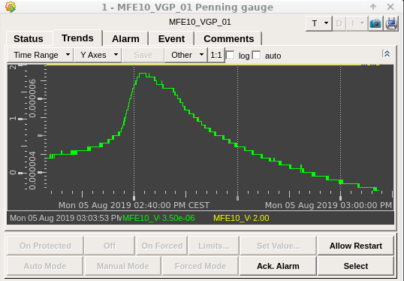
Optimized heating during collection
Outgassing
  Materials remaining in target
Temperature for optimization
  Hot enough to view Tb
  Keeping target cool enough so not to evaporate Tb
Initial rate
  Avoid tripping the target
  Efficient with time – minimal wait
Collection parameters
  Hot enough to maximize extraction of materials
  Slow enough rate to not extract all at once
Fig 1. Tb-155 Dec 3rd – target trip
Fig 2. Tb-155 Aug 5th – optimal heating

Slide 4
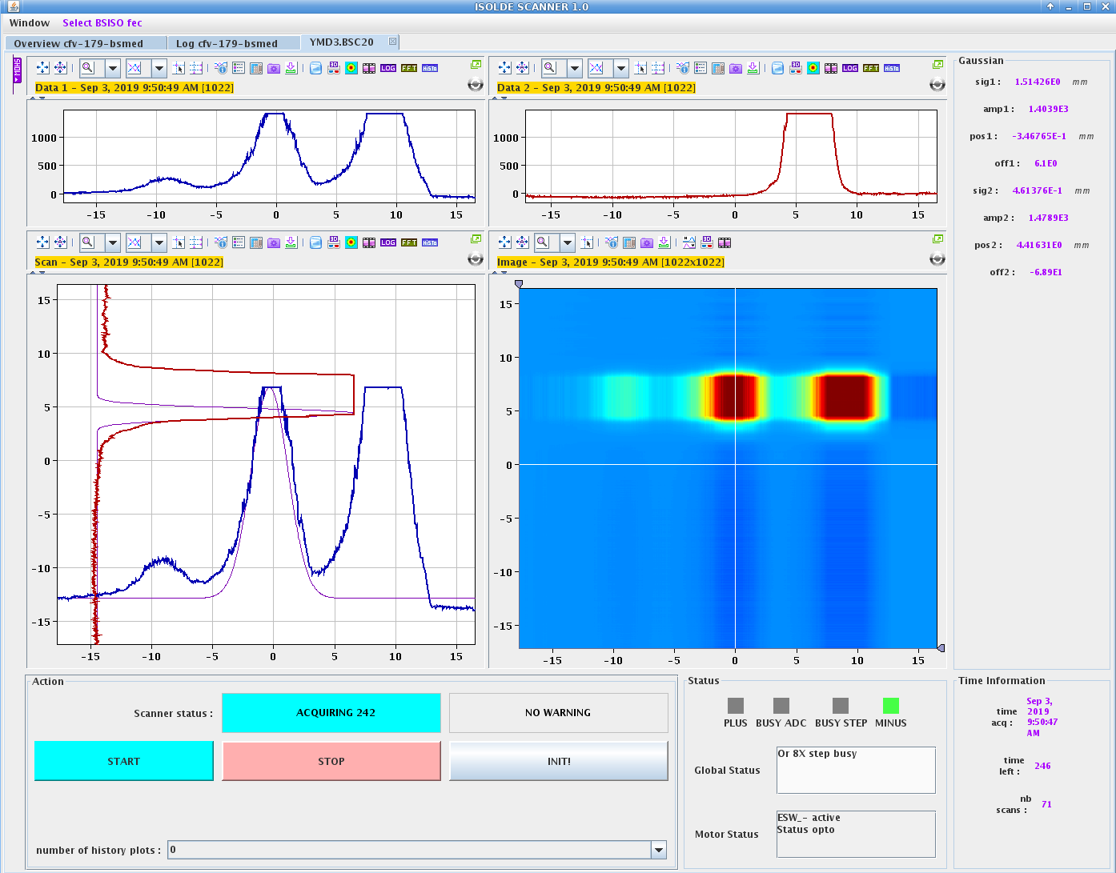
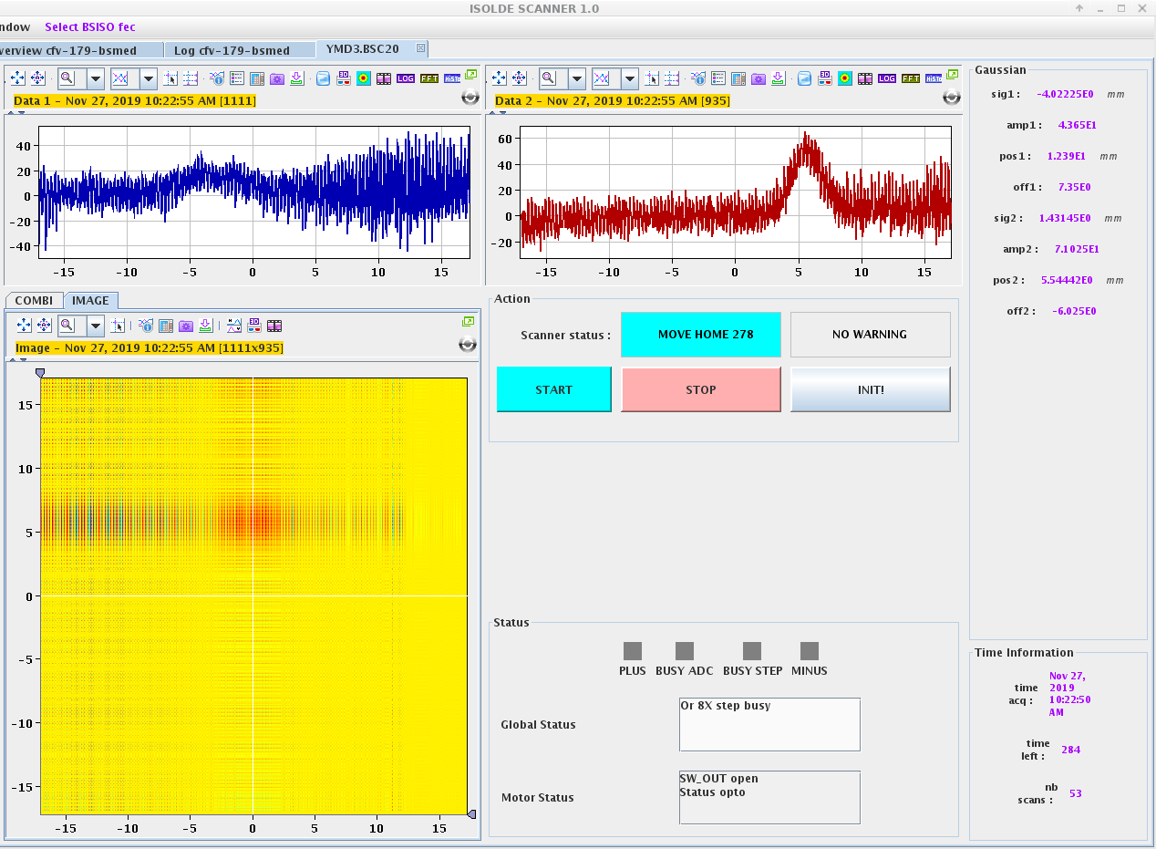
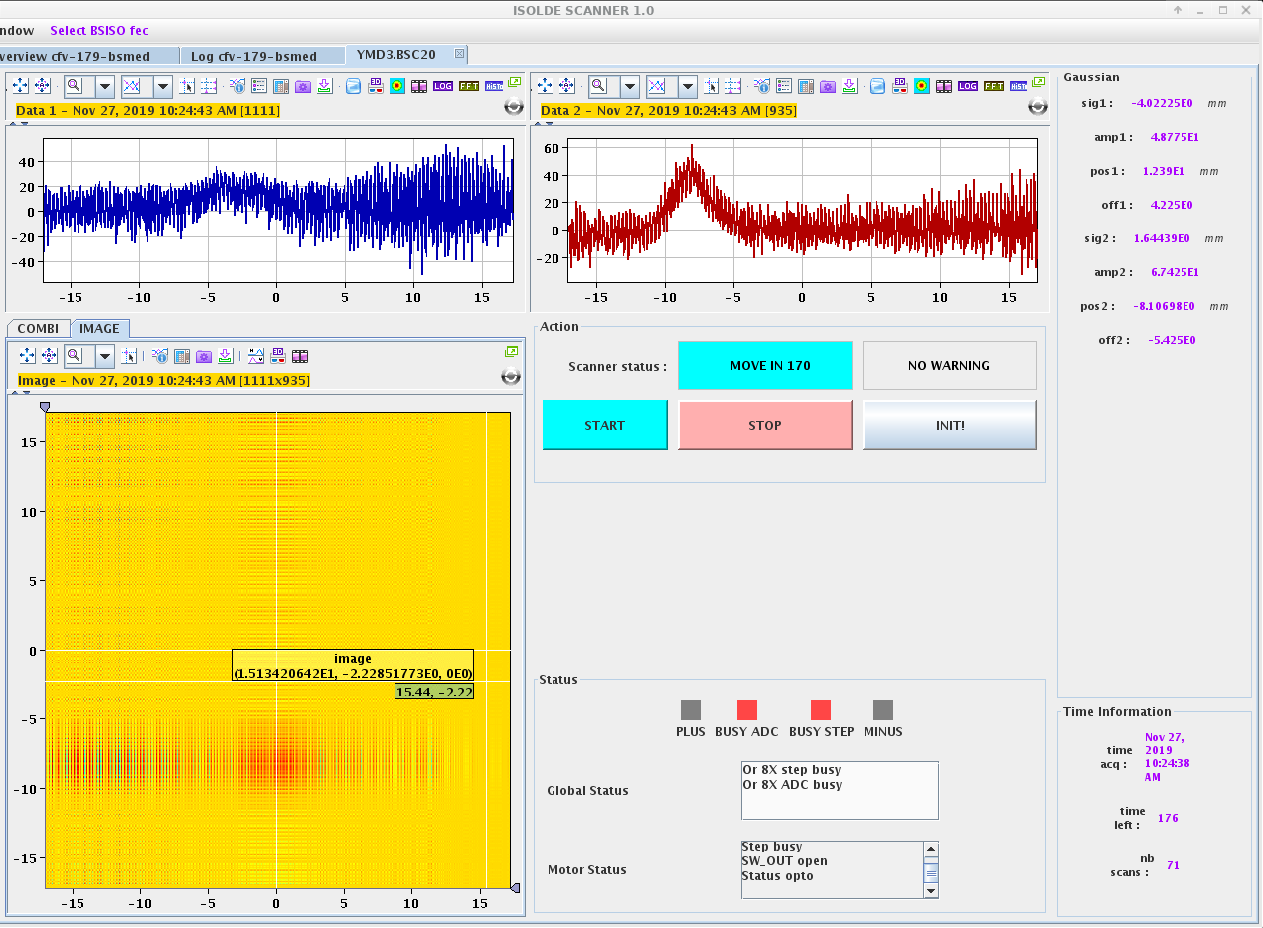
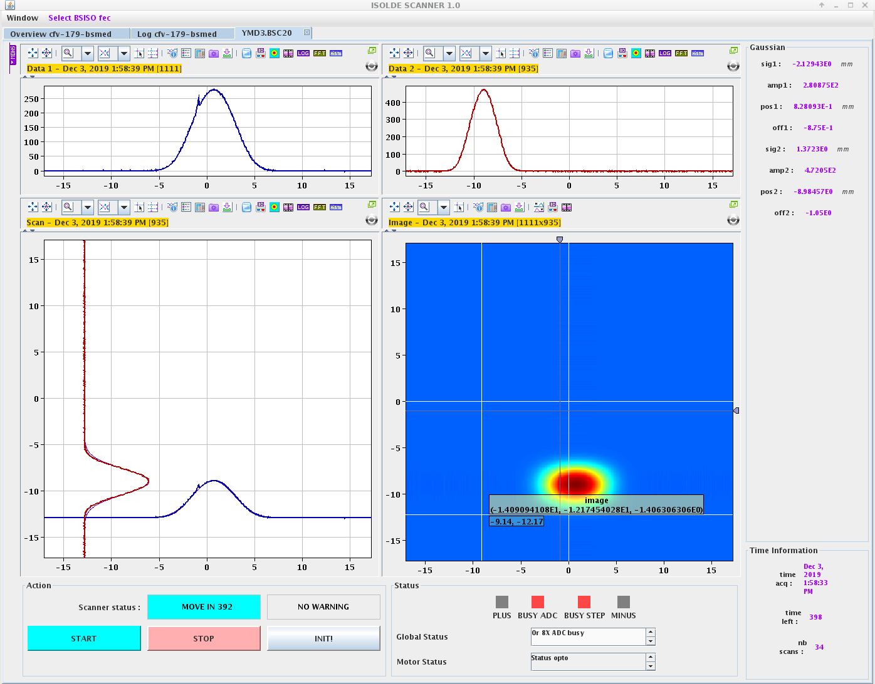
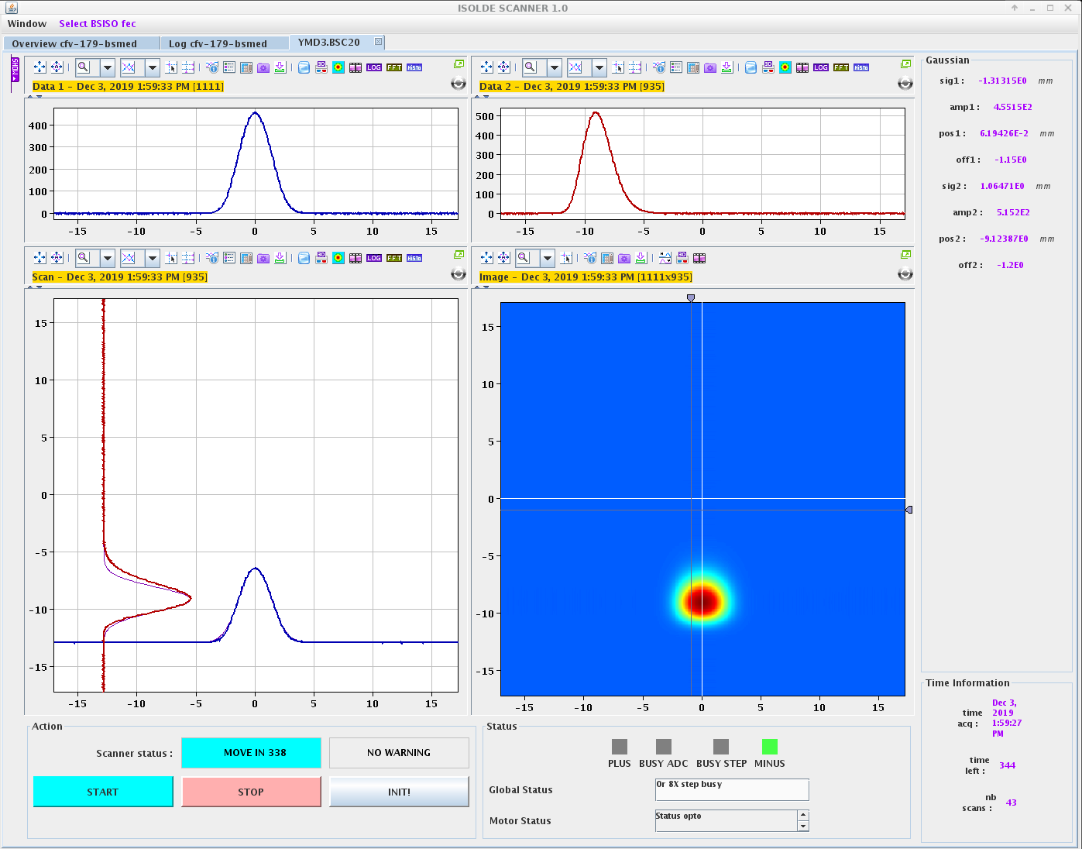
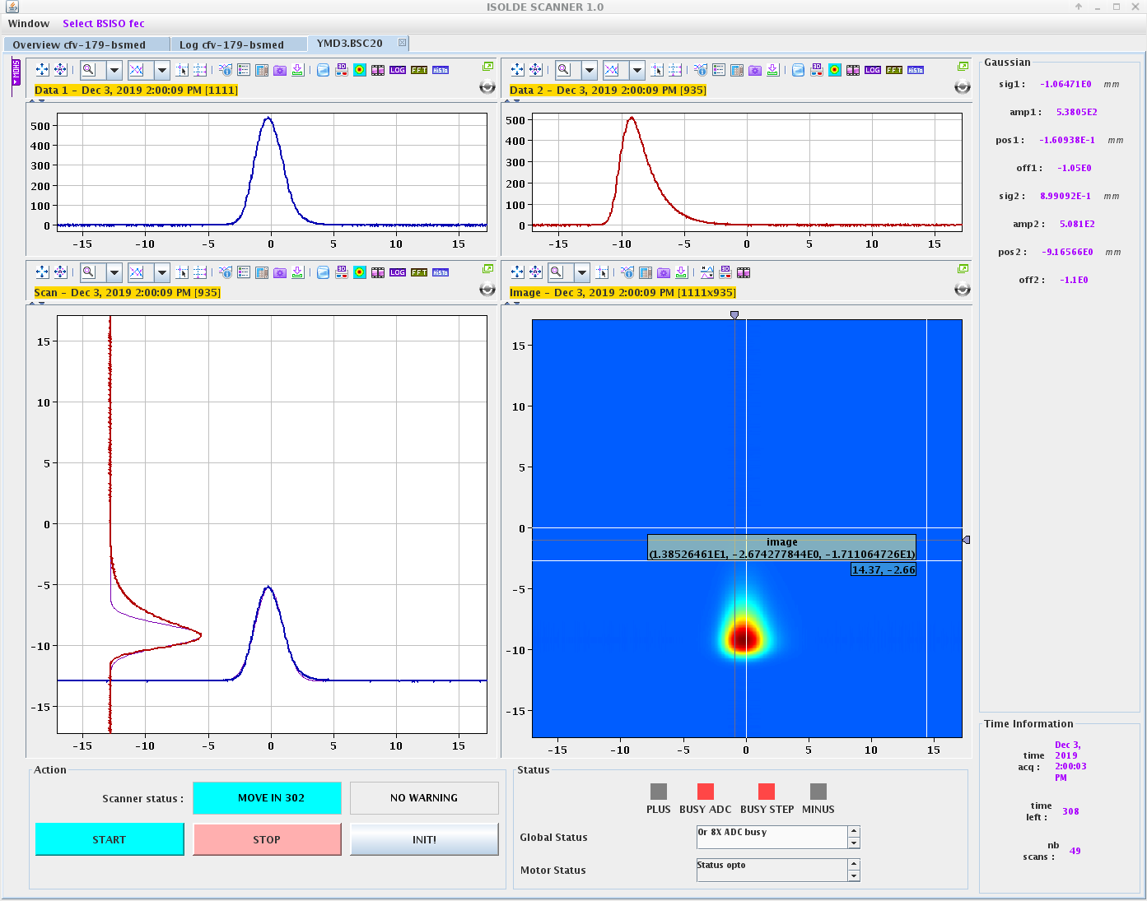
Separation and Beam Optics
Fig 1. pre-optimization, 03.09
Fig 2. Tuning deflectors, 27.11
Fig 3. Tuning deflectors, 27.11
Fig 4. Electrode position 70mm, 03.12
Fig 5. Electrode position 60mm, 03.12
Fig 6. Electrode position 55mm, 03.12

Slide 5
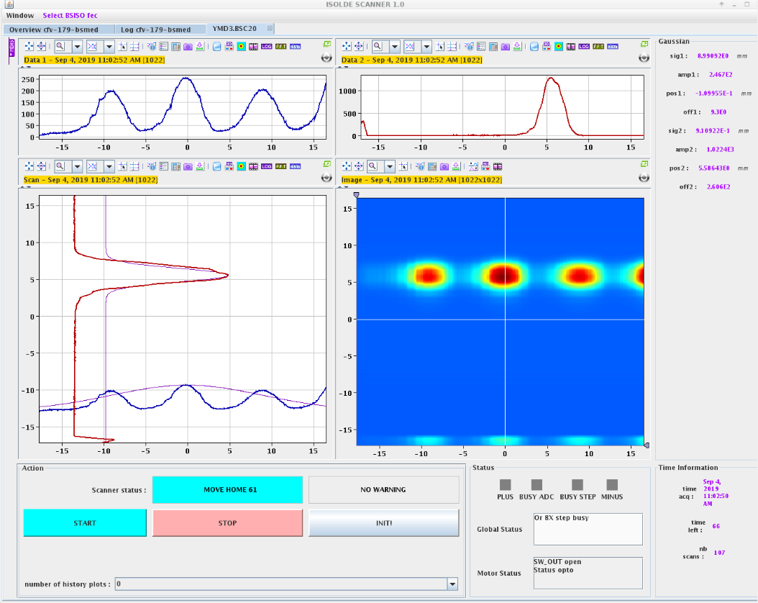
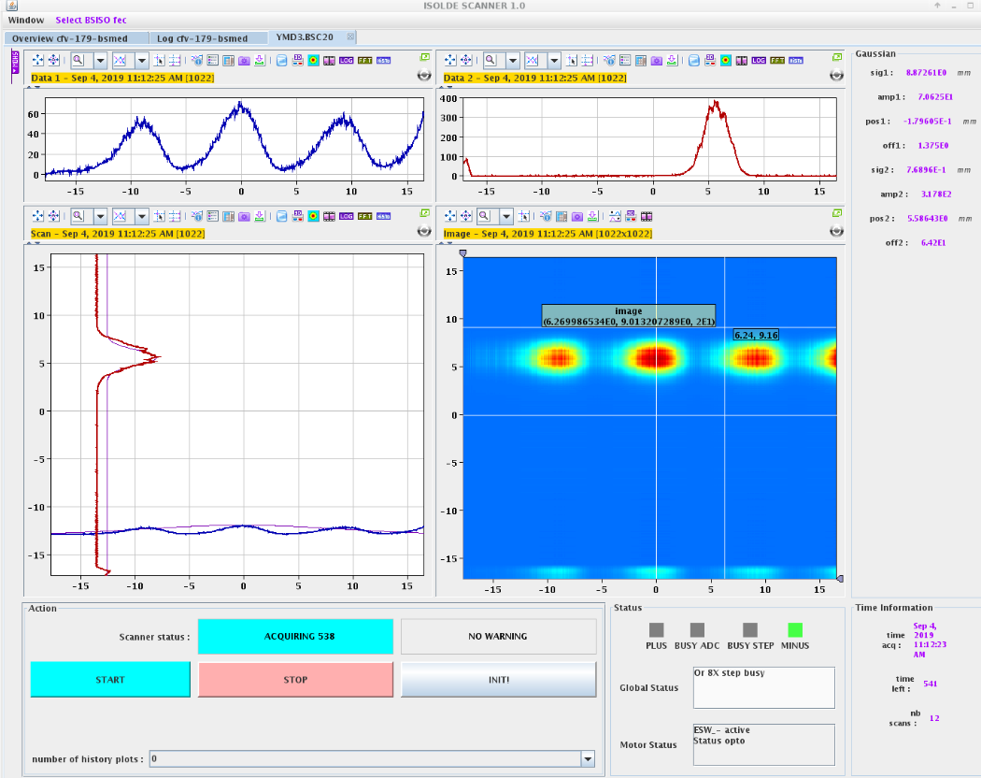
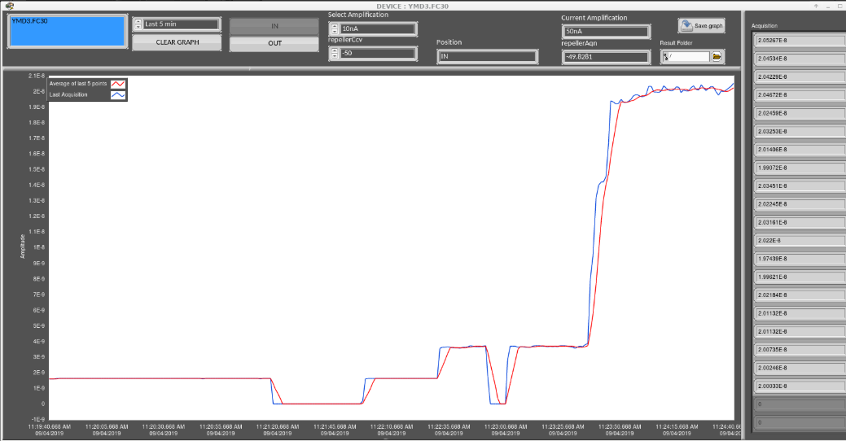
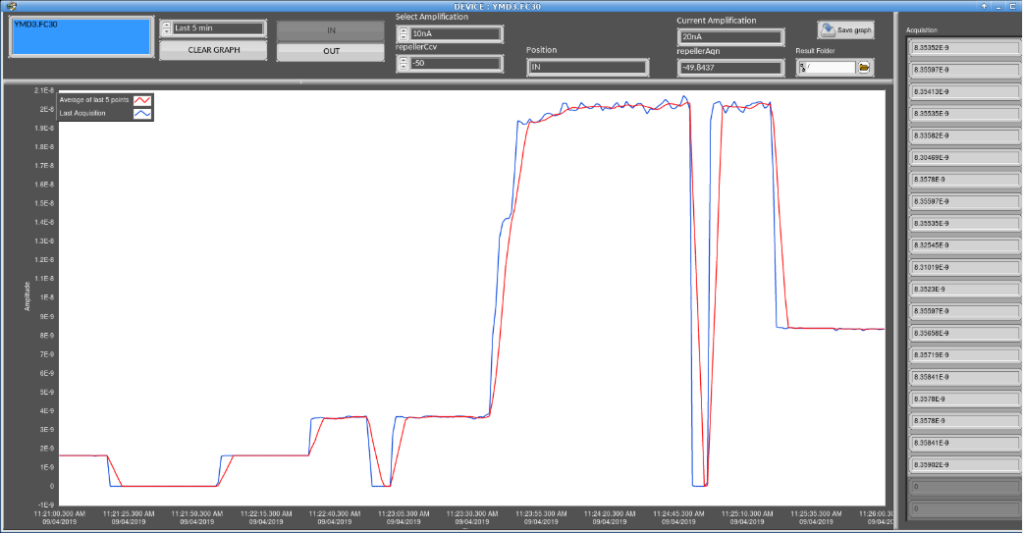
Lasers on/off – Tb155/Gd155 centered
Laser on, 20.5nA
Laser off, 8.3nA

Slide 6
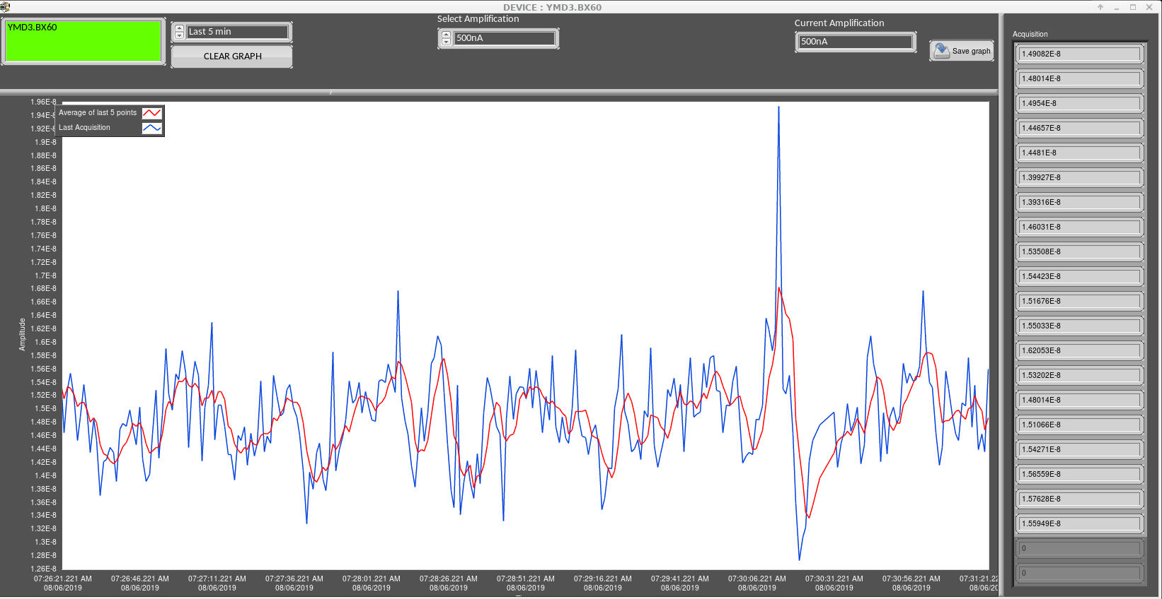
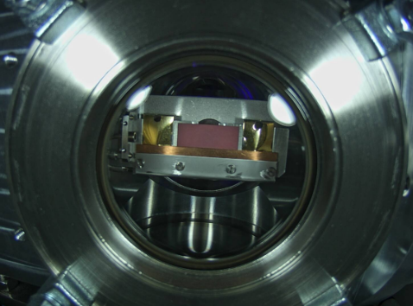
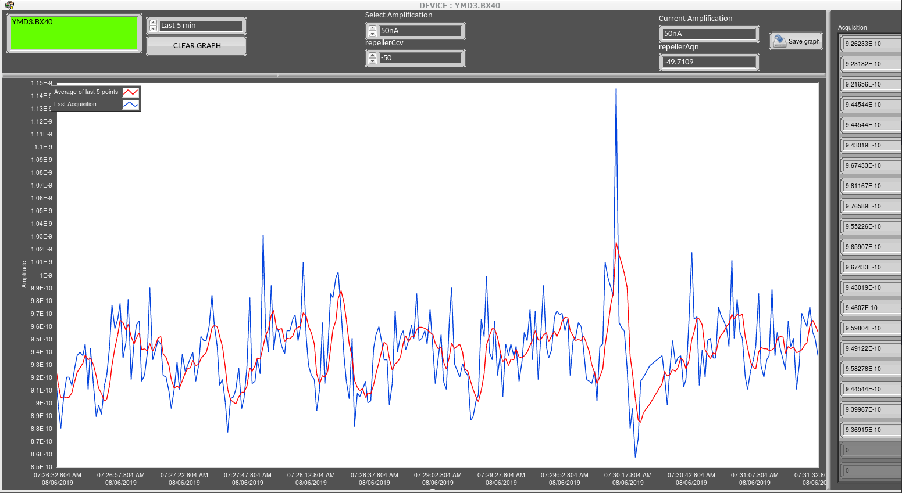
Beam alignment and implantation
Fig 1. BX60 = 15nA, 06.08
Fig 3. Foils and scintillator in collection chamber
Fig 2. BX40 = 0.98nA, 06.08

Slide 7
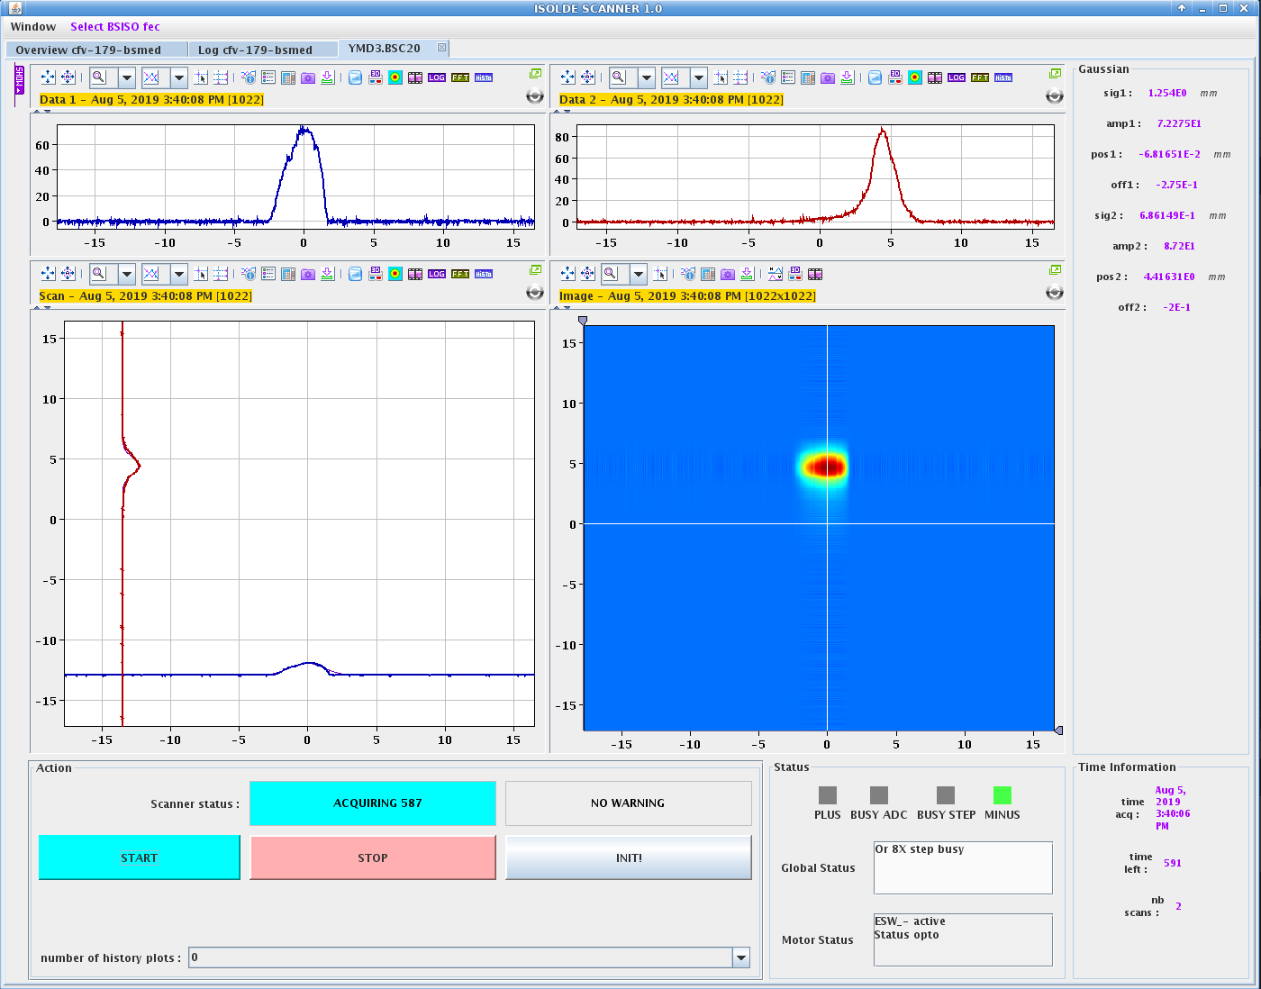
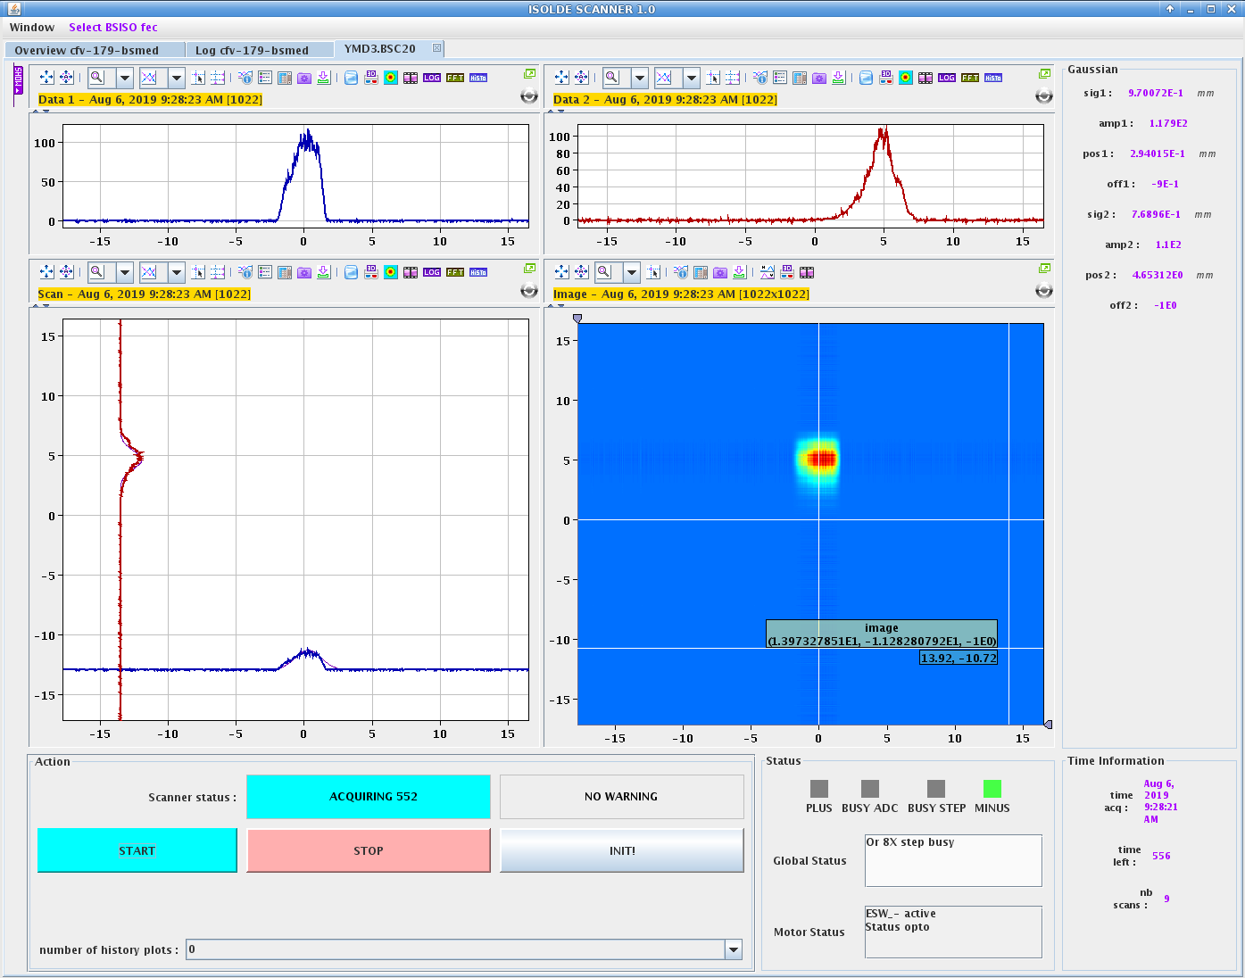
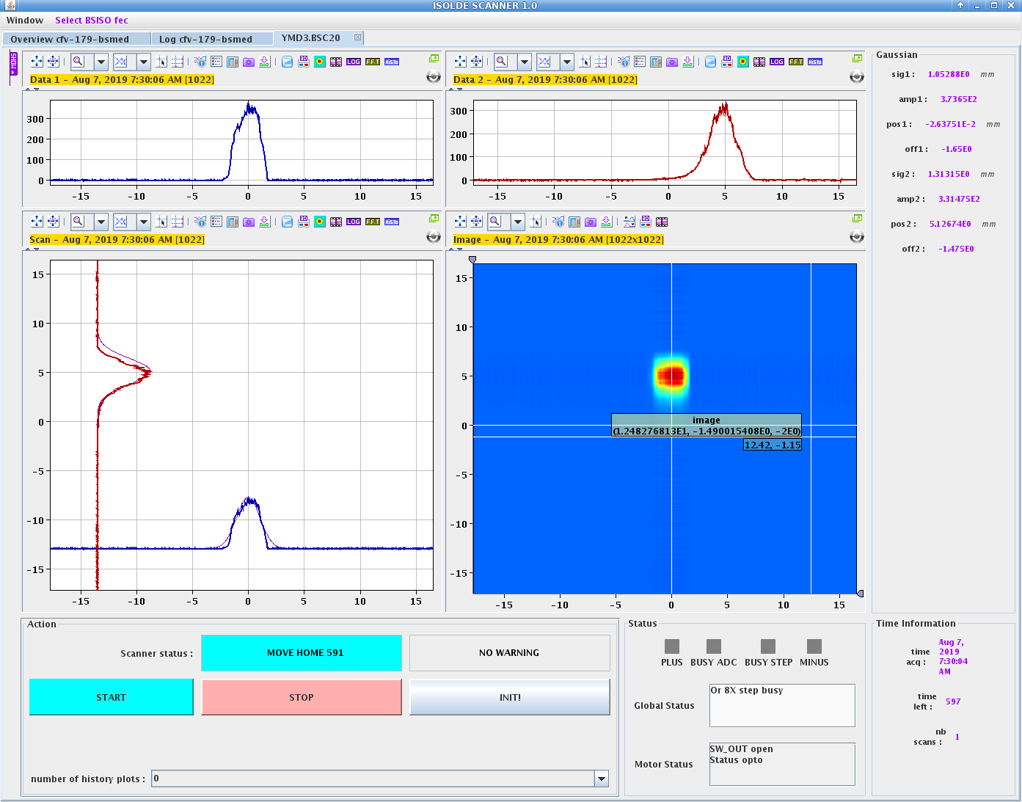
Target #671M 05.08 -> 08.08
Fig 1. Target = 700A, day1
Gd foil irradiated at Arronax
  Foil loaded into target at Arronax
  Charged target shipped to CERN
Outgassing normal
  Hot target achieved by the afternoon
  Optimisation complete after only a few hours
  Collection time successfully maximised
Smooth run
Fig 2. Target = 730A, day2
Fig 3. Target = 730A, day3

Slide 8
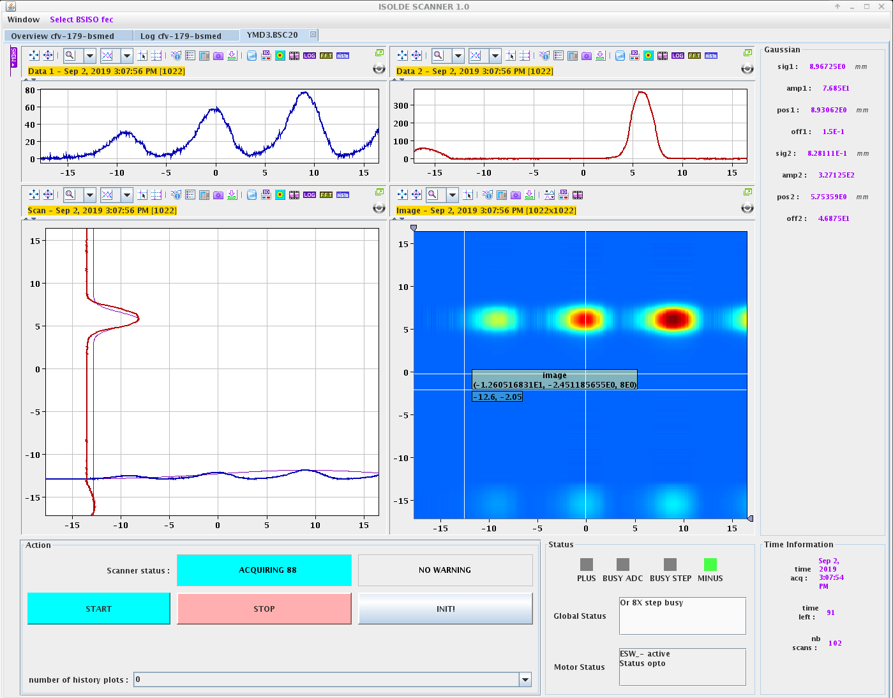
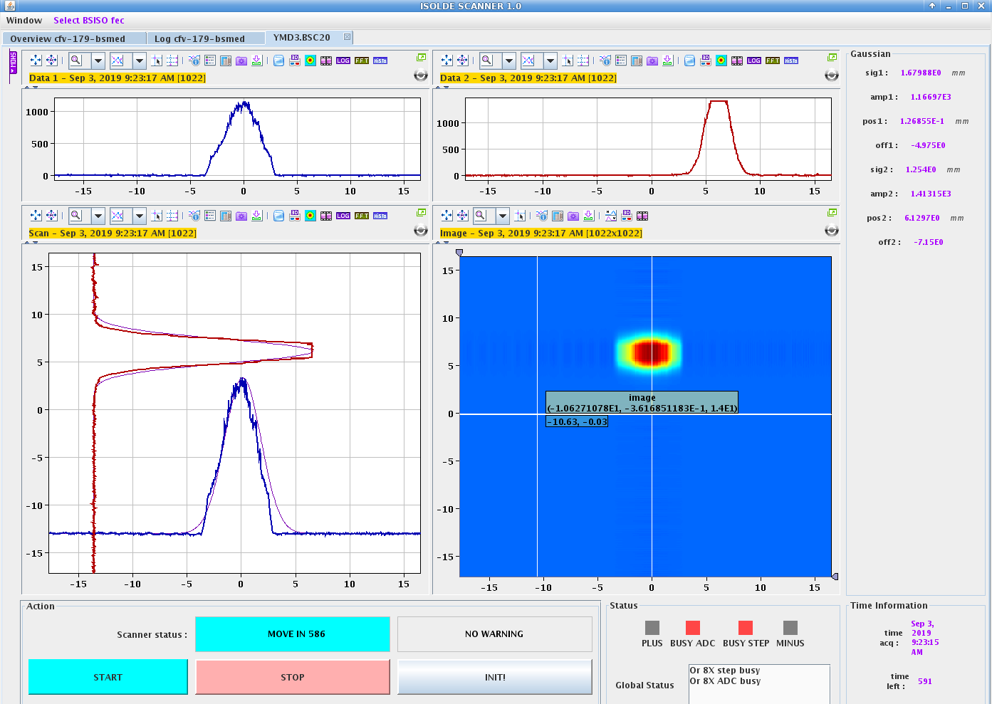
Target #645M 02.09 -> 06.09
Fig 1. Target = 350A,1st first view of 155
Gd foil irradiated at Arronax
  Foil loaded into target at Arronax
  Charged target shipped to CERN
Outgassing normal
  Hot target achieved by the afternoon
  Optimisation complete after only a few hours
  Collection time successfully maximised
Laser on/off ratios not realistic
  If values were correct, would have collected total activity in 1hr
Received by SCK-CEN
  Successfully removed 95% of Tb-155 activity
Fig 2. Lasers optimized, day2

Slide 9
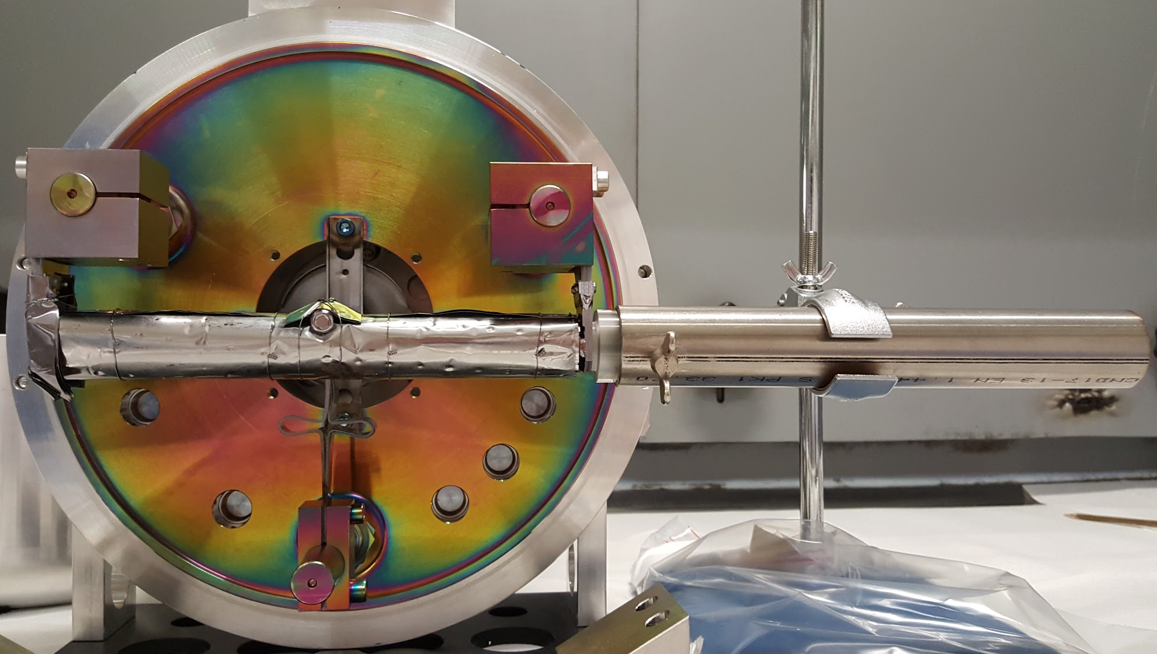
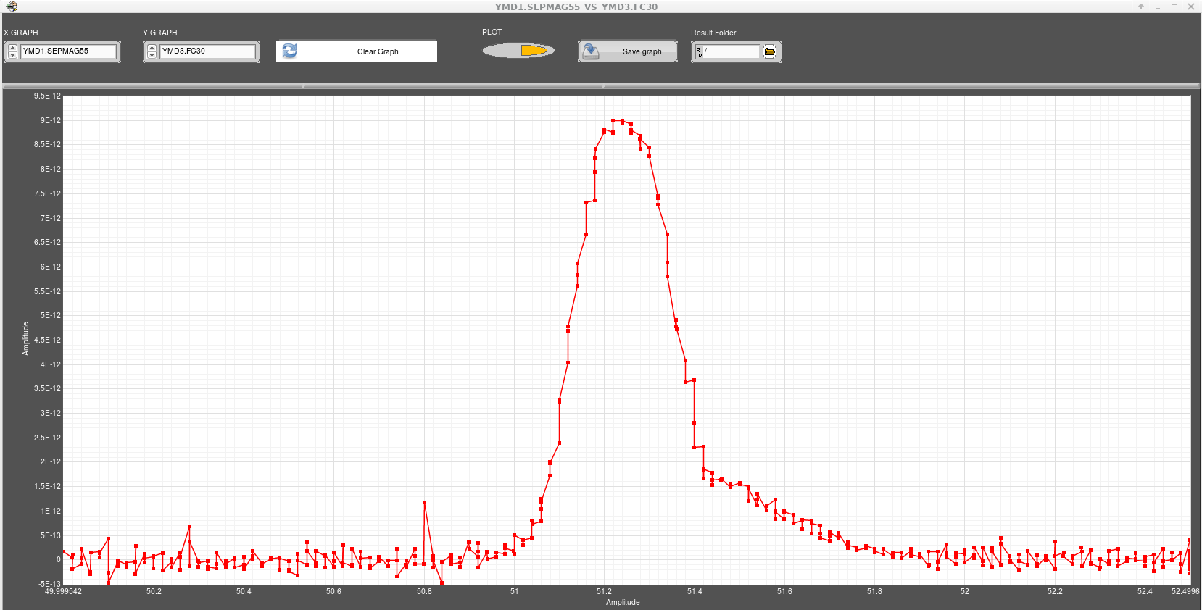
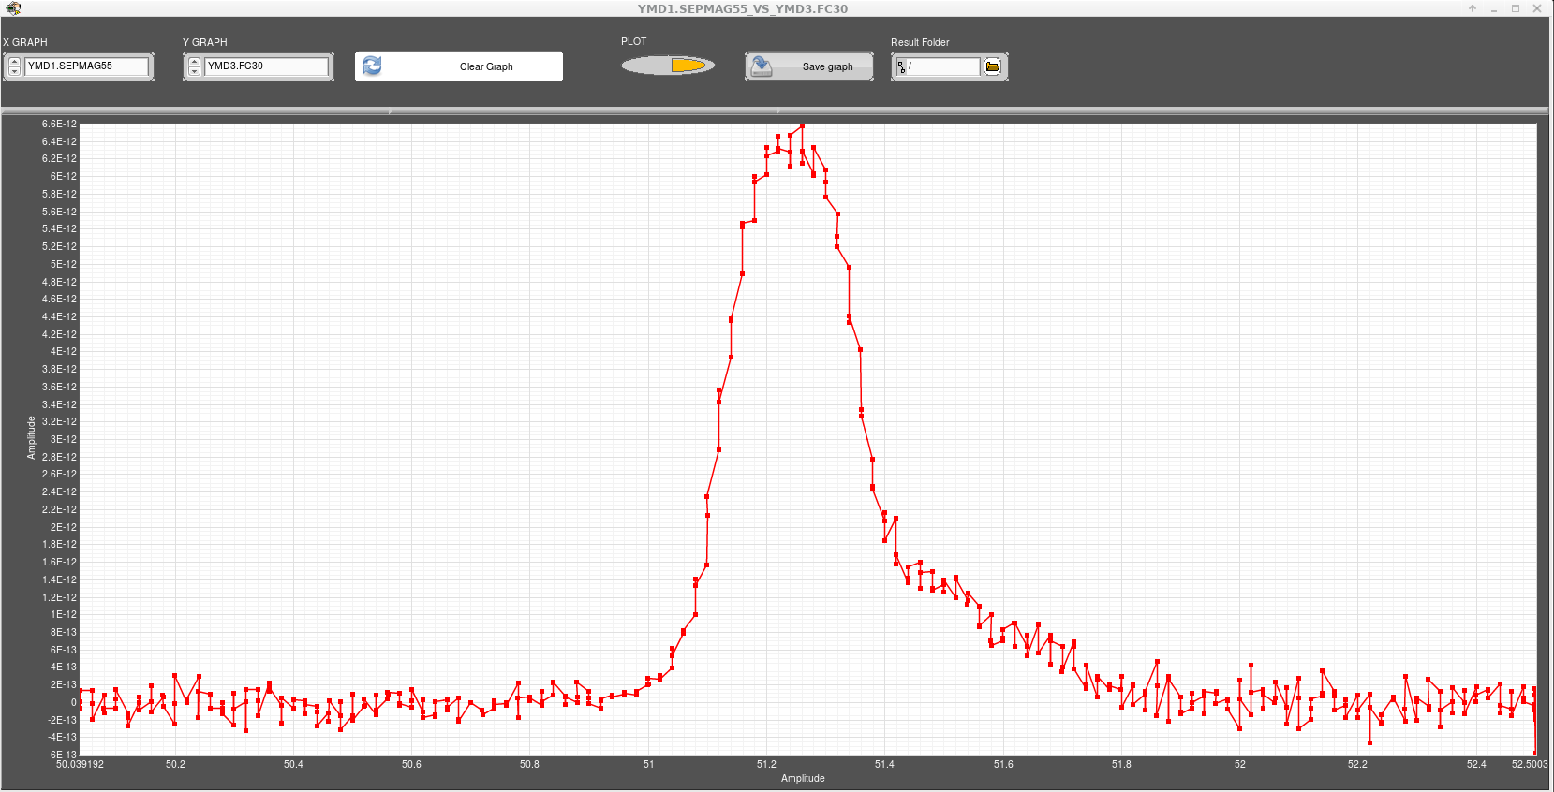
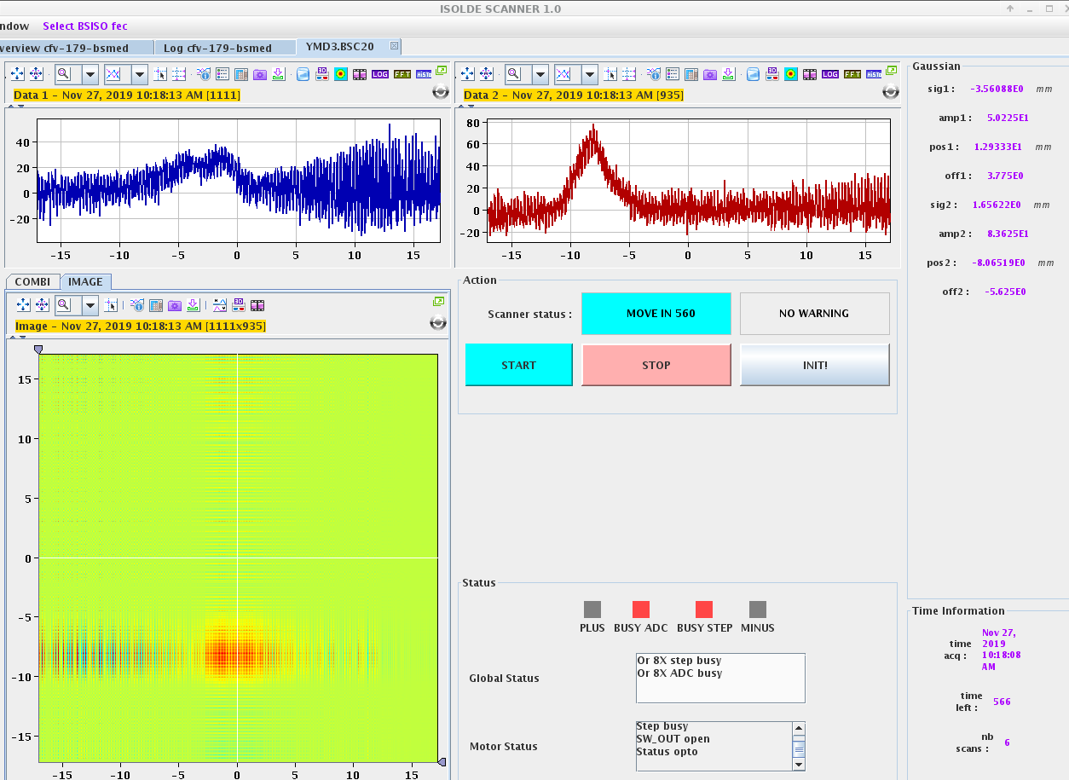
Target #645M 26.11 -> 27.11
Fig 1. Loading boat into target
First foil to go through radiochemistry post-irradiation at Arronax!
  Issues with radiochemistry resulted in ~75% of lost activity
  Boat with evaporated material sent to CERN and charged target in Class A Lab fumehood
Unsuccessful run
  Strong outgassing - target tripped several times
  Unable to go above 30kV with vacuum instability
  Software issues with beam optics
  Power cut 1.5 hrs after collection started – line broke
Fig 2. Laser on/off mass scan – only 1 visible mass
Fig 3. 155 centered, according to previous days magnet calibration - does not match field

Slide 10
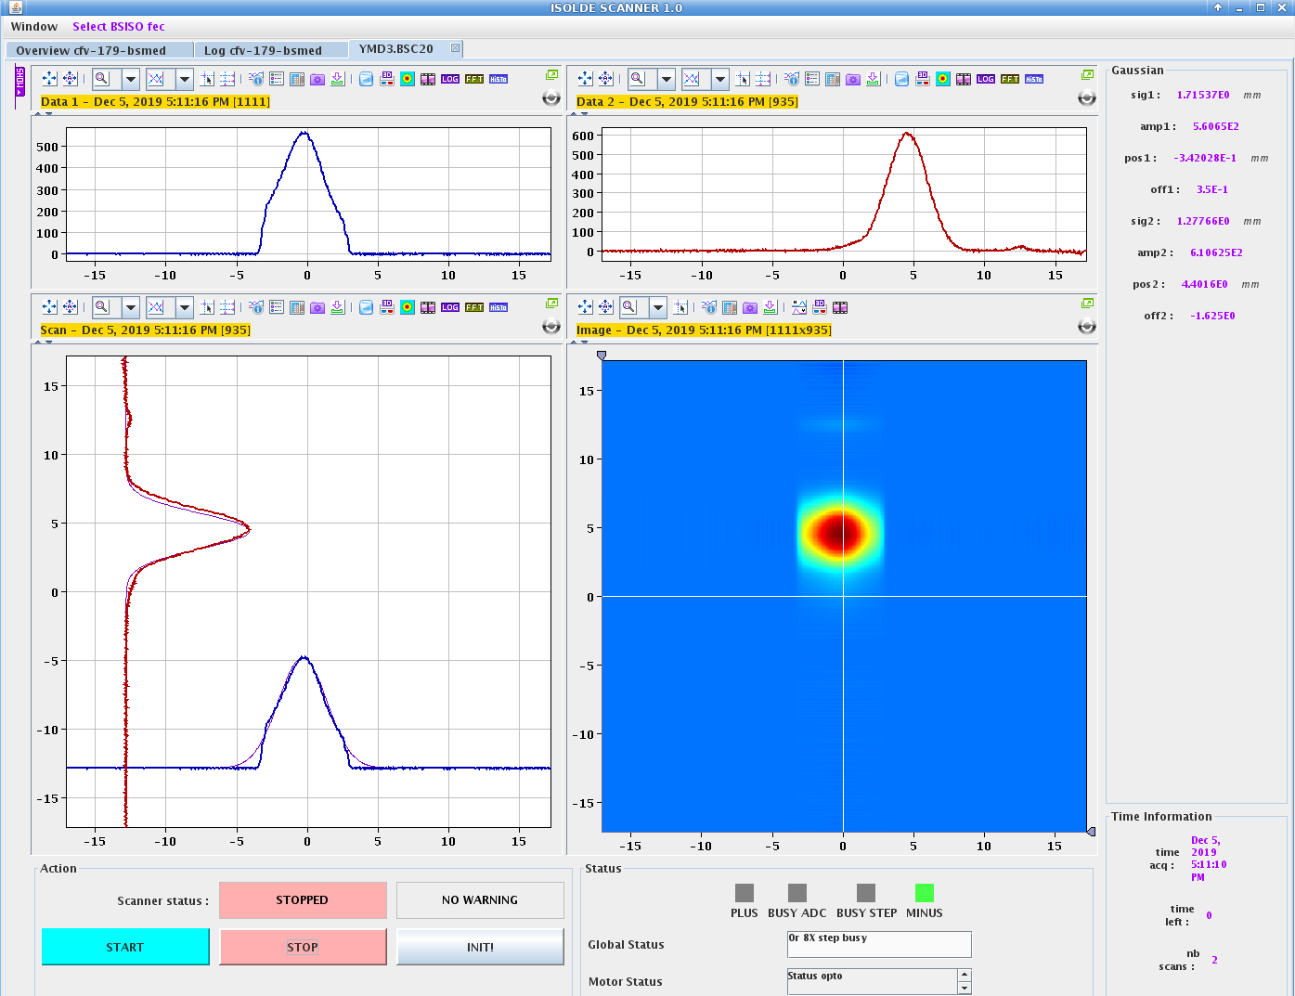
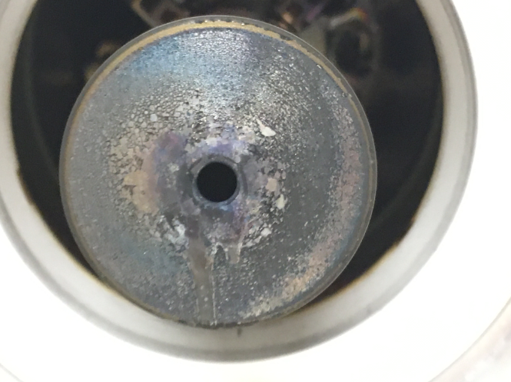
Target #671M 03.12 -> 05.12
Gd foil irradiated at Arronax
  Radiochemistry post-irradiation successful
  Charged target with boat in CERN Class A Lab fumehood
Collection
  Strong outgassing – target tripped several times
  Image mirrored to start
  Reduction in surface ions observed due to ion capacity issues
  Minimal laser effects visible – acting more like heating effect
    Laser on/off on FC30 <1pA
Issues with the extraction electrode
Fig 1. EOC
Fig 2. Damaged extraction electrode

Slide 11
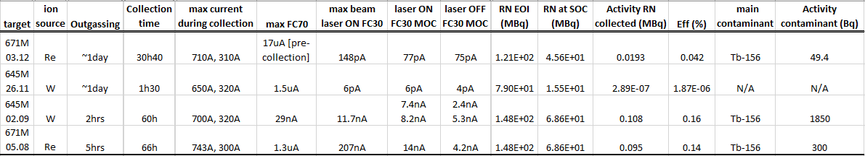
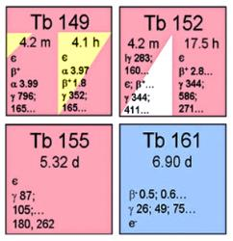
Summary of Tb-155 collections for 2019
Aug 8th and Sept 2nd
  no radiochemistry
  Both relatively smooth runs
  Problems of tailing from neighboring masses continues
Nov 26th and Dec 3rd
  radiochemistry
  A lot of outgassing observed from both targets
  Many problems with controls, software, and power cuts
  Ion capacity issues
  Extraction electrode issues

Slide 12
Conclusion
EOI
SOC
EOC
RAF
5% eff
2.5GBq
1GBq
50MBq
50MBq

Slide 13
Thank-you! Merci!

