Slide 1
OPEN SOURCE BIG DATA TOOLS ACCELERATING PHYSICS RESEARCH AT CERN
Prasanth Kothuri, CERN

Slide 2


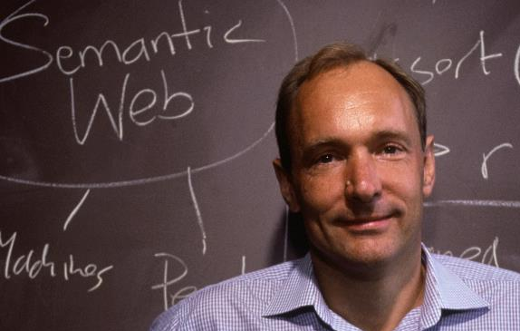

CERN
Answering questions…
CERN - European Laboratory for Particle Physics
The place where the Web was born
Home of the Large Hadron Collider and 4 big Experiments:
  ATLAS ~ CMS ~ LHCb ~ ALICE
22 member states + 6 associate members + world-wide collaborations
~3000 Members of Personnel
~12,000 users
~1000 MCHF yearly budget

Slide 3

The Large Hadron Collider (LHC)
Largest machine in the world
27km, 6000+ superconducting magnets
Fastest racetrack on Earth
Protons circulate 11245 times/s (99.9999991% the speed of light)
Emptiest place in the solar system
High vacuum inside the magnets
Hottest spot in the galaxy
During Lead ion collisions create temperatures 100 000x hotter than the heart of the sun;
18 months of production experience with 12c

Slide 4
CERN Data Centre
Answering questions…
Physics data are aggregated in the CERN Data Centre, where initial data reconstruction of physics events is performed
A remote extension of the CERN data centre is hosted in Budapest, Hungary. It provides the extra computing power required to cover CERN’s needs.
 | Meyrin Data Centre | Wigner Extension | TOTAL
Servers | 11 500 | 3 500 | 15 000
Processor cores | 174 300 | 56 000 | 230 300
Disks | 61 900 | 29 700 | 91 600 (280 PB capacity)
Tape Cartridges |  |  | 32 200 (~ 400 PB capacity)
~ 12.5 PB per month
~ 2 PB accessed every day
~ 4 megawatt of electricity

Slide 5





Data at Scale @ CERN
Answering questions…
Physics data – Today we use WLCG to handle it
  Optimised for physics analysis and concurrent access
  ROOT framework - custom software and data format
  Early stage experimental work ongoing to use Spark for physics analysis
Infrastructure data
  Accelerators and detector controllers
  Experiments Data catalogues (collisions, files etc.)
  Monitoring of the WLCG and CERN data centres
  Systems logs

Slide 6
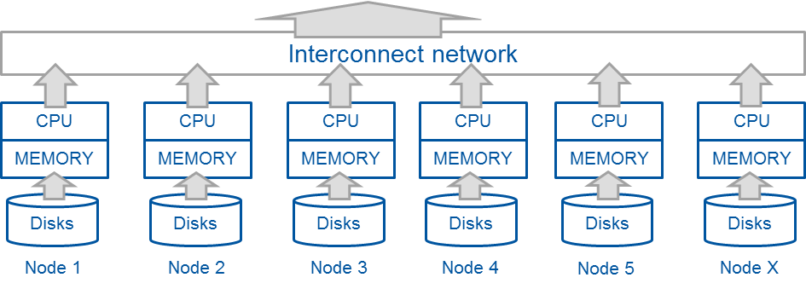
Hadoop and Spark for big data analytics
Answering questions…
  Distributed systems for data processing
    Storage and multiple data processing interfaces
    Can operate at scale by design (shared nothing)
    Typically on clusters of commodity-type servers/cloud
    Many solutions target data analytics and data warehousing
    Can do much more: stream processing, machine learning
Already well established in the industry and open source
Scale-out data processing

Slide 7
CERN Hadoop and Spark Service - Timeline
Answering questions…
2013
2014
2015
2016
2017
2018
2019
Start of Hadoop pilot service
Adoption of Hadoop 2 (YARN) and Apache Spark
Adoption of SQL-based solutions (Hive, Impala)
Starting Kafka pilot
Rolling out HDFS backups
XRD connector and monitoring
Production ready
High availability, Custom CERN distribution
Adoption of Jupyter Notebooks (SWAN)
Hadoop 3 production ready
First secured
cluster
deployed
Central IT Monitoring project commits to Hadoop
R&D of SQL on Hadoop
LHC critical projects commits to use the service
Training CERN staff on Hadoop and Spark
Spark cluster on Kubernetes

Slide 8
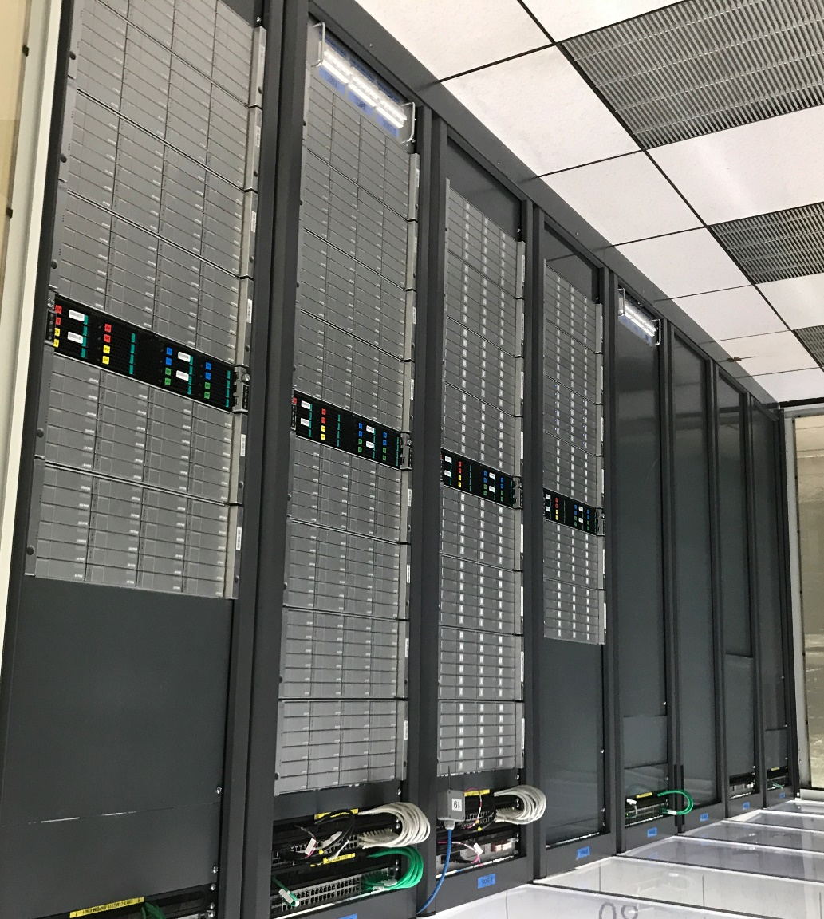
Hadoop and Spark Service at CERN IT
Answering questions…
Setup and run the infrastructure
Support user community
  Provide consultancy
  Train on the technologies
Facilitate use
  Notebook service
  Docker clients
  Package libraries and configuration

Slide 9



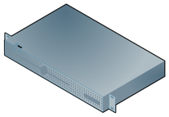




Hadoop and Spark service in numbers
Answering questions…
6 clusters
  4 production (bare-metal)
  2 QA clusters (VMs)
65 physical servers
40+ virtual machines
18+ PBs of Storage
20+ TB of Memory
1500+ physical cores
HDDs and SSDs
Data growth: 4 TB per day
CPU

Slide 10
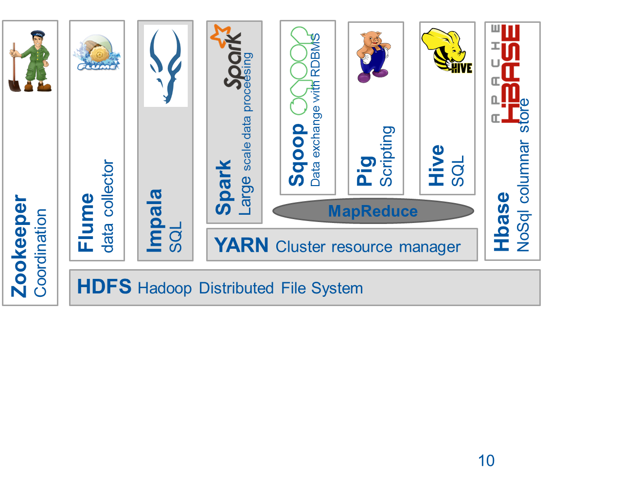
Overview of Hadoop components used
Answering questions…
Kafka:
streaming and ingestion

Slide 11









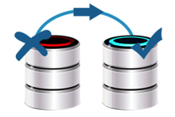

Hadoop and Spark production deployment
Software distribution
  Vanilla Apache (since 2017)
  Cloudera
Installation and configuration
  CentOS 7.6
  custom Puppet module
Security
  authentication Kerberos
  fine-grained authorization integrated with ldap/e-groups
High availability
  automatic master failover
  for HDFS, YARN and HBASE
Rolling change deployment
  no service downtime
  transparent in most of the cases
Host monitoring and alerting
  via CERN IT Monitoring infrastructure
Service level monitoring
  metrics integrated with: Elastic + Grafana
  custom scripts for availability and alerting
HDFS backups
  Daily incremental snapshots
  Sent to tapes (CASTOR)

Slide 12

Moving to Apache Hadoop distribution
Answering questions…
Better control of the core software stack
  Independent from a vendor/distributor
  In-house compilation
  Enabling non-default features (compression algorithms, R for Spark)
  Adding critical patches (that are not ported in upstream)
We do rpm packaging for core components
  HDFS and YARN, Spark, HBase
Streamlined development
  Available on Maven Central Repository

Slide 13

SWAN – Jupyter Notebooks On Demand
Answering questions…
Service for web based analysis (SWAN)
  Developed at CERN, based on Jupyter notebooks
  Tightly integrated with CERN resources; software, storage and mass compute
An interactive platform that combines code, equations, text and visualizations
  Ideal for exploration, reproducibility, collaboration
Fully integrated with Spark and Hadoop at CERN
  Python on Spark (PySpark) at scale
  Modern, powerful and scalable platform for data analysis
  Web-based: no need to install any software
Git repo: https://github.com/swan-cern

Slide 14
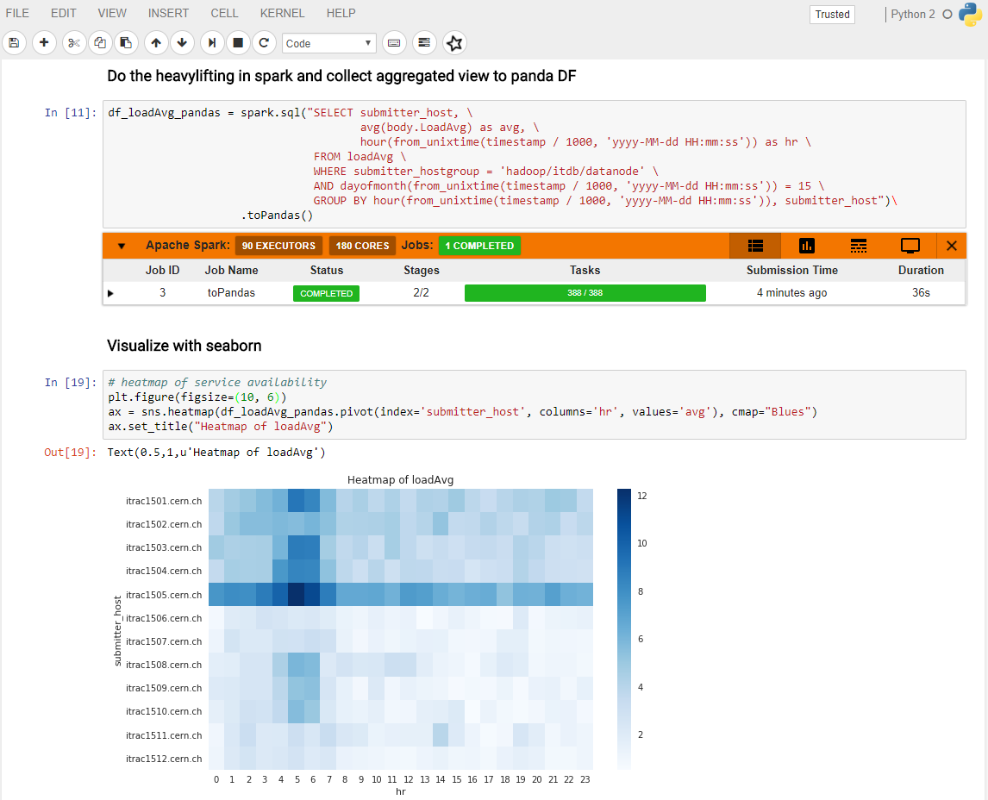
Text
Answering questions…
Code
Monitoring
Visualizations

Slide 15




SWAN – Integration with Spark
Connection to CERN Spark Clusters
  Spark: general purpose distributed computing framework
Same environment across platforms (local/remote)
  User data - EOS
  Software - CVMFS
Graphical Jupyter extensions developed
  Spark Connector
  Spark Monitor
Not only used for Physics Analysis at CERN
Spark Clusters
  NXCals – Dedicated cluster for accelerator logging
  Analytix – General purpose YARN cluster
  Cloud Containers – General purpose Kubernetes cluster
User Notebook
Spark Cluster
Spark Master
Spark Worker
Python task
Python task
Python task

Slide 16
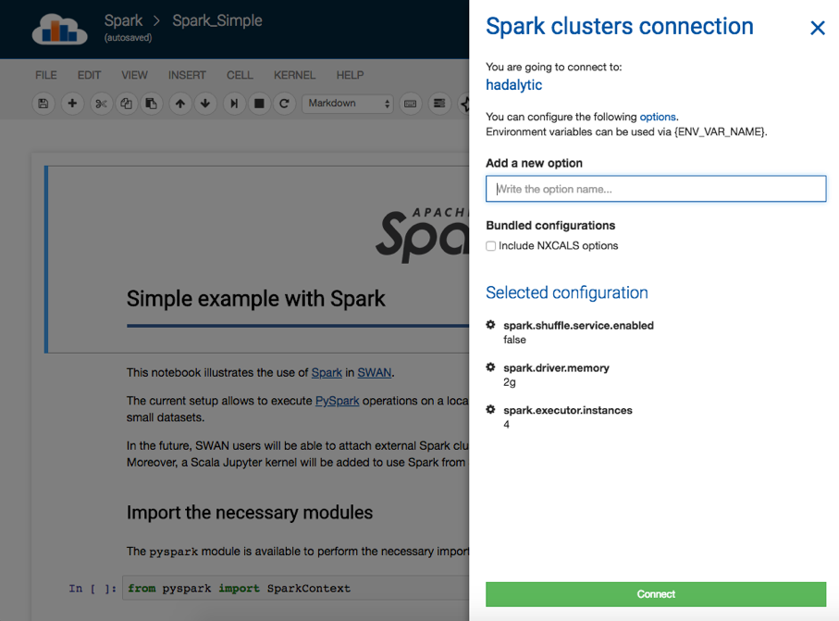
SWAN – Spark Connector
Answering questions…
Spark Connector – handling the spark configuration complexity
  User is presented with Spark Session (Spark) and Spark Context (sc)
  Ability to bundle configurations specific to user communities
  Ability to specify additional configuration

Slide 17
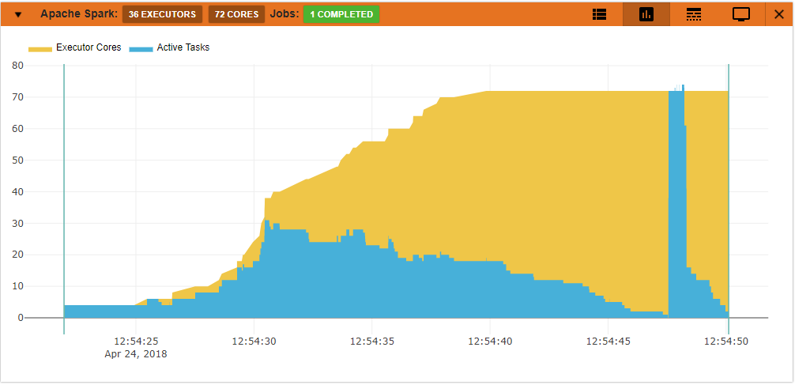
SWAN – Spark Monitor
Answering questions…
Spark Monitor – jupyter notebook extension
  For live monitoring of spark jobs spawned from the notebook
  Access to Spark WEB UI from the notebook
  Several other features to debug and troubleshoot Spark application

Slide 18
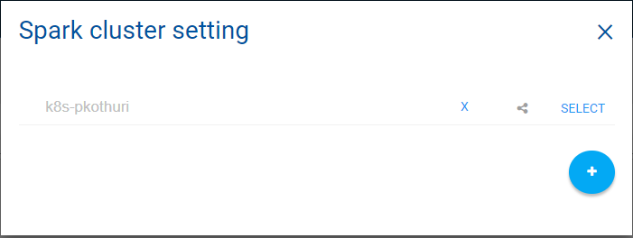
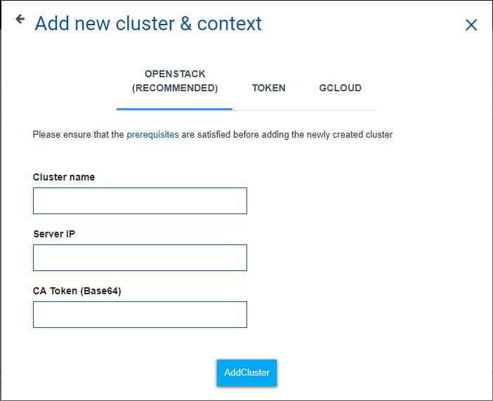
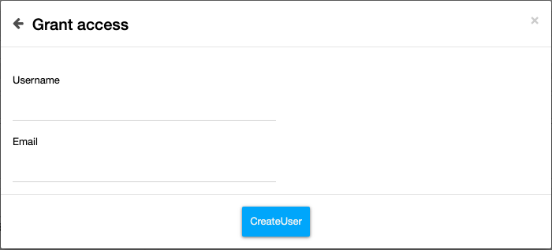
SWAN – Ephemeral Spark K8s clusters
Answering questions…
Possibility to connect to user managed Kubernetes clusters
  Offload Spark computations
  Control and user your own resources
  Quickly create, user and dispose
Share access with other users

Slide 19








Analytics Platform Outlook
Answering questions…
Integrating with existing infrastructure:
  Software
  Data
  Compute
Experiments storage
HDFS
HEP software
Personal storage

Slide 20



Spark as a service on CERN private cloud
Answering questions…
Appears to be a good solution when data locality is not needed
  CPU and memory intensive rather than IO intensive workloads
  Reading from external storages (CERN Disk Storage - EOS, foreign HDFS)
  Elasticity of compute resources
Spark clusters - on containers
  Kubernetes over Openstack
  Leveraging the Kubernetes support in Spark 2.3
Use cases
  Ad-hoc users with high demand computing resource demanding workloads
  Streaming jobs (e.g. accessing Apache Kafka)

Slide 21
Selected “Big Data” Projects at CERN

Slide 22
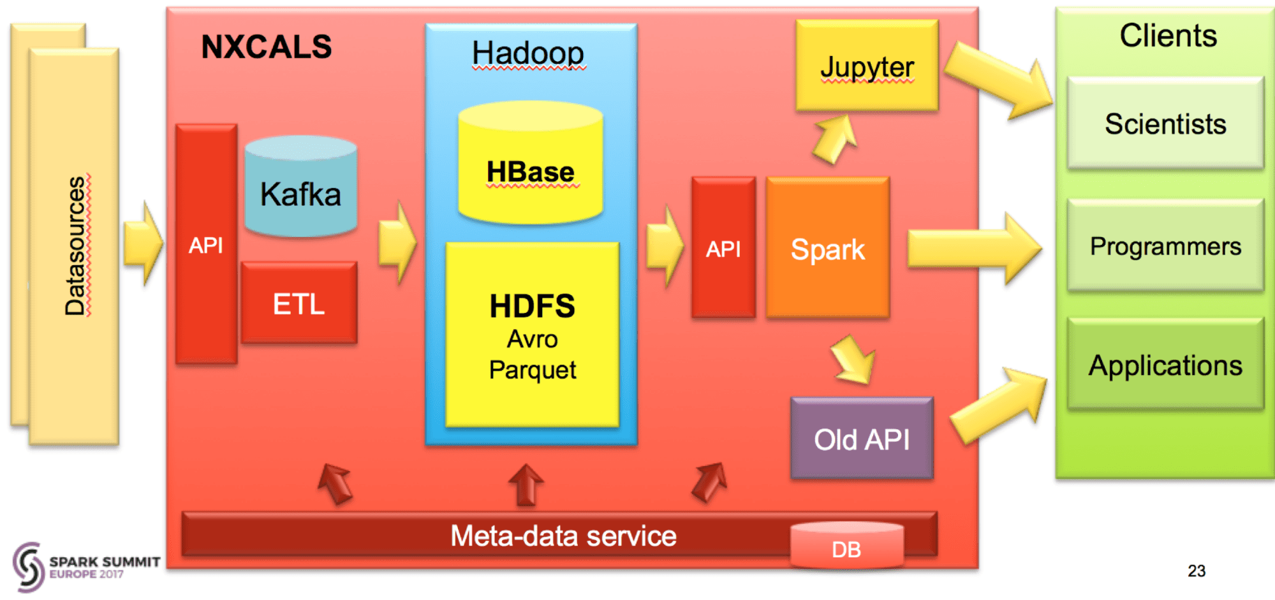
Next Gen. CERN Accelerator Logging
Answering questions…
A control system with: Streaming, Online System, API for Data Extraction
Critical system for running LHC - 700 TB today, growing 200 TB/year
Challenge: service level for critical production

Slide 23








New CERN IT Monitoring Infrastructure
Critical for CC operations and WLCG
Data
Sources
Answering questions…
Storage &
Search
Transport
Data
Access
AMQ
Flume
AMQ
Flume
Kafka
sink
Flume
sinks
Kafka cluster
(buffering) *
HDFS
FTS
DB
Flume
DB
Rucio
XRootD
HTTP feed
Flume
HTTP
ElasticSearch
Processing
Data enrichment
Data aggregation
Batch Processing
Jobs
…
Logs
Flume
Log GW
Lemon
syslog
…
Lemon metrics
Flume
Metric GW
CLI, API
app log
Others (influxdb)
Data now 200 GB/day, 200M events/day
At scale 500 GB/day
Proved to be effective in several occasions

Slide 24
Spark for Physics Data Analysis

Slide 25
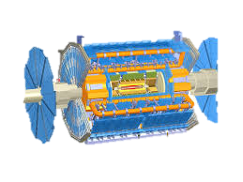
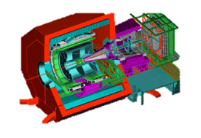
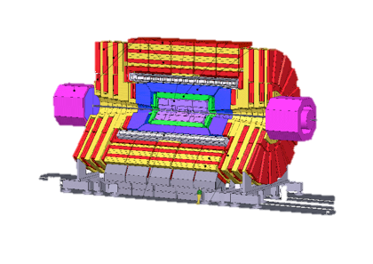
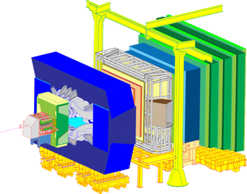

LHC Data Pipeline at CERN
Answering questions…
Data collection
Data analysis
ALICE
Event filtering
ATLAS
Results
Event selection, stat. treatment…
CMS
ROOT RDataFrame
LHCb
Raw data
Offline processing
  Analysis formats
Reconstruction
Reco
Processing, skimming
CMS Data Reduction
Notes:
This slide shows the pipeline that LHC data goes through.
These are the LHC experiments.
We start from the detectors that generate 1 PB/sec. This is of course a lot of data that needs to be filtered. This filtering happens normally in two phases, first a hardware filter or trigger and then a software filter, which select only those collisions that look interesting in terms of physics, that can potentially tell us something new. After this filtering, the volume of raw physics data that is actually stored is much smaller: around 1 PB/day. This physics data is stored in the mass storage system of CERN: EOS.
At this point, the raw data is reconstructed, which means it is processed to identify what particles were created as a result of the collision and the tracks (trajectories) they followed, and it is stored already in this ROOT format that I will discuss in a minute.
After that, it follows a phase of further processing and skimming of the data, which results in analysis formats also stored with ROOT, which are then used by the scientists to do their analysis and obtain physics results.

Slide 26
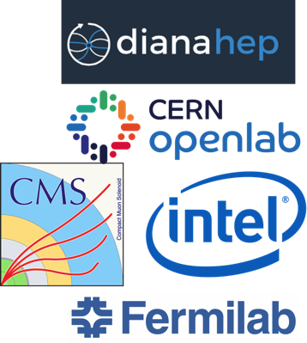
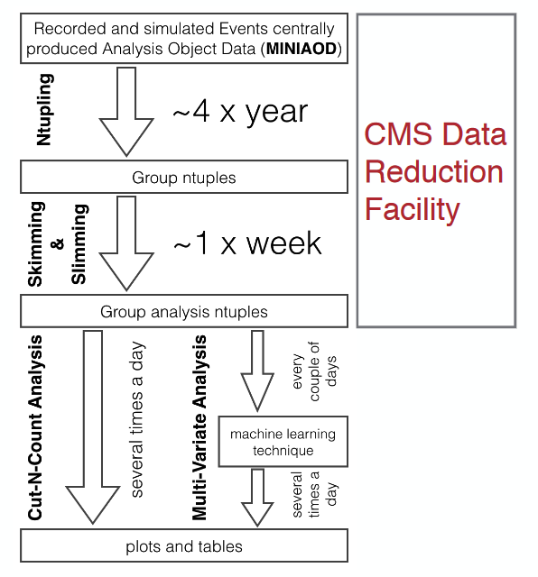
CMS Data Reduction Facility
Answering questions…
R&D, CMS Bigdata project, CERN openlab, Intel:
  Reduce time to physics for PB-sized datasets
  Exploring a possible new way to do HEP analysis Improve computing resource utilization
  Enable physicists to use tools and methods from “Big Data” and open source communities
CMS Data Reduction Facility:
  Goal: produce reduced data n-tuples for analysis in a more agile way than current methods
  Full reduction of 1PB physics data was completed; still in discussion on future direction

Slide 27


XRootD connector for Hadoop and Spark
Answering questions…
A library that binds Hadoop-based file system API with XRootD native client
  Developed by CERN IT
Allows most of components from Hadoop stack (Spark, MapReduce, Hive etc) to read/write directly from CERN storages – EOS and CASTOR
Also developed Spark data source to load ROOT files into DataFrames
C++
Java
Hadoop
HDFS
Spark
(analytix)
EOS
Storage
System
EOS
Storage
System
XrootD
Client
Hadoop-XrootD
Connector
Xrootd
Client
JNI
JNI
Git repo. - https://github.com/cerndb/hadoop-xrootd
Git repo. - https://github.com/diana-hep/spark-root

Slide 28

ROOT RDataFrame
Answering questions…
RDataFrame
  ROOT is tailored data analysis framework for HEP.
  Implemented in C++, interfaced also to Python
  Declarative API to build chain of DAG operations to process ROOT files
https://root.cern.ch
data
x,y
df = RDataFrame(dataset)
df2 = df.Filter('x > 0')
.Define('r2', 'x*x + y*y')
h = df2.Histo1D('r2')
g = df2.Graph('x', 'y')
Filter
x>0
Define
r²=x²+y²
Histo1D
r²
Graph
x,y

Slide 29
Distributed RDataFrame (experimental)
Answering questions…
Distributed RDataFrame
  Parallelize RDataFrame computations with multiple backends
  Allows to offload computations to spark clusters (Kubernetes or YARN) of possibly 1000s of vCPU
df = RDataFrame(dataset)
df2 = df.Filter('x > 0')
.Define('r2', 'x*x + y*y')
h = df2.Histo1D('r2')
g = df2.Graph('x', 'y')
Local
…
…
…
…
CPU
Computation
Graph
…
…
…
…
…
…
…
…
…
…
CPU
…
…
CPU
CPU
…
…
…
…
…
…
…
…
CPU
CPU
…
…
…
…
CPU

Slide 30

Distributed RDataFrame (experimental)
Answering questions…
Distributed RDataFrame
  Map-reduce workflow where every mapper runs the RDataFrame computation graph on a range of collision events
  Distributed computation is transparent to the user
Spark Cluster
Executor
Mapper
Spark Backend
Make ranges
px | py | pz | e
Driver
Read ranges
Reducer
Schedule tasks
Published at EuroPar 2019:
Declarative Big Data Analysis for High-Energy Physics: TOTEM Use Case

Slide 31




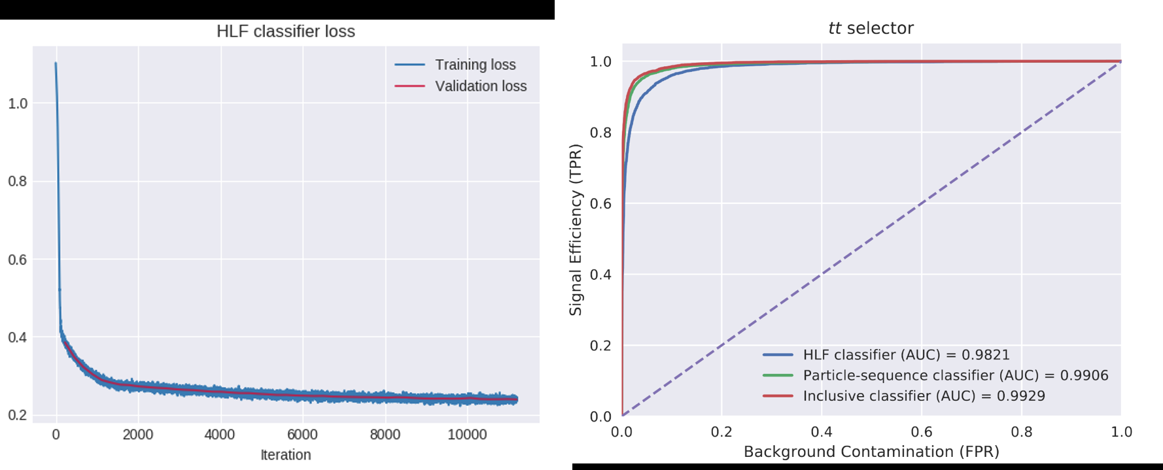


Machine Learning
Answering questions…
Data and models from Physics
Input: labeled
data and DL models
Feature engineering at scale
Distributed model training
Hyperparameter optimization (Random/Grid search)
Output: particle selector model
Machine Learning Pipelines with Apache Spark and Intel BigDL:
https://databricks.com/session/deep-learning-on-apache-spark-at-cerns-large-hadron-collider-with-intel-technologies

Slide 32
Conclusions
Answering questions…
Demand of “Big Data” platforms and tools is growing at CERN
  Many projects in-production
  Projects around Monitoring, Security, Accelerators logging/controls, physics data, streaming…
Hadoop and Spark services at CERN IT
  Service is evolving: High availability, security, backups, external data sources, notebooks, short-lived disposable clusters
Experience and community
  Technologies evolve rapidly and knowledge sharing very important
  We are happy to share/exchange our experience, tools, software with others
  Our blog - http://db-blog.web.cern.ch/

Slide 33


APACHECON Europe, Oct 24th, 2019
OPEN SOURCE BIG DATA TOOLS ACCELERATING PHYSICS RESEARCH AT CERN
Prasanth Kothuri – prasanth.Kothuri@cern.ch
Notes:
Pictures are CC License – Font is Google Montserat (free OFL).
Pictures

