Slide 1
Cooling trap development
Startup Meeting 2020/01/24
Markus Fleck

Slide 2
Synopsis
Reminder on the cooling trap & motivation
Construction of a room-temperature high-Q reference resonator
Measurements of different varactor diodes
Outlook

Slide 3
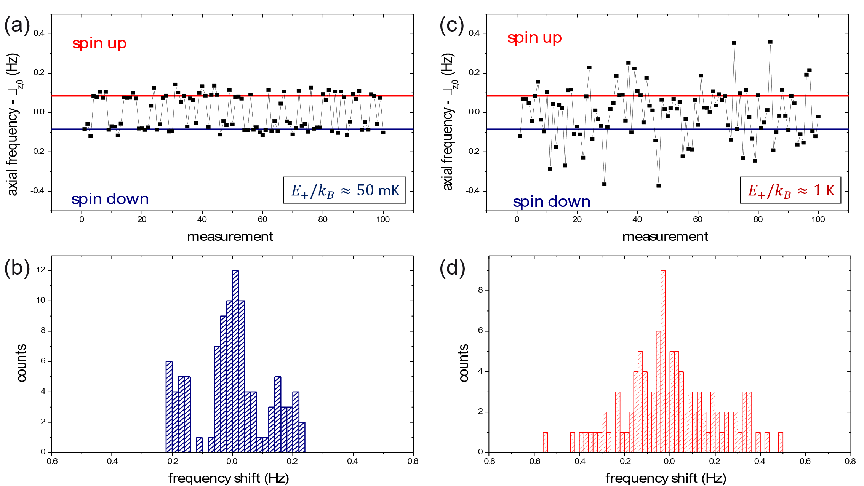
Reminder
Why a cooling trap?
  While spin-flips cause shifts in the axial frequency in the AT, so do changes in the quantum levels of the particle
  The heating rate of said quantum states is proportional to the quantum states, so a low quantum state, resp. energy is crucial for achieving low heating rates
  So far, cooling of the cyclotron mode has been done in the PT
  However, the PT does not have a magnetic bottle, so the energy can only be measured in the AT
  Such cooling cycles consume rather large parts of the time budget for a g-factor measurement
  Some numbers: PT cooling time constant: 380 s, transport time: 3 min, ~70 cycles needed => total cooling time for one particle ~10 h

Slide 4
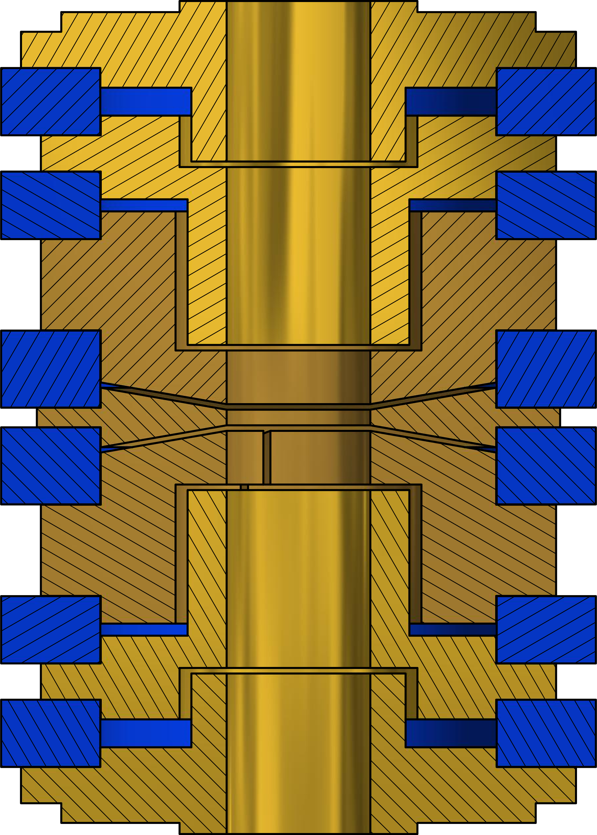
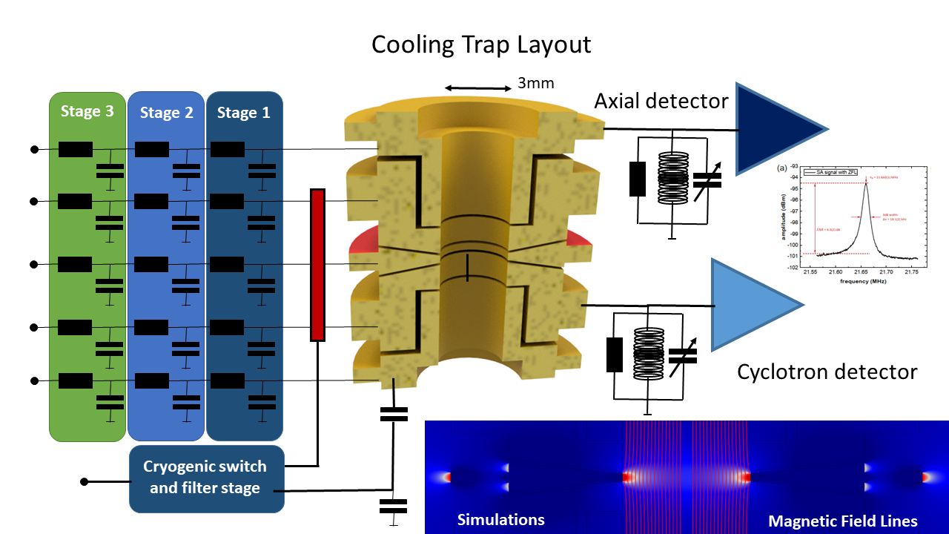
Reminder
Key design points of the CT:
  smaller diameter, resulting in a smaller pickup length
  Magnetic bottle to allow energy measurements
  Both axial and cyclotron detectors
In total, a reduction of the cooling time by a factor of ~50-70 is expected, cutting down 10h to several minutes

Slide 5
High-Q reference resonator
The CT cyclotron detector has to fulfill two criteria:
  High Q factor resulting in a high parallel resistance and therefore a short cooling time
  Wide tuning range allowing for a far detune of the cyclotron detector to reduce its residual influence on the particle
The dominant limit on the resonator’s unloaded Q stems from the varactor diodes
In order to explore that limit, a new resonator with a high unloaded Q at room temperature was constructed
Setup is still being optimised

Slide 6
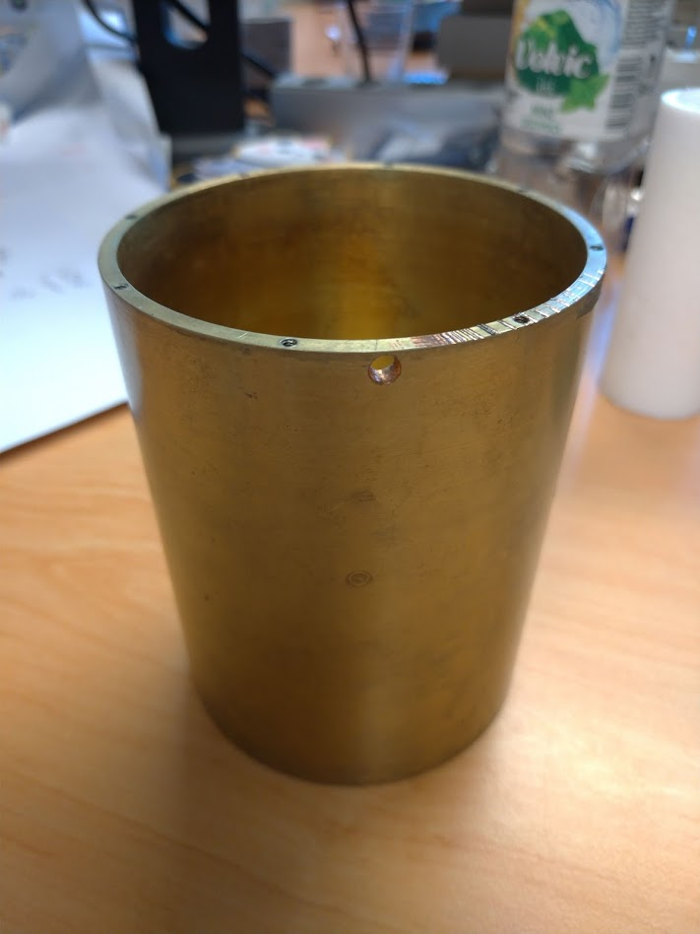
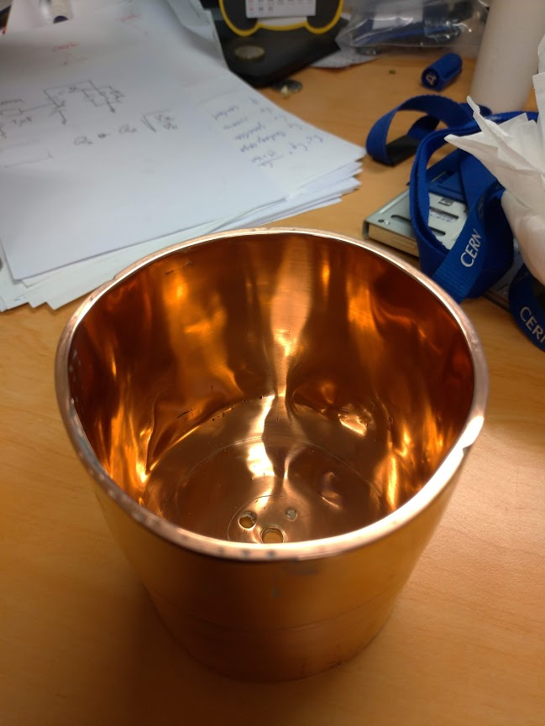
Resonator shield

Slide 7
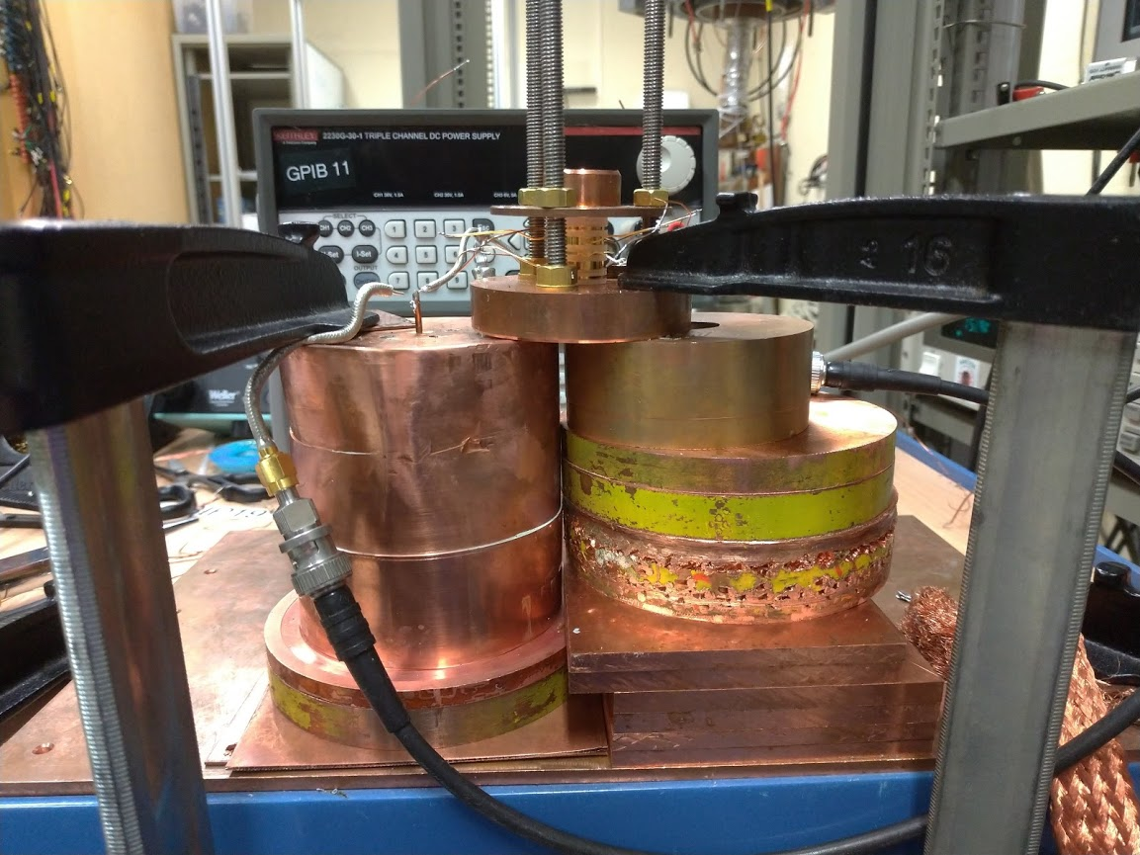
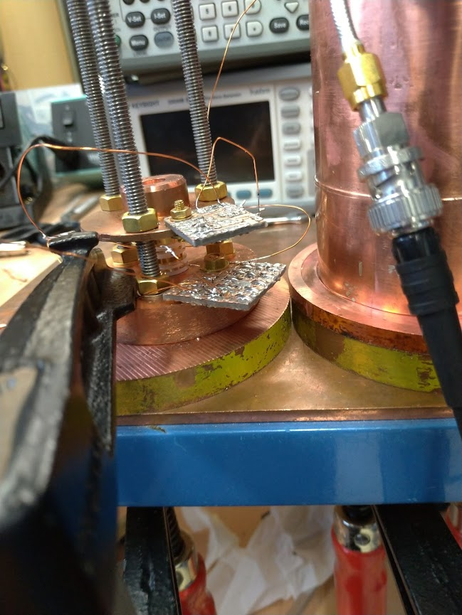
Setup

Slide 8
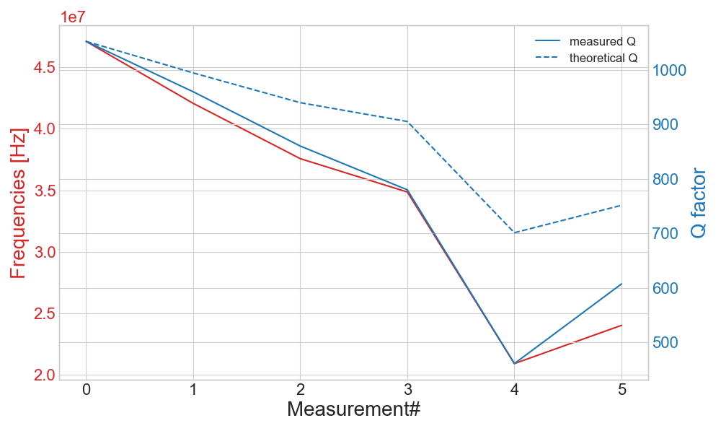
Q factor evaluation of different setups
~120mOhm

Slide 9
Q factor limitations by varactor diodes
Even high-Q varactors limit the totally achievable Q factor for the detection system
Effect can be regulated by varying the coupling strength between resonator/trap and the varactor network
Strong coupling has the side-effect of increasing the attainable tuning range
So far, coupling capacitances up to 5.6 pF were tested with four different varactor diodes
Out of these, three show no limitation so far, while one model (MA46477) was sorted out due to strong effects even at weak couplings

Slide 10
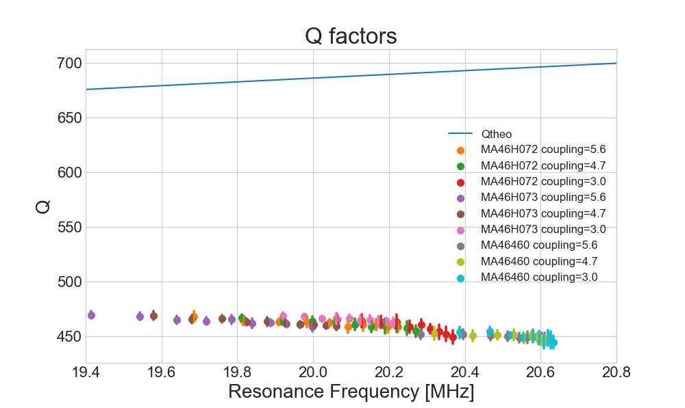
Q factors using the reference resonator

Slide 11
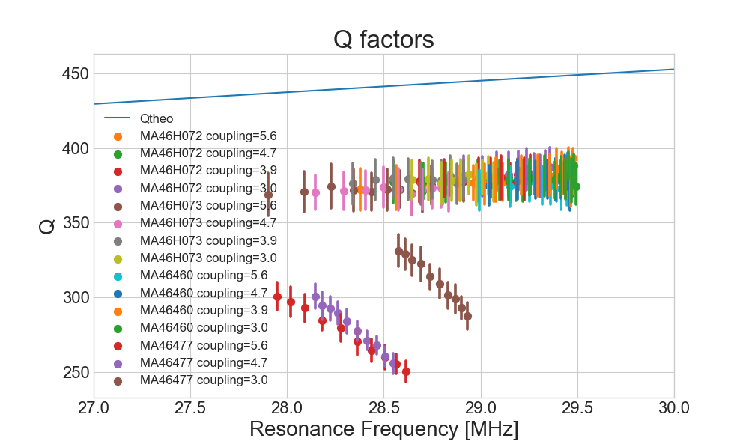
Q factors using the proton resonator

Slide 12
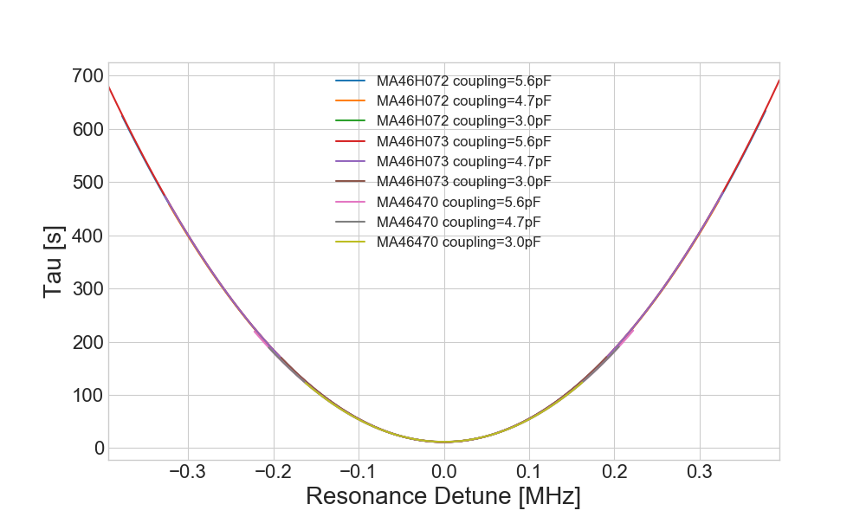
Off-resonance cooling time constant

Slide 13
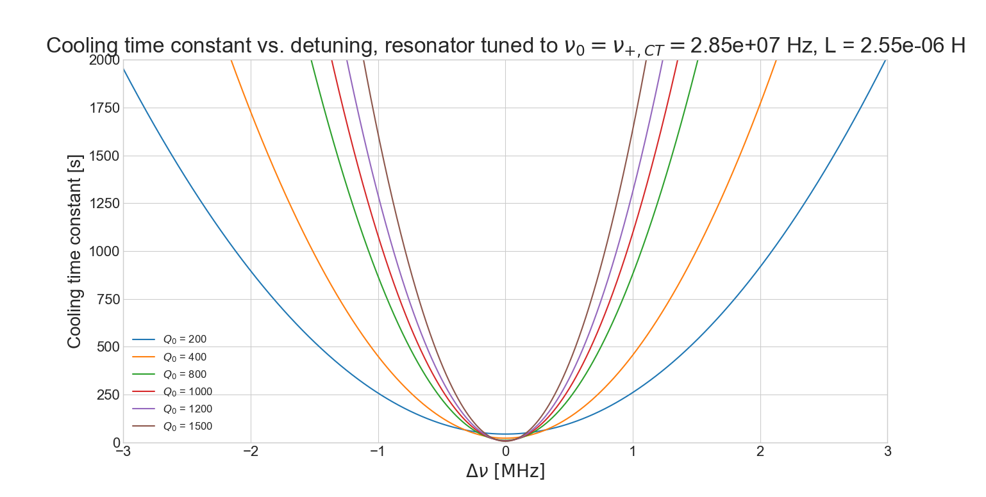
Off-resonance cooling time constant

Slide 14
Outlook
Next steps:
  Minimise losses in the test setup
    Further reduce wire lengths
    Pin-point causes of limitations
    If necessary redesign electronics boards
  Measure varactor diodes with increasing couplings to characterise the upper Q and tuning range limits for each diode
If everything proceeds smoothly, these measurements should be done within the next week
Next next steps:
  Analyse data and understand the fundamental limitations – during next stay at RIKEN
  Design the electronics for the cyclotron detector with the requirements of the CT using what was learned during the current measurement phase - February

