Slide 1

Agenda
Amplifiers
Magnet sandwich
Noise measurement
Lessons learned
Notes:
Quick Update on what I have been working since november
A lot of time into learning process, therefore focus also on things stuck

Slide 2
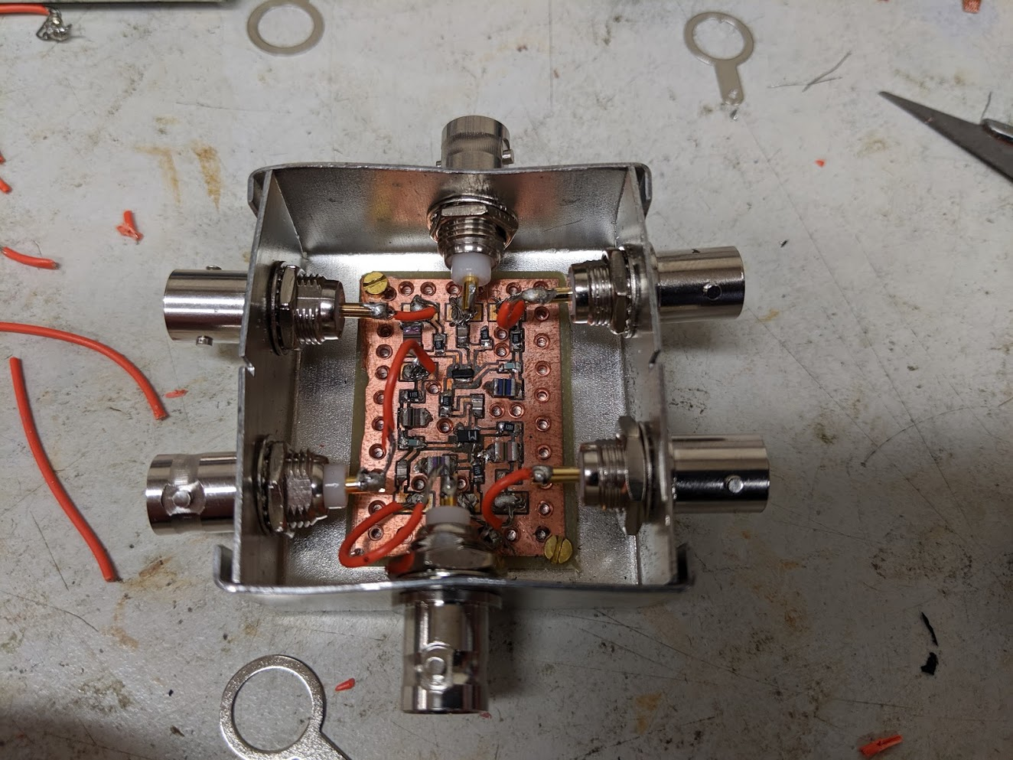
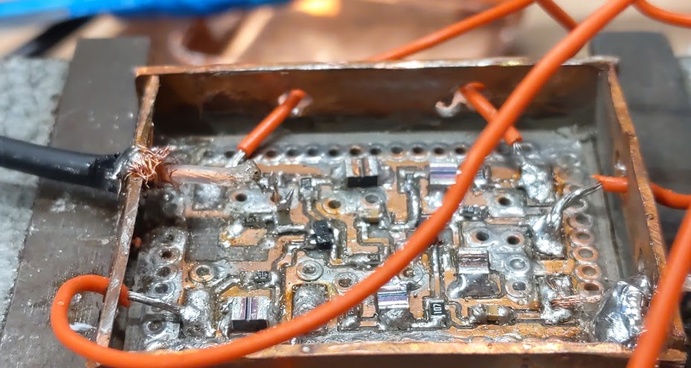
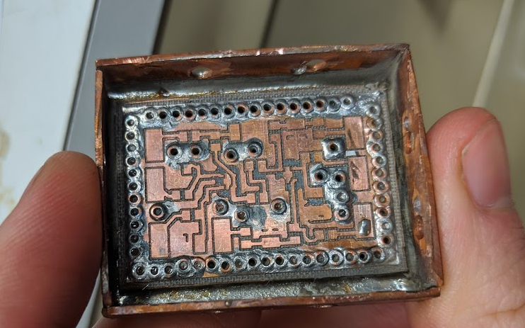
first Amp Vs second Amp
1.
The second Amp is build in a copper case, therefore magnetproof
In the second Amp, IN and OUT are connected via coax [high impact]
The board of the second Amp has slightly improved layout
Problem: loose cables have a mechanical impact on the board
2.
Solved by soldering the cables on the box

Slide 3
Agenda
Amplifiers
Magnet sandwich
Noise measurement
Lessons learned
Notes:
Fußzeilen!

Slide 4
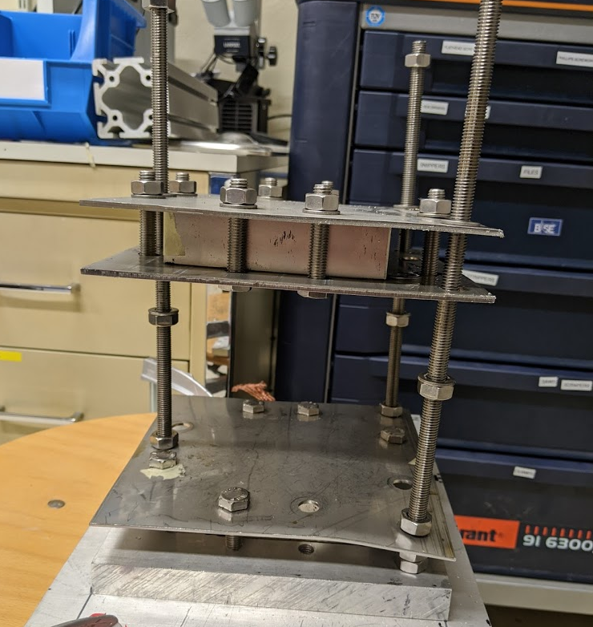
Construction of the magnet sandwich
B Field
Notes:
Gewindestange = threaded rods

Slide 5
-60
400
Magnetic field inside
-20
420
-15
390
450
-50
380
430
400
440
420
-70
B Field
420
385
-55
360
-15
400
*Values in [mT]
-12

Slide 6
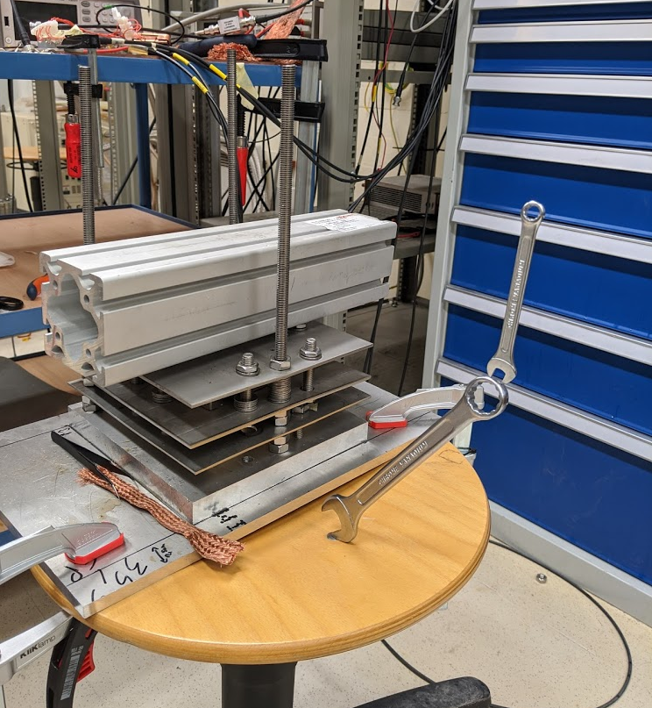
Construction of the magnet sandwich
B Field
Notes:
Gewindestange = threaded rods

Slide 7
Possible improvement for higher fieldstrength
B Field
1cm
0,5cm
B Field

Slide 8
Agenda
Amplifiers
Magnet sandwich
Noise measurement
Lessons learned
Notes:
Fußzeilen!

Slide 9
The question behind my project
What influence does a [strong] magnetic field have on the equivalent input noise of my amplifier

Slide 10
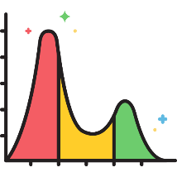
e_{n,} G₁
z_{n,} G₂
N_{n}
H-Amp
ZFL
Analysator
e_{n}²G₁² G₂² + z_{n}²G₂²+s_{n}² = N_{n}²
In practical terms:
e_{n} equivalent input noise [calculated]
N_{n} total output noise [Spectrum A.]
z_{n} noise of the ZFL [calculated]
s_{n} noise of the Sp.A. [Spectrum A.]
G₁ Gain of my Amps [Network A.]
G₂ Gain of the ZFL [Network A.]
…Units…
Measured data vs. Calculated data
Labview
Mathematica
How to spectrum analyzer
RBW*#Points < Span -> interpolation

Slide 11
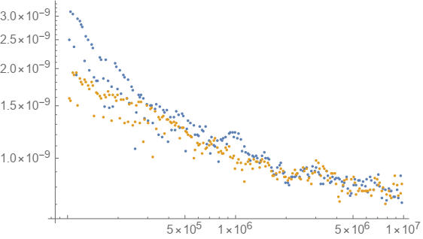
Without Magnet
With Magnet
Noise density in Log( V/√Hz)
But:
RBW*#Points < Span -> interpolation
Frequency in Log(Hz)

Slide 12
Agenda
Amplifiers
Magnet sandwich
Noise measurement
Lessons learned
Notes:
Fußzeilen!

Slide 13

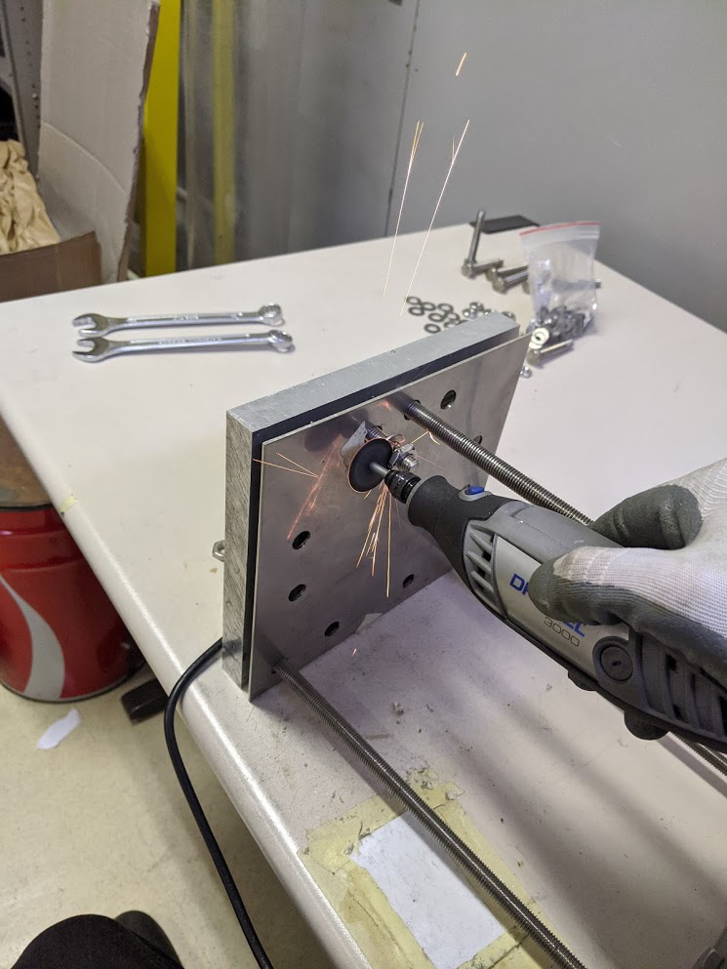
My lessons learned at BASE
1.
Hardwelding is a thing…
2.
3.
4.

Slide 14
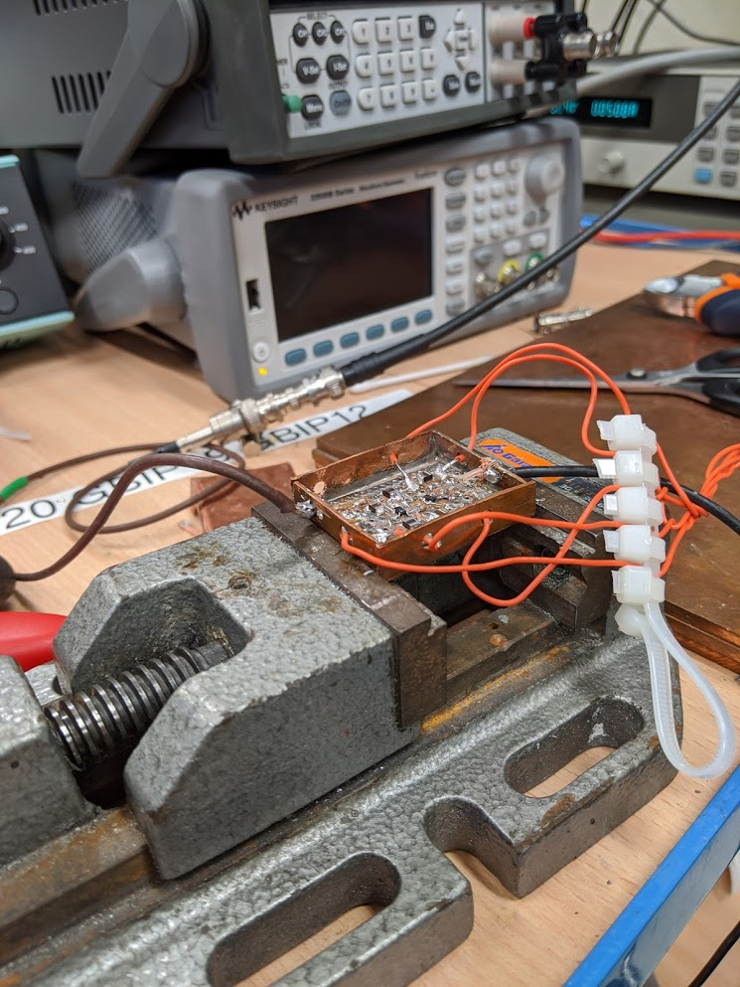

My lessons learned at BASE
1.
Hardwelding is a thing…
Hardwelding is a thing…
2.
There are problems to look into and some not to…
3.
4.

Slide 15
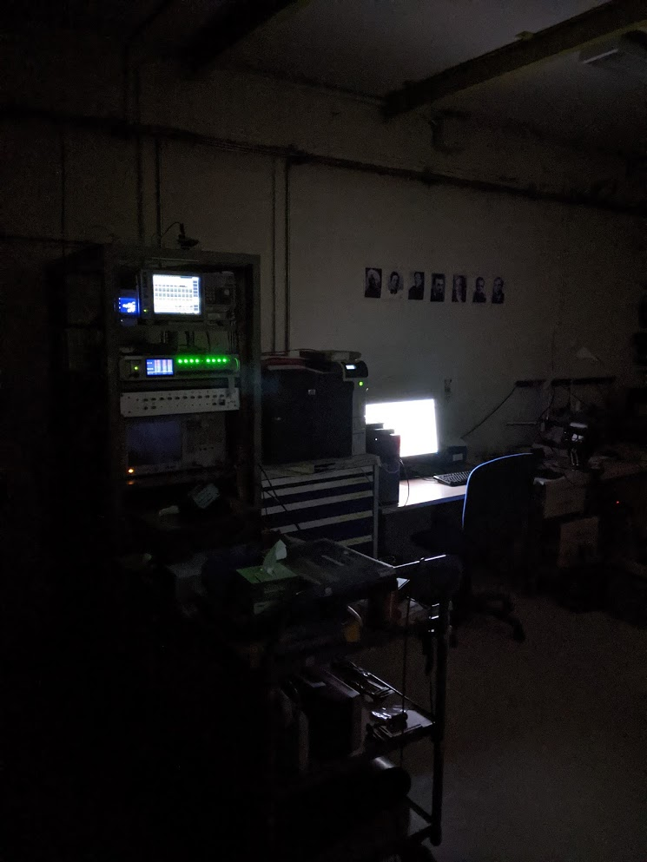

My lessons learned at BASE
1.
Hardwelding is a thing…
2.
There are problems to look into and some not to…
3.
Don´t try to finish something in a rush on the same day…
4.

Slide 16
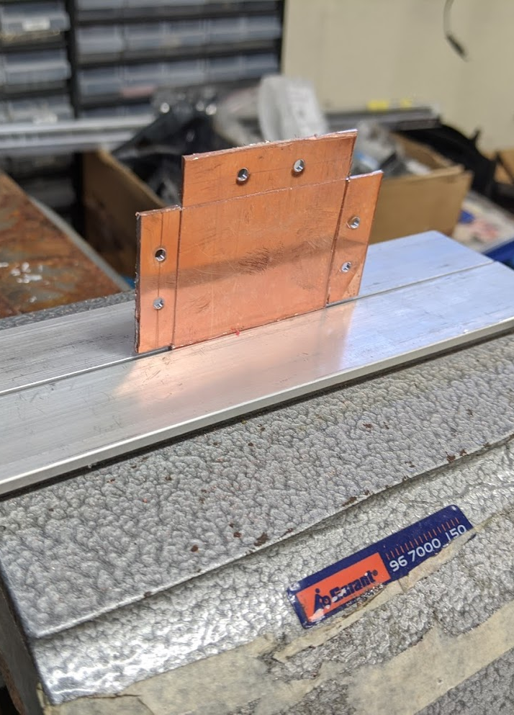

My lessons learned at BASE
1.
Hardwelding is a thing…
2.
There are problems to look into and some not to…
3.
Don´t try to finish something in a rush on the same day…
4.
Detailed sketches save measurement time…

Slide 17
My lessons learned at BASE
1.
Hardwelding is a thing…
2.
There are problems to look into and some not to…
& good grounding is not trivial…
3.
Don´t try to finish something in a rush on the same day…
4.
Detailed sketches save measurement time…

