Slide 1
Speckles at FCC
January update
Topics
A semi-analytic method to simulate the speckle pattern
Analysis of the impact of polychromatic light
An idea to measure the transfer function of a 20x magnification and the BASLER acA1600-20gm

Slide 2
--(SRW)--
electron
YAG
Step 1) simulating the wavefront of one electron passing through the FCC arcdipole with SRW at the position of the YAG

Slide 3
E_i
colloid_i
electron
YAG
Step 2) For each of the colloid (i) calculate the position where the center of the speckle will appear on the YAG. Save the value of the electric field at that point.

Slide 4
r
E_i
colloid_i
electron
YAG
Step 3) Emit a spherical wave from the colloid. Adding the phase of E_i and subtracting the phase difference of the distance r. Shaping this spherical wave by the airy function.

Slide 5
electron
YAG
Step 4) Loop for all the colloids adding their electric fields and the electric field of the initial wave. Calculating the intensity and adding those intensities from all the other electrons.
The electrons are randomly distributed on a Gaussian shape with a sigma of 5um.

Slide 6
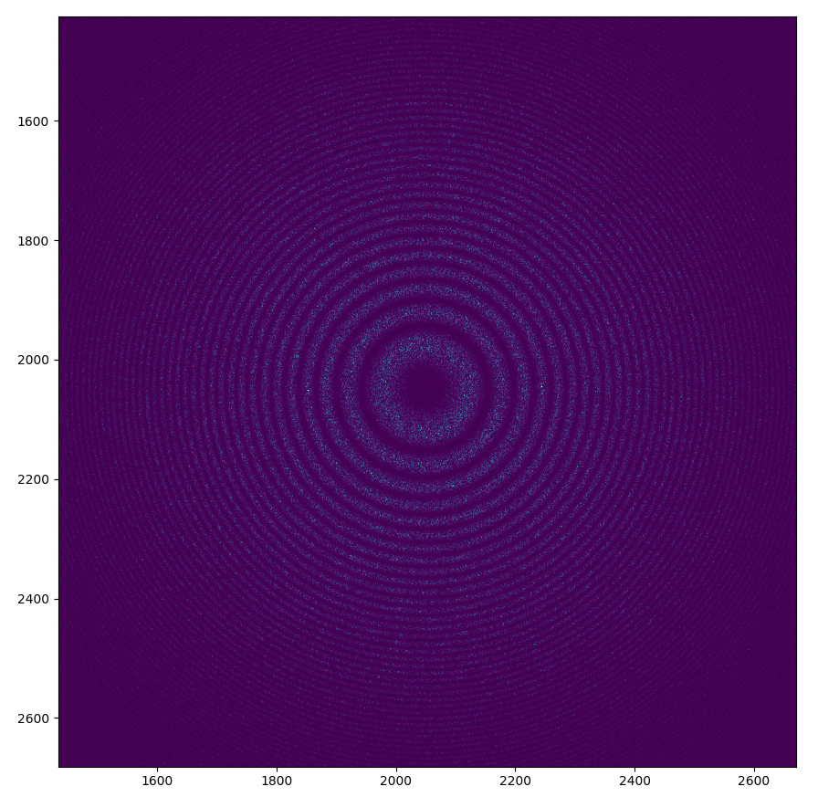
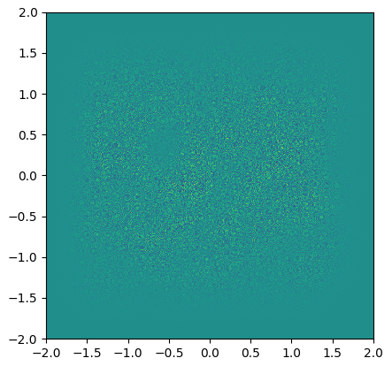
Using the following parameters:
Distance from source to colloids=100m
Distance from colloids to YAG=20m
Extension of the mesh=4mmx4mm
Pixels=4096x4096
Size of colloids=2um diameter
Number of colloids=1000 (distributed on 3mmx3mm)
Sigma of the beam=5um (radially symmetric)
dual space
direct space [mm]

Slide 7
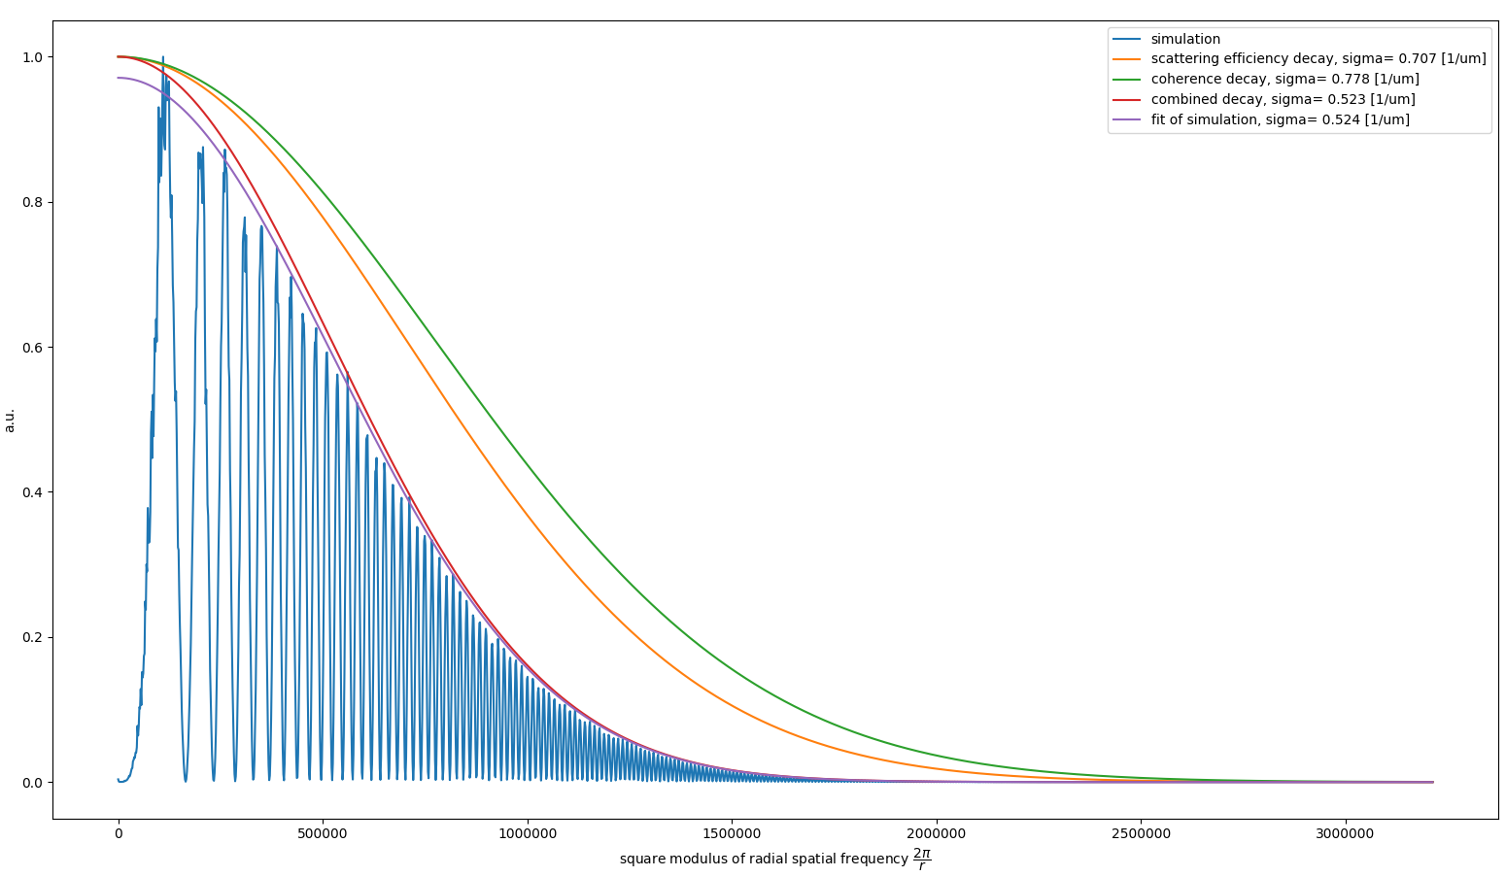
Radially averaged square modulus of 2d-FFT of interference pattern of ~500 particles

Slide 8
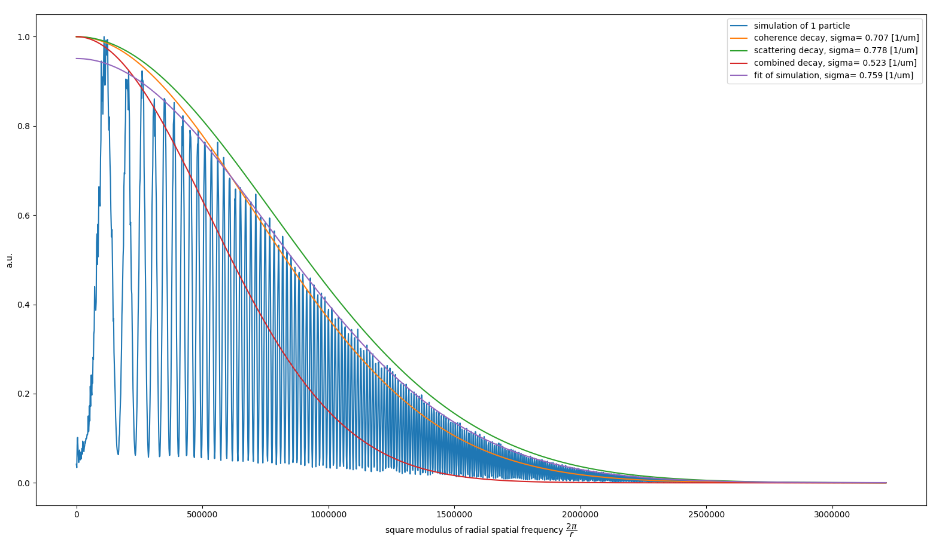
Radially averaged square modulus of 2d-FFT of interference pattern of 1 particle

Slide 9
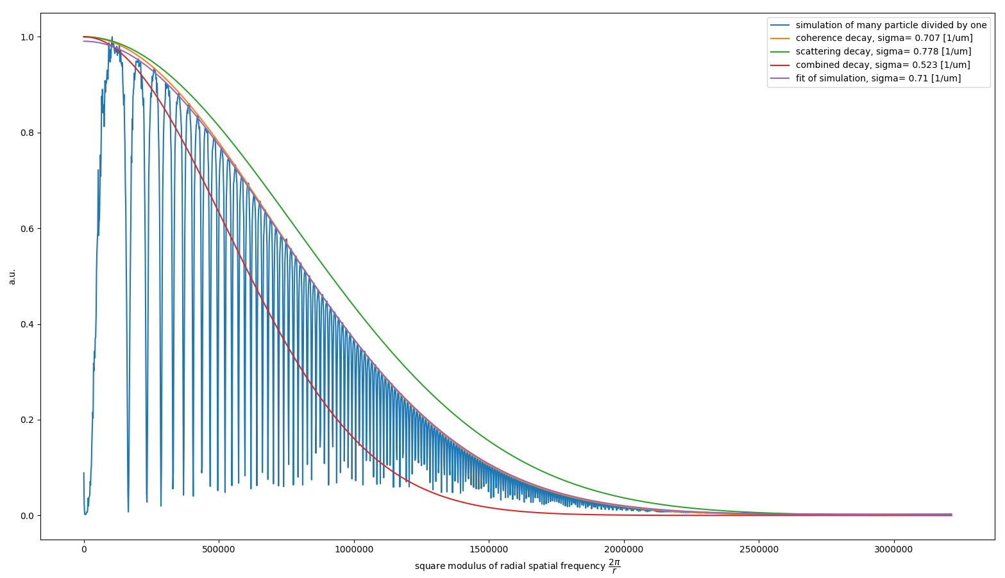
FFT of 500 particles divided by FFT of 1 particle

Slide 10
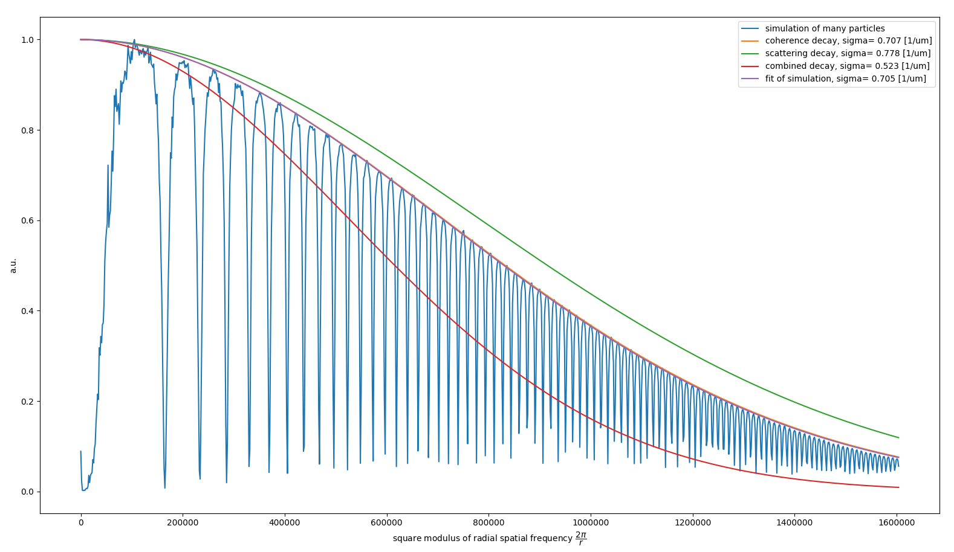
Binning down to 2048x2048px, FOV 4mmx4mm (no magnification)

Slide 11
Notes on the extension and the FFT
sigma of the combined decay (decay due to coherence loss and due to scattering efficiency) = 0.5 [1/um]
3 times this sigma = 1.5 [1/um]
resolution in FFT = 1/extension *2*pi
maximum frequency in FFT = pixel/extension/2 *2*pi
using 2048 pixel on 4mm => 1.6 [1/um]
Notes on the method
Advantages
  Feasible CPU time and storage consumption (10min on 4 cores and 100MB per particle)
  Realistic wavefront using SRW
Disadvantages
  Scattering efficiency imposed by approximated theory (might be not physical, but its not important in the end because we divide by it)

Slide 12
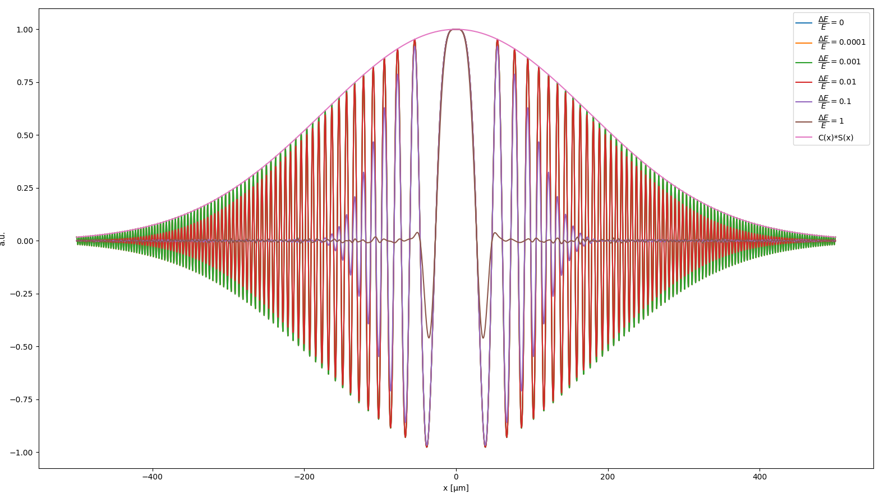
Analysis of energy spread in direct space
Using point emitters as source particles and one single scattering particle -> one speckle pattern!
z1=100, z2=20, colloids=2um, energy=20keV, extension=1mm, pixel=2e4, source particles = 8000, different DeltaE/E

Slide 13
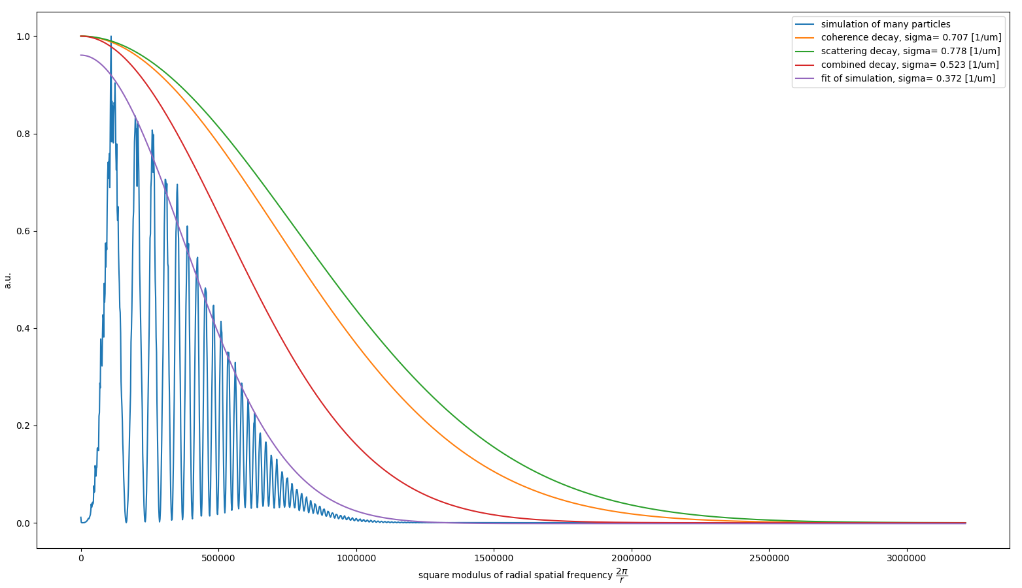
1000 particles distributed by a Gaussian in beam position (sigma of 5um, x0=0)
and a Gaussian in energy (20keV with FWHM/energy=0.05)

Slide 14
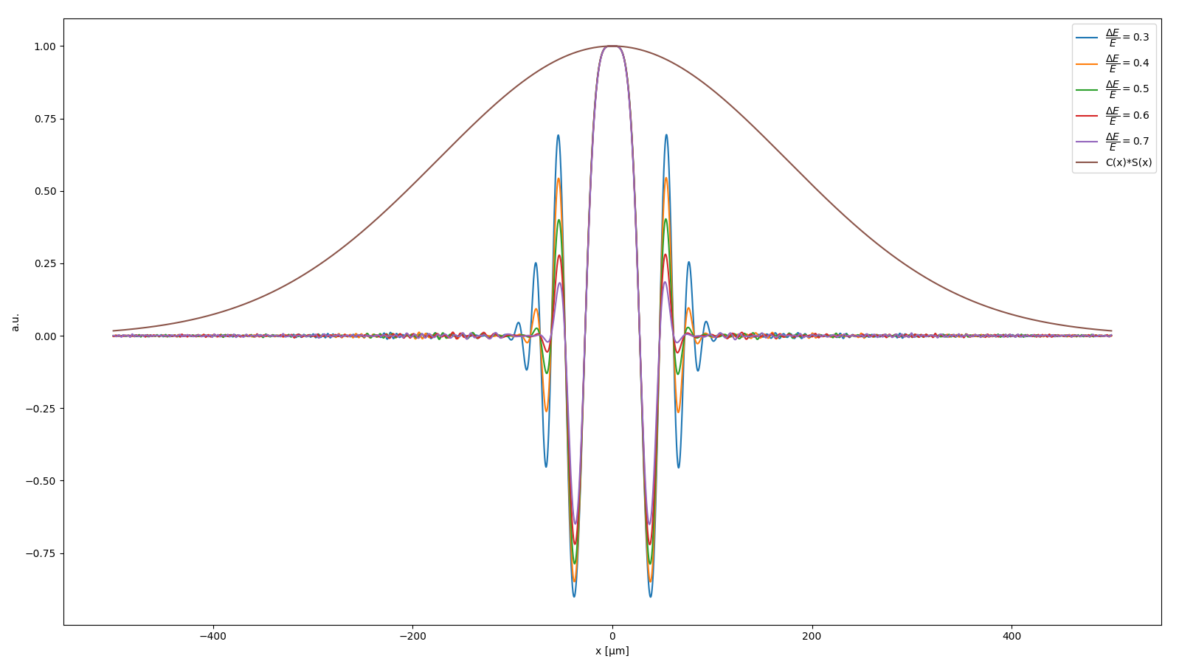
What is the limit?
Below FWHM/energy < 0.4 the second Talbot oscillation is suppressed by more than 50% (for the given parameters).
Energy spread effect will be a major player => I(q)=H(q)*S(q)*C(q)*T(q)*DeltaE(q)+..

Slide 15
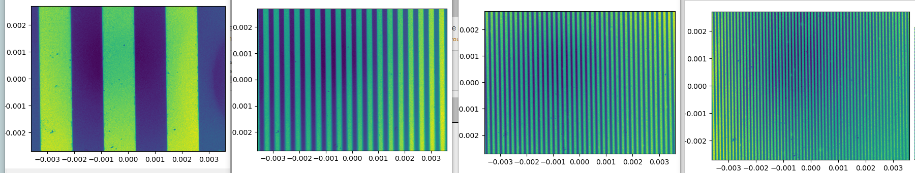
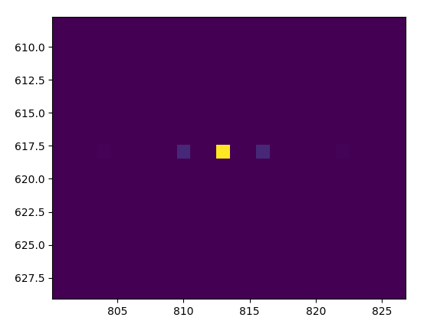
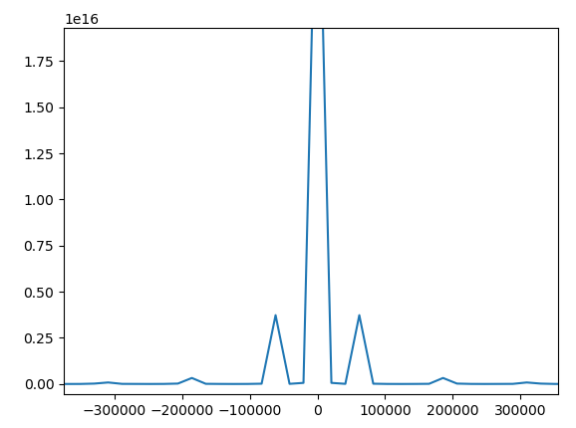
Transfer Function of the BASLER + 23x
red LED -> diffraction plate -> 23x -> BASLER acA1600-20gm
10 lines/mm
60 lines/mm
130 lines/mm
200 lines/mm
2d FFT
cut
w=2*pi*10/(0.001) = 62,831

Slide 16
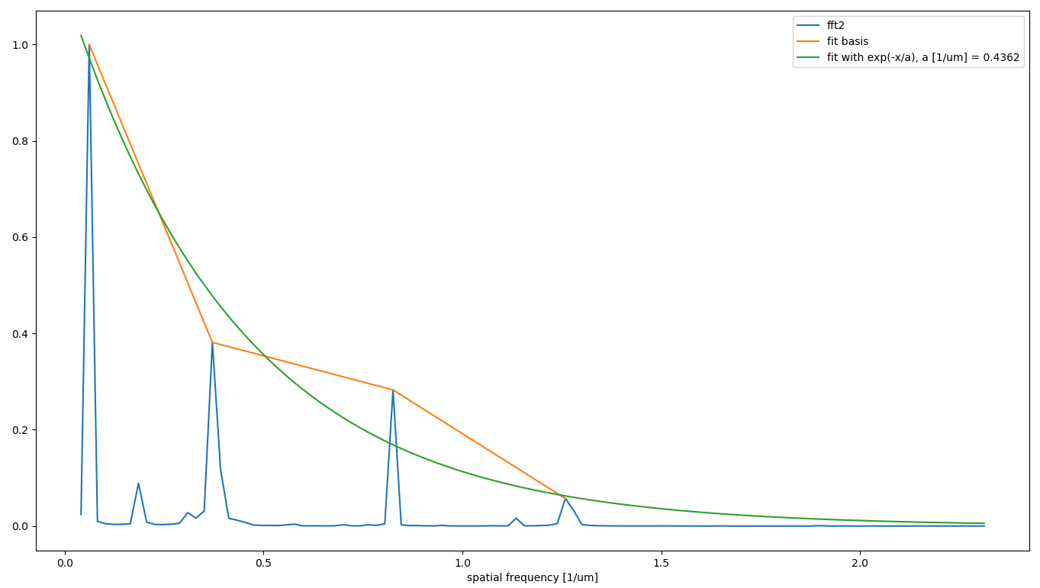
Summing up all the crosscuts
More frequencies and more images per frequency necessary for a good fit…

Slide 18
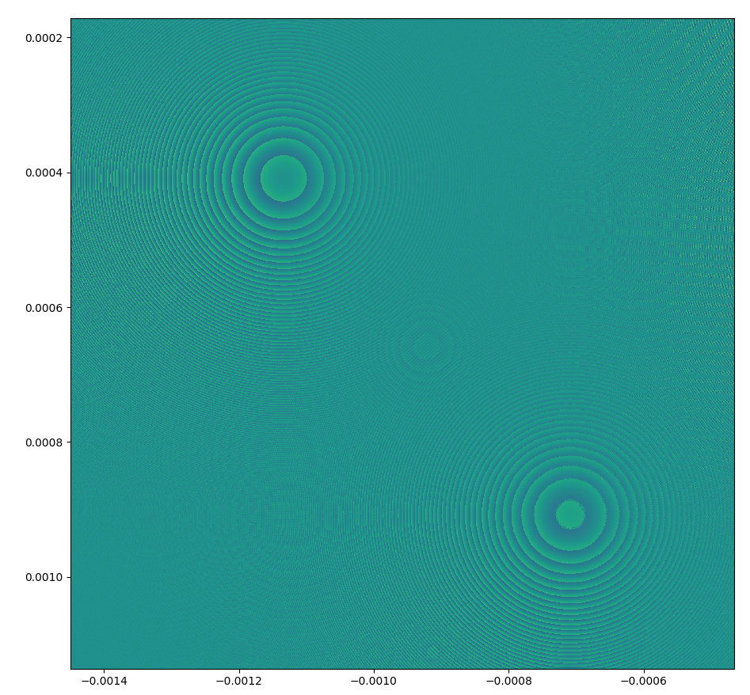
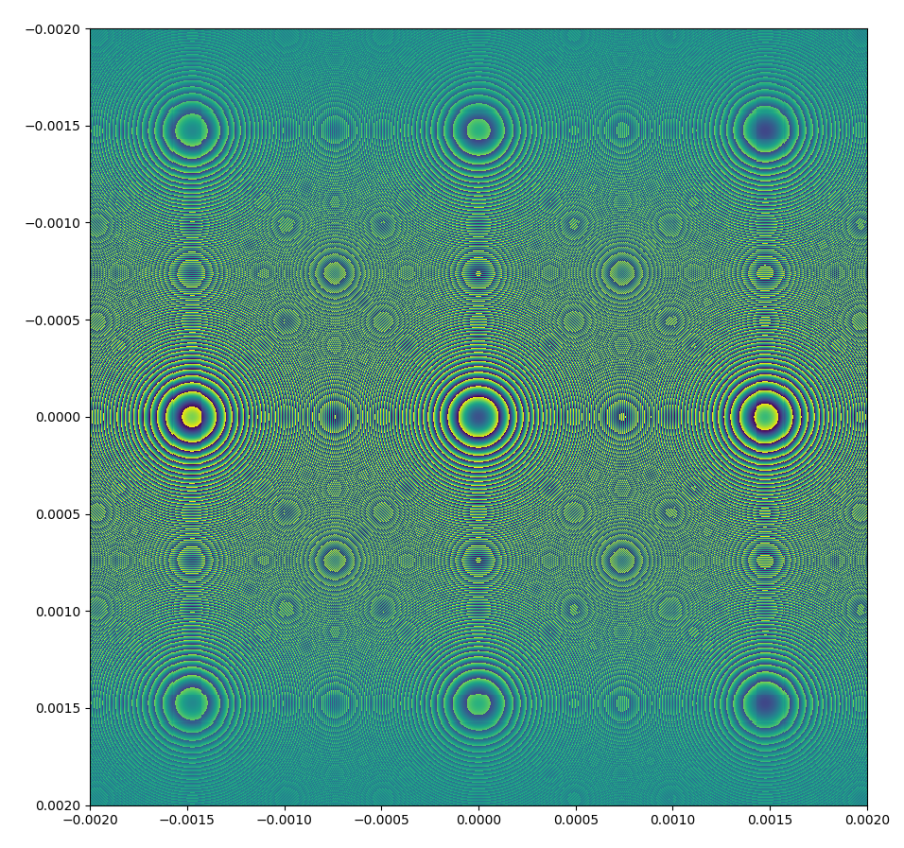
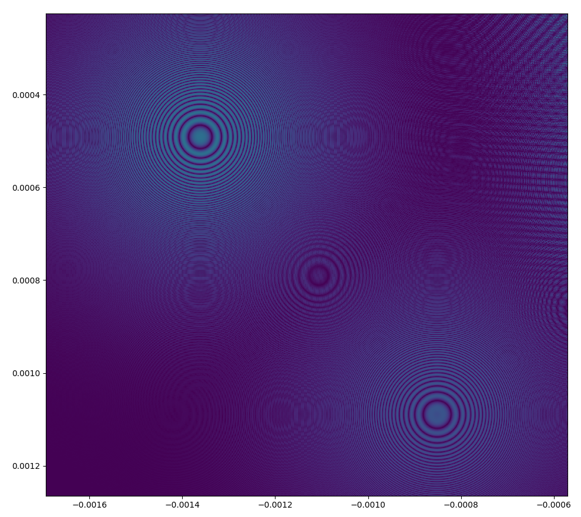
SRW wavefront of an FCC arcdipole
Theoretical airy shaped scattered wave
Intensity of interference
Illustrated by abs(E)*phase(E)

