Slide 1
Refractive index for speckles mask
SM, 15/1/2020

Slide 2
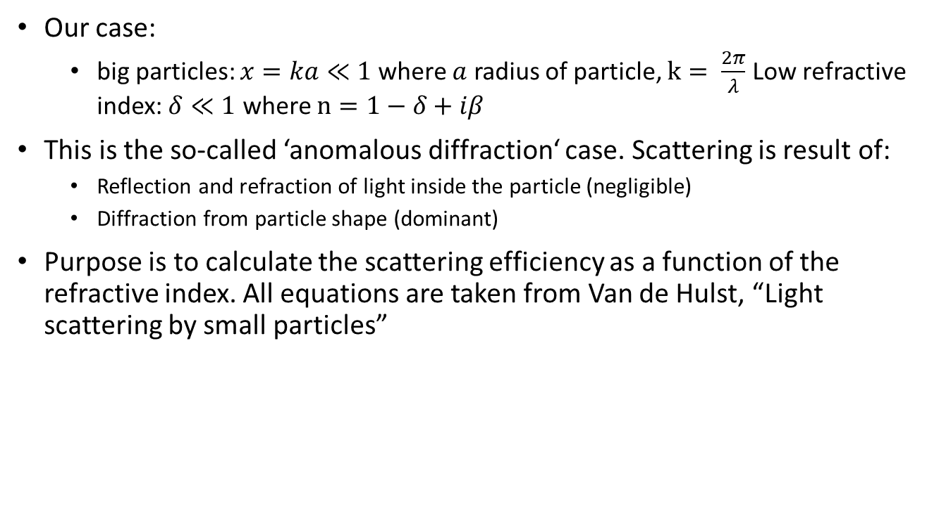
Intro
Our case:
  big particles: $x=ka≪1$ where $a$ radius of particle, $k= \frac{2π}{λ}$ Low refractive index: $δ≪1$ where $n=1−δ+iβ$
This is the so-called ‘anomalous diffraction‘ case. Scattering is result of:
  Reflection and refraction of light inside the particle (negligible)
  Diffraction from particle shape (dominant)
Purpose is to calculate the scattering efficiency as a function of the refractive index. All equations are taken from Van de Hulst, “Light scattering by small particles”

Slide 3
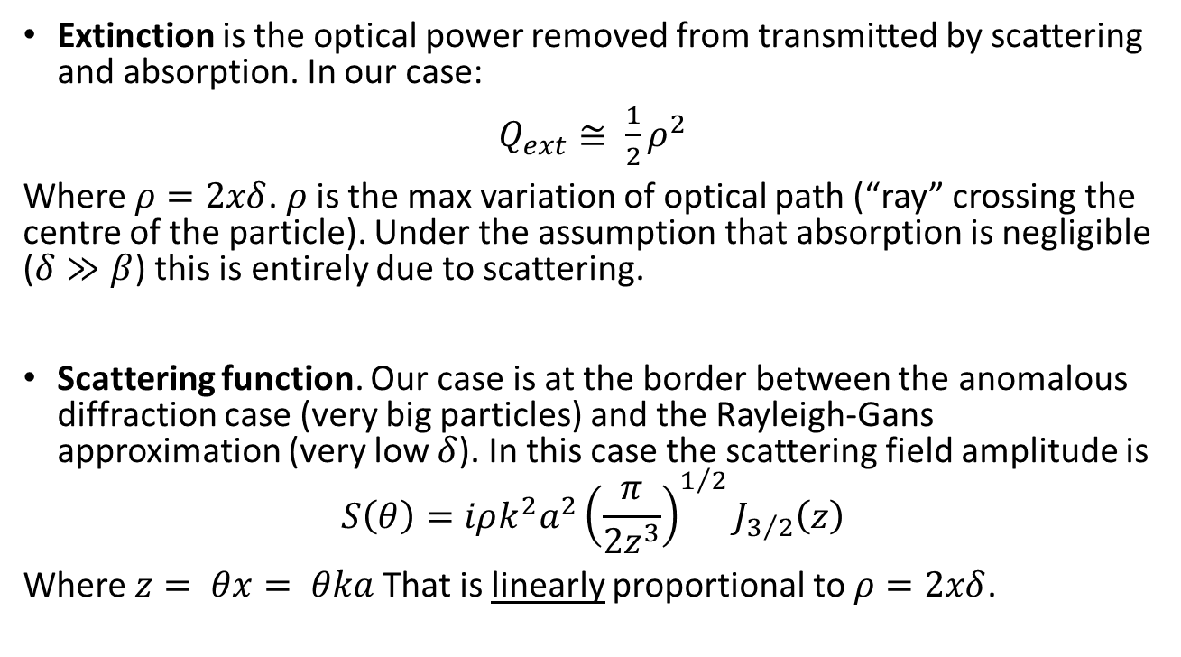
Extinction and scattering function
(single particle)
Extinction is the optical power removed from transmitted by scattering and absorption. In our case:
$Q_{ext}≅ \frac{1}{2}ρ^{2}$
Where $ρ=2xδ$. $ρ$is the max variation of optical path (“ray” crossing the centre of the particle). Under the assumption that absorption is negligible ($δ≫β$) this is entirely due to scattering.
Scattering function. Our case is at the border between the anomalous diffraction case (very big particles) and the Rayleigh-Gans approximation (very low $δ$). In this case the scattering field amplitude is
$$S\left(θ\right)=iρk^{2}a^{2}{\left(\frac{π}{2z^{3}}\right)}^{1/2}J_{3/2}\left(z\right)$$
Where $z= θx= θka$ That is linearly proportional to $ρ=2xδ$.

Slide 4
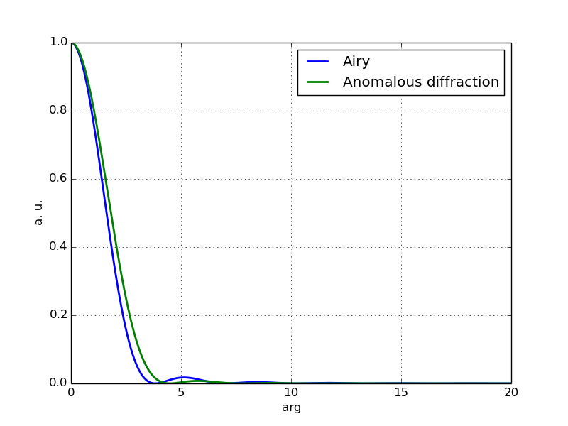
Comparison with pure diffraction

Slide 5
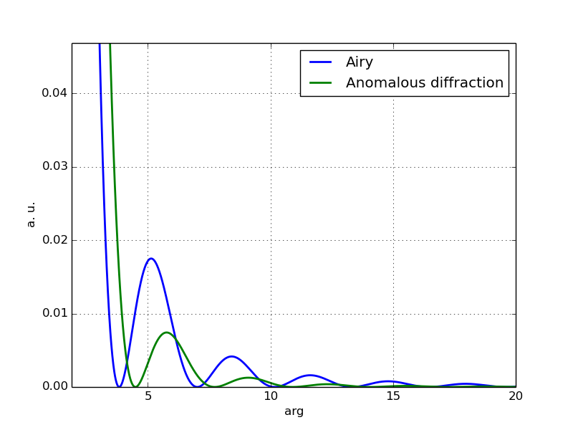
Comparison with pure diffraction

Slide 6
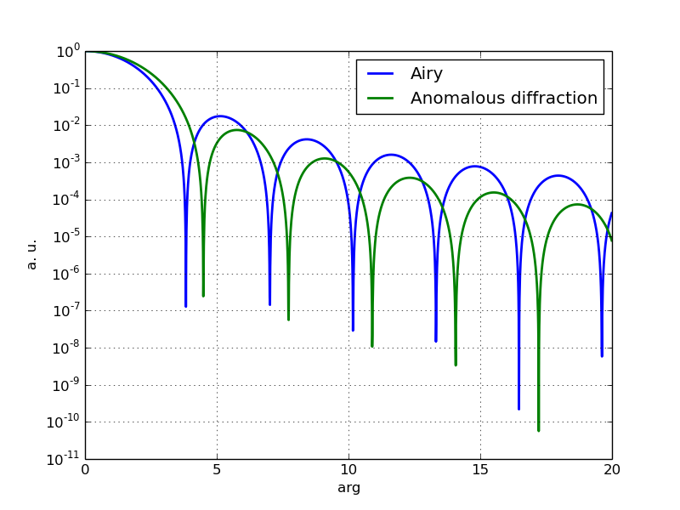
Comparison with pure diffraction

Slide 7
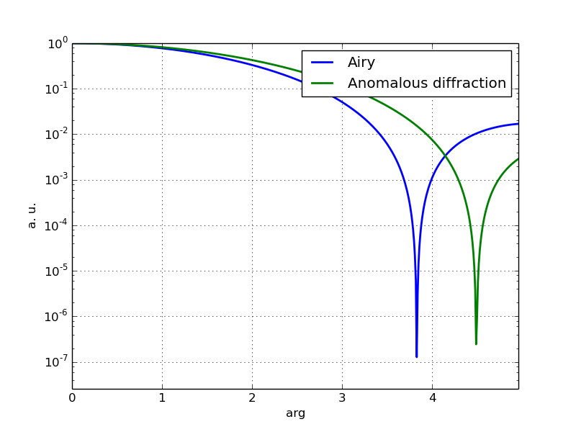
Comparison with pure diffraction

Slide 8
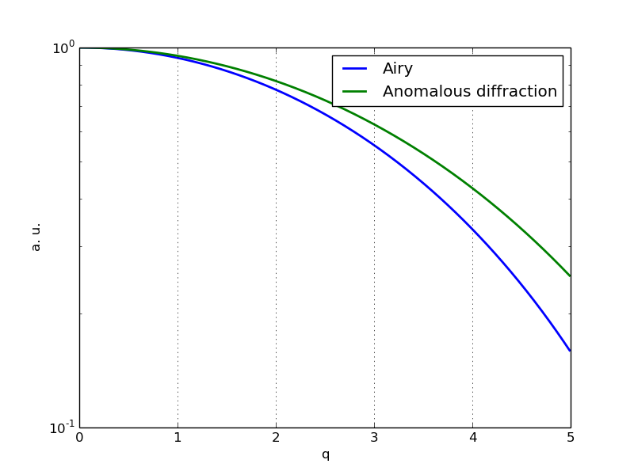
Comparison with pure diffraction

Slide 9
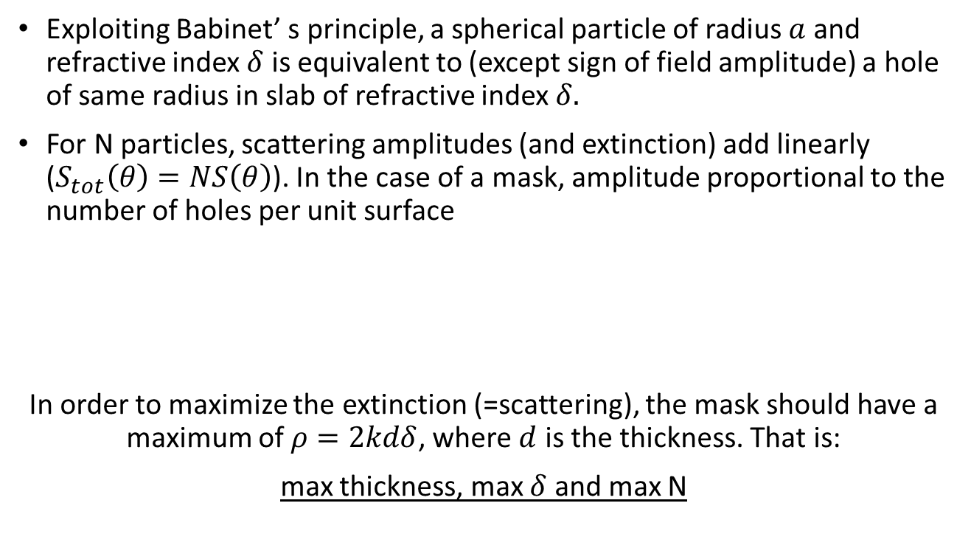
Mask vs particles
Exploiting Babinet’ s principle, a spherical particle of radius $a$ and refractive index $δ$ is equivalent to (except sign of field amplitude) a hole of same radius in slab of refractive index $δ.$
For N particles, scattering amplitudes (and extinction) add linearly ($S_{tot}\left(θ\right)=NS\left(θ\right)$). In the case of a mask, amplitude proportional to the number of holes per unit surface
In order to maximize the extinction (=scattering), the mask should have a maximum of $ρ=2kdδ$, where $d$ is the thickness. That is:
max thickness, max $δ$ and max N

Slide 10
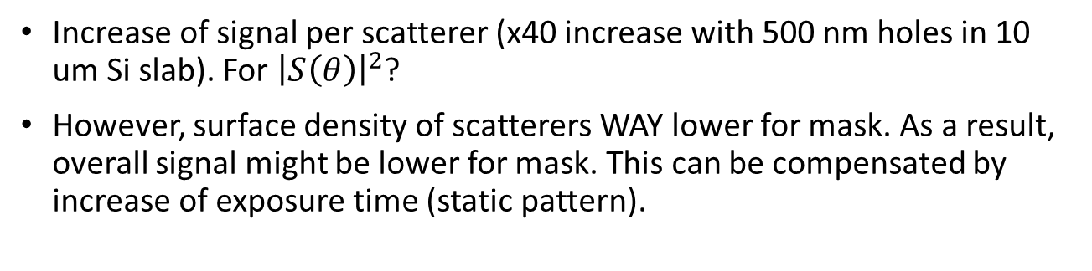
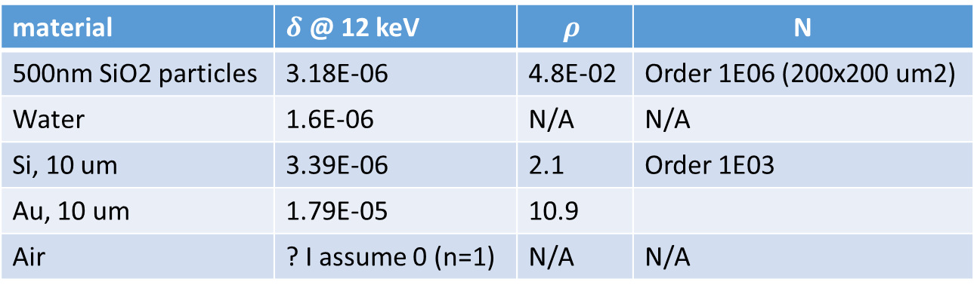
A few numbers
material | $δ$ @ 12 keV | $$ρ$$ | N
500nm SiO2 particles | 3.18E-06 | 4.8E-02 | Order 1E06 (200x200 um2)
Water | 1.6E-06 | N/A | N/A
Si, 10 um | 3.39E-06 | 2.1 | Order 1E03
Au, 10 um | 1.79E-05 | 10.9
Air | ? I assume 0 (n=1) | N/A | N/A
Increase of signal per scatterer (x40 increase with 500 nm holes in 10 um Si slab). For ${\left|S\left(θ\right)\right|}^{2}$?
However, surface density of scatterers WAY lower for mask. As a result, overall signal might be lower for mask. This can be compensated by increase of exposure time (static pattern).

Slide 11
