Slide 1
Welcome and introduction

Slide 2
Welcome
Thanks for coming!
Covid-19 makes travel not so straightforward
My thoughts, and best wishes, to our Italian colleagues
who have been and are in the fore-front of the European
Covid-19 epidemic

Slide 3
Papers
Status of MICE

Slide 4
Published in Nature
https://doi.org/10.1038/s41586-020-1958-9

Slide 5
Papers

Slide 6
Outreach to go alongside Nature paper
Press release:
  STFC lead, coordinate through existing lab network
    Need to coordinate at institute level through CB
Peer-group seminar at RAL
Event at RAL/DL:
  Peer-group meeting:
    MICE results, impact on muon collider/neutrino factory
    nuSTORM
  Early-evening public lecture
Film with Science Animated
News/article in, e.g., CERN Courier, Symmetry
  Perhaps also newspaper
Finaised.
27Feb20; 15:00 GMT; RAL and broadcast to DL
Stalled.
Reinitiate.
P. Kyberd now underway
Published online
will be in next hardcopy
P.Kyberd, KL, C.Rogers

Slide 7
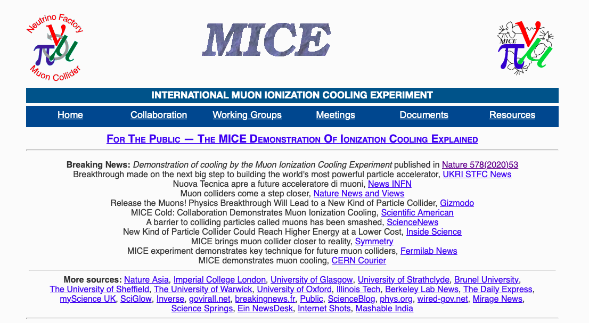

Slide 8
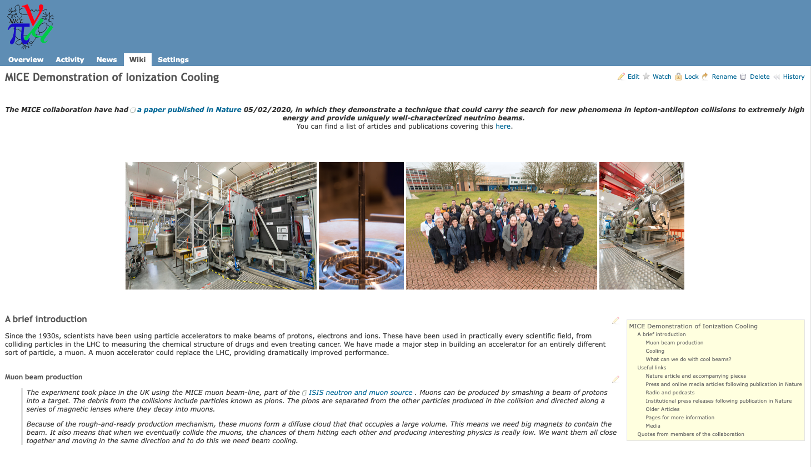

Slide 9
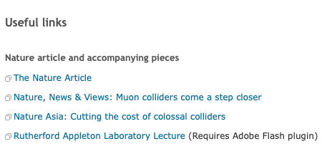

Slide 10
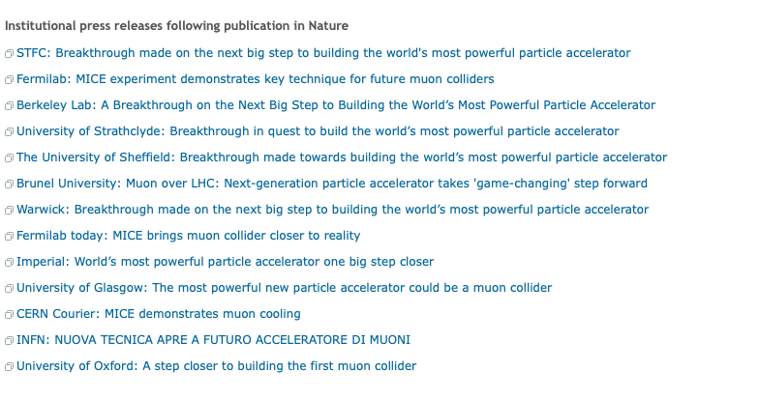

Slide 11
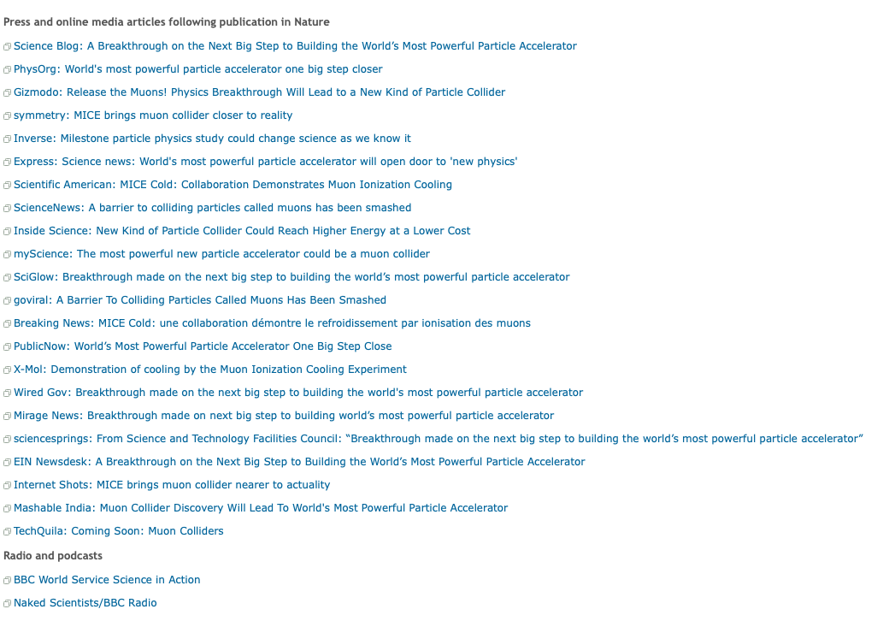
Amy Pollock (Comms), Josephine Taylor (PPD)
C. Rogers (ISIS)

Slide 12
And now …
Welcome and introduction

Slide 13
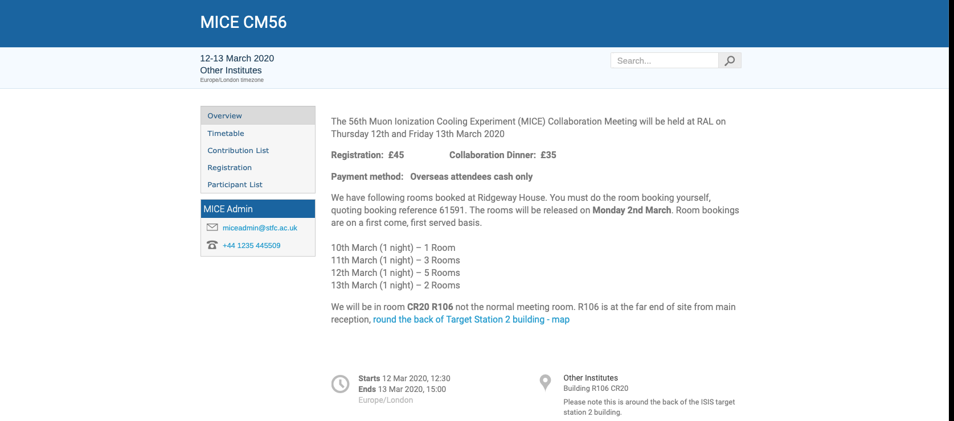
Over to you!

