Slide 1

FEE - assembly
R. Santoro and N. Ampilogov
Università degli Studi dell’Insubria (COMO) and INFN (Milano)

Slide 2
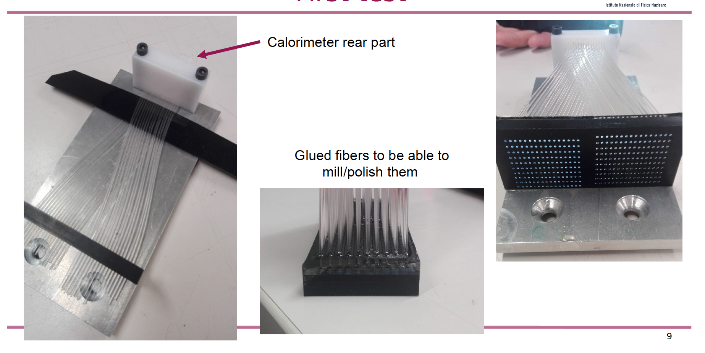
Starting Point
Calorimeter rear part
Scintillating
fibres
Clear
fibres
Here there will be a unique FEE board equipped with all SiPMs.
The board will be fixed to the mechanical support in one go and from the back (or from the side) there will be flat cables running towards to the FERS system
R. Santoro

Slide 3
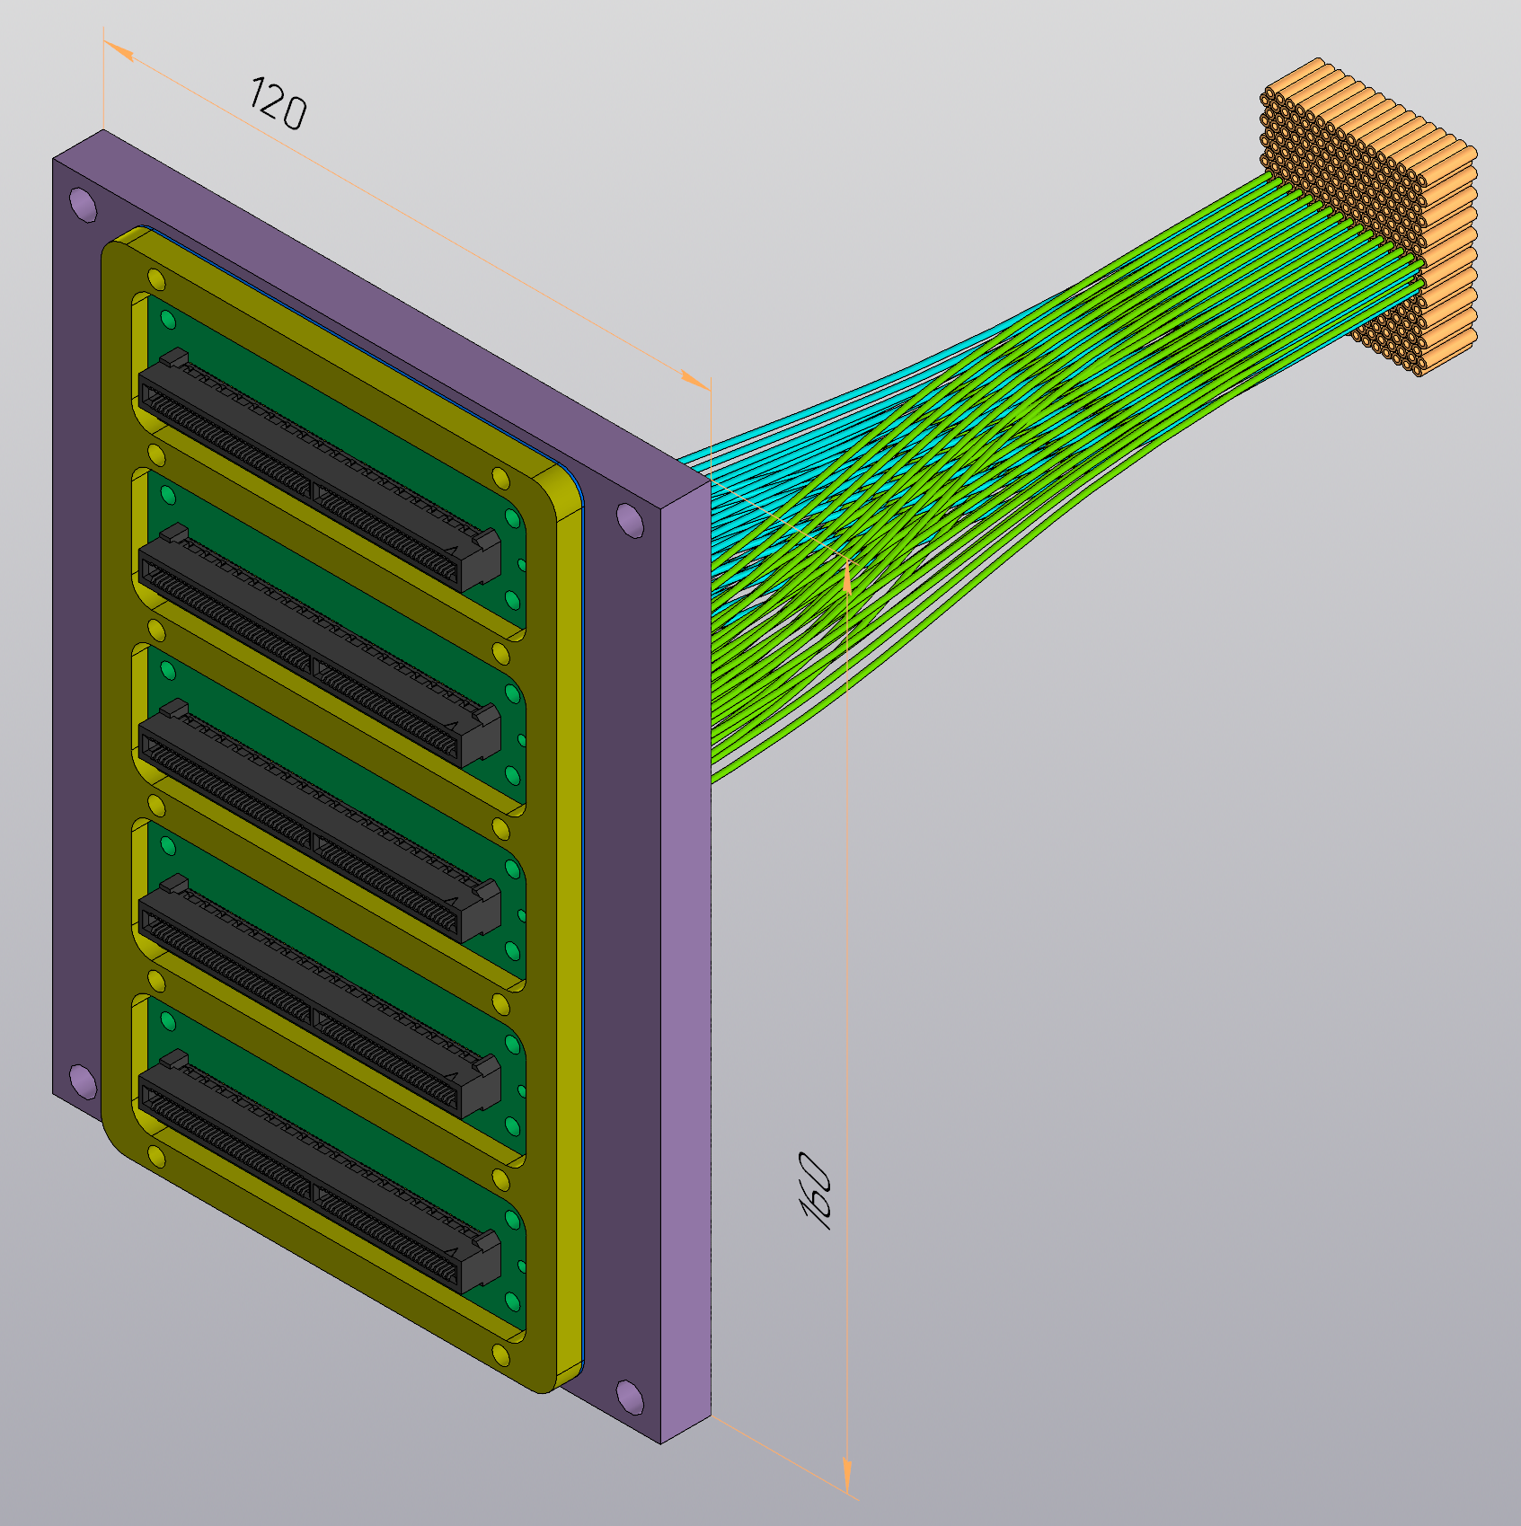
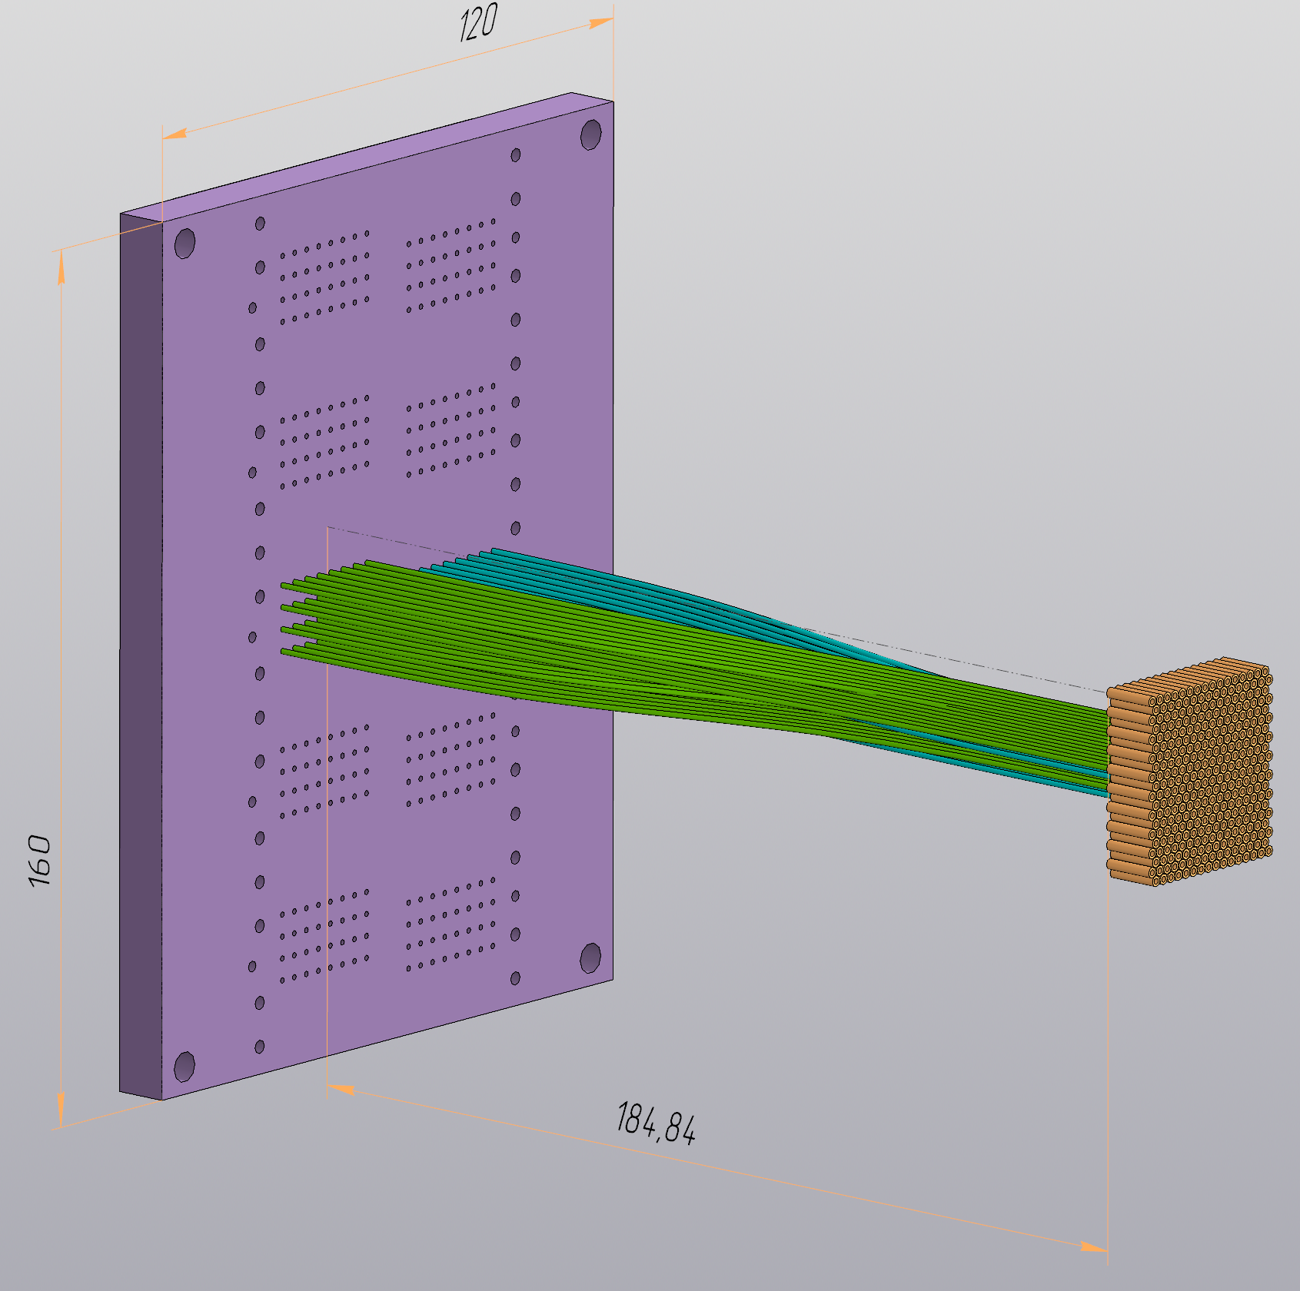
New Proposal
Calorimeter
Scintillating
Fibres
Optical - Collector
Calorimeter
Cherenkov
Fibres
Fibres
Optical insulation
64 holes:
32 – Ch / 32 – Sc
5 FEE - Boards

Slide 4
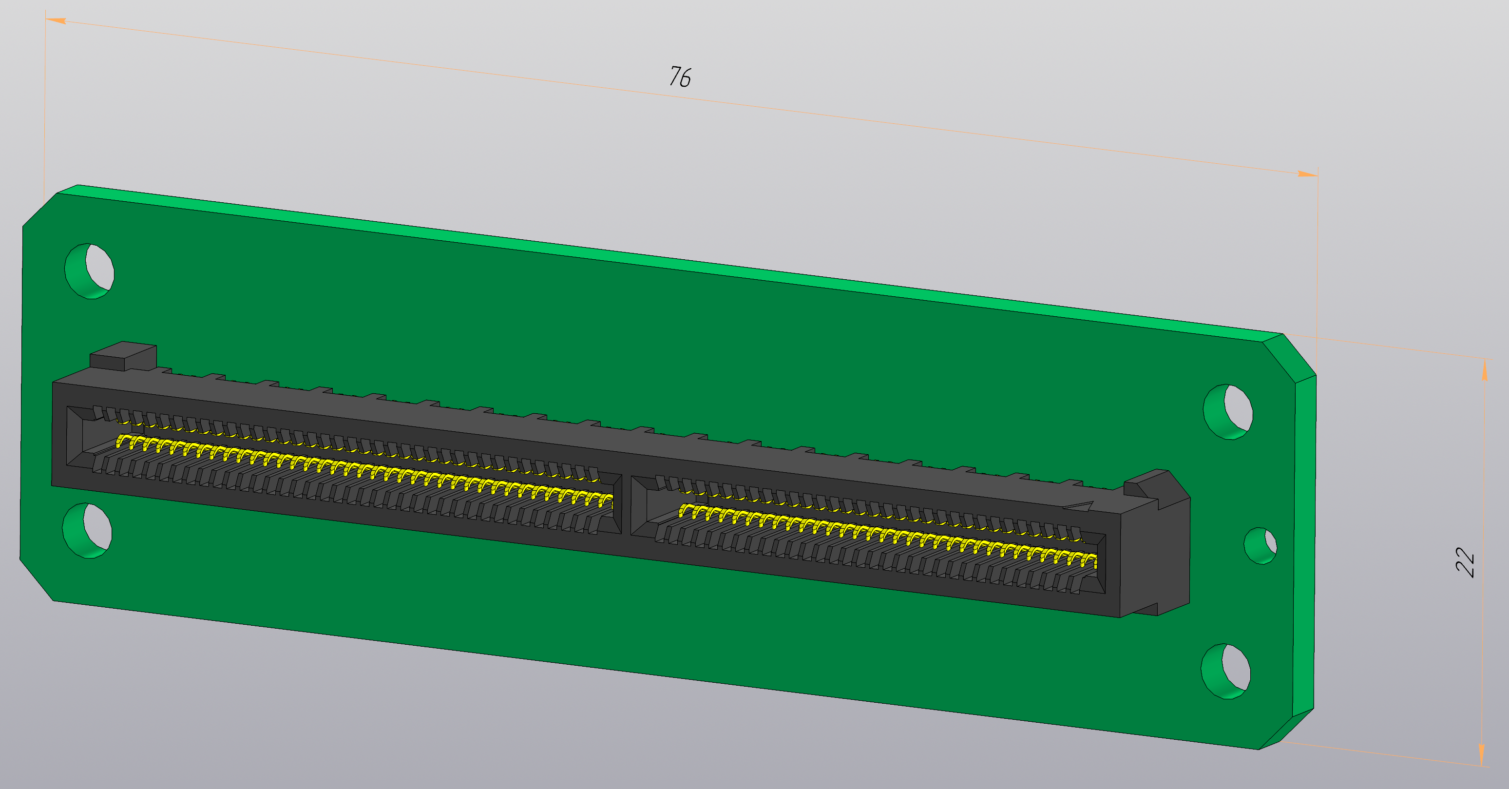
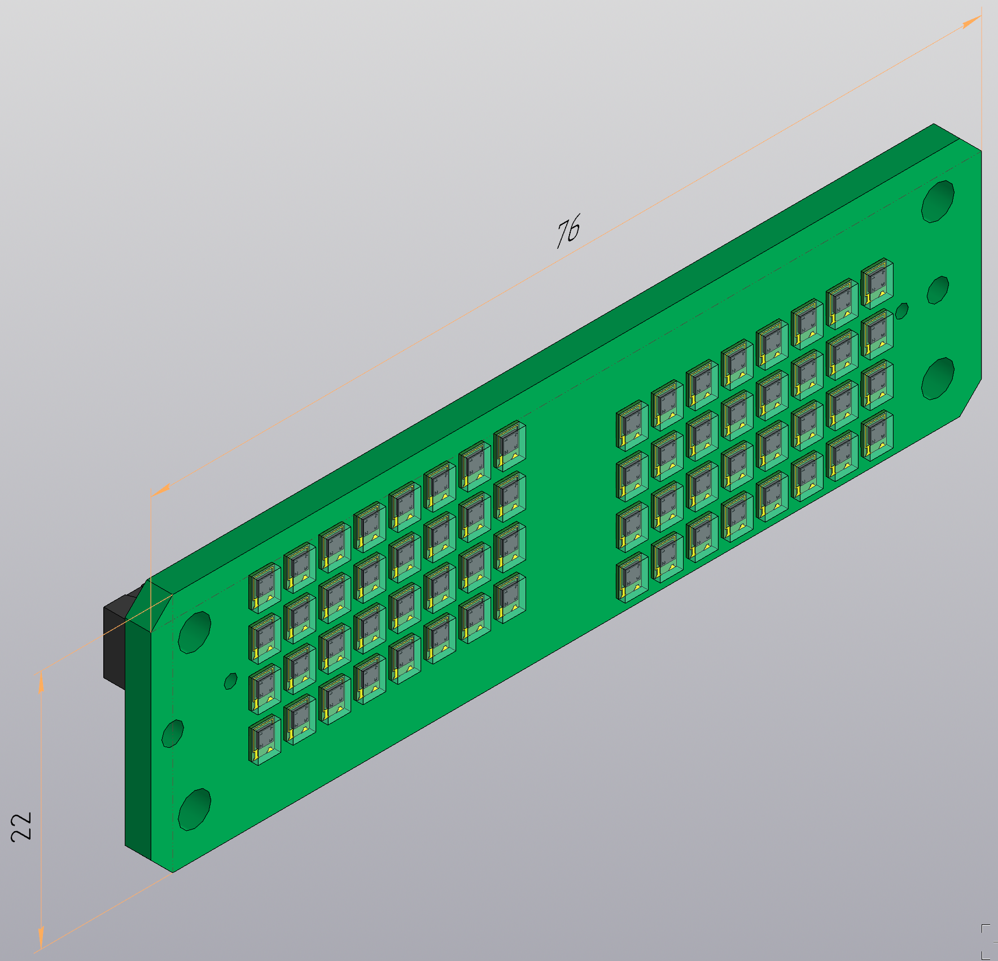
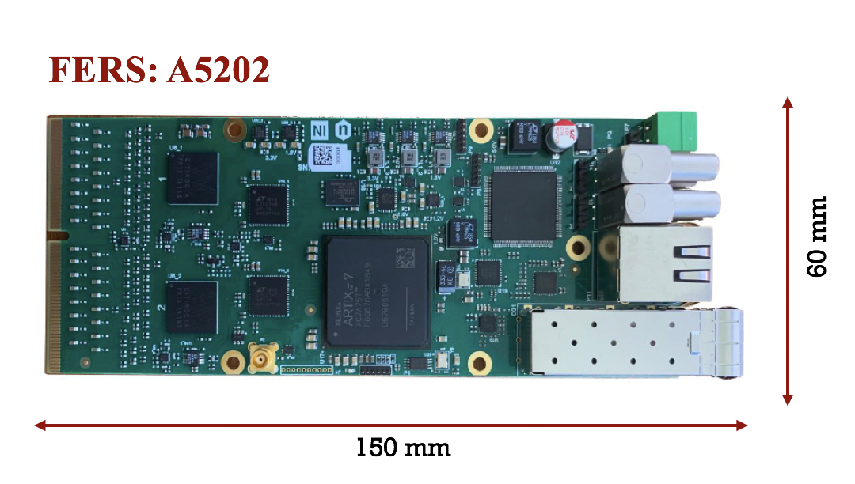
FEE - Board
1 FERS per Board
32 Ch - SIPMS
Back - Side
32 Sc - SIPMS
Front - Side

Slide 5
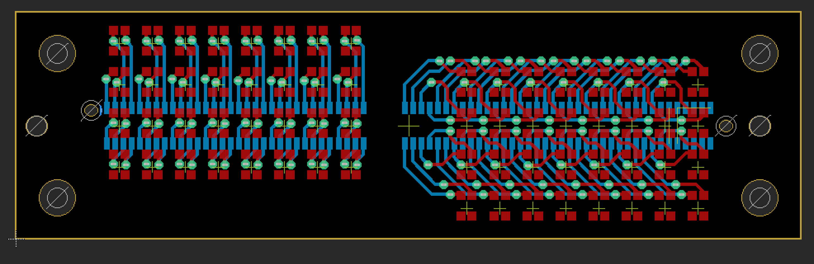
FEE - Board routing

