Slide 1


PS Internal Dumps & Ralentisseur: Assembly and qualification progress
28th January 2019
François-Xavier Nuiry

Slide 2
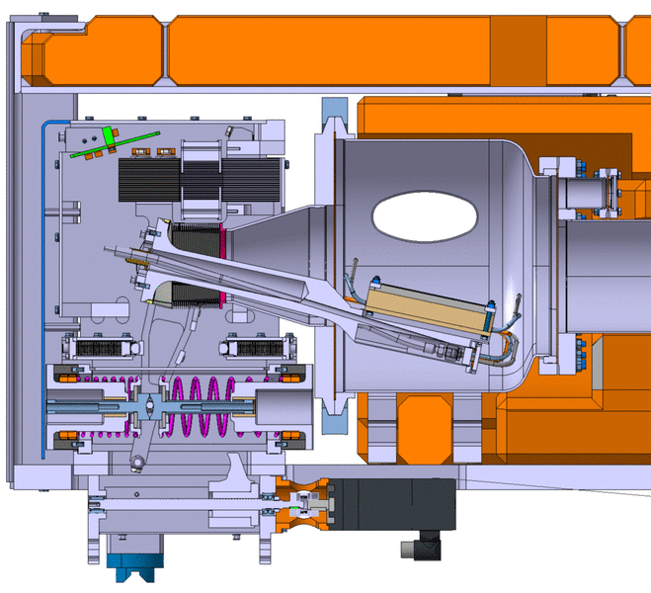
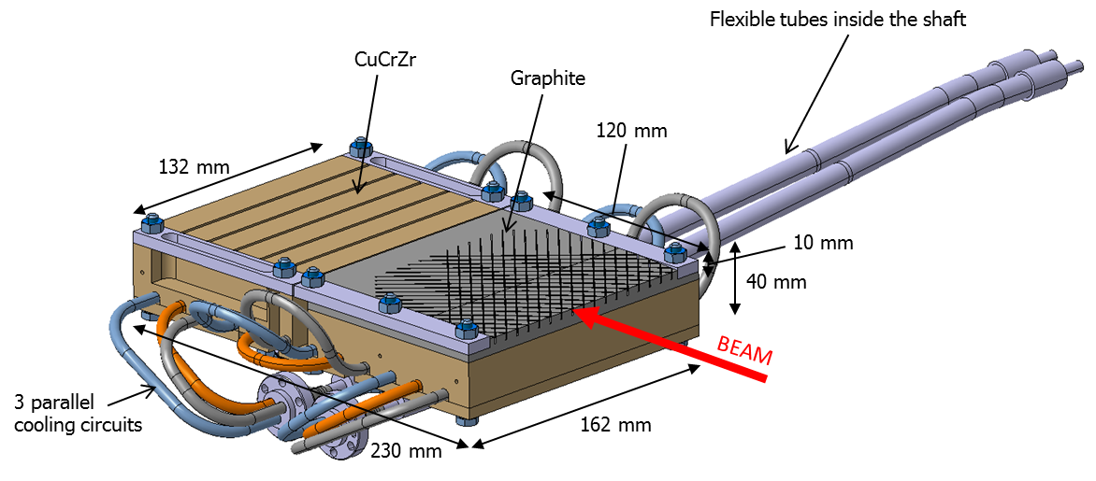
Outlines
  PS DUMP STATUS
  PS DUMP IST REMINDER
  PS DECELERATOR (RALENTISSEUR) STATUS
  PS DECELERATOR (RALENTISSEUR) IST REMINDER

Slide 3
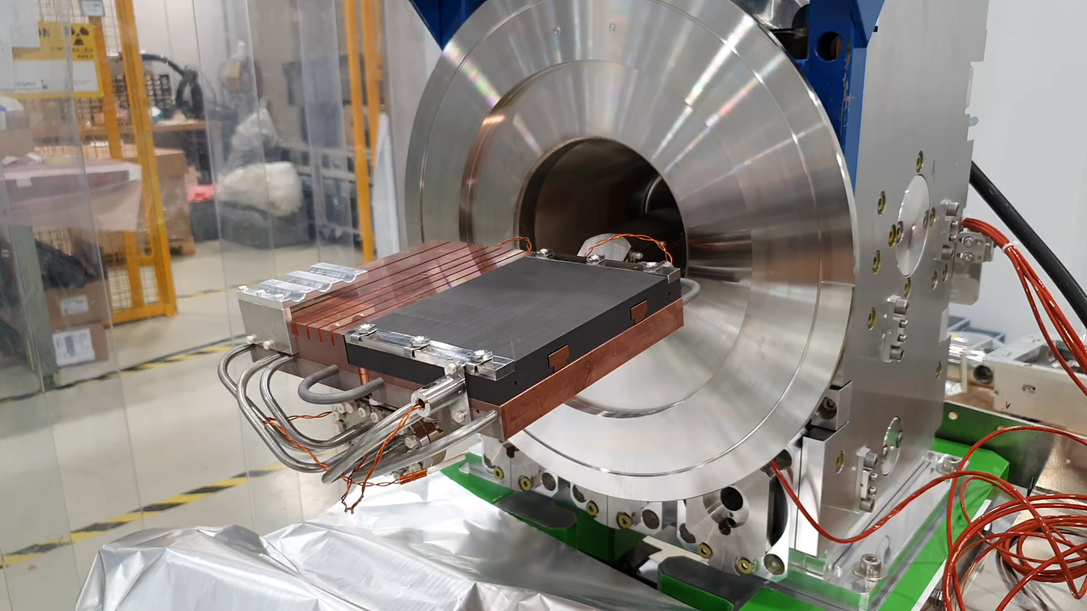
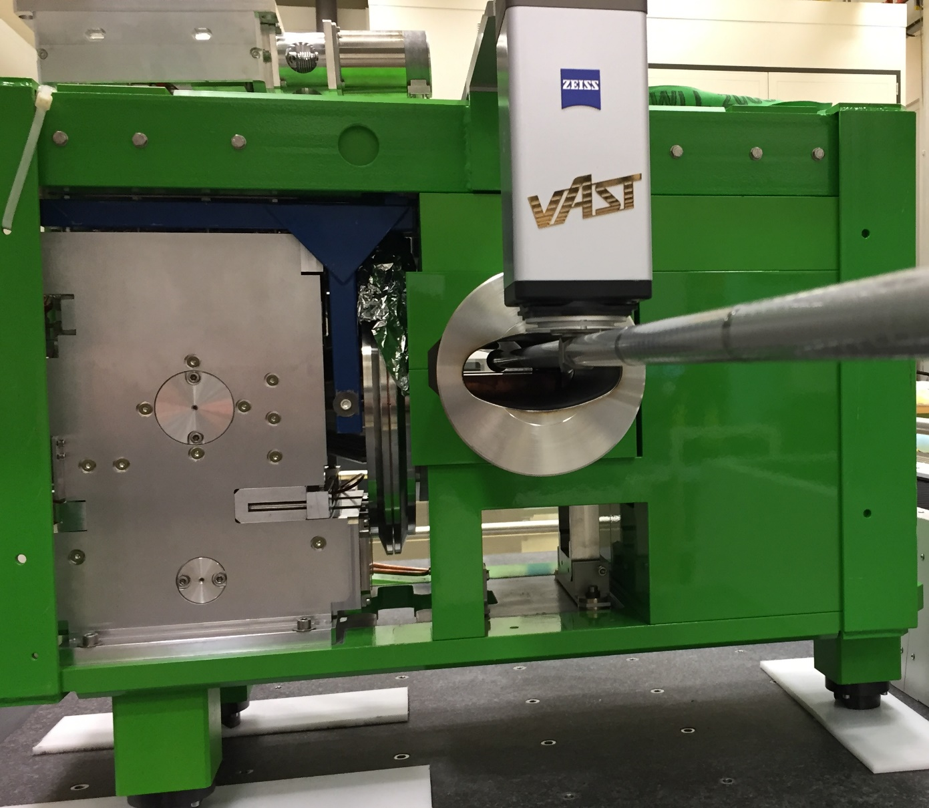
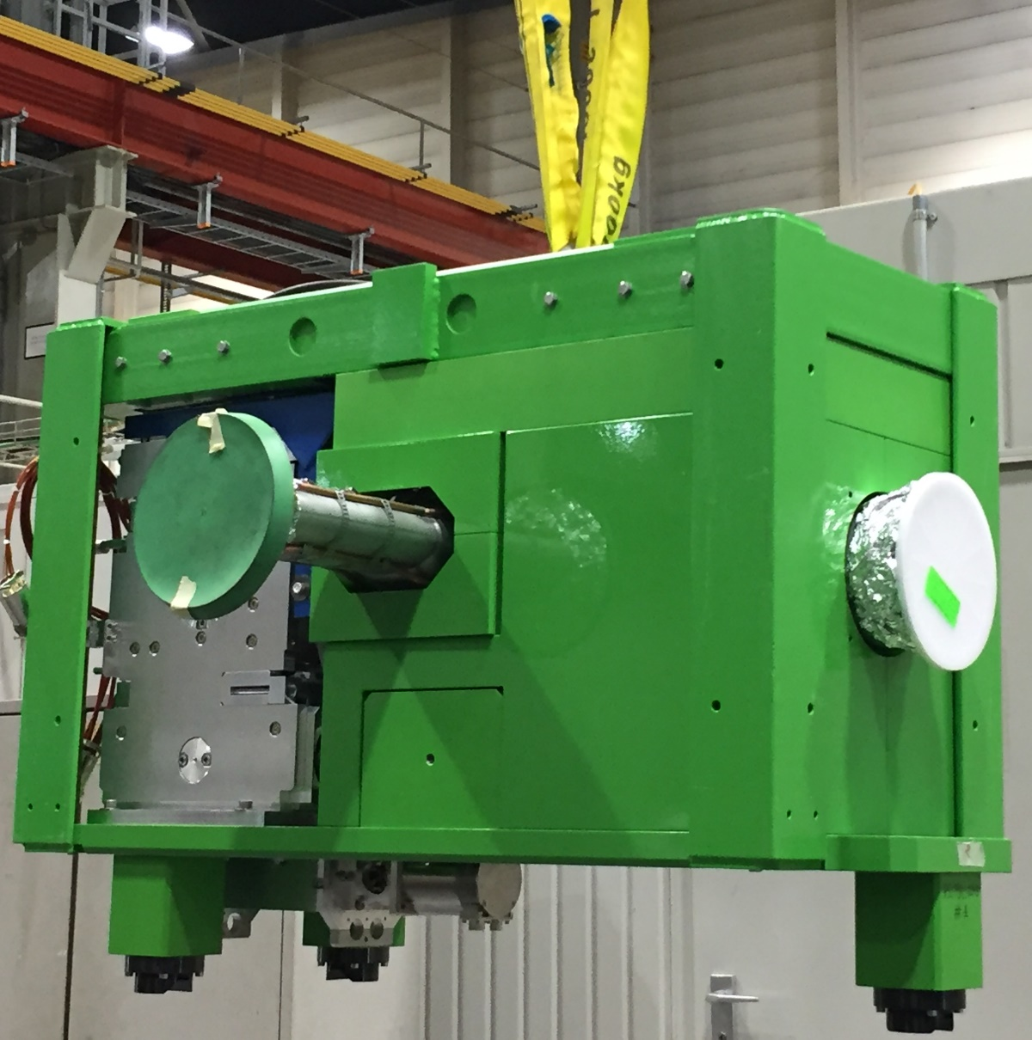
PS dump #1 status
PS DUMP #1 : →Assembly: Finished
→Control system: Operational
→Impedance Test: Done
→UHV: Accepted
→Running-in test: Ongoing 31000 cycles
Expected readiness: End March 2020
1646 kg

Slide 4
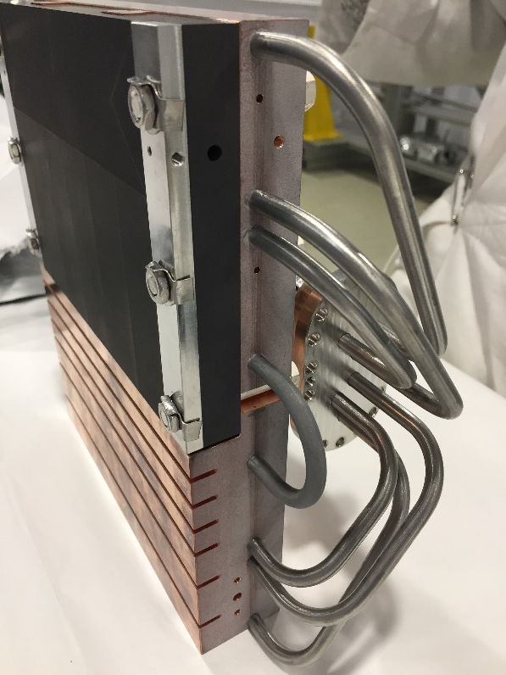
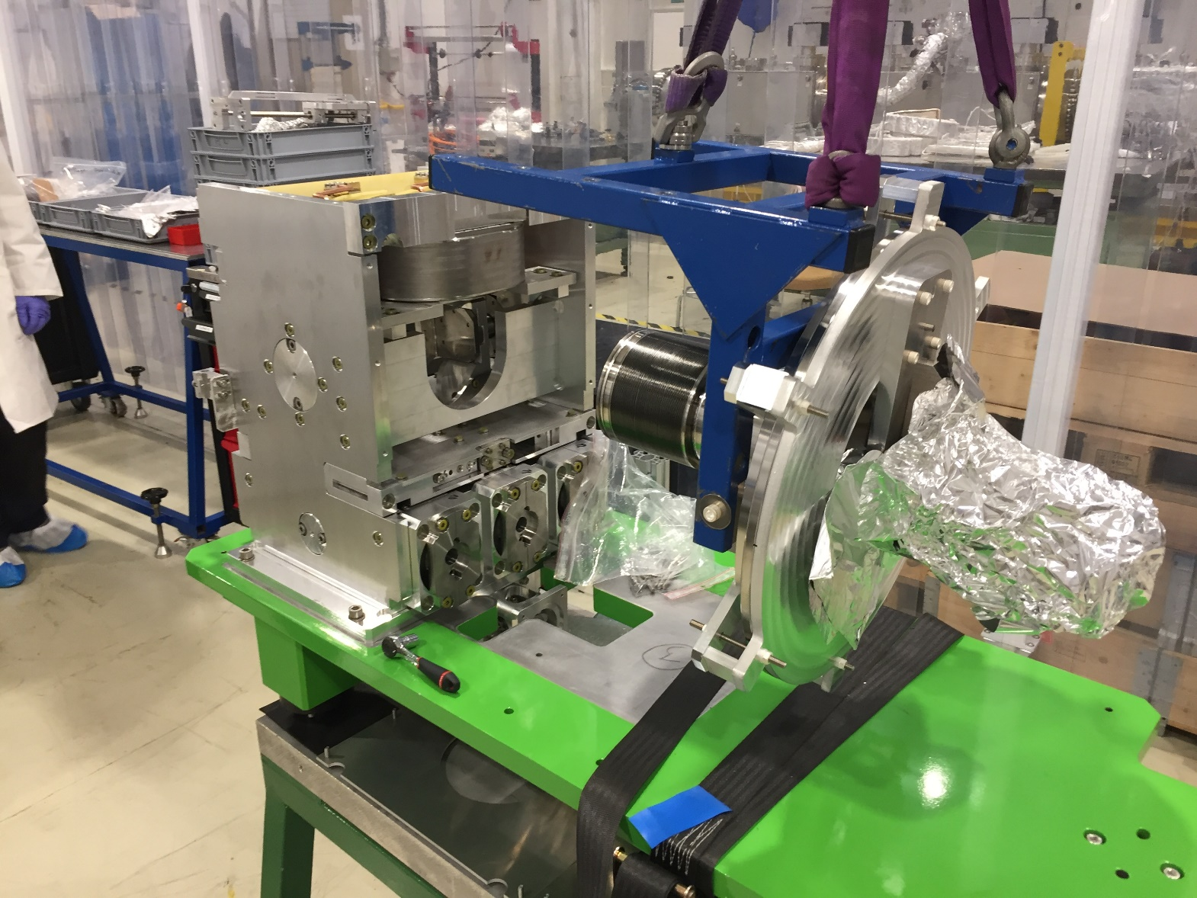
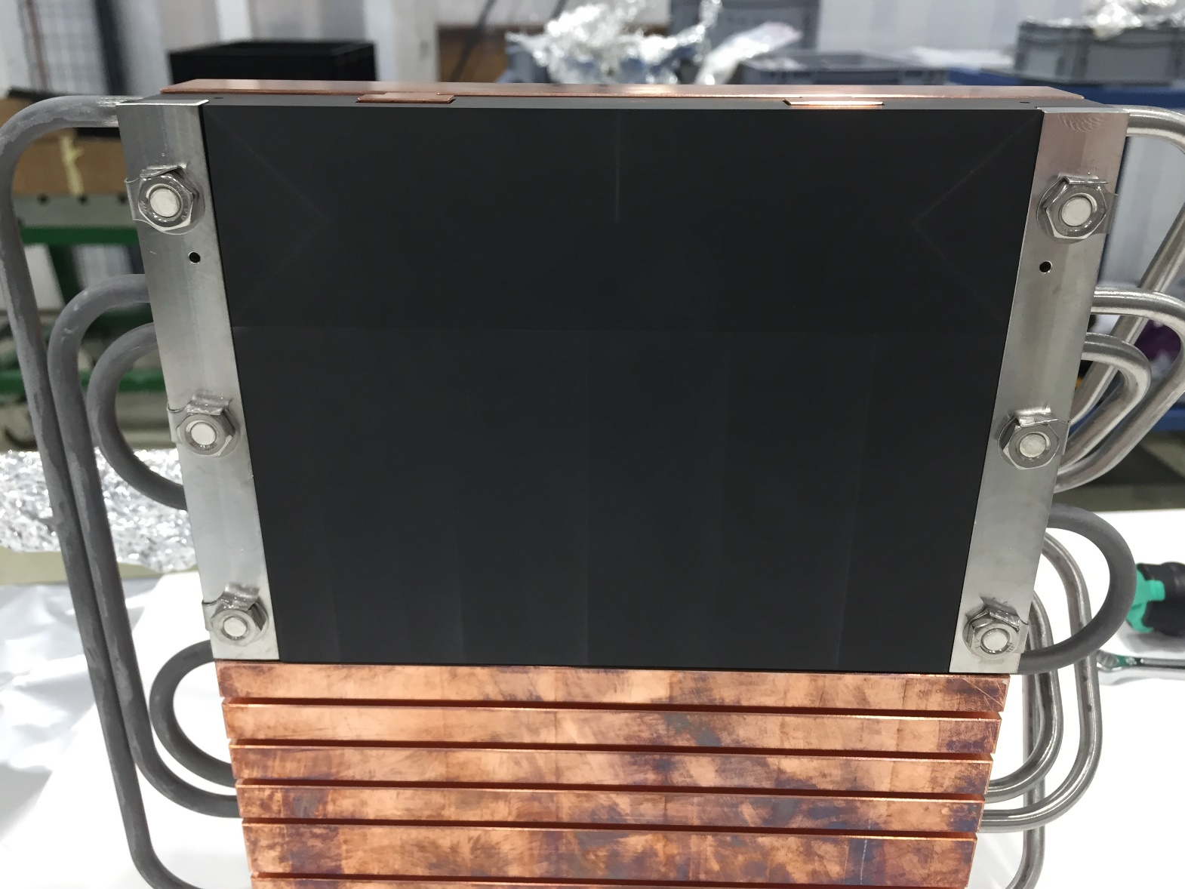
PS dump #2 status
PS DUMP #2 :
→Assembly: Ongoing
→Control system: Shared with Dump#1
→Impedance Test: Planned
→UHV: Planned
→Running-in test: Only 2-3 weeks in March (very tight)
Expected readiness: 6/04/2020

Slide 5
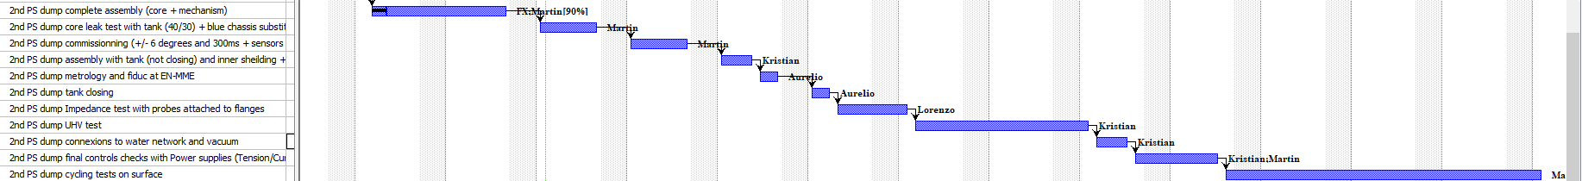
PS DUMP #2 planning

Slide 6
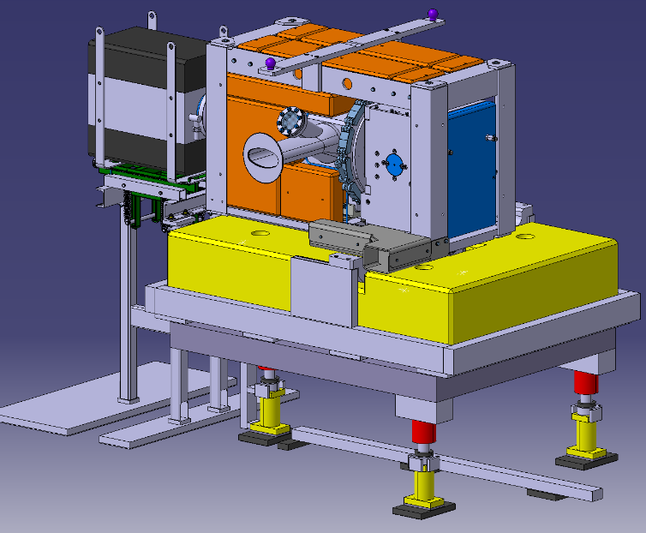
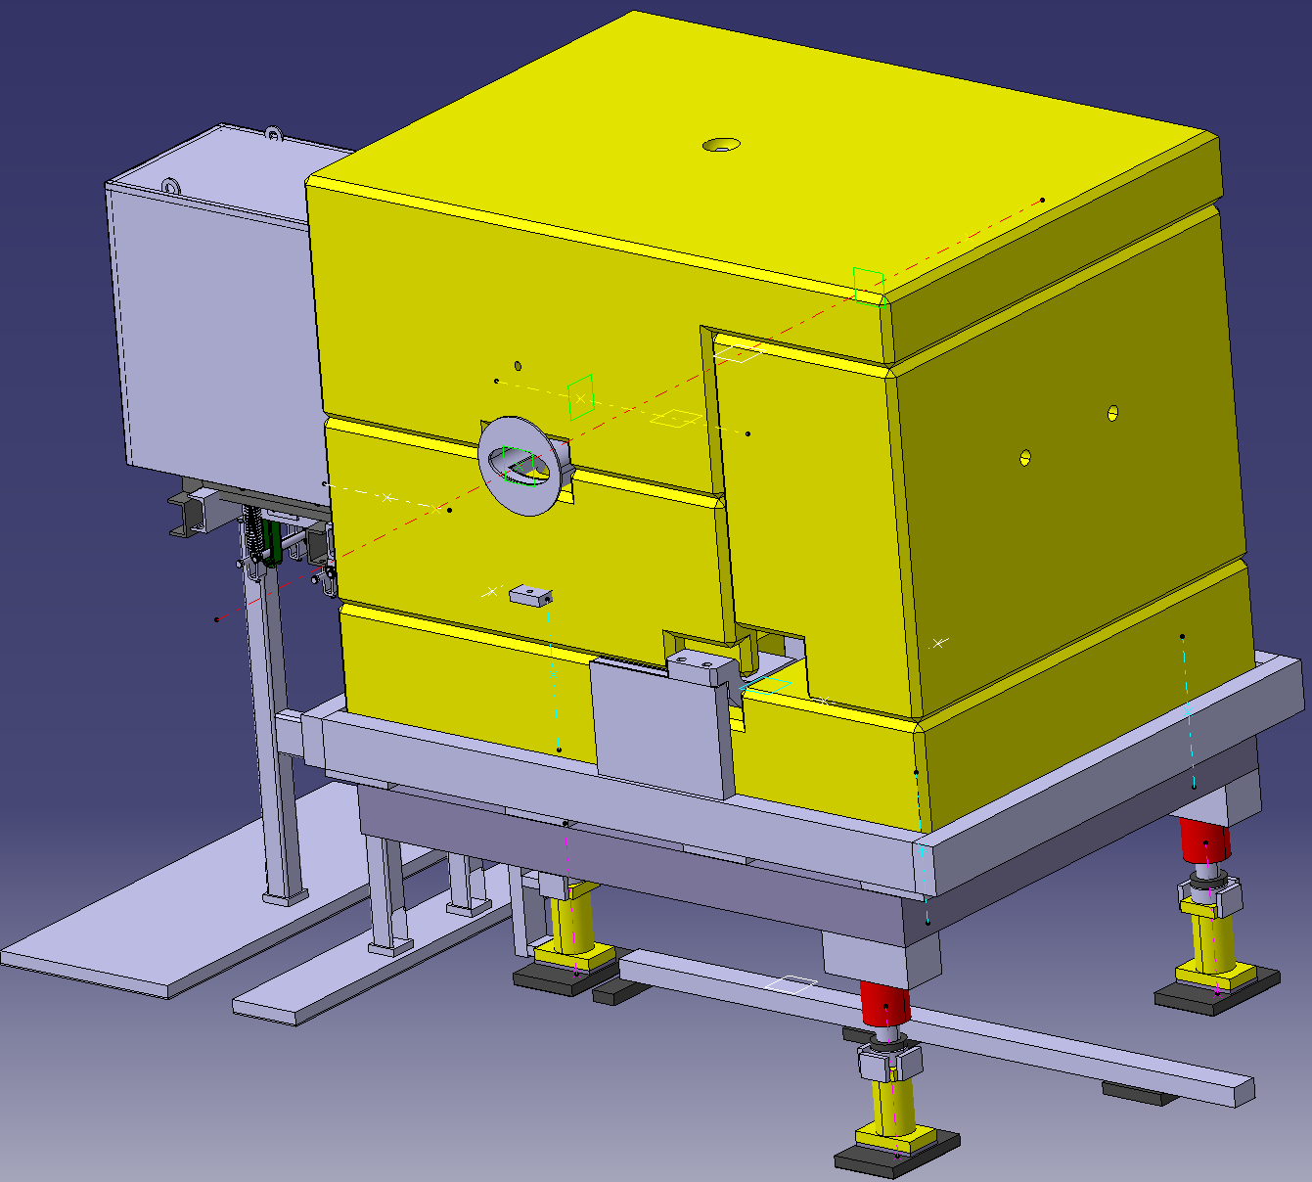
PS dump installation overview
Machine installation (2 dumps)
Transport
Services connection (Water, control cables)
Alignment
Installation tests = IST (oscillations, sensors check)
Vacuum commissioning
Shielding closing
+ Control system installation in surface building.
→ Followed by beam commissioning

Slide 7
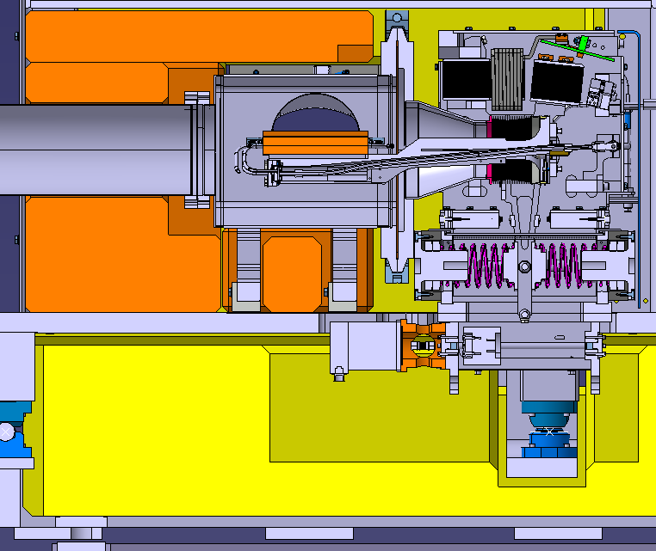
PS dump IST Summary
WHEN IN THE MACHINE:
Check electrical grounding of the system;
System under vacuum: leak test.
Vacuum sector PR20 is validated when all equipment are
approved, including KFA45, SMH42, SEMgrid in 43 and
new bumper magnets in 40, 41, 43 and 44.
Check of the good signal of all sensors:
  Switches,
  Temp sensors,
  Water flow meters (on the patch panel),
  Pressure extracted from the Ion pump;
Temp. sensors
Switches

Slide 8
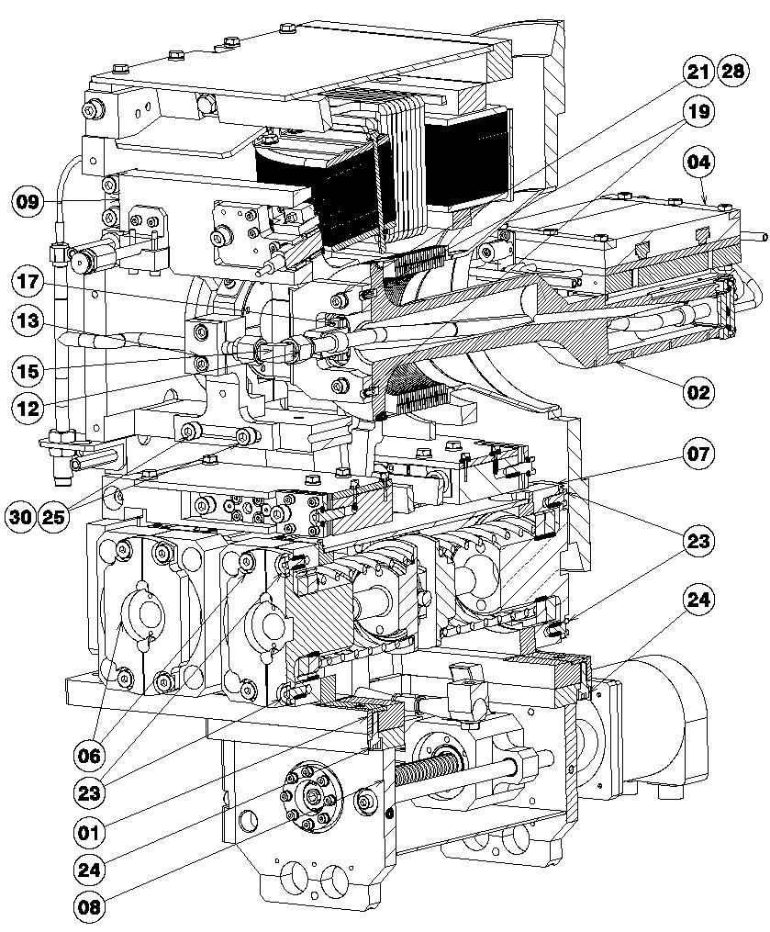
PS dump IST Summary
Powering of the electro-magnet;
Motor powering and test over the full stroke;
Simulation of a dump lost due to magnet power off and motor actuation;
Few hundreds mechanical cycles tests; and check of the system behaviour (noise when back to the magnet, switches actuation).
IST Plan: 22/05 → 12/06
Electromagnet
Motor

Slide 9
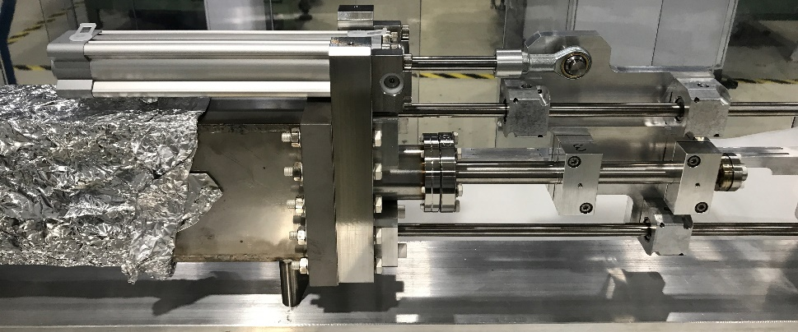
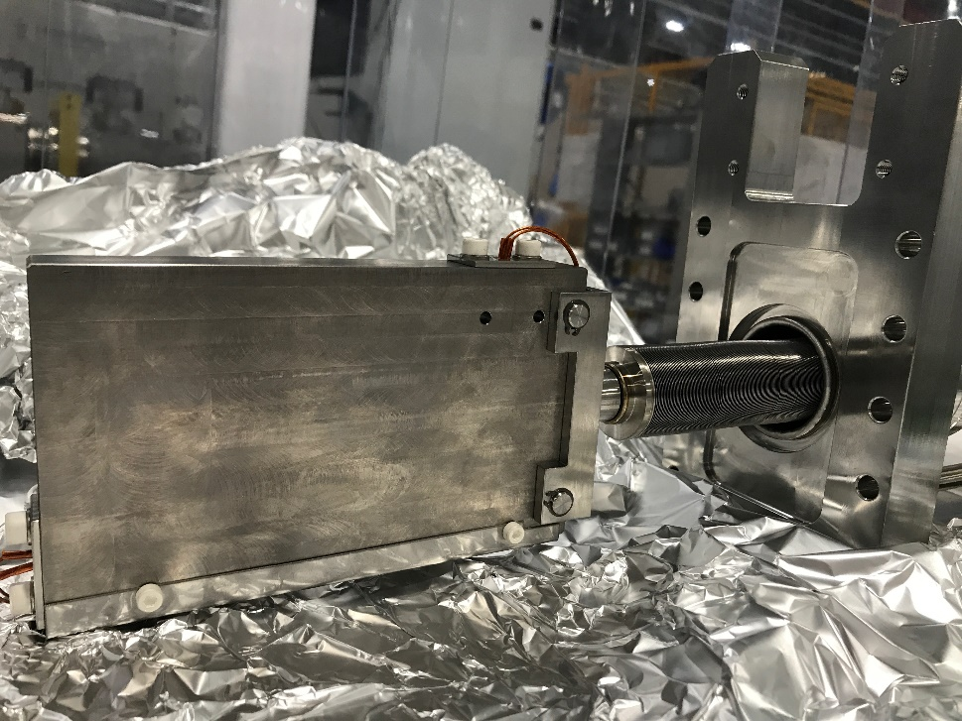
PS Decelerator (Ralentisseur) status
PS Ralentisseur #1 :
→Assembly: Finished
→Control system: Operational
→Impedance Test: No
→UHV: Accepted
Leak tightness of the main flange to vacuum
vessel to be checked in situ.
Expected installation date: 30/01/2020
PS Ralentisseur #2 (SPARE):
→Assembly to be finalized (all components ready)

Slide 10
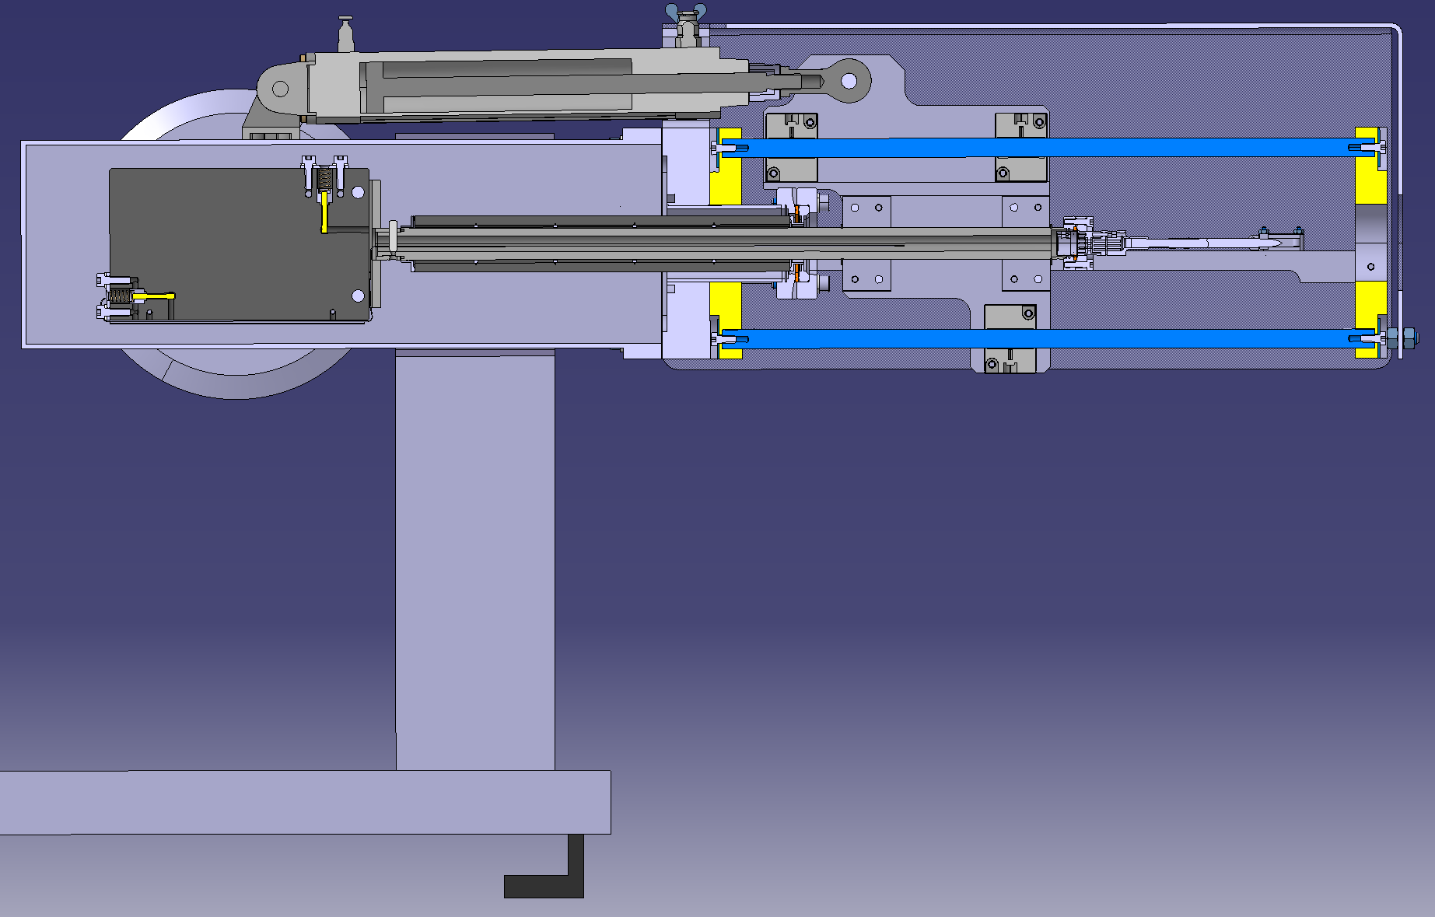
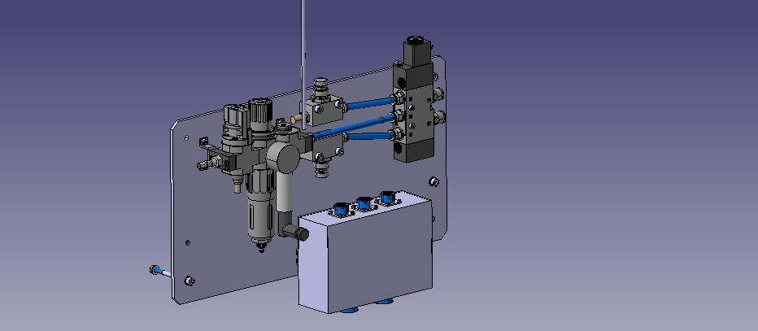
PS Decelerator (Ralentisseur) IST summary
Pneumatic piston
WHEN IN THE MACHINE:
Check electrical grounding of the system;
System under vacuum: leak test.
Vacuum sector PR20 is validated when all equipment are
approved, including dummy septum in SS15 and SMH16.
Check of the good signal of all sensors:
  (Temp. sensors, switches);
Powering distribution box;
Few mechanical cycles tests (in-out beam); and check of the system behaviour (switches actuation);
10 working days of access in SS12 following the installation.
When is the vacuum expected in SS12?? 17/02/2020 → according to VSC
The 10 days IST period shall start from the 17/02 onwards
Switches
Temp. sensors
Pressurized air distribution box

