Slide 2
Louis de MALLAC, Serge PITTET
With inputs from his colleagues
CERN, for LIU-PS coordination meeting , 2020-01 @ CERN
TE/EPC equipment readiness
LIU-PS
Meeting link (indico)
https://indico.cern.ch/event/882837/

Slide 3
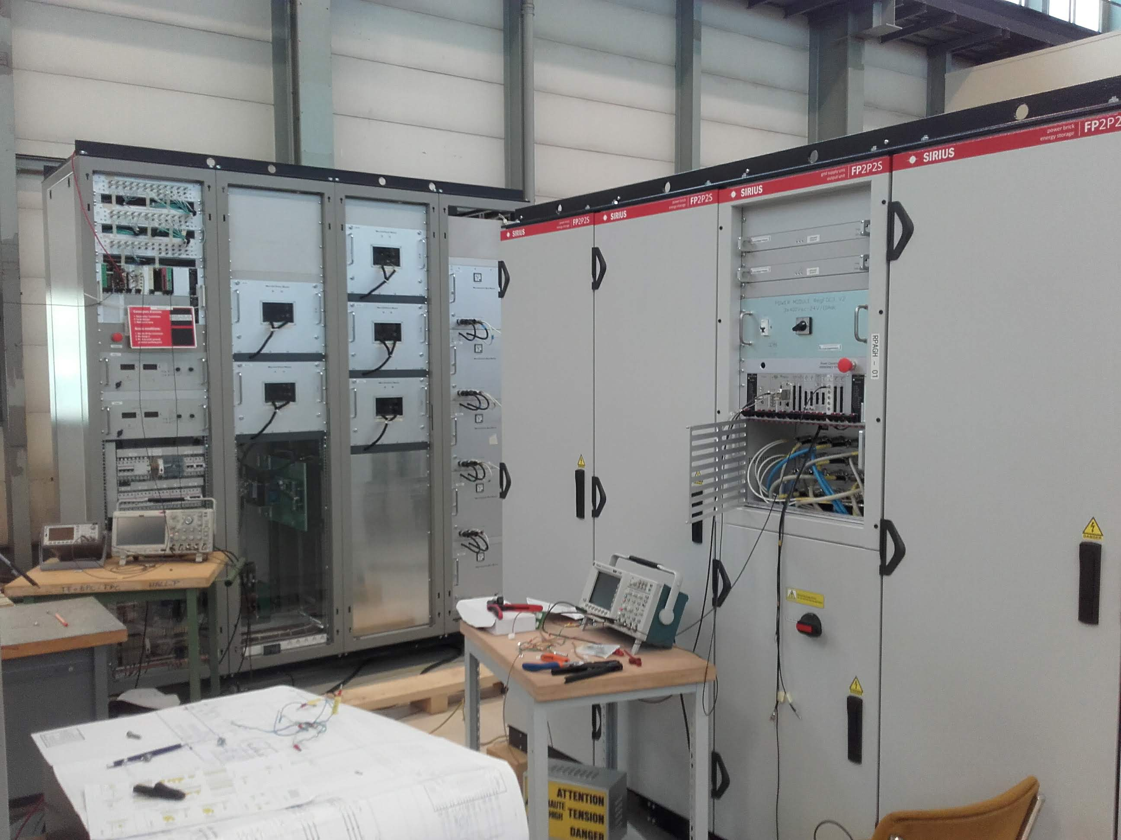
PI.SMH42 Power Converters
    EPC Activity Coordinator
      Nicolas David
    Bdg. 365 - Room R-004
      Tests ongoing.
      Installation foreseen end of march.
      All services available under false floor and ready to be connected.

Slide 4
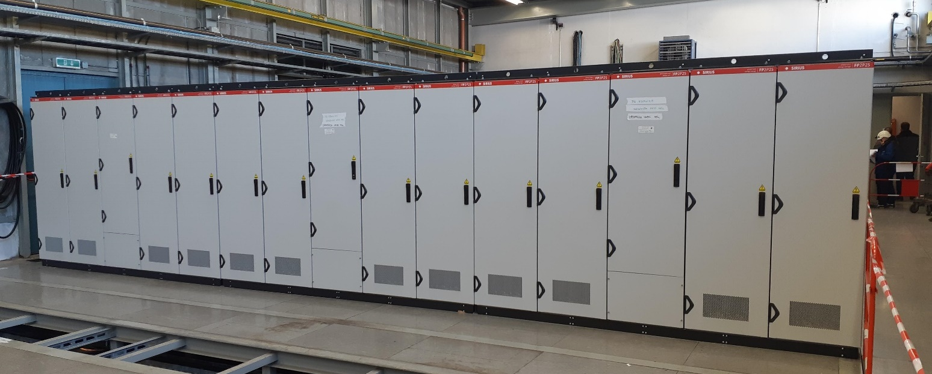
PI.BSM42 Power Converters
    EPC Activity Coordinator
      Nicolas David
    Bdg. 365 - Room R-004
      Converter installed.
      DC ends of cables will be done in march.
      Other services available.

Slide 5
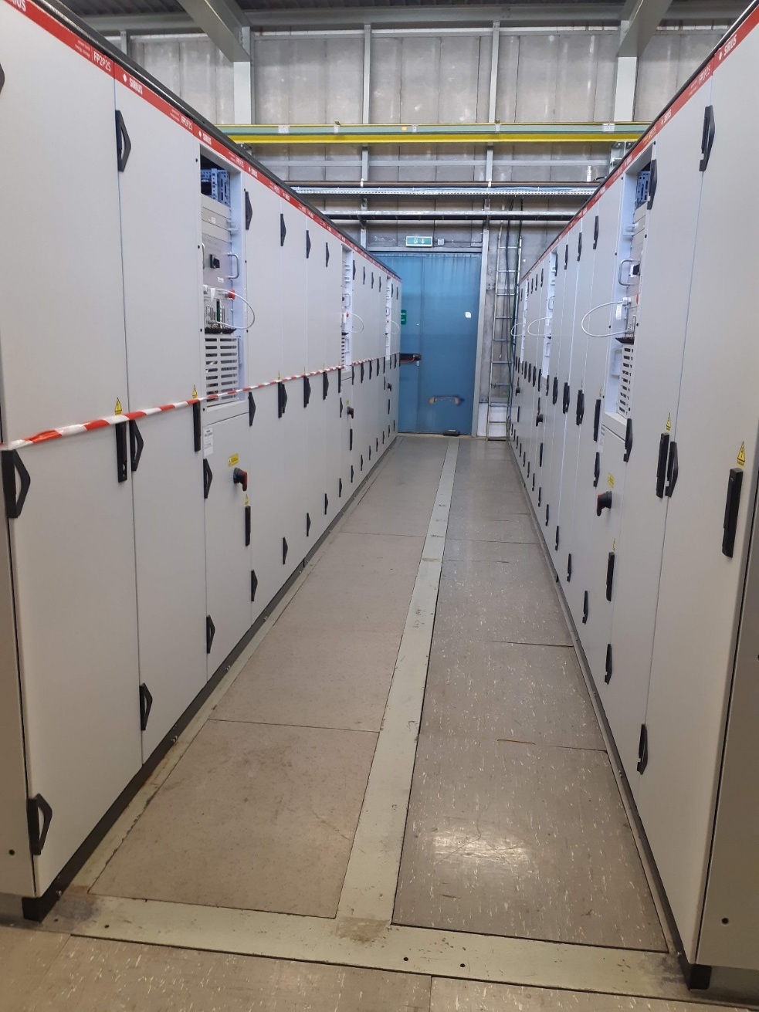
PI.BSM40, 41, 43 & 44 Power Converters
    EPC Activity Coordinator
      Nicolas David
    Bdg. 365 - Room R-004
      Converter installed.
      DC ends of cables will be done in march.
      Other services available.

Slide 6
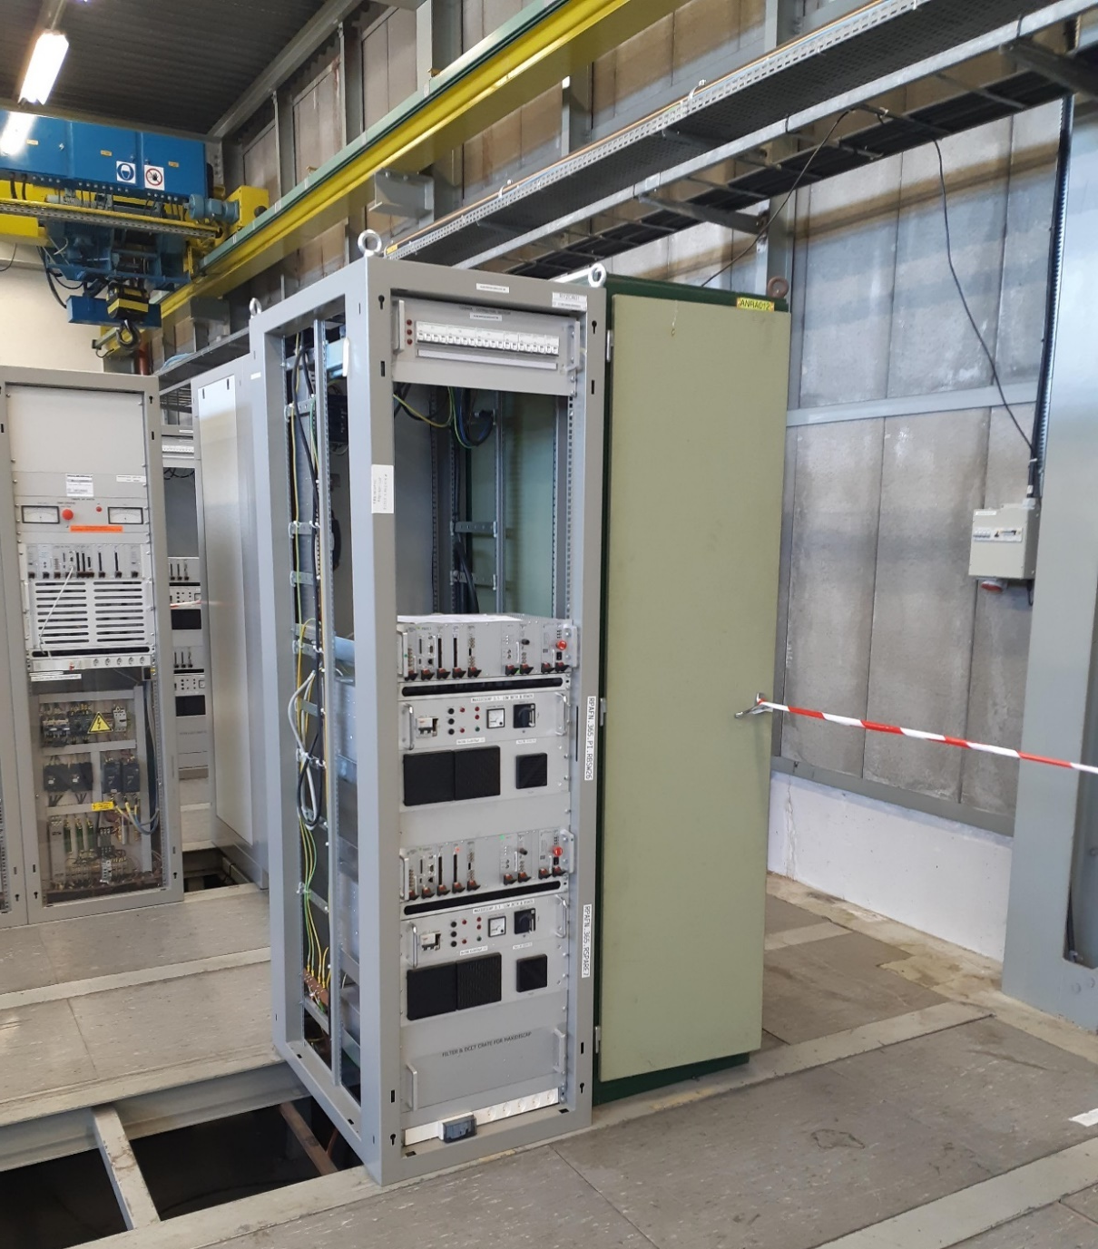
PS injection low beta quadrupoles Power Converters
    EPC Activity Coordinator
      Nicolas David
    Bdg. 365 - Room R-004
      Converter installed.
      All services available.
      Ready for commissioning.

Slide 7
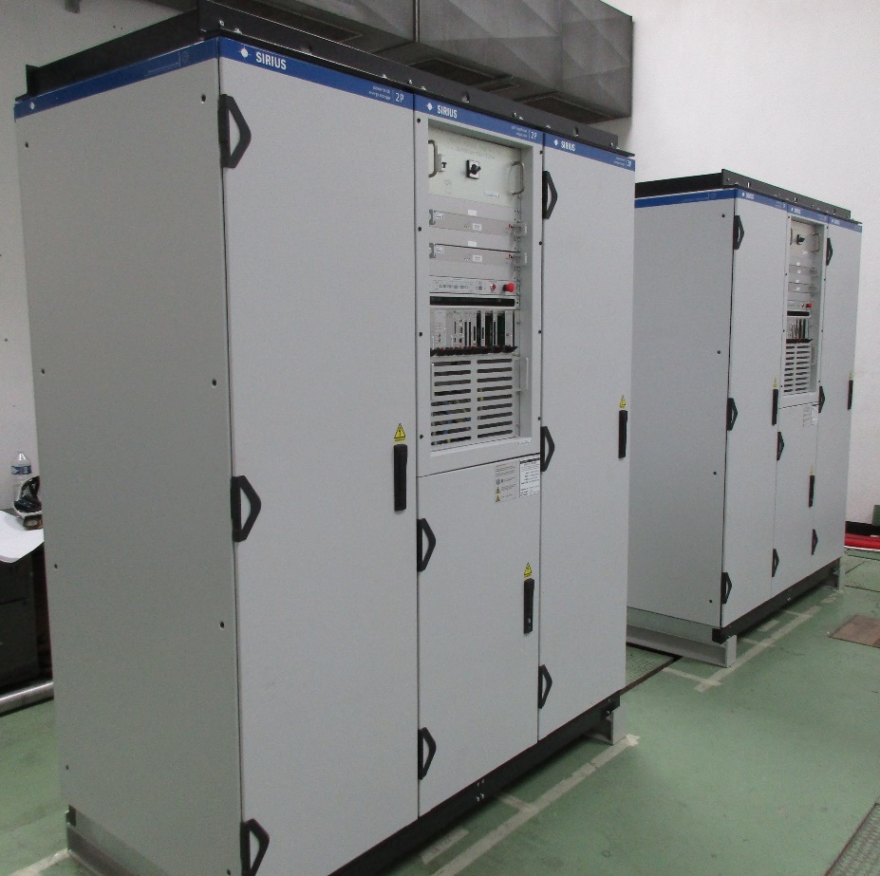
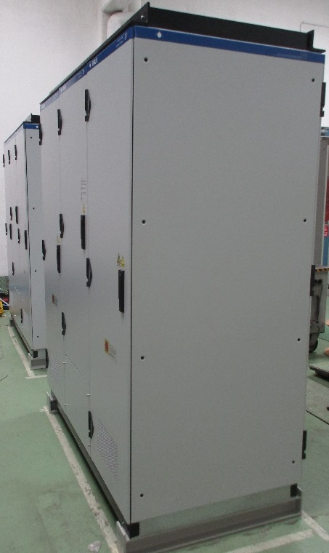
IPM magnet Power Converters
    EPC Activity Coordinator
      Frédéric Daligault
    Bdg. 355 - Room R-003
      Converter installed.
      AC and Cooling available.
      DC cables expected end of January.

Slide 8
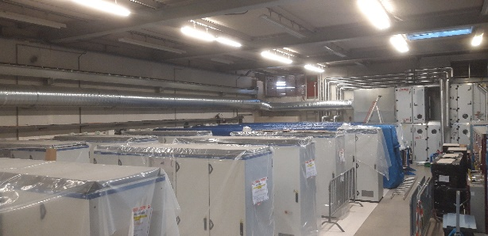
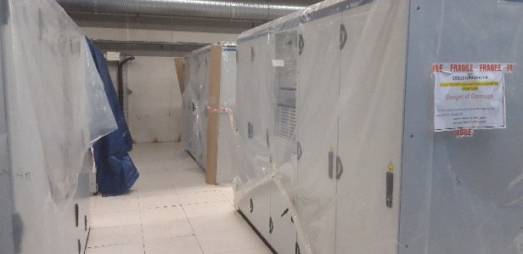
TT2 Power Converters
    EPC Activity Coordinator
      Stéphane Reignier
    Bdg. 269 - Room R-005
      SIRIUS Converters installed.
      DC cables and connection boxes to be finalized in March.
      Water cooling connexion expected end February.

Slide 9
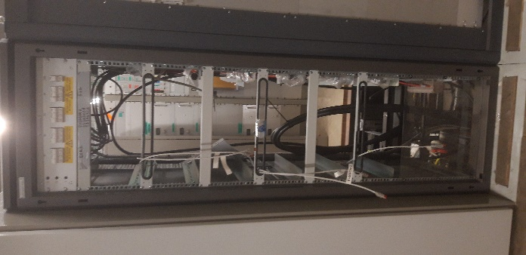
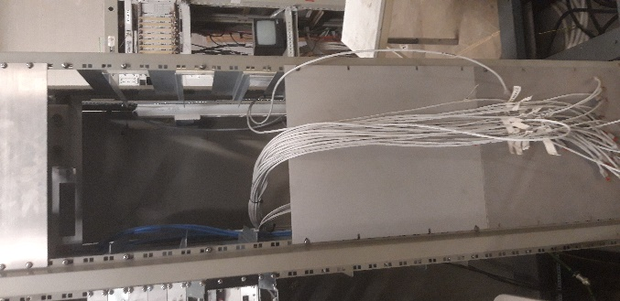
TT2 Power Converters
    EPC Activity Coordinator
      Stéphane Reignier
    Bdg. 269 - Room R-005
      CANCUN and COMBO racks installed.
      All services available.
      Modules will be installed in March.

Slide 10
Conclusion
    Most power converters have been installed;
    Waiting for services to start the commissioning
    Ready for ISTs as scheduled

