Slide 1
1L1 dismounting test of BSW1
C. Baud TE/ABT/SE

Slide 2
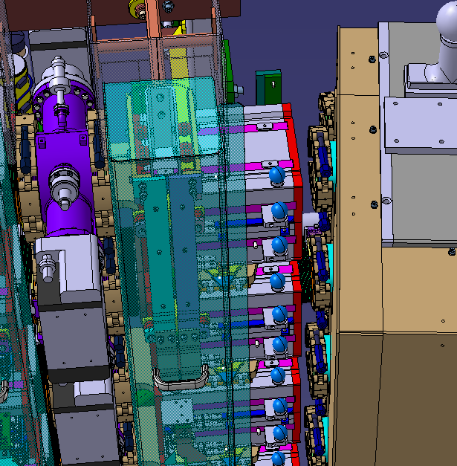
Situation
Theory: 15 mm gap between magnet BHZ162 (without safety covers) and BSW1 chambers (completely compressed)
Reality: need to be checked

Slide 3
Alternative
Dismounting ionic pump between BSW1 and BSW2_3 ?
  May be not necessary to remove BHZ protective cover
  RP has to confirm in WDP best solution

Slide 4
Back-up slides

Slide 5
