Slide 1



Istituto SPIN-CNR
INFN Sezione di Napoli
Universita’ di Napoli Federico II
Dipartimento di Fisica “Ettore Pancini”
EASISchool 3, Genova Sept. 28, 2020
Ruggero Vaglio
BASIC PRINCIPLES OF RF SUPERCONDUCTIVITY

Slide 2
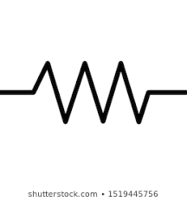

Two –fluid model
n
s
«local limit»

Slide 3
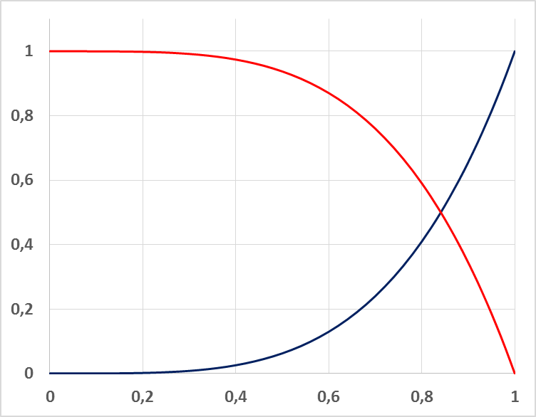
(frequency independent)

Slide 4
BCS (Matthis-Bardeen theory) :
N_{s}(E)/N_{N}
1
0
1

Slide 5
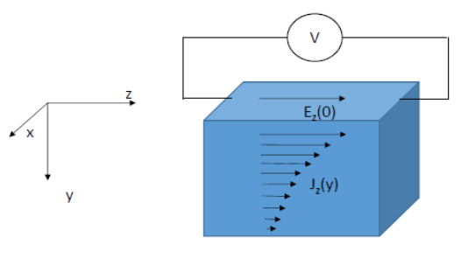
Surface impedance
~
d
d
S=d²
;

Slide 6
Normal metals (Ohm law+Maxwell equations):
Superconductors (local limit):
Thin films :
d : film thikness

Slide 7
Superconductors:

Slide 8

Two fluid model:
$$Rs∝ω^{2}$$
HTS superconductors :

Slide 9

BCS :
Low frequency limit :
Low temperature :
$$\frac{Δ_{0}}{KBT_{C}}=1.76$$

Slide 10
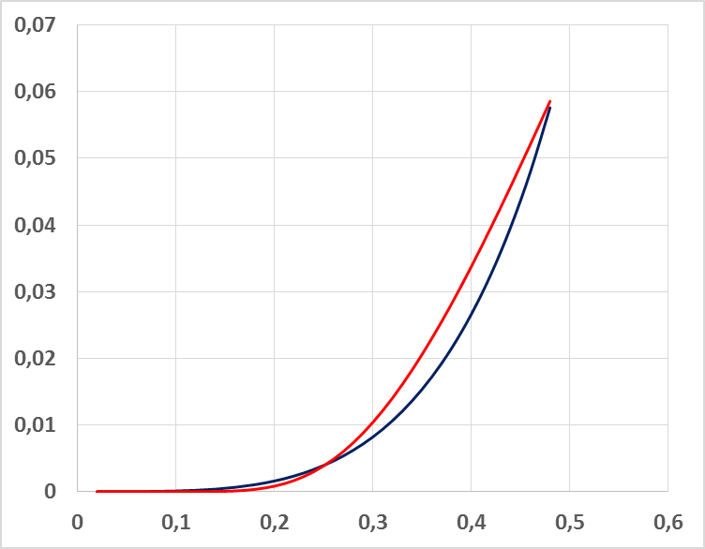
BCS
R_{s} (a.u.)
Two-fluid
HTS
HTS
BCS

Slide 11
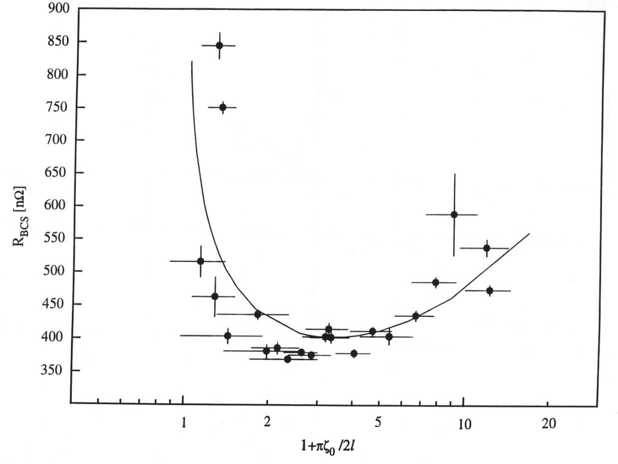
Non-local theory (Pippard 1950)
ξ
The local limit applies always well enough in superconducting compounds
and alloys (l small compared to λ , «local dirthy limit)) and HTS (ξ_{o} small
compared to λ, «local clean limit»), but not for high purity bulk Nb !
Nb, T=4.2K, f=1.5GHz
Benvenuti et al, Physica C
Physica C 316 ,153 (1999)
local limit validity zone
(l < ξ_{o} , RRR<20)
Setting :
Full non-local theoretical calculation
(Halbritter code)
with :
extends the validity of the BCS low
frequency, low temperature,dirthy
limit approximate formulas up to

Slide 12
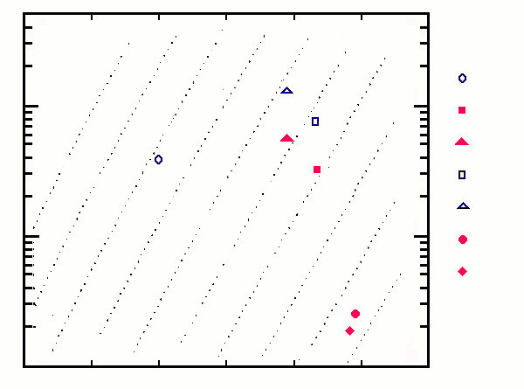
R_{s}^{BCS} for different superconducting materials in the local limit
Lines of equal R_{s}^{BCS} in the (ρ_{n}, T_{C}) plane at T = 4.2 K and ƒ = 0.5 GHz (V. Palmieri, Thesis , 1985)
Nb Thin film
MoRe
NbTiN
NbTiN (T_{S} = 200 °C)
NbN
NbN (T_{S} = 200 °C)
Nb₃Sn
V₃Si
MgB₂
100
10
1
128 nΩ
64
32
16
8
4
2
1 nΩ
0.5
0.25
8 10 12 14 16 18

Slide 13
R_{s}^{BCS} frequency dependence
R_{s} ^{BCS}(Ω)
Normal metals :
10⁻¹
Superconductors :
10⁻²
Cu 77K
YBCO polycrystalline, measured values at 77k
BCS
10⁻³
two fluid
YBCO measured values at 77K
10⁻⁴
10⁻⁵
Nb, T=4.2K
Nb₃Sn, T=4.2K
10⁻⁶
0.1
1
10
100
f (GHz)

Slide 14
Measurements of the surface impedance temperture dependence :
V₃Si (BCS)
BCS theory, local limit
BCS theory, local limit
R_{s}(μΩ)
X_{s}(T)/X_{s}(0)=λ(T)/ λ(0)
R_{o}
T(K)
T(K)
A.Andreone, A.Cassinese, A. DiChiara, M.Salluzzo , R. Vaglio, JAP 78,1862 (1995).

Slide 15
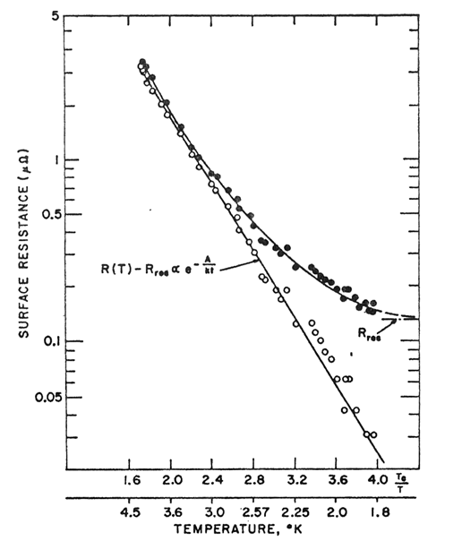
Surface impedance measurements (Nb film)
Nb, 1.5GHz
R_{o}

Slide 16
Surface resistance measurements (YBCO film)
Honma et al, Physica C 484, 46 (2013)
R_{o}

Slide 17
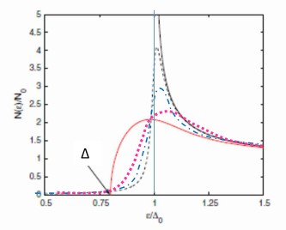
BCS surface resistance dependence on the rf field amplitude
The following phenomenological expression appears to be approximately valid :
(up to intermediate rf fields)
There is no full consensus on the theoretical interpretation. One approach is to perform the
Matthis-Bardeen BCS calculations using the full DOS as modified in a current-carrying state :
Xiao et al, Physica C 490, 26 (2013)
For very pure samples negative α values have been
observed and can be justified within this model
Δ/Δ_{o}

Slide 18
Residual resistivity possible origins :
1) Grain boundaries (in policrystalline materials)
2) Trapped magnetic flux
3) Defects due to localized «normal» or magnetic inclusions
4) ………………………………..

Slide 19
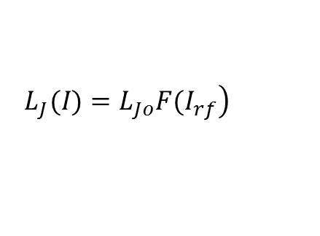
Grain boundaries (polycrystalline materials)
Weak superconducting links : Josephson effect
I
R_{J}
S₁, ψ₁
S₂,ψ₂
I_{c}
V
$$\left.L_{J}(I)=L_{Jo}F(I_{rf}\right)$$
Non-linear Josephson inductance

Slide 20
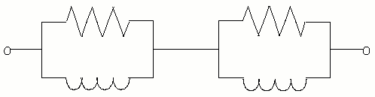
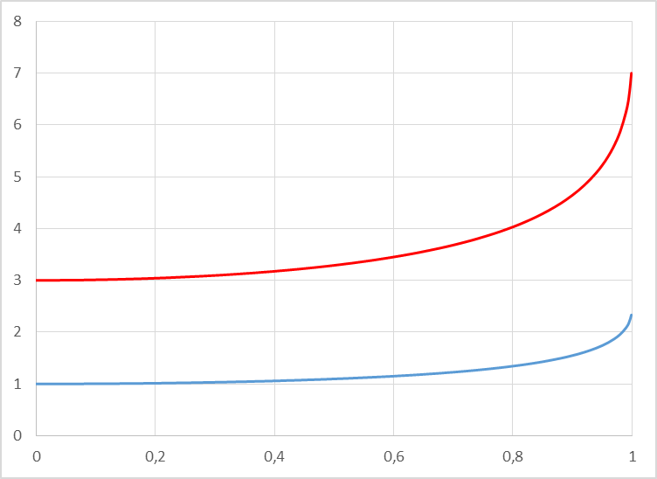
S₁, ψ₁
S₂,ψ₂
R_{ogb}
Vaglio et al, Physical Review B 43, 6128 (1991)
2
1
B_{rf}/ B_{cJ}

Slide 21
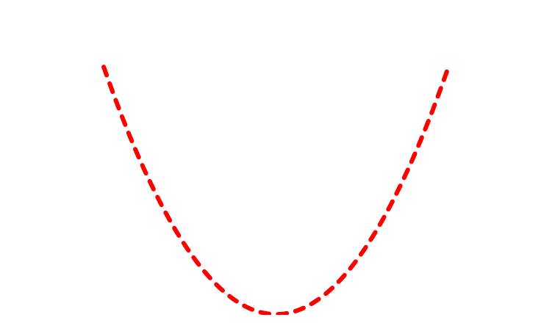
Trapped magnetic flux
normal core
supercurrents
x
magnetic flux lines :
Gittleman and Rosenblum:
Phys Rev. Lett. 16, 734 (1966)
̴
m : fluxon mass per unit lenght 0
fluxon viscosity per unit lenght
:
«depinning frequency»

Slide 22
+ Maxwell equations
General expression for the surface impedance of a superconductor in presence
of rigidly oscillating vortices , with the rf current perpendicular to the magnetic field
Surface resistance
Surface reactance
S. Calatroni, R.Vaglio : IEEE Trans. Superconductivity 2017

Slide 23
For small fields, i.e. for a small number of trapped vortices :
with
The observed rf field dependence can be due to a nonlinear pinning force,
Calatroni, Vaglio, PRB Acc. & Beams 22, 022001 (2019)

Slide 24
Istituto SPIN-CNR
INFN Sezione di Napoli
Universita’ di Napoli Federico II
Dipartimento di Fisica “Ettore Pancini”
BASIC PRINCIPLES OF RF SUPERCONDUCTIVITY
Ruggero Vaglio
EASISchool 3, Genova Sept. 28, 2020
Conclusions
Rf properties of materials are well characterized by their surface impedance. Superconductors present a non zero surface resistance but lower that any other material at low-intermediate frequencies
The rf properties of “conventional” superconductors are very well described by the BCS theory, but for the presence of a “residual” (temperature independent) term R_{o}. The rf field dependence is a still open theoretical issue
For most BCS superconductors of practical interest the local limit applies, where The BCS equations take a simple form at low frequency and T<T_{c}/2 (only for high purity, high RRR bulk Nb this is not true)
HTS are well described by a modified 2-fluid model. Also in this case a significant residual term is present a low temperatures.
The residual term R_{o} can have different origins and different frequency and rf field dependence. Some of the possible mechanisms (weak grain boundaries, trapped flux and others ) are well theoretically understood.

