Slide 1

Cavity Design
Elliptical and non-elliptical cavities
Erk JENSEN, CERN
https://cernbox.cern.ch/index.php/s/E4qimjeXzf67RLS
Password: easischool

Slide 2
Outline
From waveguide to cavity
Characterizing a cavity
Multipactor
Many gaps
Elliptical cavities
Higher Order Modes
Non-elliptical cavities
Power couplers
Tuners

Slide 3
From Waveguide to Cavity

Slide 4
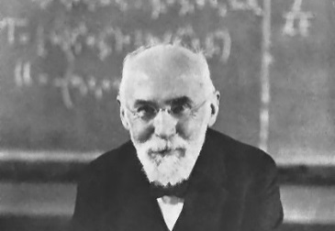
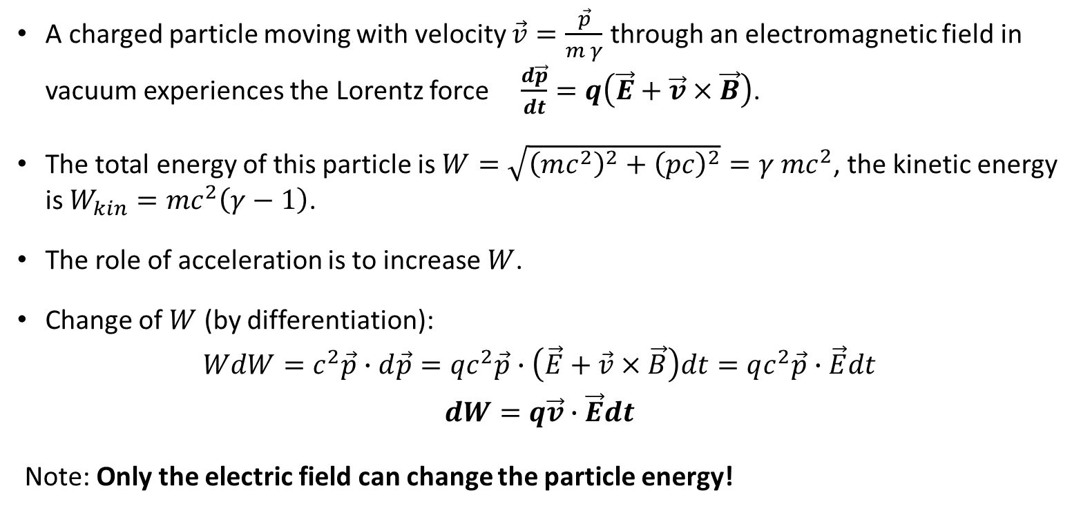
Lorentz force
Hendrik A. Lorentz 1853 – 1928
A charged particle moving with velocity $\vec{v}=\frac{\vec{p}}{m γ}$ through an electromagnetic field in vacuum experiences the Lorentz force $\frac{d\vec{p}}{dt}=q\left(\vec{E}+\vec{v}×\vec{B}\right)$.
The total energy of this particle is $W=\sqrt{{\left(mc^{2}\right)}^{2}+{\left(pc\right)}^{2}}=γ mc^{2}$, the kinetic energy is $W_{kin}=mc^{2}\left(γ−1\right)$.
The role of acceleration is to increase $W$.
Change of $W$ (by differentiation):
$$WdW=c^{2}\vec{p}∙d\vec{p}=qc^{2}\vec{p}∙\left(\vec{E}+\vec{v}×\vec{B}\right)dt=qc^{2}\vec{p}∙\vec{E}dt$$
$$dW=q\vec{v}∙\vec{E}dt$$
Note: Only the electric field can change the particle energy!

Slide 5
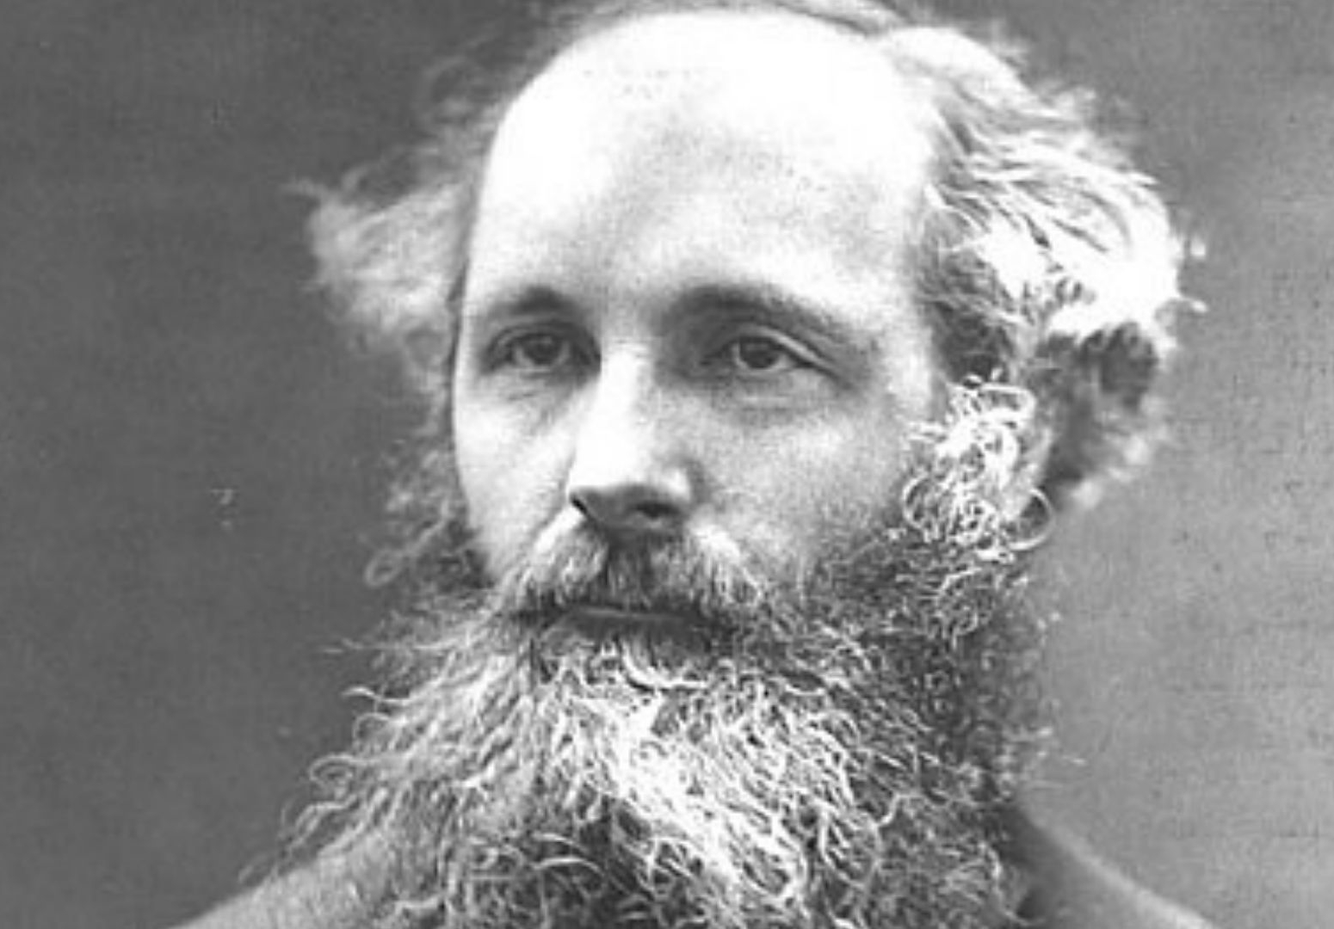
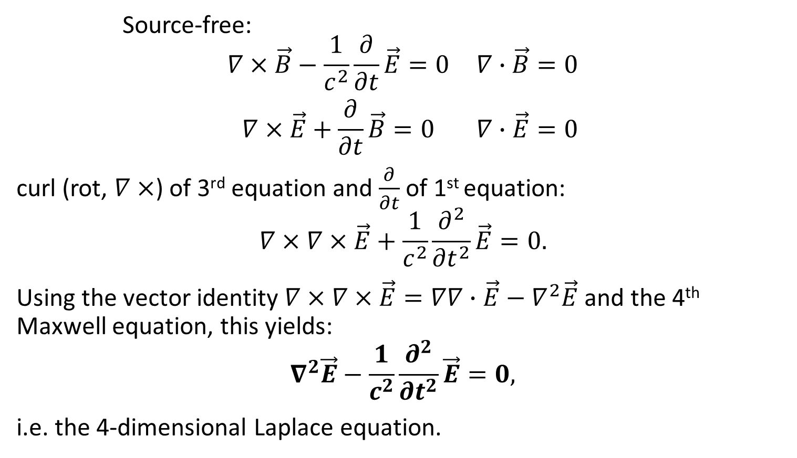
Maxwell’s equations in vacuum
James Clerk Maxwell
1831 – 1879
Source-free:
$$\begin{matrix}∇×\vec{B}−\frac{1}{c^{2}}\frac{∂}{∂t}\vec{E}=0 & ∇∙\vec{B}=0 \\ ∇×\vec{E}+\frac{∂}{∂t}\vec{B}=0 & ∇∙\vec{E}=0\end{matrix}$$
curl (rot, $∇×$) of 3rd equation and $\frac{∂}{∂t}$ of 1st equation:
$$∇×∇×\vec{E}+\frac{1}{c^{2}}\frac{∂^{2}}{{∂t}^{2}}\vec{E}=0.$$
Using the vector identity $∇×∇×\vec{E}=∇∇∙\vec{E}−∇^{2}\vec{E}$ and the 4th Maxwell equation, this yields:
$$∇^{2}\vec{E}−\frac{1}{c^{2}}\frac{∂^{2}}{{∂t}^{2}}\vec{E}=0,$$
i.e. the 4-dimensional Laplace equation.

Slide 6
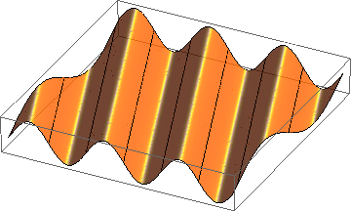

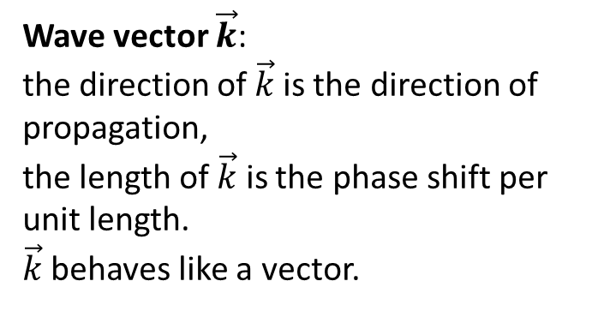
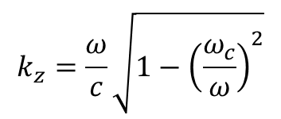

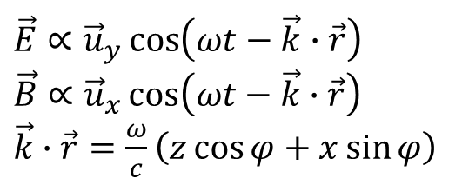
Homogeneous plane wave
$\vec{E}∝{\vec{u}}_{y}\cos\left(ωt−\vec{k}∙\vec{r}\right)$
$\vec{B}∝{\vec{u}}_{x}\cos\left(ωt−\vec{k}∙\vec{r}\right)$
$\vec{k}∙\vec{r}=\frac{ω}{c}\left(z\cos{φ}+x\sin{φ}\right)$
Wave vector $\vec{k}$:
the direction of $\vec{k}$is the direction of propagation,
the length of $\vec{k}$ is the phase shift per unit length.
$\vec{k}$ behaves like a vector.
x
$$k_{⊥}=\frac{ω_{c}}{c}$$
$$k=\frac{ω}{c}$$
E_{y}
φ
$$k_{z}=\frac{ω}{c}\sqrt{1−{\left(\frac{ω_{c}}{ω}\right)}^{2}}$$
z

Slide 7
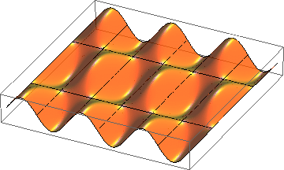
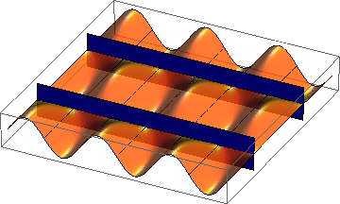
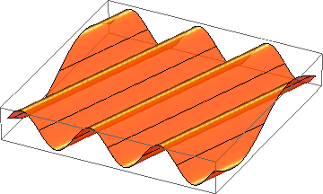
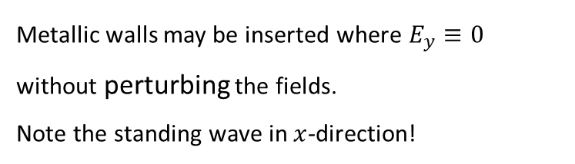



Superposition of 2 homogeneous plane waves
$$E_{y}$$
$$x$$
$$z$$
+
=
Metallic walls may be inserted where $E_{y}≡0$
without perturbing the fields.
Note the standing wave in $x$-direction!
This way one gets a hollow rectangular waveguide.

Slide 8
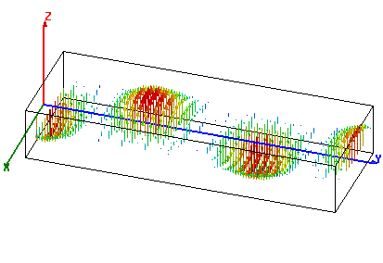
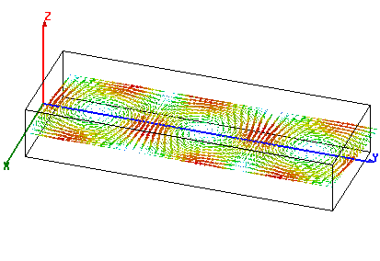



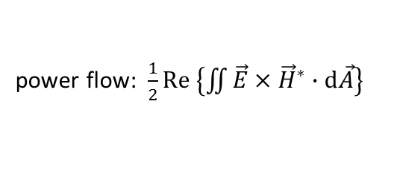
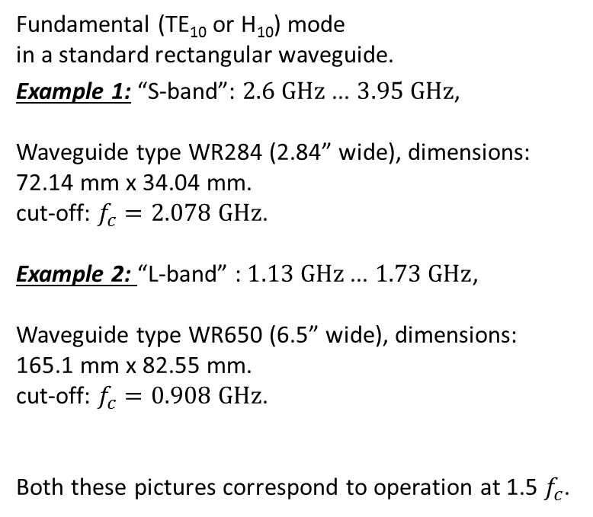
Rectangular waveguide
Fundamental (TE₁₀ or H₁₀) mode
in a standard rectangular waveguide.
Example 1: “S-band”: $2.6 \text{GHz}$... $3.95 \text{GHz}$,
Waveguide type WR284 (2.84” wide), dimensions: 72.14 mm x 34.04 mm.
cut-off: $f_{c}=2.078 \text{GHz}$.
Example 2: “L-band” : $1.13 \text{GHz}$... $1.73 \text{GHz}$,
Waveguide type WR650 (6.5” wide), dimensions: 165.1 mm x 82.55 mm.
cut-off: $f_{c}=0.908 \text{GHz}$.
Both these pictures correspond to operation at 1.5 $f_{c}$.
power flow
electric field
$$y$$
$$x$$
$$z$$
magnetic field
power flow
power flow: $\frac{1}{2}\text{Re} \left\{\iint{\vec{E}}×{\vec{H}}^{∗}∙\text{d}\vec{A}\right\}$

Slide 9
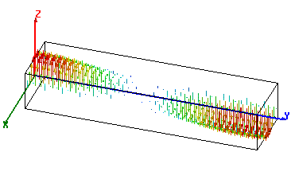
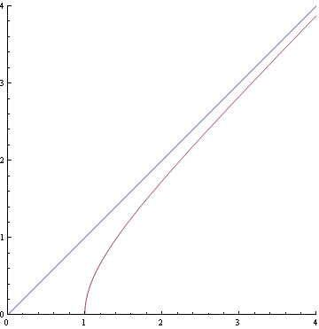
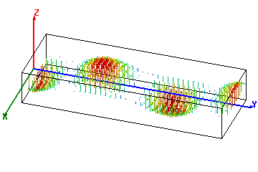
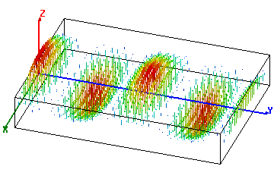



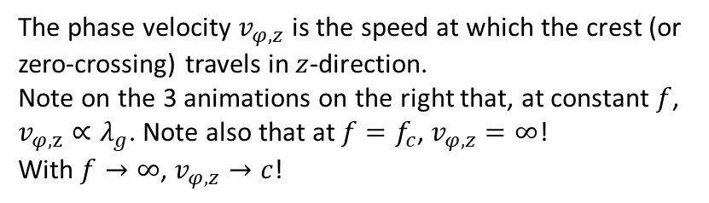


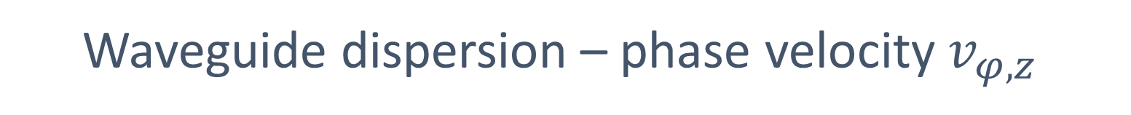
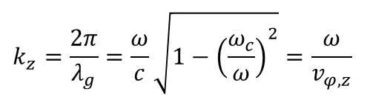

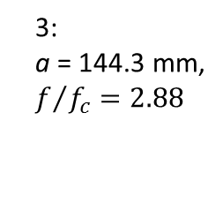

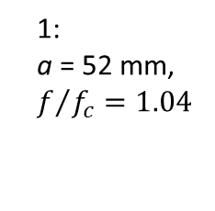
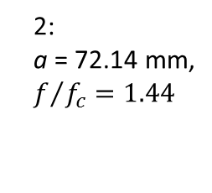

Waveguide dispersion – phase velocity $v_{φ,z}$
The phase velocity $v_{φ,z}$ is the speed at which the crest (or zero-crossing) travels in $z$-direction.
Note on the 3 animations on the right that, at constant $f$, $v_{φ,z}∝λ_{g}$. Note also that at $f=f_{c}$, $v_{φ,z}=∞$!
With $f→∞$, $v_{φ,z}→c$!
$$f=3 \text{GHz}$$
1:
a = 52 mm,
$f/{f_{c}}=1.04$
$$k_{c}$$
$$y$$
$$x$$
$$k=\frac{ω}{c}$$
$$z$$
2:
a = 72.14 mm,
$f/{f_{c}}=1.44$
3
$$k_{z}=\frac{2π}{λ_{g}}=\frac{ω}{c}\sqrt{1−{\left(\frac{ω_{c}}{ω}\right)}^{2}}=\frac{ω}{v_{φ,z}}$$
3:
a = 144.3 mm,
$f/{f_{c}}=2.88$
2
$$\frac{ω}{ω_{c}}$$
1
cutoff: $f_{c}=\frac{c}{2a}, v_{φ,z}=∞$

Slide 10
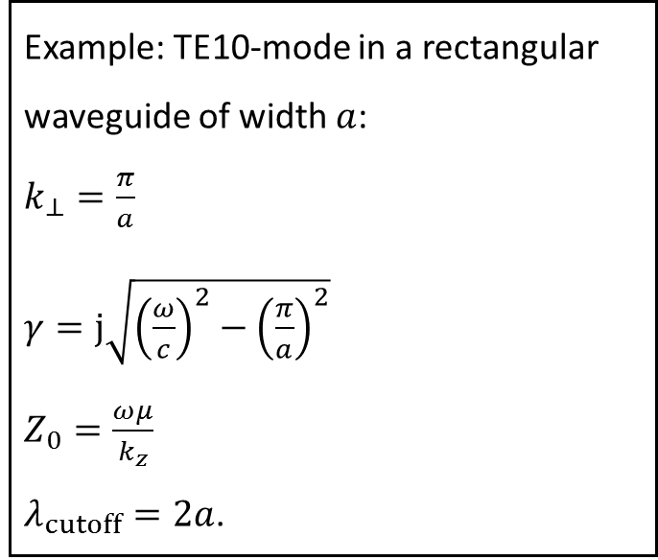
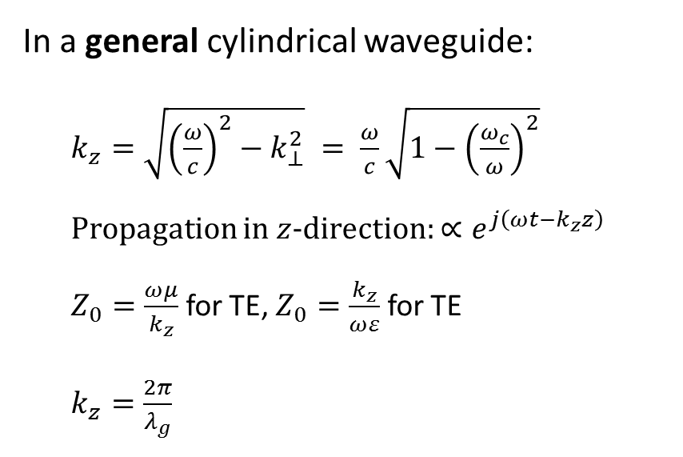
Summary waveguide dispersion and phase velocity:
In a general cylindrical waveguide:
  $k_{z}=\sqrt{{\left(\frac{ω}{c}\right)}^{2}−k_{⊥}^{2}} = \frac{ω}{c}\sqrt{1−{\left(\frac{ω_{c}}{ω}\right)}^{2}}$
  Propagation in $z$-direction: $∝ⅇ^{j\left(ωt−k_{z}z\right)}$
  $Z_{0}=\frac{ωμ}{k_{z}}$ for TE, $Z_{0}=\frac{k_{z}}{ωε}$ for TE
  $k_{z}=\frac{2π}{λ_{g}}$
Example: TE10-mode in a rectangular waveguide of width $a$:
$k_{⊥}=\frac{π}{a}$
$γ=\text{j}\sqrt{{\left(\frac{ω}{c}\right)}^{2}−{\left(\frac{π}{a}\right)}^{2}}$
$Z_{0}=\frac{ωμ}{k_{z}}$
$λ_{cutoff}=2a$.
In a hollow waveguide: phase velocity $v_{φ}>c$, group velocity $v_{gr}<c$, $v_{gr}∙v_{φ}=c^{2}$.

Slide 11
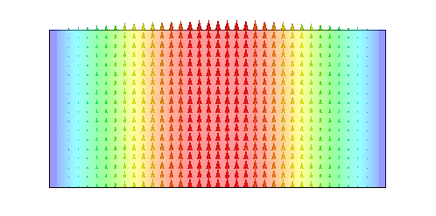
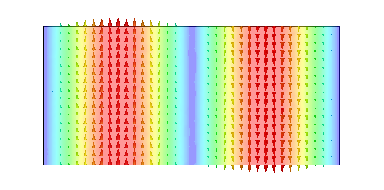
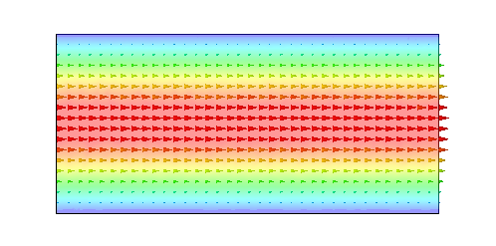
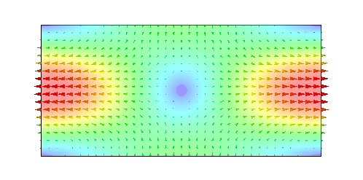
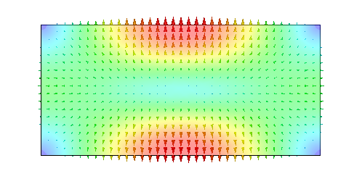
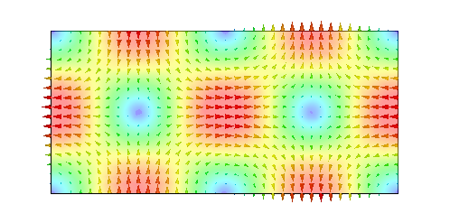
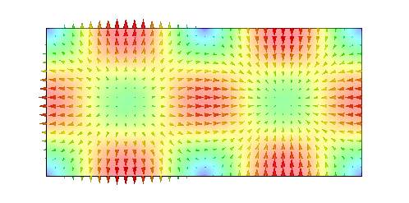
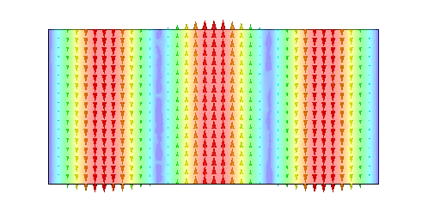
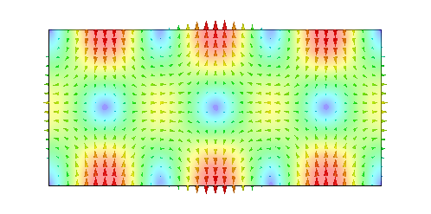
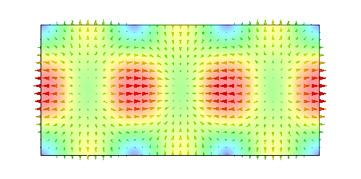
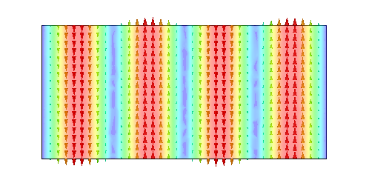
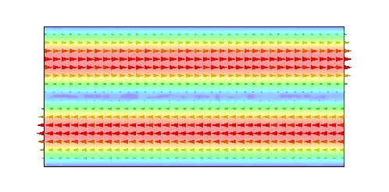
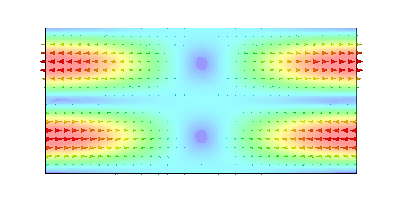
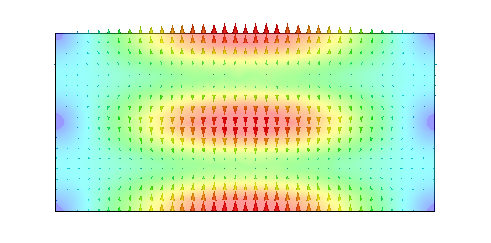
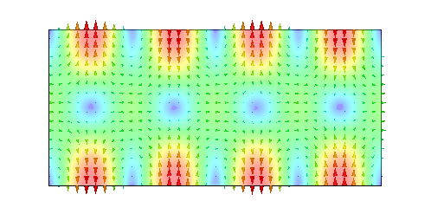
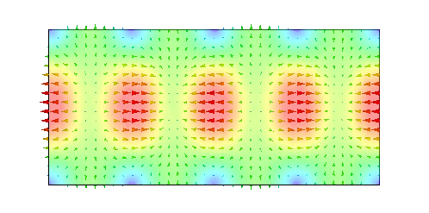
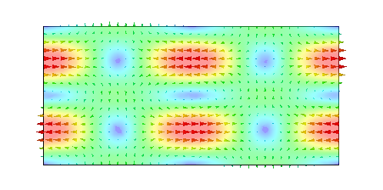
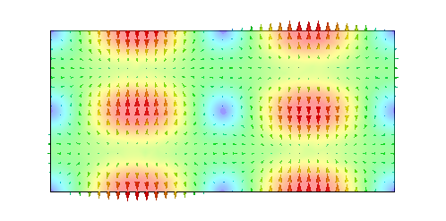
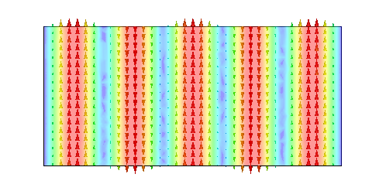
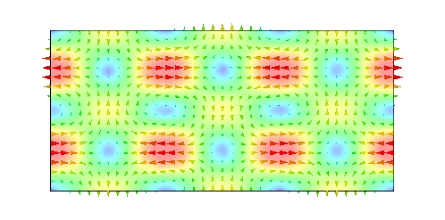
Rectangular waveguide modes
TE₁₀
TE₂₀
TE₀₁
TE₁₁
TM₁₁
TE₂₁
TM₂₁
TE₃₀
TE₃₁
TM₃₁
TE₄₀
TE₀₂
TE₁₂
TM₁₂
TE₄₁
TM₄₁
TE₂₂
TM₂₂
TE₅₀
TE₃₂
plotted: E-field

Slide 12
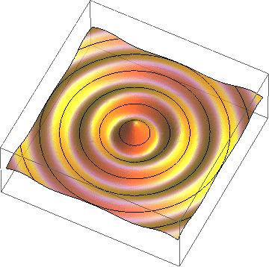
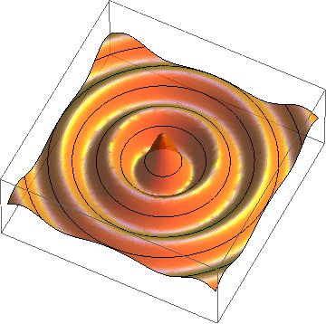
Radial waves
Also radial waves may be interpreted as superposition of plane waves.
The superposition of an outward and an inward radial wave can result in the field of a round hollow waveguide.

Slide 13






Round waveguide
f/f_{c} = 1.44
TE₁₁ – fundamental
TM₀₁ – axial field
TE₀₁ – low loss

Slide 14









Circular waveguide modes
TE₁₁
TE₁₁
TM₀₁
TE₂₁
TE₂₁
TE₃₁
TE₃₁
TE₀₁
TM₁₁
plotted: E-field

Slide 15


Waveguide perturbed by notches
perturbations (“notches”)
Signal flow chart
Reflections from notches lead to a superimposed standing wave pattern.
“Trapped mode”

Slide 16




Short-circuited waveguide
TM₀₁₀ (no axial dependence)
TM₀₁₁
TM₀₁₂

Slide 17








Single WG mode between two shorts
short
circuit
$$a$$
$$e^{−jk_{z}ℓ}$$
short
circuit
$$−1$$
Signal flow chart
$$−1$$
$$e^{−jk_{z}ℓ}$$
$$−ae^{−jk_{z}ℓ}$$
$$ℓ$$
Eigenvalue equation for field amplitude $a$:
$$a=e^{−jk_{z}2ℓ}a$$
Non-vanishing solutions exist for $2k_{z}ℓ=2πm$:
With $k_{z}=\frac{ω}{c}\sqrt{1−{\left(\frac{ω_{c}}{ω}\right)}^{2}}$, this becomes $f_{0}^{2}=f_{c}^{2}+{\left(c\frac{m}{2𝓁}\right)}^{2}$.

Slide 18


Simple pillbox
(only 1/2 shown)
TM₀₁₀-mode
electric field (purely axial)
magnetic field (purely azimuthal)

Slide 19





Pillbox cavity field (w/o beam tube)
$$T\left(ρ,φ\right)=\sqrt{ \frac{1}{π} }\frac{J_{0}\left(\frac{χ_{01}ρ}{a}\right)}{χ_{01} J_{1}\left(\frac{χ_{01}}{a}\right)}$$
h
with $χ_{01}=2.40483…$
Ø 2a
The only non-vanishing field components :
$$E_{z}=\frac{1}{ⅉωε}\frac{χ_{01}}{a} \sqrt{ \frac{1}{π} }\frac{J_{0}\left(\frac{χ_{01}ρ}{a}\right)}{a J_{1}\left(\frac{χ_{01}}{a}\right)}$$
$$B_{φ}=μ_{0}\sqrt{ \frac{1}{π} }\frac{J_{1}\left(\frac{χ_{01}ρ}{a}\right)}{a J_{1}\left(\frac{χ_{01}}{a}\right)}$$
${\left.ω_{0}\right|}_{pillbox}=\frac{χ_{01}c}{a}$, $η=\sqrt{\frac{μ_{0}}{ε_{0}}}=377 Ω$
$$Q{\left.​\right|}_{pillbox}=\frac{\sqrt{2aησχ_{01}}}{2\left(1+\frac{a}{h}\right)}$$
$${\left.\frac{R}{Q}\right|}_{pillbox}=\frac{4η}{χ_{01}^{3}πJ_{1}^{2}\left(χ_{01}\right)}\frac{\sin^{2}{(\frac{χ_{01}}{2}\frac{h}{a})}}{h/a}$$

Slide 20


Pillbox with beam pipe
TM₀₁₀-mode
(only 1/4 shown)
One needs a hole for the beam passage – circular waveguide below cutoff
electric field
magnetic field

Slide 21


A more practical pillbox cavity
TM₀₁₀-mode
(only 1/4 shown)
Rounding of sharp edges (to reduce field enhancement!)
electric field
magnetic field

Slide 22


A (real) elliptical cavity
TM₀₁₀-mode
(only 1/4 shown)
electric field
magnetic field

Slide 23
Characterizing a Cavity

Slide 24


Acceleration voltage and $R/Q$
I define
$$V_{acc}=\int_{−∞}^{∞}{E_{z}ⅇ^{ⅉ\frac{ω}{βc }z}ⅆz}.$$
The exponential factor accounts for the variation of the field while particles with velocity $βc$ are traversing the cavity gap.
With this definition, $V_{acc}$ is generally complex – this becomes important with more than one gap (cell).
For the time being we are only interested in $\left|V_{acc}\right|$.
The square of the acceleration voltage ${\left|V_{acc}\right|}^{2}$ is proportional to the stored energy $W;$the proportionality constant defines the quantity called “$R$-upon-$Q$”:
$$\frac{R}{Q}=\frac{{\left|V_{acc}\right|}^{2}}{2ω_{0}W}.$$
Attention – different definitions are used in literature!
electric field

Slide 25



Transit time factor
The transit time factor is the ratio of the acceleration voltage to the (non-physical) voltage a particle with infinite velocity would see:
$$TT=\frac{\left|V_{acc}\right|}{\left|∫E_{z}ⅆz\right|}=\frac{\left|\int{\left.E_{z}ⅇ^{ⅉ\frac{ω}{βc}z}ⅆz\right. }\right|}{\left|∫E_{z}ⅆz\right|}.$$
The transit time factor of an ideal pillbox cavity (no axial field dependence) of height (gap length) $h$ is:
$TT=\frac{sin\left(\frac{χ_{01}h}{2a}\right)}{\frac{χ_{01}h}{2a}}$
(remember: $ω_{0}=\frac{2πc}{λ}=\frac{χ_{01}c}{a}$)
Field rotates by 360° during particle passage.
$$TT$$
$$\frac{h}{λ}$$

Slide 26


Stored energy
The energy stored in the electric field is
$$W_{E}=\iiint_{cavity}{\frac{ε}{2}{\left|\vec{E}\right|}^{2}dV}.$$
The energy stored in the magnetic field is
$$W_{M}=\iiint_{cavity}{\frac{μ}{2}{\left|\vec{H}\right|}^{2}dV}.$$
Since $\vec{E}$ and $\vec{H}$ are $90°$ out of phase, the stored energy continuously swaps from electric energy to magnetic energy.
On average, electric and magnetic energy must be equal.
In steady state, the Poynting vector describes this energy flux.
In steady state, the total energy stored (constant) is
$$W=\iiint_{cavity}{\left(\frac{ε}{2}{\left|\vec{E}\right|}^{2}+\frac{μ}{2}{\left|\vec{H}\right|}^{2}\right)ⅆV.}$$
$$W_{E}$$
$$\vec{E}$$
$$W_{M}$$
$$\vec{H}$$

Slide 27




Stored energy and Poynting vector
John Henry Poynting
1852 – 1914
electric field energy
Poynting vector
magnetic field energy

Slide 28



Wall losses & $Q_{0}$
The losses $P_{loss}$ are proportional to the stored energy $W$.
The tangential $\vec{H}$ on the surface is linked to a surface current ${\vec{J}}_{A}=\vec{n}×\vec{H}$ (flowing in the skin depth $δ=\sqrt{2∕\left(ωμσ\right)}$).
This surface current ${\vec{J}}_{A}$ sees a surface resistance $R_{s}$, resulting in a local power density $R_{s}{\left|H_{t}\right|}^{2}$ flowing into the wall.
$R_{s}$ is related to skin depth $δ$ as $δσR_{s}=1$.
  Cu at $300 \text{K}$ has $σ≈5.8∙{{10}^{7}\text{S}}/{\text{m}}$, leading to $R_{s}≈8 \text{mΩ}$ at 1 GHz, scaling with $\sqrt{ω}$.
  Nb at $2 \text{K}$ has a typical $R_{s}≈10 \text{nΩ}$ at 1 GHz, scaling with $ω^{2}$.
The total wall losses result from $P_{loss}=\underset{wall}{∬}R_{s}{\left|H_{t}\right|}^{2}ⅆA$.
The cavity $Q_{0}$ (caused by wall losses) is defined as $Q_{0}=\frac{ω_{0}W}{P_{loss}}.$
Typical $Q_{0}$values:
  Cu at $300 \text{K}$ (normal-conducting): $𝒪\left({10}^{3}…{10}^{5}\right)$, should improve at cryogenic $T$ by a factor $\sqrt{RRR}$.
  Nb at $2 \text{K}$ (superconducting): $𝒪\left({10}^{9}…{10}^{11}\right)$
No! Anomalous skin effect!
improves only by a factor $≈10$!

Slide 29

Shunt impedance
Also the power loss $P_{loss}$ is also proportional to the square of the acceleration voltage ${\left|V_{acc}\right|}^{2}$; the proportionality constant defines the “shunt impedance”
$$R=\frac{{\left|V_{acc}\right|}^{2}}{2 P_{loss}}.$$
Attention, also here different definitions are used!
Traditionally, the shunt impedance is the quantity to optimize in order to minimize the power required for a given gap voltage.
Now the previously introduced term “$R$-upon-$Q$” makes sense:
$\left(\frac{R}{Q}\right)=R/Q$

Slide 30

Geometric factor
With
$$Q_{0}=\frac{ω_{0}W}{\underset{wall}{∬}R_{s}{\left|H_{t}\right|}^{2}ⅆA},$$
and assuming an average surface resistance $R_{s}$, one can introduce the “geometric factor”$G$ as
$$G=Q_{0}∙R_{s}=\frac{ω_{0}W}{\underset{wall}{∬}{\left|H_{t}\right|}^{2}ⅆA}.$$
$G$ has dimension Ohm, depends only on the cavity geometry (as the name suggests) and typically is $𝒪\left(100 \text{Ω}\right)$.
Note that $R_{s}∙R=G∙\left(R/Q\right)$ (dimension ${\text{Ω}}^{2}$, purely geometric)
$G$ is only used for SC cavities.

Slide 31









Cavity resonator – equivalent circuit
Simplification: single mode
$$I_{G}$$
$$V_{acc}$$
$$I_{B}$$
$$P_{loss}$$
Generator
Z
Beam
$$R/β$$
$$C$$
$$L$$
$$R$$
$β$: coupling factor
$R$: shunt impedance
$\sqrt{L/C}=\frac{R}{Q}$: $R$-upon-$Q$
Cavity

Slide 32



Power coupling - Loaded $Q$
Note that the generator inner impedance also loads the cavity – for very large $Q_{0}$ more than the cavity wall losses.
To calculate the loaded $Q$ ($Q_{L}$), losses have to be added:
$$\frac{1}{Q_{L}}=\frac{P_{loss}+P_{ext}+…}{ω_{0} W}=\frac{1}{Q_{0}}+\frac{1}{Q_{ext}}+\frac{1}{…}.$$
The coupling factor $β$ is the ratio ${P_{ext}}/{P_{loss}}$.
With $β$, the loaded $Q$ can be written
$$Q_{L}=\frac{Q_{0}}{1+β}.$$
For NC cavities, often $β=1$ is chosen (power amplifier matched to empty cavity); for SC cavities, $β=𝒪\left({10}^{4}…{10}^{6}\right)$.

Slide 33








Resonance
$$\frac{Z\left(ω\right)}{R/Q}$$
$$Q_{0}=1000$$
While a high $Q_{0}$ results in small wall losses, so less power is needed for the same voltage.
On the other hand the bandwidth becomes very narrow.
Note: a 1 GHz cavity with a $Q_{0}$ of ${10}^{10}$ has a natural bandwidth of 0.1 Hz!
… to make this manageable, $Q_{ext}$ is chosen much smaller!
$$Q_{0}=100$$
$Q_{0}=1$0
$$Q_{0}=1$$
$$\frac{ω}{ω_{0}}$$

Slide 34













Loss factor
Impedance seen by the beam
V (induced)
$$I_{B}$$
$$k_{loss}=\frac{ω_{0}}{2}\left(\frac{R}{Q}\right)=\frac{{\left|V_{acc}\right|}^{2}}{4 W}=\frac{1}{2C}$$
Beam
Energy deposited by a single charge $q$: $k_{loss}q^{2}$
$$R/β$$
$$C$$
$$L$$
$$R$$
$$L=R/{\left(Q_{0}{ ω}_{0}\right)}$$
$$C={Q_{0}}/{\left(R ω_{0}\right)}$$
Voltage induced by a single charge $q$: $2 k_{loss}q$
Cavity
$$ⅇ^{−\frac{ω_{0}}{2Q_{L}}t}$$
$$\frac{V_{acc}}{2 k_{loss} q}$$
$$f_{0}t$$

Slide 35





Summary: relations $V_{acc}$, $W$ and $P_{loss}$
Attention – different definitions are used in literature !
$$V_{acc}$$
Accelerating voltage
𝑉_acc
Accelerating voltage
$$P_{loss}$$
wall losses
𝑃_loss
wall losses
$$W$$
Energy stored
𝑊
Energy stored
$$\frac{R}{Q}=\frac{{\left|V_{acc}\right|}^{2}}{2ω_{0}W}$$
$$R=\frac{{\left|V_{acc}\right|}^{2}}{2P_{loss}}=\frac{R}{Q}Q_{0}$$
$$k_{loss}=\frac{ω_{0}}{2}\frac{R}{Q}=\frac{{\left|V_{acc}\right|}^{2}}{4W}$$
$$Q_{0}=\frac{ω_{0}W}{P_{loss}}$$

Slide 36


Beam loading
The beam current “loads” the cavity, in the
equivalent circuit this appears as an impedance in
parallel to the shunt impedance.
If the generator is matched to the unloaded cavity
($β=1$), beam loading will (normally) cause the accelerating voltage to decrease.
The power absorbed by the beam is $−\frac{1}{2}ℜ\left\{V_{acc}I_{B}^{∗}\right\}$.
For high power transfer efficiency RF → beam, beam loading must be high!
For SC cavities (very large $β)$, the generator is typically matched to the beam impedance!
Variation in the beam current leads to transient beam loading, which requires special care!
Often the “impedance” the beam presents is strongly reactive – this leads to a detuning of the cavity.

Slide 37


Multipactor
The words “multipactor”, “to multipact” and “multipacting” are artificially composed of “multiple” “impact”.
Multipactor describes a resonant RF phenomenon in vacuum:
  Consider a free electron in a simple cavity – it gets accelerated by the
  electric field towards the wall
  when it impacts the wall, secondary electrons will be emitted, described
  by the secondary emission yield (SEY)
  in certain impact energy ranges, more than one electron is emitted for
  one electron impacting! So the number of electrons can increase
  When the time for an electron from emission to impact takes exactly
  ½ of the RF period, resonance occurs – with the SEY>1, this leads to an
  avalanche increase of electrons, effectively taking all RF power at this
  field level, depleting the stored energy and limiting the field!
For this simple “2-point MP”, this resonance
condition is reached at $\frac{1}{4π}\frac{e}{m}V={\left(fd\right)}^{2}$ or
$\frac{V}{112 \text{V}}={\left(\frac{f}{\text{MHz}}\frac{d}{\text{m}}\right)}^{2}$. There exist other resonant bands.
courtesy: Sarah Aull/CERN

Slide 38

Multipactor (contd.)
Unfortunately, good metallic conductors (Cu, Ag, Nb) all have SEY>1!
1-point MP occurs when the electron impact where they were emitted
Electron trajectories can be complex since both $\vec{E}$ and $\vec{B}$ influence them; computer simulations allow to determine the MP bands (barriers)
To reduce or suppress MP, a combination of the following may be considered:
  Use materials with low SEY
  Optimize the shape of your cavity (→ elliptical cavity)
  Conditioning (surface altered by exposure to RF fields)
  Coating (Ti, TiN, NEG, amorphous C …)
  Clearing electrode (for a superimposed DC electric field)
  Rough surfaces

Slide 39
Many gaps

Slide 40










What do you gain with many gaps?
The $R/Q$ of a single gap cavity is limited to some $100 Ω$.
Now consider to distribute the available power to $n$ identical cavities: each will receive $P/n$, thus produce an accelerating voltage of$\sqrt{{2RP}/n}$. (Attention: phase important!)
The total accelerating voltage thus increased, equivalent to a total equivalent shunt impedance of $nR$.
$$\left|V_{acc}\right|=n\sqrt{2R\frac{P}{n}}=\sqrt{2\left(nR\right)P}$$
$$P/n$$
$$P/n$$
$$P/n$$
$$P/n$$
$$1$$
$$2$$
$$3$$
$$n$$

Slide 41

Standing wave multi-cell cavity
Instead of distributing the power from the amplifier, one might as well couple the cavities, such that the power automatically distributes, or have a cavity with many gaps (e.g. drift tube linac).
Coupled cavity accelerating structure (side coupled)
The phase relation between gaps is important!

Slide 42





Brillouin diagram;
Travelling wave structure
π
$${ωL}/{c }$$
2π
speed of light line,
ω = β /c
2π/3
π
synchronous
π/2
π/2
0
0
π/2
β L
π

Slide 43





The elliptical cavity
At $1.3 GHz$:
$R_{0}=103.3 mm$,
$2L=115.3 mm$.
The elliptical shape was found as
optimum compromise between
  maximum gradient ($E_{acc}/E_{surface}$)
  suppression of multipactor
  mode purity
  machinability
A multi-cell elliptical cavity is typically
operated in $π$-mode, i.e. cell length
is exactly ${βλ}/2$.
It has become de facto standard,
used for ions and leptons! E.g.:
  ILC/X-FEL: 1.3 GHz, 9-cell cavity
  SNS (805 MHz)
  SPL/ESS (704 MHz)
  LHC (400 MHz)
D. Proch, 1993 ^{*)}
*): http://accelconf.web.cern.ch/AccelConf/SRF93/papers/srf93g01.pdf‎

Slide 44
Elliptical cavities

Slide 45




Elliptical cavities – the de facto standard for SRF
FERMI 3.9 GHz
TESLA/ILC 1.3 GHz
LEP 0.352 GHz
S-DALINAC 3 GHz
SNS $β=0.61, 0.81$, 0.805 GHz
CEBAF 1.5 GHz
HERA 0.5 GHz
cells
HEPL 1.3 GHz
TRISTAN 0.5 GHz
CESR 0.5 GHz
KEK-B 0.5 GHz

Slide 46


Practical RF parameters 1
Average accelerating gradient: $E_{acc}=\frac{\sqrt{ωW\left(R/Q\right)}}{l_{active}}$
$B_{peak}$ on the wall
$E_{peak}$ on the wall
$$\frac{E_{peak}}{E_{acc}}$$
$$\frac{B_{peak}}{E_{acc}}$$
Contour plot of $\left|E\right|$
Contour plot of $\left|B\right|$
$$l_{active}$$
The ratio shows sensitivity of the shape to the field emission of electrons.
The ratio shows limit in E_{acc} due to the breakdown of superconductivity (quench,
Nb: $≈190 mT$).
courtesy: Jacek Sekutovicz/DESY

Slide 47

Practical RF parameters 2
$$G∙\left(R/Q\right)$$
Both $G$ and $R/Q$ are purely geometric parameters.
Like the shunt impedance $R$, the product $G∙\left(R/Q\right)$ is a measure of the power loss for given acceleration voltage $V_{acc}$ and surface resistance $R_{s}$.
$$P_{loss}=\frac{{\left|V_{acc}\right|}^{2}R_{s}}{2 G∙\left(R/Q\right)}$$
Minimize $R_{s}$:
  operation at lower $T$,
  better surface cleanliness,
  lower residual resistance
Optimize geometry maximizing $G∙\left(R/Q\right)$.
courtesy: Jacek Sekutovicz/DESY

Slide 48
Single-cell versus multi-cell cavities
Advantages of single-cell cavities:
  It is easier to manage HOM damping
  There is no field flatness problem.
  Input coupler transfers less power
  They are easy for cleaning and preparation
Advantages of multi-cell cavities:
  much more acceleration per meter!
  better use of the power ($R→n R$)
  more cost-effective for most applications
courtesy: Jacek Sekutovicz/DESY

Slide 49
Practical RF parameters 3
Cell-to-cell coupling $k_{cc}$ will determine the width of the passbands in multi-cell cavities.
$$k_{cc}=2\frac{{ω_{π}−ω}_{0}}{ω_{π}+ω_{0}}$$
$$2π$$
Brillouin diagram
$${ωL}/c$$
$0$-mode
$π$-mode
$$π$$
$${ω_{π} L}/c$$
$$π/2$$
$${ω_{0} L}/c$$
0
$$π/2$$
$k_{z}L$
$$π$$
courtesy: Jacek Sekutovicz/DESY

Slide 50
Field flatness
Field amplitude variation from cell to cell in a multi-cell structure
Should be small for maximum acceleration.
Field flatness sensitivity factor $a_{ff}$ for a structure made of $N$ cells:
$$\frac{ΔA_{i}}{A_{i}}=a_{ff}\frac{Δf_{i}}{f_{i}}$$
  $a_{ff}$is related to the cell-to-cell coupling as $a_{ff}=\frac{N^{2}}{k_{cc}}$ and describes the sensitivity of the field flatness on the errors in individual cells.
courtesy: Jacek Sekutovicz/DESY

Slide 51

Criteria for Cavity Design (1)
Here: Inner cells of multi-cell structures
Parameters for optimization:
  Fundamental mode: $\frac{R}{Q}$, $G$, $\frac{E_{peak}}{E_{acc}}$, $\frac{B_{peak}}{E_{acc}}$, $k_{cc}$.
  Higher order modes: $k_{⊥}$, $k_{z}$.
The elliptical cavity design has distinct advantages:
  easy to clean (rinse)
  little susceptible to MP – can be conditioned …
Geometric parameters for optimization:
  iris ellipse half axes: $a$, $b$:
  iris aperture radius: $r_{i}$,
  equator ellipse half axes: $A$, $B$
Problem: 7 parameters to optimize, only 5 to play
with – some compromise has to be found!
courtesy: Jacek Sekutovicz/DESY

Slide 52

Criteria for Cavity Design (2)
Criterion | RF parameter | Improves if | examples
high gradient operation | ${E_{peak}}/{E_{acc}}$ ${B_{peak}}/{E_{acc}}$ | $r_{i}$ | ILC, CEBAF 12 GeV HG
low cryogenic losses | $$\frac{R}{Q}∙G$$ | $r_{i}$ | CEBAF LL
High $I_{beam}$ | $k_{⊥}$, $k_{z}$ | $r_{i}$ | B-factory RHIC cooling LHeC
We see here that $r_{i}$ is a very “powerful” variable to trim the RF-parameters of a cavity.
Of course it has to fit the aperture required for the beam!
courtesy: Jacek Sekutovicz/DESY

Slide 53
Effect of $r_{i}$
Smaller $r_{i}$ allows to concentrate $E_{z}$ where it is needed for acceleration
$$r_{i}=40 mm$$
$$r_{i}=20 mm$$
$E_{z}\left(z\right)$ for small and big iris radius
courtesy: Jacek Sekutovicz/DESY

Slide 54
Example: cell optimization at 1.5 GHz
A. Mosnier, E. Haebel, SRF Workshop 1991

Slide 55

Equator shape optimization
${B_{peak}}/{E_{acc}}$ (and $G$) change when changing the equator shape.
courtesy: Jacek Sekutovicz/DESY

Slide 56

Iris shape optimization
${E_{peak}}/{E_{acc}}$ changes with the iris shape
$$25 mm$$
$$20 mm$$
$$42 mm$$
$$42 mm$$
Both cells have the same: $f_{0}$, $R/Q$, and $r_{i}$.
courtesy: Jacek Sekutovicz/DESY

Slide 57



Minimizing HOM excitation
HOMs loss factors ($k_{loss,⊥}$ , $k_{loss}$)
$$r_{i}=20 mm$$
$$r_{i}=40 mm$$
$R/Q=152 \text{Ω}$
${B_{peak}}/{E_{acc}}=3.5{\text{mT}}/{\left({MV}/m\right)}$
${E_{peak}}/{E_{acc}}=1.9$
$R/Q=86 \text{Ω}$
${B_{peak}}/{E_{acc}}=4.6{\text{mT}}/{\left({MV}/m\right)}$
${E_{peak}}/{E_{acc}}=3.2$
courtesy: Jacek Sekutovicz/DESY

Slide 58
Cell-to-cell coupling $k_{cc}$
$$r_{i}=20 mm$$
$$r_{i}=40 mm$$
$R/Q=152 \text{Ω}$
${B_{peak}}/{E_{acc}}=3.5{\text{mT}}/{\left({MV}/m\right)}$
${E_{peak}}/{E_{acc}}=1.9$
$R/Q=86 \text{Ω}$
${B_{peak}}/{E_{acc}}=4.6{\text{mT}}/{\left({MV}/m\right)}$
${E_{peak}}/{E_{acc}}=3.2$
courtesy: Jacek Sekutovicz/DESY

Slide 59

Scaling the frequency
$$×2 =$$
$$f_{π}$$ | [MHz] | 2600
$$R/Q$$ | [Ω] | 57
$$r/Q$$ | [Ω/m] | 2000
$$G$$ | [Ω] | 271
$$f_{π}$$ | [MHz] | 1300
$$R/Q$$ | [Ω] | 57
$$r/Q$$ | [Ω/m] | 1000
$$G$$ | [Ω] | 271
$r/Q={\left(R/Q\right)}/l∝f$ (or ${\left(R/Q\right)}/λ=const$)
courtesy: Jacek Sekutovicz/DESY

Slide 60

Historic evolution of inner cell geometry
Example: ILC
TESLA,
optimized ${E_{peak}}/{E_{acc}}$
Re-entrant,
optimized ${B_{peak}}/{E_{acc}}$
Low-loss (LL)
optimized ${B_{peak}}/{E_{acc}}$
1992
2002/04
2002/04
$$r_{i}$$ | [mm] | 35 | 30 | 30
$$k_{cc}$$ | [%] | 1.9 | 1.56 | 1.52
$${E_{peak}}/{E_{acc}}$$ | - | 1.98 | 2.30 | 2.36
$${B_{peak}}/{E_{acc}}$$ | [mT/(MV/m)] | 4.15 | 3.57 | 3.61
$$R/Q$$ | [Ω] | 113.8 | 135 | 133.7
$$G$$ | [Ω] | 271 | 284.3 | 284
$$R/Q∙G$$ | [Ω*Ω] | 30840 | 38380 | 37970
$k_{loss,⊥}$ ($σ_{z}=1 mm$) | [V/pC/cm²] | 0.23 | 0.38 | 0.38
$k_{loss}$ ($σ_{z}=1 mm$) | [V/pC] | 1.46 | 1.75 | 1.72
courtesy: Jacek Sekutovicz/DESY

Slide 61

Cavity optimization example
courtesy: Frank Marhauser/JLAB

Slide 62
Higher Order Modes

Slide 63
Higher order modes
external dampers
R₁, Q₁,ω₁
R₂, Q₂,ω₂
R₃, Q₃,ω₃
...
...
n₁
n₂
n₃
I_{B}

Slide 64


Pillbox: 1st dipole mode
TM₁₁₀-mode
(only 1/4 shown)
electric field
magnetic field

Slide 65

7-cell 1.3 GHz structure for
Band diagram (top) and Q-factors (bottom)
Reminder:
0-mode $π$-mode
Galek et al.: IPAC2013

Slide 66
HOMs: Example 5-cell cavity
First passbands of HOMs typically dangerous
courtesy: Rama Calaga/CERN

Slide 67
HOM dampers
Ferrite absorbers: broadband damper, room temperature
Waveguides: better suited for higher frequencies (size!)
Notch filters: narrow-band; target specific mode
Multi-cell cavities require broadband dampers!
ferrite absorber
waveguides
notch filter
bandpass filter
double notch

Slide 68
Non-elliptical cavities
Special thanks to R. Laxdal (TRIUMF) and A. Facco (INFN & FRIB)

Slide 69




Useful relations
Protons/H- ($A=1$, $Q=1$)
Heavy Ions ($A$, $Q$)
$$p=γβm_{0}c=\frac{γβE_{0}}{c}$$
$$E=E_{kin}+E_{0}=γE_{0}$$
$$E_{kin}=\left(γ−1\right)E_{0}$$
$$E_{kin}=\left|e\right|V_{eff}\cos{φ}$$
$$p=γβAm_{0}c=\frac{γβAE_{0}}{c}$$
$$E=E_{kin}+AE_{0}=γAE_{0}$$
$${E_{kin}}/A=\left(γ−1\right)E_{0}$$
$${E_{kin}}/A=\left(Q/A\right) V_{eff}\cos{φ}$$

Slide 70






Particle velocity vs. kinetic energy
$$E_{kin}=\frac{m_{0}}{2}v^{2}$$
$$1−\frac{1}{2γ^{2}}$$
$$\sqrt{1−\frac{1}{γ^{2}}}$$
$$β=v/c$$
electron @ 5.4 keV
proton @ 1 MeV
electron @ 511 keV
proton @ 938 MeV
electron @ 50 MeV
proton @ 91.8 GeV
$${E_{kin}}/{E_{0}}=γ−1$$

Slide 71

Accelerating electrons vs. accelerating ions

Slide 72



Accelerating electrons vs. accelerating ions
Electrons
Ions
Common building blocks – all designed for $β=1$.
Various building blocks – different technologies, each optimized for a certain velocity range

Slide 73


Limitations of elliptical cavities
Elliptical cavities have been designed starting at $β≥0.5$ for CW applications, for $β≥0.6$ for pulsed (SNS, ESS).
The $π$-mode requires cell-to-cell distance of ${βλ}/2$, but outer diameter $≈0.9 λ$, i.e. at low $β$ the cavity looks more like bellows, sensitive to LFD!

Slide 74

Non-elliptical SRF Community around the world

Slide 75


Resonator types for low beta acceleration
Quarter wave resonator (QWR) $β≈0.04 …0.2$
Half wave resonator (HWR) $β≈0.1 …0.5$
Single spoke resonator (SSR) $β≈0.15 …0.7$
Multi-spoke resonator (MSR) $β≈0.06 …1$
For comparison: Elliptical cavities $β≈0.5 …1$

Slide 76


Coaxial resonator
Consider a coaxial geometry with grounded end plates, an inner conductor with radius $a$ and an outer conductor with radius $b$.
A standing wave occurs with $E_{r}$ vanishing on the end walls at $z=0$ and $z=d$.
The remaining non-zero field components are
$B_{θ}=\frac{μ_{0}I_{0}}{πr}\cos\left(\frac{pπz}{d}\right)$,
$E_{r}=−ⅉ2\sqrt{\frac{μ_{0}}{ε_{0}}}\frac{I_{0}}{2πr}\sin\left(\frac{pπz}{d}\right)$,
where $ω=\frac{pπc}{d}$, $p=1,2,3,…$
Peak voltage:
$\hat{V}\left(z\right)=\int_{a}^{b}{E_{r}\left(z\right)ⅆr}=\sqrt{\frac{μ_{0}}{ε_{0}}}\frac{I_{0}}{π}\ln{\frac{b}{a}}\sin\left(\frac{pπz}{d}\right)$

Slide 77


Quarter-wave resonator (QWR)
The most popular coaxial TEM mode cavity is the quarter wave resonator – capacitively loaded $λ/4$ transmission line
The inner conductor is open at one end with a resonant length of $\left(1+2p\right)λ/4$, $p=0,1,2,…$
For acceleration, $p=0$ is chosen.
The maximum voltage builds up on the open tip – the maximum current at the root.
A beam tube is arranged near the end of the tip.

Slide 78


Half-wave resonator (HWR)
In the HWR the beam port is at the centre of the inner conductor of a coaxial resonator, coincident with the maximum voltage for $p=1$.
Magnetic fields loop around the inner conductor with peak fields at the shorted ends.
For acceleration, $p=1$ is chosen.

Slide 79


QWR vs. HWR
QWR is the cavity of choice for low beta applications where a low frequency is needed
  requires ~50% less structure compared to HWR for the same frequency – rf power loss is ~50% of HWR for same frequency and $β_{0}$.
  allows low frequency choice giving larger longitudinal acceptance.
  $R/Q$ twice that of HWR.
  Asymmetric field pattern introduces vertical steering especially for light ions that increases with velocity – avoid use for $β_{0}>0.2$.
  Less mechanically stable than HWR due to unsupported end (microphonics).
HWR is chosen in mid velocity range ($β_{0}>0.2$) or where steering must be eliminated (i.e. high intensity light ion applications)
  produces twice rf losses for the same $β_{0}$ and $λ$.
  is 2x longer for the same frequency.
  Pluses are the symmetric field pattern and increased mechanical rigidity.

Slide 80


HWR vs. Single Spoke Resonator (SSR)
A single spoke resonator (SSR) is another variant of the half-wave TEM mode cavity class.
In HWR the outer conductor is coaxial with the inner conductor (with diameter $β_{0}λ$) while in the spoke cavities the outer cylinder is co-axial with the beam tube with diameter $λ/2$. It means that for $β_{0}<0.5$ the SSR has a larger overall physical envelop than the HWR for the same frequency.
Thus for low beta applications ($0.1<β<0.25$) HWRs are chosen at $≈160 MHz$, while SSRs are preferred at $≈320 MHz$.
The spoke geometry allows an extension along the beam path to provide multiple spokes in a single resonator giving higher effective voltage, but with a narrower transit time acceptance.

Slide 81


Cavity types – QWRs
Typical range:
$0.04<β<0.2$
$50 MHz≤f≤160 MHz$

Slide 82


Cavity types – HWRs
Typical range:
$0.1<β<0.5$
$140 MHz≤f≤325 MHz$

Slide 83


Cavity types – SSRs
Typical range:
$0.15<β<0.7$
$320 MHz≤f≤700 MHz$

Slide 84

Cavity types – multi-cell
CH: Crossbar H-mode

Slide 85

Accelerating cavity velocity/frequency chart

Slide 86




Transit Time factor vs. $β$ for multiple gaps
$${T\left(β\right)}/{T\left(β_{0}\right)}$$
$$β/{β_{0}}$$

Slide 87



High-$β$ spoke cavities
High velocity spoke cavities with $β>0.8$ are being designed as alternative to elliptical cavities
Features:
  relatively compact
    between 20% and 50% smaller (radially) for low-$β$ cavities
    for high $β$ diameter close to TM counterparts
  allows low frequency at reasonable size
  mechanically stable – high shunt impedance

Slide 88

Deflecting mode cavities

Slide 89



Prototype HL-LHC Crab Cavity prototypes
“DQW” (vertical deflection)
“RFD” (vertical deflection)

Slide 90


The real thing (HL-LHC Crab Cavity)
CERN-PHOTO-201708-196-10
CERN-PHOTO-2018-026-5

Slide 91
Power Couplers

Slide 92





Fundamental Power Coupler – FPC
The Fundamental Power Coupler is the connecting part between the RF transmission line and the RF cavity
It is a specific piece of transmission line that also has to provide the cavity vacuum barrier.
FPCs are amongst the most critical parts of the RF cavity system in an accelerator!
A good RF design, a good mechanical design and a high quality fabrication are essential for an efficient and reliable operation.
LHC FPC
SPL FPC
HL-LHC FPC
courtesy: Eric Montesinos/CERN

Slide 93
Magnetic (loop) coupling
The magnetic field of the cavity main mode is intercepted by a coupling loop
The coupling can be adjusted by changing the size or the orientation of the loop.
Coupling: $∝∭\vec{H}∙{\vec{J}}_{m}ⅆV$
coupling loop
$${\vec{J}}_{m}$$
$$\vec{H}$$
courtesy: David Alesini/INFN

Slide 94
Electric (antenna) coupling
The inner conductor of the coaxial feeder line ends in an antenna penetrating into the electric field of the cavity.
The coupling can be adjusted by varying the penetration.
Coupling $∝∭\vec{E}∙\vec{J}ⅆV$
antenna
$$\vec{J}$$
$$\vec{E}$$
courtesy: David Alesini/INFN

Slide 95
Tuners

Slide 96

Small boundary perturbation
Perturbation calculation is used to understand the basics for cavity tuning – it is used to analyse the sensitivity to (small) surface geometry perturbations.
  This is relevant to understand the effect of fabrication tolerances.
  Intentional surface deformation or introduced obstacles can be used to tune the cavity.
The basic idea of the perturbation theory is use a known solution (in this case the unperturbed cavity) and assume that the deviation from it is only small. We just used this to calculate the losses (assuming $H_{t}$ would be that without losses).
The result of this calculation leads to a convenient expression for the (de)tuning:
$$\frac{ω−ω_{0}}{ω}=\frac{\iiint_{ΔV}{\left(μ_{0}{\left|H_{0}\right|}^{2}−ε{\left|E_{0}\right|}^{2}\right)ⅆV}}{\iiint_{V}{\left(μ_{0}{\left|H_{0}\right|}^{2}+ε{\left|E_{0}\right|}^{2}\right)ⅆV}}$$
V
ΔV
V
John C. Slater
1900 – 1976
Slater’s Theorem
unperturbed: $ω_{0}$
perturbed: $ω$

Slide 97

Lorentz force detuning (“LFD”)
The presence of electromagnetic fields inside the cavity lead to a mechanical pressure on the cavity.
Radiation pressure: $P=\frac{1}{4}(μ_{0}{\left|H\right|}^{2}−ε_{0}{\left|E\right|}^{2})$
Deformation of the cavity shape:
Frequency shift: $Δf=K L {\left|E_{acc}\right|}^{2}$; typical: $K L≈−{\left(1…10\right)\text{Hz}}/{{\left(\frac{\text{MV}}{\text{m}}\right)}^{2}}$
This requires good stiffness – and the possibility to tune rapidly!

Slide 98

Tuner principle
Slow tuners:
  compensate for mechanical tolerances,
  realized with stepper motor drives
Fast tuners:
  compensate Lorentz-force detuning and reactive beam loading
  realized with piezo crystal (lead zirconate titanate – PZT)
Tuning of SC cavities is often realized by deforming the cavity:
courtesy: Eiji Kako/KEK

Slide 99



Blade tuner
Developed by INFN Milano
Azimuthal motion transferred to longitudinal strain
Zero backlash
CuBe threaded shaft used for a screw nut system
Stepping motor and gear combination driver
Two piezo actuators for fast action
All components in cold location
courtesy: Eiji Kako/KEK

Slide 100




“Saclay” lever-arm tuner
Developed by DESY based on the Saclay design
Double lever system (leverage 1.25)
Cold stepping motor and gear combination
Screw nut system
Two piezo actuators for fast action in a preloaded frame
All components in cold location
courtesy: Eiji Kako/KEK

Slide 101




Slide-jack tuner
Developed by KEK for STF cryomodule
Slide-jack mechanism
Single high voltage piezo actuator for fast action
Warm stepping motor for easy maintenance
Access port for replacing piezo
courtesy: Eiji Kako/KEK

Slide 102



Microphonics
Driven by mechanical vibration in the environment.
QWRs are particularly problematic due to the pendulum action of the inner conductor, which can have very low mechanical frequencies ($\left(50…100\right) Hz$)
  need to reduce the RMS detuning to $≪10\%$ of the available BW to avoid nuisance
  the other option is to increase the BW (lower $Q_{L}$,
  costs power)
Mitigation:
  stiffening during design/manufacture
  centring the inner conductor by plastic deformation
  so that ${ⅆf}/{ⅆx}=0$.
  adding passive dampers
  reduce environmental noise

Slide 103



Frequency compensation/tuning
For QWRs a tuning plate at the open end near the beam tube is generally used.
For QWRs with removable tuning plate, a Nb puck can be welded to it – this reduces the cavity $f_{0}$ by increasing the equivalent $C$.
This puck can be trimmed after final fabrication
tuning plate

Slide 104
Thank you very much!

