Slide 1

SRF Cavity Fabrication
D. Sertore
Istituto Nazionale di Fisica Nucleare
Laboratorio Acceleratori e Superconduttività Applicata
Segrate - Italy

Slide 2
Outline
SRF Cavity fabrication, a long chain …
From EM design to fabrication
A fabrication cycle
From raw Nb to sheets
From sheets to cavity
Cavity treatments

Slide 3




Fabrication activities at LASA
INFN LASA has a long experience on cavity design and, in collaboration with industry, in fabrication of cavities
  We have significantly contributed to the design of the
  SNS cavities at 805 MHz
  TRASCO cavities were design at LASA and fabricated at 704.4 MHz
  LASA was deeply involved in the mass production of the 800 cavities
  for XFEL at 1.3 GHz
  20 3.9 GHz cavities for the third harmonic module of XFEL
  were designed at LASA and fabricated
  38 704.4 MHz cavities for the Medium Beta Section of the European Spallation Source
  2 650 MHz prototype cavities for the Low Beta Section of
  PIP-II in preparation for the 38 cavities in-kind contribution

Slide 4
SC cavities production: a long chain, but…
    A chain is as strong as its weakest link !!!
Chain of
- Material
- Fabrication
- Surface Preparation
incl. cleanroom, media, procedures, human factor
- Vacuum
- Quality assurance
For high gradient / low loss SRF cavities all aspects have to be fulfilled

Slide 5
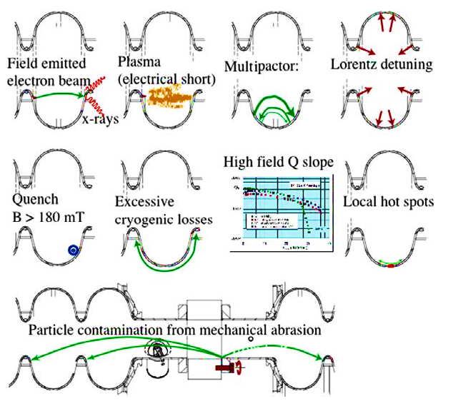
SC cavities may have various “illness”

Slide 6
Anomalous loss mechanism

Slide 7
Some general statements
Anomalous loss mechanisms:
  Quench (local thermal instability)
  => material + fabrication (=> cleanliness)
  Field emission
  => Cleanliness of surface treatment, assembly, handling + vacuum
  Q-drop (without field emission) + Q-slope => ?
  Multipacting
  => Cavity shape + RF surface condition
  Hydrogen Q-disease
  => Chemical surface treatment
  Increased residual surface resistance
  => Cleanliness of surface treatment, assembly, handling + vacuum

Slide 8
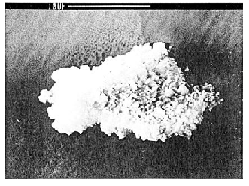
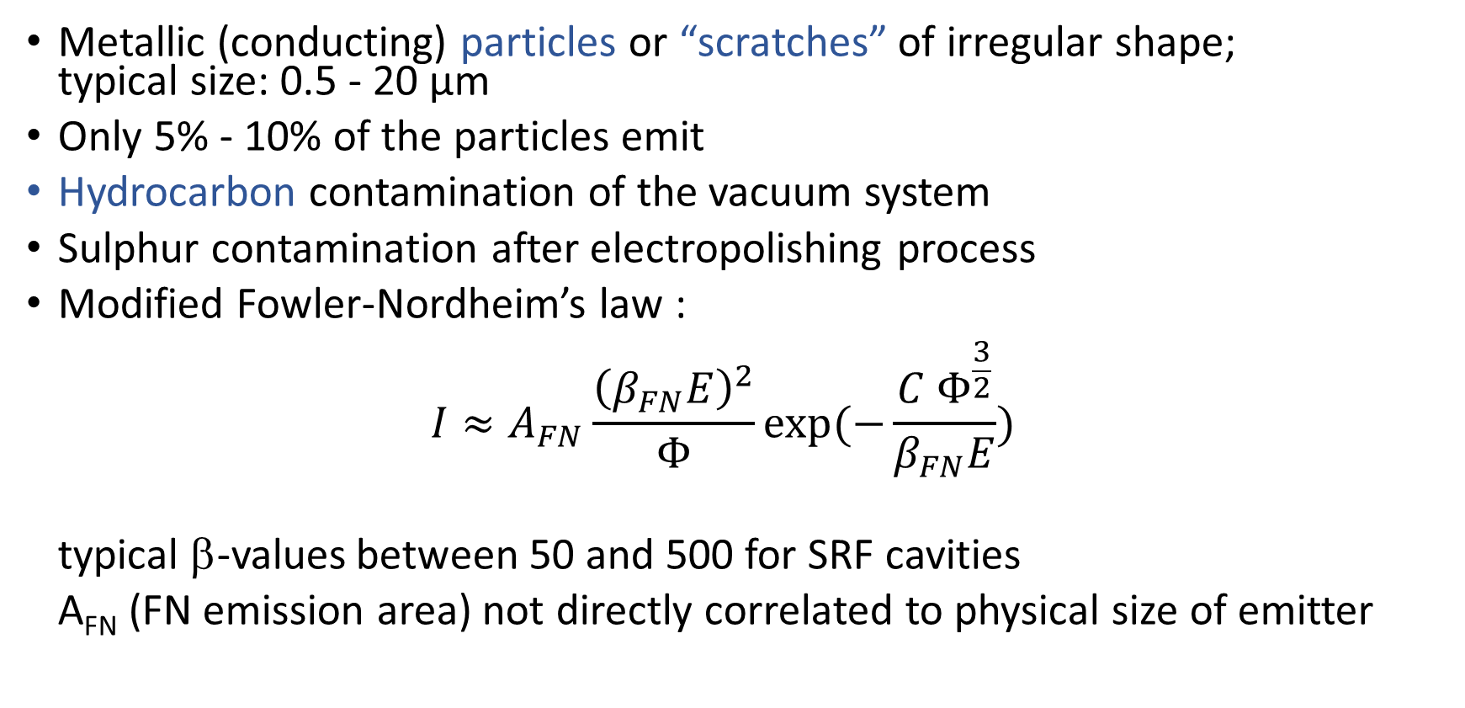
Present picture of field emission: observations
Metallic (conducting) particles or “scratches” of irregular shape;
typical size: 0.5 - 20 µm
Only 5% - 10% of the particles emit
Hydrocarbon contamination of the vacuum system
Sulphur contamination after electropolishing process
Modified Fowler-Nordheim’s law :
$I≈A_{FN}\frac{{\left(β_{FN}E\right)}^{2}}{Φ}exp⁡(−\frac{C Φ^{\frac{3}{2}}}{β_{FN}E})$
typical β-values between 50 and 500 for SRF cavities
A_{FN} (FN emission area) not directly correlated to physical size of emitter
Notes:
A short summary of field emission:
FE originates mainly from irregular shaped, electrical conducting particles. The typical size is in the order of µm.
Regular shaped metallic particles show much less FE. Isolating particles show no or only weak FE.
Typically only 5% - 10% of the particles emit.
Ebenfalls wichtig: hydrocarbon Verunreinigungen des Vakuumsystems
Both, dc and rf FE is well described by the modified FN-equation, which gives the exponential relation between current and local electrical surface field. Parameters are A and β. β is the so-called field-enhancement factor. It varies between 50 and 500. A is the emission area, which is not identical with the physical emitter size.
Φ is the Nb work function and C a constant.
For the major effects there is no substantial difference between rf and dc behaviour.

Slide 9
FE onset field vs. defect size: correlations? YES
A. Dangwal, G. Müller
Wuppertal University

Slide 10
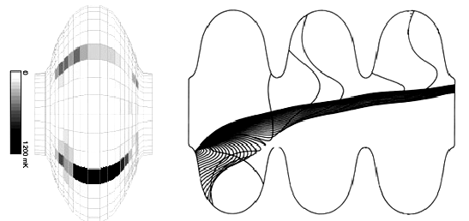
Some general statements: field emission
Field Emission is critical, more for multi-cell
cavities for high RF accelerating fields
P. Kneisel + B. Lewis, SRF Workshop 1995:
“Progress towards routinely achieving higher gradients for future
applications of RF-superconductivity goes hand in hand with shifting the onset of field emission loading towards higher fields.”
“It is generally accepted that the field emission behavior of a niobium cavity reflects the level of cleanliness of the superconducting surfaces subject to the RF-fields.”
Improved clean preparation techniques allow an increased field emission onset
Notes:
As you all know by your experience field emission is the major limitation of srf cavities of the last 5-10 years. It results in rapidly increasing losses limiting the operating gradient of the cavity and in accelaerator operation in dark currents limiting the machine performance.
The sentences of Peter given in his paper at the Saclay Workshop 10 years ago are absolutely valid:

Slide 11
From EM design to fabrication

Slide 12
Few considerations
From the EM point of view, the cavity is design at the operative conditions (usually 2 K, in vacuum, with tuner).
When you fabricate the cavity, you are at room temperature, in air and the cavity needs to be treated before being operational
You need then to consider
  Thermal shrinkage from 2 K to 300 K (geometry, frequency)
  Pressure effect (frequency)
  Dielectric constant effect (frequency)
  Over-metal for chemical treatment (geometry, frequency)
  Pre-tuning (frequency)
P.S. When you fabricate a cavity, be sure that the design couples with the feasibility of the processes you are going to apply

Slide 13
The ESS example
Step | Df [MHz] | Cavity Frequency [MHz] | Comment
Goal Frequency |  | 704.420 MHz | 2 K in vacuum
Pre-load for tuner | -0.100 MHz | 704.320 MHz | Unloaded cavity at cold
Room Temperature | -1.028 MHz | 703.292 MHz | Shrinkage from 2 K to 300 K ª
In Air | -0.234 MHz | 703.058 MHz | Dielectric constant ^{b}
Etching | +0.480 MHz | 703.538 MHz | Before Chemistry (150 μm) ^{c}
Weld Seam | +0.000 MHz | 703.538 MHz | Weld Seam perturbation ^{d}
ª Integral shrinkage from 2 K to 300 K tabulated
^{b} Inversely proportional to square root of dielectric constant
^{c} Estimated from Slater’s perturbation on cavity inner surface
^{d} Estimated from direct measurement. More significant for high frequency cavities

Slide 14
A fabrication cycle

Slide 15
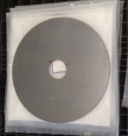





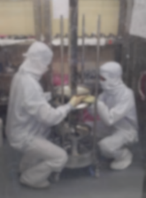
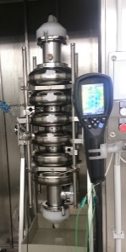
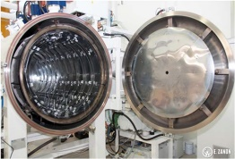
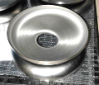
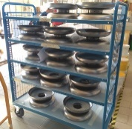
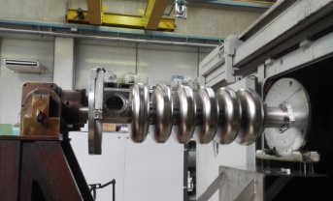

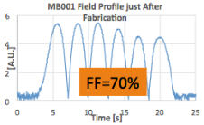
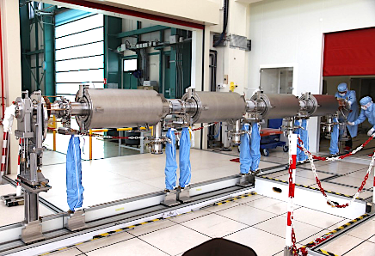





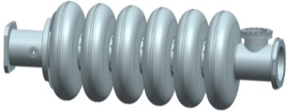





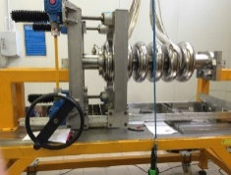
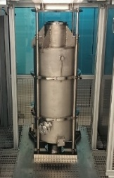
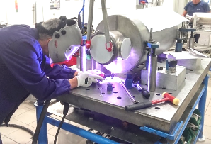
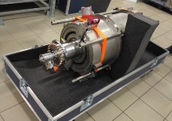
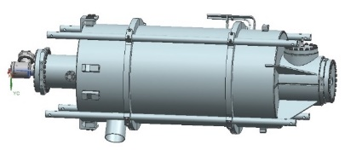
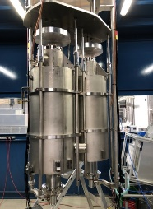
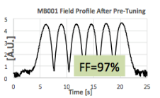
The ESS fabrication cycle
Nb sheets and raw materials
Subcomponents preparation
Cavity EBW
Bulk BCP
180 μm
Annealing
De Hydrog.
Al1
EC
PC
IC
PC
EC
EGP
PD
ID
CD
EGC
Tuning
Al2
CEA
Al3
Al5
DESY
Final Check and delivery
Accessories installation
Final BCP:
20 μm + HPR
Cavity integration
(He tank)
Al4

Slide 16
From raw Nb to cavity

Slide 17
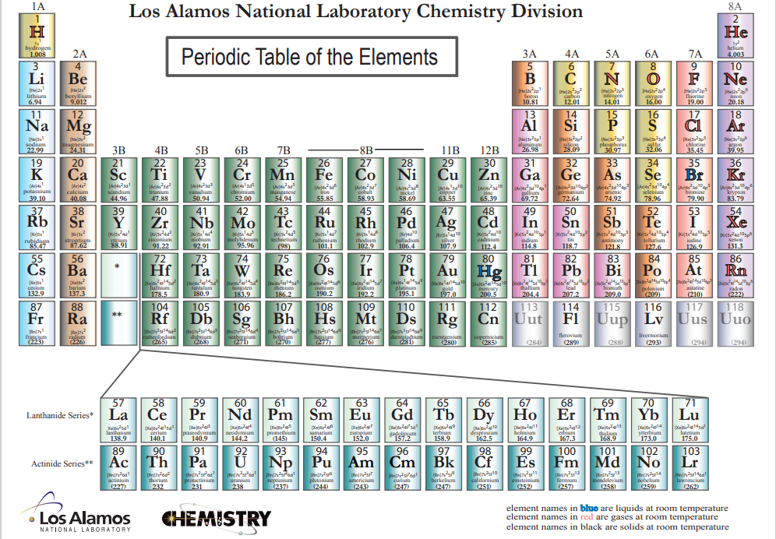
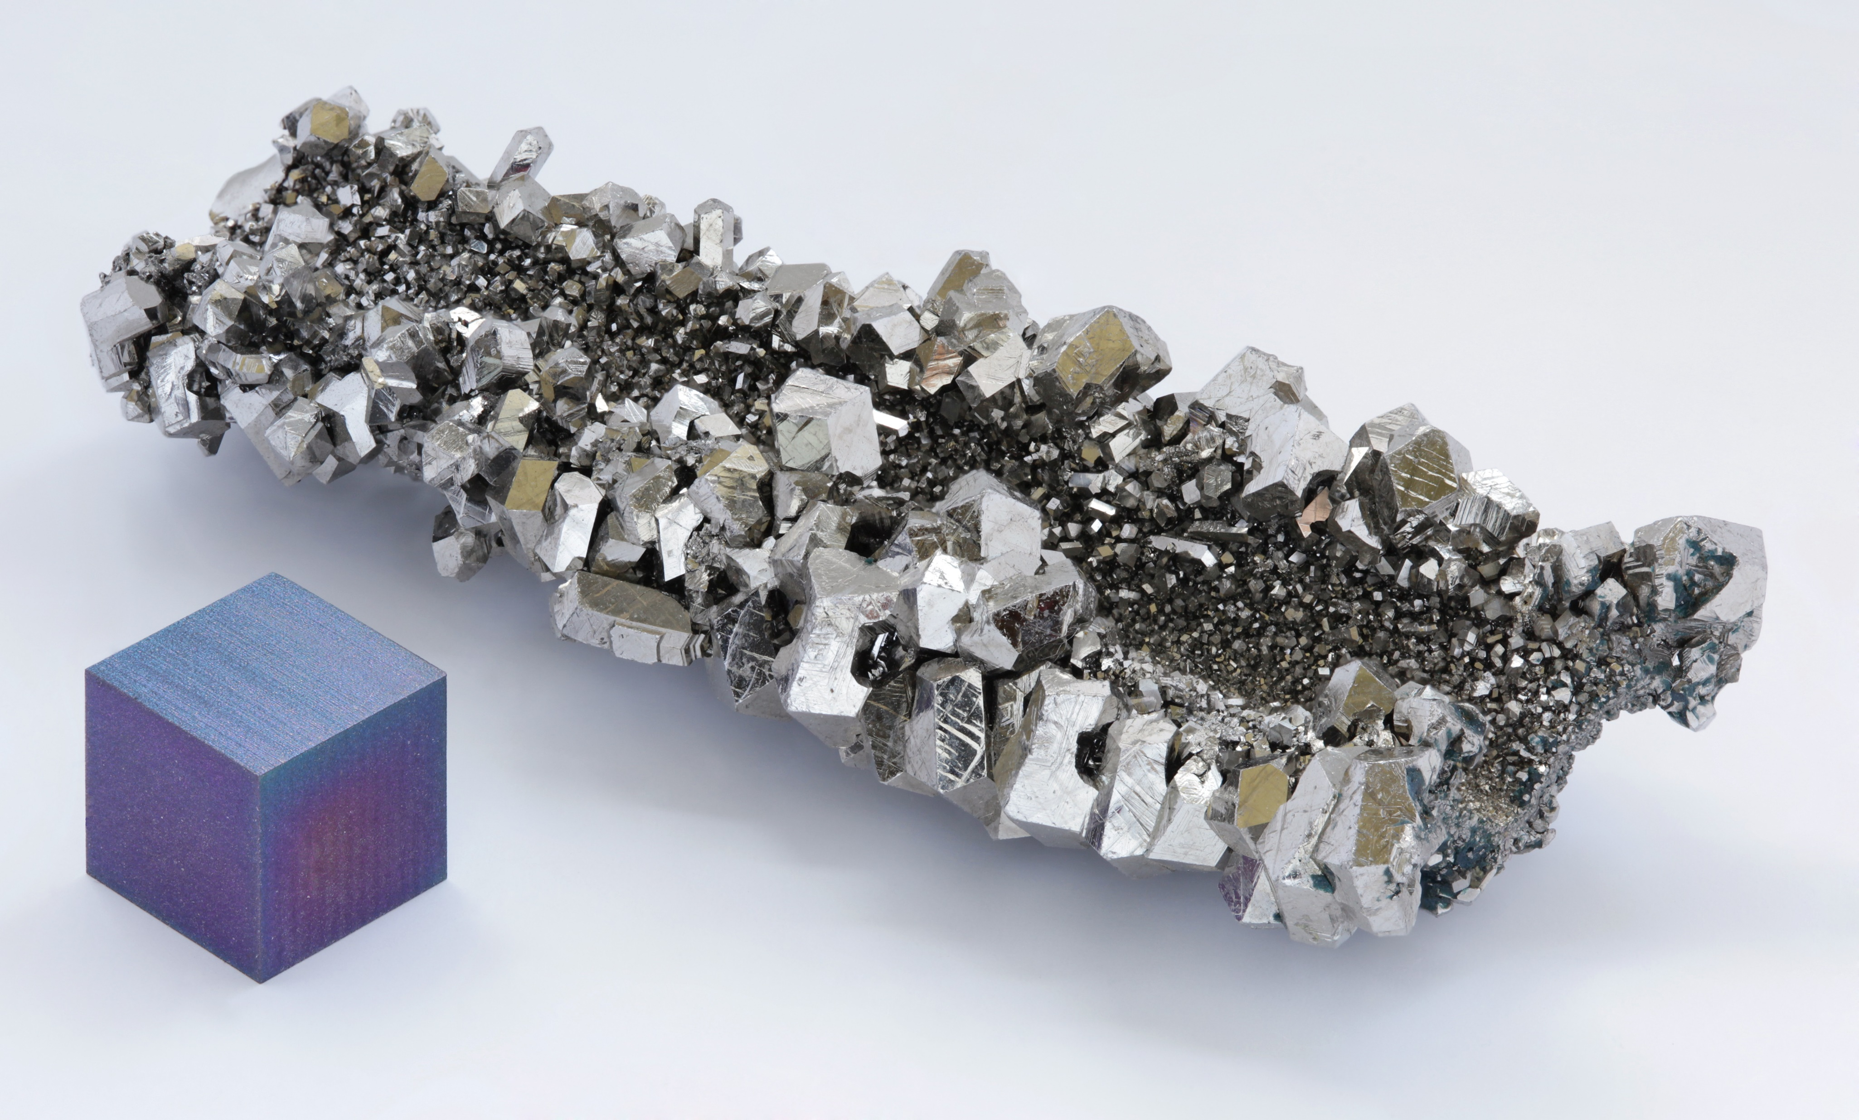
Niobium
Niobium is THE material for fabrication of supercondiucting cavities
  Critical temperature T_{c} = 9.25 K
  High critical field (H_{c}(0 K) ≅ 240 mT)
  Chemically inert (surface covered by Niobium pentoxide Nb₂O₅)
  Easily machined and deep drawn
  Available as bulk and sheets of any size
  and different shapes
Highest between pure metals

Slide 18
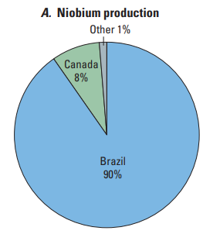
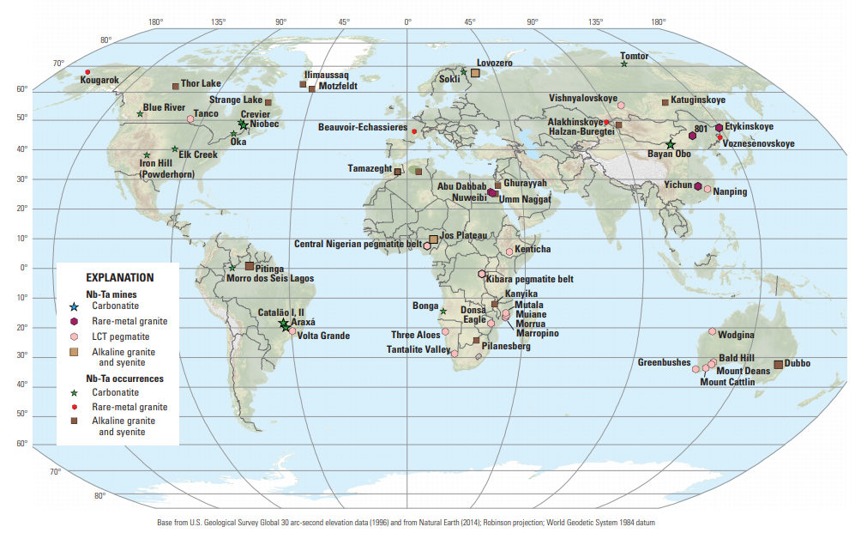

Niobium Production
CBMM, Arexà,Brazil
8 km

Slide 19
Niobium Production
The leading use of niobium (about 75 %) is in the production of high strength steel alloys used in pipelines, transportation infrastructure, and structural applications.
Niobium is primarily derived from the complex oxide minerals of the pyrochlore group and carbonatites, usually together with Tantalum
The estimated global reserves appear more than sufficient to meet global demand for the foreseeable future, possibly the next 500 years

Slide 20
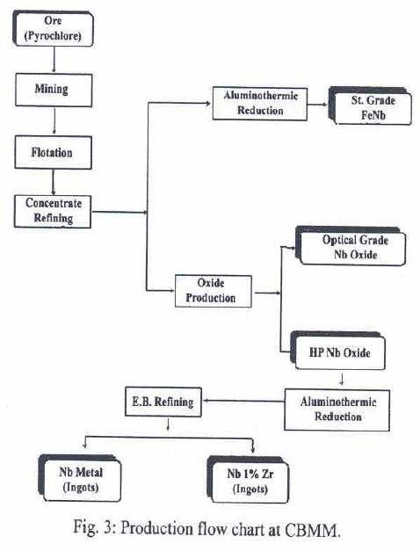
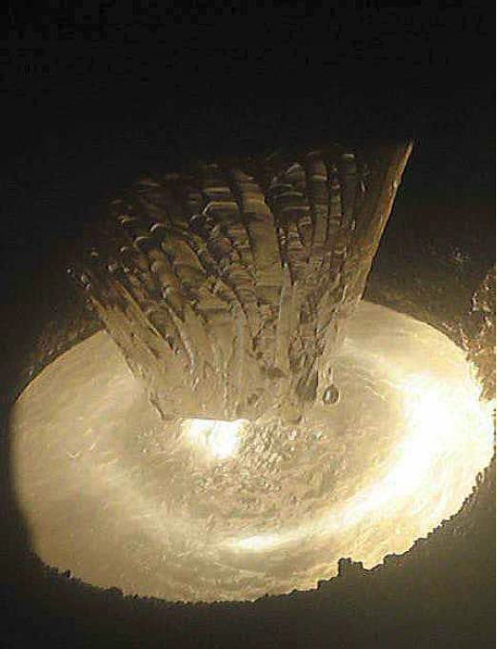
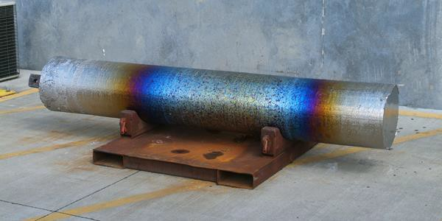
Niobium Prodution Process
The ore (Pyroclore in this case) is
treated and refined at different stages untill it reaches the purity necessary for the Electron Beam Refining.
The Electron Beam process
reduces the impurites
present in the incoming Niobium
EB Refining
35 cm
2.75 m

Slide 21
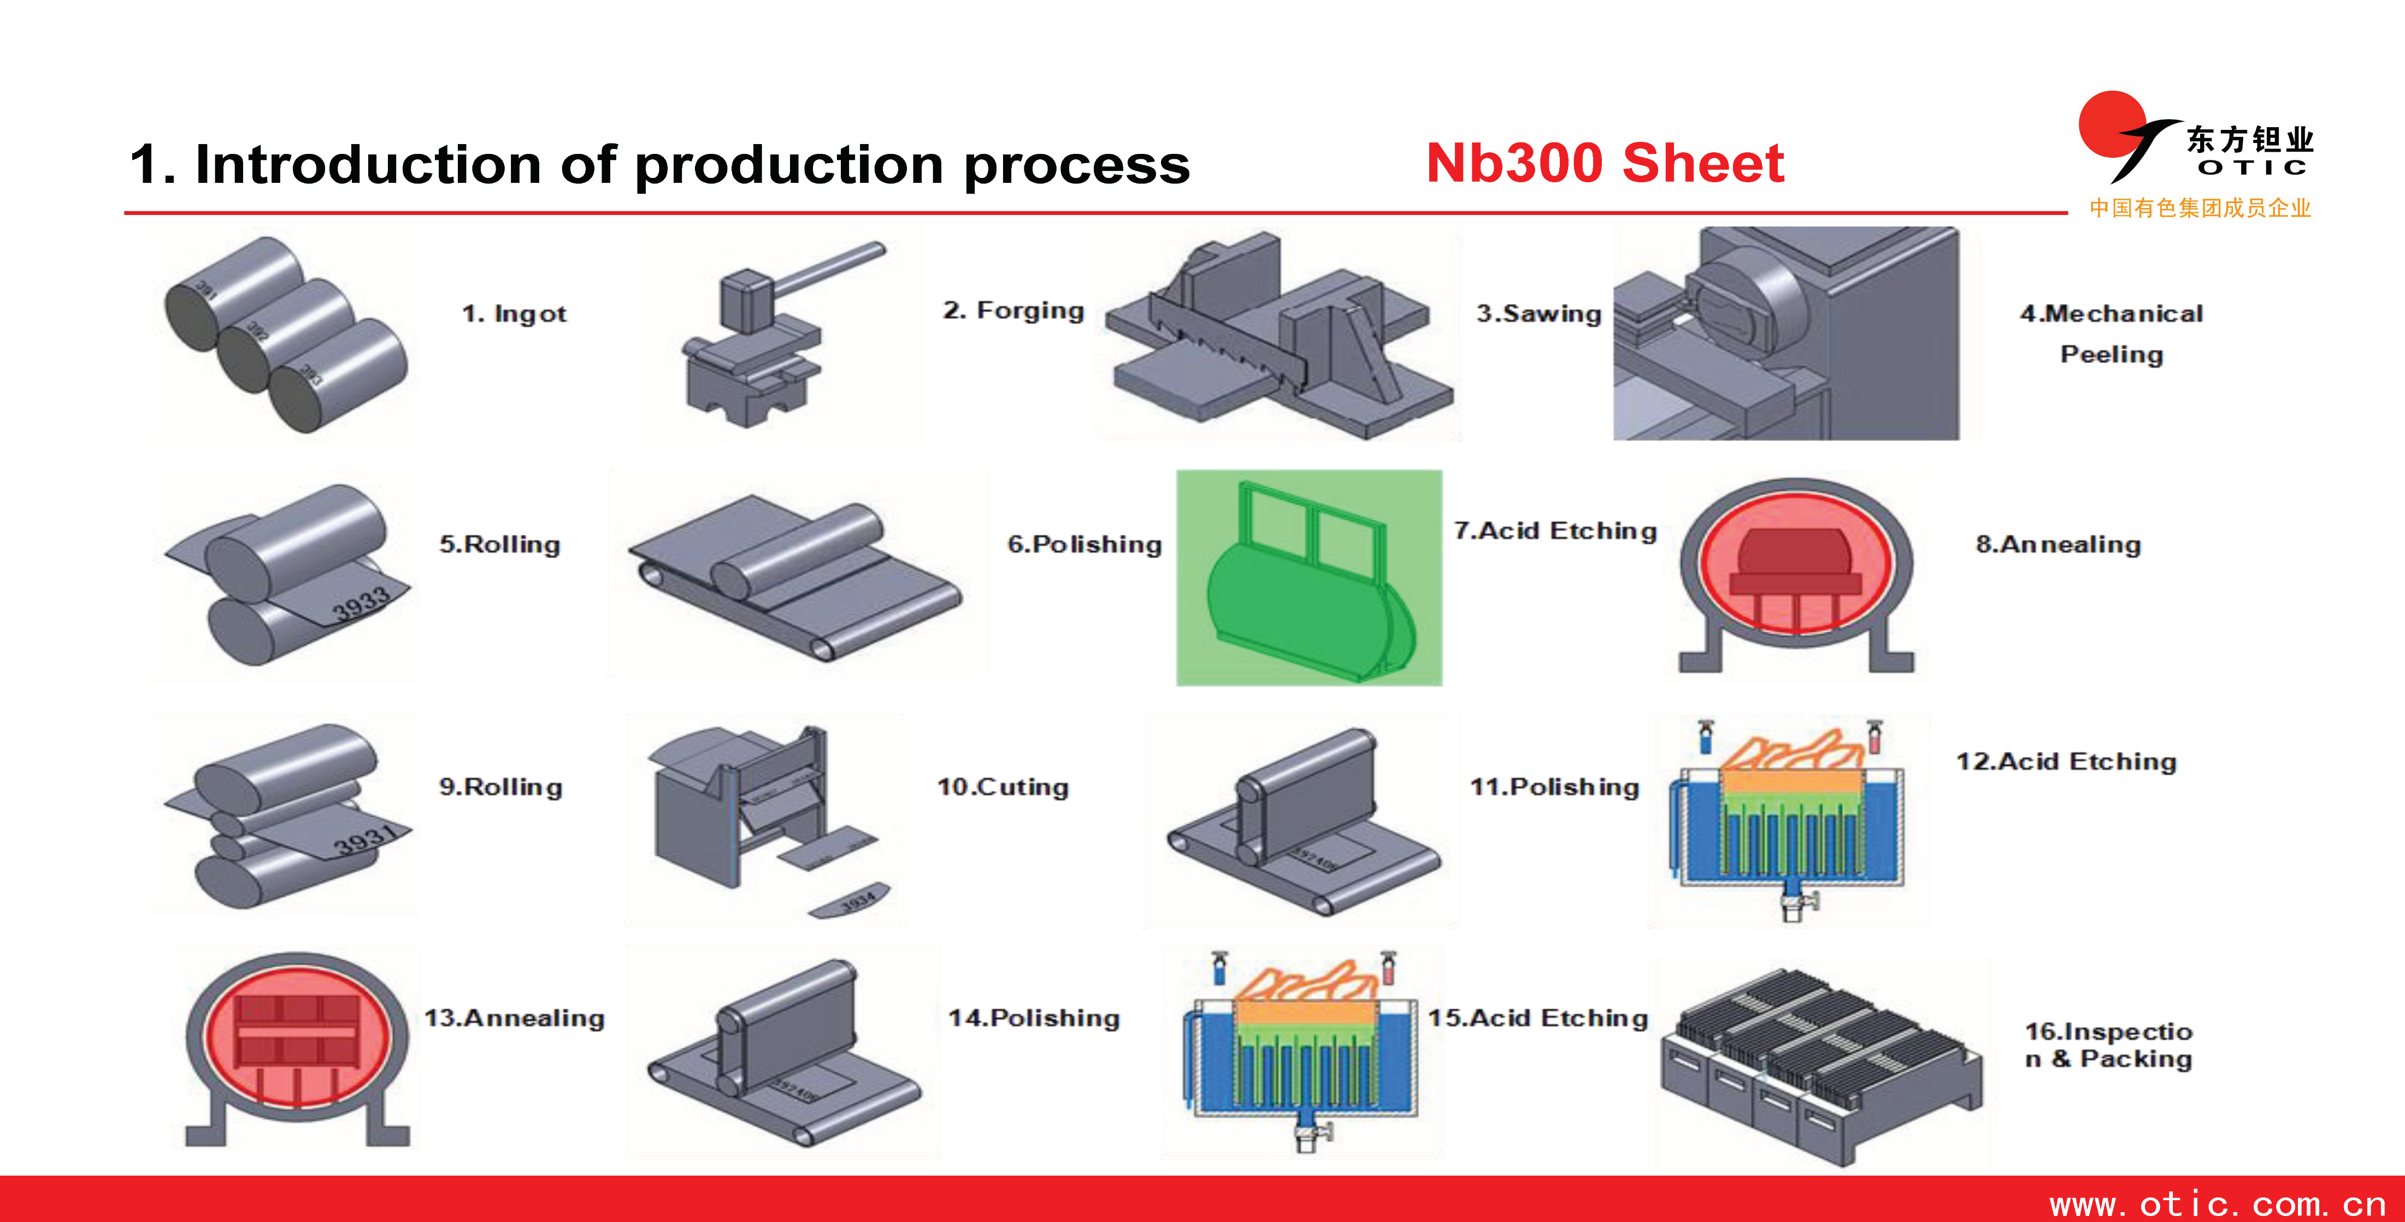
Niobium sheets production

Slide 22
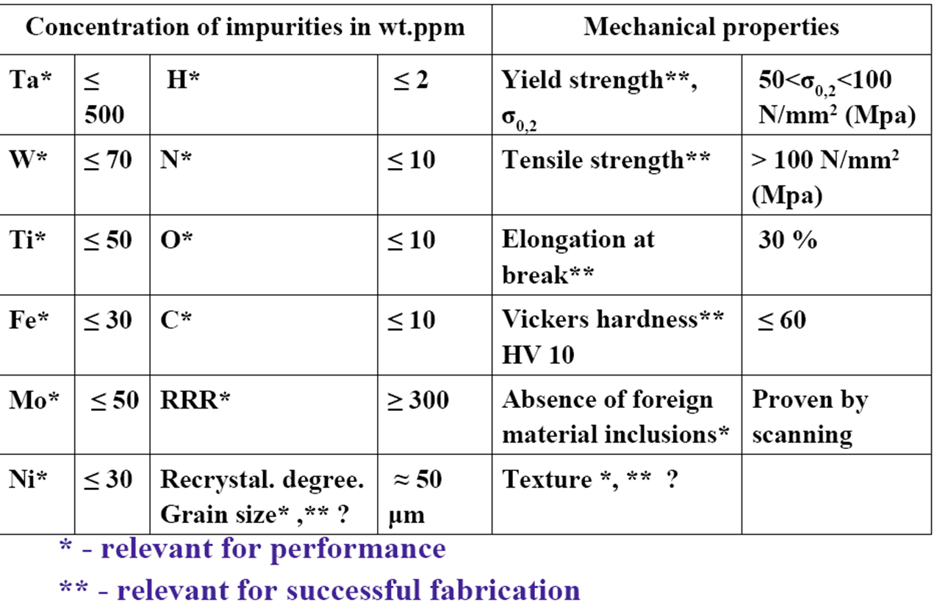
Nb Technical Specifications (typical)

Slide 23
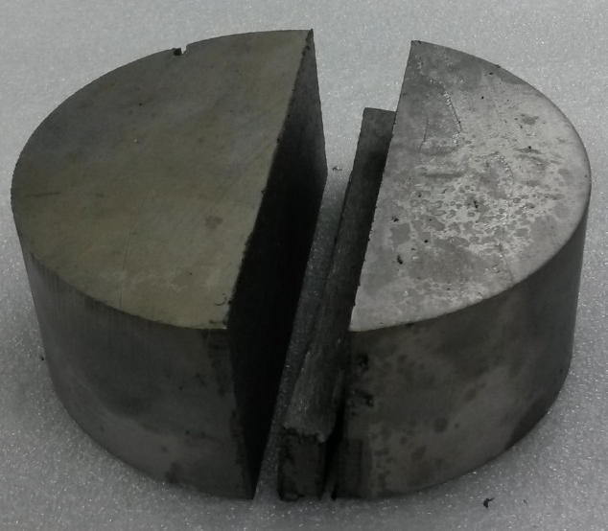
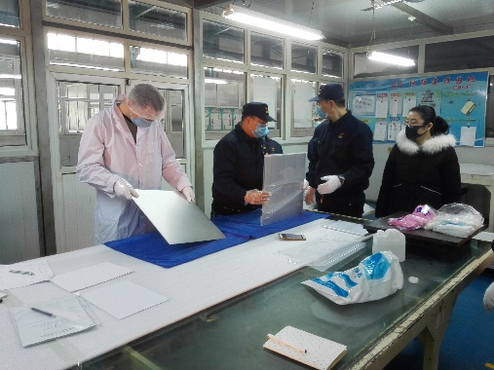
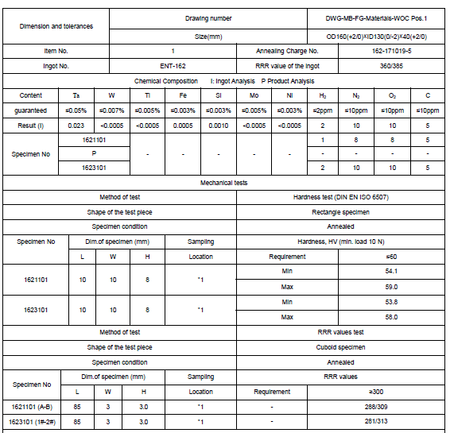
Nb sheets QC at productor premises
Visual Inspections
Ingot
  RRR
  Mechanical Properties
  Gas analysis
  Crystallography
All sheets
  Visual Inspection
    Defects (i.e. scratches)
    Delamination
  “Rust” test
    Coarse check for
    Fe inclusions
Sample preparation for
RRR measurement
Microstructure
Final Report

Slide 24
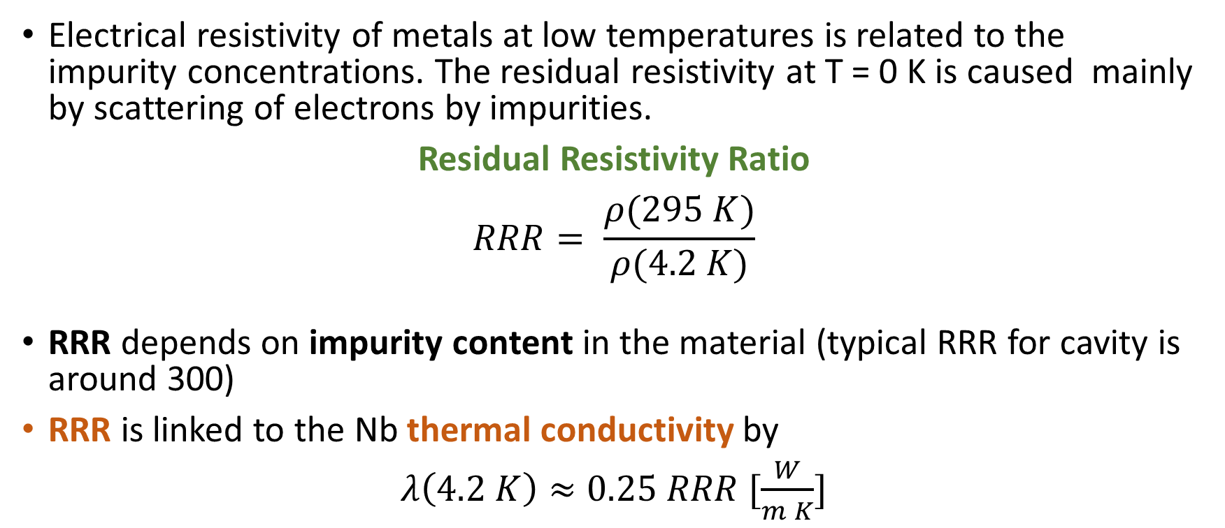
Residual Resistance Ratio (RRR)
Electrical resistivity of metals at low temperatures is related to the impurity concentrations. The residual resistivity at T = 0 K is caused mainly by scattering of electrons by impurities.
Residual Resistivity Ratio
$$RRR= \frac{ρ(295 K)}{ρ(4.2 K)}$$
RRR depends on impurity content in the material (typical RRR for cavity is around 300)
RRR is linked to the Nb thermal conductivity by
$λ\left(4.2 K\right)≈0.25 RRR [\frac{W}{m K}]$

Slide 25
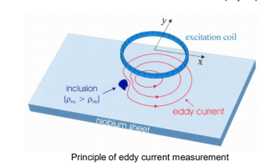
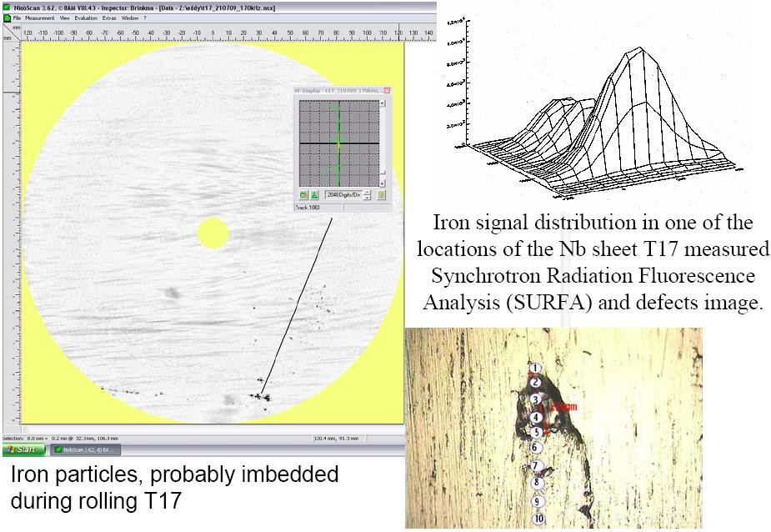
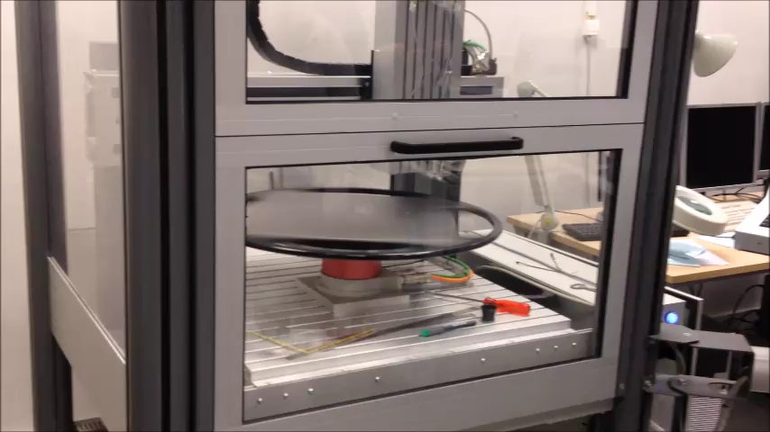
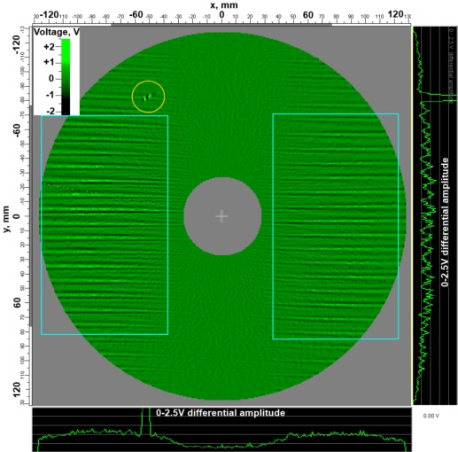
Nb Eddy Current Scanning
DESY Eddy Current principle
When an AC current flows in a coil in close proximity to a conducting surface the magnetic field of the coil will induce circulating (eddy) currents in that surface.
The magnitude and phase of the eddy currents will affect the loading on the coil and thus its impedance. If there is a deep crack in the surface immediately underneath the coil, it will interrupt or reduce the eddy current flow, thus decreasing the loading on the coil and increasing its effective impedance.
The operating frequency is between 100 kHz to few MHz and can span
from the surface down into the materials for some hundreds of microns.
Iron Defect, probably included during rolling

Slide 26
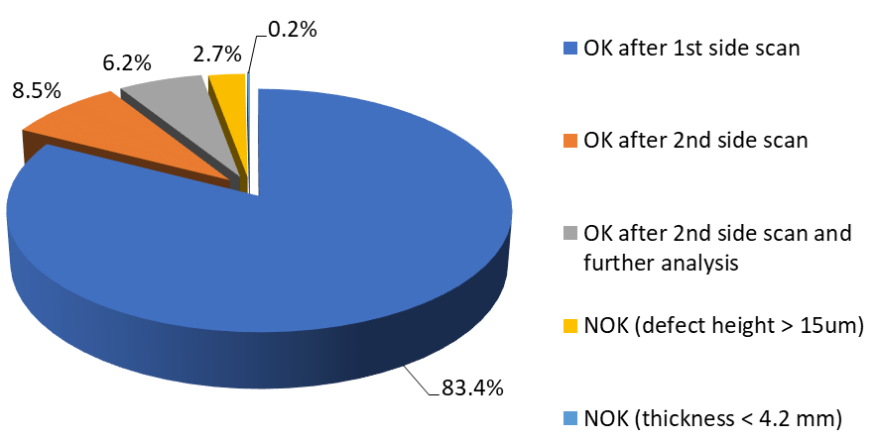
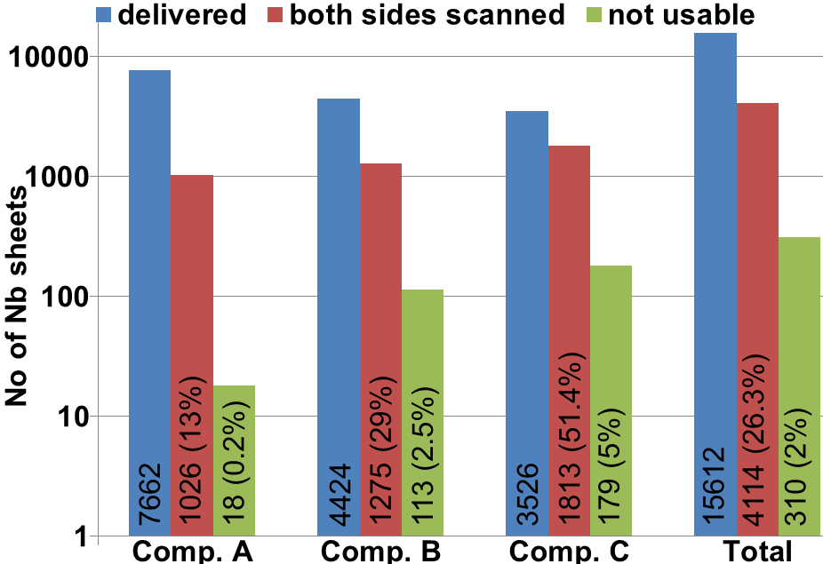
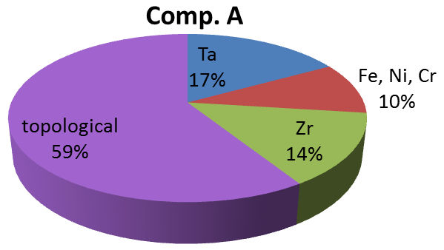
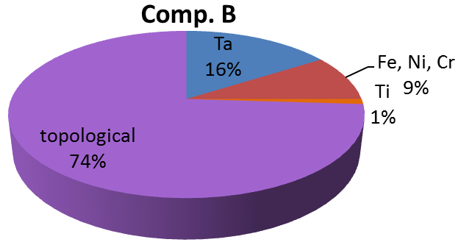
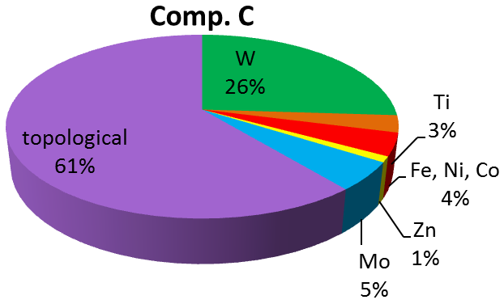
Eddy Current results
ESS Nb Sheets (456)
European XFEL
On the 15612 sheets
  26% scanned on both sides
  2% rejected (foreign material > 100 μm,
  delamination, etc.)
EXFEL Defects Analysis
W. Singer et al.,
SUST 28 (2015) 085014

Slide 27
From sheets to cavity

Slide 28
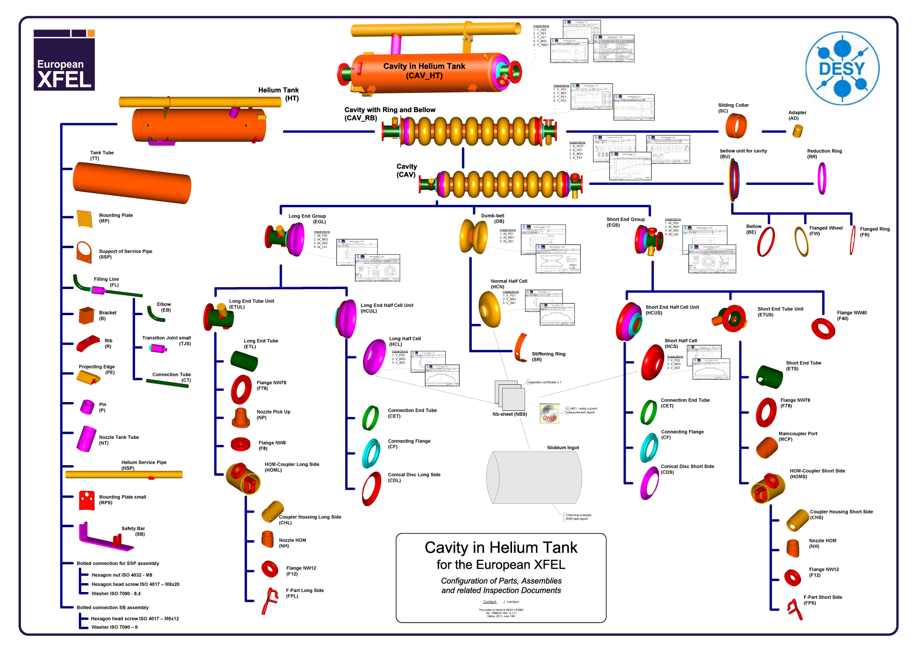
Cavity components

Slide 29
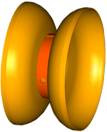
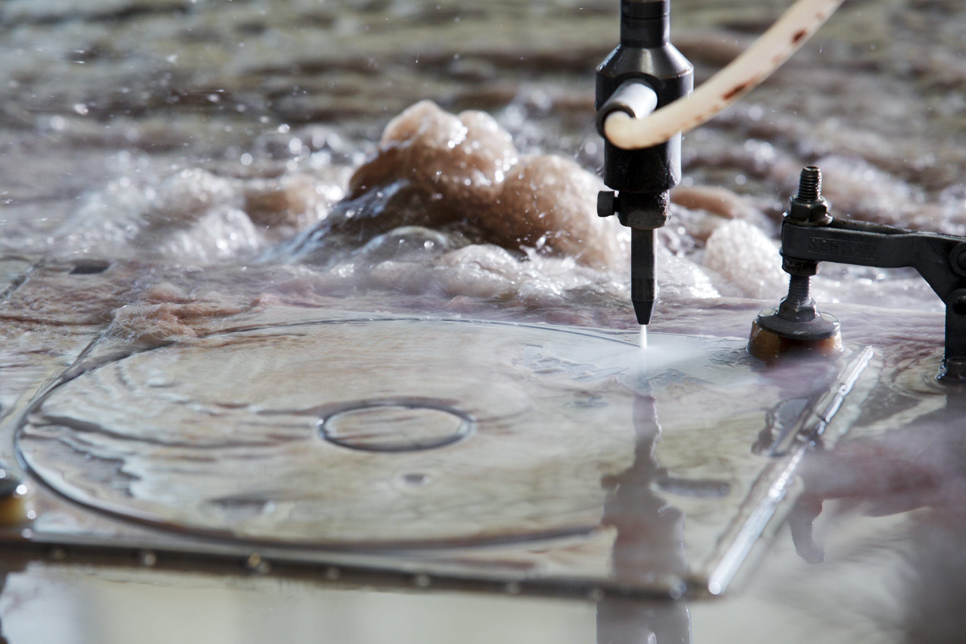
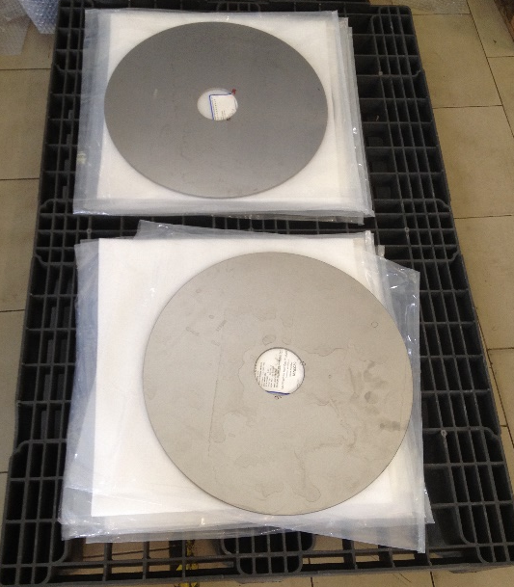
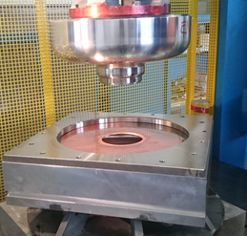
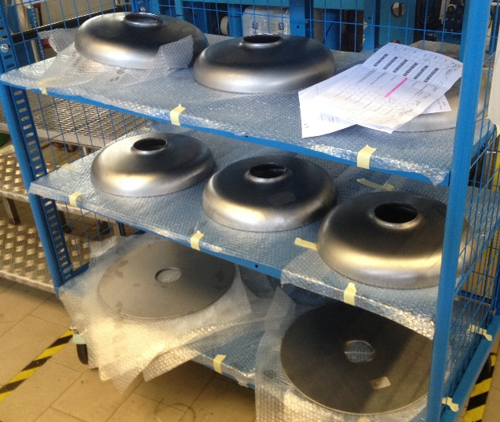
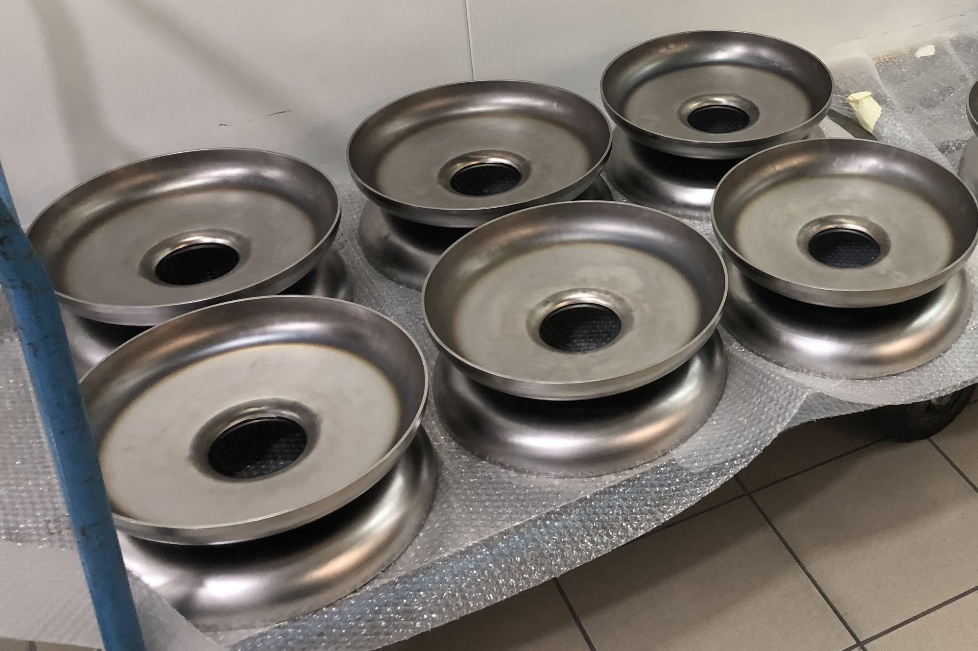
Dumb-bell Fabrication (an example)
Nb sheets cutting
Deep drawing
Mechanical measurement
Cleaning (by ultrasonic cleaning +rinsing)
Trimming of iris region and reshaping of cups if needed
Cleaning
Rf measurement of cups
Buffered chemical polishing + rinsing (for welding of Iris)
Welding of Iris
Welding of stiffening rings
Mechanical measurement of dumb-bells
Reshaping of dumb bell if needed
Cleaning
Rf measurement of dumb-bell
Trimming of dumb-bells ( Equator regions )
Cleaning
Intermediate chemical etching ( BCP /20- 40 µm ) + rinsing
Visual Inspection of the inner surface of the dumb-bell
Local grinding if needed + (second chemical treatment + inspection )

Slide 30




Mechanical QC
Half Cell dime control
3D profile
Visual Inspection
Mechanical measurements

Slide 31




Frequency QC
Measure frequency and length to determine how much to trim at the equator to obtain target frequency and length of the cavity fully welded
Co.Co.De for
HC and DB RF measurements
Pen Cells

Slide 32




Mechanical Grinding
Mechanical grinding of visible local defects (deeper than 15 μm for EXFEL) with aluminum oxide grinding discs or rubberized abrasive (CRATEX®)
Rubberized abrasive

Slide 33












Cavity parts EB welding
EC
PC
IC
PC
EC
Degreasing and rinsing of parts
Drying under clean condition
Chemical etching at the welding area
(equator)
Careful and intensive rinsing with
Ultra Pure Water
Dry under clean conditions
Install parts to fixture under clean conditions
Install parts into Electron Beam (EB) welding chamber
(no contamination on the weld area allowed)
Pump down to vacuum in the EBW chamber in the 10⁻⁵ mbar range
Welding and cool down of Nb to T < 150 °C, then venting with N₂
Leak check of welds
EGP
PD
ID
CD
EGC
Mxxx

Slide 34



Electron Beam Welding
Welding under good vacuum, 10⁻⁵ mbar range
Broad welding seam
  Operate with defocussed beam
  Smooth underbead
Overlap at end of welding to avoid accumulation
of impurities
Wait to cool down before opening chamber
JLAB EBW
Welding Scheme (circular raster)
Electron beam (Р0-power of the beam, r-spot radius on the surface, L-scanning amplitude, V- velocity of the beam movement)
Nb sheet
melting zone (z-depth of the melting zone)
4 mm
ESS Weld Seam

Slide 35



Mechanical and frequency QC
Dimensional check
After EBW, the cavity is mechanical measured,
inner inspected and the frequency is controlled

Slide 36
Cavity treatment

Slide 37

Overview
Claire Antoine CAS Erice

Slide 38
A general consideration
Do not make Nb surface worst than before with the next treatment!
Do not apply treatments that affect the Nb surface and could not be “accepted” by the next step
If a mistake is done, go back in the procedure until the step where contaminant can be removed without contaminating the system
Chemical reactions in many cases can not be stopped simply removing acid (residuals, no cooling, …). Rinsing is needed!
Do not contaminate US bathes with material that can not be diluted, as for silicone grease, oil, etc. Moreover take care of contaminants that can float over the liquid surface!
Wet components are more “sensitive” for collecting particles.
Duration limit for a final treated cavity is about 24 hours (XFEL) Do not leave open cavities for longer time

Slide 39
Cavity preparation for SRF qualification
Degreasing surfaces to remove contaminates
Chemical removal of exterior films incurred from welding
Removal of damage layer of niobium from fabrication (≈ 150÷200 μm)
Removal of hydrogen from bulk Nb
Mechanical tuning
Chemical removal of internal surface for clean assembly (10-20 μm)
– Additional “cleaning” steps if Electropolishing (EP) is used
High Pressure Rinsing (HPR) to remove particulates from interior surfaces (incurred during chemistry and handling)
Drying of cavity for assembly in cleanroom (reduce risk of particulate adhesion and reduce wear on vacuum systems)
Clean assembly
Clean evacuation
Low-temperature baking

Slide 40
Cavity preparation for SRF qualification
Degreasing surfaces to remove contaminates
Chemical removal of exterior films incurred from welding
Removal of damage layer of niobium from fabrication (≈ 150÷200 μm)
Removal of hydrogen from bulk Nb
Mechanical tuning
Chemical removal of internal surface for clean assembly (10-20 μm)
– Additional “cleaning” steps if Electropolishing (EP) is used
High Pressure Rinsing (HPR) to remove particulates from interior surfaces (incurred during chemistry and handling)
Drying of cavity for assembly in cleanroom (reduce risk of particulate adhesion and reduce wear on vacuum systems)
Clean assembly
Clean evacuation
Low-temperature baking

Slide 41
Degreasing and surface preparation
After mechanical fabrication, all contaminants (fingerprints, oil, residuals from machining and QC) must be removed, similar to preparation of Ultra High Vacuum components.
Typical process:
  Water rinsing with specific detergent (Tikopur TR33, Micro -90, Liqui-Nox) usually 1-3%
    For “dirty” component, alcohol and acetone could be used before
  Water is usually Ultra Pure Water with 18 MΩ cm and filtered below 200 nm
  Often in HEPA filter environment
For entering ISO7 clean room, dishwashers are used for small components and car-wash for large components
For entering ISO4 clean room, UltraSound is mandatory

Slide 42
Ultra Pure Water
Typical UPW plant
UPW Specifications
  Resistivity:
  18.2 MΩ cm
  Total organic carbon (TOC):
  < 5 ppb
  Particulate counts (> 0.3 μm/l): < 10
  Bacteria counts:
  < 0.1 CFU/100 ml
The water quality is as for the semiconductor industry:
ASTM- D 5127-07 E-1.2
Filter
Water softener
Filter
RO - Revers osmosis
First stage
Tap water
Hg UV
lamp
DRAIN
E
D
I
Hg UV lamp
RO - Revers osmosis
Second stage
STORAGE
TANK
DRAIN
UPW loop (PVDF)
N2
Diaphragm
for trickle
flow
Ultra filtration +
resins
Hg UV lamp
Circulation
pump
POU
with filter

Slide 43
Ultra Pure Water QA
Conductivity: ion concentration, indicates water purity with respect to “salts”, ions, metals, anions, etc.
TOC: Total Organic (oxidizable) Carbon. Organic carbon, but for instance lubricant oils are hard to be oxidized and therefore are not easily measured with TOC monitor.
Particle count: number of particles suspended or in flow in the water. Counting is done using devices (laser counter) similar with the ones used for clean room particle monitoring (for the air).
Bacteria: colonies count. Usually sampling and incubation on Petri capsule.
Hydrocarbon (oils): they MUST NOT be present. OFFLINE extraction method (with hexane) and gas chromatographic analysis.

Slide 44


Industrial and laboratory plant
Large system:
Production: 3000 l/h
Storage: 9000 l
Typ. TOC: 3 ppb
Small lab production plant:
Production: 170 l/h
Storage: 6000 l
Typ. TOC: 3 ppb
LASA

Slide 45
Ultrasonic Cleaning
Immersion of components in DI water and detergent medium
Wave energy forms microscopic bubbles on component surfaces
Bubbles collapse (cavitation) on surface loosening particulate matter
Transducer provides high intensity ultrasonic fields that set up standing waves. Higher frequencies lowers the distance between nodes which produce less dead zones with no cavitation
Ultrasonic transducers are available in many different wave frequencies from 18 kHz to 120 kHz, the higher the frequency the lower the wave intensity
Cavities and all hardware components (Flanges, nuts & bolts…)
have to be degreased with ultrasonic cleaning

Slide 46


US Cleaning efficiency
https://sonosys.de/en/ultrasonic-megasonic.html

Slide 47


Water Break Test on Nb Sample
It’s a standard test for testing cleaning procedure with UPW and US
Not efficient cleaning
After good US cleaning procedure
ASTM F22 - 02(2007) Standard Test Method for Hydrophobic Surface Films by the Water-Break Test.

Slide 48


Small parts cleaning
Water: UPW (r >10 MW×cm)
Inline particle filter
Standard dish washer machine are successfully used, with a few corrosion problem (lifetime)
Special stainless-steel dish washer for chemical and bio labs are available on the market (but expensive)
Detergent can be the same used in US bath (foam!) as Tickopur
No additives: salt or cleanser
Rapid cycling (5 min) dish washer available

Slide 49

Large parts cleaning
UPW( ρ >10 MΩ×cm)
Pressure: 100 bar
Pump: car wash piston pump
Detergent as TICKOPUR R 33, but not used at companies for EXFEL
Automatic systems with rotating table supporting the cavity frame
5 min spray with detergent, if used
Water Rinse (5 – 10 min)
Widely used for cleaning before entering Clean Room

Slide 50



Ultrasonic tanks for cavity cleaning
DESY Courtesy

Slide 51
Cavity preparation for SRF qualification
Degreasing surfaces to remove contaminates
Chemical removal of exterior films incurred from welding
Removal of damage layer of niobium from fabrication (≈ 150÷200 μm)
Removal of hydrogen from bulk Nb
Mechanical tuning
Chemical removal of internal surface for clean assembly (10-20 μm)
– Additional “cleaning” steps if Electropolishing (EP) is used
High Pressure Rinsing (HPR) to remove particulates from interior surfaces (incurred during chemistry and handling)
Drying of cavity for assembly in cleanroom (reduce risk of particulate adhesion and reduce wear on vacuum systems)
Clean assembly
Clean evacuation
Low-temperature baking

Slide 52

Removal of damage layer
After all the mechanical operations, a thin layer of about 200 μm must be removed
P. Kneisel

Slide 53



Centrifugal Barrel Polishing (CBP)
Implementation:
Plastic stones and liquid abrasive added inside cavity and rotated
Stones rubbing on surface removes material thus smoothing the surfaces (including weld areas)
Benefit is less overall chemistry needed
(80 μm) and smooth weld areas
Removal of material 2x on equators then irises. Average removal rate ≈ 5 μm/h
Inside equator EBW
KEK 2001
Before CBP
After CBP

Slide 54




Barrel Polishing Machine @ JLAB
NEW
USED
Coarse
Medium
Coarse
Coarse
Medium
Coarse
Removal rate ∼ 3 – 4 μm/h

Slide 55
(Electro-)Chemical Nb removal
Nb is resistant to chemical attack
  HNO₃: oxidation of Nb surface and passivation, i.e. no more corrosion of the metal.
  HF: dissolve only Nb oxides, but doesn’t attack Nb itself
  HCl: no attack
  H₂SO₄: no attack
  Strong alkaline solution (NaOK, KOH, NH₄OH): no attack
Two effects have to be coupled: Nb oxidation (e.g. HNO₃) and Nb oxides dissolution (HF).

Slide 56

Buffer Chemical Polishing and Electro Polishing
Buffer Chemical Polishing (BCP)
  A mixture of Hydrofluoric (HF), Nitric Acid (HNO₃) and Phosphoric acid (H₃PO₄), usually in 1:1:1 or 1:1:2 ratio in volume
Electro Polishing (EP)
  A mixture of Hydrofluoric Acid (HF) and Sulfuric Acid (H₂SO₄) + electric current
Sometimes, the two processes are used together to achieve better surface polishing (see EXFEL final steps)
BCP Flash
Final EP
EXFEL Cavity preparation

Slide 57


Buffered Chemical Process (BCP)
Mixture of concentrated Hydrofluoric Acid (HF, 40%), Nitric acid (HNO₃, 70%) and Phosphoric Acid (H₃PO_{4,} 85%)
H₃PO₄ doesn’t participate the reaction: it act like a buffer slowing down the speed of the exothermic reaction (self exiting!).
1:1:2, generally used, 1 μm/min @ 20 °C
Brownish gas
Oxidation
$$\text{2}\text{N}{\text{O}}_{2}⇒N_{2}O_{4}$$
$$\text{2}\text{Nb}+\text{5}\text{N}{\text{O}}_{3}^{−}⇒\text{N}{\text{b}}_{2}O_{5}+\text{5}\text{N}{\text{O}}_{2}+\text{5}{\text{e}}^{−}$$
Dissolve
$$\text{N}{\text{b}}_{2}O_{5}+\text{6}\text{HF}⇒H_{2}\text{NbO}{\text{F}}_{5}\left(\text{soluble}\right)+\text{Nb}{\text{O}}_{2}F ∙\text{0.5}{\text{H}}_{2}\text{O} (\text{not} \text{soluble})+\text{1.5}{\text{H}}_{2}O$$
$$\text{Nb}{\text{O}}_{2}F∙\text{0.5}{\text{H}}_{2}O+\text{4}\text{HF}⇒H_{2}\text{NbO}{\text{F}}_{5}+\text{1.5}{\text{H}}_{2}O$$

Slide 58


Use of BCP Process
1:1:1 still used for subcomponents due to high etching rate (∼ 8 μm/min)
1:1:2 used for cavity treatment (∼ 1 μm/min)
BCP must mixed before used because it stratifies
BCP is usually cool down before and during etching to mitigate temperature increase and hydrogen content (starts at 3-5 °C and ends around 20 °C)
Etching rate versus dissolved Nb
Hydrogen content vs BCP Temperature
(XFEL max Nb content
is 4 g/l) for flash BCP
Gas content of Nb at different etching temperatures (Schölz).
Etching time 20 min, BCP 1:1:4

Slide 59


BCP smoothing
“Simple” process
Roughness of 2 -5 μm (100 x 100 μm² scale) after 100 μm etching
High etching rate
Courtesy G. Ciovati

Slide 60

BCP Plant Layout
N₂ for dumping
SCRUBBER
All components in the acid mixture
circuit MUST be resistant to acid
attack
Operative temperature: below 20 °C,
to reduce hydrogen diffusion in Nb.
Usually treatment starts at
about 5°C ÷ 6 °C
Exothermic reaction: heat exchanger or
cooled barrel is needed
Cavity held in vertical position, acid flow from
the bottom part
Temperature gradient causes increased etching from one end to the other
Usually etching rate on iris is 2 x the equator one
Used both for bulk removal and final etching: for EXFEL only for final etching of half of cavities
Bypass lines for “small” port etching
UPW Plant
for rinsing
and leak test
Chiller
Flow
meter
ACID
BARREL
Filter
Pump
Heat
exchanger
Fast dumping
basin
Filter

Slide 61



BCP Plant in Operation in Labs
BCP Cabinet JLAB
DESY BCP

Slide 62


BCP Plant in Operation at Qualified Vendors
Automatic BCP system for subcomponents @ Ettore Zanon for EXFEL (etching + rinsing)

Slide 63

Electropolishing (EP)
A constant voltage is kept between an Aluminum
electrodes and the cavity immerse in a mixture of
Hydrofluoric Acid (HF, 49%) and Sulfuric Acid (H₂SO₄, 96%)
in a ratio 1:9 (typical) in volume.
Reaction is not self sustained: no current - no reaction
Oxidation
$$\text{2}\text{Nb}+\text{5}S{\text{O}}_{4}^{2−}+5H_{2}O⇒\text{N}{\text{b}}_{2}O_{5}+\text{10}H^{+}\text{ +}\text{5}S{\text{O}}_{4}^{2−}+\text{10}{\text{e}}^{−}$$
Dissolve
$$\text{N}{\text{b}}_{2}O_{5}+\text{6}\text{HF}⇒H_{2}\text{NbO}{\text{F}}_{5}\left(\text{soluble}\right)+\text{Nb}{\text{O}}_{2}F ∙\text{0.5}{\text{H}}_{2}\text{O} (\text{not} \text{soluble})+\text{1.5}{\text{H}}_{2}O$$
$$\text{Nb}{\text{O}}_{2}F∙\text{0.5}{\text{H}}_{2}O+\text{4}\text{HF}⇒H_{2}\text{NbO}{\text{F}}_{5}+\text{1.5}{\text{H}}_{2}O$$

Slide 64

EP Mechanism
Anodization of Nb in H₂SO₄ forces growth
of Nb₂O₅
F⁻ dissolves Nb₂O₅
These competing processes result in current
flow and material removal
Above a certain anodization potential, the
reaction rate plateaus, limited by how fast fresh F⁻ can arrive at the surface (diffusion-limited)
The diffusion coefficient sets a scale for optimum leveling effects
Compact Salt Film
(∼ nm)

Slide 65

EP V vs J
Current Density
V1 V2
V3
Potential
0-V2: Concentration Polarization occurs, active dilution of niobium
V2-V3: Limiting Current Density, viscous layer on niobium surface
>V3: Additional Cathodic Processes Occur, oxygen gas generated
Kenji Saito, KEK, 1989

Slide 66



Surface Polishing BCP vs EP
As received
The main difference between BCP
and EP is smoothening of grain
boundaries.
After 120 μm BCP
After 120 μm EP

Slide 67



Basic EP for SRF cavity
EP mixture
level
EP mixture inlet
Acid flow direction
Al 99%
Cathode
(not rotating)
Cavity
Rotates
-
V
holes / nozzles
At each equator
EP mixture
Overflow &
level control
DC Power Supply
+
I
EP mixture
level
Net for Hydrogen confinement
Insulators to avoid excessive iris etching

Slide 68
Electropolishing of SRF cavities
Etching rate typical 0.3 ÷ 0.4 μm/min
Cavity (or electrode) is rotating
It requires ethanol rinsing to remove Sulphur
The current density (30-100 mA/cm²) in the plateau region:
  decreases linearly with lower HF/H₂SO₄ ratio
  increases with increasing temperature
Temperature during the process is maintained between 25 – 35 °C
Current oscillations often observed during polishing (dynamic balance between oxide formation and dissolution). It’s not a necessary condition for good surface finishing but indication of good processing parameters (temperature, voltage, agitation, HF concentration)
Finding the right balance among the processing parameters becomes complicated when polishing multi-cell cavities!

Slide 69




EP Systems
CERN
DESY

Slide 70


EP Ethanol Rinse
Motivation: during EP process sulfur is produced and can cause field emission
Sulfur segregates out of the acid as a reaction with the Al electrode, and is deposited all over the system, and also on the Nb surface
Risk of reaction with Nb during 800 °C heat treatment: S must be removed before this step
Sulfur is insoluble in water, but (slightly) soluble in ethanol
Either ethanol rinse or cleaning with detergent + US necessary
PVDF tube before and after ethanol cleaning
Sulfur removed from a PVDF tube

Slide 71

BCP vs EP
BCP
  2 Volumes of H₃PO₄ (buffer, very viscous)
  1 Volume of HNO₃ (oxidant, transforms Nb
  into Nb⁵⁺)
  1 Volume of HF (complexant of Nb⁵⁺, dissolves the oxide layer formed by HNO₃ into NbF₅)
  Pros
    Easy to handle, middle stirring necessary
    Fast etching rate
    Very reproducible
  Cons
    This is not “polishing” but “etching”: all crystalline defects are preferentially attacked (etching pits, etching figures)
    Grains with various orientations are not etched at the same rate, which induced roughness!
    Except for a few cases E_{acc}^{max}∼25-30 MV/
  Caution!
    Do not process at temperatures higher than 25 °C
    Risk of runaway

Slide 72
BCP vs EP
EP
  9 Volumes of H₂SO₄ (buffer, very viscous)
  1 Volume of HF (complexant of Nb⁵⁺, dissolves the oxide
  layer formed due to the high potential applied to Nb)
  Pros (Ideal condition, i.e. viscous layer present)
    This is really “polishing”, not sensitive to crystallographic defects – it produces a smooth surface
    Should not be sensitive to the cathode-anode distance - the same etching rate everywhere
    It gives (but not always) the best ever E_{acc}^{max} ∼ 45 MV/m (TESLA shape -> ∼180 mT)
  Cons
    It is not possible to reach an ideal state in most of our processing conditions
    Very sensitive to stirring condition, temperature, and aging of the mixture
    Not very reproducible
    Safety issues (acid mixture sensitive to water, H2 evolution, etc.)
  Caution!
    If T increases: the etching rate increases but there is also a risk of pitting, H loading and HF evolution
    It V increases: the etching rate increases but there is also a risk of pitting, the generation of Sulphur particles and sensitivity to the cathode-anode distance
How to Achieve the Best SRF Performance: (Practical) Limitations and Possible Solutions1
C. Z. Antoine

Slide 73
Cavity preparation for SRF qualification
Degreasing surfaces to remove contaminates
Chemical removal of exterior films incurred from welding
Removal of damage layer of niobium from fabrication (≈ 150÷200 μm)
Removal of hydrogen from bulk Nb
Mechanical tuning
Chemical removal of internal surface for clean assembly (10-20 μm)
– Additional “cleaning” steps if Electropolishing (EP) is used
High Pressure Rinsing (HPR) to remove particulates from interior surfaces (incurred during chemistry and handling)
Drying of cavity for assembly in cleanroom (reduce risk of particulate adhesion and reduce wear on vacuum systems)
Clean assembly
Clean evacuation
Low-temperature baking

Slide 74
Annealing – Cavity firing at high temperature
H diffuses in the bulk during the various etching treatments.
See R. E. Ricker and G. R. Myneni, J. Res. Natl. Inst. Stand. Technol. 115, 353-371 (2010), Evaluation of the Propensity of Niobium to Absorb Hydrogen During Fabrication of Superconducting Radio Frequency Cavities for Particle Accelerators.
Nb is an active metal with respect to various gases: it acts like a getter.
Hydrogen makes a solid solution in Nb, H₂ equilibrium pressure is driven by Sievert Law
ln p_{H2} = 2lnQ_{Hbulk} + B/T + A
where Q_{HBulk} is the concentration of H₂ in the metal, B and A are constants.
Equilibrium pressure is temperature dependent and increasing the temperature, maintaining a low H₂ partial pressure, H₂ is desorbed from the bulk (Nb)

Slide 75



Hydrogen in Niobium
Q “disease”
Cavities that remain at 70-150 K for several hours
(or slow cool-down, < 1 K/min) experience a sharp increase of residual resistance
More severe in cavities which have been heavily chemically etched
H is readily absorbed into Nb where the oxide layer is removed (during chemical etching or mechanical grinding)
H has high diffusion rate in Nb, even at low temperatures.
H precipitates to form a hydride phase with poor superconducting properties: T_{c}=2.8 K, H_{c}=60 G
At room temperature the required concentration to form a hydride is 103- 104 wppm
At 150 K it is < 10 wppm

Slide 76


Annealining
Hydrogen outgassing
=> most efficient at 750°C – 800°C, 2h under good vacuum
Recrystallization (goal is close to 100% with highest RRR)
  Removing of defects and curing of dislocations
  Nucleation of new grains and growing of new crystals
  Grain growth (depending on temperature and purity)
Nb becomes softer and this facilitate the cavity tuning process
Different parameters at different labs:
  600 °C/10 h at Jlab
  800 °C/2 h at DESY
  750 °C/3 h at KEK
No completely recrystallized Nb
Completely recrystallized Nb

Slide 77


EZ Furnace

Slide 78
Cavity preparation for SRF qualification
Degreasing surfaces to remove contaminates
Chemical removal of exterior films incurred from welding
Removal of damage layer of niobium from fabrication (≈ 150÷200 μm)
Removal of hydrogen from bulk Nb
Mechanical tuning
Chemical removal of internal surface for clean assembly (10-20 μm)
– Additional “cleaning” steps if Electropolishing (EP) is used
High Pressure Rinsing (HPR) to remove particulates from interior surfaces (incurred during chemistry and handling)
Drying of cavity for assembly in cleanroom (reduce risk of particulate adhesion and reduce wear on vacuum systems)
Clean assembly
Clean evacuation
Low-temperature baking

Slide 79



Frequency tuning
f
After the treatments, the cavity needs to be
tuned to the right frequency and field flatness.
This operation is done by tuning each single cell
to achieve proper field distribution
f
3.9 GHz EXFEL cavity

Slide 80
Cavity preparation for SRF qualification
Degreasing surfaces to remove contaminates
Chemical removal of exterior films incurred from welding
Removal of damage layer of niobium from fabrication (≈ 150÷200 μm)
Removal of hydrogen from bulk Nb
Mechanical tuning
Chemical removal of internal surface for clean assembly (10-20 μm)
  Additional “cleaning” steps if Electropolishing (EP) is used
High Pressure Rinsing (HPR) to remove particulates from interior surfaces (incurred during chemistry and handling)
Drying of cavity for assembly in cleanroom (reduce risk of particulate adhesion and reduce wear on vacuum systems)
Clean assembly
Clean evacuation
Low-temperature baking

Slide 81

Post EP treatment
The early EP treatment
was quite unstable
and with large scatter
in the results
A proper post EP
treatment was
found ….
9-cell cavity data

Slide 82

Post EP treatment
Ethanol Rinse (DESY)
“Flash” BCP (10 μm) (DESY)
“Flash” EP (3 μm, fresh acid, no re-circulation) (KEK)
Ultrasonic Degreasing with Micro-90 and hot water (JLab)
Courtesy G. Ciovati

Slide 83
Cavity preparation for SRF qualification
Degreasing surfaces to remove contaminates
Chemical removal of exterior films incurred from welding
Removal of damage layer of niobium from fabrication (≈ 150÷200 μm)
Removal of hydrogen from bulk Nb
Mechanical tuning
Chemical removal of internal surface for clean assembly (10-20 μm)
  Additional “cleaning” steps if Electropolishing (EP) is used
High Pressure Rinsing (HPR) to remove particulates from interior surfaces (incurred during chemistry and handling)
Drying of cavity for assembly in cleanroom (reduce risk of particulate adhesion and reduce wear on vacuum systems)
Clean assembly
Clean evacuation
Low-temperature baking

Slide 84


High Pressure Rinsing
The final step in cavity assembly is the Rinsing with a High Pressure UPW jet to remove particulate from the handling and residual from chemical treatments
Water jet must be moved continuously: if jet impacts stably in one-point Nb surface can be damaged
Continuous motion of the cavity respect jets (drawing a spiral behavior that cover completely the Nb surface)
Ultra pure (6.0) filtered (40 nm) nitrogen protection gas injection coaxial with water to reduce risk of particles entering
Cavity must be grounded otherwise it will be electrically charged
∼ 100 bar
∼ 0.02 μm
Oxidation induced by fixed HPR jets

Slide 85




HPR Process
Hydrodynamic model allows estimating the shear stress τ of the water jet, which depends on flow rate and pressure
Particle removal by rolling if the water shear stress is greater than a critical shear stress τ₀, related to the particle size, adhesion force and surface roughness
$$τ_{0}=\frac{F_{ad}}{44 a_{p}^{2}}\sqrt{2\frac{H}{a_{p}}+{\left(\frac{H}{a_{p}}\right)}^{2}}$$
https://doi.org/10.1063/1.4949242

Slide 86

HPR Effect
Cavity had a problem in the 120°C treatment (vacuum system power failure) that produced a rapid change of pressure (a bump) in the cavity during last pump-down, with particle movement in the system. Consequences are clearly visible (dark blue curve).
After HPR, with no further
chemical etching, cavity
performances are completely
recovered.

Slide 87



HPR Systems
Rinsing cabinet of
“old“ DESY HPR system
Rinsing cabinet of “new“ DESY HPR system with “plastic” cavity
CEA HPR system

Slide 88


HPR QA
HPR Head QA
Examples of QC at HPR systems
(DESY, EXFEL cavities production@ companies)
Check of Point-of-use supply water quality:
  UPW conductivity
  Particles: online particle counter
  Particles: off-line sampling &
  identification (SEM optical microscope)
  TOC: online monitoring
  TOC drain line: sampling, after maintenance
  Bacteria (=> offline)
HPR Water Collector

Slide 89





HPR Spray Head Optimization
For a given pump displacement the nozzle opening diameter and number of nozzles sets the system pressure and flow rate
The HPR spray head needs to be optimized for each cell geometry!
Very effective on irises
Equator fill with water too high flow rate

Slide 90







HPR Water Jet Characterization (INFN-LASA)
Use a load-cell to measure the jet force
$$u= \sqrt{\frac{2 p}{ρ}}$$
u = velocity
Q = flow
p = pressure
ρ = density
$$F=ρ Q u$$
Test at DESY
Jet Profile
Jet Evolution
Jet Force vs Pressure

Slide 91
Cavity preparation for SRF qualification
Degreasing surfaces to remove contaminates
Chemical removal of exterior films incurred from welding
Removal of damage layer of niobium from fabrication (≈ 150÷200 μm)
Removal of hydrogen from bulk Nb
Mechanical tuning
Chemical removal of internal surface for clean assembly (10-20 μm)
  Additional “cleaning” steps if Electropolishing (EP) is used
High Pressure Rinsing (HPR) to remove particulates from interior surfaces (incurred during chemistry and handling)
Drying of cavity for assembly in cleanroom (reduce risk of particulate adhesion and reduce wear on vacuum systems)
Clean assembly
Clean evacuation
Low-temperature baking

Slide 92
What is a cleanroom?
The ISO 44644 definition
“A room in which the concentration of airborne particles is controlled, and which is constructed and used in a manner to minimize the introduction, generation and retention of particles inside the room and in which other relevant particles inside the room and in which other relevant parameters, e.g. temperature, humidity and pressure, are controlled as necessary.”
A cleanroom is likely to have between some tens of air changes per hour up to many hundreds of them.
A cleanroom uses filters that would normally be 99.97 % and more efficient in removing particles greater than 0.3 μm from the room air supply. These filters are known as High Efficiency Particle Air (HEPA) filters, although Ultra Low Particle Air (ULPA) filters, which have a higher efficiency, are used in microelectronic fabrication areas.

Slide 93

Particulate in air
Cleanroom technology is required to prevent airborne particulates from settling on the surface of SRF cavities
Particle size (μm)

Slide 94




Type of cleanrooms
Non-Unidirectional airflow type
Supply fresh air from fans
FAN
FAN
FAN
FAN
FAN
Class 1/100
100 % HEPA ceiling with distributed fans with independent speed control
Return air
Return air
Utility and equipment chase
Perforated floor
Unidirectional airflow type
Unidirectional airflow type with recirculation

Slide 95

Cleanroom classification
Cavity
assembly
Cleanroom for SRF

Slide 96

Human generated particle

Slide 97



Clean room «dress» code
People are a major source of particulate contamination inside a clean room through:
  Body Regenerative Processes - Skin flakes, oils, perspiration and hair.
  Behavior - Rate of movement, sneezing and coughing.
  Attitude - Work habits and communication between workers.

Slide 98


Particle counters
To ensure the proper cleanness, all components before installation need to be washed, rinsed and particle counted

Slide 99



Cavity Assembly
The cavity strings have to be vacuum tight to a leak rate of < 1 10⁻¹⁰ mbar l/sec
The sealing gaskets and hardware have to be reliable and particulate-free
The clamping hardware should minimize the space needed for connecting the beamlines
UHV Gasket
  Present choice for SRF cavities:
diamond-shaped AlMg₃ –gaskets +
NbTi flanges + bolts
AlMg-Gasket

Slide 100
Cavity preparation for SRF qualification
Degreasing surfaces to remove contaminates
Chemical removal of exterior films incurred from welding
Removal of damage layer of niobium from fabrication (≈ 150÷200 μm)
Removal of hydrogen from bulk Nb
Mechanical tuning
Chemical removal of internal surface for clean assembly (10-20 μm)
  Additional “cleaning” steps if Electropolishing (EP) is used
High Pressure Rinsing (HPR) to remove particulates from interior surfaces (incurred during chemistry and handling)
Drying of cavity for assembly in cleanroom (reduce risk of particulate adhesion and reduce wear on vacuum systems)
Clean assembly
Clean evacuation
Low-temperature baking

Slide 101
Slow Pumping – Slow Venting
  Avoid particle transport from outside into the vacuum system and
  avoid movement of particles already in the vacuum system
  For abs. pressure p > 1 mbar and differential pressure Δp > 1 mbar
  (e.g. opening of valves, start pumping) => movement of particles observed
  For abs. pressure p < 1 mbar => no movement of particles observed
  Manual dosing valves cannot safely avoid particle transport

Slide 102

SPSV motivation
Both rapid venting and rapid pumping introduce
particle motion

Slide 103

SPSV at INFN LASA
Pump down from atmospheric pressure
Slow venting
Pumpdown at p< 1 mbar
Leak check
He
Dry pump 1: scroll pump, Triscroll 600
TMP1: Pfeiffer TMP
TMP2: TMP of the LDS1000 Oerlikon LD
LD1: LDS1000 Oerlikon Inficon sensing head
V6, V8, V9, V10, V3: Varian Viton seal on the bonnet,
metal seal on the body
MFC1: MKS, 5 slm flow controller
MFC2: MKS, 100 slm flow controller

Slide 104

SPSV at LASA
Connection to the TMP
Cal. leak
Pumping line: controller and valves
Venting line: controller and valves

Slide 105


Residual Gas Analysis (RGA)
UHV partial pressure measurement system used for:
  Partial pressure evaluation of various gases: e.g. for discriminate water desorption from leaks and outgas
  Vacuum quality check
    Leak check
    Impurities and contaminants evaluation: specific fingerprint are available for some components (for instance for isopropanol, acetone, ethanol, etc.)
Evaluation of Hydrocarbon content
Detector
Ion source
Mass (m/e) filter
(from NIST, http://webbook.nist.gov/chemistry/name-ser.html).

Slide 106

Definition of hydrocarbon free parts for EXFEL
Appropriate proofs have to be performed using a sufficiently sensitive residual gas analyzer, usually equipped with a secondary electron multiplier (SEM).
Components are considered free of hydrocarbons if in a leak-free system with a total pressure below 10⁻⁷ mbar the sum of the partial pressures of masses above mass 45 is less than 10⁻³ of the total pressure (1 : 1000).
OK Hydrocarbon free
NOK Hydrocarbon contaminated

Slide 107
Cavity preparation for SRF qualification
Degreasing surfaces to remove contaminates
Chemical removal of exterior films incurred from welding
Removal of damage layer of niobium from fabrication (≈ 150÷200 μm)
Removal of hydrogen from bulk Nb
Mechanical tuning
Chemical removal of internal surface for clean assembly (10-20 μm)
  Additional “cleaning” steps if Electropolishing (EP) is used
High Pressure Rinsing (HPR) to remove particulates from interior surfaces (incurred during chemistry and handling)
Drying of cavity for assembly in cleanroom (reduce risk of particulate adhesion and reduce wear on vacuum systems)
Clean assembly
Clean evacuation
Low-temperature baking

Slide 108



Why low temperature baking (120 °C)?
  Baking: shifts high field dissipation to higher field
      Discovered at Saclay in 1998 (B. Visentin)
      Low temperature treatment : 110-120°C, 48 H : few changes expected
      Dramatic effect on performances
      Still resists full explanation
EP
EP+ baking

Slide 109



120 °C baking
  Cure of characteristic Q-drop
  Standard recipe:
    T = 110 - 125°C for 48h
    Active pumping (TMP)
    Oil free vacuum system, UHV-conditions
    Fully assembled cavity
    Nitrogen or argon external atmosphere
    to avoid oxidation
    External volume: purging with vacuum
    before inert gas (N₂ or Ar) filling
Cavity
Heaters
N₂
CEA
Infrared Heater
Rough pumping system
UHV TMP system

Slide 110


If everything went well you will get …
JLAB
DESY
E_{p} ≅ 80 MV/m, B_{p} ≅ 170 mT can be achieved in the vertical test of
9-cell ILC cavities (∼ 1 m² of Nb surface)

Slide 111
Thanks!!

Slide 112
Reference
http://cas.web.cern.ch/CAS/Spain-2006/PDFs/Taborelli.pdf
NIST, http://webbook.nist.gov/chemistry/name-ser.html
Paolo Chiggiato, CAS school on vacuum
Ed by W. White, Cleanroom design
W. Kern ed., Handbook of Semiconductor Wafer Cleaning Technology
A User's Guide to Vacuum Technology , O. Hanlon
C. Antoine, Erice School
L.Gail, H.P.Hortig, Reinraumtechnik (in german), 2002
P. Kneisel,B. Lewis, SRF Workshop, 1995
P. Kneisel, Contamination Workshop Jlab, 1997
H.Padamsee, J.Knobloch, T.Hays, RF Superconductivity f. Accelerators, 1998
D.L. Tolliver, Handbook of Contamination Control in Microelectronics, 1988
G. Ciovati “Cavity fabrication” and “Surface Preparation”, USPAS 2015
P. Michelato “Cavity Processing: EP/BCP, heat treatments, baking and clean room techniques”, SRF2013 Tutorial
P. Kneisel, “Lecture 11”, 1st ILC School, 2005
W. Singer, “SRF Cavity Fabrication and Materials”
- In general all Proceedings of:
USPAS Schools
SRF Workshop Tutorials
ILC Schools
CAS School

