Slide 1
Superconducting Nanowire Single Photon Detectors
Gaggero Alessandro
Istituto di Fotonica e Nanotecnologie - IFN-CNR

Slide 2
Why Superconducting Detectors?
Superconducting detectors are the natural choice for very sensitive optical detection:
1- they have small energy gap
2- they work at cryogenic temperatures.
A small energy gap (~1 meV) as compared to semiconductors (~1 eV) implies an absorbed photon produces a much larger number of excitations (no needs to trigger an avalanche)
the inconvenience of operating at cryogenic temperatures (T~4 K) becomes a big advantage in terms of dark count as it is thermally activated

Slide 3
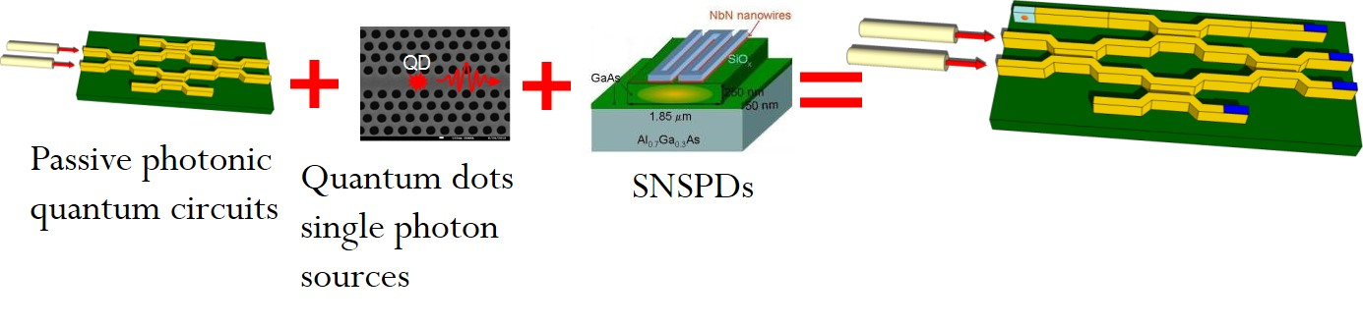
Why Superconducting Nanowires Single Photon Detectors (SNSPD)?
Why superconducting nanowire single photon detector?
single photon counting from X-ray to MIR
low dark count rate
low jitter <100 ps (record 12 ps),
fast count rates ~GHz;
Integration in photonic circuits (PICs)

Slide 4
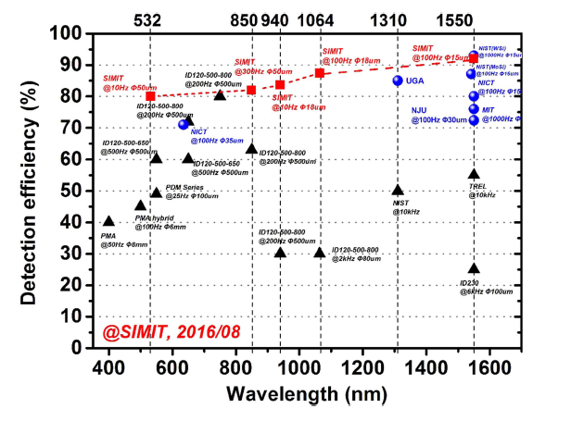
SPD technologies VIS-NIR
Lixing You et al., SUST (2017)

Slide 5
SPD technologies @1550nm
Detector | DE | Maximum count rate | Dark count rate | FWHM Jitter | Operating temp.
PMT | 2% | 10 MHz | 200 kHz | 300 ps | 200 K
InGaAs APD | 10% | 100 MHz | 16 kHz | 55 ps | 250 K
TES | 95% | 100 kHz | < 1Hz | 100 ns | 0.1K
SNSPD | 93% | 1GHz (potential) | < 10 Hz | < 20 ps | 2.5 K
DE=
(detection efficiency)
# detected photons
# incident photons
H. Terai, et al.” in Optical Fiber Communication Conference, paper M3G.4 (2018);

Slide 6
SNSPD working principle
Bias-T
I_{B} < I_{C}
V_{out}
2 states: R_{N}= 0;
+
R_{N}~ 1kΩ;
R_{B}
V_{out}≈ I_{B} × R_{out}
R_{N}
V_{B}
+
R_{out}
R_{out}=50 Ω
-
L_{k}
NbN meander
τ_{r} =
-
V
50 Ω + R_{n}
T<<T_{C}
τ_{r}
τ_{f}
L_{k}
τ_{r} =
50 Ω
Time

Slide 7
Summary
Active materials;
Detection mechanism models;
(counts vs Darkcounts)
    Detection efficiency;
    Single photon absorption in thin films, DE & SDE;
    Maximum Count rate;
    Timing resolution;
    Integration in photonics circuits (PICS);
    Photon number resolving functionality;
    Multiplexing;

Slide 8
Active materials
Superconductors that have demonstrated capability of single-photon detection are films of compounds or alloys (classified as Type II superconductors):
Polycrystalline films: NbN (niobium nitride), NbTiN (niobium titanium nitride), NbSi, TaN...
Amorphous films: WSi (tungsten silicide) MoSi (Molibdenum Silicide), MoGe (Molybdenum Germanium) etc

Slide 9
Polycrystalline films
NbN, NbTiN Type II superconductors have short ξ.
They can be grown as ultra thin films (with thickness ~ ξ = 3-10 (nm)
ξ₀ = ν_{F}/π∆
Coherence length ~ Cooper pair size
Type I superconductors
(Pb, Sn, Al, In)
(λ< ξ)
Type II superconductors
(alloy and compound)
(λ> ξ)
B≠0 R=0 mixed state
B=0 R=0
Type I materials: at Hc, abrupt breakdown of the superconductivity
Type II materials: at Hc₁ B begins to penetrate;
at Hc₂ total penetration of B

Slide 10
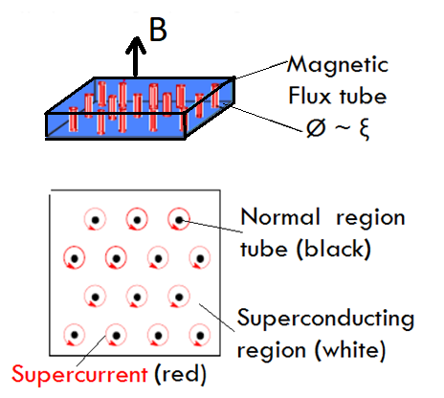
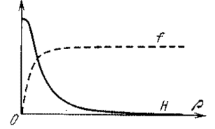
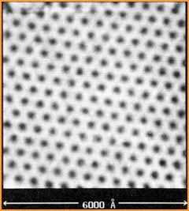
Magnetic Vortices in Type II mixed state
Abrikosov (1957) Nobel Prize 2003
Δ
ξ/2
λ/2
H
r
A magnetic vortex has a normal-conducting cylindrical core of radius ~ξ, where a magnetic field persists enclosed by a circular supercurrent surrounded of the superconductive region over a length λ_{L} .
Abrikosov lattice on the surface of NbSe2 film, imaged using STM. In the mixed state the density of vortices increases with Ha

Slide 11
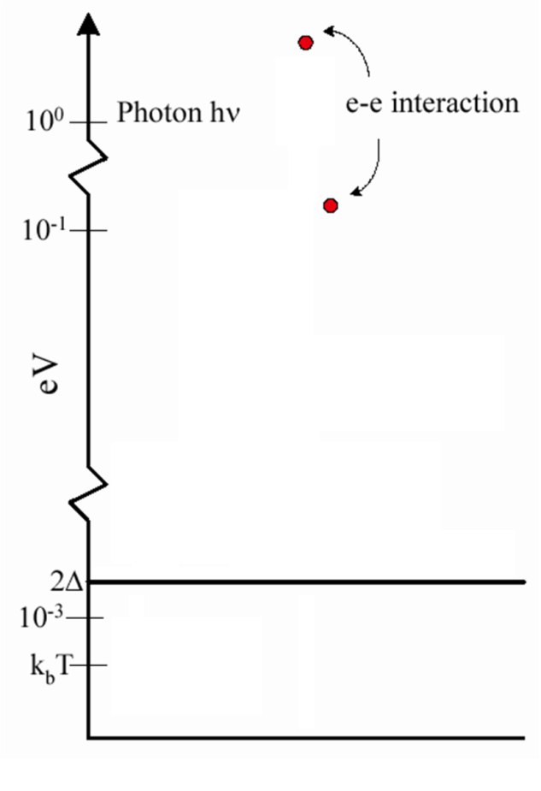
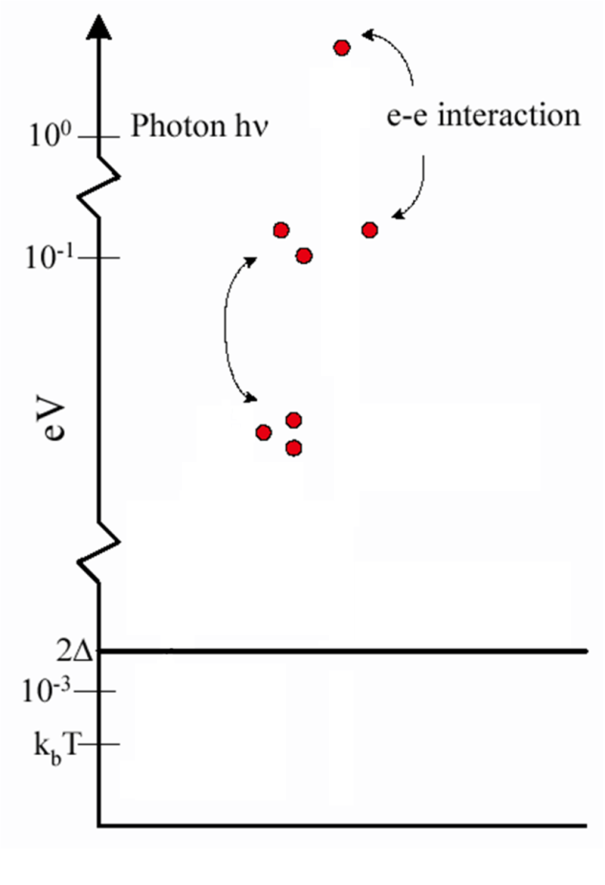
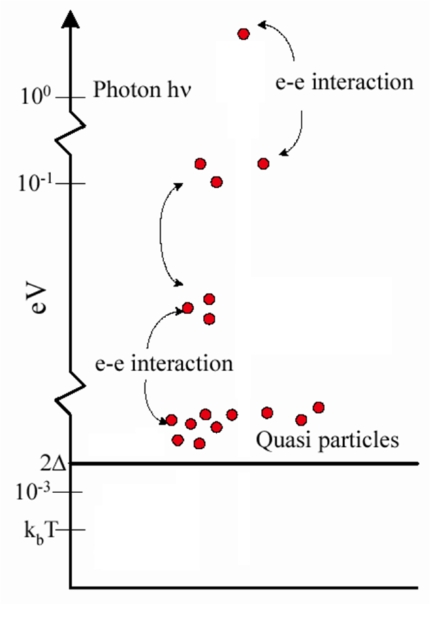
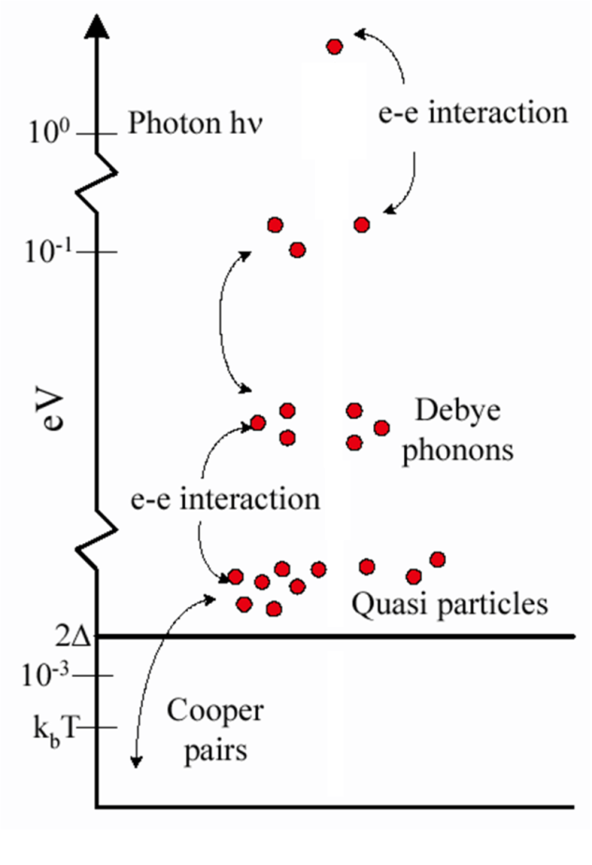
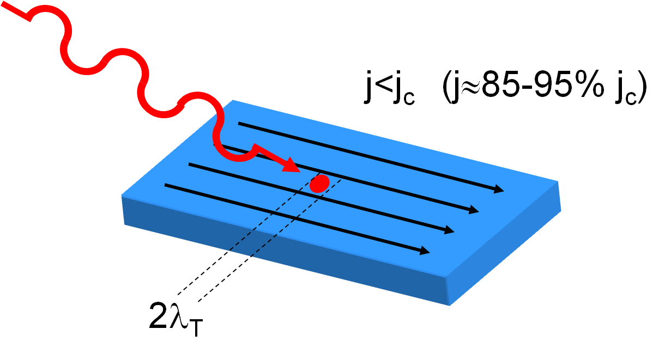
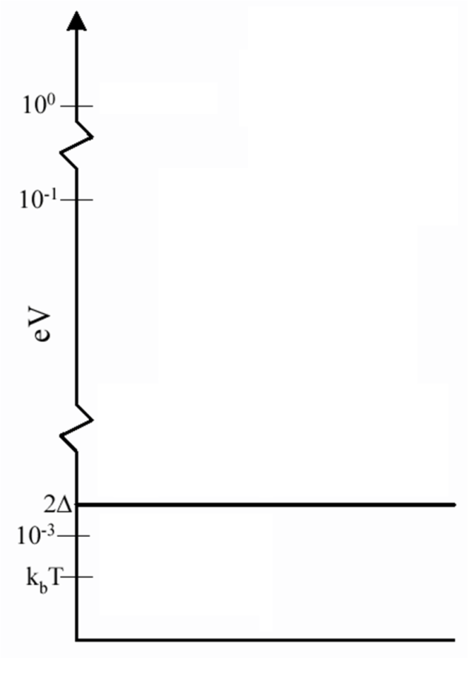
Absorption and Quasi Particle Cloud
w~100nm wide, t~4nm thick NbN Nanowire @T_{b}~3K
A photon with energy E_{ph} ~ 1eV gets absorbed by breaking a Cooper pair (E_{ph}>> ∆), creating an excited electron
by Goltsman et al., APL (2001)
the hot (excited) electron relaxes, giving rise to a cascading process where several Cooper pairs are broken into excited electrons, creating a cloud of Quasi-Particles (QPs)

Slide 12
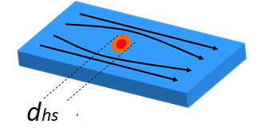
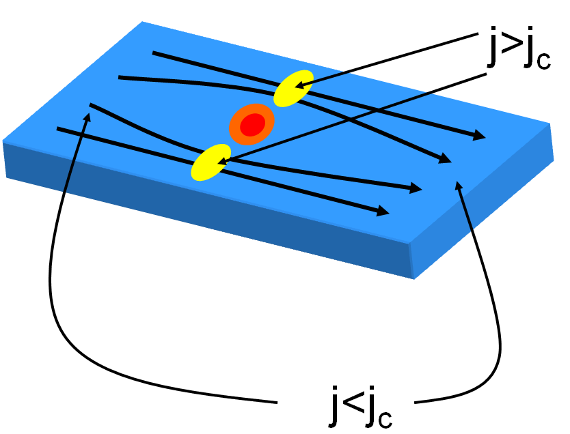
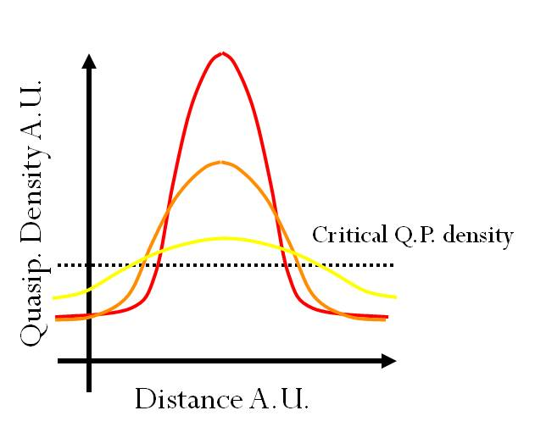
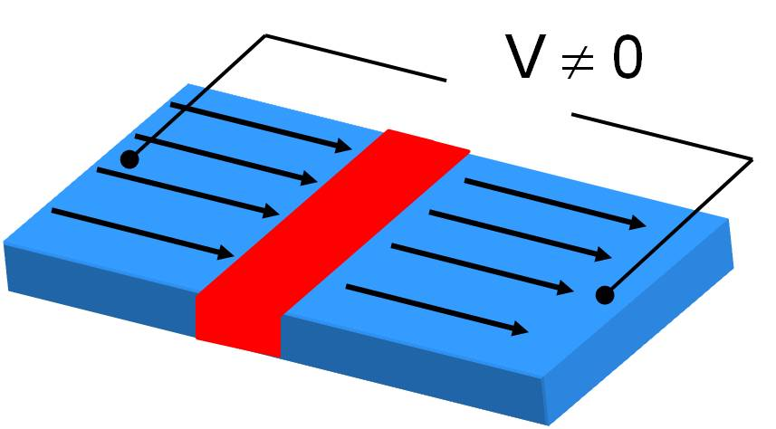
Normal-Core Hotspot Model
resistive core
The QPs cloud diffuses in the nanowire creating normal-conducting core (the Hotspot);
Bias-T
+
R_{B}
+
V_{B}
-
R_{out}
V_{out}
-

Slide 13
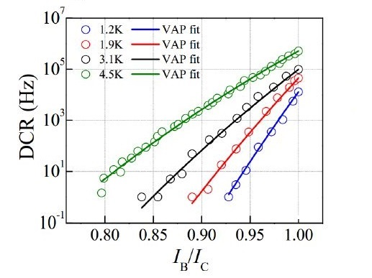
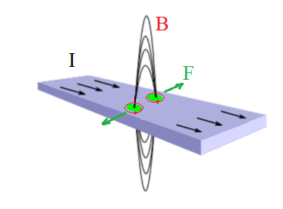


Origin of Dark Counts in SNSPDs
Z. Zhou PhD thesis 2014
Kosterlitz–Thouless (KT) transition, Nobel Prize 2016
NbN nanowire (thickness ~ξ, width >>ξ) behaves like a 2-D Superconductor.
Vortex- antivortex pairs (VAP) are pinned in the film (net B=0) below critical temperature T_{KT}
VAP unbinding due to:
- Lorentz force F = I x B
- Temperature fluctuations
FIT
Crossing of an unbound vortex (that has a normal core) creates decoherence due to dissipation and then triggers a resistive transition (false pulse => DCR)
Binding VAP potential
Yamashita APL (2011)

Slide 14
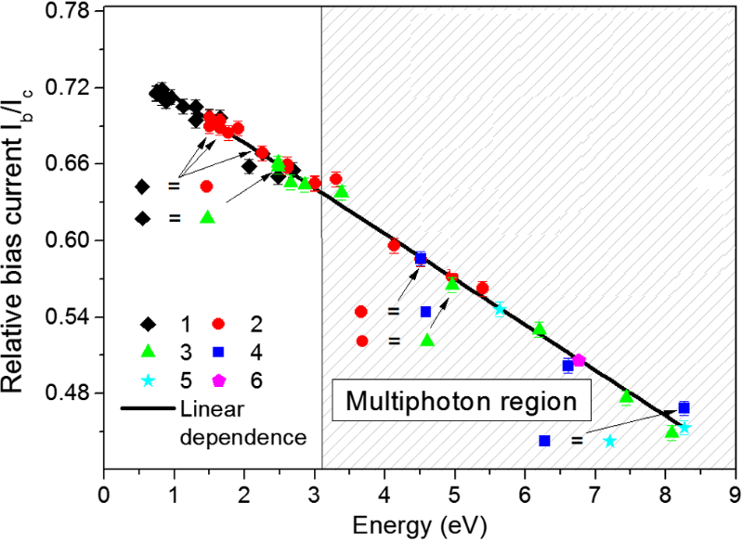
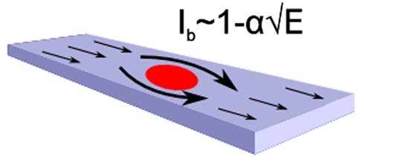
Limits of the Normal-Core Hotspot Model
1)
The model does not explain origin of dark counts
dark counts due to vortex crossing
Yamashita APL (2011)
2)
The model predicts:
I_{b}~1-γE
(needed to have a DE≈1%)
instead
A detection event need J>J_{C} (close the hotspot), 2i.e. I_{b}/I_{c}> 1- d_{hs}/w.
d_{hs}~ E^{1/2} the hotspot diameter
Renema et al., PRL (2014)

Slide 15
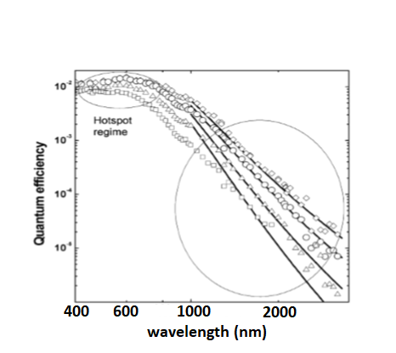
Limits of the Normal-Core Hotspot Model
3) The model predicts a sharp spectral cut-off of the DE with the photon energy.
Reason: At low energies the hotspot size to small to trigger the resistive transition
instead
Detection efficiency
I_{b} from 0.79 to 0.98 Ic
Wavelength (nm)
A. Semenov et al 2008

Slide 16
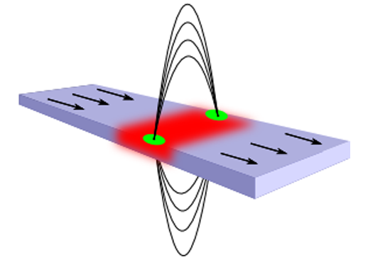

Vortex-crossing model
The cloud of QPs (n_{qp}) diffuse outward from the point of absorption, creating a (red) band of depleted superconductivity with a lower energy gap Δ. This effect stimulates VAP unbinding.
A. Semenov et al 2008
U_{VAP} (Δ) Binding VAP potential
Fit using Vortex and antivortex THY
Hotspot regime
$$UVAP∝∆$$
Detection efficiency
A lower Δ decreases U_{VAP} allowing VAP unbinding
Vortex crossing in the film triggers the resistive transition
I_{b} from 0.79 to 0.98 Ic
Wavelength (nm)

Slide 17
In conclusion, Photon Detection results from the combination of Cooper pair breaking, QP diffusion and Vortex crossing.
- QP diffusion dominates at high energies
- Vortex crossing at low energies

Slide 18
Detection Efficiency
The Detection efficiency (DE) is defined as:
# Counts - # Dark counts
DE =
#incident photons
DE is a function of the detector bias current DE(I_{B}).

Slide 19
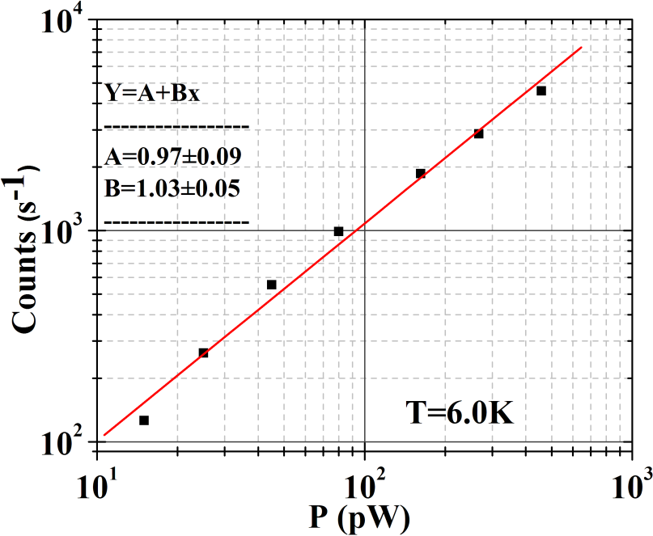
Measuring DE: single photon regime
µ= average number of photons
n= number of photons
e^{-µ} µ^{n}
P (n) =
n!
If µ<<1:
µ^{n}
P (n) =
⇒ P(1)= µ; P(2)∝ µ²; P(3)∝ µ³
n!

Slide 20
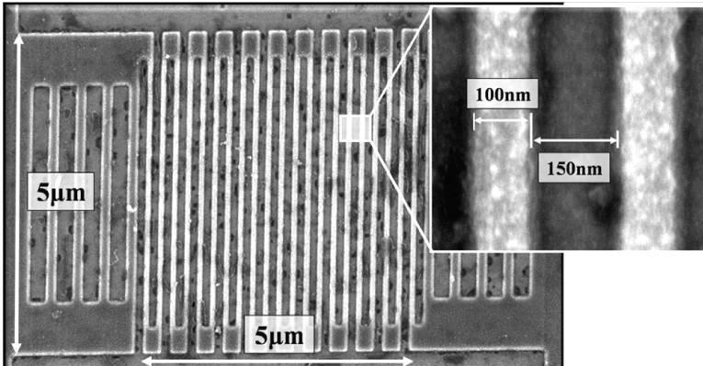

System detection efficiency SDE
DE= η_{a} x η_{i}
η_{i} = internal efficiency;
η_{a} = probability of absorption
SDE= η_{C} x η_{a} x η_{i}
η_{C} = optical losses in the cryostat;
η_{i} improved by:
Homegenity and uniformity of the nanowire;
Geometry
(width, thickness);
Fabbrication parameters;
η_{a} improved by
Single pass cavity
Integration on waveguide
η_{C} improved by:
Meander structuring
Fiber alignment
Grating couplers
Notes:
Nanowires are very thin (4-5nm),
Strategy to enhance the ph. absorptance with semiconductors (GaAs, Si, SiN)

Slide 21
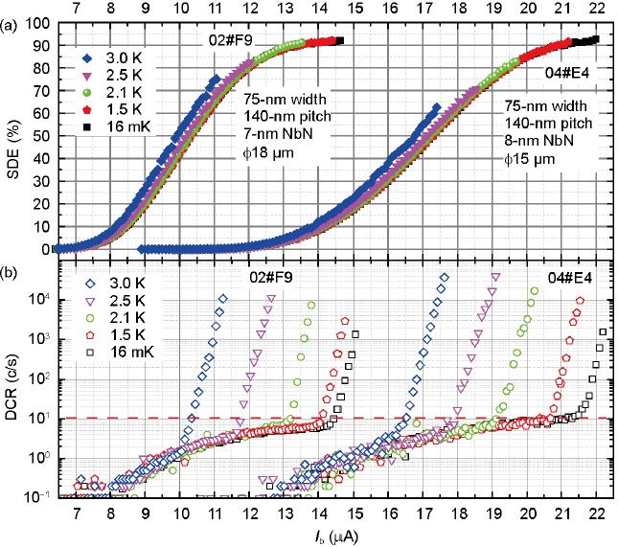
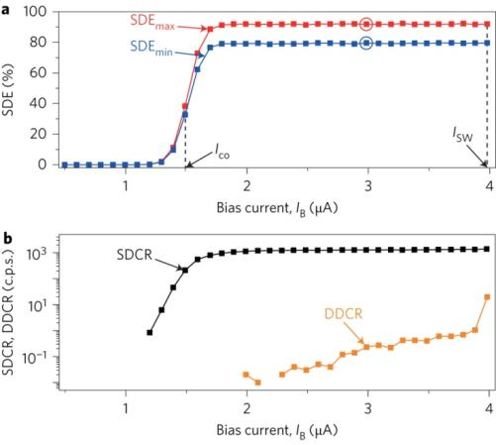
Internal efficiency, η_{i}
Polycristalline: NbN, NbTiN;
high SNR, low jitter, high repetition rate, low yield
Amorphous: WSi, MoSi;
high SQE, high yield, low SNR, high jitter.
W. J. Zhang et al. Sci. China Phys. Mech. Astron. (2017)
Marsili et al. Nat. Phot (2013);

Slide 22
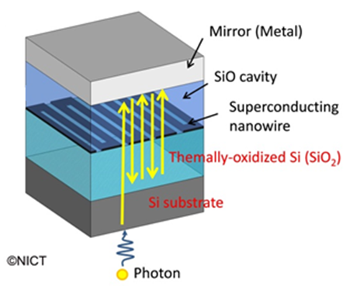
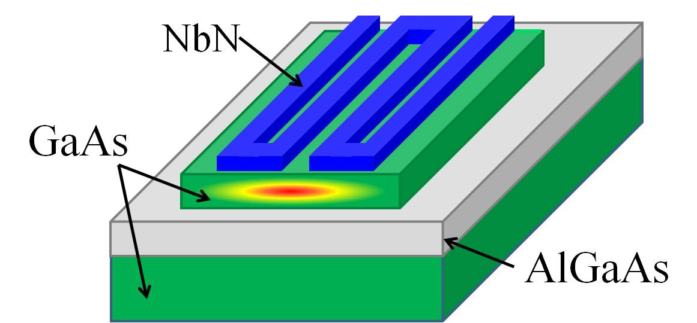
Single photon absorption in Nanowires, η_{a}
Thin superconducting film (3 nm<d <9 nm), low absorption!
Top coupling
Travelling wave
Efficiently Fiber Coupled Detectors
Integration in photonic circuits
Not Scalable, slower response.
High optical coupling, suitable fiber coupling with external experiments
Scalable, faster response, better timing jitter.
High coupling losses, suitable for quantum optics experiments with integrated circuits.
Notes:
Nanowires are very thin (4-5nm),
Strategy to enhance the ph. absorptance with semiconductors (GaAs, Si, SiN)

Slide 23
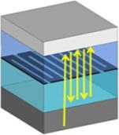
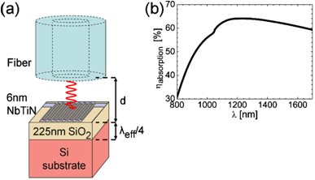
Efficiently Fiber Coupled Detectors:
Absorption in Nanowires, η_{a}
Broad optical cavity:
quarter wavelength mirror
M. G. Tanner et al., Appl. Phys. Lett. (2010)

Slide 24
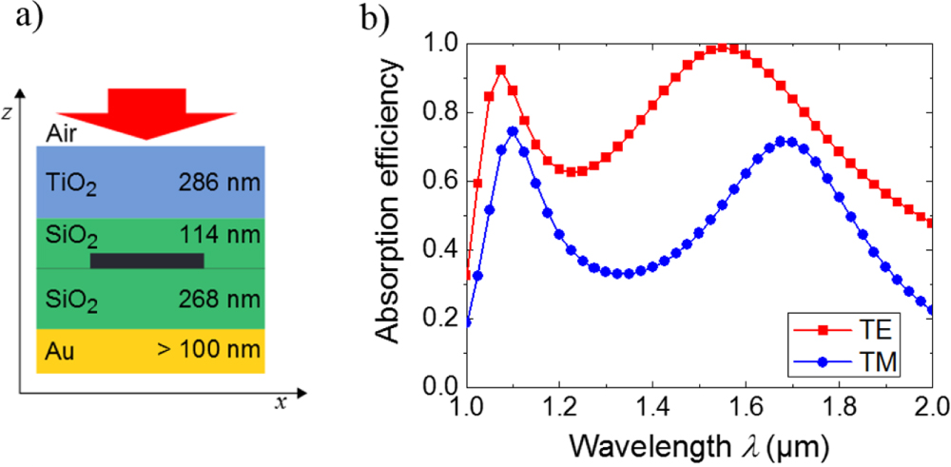
Efficiently Fiber Coupled Detectors:
Absorption in Nanowires, η_{a}
Broad optical cavity:
quarter wavelength mirror
L Redaelli et al., SUST (2016)

Slide 25
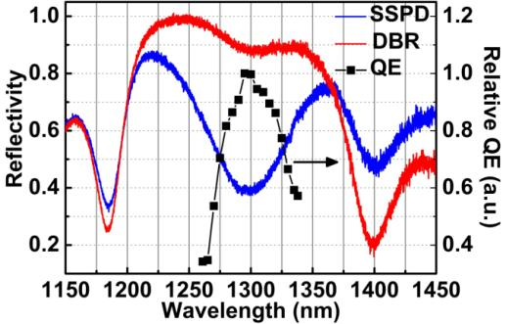
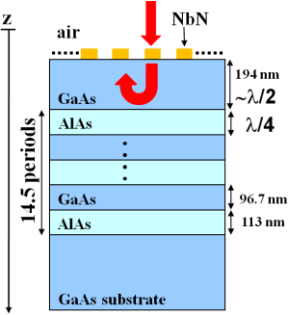
Efficiently Fiber Coupled Detectors:
Absorption in Nanowires, η_{a}
Narrow optical cavity:
distributed bragg reflector
DBR
Reletive DE (a.u)
SNSPD
DE
A. Gaggero et al. ,Applied Physics Letters (2010)

Slide 26
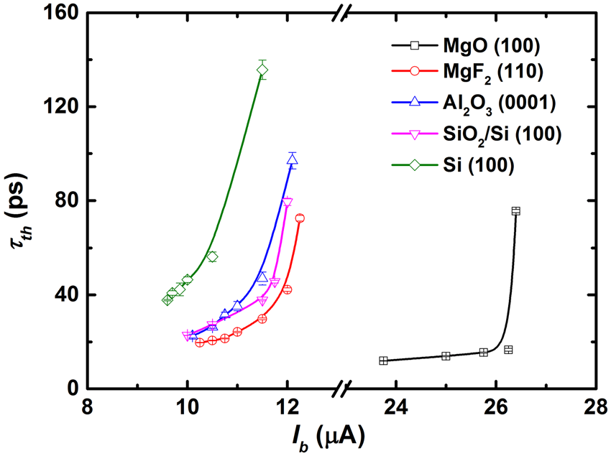
Maximum Countrate: Hotspot relaxation time (τ_{th})
substrate | t (nm) | w (nm) | s (nm) | I_{sC} (µA) | J_{C} (MA/cm²) | τ_{th} (ps)
MgO (100) | 5.5 | 90 | 110 | 33 | 6.7 | 11.6±0.1
MgF2 (110) | 4.5 | 90 | 110 | 22.5 | 5.4 | 19.7±0.1
Al2O3 (0001) | 7 | 130 | 70 | 21.5 | 2.4 | 22.5 ± 0.7
SiO2/Si (100) | 7 | 90 | 110 | 21 | 3.3 | 22.7 ± 0.1
Si (100) | 7.5 | 90 | 110 | 19 | 2.8 | 34.5 ± 0.3
τ_{th} (hotspot relaxation time) depends on film disorder.
τ_{th} physical limit to the maximum countrate achievable
τ_{th} → tens of ps R → GHz
Zhang et al. Scientific reports 2018

Slide 27
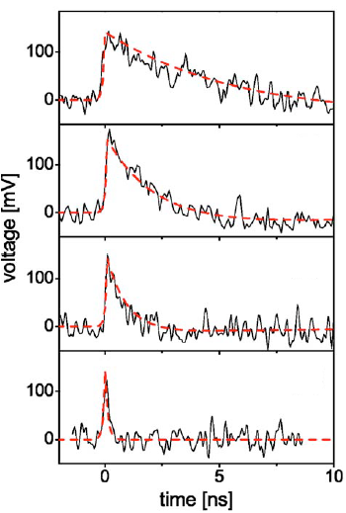
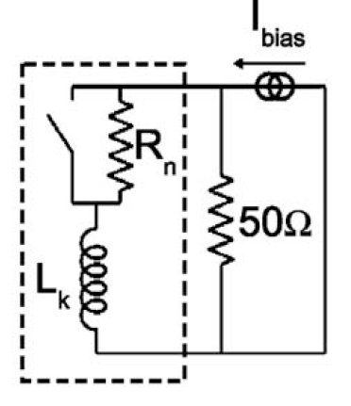
Maximum Countrate: Kinetic Inductance L_{K}
In a current-biased superconducting film, after the destruction of a certain number of Cooper pairs, the remaining pairs accelerate to carry the same bias current. Because the pairs are characterized by nonzero inertia, this process can be modelled as time-varying kinetic inductance L_{K}
L=500 µm
L_{K} = 415 nH
L=120 µm
L_{K} = 110 nH
m
L
L_{K} =
2n_{s}e²
wd
L=50 µm
L_{K} = 44.5 nH
L_{k}
L_{k}
τ_{r} =
τ_{f} =
L=5 µm
50 Ω + R_{n}
50 Ω
L_{K} = 6.10 nH
τ_{f} → tens of ns R → MHz
Kerman et al., app phys lett. 2006

Slide 28
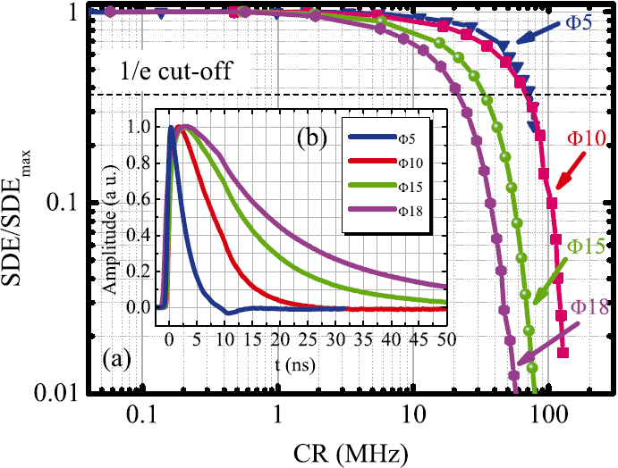
Maximum Countrate vs DE
Detector active area diameters Φ = 5, 10, 15, and 18 μm
φ (µm) | τ_{f} (ns) | MCR (MHz)
5 | 4.8 | 208
10 | 11.9 | 84
15 | 26.2 | 38
18 | 44.4 | 23
Zhang et al. AIP Advances (2015)

Slide 29
Timing resolution: Jitter
Timing jitter characterizes the time delay between the detection pulse and the the corresponding incident photon. It is the detector time resolution.
Gaussian distribution and the timing jitter is FWHM
Photon arrival
SNSPD response
time
Jitter
FWHM
time

Slide 30
Timing resolution: Jitter
J²_{System}= J²_{SNR} + J²_{geom}+ J²_{hp}+ J²_{Setup}
J²_{SNSPD}
DE
I_{B}

Slide 31
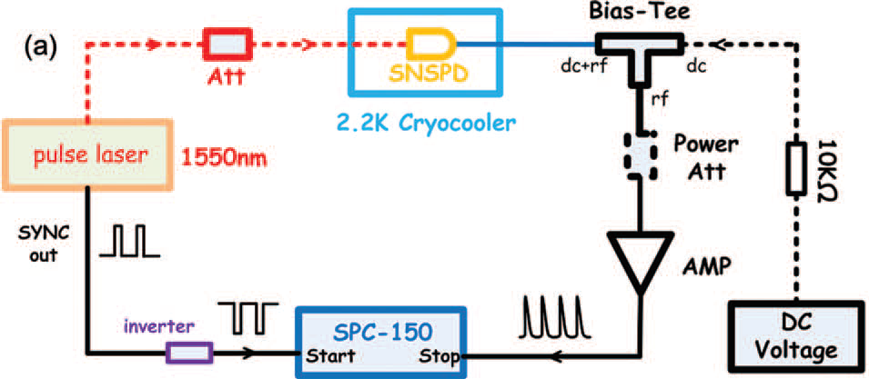
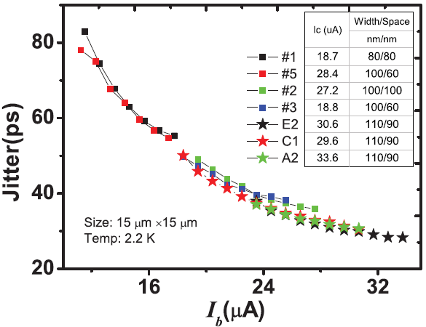

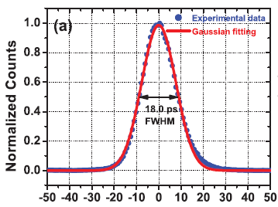
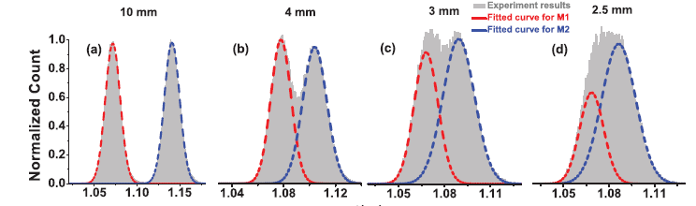
Timing resolution: Jitter vs I_{B}
λ=1550 nm, LiDAR, time of flight TOF WD ~115 m with a depth resolution of 3 mm.
L. You et al., AIP Advances (2013)

Slide 32
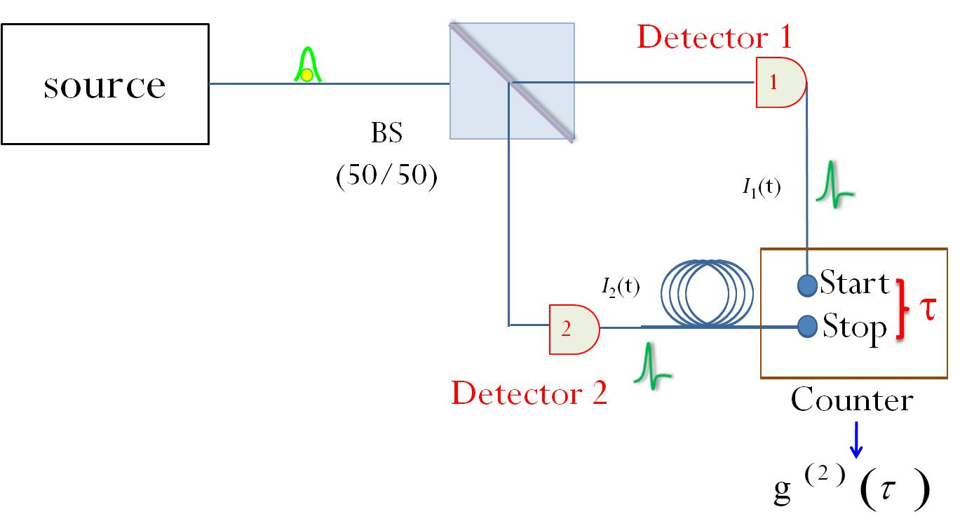
Single photon emitter characterization
Source 1:
CW or Pulsed Laser
CW
# of coincidence
Frequency = f
0
Time delay (τ)

Slide 33
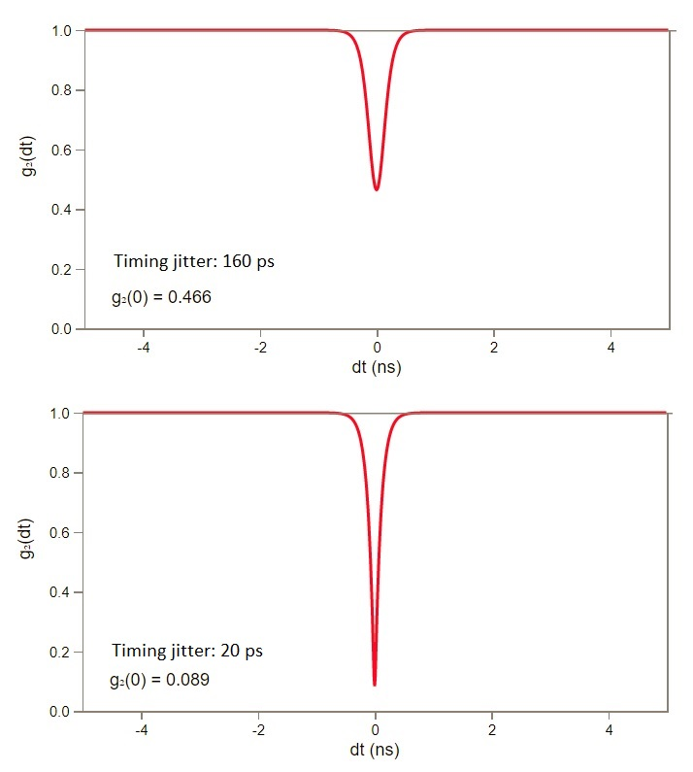
Single photon emitter characterization
Source 2:
Quantum emitter of single photons
CW
# of coincidence
0
Time delay (τ)

Slide 34
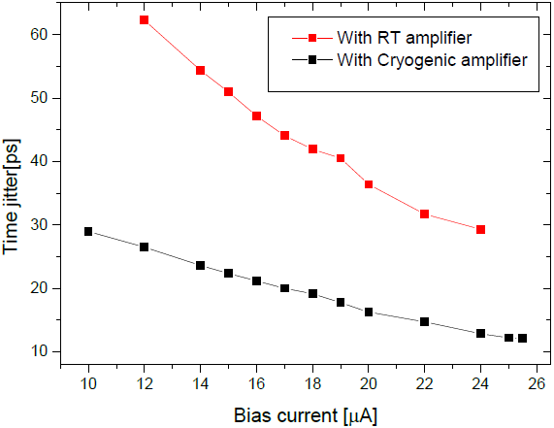
Timing resolution: Jitter
I. Zadeh et al., arXiv (2018)

Slide 35
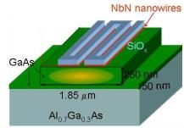
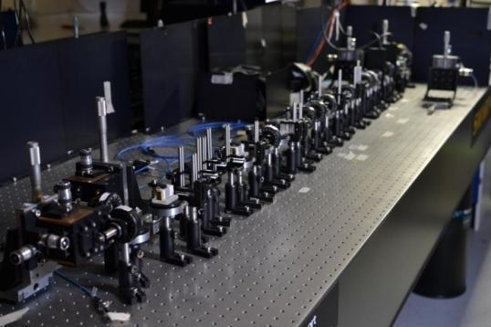
Adding Detection Functionality to PICs
PIC
SNSPDs
single photon sources
GaAs substrate
Conventional approach

Slide 36

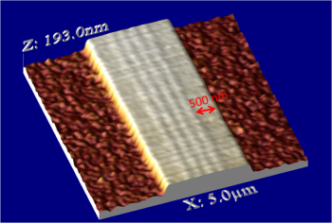

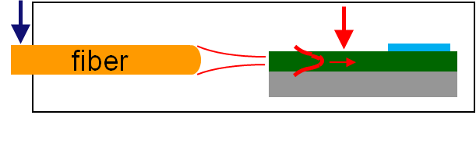
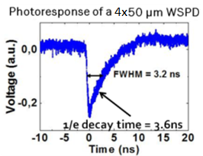
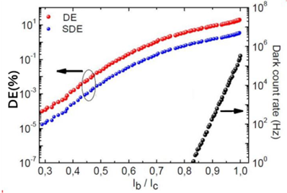
Waveguide Single Photon Detectors: GaAs
SDE
DE
End fire coupling
J. P. Sprengers, Gaggero et al APL (2011)
DE = 20 %
SDE = 3.4 %
η_{c} = 17 %
η_{c} is low, but the goal is to integrate either sources and detectors in the PICs
Coll. TUE CNR-IFN

Slide 37
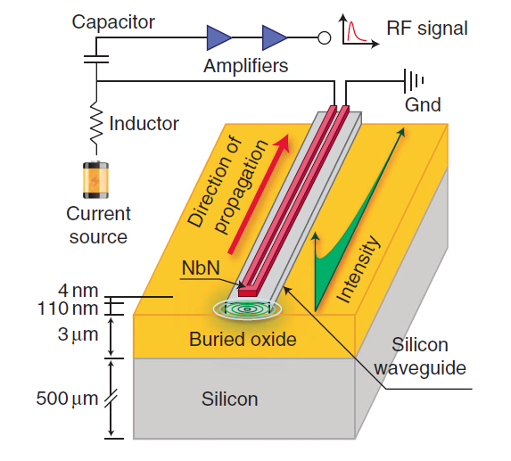



Waveguide Single Photon Detectors: SOI
DE = 88 %
SDE = 2 %
η_{c} ≈ 2.4 %
SOI vs GaAs
Higher index contrast
Higher NbN deposition temperature
Pernice et al., Nat Comm (2012)
Notes:
The pulse on soi refer to a 100nm wide and 20um long wire. While the one on GaAs to 100nm wide 50um long

Slide 38
After these first succesful integrations of WSPDs on GaAs and SOI platforms, this approach has been followed also on SiN, Diamond and (work is in progress) on AlN and SiC and other materials suitable for integrated photonics.

Slide 39
Photon Number Resolution
SNSPD
Strongly non-linear response!
PNRD
Linear response vs # of detected photons
photon number resolving detectors (PNRDs):
have the sensitivity at level of single photon
Have an output proportional to the # of incident photons.

Slide 40

Photon Number Resolving detectors
Photon number resolution achieved using the concept of spatial multiplexing.
The area of the detector is divided in pixels, i.e. smaller meanders with equal resistors in parallel.
Pixels are connected in series
Pulse amplitude proportional to the # of photon absorbed

Slide 41

4-Pixels Waveguide PNRD: GaAs
Sahin, Gaggero et al APL (2013)
fiber
The nanowires are distinct detecting elements sensing different parts of the same waveguide mode
DE_{(TM)}= 22%
DE_{(TE)}= 24%
λ =1300nm;
T< 4 K
Coll. TUE CNR-IFN

Slide 42
4-Pixels Waveguide PNRD: GaAs
P(n, µ) ∝µ^{n} , for a Poissonian source in the regime, where detected average photon number µ<< l, as shown by the fits.

Slide 43


Readout
Integrated Photonic Circuits.
Deep Space Communications
Crespi et al., Nature Photonics 7, 322 (2013)
Carolan et al., Nature Photonics 8, 612 (2014)

Slide 44










Readout
Zhu et al., nat. Nanotech., 13, 596,(2018)
Verma et al.; Appl. Phys. Lett., 104 (2014)
104, 051115 (2014)
Readout circuit:
NxN detectors
2N coaxial cables
Position is encoded in a combination of row and column pulses
104, 051115 (2014)
Low temperature SFQ readout electronic
104, 051115 (2014)
2 coaxial cables: frequency division multiplexing scheme (usually used for KIDs)
Doerner et al., Ieee Trans. App. Super., 26, (2016)
Yamashita et al.,Opt. Lett., 37, 2982 (2012)

Slide 45

Readout
Unpractical!
Integrated Photonic Circuits.

Slide 46
Amplitude Multiplexing
Bias-T
Bias-T
R_{out}
R_{B}
R_{out}
R_{B}
I_{B}
+
R_{N}
+
V_{B}
V_{B}
-
R₁
-
I_{B}
I_{B}
V
R_{N}
R₂
R₂
I_{B}
R_{M}
R₁
R_{M}
t

Slide 47





Integrated array
6 nm thick, 80nm wide NbN nwrs
350 nm thick and 1.9 µm wide S₃N₄ ridge Wg
Grating Simulated CE=35% @1530nm @ 300K
measured CE=10% @1550nm @ 300K
R_{D1}
D1
D1
Alignment waveguide
2nd Y-Splitter
1st Y-Splitter
Input
Output
D2
D2
R_{D2}
Gaggero et al. Optica (2019)

Slide 48





Set-up
Notes:
-where a plasma of Ar and Nitrogen is used to sputter a target of Niobium

Slide 49


Optical Characterization @ T<3K
λ= 1550 nm, f= 1MHz, <n> = 0.1
Pulse width 10 ps

Slide 50




Optical Characterization @ T<3K
ODE ≈ 20% @ DCR ≈ 100 Hz,
≈ 10% @ DCR < 10 Hz
≈ 5% @ DCR ≤ 1 Hz
λ= 1550 nm, f= 1MHz, <n> = 0.1
Pulse width 10 ps
ODE_{d1}= 30.4 % @ 4 kHz DCR
ODE_{d2}= 15.6 % @ 100 Hz DCR

Slide 51

Scalability
Gain~ 49 dB @ 500MHz
V_{σ} = 3.7 mV
I_{B}= 17.0 µA ⇒ ∆R_{2σ}= V_{2σ}/ I_{B} = 1.6 Ω
∆R_{6σ}= V_{6σ}/ I_{B} = 4.7 Ω
V_{th}= (4k_{B}BT50Ω)^{1/2}= 20.3 µV ⇒ ∆R_{th}= 1.2 Ω
Ch_{i}= R_{M}/∆R_{i}
R _{in} (Ohm) | T (K) | B (MHz) | ∆R_{th} (Ohm) | 𝞓R_{2𝞼} (Ohm) | 𝞓R_{6𝞼} (Ohm) | R_{M} (Ohm) | Ch_{2𝞼} | Ch_{6𝞼}
50 | 300 | 0.1-500 | 1.2 | 1.6 | 4.7 | 50 | 30 | 10

Slide 52

Prospects: Scalability
Gain~ 49 dB @ 500MHz
V_{th}= (4k_{B}BT50Ω)^{1/2}
M Ejrnaes et al. Appl. Phys. Lett., 91 (2007)
F. Marsili et al., Nano Lett. 11 (2011)

Slide 53

Prospects: Cryogenic Amplifier
V_{th}= (4k_{B}BTR_{in})^{1/2}
NF @ 20 K: < 0.11 dB, from .0001 to 1.5 GHz
NF @ 300K <1.5 dB from .0001 to 1.5 GHz
www.cosmicmicrowavetechnology.com/citlf1
R _{in} (Ohm) | T (K) | B (MHz) | R_{th} (Ohm) | 𝞓R_{2𝞼} (Ohm) | 𝞓R_{6𝞼} (Ohm) | R_{M} (Ohm) | Ch_{2𝞼} | Ch_{6𝞼}
50 | 300 | 0.1-500 | 1.2 | 1.6 | 4.7 | 50 | 30 | 10
50 | 20 | 0.1-500 | 0.31 | 0.4 | 1.2 | 50 | 121 | 41

Slide 54
Thank you for the attention!

