Slide 1
SC cavity measurements
Walter Venturini Delsolaro
CERN
EASISchool on superconductivity,
29 September 2020

Slide 2
Topics
Introduction: measurements, errors, uncertainty
Quantities of interest
    Resonant frequency, operational bandwidth → beam requirement
    Qo value→ heat load on cryogenics
    Accelerating field Ea→ beam requirement
RF basics
  Transmission line theory; characteristic impedance, reflection coefficient
  Standing waves, resonators
  S parameters
  RF components: cables and connectors, matched loads, attenuators, splitters, directional couplers
  Measurement equipment: network analyser, spectrum analyser, power meters
Superconducting RF cavity measurements
  Qo and Ea measurement method(s)
  Sources of uncertainty, evaluation and mitigation
  Cool down precautions and effects
  Multipacting
  Field emission
  Quenches
  Q switches
  Disentanglement of Rs “components”

Slide 3
Measurement
Determining the/a value of a measurand (the quantity to be measured), implies:
  Definition of the measurand
  Definition of the measurement unit (the value of the measurand is a real number expressing the ratio between the measurand and the unit)
  Definition of the principle of measurement (example: thermal contraction)
  Definition of the method of measurement (example: by difference)
  Definition of the measurement procedure (the sequence of actions to carry out the measurement)

Slide 4
Errors and uncertainty
Error is an idealised concept: the “true” value of a quantity is metaphysical, sometimes even conceptually hard to define (think to the length of an object…)
Exception: conventional true values (speed of light, Avogadro number, etc..)
In science we believe “something is out there”, but “errors” cannot be known
Traditionally errors are viewed as having two components: systematic and random. The distinction has to do with their behaviour in time. However:
A “random” error in determining an influence variable or a calibration constant becomes “systematic” in the end result
Known systematic errors should be eliminated by correction factors; these are in turn affected by “errors”
Uncertainty reflects the lack of knowledge on the value of the measurand, of which the measurement results is only an estimate

Slide 5
Sources of uncertainty
  Incomplete definition of the measurand
  Imperfect realization of the definition
  Under sampling (non representative samples)
  Uncertainty on measurement of influence variables
  Unknown effect of all environmental conditions
  Operator bias, human error
  Errors on calibration standards
  Errors on parameters in the data reduction algorithm
  Numerical errors
  Approximations in the models
  “Unknown unknowns”

Slide 6
Standard uncertainty
The standard deviation of the probability distribution of measured values around the “true” value(s)
Type A and Type B uncertainties: the distinction refers to the method of deriving the uncertainty, conceptually they are the same, and both are accepted by the ISO norm
  Type A is obtained with statistical procedures applied to repeated observations (frequentist probability)
  Type B is obtained from an assumed probability density function based on the degree of belief that an event will occur (subjective probability)

Slide 7
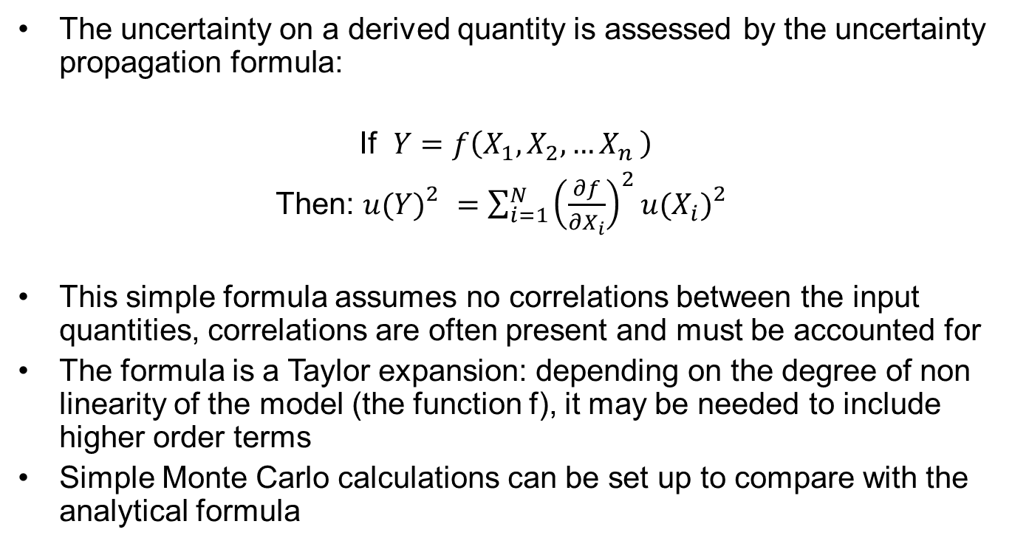
Combined standard uncertainty
The uncertainty on a derived quantity is assessed by the uncertainty propagation formula:
If $Y=f\left(X_{1},X_{2}{,…X}_{n}\right)$
Then: ${u(Y)}_{}^{2}=\sum_{i=1}^{N}{{\left(\frac{∂f}{∂X_{i}}\right)}^{2}{u(X_{i})}_{}^{2}}$
This simple formula assumes no correlations between the input quantities, correlations are often present and must be accounted for
The formula is a Taylor expansion: depending on the degree of non linearity of the model (the function f), it may be needed to include higher order terms
Simple Monte Carlo calculations can be set up to compare with the analytical formula

Slide 8
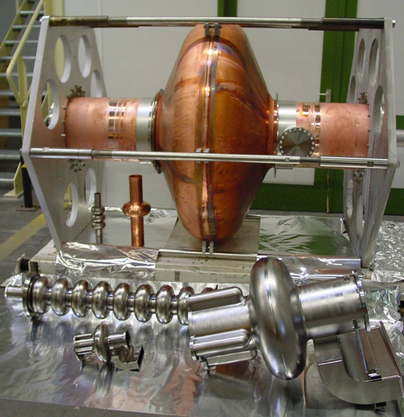
Superconducting cavities

Slide 9
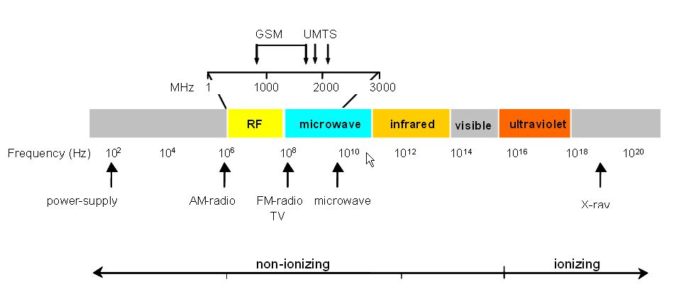
Electromagnetic spectrum

Slide 10
Frequency
Resonance frequency vs operating frequency
Accelerators dictate the operating frequency to the cavities, not vice versa: tuners shift the resonance frequency toward the operating frequency
Frequency control is an essential part of cavity production→ knowledge of frequency shifts all along, tuning range
Precise frequency not being critical for cavity testing, it can easily be forgotten. Keep in mind this is the simplest and yet essential “figure of merit” in cavity test

Slide 11
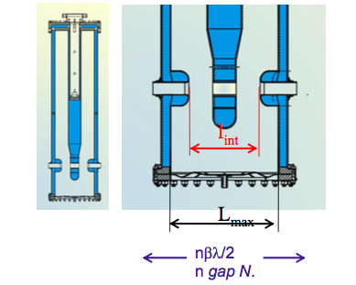
Accelerating field
The energy gained by a charged particle traversing the cavity (on axis and with the right phase wrt to the cavity field) is the charge times an integral involving the E field over the transit
The E field in the cavity changes along the path and in time (transit time factor).
The accelerating field (aka gradient)is defined as the maximum possible voltage gain divided by a suitable (but conventional) length representing the accelerating gap
The observable from which the accelerating field is derived is usually the power transmitted by the cavity to a calibrated pick up antenna
From Ref. 7
Notes:
The useful quantity is the accelerating field. We pay MV/m with Watts of dissipated power at the operational temperature (4.2 K or 1.8 K)→ Carnot and refrigerator efficiencies have to be taken into account to get the “real” power consumption

Slide 12
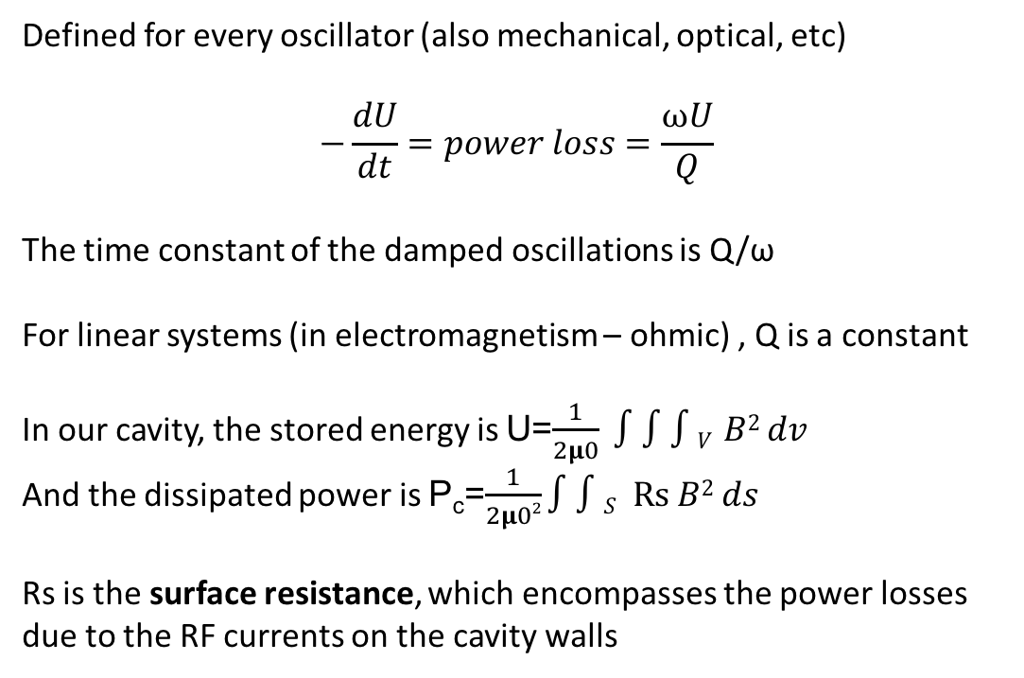
Quality factor
$$Q=\frac{2π (Energy stored per cycle)}{Energy dissipated per cycle}=\frac{ω (stored energy)}{Power loss}$$
Defined for every oscillator (also mechanical, optical, etc)
$$−\frac{dU}{dt}=power loss=\frac{ωU}{Q}$$
The time constant of the damped oscillations is Q/ω
For linear systems (in electromagnetism – ohmic) , Q is a constant
In our cavity, the stored energy is U=$\frac{1}{2μ0} ∫∫∫V B2 dv$
And the dissipated power is P_{c}=$\frac{1}{2μ02}∫∫S Rs B2 ds$
Rs is the surface resistance, which encompasses the power losses due to the RF currents on the cavity walls

Slide 13
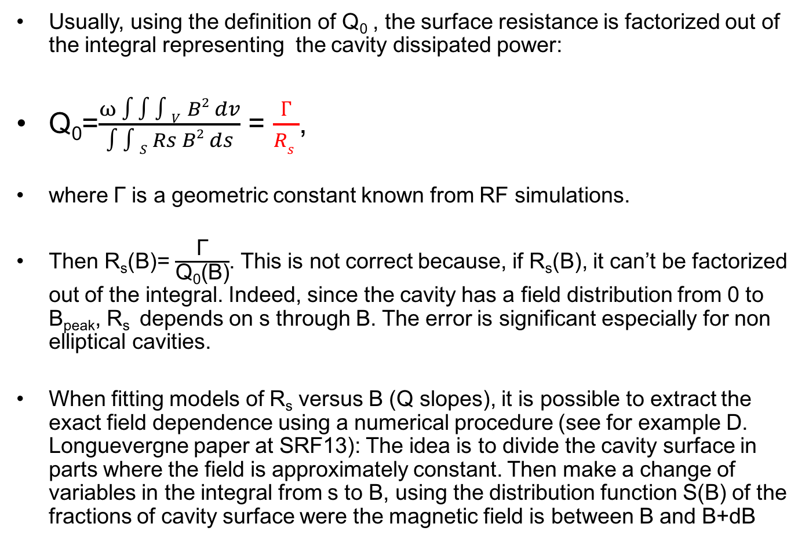
From Q₀(H) to R_{s}(H)
Usually, using the definition of Q₀ , the surface resistance is factorized out of the integral representing the cavity dissipated power:
Q₀=$\frac{ω ∫∫∫V B2 dv}{∫∫S Rs B2 ds}$ = $\frac{Г}{Rs }$,
where Г is a geometric constant known from RF simulations.
Then R_{s}(B)= $\frac{\text{Г}}{\text{Q}\text{0}\text{(}\text{B}\text{)}}$. This is not correct because, if R_{s}(B), it can’t be factorized out of the integral. Indeed, since the cavity has a field distribution from 0 to B_{peak}, R_{s} depends on s through B. The error is significant especially for non elliptical cavities.
When fitting models of R_{s} versus B (Q slopes), it is possible to extract the exact field dependence using a numerical procedure (see for example D. Longuevergne paper at SRF13): The idea is to divide the cavity surface in parts where the field is approximately constant. Then make a change of variables in the integral from s to B, using the distribution function S(B) of the fractions of cavity surface were the magnetic field is between B and B+dB

Slide 14
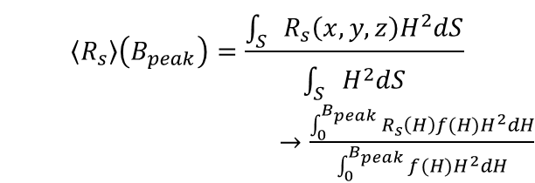
Example of application
If the local surface resistance uniform is Rs(x, y, z) = Rs[H(x, y, z)]
$$\left\langle R_{s}\right\rangle \left(B_{peak}\right)=\frac{\int_{S}{R_{s}\left(x, y, z\right)H^{2}dS}}{\int_{S}{H^{2}dS}}$$
$→\frac{\int_{0}^{B_{peak}}{R_{s}\left(H\right)f(H)H^{2}dH}}{\int_{0}^{B_{peak}}{f(H)H^{2}dH}}$
QS16 2K Rs(H)
QS16 2K
<Rs>(H)
QSS2 2K Rs(H)
QSS2 2K <Rs>(H)
The correction is significant when the Q slope is large, it can be neglected if the Q slope is small
Fraction of B on the RF surface

Slide 15
How to decompose the surface resistance?
Traditionally: R_{s}(T, B, ω)= R_{BCS}(T, ω)+ R_{res}(B, ω)
R_{s}(T→0)= R_{fl}+R_{res}=R_{fl}+R_{res0}+R_{res}(B)
R_{fl}=(R_{fl0}+R_{fl1} H_{rf}) H_{ext}
(see Physica C 351 (2001) 421-37)
R_{BCS}(T, ω), from Matthis-Bardeen theory, is a low field approximation
Disentanglement at high field is not obvious!
Consequently, R_{res} is also only known at low field

Slide 16
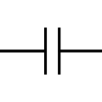



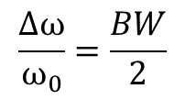

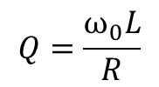
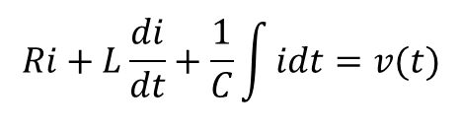

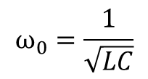

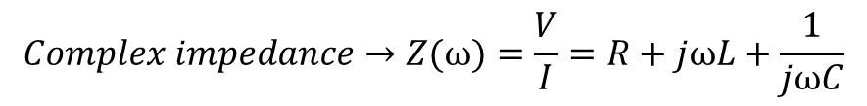
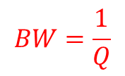
RLC circuit, amplitude and phase responses
$$Ri+L\frac{di}{dt}+\frac{1}{C}\int{idt=v(t)}$$
R
C
L
$$v\left(t\right)=Re\{Ve^{jωt}\}$$
$$i\left(t\right)=Re\{Ie^{jωt}\}$$
$$Complex impedance→Z(ω)=\frac{V}{I}=R+jωL+\frac{1}{jωC}$$
Circuit is voltage driven, the current is the response. The modulus of the current is maximum at resonance →
$$ω_{0}=\frac{1}{\sqrt{LC}}$$
$$ω−ω_{0}=∆ω$$
$$→ ω^{2}−{ω_{0}}^{2}\sim 2ω∆ω$$
$$Q=\frac{ω_{0}L}{R}$$
$$\frac{∆ω}{ω_{0}}=\frac{BW}{2}$$
$$BW=\frac{1}{Q}$$
Notes:
Circuit is voltage driven, the current is the response. Modulus of Z is minimum (current is maximum) for ω=1/Sqrt(LC) (resonance)

Slide 17
Driven oscillator, amplitude and phase responses
C
R
V=cos(ωt)
L
Close to resonance the phase undergoes a dramatic change, sometimes exploited to “find” the cavity
In a 1.3 GHz SC cavity with Qo ~ 10¹⁰
Δf ~ 0.1 Hz
Δf ~ 0.1 Hz

Slide 18
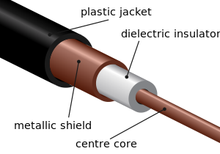


RF basics- transmission lines
From lumped circuits to distributed parameters: telegraph equations
R
L
I(z+Δz)
I(z)
V(z+Δz)
V(z)
G
C
$$−\frac{∂V(z) }{∂z}=(R+jωL) I(z)$$
$$−\frac{∂I(z) }{∂z}=(G+jωC) V(z)$$
$(R+$j ω L) I(z) Δz+ V(z+ Δz)=V(z)
I(z) - V(z+ Δz) $(G+$j ω C) =I(z + Δz)

Slide 19
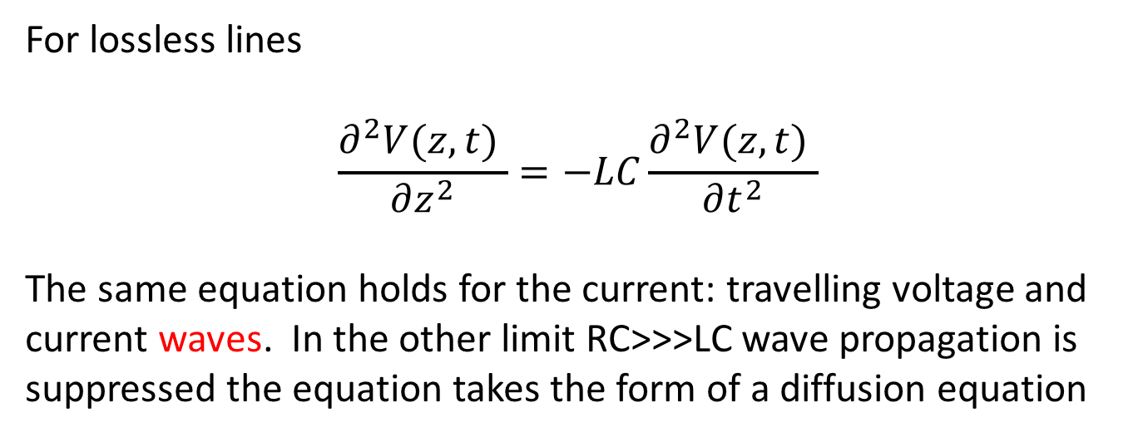
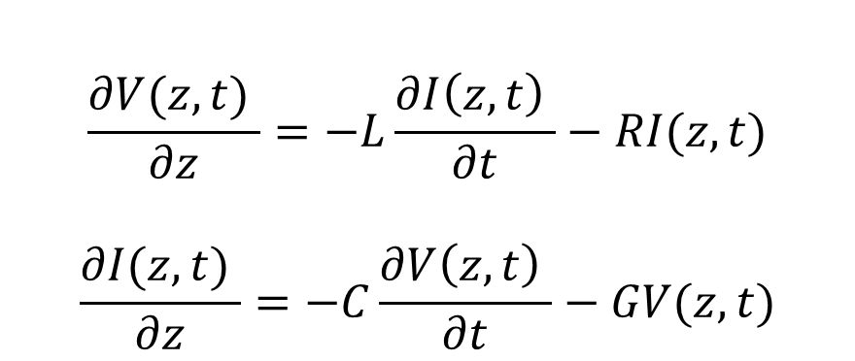
Telegraph equations
$$\frac{∂V(z,t) }{∂z}=−L\frac{∂I\left(z,t\right) }{∂t}−RI(z,t)$$
$$\frac{∂I(z,t) }{∂z}=−C\frac{∂V\left(z,t\right) }{∂t}−GV(z,t)$$
For lossless lines
$$\frac{∂^{2}V(z,t) }{∂z^{2}}=−LC\frac{∂^{2}V(z,t) }{∂t^{2}}$$
The same equation holds for the current: travelling voltage and current waves. In the other limit RC>>>LC wave propagation is suppressed the equation takes the form of a diffusion equation

Slide 20

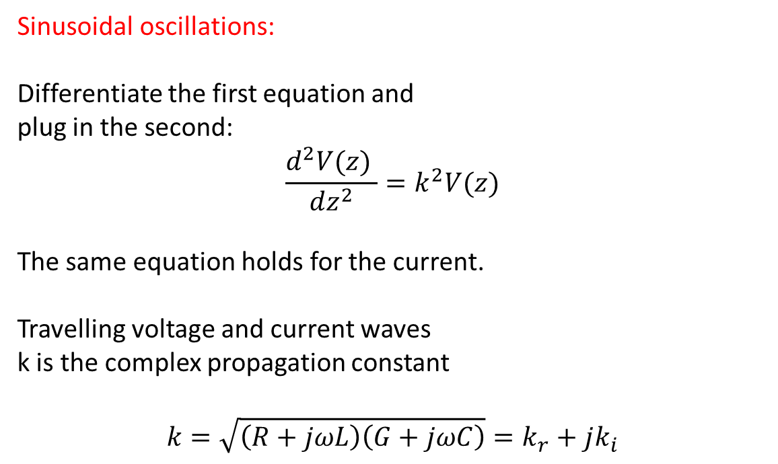
Propagation constant
$$−\frac{∂V(z) }{∂z}=(R+jωL) I(z)$$
$$−\frac{∂I(z) }{∂z}=(G+jωC) V(z)$$
Sinusoidal oscillations:
Differentiate the first equation and
plug in the second:
$$\frac{d^{2}V(z) }{dz^{2}}=k^{2}V(z)$$
The same equation holds for the current.
Travelling voltage and current waves
k is the complex propagation constant
$$k=\sqrt{\left(R+jωL\right)\left(G+jωC\right)}=k_{r}+jk_{i}$$

Slide 21
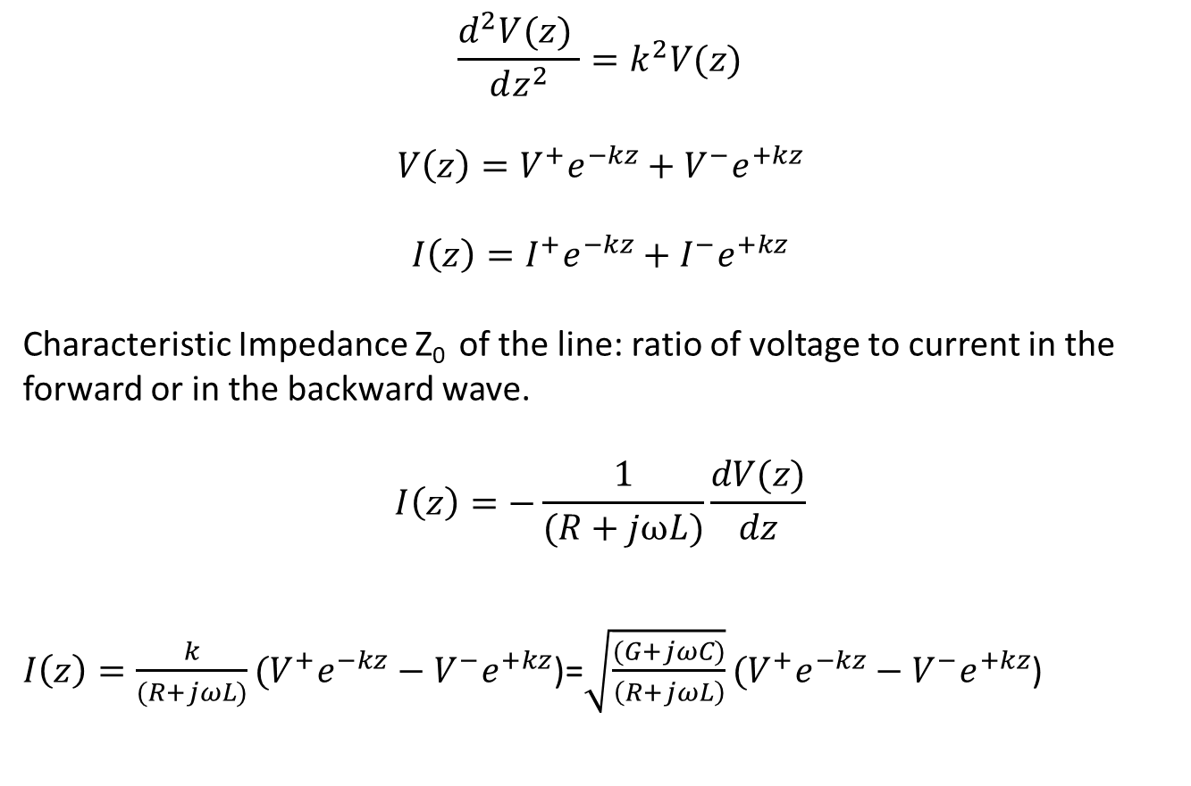
Line impedance
$$\frac{d^{2}V(z) }{dz^{2}}=k^{2}V(z)$$
$$V\left(z\right)=V^{+}e^{−kz}+V^{−}e^{+kz}$$
$$I\left(z\right)=I^{+}e^{−kz}+I^{−}e^{+kz}$$
Characteristic Impedance Z₀ of the line: ratio of voltage to current in the forward or in the backward wave.
$$I\left(z\right)=−\frac{1}{(R+jωL)}\frac{dV(z)}{dz}$$
$I\left(z\right)={\frac{k}{(R+jωL)}(V}^{+}e^{−kz}−V^{−}e^{+kz}$)=${\sqrt{\frac{(G+jωC)}{\left(R+jωL\right)}}(V}^{+}e^{−kz}−V^{−}e^{+kz}$)

Slide 22
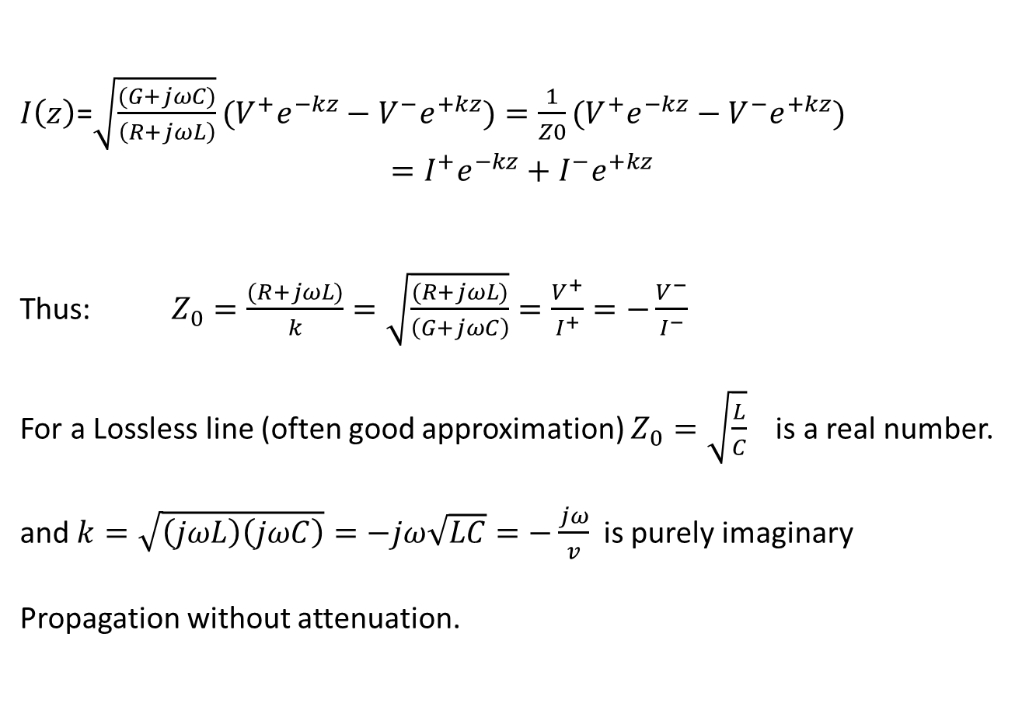
Impedance (cont.)
$I\left(z\right)$=${\sqrt{\frac{(G+jωC)}{\left(R+jωL\right)}}(V}^{+}e^{−kz}−V^{−}e^{+kz})=\frac{1}{Z0}({V^{+}e}^{−kz}−V^{−}e^{+kz})$
$$=I^{+}e^{−kz}+I^{−}e^{+kz}$$
Thus: $Z_{0}=\frac{(R+jωL)}{k}=\sqrt{\frac{(R+jωL)}{\left(G+jωC\right)}}=\frac{V^{+}}{I^{+}}=−\frac{V^{−}}{I^{−}}$
For a Lossless line (often good approximation) $Z_{0}=\sqrt{\frac{L}{C}}$ is a real number.
and $k=\sqrt{\left(jωL\right)\left(jωC\right)}=−jω\sqrt{LC}=−\frac{jω}{v}$ is purely imaginary
Propagation without attenuation.

Slide 23
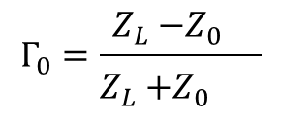

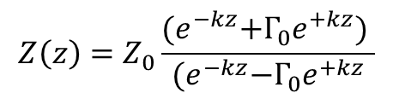
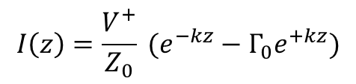

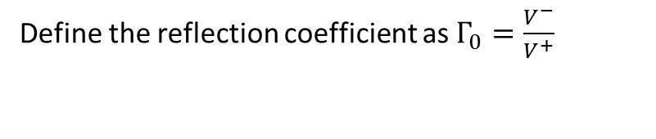
Transmission lines: reflection coefficient
The line impedance is Z₀ but at the load the ratio V/I must be Z_{L} so there must be a reflected wave
Z₀
Z_{L}
$$V\left(z\right)=V^{+}e^{−kz}+V^{−}e^{+kz}$$
-L
0
z
Define the reflection coefficient as $Γ_{0}=\frac{V^{−}}{V^{+}}$
$$I\left(z\right)=\frac{V^{+}}{Z_{0}} (e^{−kz}−Γ_{0}e^{+kz})$$
$$V\left(z\right)=V^{+}(e^{−kz}+Γ_{0}e^{+kz})$$
$$Z\left(z\right)=Z_{0}\frac{{(e}^{−kz}+Γ_{0}e^{+kz}) }{{(e}^{−kz}−Γ_{0}e^{+kz}}$$
$$Γ_{0}=\frac{Z_{L}{−Z_{0}}_{}}{{Z_{L}{+Z_{0}}_{}}^{}}$$
Notes:
Gamma is the ratio of the complex amplitude of the reflected wave to that of the incident wave
The power actually delivered to the load thus reduced by 1 − | Γ | 2

Slide 24





Transmission lines: Standing waves
Z₀
$$Γ=−1$$
0
Z=L
$V\left(z\right)=V^{+}(e^{−kz}+Γ_{0}e^{+kz})$=$V^{+}(e^{−kz}−e^{+kz})$
Case of lossless line, k=jω/v
Change z→ -z; ω/v=𝛽=2π/λ
$V\left(z\right)$=$V^{+}(e^{+j\text{β}z}−e^{−j\text{β}z})$
…use Euler’s identity
$V\left(z\right)$=2${jV}^{+}$sin($\text{β}z$)
…go back to real:
v$\left(z,t\right)=Re\left\{ V\left(z\right)e^{jωt}\right\}$
v$\left(z,t\right)=\left\{\text{2}{jV}^{+}\text{sin}\text{(}\text{β}z\text{)}e^{jωt}\right\}=Re\left\{2V^{+}\text{sin}\text{(}\text{β}z\text{)}e^{jωt}e^{j\frac{π}{2}}\right\}=2V^{+}\sin\left(\text{β}z\right)cos(ωt+\frac{π}{2})$
Standing wave: time and space are decoupled, no propagation

Slide 25
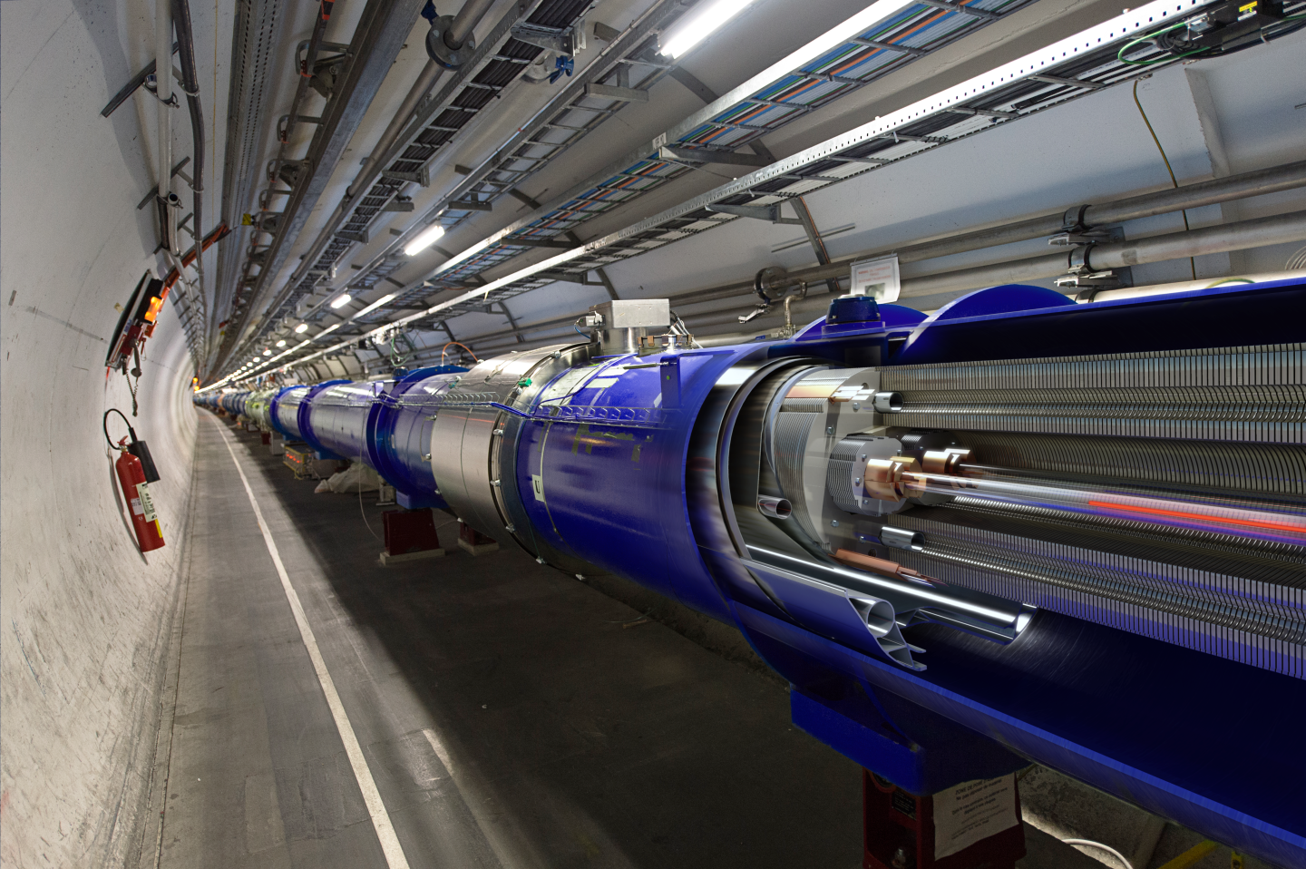
A peculiar example of transmission line: the LHC dipole string

Slide 26

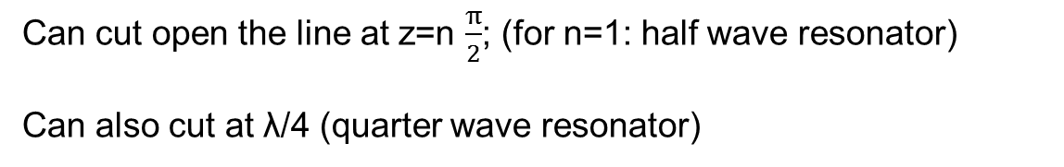
Standing waves, resonators
Z₀
$$Γ=−1$$
v$\left(z,t\right)=2V^{+}\sin\left(\frac{2π}{λ}z\right)cos(ωt+\frac{π}{2})$
0
Z=L
Can cut open the line at z=n $\frac{π}{2}$; (for n=1: half wave resonator)
Can also cut at λ/4 (quarter wave resonator)

Slide 27
Quarter Wave Resonator
Magnetic Field
f= 101.28 MHz
λ₀=2.96 m
L
I
l~λ/4
l ~λ/4
V
C
̴ βλ
Electric Field

Slide 28


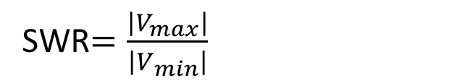

Transformation of the reflection coefficient and standing wave ratio
Lossless line:
$$V\left(d\right)=V^{+}\left(e^{jβd}+Γ_{0}e^{−jβd}\right)=V^{+}e^{jβd}\left(1+Γ_{0}e^{−j2βd}\right)$$
$$V\left(d\right)=A\left(d\right)[1+Γ\left(d\right)]$$
$$Γ\left(d\right)=Γ_{0}e^{−j2βd}$$
Is the reflection coefficient at the distance d
Distance between two maxima of the reflection coefficient= λ/2
Define the standing wave ratio SWR
SWR$=\frac{\left|V_{max}\right|}{\left|V_{min}\right|}$
Looking at the extremes of the modulus of V(d):
$$SWR=\frac{1+Γ_{0}}{1−Γ_{0}}$$
Remember: defined only for a lossless line

Slide 29
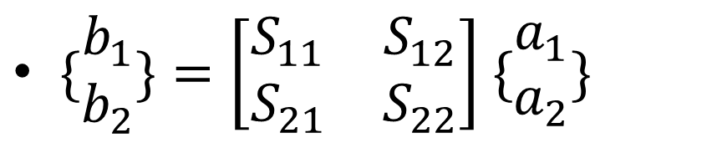
S parameters for a 2 port network
$\{\begin{matrix}b_{1} \\ b_{2}\end{matrix}\}=\left[\begin{matrix}S_{11} & S_{12} \\ S_{21} & S_{22}\end{matrix}\right]$ $\{\begin{matrix}a_{1} \\ a_{2}\end{matrix}\}$
a₂
a₁
b₁
b₂
S_{xy}: power enters port x
Define: a₁=V₁⁺, b₁=V₁⁻, a₂=V₂⁺, b₂=V₂⁻ complex voltages
S₁₁ Input port voltage reflection coefficient
S₂₁ Forward voltage gain
S₂₂ Output port voltage reflection coefficient
S₁₂ Reverse voltage gain
│S₂₁│ is the scalar linear gain, that is │V₂⁻ /V₁⁺│ , the phase information is dropped.
The insertion loss is expressed in decibels, that is IL= -20 Log₁₀(│S₂₁│)
Notes:
IL is the extra loss produced by the introduction of the device under test (DUT) between the 2 reference planes of the measurement. The extra loss may be due to intrinsic loss in the DUT and/or mismatch.

Slide 30
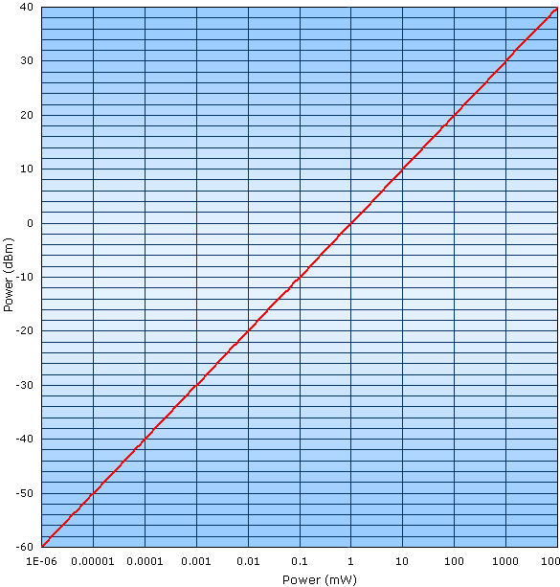
Power units
Relative power levels are expressed in decibel
P(dB)=10 Log(P₁/P₂)
Absolute power measurements often are expressed in dBm: 1 mW is taken as a power reference level
P(dBm)=10Log(P in mW)
P(mW) = 10^{[P(dBm)/10]}
Less than 30 dBm is less than 1 W
A negative number of dBm is less than 1 mW!
10000

Slide 31
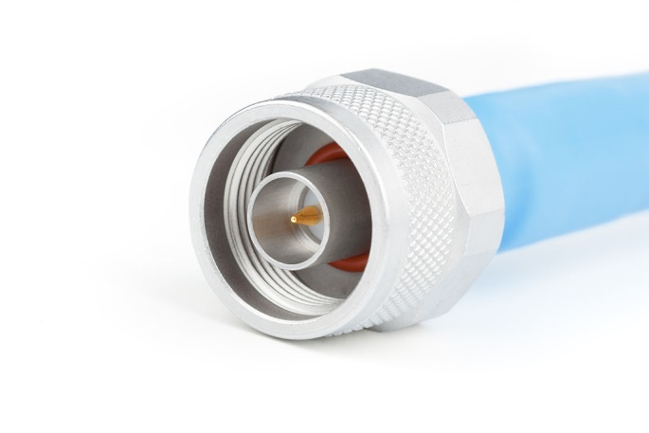
RF components: cables and connectors
Coaxial cables: Characteristics
  Shunt capacitance per unit length, in farad per meter
  Series inductance per unit length, in henrys per meter
  Series resistance per unit length, in ohms per meter
  Shunt conductance per unit length, in siemens per meter
  Characteristic impedance in ohms
  Attenuation (loss) per unit length, in dB per meter
  Velocity of propagation, in meters per second
  Single-mode band (in coax, TEM have zero cut-off frequency, but other modes set in at high freq.)
  peak voltage ( set by the breakdown voltage of the insulator)
Connectors
Many types: BNC, N, SMA, 7/16 DIN (rated according to max frequency)
Decreasing the diameter of the outer conductor increases the highest usable frequency
RF and microwave connectors are precision-made parts, easily damaged by mistreatment: as a rule, the only thing which has to be rotated is the threaded sleeve
Connectors give important contributions to loss and mismatch on the line

Slide 32
RF components: attenuators, DC stoppers, matched loads shorts, open
Attenuators: reduce power (absorbing it) without distorting the waveforms.
Characteristics:
  Attenuation expressed in dB of relative power
  Frequency bandwidth
  Power dissipation
  SWR for input and output ports
  Accuracy
  Repeatability
DC blocks: prevent the flow of DC (and audio) power, used to protect sensitive equipment (for example power meters), or when these components are undesired
Loads: calibrated at the characteristics impedance of the line.
Shorts, open: mainly as calibration standards.

Slide 33
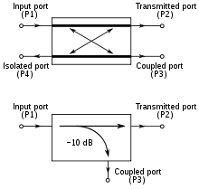
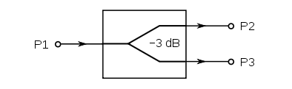
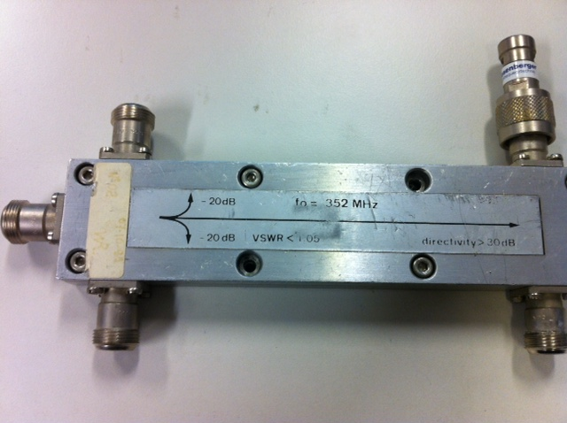
RF components: splitters, directional couplers
Power splitters (or power combiners)
Directional couplers: characteristics
  Coupling factor in dB :-10 Log (P3/P1). always < -3 dB
  Insertion Loss in dB :-10 Log (P2/P1)
  Isolation: -10 Log (P4/P1); -10 Log(P3/P2) (they can differ)
  Directivity: -10 Log (P4/P3)= -10 Log (P4/P1)+10 Log (P3/P1)
  Directivity= Isolation-coupling factor: should be as high as possible
  Directivity is “narrow band”, it relies on destructive interference

Slide 34
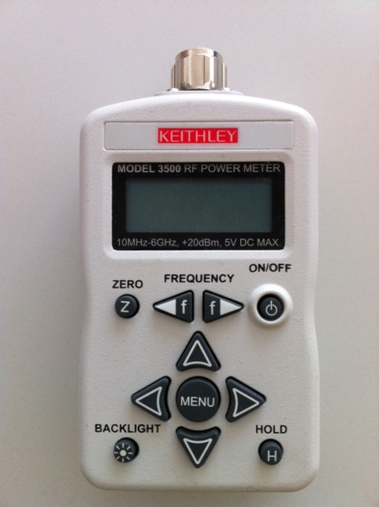
Power measurements, power meters
Below ~ 10 kHz power is measured by measuring V and I: it is a derived quantity
Up to 100 MHz direct measurements of voltage and current are still possible; but it is easier and more accurate to measure power directly with a power meter
In the GHz range and beyond, power is the fundamental quantity: voltage and current are the derived quantities
Thermistors (bolometers), Thermocouples, and diode detectors are the most common sensors used to measure RF power

Slide 35
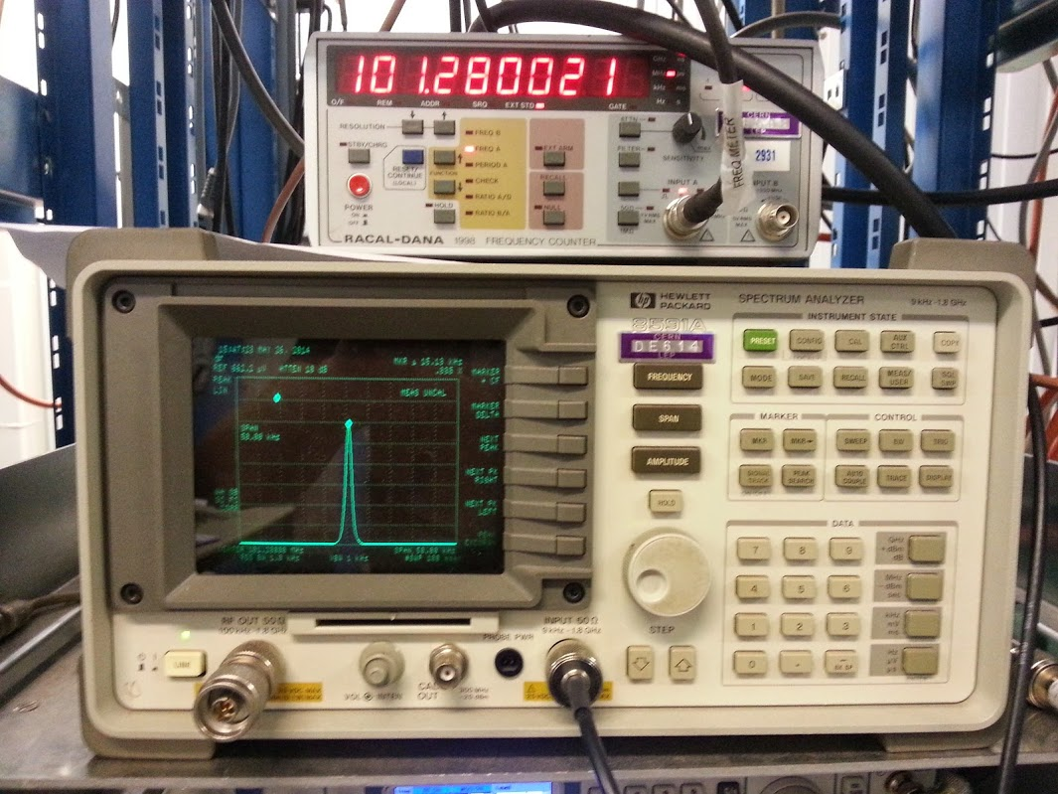
Spectrum analyzer

Slide 36
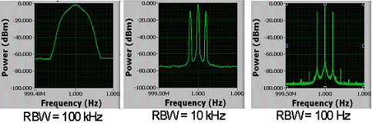
Resolution Bandwidth
Larger RBW | Smaller RBW
Smaller FFT size; fewer samples; requires less acquisition and computation time; often unable to resolve two closely spaced tones in a spectrum. | Larger FFT size; more samples; requires more acquisition and computation time; tones are easily resolved.

Slide 37
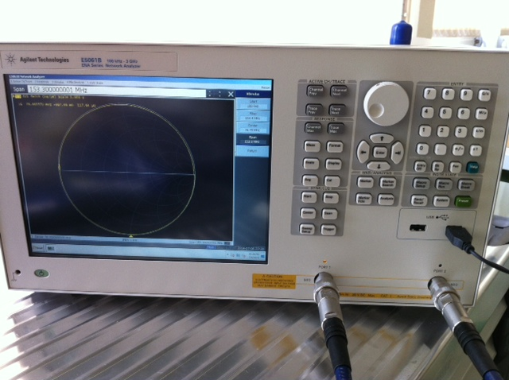
Network analysers
Measure S parameters as a function of frequency
S parameters are complex quantities
Two types:
  Scalar Network Analysers (SNA): measure amplitudes
  Vector Network Analysers (VNA): measure amplitudes and phases
VNA are the most common nowadays
Usually two ports (4 ports and more are also available but expensive)
With a two ports one can measure S11, S22, S12, and S21 (reflection and transmission from or through a DUT).
Measurement output in several formats
Require calibration performed by the user at each use on top of the periodic calibration at the factory

Slide 38
Basic measurement circuit
Circulator
LLRF drive
Directional coupler
Cryostat top plate
RF power amplifier
Matched load
Transmitted power meter
Forward power meter
Reflected power meter
Input coupler
LHe
Pick up antenna

Slide 39
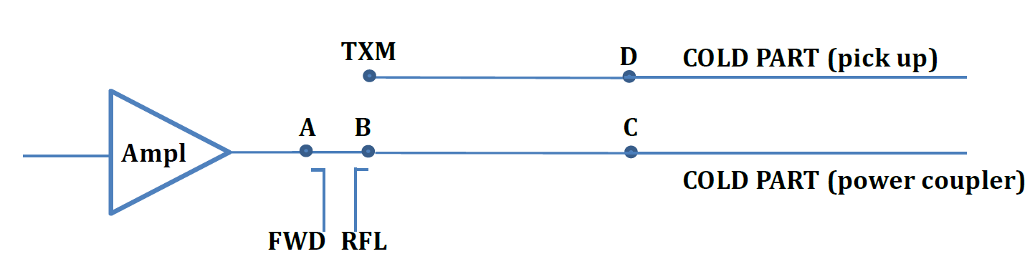
Attenuation measurements (cable calibrations)
The readings of the power meters on the rack must be referred to the powers at the cavity, taking into account the attenuation of the lines:
The total attenuation values are:
FWD= (A→FWD) - (A→C) - Cold part (coupler)
RFL=(B→RFL ) + (B→C) + Cold part (coupler)
TXM=(D→TXM) + Cold part (antenna)

Slide 40
Cavity measurement analysis
Equivalent circuit model (for one mode)
Transmission line
1:n
C
G_{c}
G_{g}
L
Generator + Circulator
Input Coupler
Cavity

Slide 41
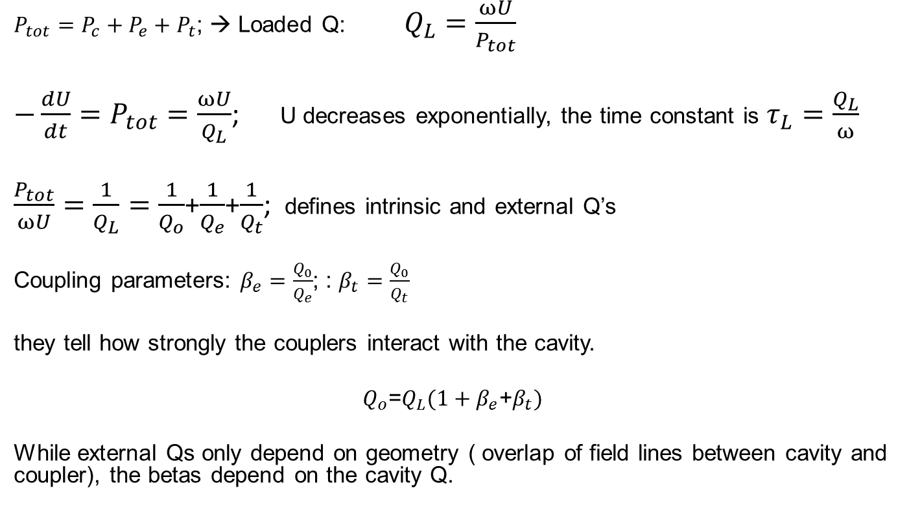
Cavity measurement analysis: undriven cavity:
$P_{tot}=P_{c}+P_{e}+P_{t}$; → Loaded Q: $Q_{L}=\frac{ωU}{P_{tot}}$
$−\frac{dU}{dt}=P_{tot}=\frac{ωU}{Q_{L}}$; U decreases exponentially, the time constant is $τ_{L}=\frac{Q_{L}}{ω}$
$\frac{P_{tot}}{ωU}=\frac{1}{Q_{L}}=\frac{1}{Q_{o}}$+$\frac{1}{Q_{e}}$+$\frac{1}{Q_{t}}$; defines intrinsic and external Q’s
Coupling parameters: $β_{e}=\frac{Q_{0}}{Q_{e}}$; : $β_{t}=\frac{Q_{0}}{Q_{t}}$
they tell how strongly the couplers interact with the cavity.
$Q_{o}$=$Q_{L}(1+β_{e}$+$β_{t})$
While external Qs only depend on geometry ( overlap of field lines between cavity and coupler), the betas depend on the cavity Q.

Slide 42
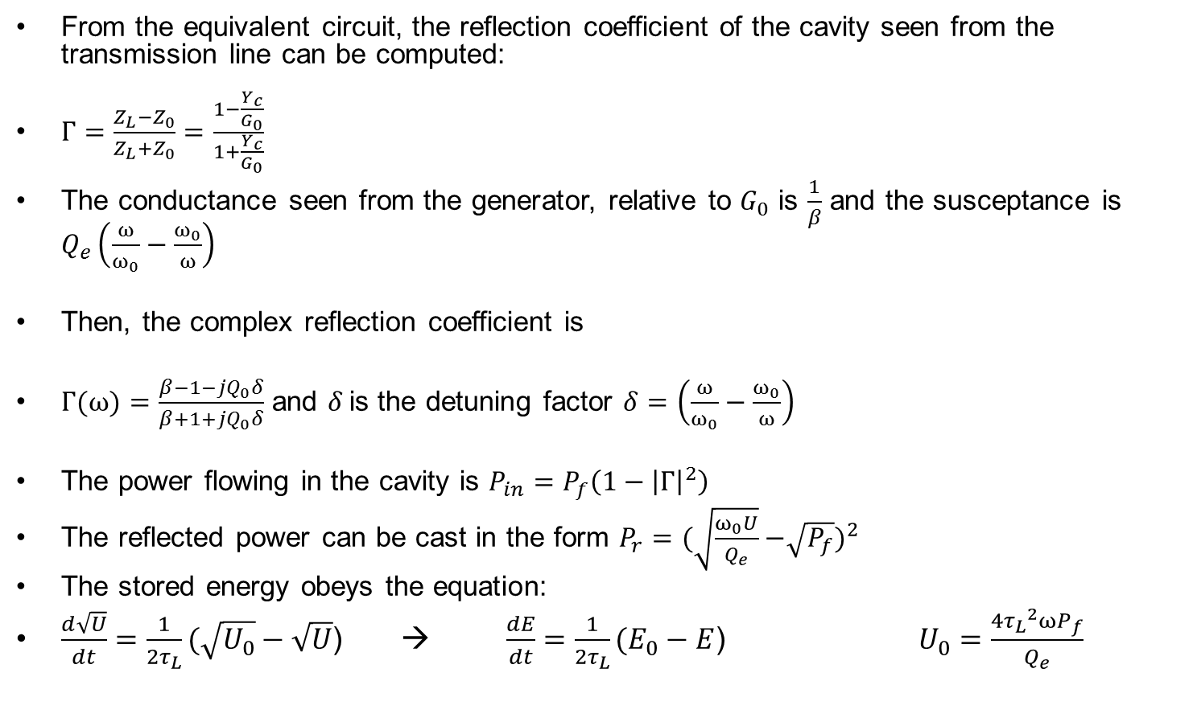
Cavity measurement analysis: driven cavity with one coupler
From the equivalent circuit, the reflection coefficient of the cavity seen from the transmission line can be computed:
$Γ=\frac{Z_{L}−Z_{0}}{Z_{L}+Z_{0}}=\frac{1−\frac{Y_{c}}{G_{0}}}{1+\frac{Y_{c}}{G_{0}}}$
The conductance seen from the generator, relative to $G_{0}$ is $\frac{1}{β}$ and the susceptance is $Q_{e}\left(\frac{ω}{ω_{0}}−\frac{ω_{0}}{ω}\right)$
Then, the complex reflection coefficient is
$Γ(ω)=\frac{β−1−jQ_{0}δ}{β+1+jQ_{0}δ}$ and 𝛿 is the detuning factor $δ=\left(\frac{ω}{ω_{0}}−\frac{ω_{0}}{ω}\right)$
The power flowing in the cavity is $P_{in}=P_{f}\left(1−{\left|Γ\right|}^{2}\right)$
The reflected power can be cast in the form $P_{r}=(\sqrt{\frac{ω_{0}U}{Q_{e}}}{−\sqrt{P_{f}})}^{2}$
The stored energy obeys the equation:
$\frac{d\sqrt{U}}{dt}=\frac{1}{2τ_{L}}(\sqrt{U_{0}}−\sqrt{U}$) → $\frac{dE}{dt}=\frac{1}{2τ_{L}}(E_{0}−E$) $U_{0}=\frac{4{τ_{L}}^{2}ωP_{f}}{Q_{e}}$
Equilibrium value of U for a given Pf
(detailed derivations in Ref [8], p. 150)

Slide 43
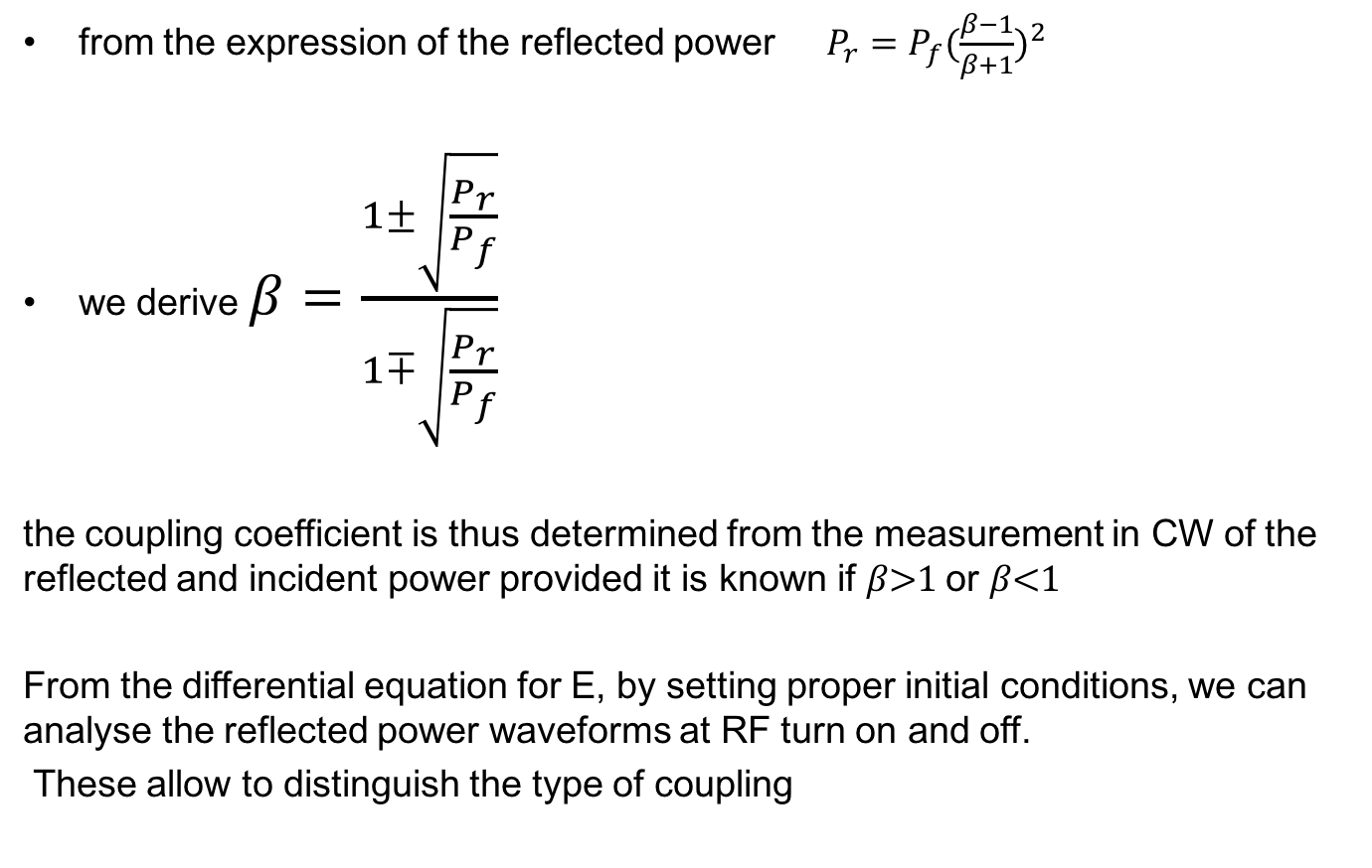
Steady state
from the expression of the reflected power $P_{r}=P_{f}({\frac{β−1}{β+1})}^{2}$
we derive $β=\frac{1±\sqrt{\frac{P_{r}}{P_{f}}}}{1∓\sqrt{\frac{P_{r}}{P_{f}}}}$
the coupling coefficient is thus determined from the measurement in CW of the reflected and incident power provided it is known if 𝛽>1 or 𝛽<1
From the differential equation for E, by setting proper initial conditions, we can analyse the reflected power waveforms at RF turn on and off.
These allow to distinguish the type of coupling

Slide 44
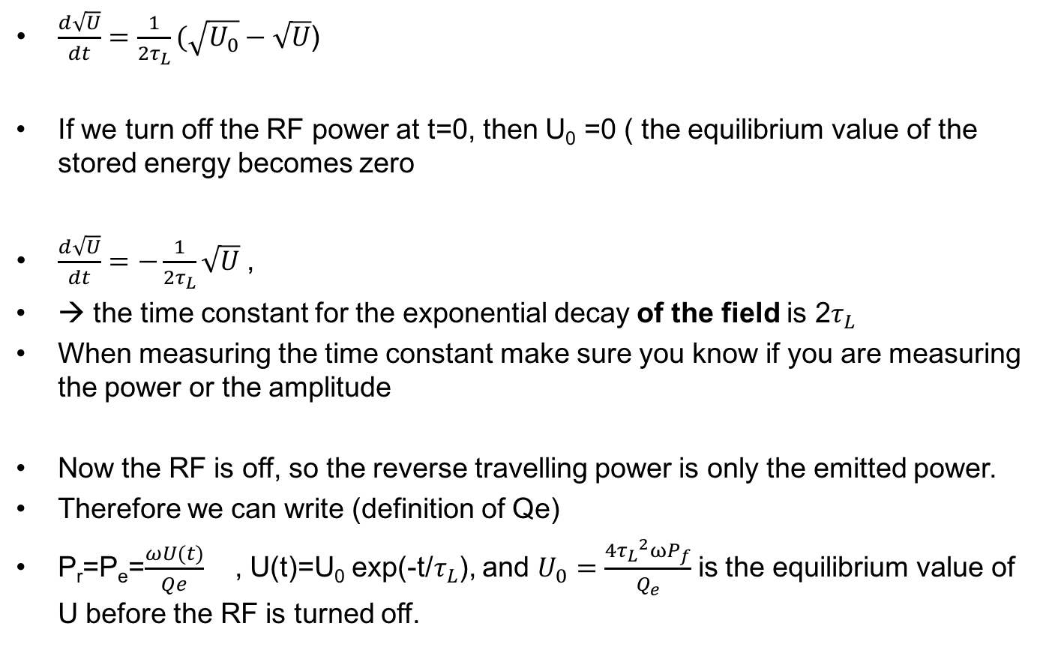
RF off - transient
$\frac{d\sqrt{U}}{dt}=\frac{1}{2τ_{L}}(\sqrt{U_{0}}−\sqrt{U}$)
If we turn off the RF power at t=0, then U₀ =0 ( the equilibrium value of the stored energy becomes zero
$\frac{d\sqrt{U}}{dt}=−\frac{1}{2τ_{L}}\sqrt{U}$ ,
→ the time constant for the exponential decay of the field is 2$τ_{L}$
When measuring the time constant make sure you know if you are measuring the power or the amplitude
Now the RF is off, so the reverse travelling power is only the emitted power.
Therefore we can write (definition of Qe)
P_{r}=P_{e}=$\frac{ωU(t)}{Qe}$ , U(t)=U₀ exp(-t/$τ_{L}$), and $U_{0}=\frac{4{τ_{L}}^{2}ωP_{f}}{Q_{e}}$ is the equilibrium value of U before the RF is turned off.

Slide 45
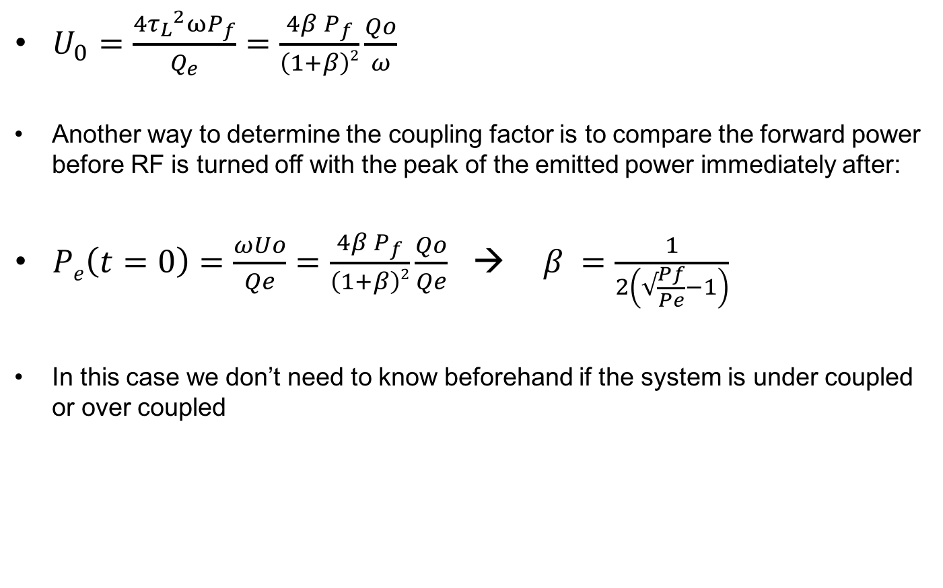
Coupling determination from RF off transient
$U_{0}=\frac{4{τ_{L}}^{2}ωP_{f}}{Q_{e}}=\frac{4β P_{f}}{\left(1+β\right)2}{\frac{Qo}{ω} }_{ }$
Another way to determine the coupling factor is to compare the forward power before RF is turned off with the peak of the emitted power immediately after:
$Pe\left(t=0\right)=\frac{ωUo}{Qe}=\frac{4β P_{f}}{\left(1+β\right)2}{\frac{Qo}{Qe} }_{ }$ → $β =\frac{1}{2\left(√\frac{Pf}{Pe}−1\right)}$
In this case we don’t need to know beforehand if the system is under coupled or over coupled

Slide 46
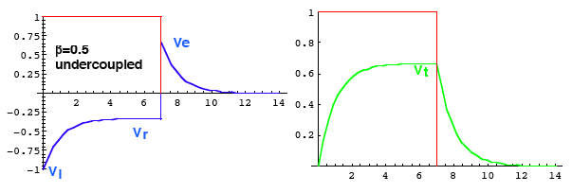
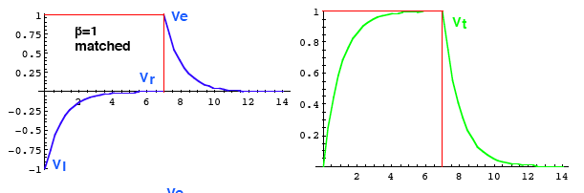
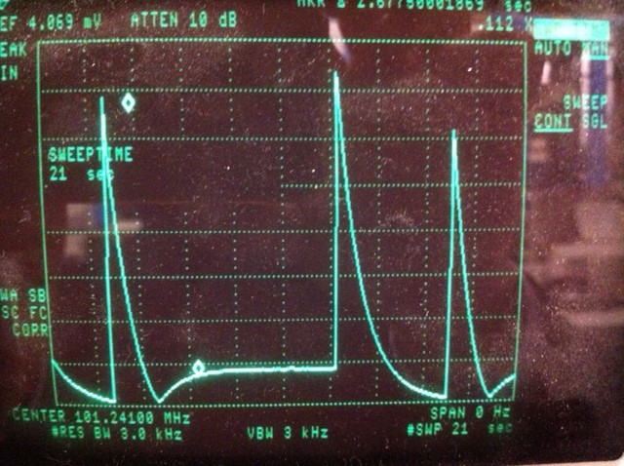
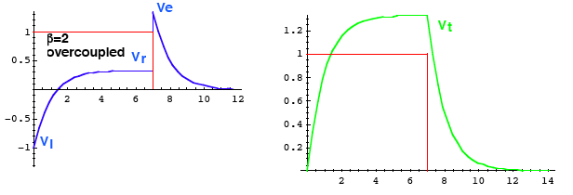
Determination of the coupling factor
Voltage waveforms
Reflected power from a square pulse when 𝛽>1

Slide 47

Locking the cavity: generator driven systems
Block diagram of a VCO PLL System. The encircled elements can be replaced by an RF generator which accepts frequency modulation from the DC output of the mixer (phase error-> frequency error around resonance).
From Ref. 8

Slide 48

Locking the cavity: Self excited loop
High gain, positive feedback loop: the cavity selects its own resonance frequency from the noise floor and the circuits starts to oscillate. It only works with correct phase shift on the return path.
Finds and tracks the cavity resonance

Slide 49

Real measurement circuit

Slide 50

Test stand

Slide 51


Measurement procedure
1) Lock the cavity on resonance
2) Calibration point:
Determine input coupling condition
Measure in CW: P_{i}, P_{r} and P_{t}
Measure the time constant of U
From 𝛽 and 𝜏_{L} Q₀=ω₀ 𝜏_{L} (1+ 𝛽)
From the measurement in CW,
obtain the dissipated power P_{c}=P_{i}-P_{r}-P_{t}
Find the stored energy by the definition of Q₀:
$U_{0}=\frac{P_{c}Q_{0}}{ω}$
Find the accelerating field $E_{acc}=k_{e}\sqrt{U_{o}}$
Find the calibration constant of the pickup
$$Kpu=\frac{U_{0}}{P_{t}}=\frac{Q_{ext pu}}{ω}$$
2) Q-E scan
Increasing the power level, U is determined by the transmitted power, knowing $Kpu$ hence the field is determined knowing $k_{e}$
The corresponding value of Q is determined by the definition, knowing the stored energy and the dissipated power
MP
k_{e} is obtained by means of computer simulations

Slide 52

Warm measurement of high Q_{ext} (pickup calibration)
The external Q of the pickup probe is essential for the measurement of E_{acc}
As good practice it should be chosen ~ 100xQ₀
It is derived when measuring Q₀ with the decay time (calibration)
It is good to measure it at warm as a consistency check
(it is a geometric parameter)
Q_{ext} can be determined from the reflection coefficient and the loaded Q
A VNA can display a polar plot of the reflection coefficient, normalised to the characteristic impedance (Smith chart)
Remember $Γ(ω)=\frac{β−1−jQ_{0}δ}{β+1+jQ_{0}δ}$ , and $δ=\left(\frac{ω}{ω_{0}}−\frac{ω_{0}}{ω}\right)$

Slide 53

Warm measurement of Q_{ext} with network analyser
1st method (used for $β$not too far from 1):
Determine from the Smith chart if the cavity is under- or over-coupled
Measure the Standing Wave Ratio (SWR) on resonance
$β=\left\{\begin{aligned} \\ SWR ifβ>1 \\ \frac{1}{SWR}ifβ<1\end{aligned}\right.$,
Determine Q_{L} from the 3dB bandwidth: $\text{Q}\text{L}\text{=}\frac{\text{f}}{\text{∆}\text{f} }$
Q₀=(1+$β$),
$\text{Q}\text{ext}\text{=}\frac{\text{Q}\text{0}}{β }$

Slide 54

Warm measurement of high Q_{ext} with network analyser (pickup calibration)
2nd method, used for pickup calibration, must use a coupler with $β$ not too far from 1
Measure $β$ from S₁₁ (see method 1)
Measure S₂₁ and Q_{L}
$β_{pu}=\frac{{\left|S21\right|}^{2}}{\frac{4β}{{(1+β)}^{2}}−{\left|S21\right|}^{2}}$: (Ex. derive it from P_{in}= P_{f} - P_{r}=P_{c}+ P_{t} )
$Q_{0}=(1+β+β_{pu})$ $Q_{L}$
$\text{Q}\text{ext}\text{−}\text{pu}\text{=}\frac{\text{Q}\text{0}}{β_{pu} }$

Slide 55



Measurement Setup
Pick-Up Antenna
S₂₁ -> Q_{ext,Pick-Up}
Reference Antenna
(∼ critical coupled)
input
Pick uo

Slide 56

Interpretation of cavity behaviours
Fitting Q(T) data with the standard BCS expression reveals the so called “non BCS losses”
The global transition of the cavity to the normal conducting state is a catastrophic event, can happen to bulk Nb cavities in case of large beam losses
Multipacting is easily recognized by the “field lock” feature. Also is recurs at the same field levels for the same cavity geometry
Field emission most striking mark is the emission of X rays. The endpoint energy of the spectrum corresponds to the maximum kinetic e⁻ energy
Many theories available, a lot still to understand
Q switches are small (local) quenches. The cooling power is sufficient to prevent global quench.
Typical hysteretic behaviour

Slide 57

Multipacting: SEY of Nb

Slide 58







Multipacting (Cavity Top)
8ns
30ns
50ns
70ns
87.5ns
# of initial electrons: 742
Kinetic energy: 0-4eV (uniform)
Emission angle: 0-180 deg. (random)
Max time steps: 4000
Eacc=1MV/m (30 deg)
Pei Zhang

Slide 59






Regions of Potential Multipacting
E-field
H-field
Pei Zhang

Slide 60





QWR multipacting Summary
MP happens at low fields for antenna region and outer wall
- E_{acc} = 0.05-0.1MV/m
MP happens at higher fields for cavity top region
- E_{acc} = 0.8-2 MV/m
MP region
MP-free region
Pei Zhang

Slide 61

Cavity spectrum during multipacting conditioning

Slide 62
Field Emission

Slide 63

Temperature & Radiation
The cavity bottom was heated up exponentially and the radiation level went up exponentially as well, a clear indication of field emission.

Slide 64
X rays spectrum (bremsstrahlung)
In principle it is possible to calibrate field measurements with X rays spectrum, but it is quite tricky:
only a small fraction of the emitted electrons experience the full accelerating voltage. One needs to resolve the upper tail of the spectrum from the background….

Slide 65






Electron field emission
Typical particulate emitters
2 µm
2 µm
500 nm
E_{on}(2nA) =140 MV/m
= 31, S = 6.8·10⁻⁶ µm²
E_{on}(2nA) = 132 MV/m
β = 27, S = 7·10⁻⁵ µm²
E_{on}(2nA) > 120 MV/m
= 46, S = 6·10⁻⁷ µm²
Si Nb
Al Mg Nb
Al

Slide 66

He processing
Uses RF power in ignite a low pressure plasma in the cavity filled with gaseous helium
He pressure must be high enough for this but not higher, risk of breakdown and damage to cavity and couplers
Used as a last resort against field emission when cavity can’t be easily removed and rinsed with high pressure water or other chemical or mechanical treatments
X ray dose rate data

Slide 67

Low Field Q switch
Q0 lost 2%
ΔRs = 0.5 nΩ
Rs ~ 25 nΩ

Slide 68
Example of giant Q switch
(NC transition of the tuning plate in a QWR)

Slide 69
Sources of uncertainty in SC cavity measurements
Power meter accuracy and resolution
  Determination of coupling β
  Direct measurement of power in Q - E scans
Cross contamination of forward and reflected power due to poor directivity of directional couplers
Detuning
Dependence of cable attenuations on power level
Uncertainty on time constant measurement due to
  Q slope (non exponential decay)
  Multiple reflections during decay (circulator mismatch)
  Fit error
  Instrument accuracy
Uncertainty on geometric constants (simulations assume perfect geometry)

Slide 70

Q₀ measurement uncertainties
…from $Q_{o}$=${ωτ}_{L}(1+β)$→
(${σQ}_{o}$)²=($\frac{∂\text{Q} \text{o} }{∂β}$)² ($σ_{β}$)² + ($\frac{∂\text{Q} \text{o} }{∂τ_{L}}$)² ($σ_{τL}$)²
under ideal conditions this leads relative uncertainties of a few %.
See for example: O. Melnychuk, A. Grassellino, and A. Romanenko, Review of Scientific Instruments 85, 124705 (2014)
However this assumes:
perfect directivity of the directional couplers,
perfect matching of the circulator protecting the amplifier
no detuning during the decay measurement
These effects can be very important in some conditions

Slide 71

Directivity error experiment
In theory, the measurement of the forward power from the directional coupler port should not depend on the phases, but…
Picture from J.P. Holzbauer, Yu. Pishalnikov, D. A. Sergatzkov, W. Schappert, S. Smith, Nucl. Instrum. Meth.A 830 (2016) 22-29

Slide 72

Directivity error experiment
From J.P. Holzbauer, Yu. Pishalnikov, D. A. Sergatzkov, W. Schappert, S. Smith, Nucl. Instrum. Meth.A 830 (2016) 22-29

Slide 73

Bias on τ_{L} due circulator mismatch
Picture from J.P. Holzbauer, Yu. Pishalnikov, D. A. Sergatzkov, W. Schappert, S. Smith, Nucl. Instrum. Meth.A 830 (2016) 22-29

Slide 74


Improving measurement tools: variable coupler
Constant (and minimal) measurement uncertainty independent of cavity Q₀
2) Easiness of MP conditioning

Slide 75

Bias from reflected power

Slide 76

Simple cross checks
The external Q of fixed couplers should be constant at all field levels, and equal to the values found at the calibration step. It can be computed from Q₀ and 𝛽 all along the Q-E scan.
with the phase locked-loop open and the generator drive frequency off resonance, Pr/Pf should stay close to unity at all power levels, and constant over a small bandwidth ($f−{\text{f}}_{\text{0}}<±1 \text{MHz}$)

Slide 77

Double-check the measurement
Four different calibrations were conducted
- over coupled, under coupled, critical coupled

Slide 78
Cool down precautions
The way the cavity is cooled down can influence the result: main effects are:
«H disease»
Flux trapping
Thermo electric currents

Slide 79

Effects of thermal gradient when crossing Tc
First cool down with high thermal gradient
Thermal cycle above Tc, second cool down with more homogeneous temperature

Slide 80


Residual Resistance due to Flux trapping
$Rfl=Bout η(l,∇T,…\text{) }S(l,ω, BRF$)
External magnetic field: B_{out} , B_{a} ,B_{NC} , B_{avg ,} B_{o}
Expulsion inefficiency, or trapping efficiency, or trapping ratio, $η$_{t} , τ_{eq} , B_{trapped}/B_{out}.
Related to the observable field enhancement B_{SC}/B_{NC} at cavity equator when crossing Tc ( expulsion ratio, Posen ratio, r, ε_{eq} )
Sensitivity (in nΩ/mG): S, R₀/B_{trap} , r_{fl}

Slide 81

Temperature and field Q scans
“Field cooled”
Akira Miyazaki

Slide 82



Analysis of Q slopes
B-field compensated when cavity crossed Tc
B-field enhanced when cavity crossed Tc
enlarged
4.6K
4.6K
2.4K
2.4K
Intrinsic Q-slope is temperature dependent curvature component
Q-slope by trapped vortex is close to linear at low fields and weakly temperature dependent
Akira Miyazaki

Slide 83



An empirically found formula to fit the non-linear Q-slope
$$R_{s}\left(T,B\right)=\frac{A}{T}\exp\left(−\frac{∆}{k_{B}T}+αB\right)+R_{res}+R_{fl}B$$
$(A, ∆, R_{res})$ from R_{s} vs T data
Fit R_{s} vs H and determine $α$
4.5K
T [K] | α [T⁻¹]
2.3 | 37
4.5 | 27
2.3K
Such an exponential dependence has been reported by others (bulk Nb and Nb/Cu)
R. L. Geng (Cornell) ”Thermal analysis of a 200MHz Nb/Cu cavity” SRF2001
D. Longuevergne (IPNO) ”Magnetic dependence of the enegy gap:…” SRF2013
Akira Miyazaki

Slide 84
Cryomodule testing
Cryomodules are complex units ready for installation in accelerator, the power coupler is already adapted to the beam loading (usually β>>1)
Besides RF measurements, static heat loads and alignment are important
Precise measurement of Q₀ with RF methods is impossible (without beam, almost all power is reflected back)
Calorimetric methods are applied
Field measurement are still possible (if pickup calibration was preserved in cavity assembly)

Slide 85

Example of dynamic heat load measurement on a cryomodule
RF on (total ~ 31 W)
RF off : mass flow reduces by ~ 1.5 g/s
DC heaters on (31 W DC)

Slide 86

First beam acceleration with a
HIE ISOLDE superconducting QWR

Slide 87

Linac phasing with 4 cavities: first try
~3 MeV/Cavity
~3.9 (±0.16) MeV/u (¹²C⁴⁺ )

Slide 88
Sources
[1] Wikipedia.org
[2] Guide to the expression of uncertainty in measurement, BIPM, IEC, ISO, 1995
[3] J. C. Slater: Microwave electronics, Rev. Mod. Physics, 18, 4, p. 441, Oct. 1946
[4] Jackson: Classical Electrodynamics John Wiley & Sons Ltd. 1962
[5] S. Ramo, J. R. Whinnery, T. V. Duzer: Fields and waves in communication electronics, John Wiley & Sons Ltd. 1965
[6] D. M. Pozar, Microwave Engineering, John Wiley & Sons Ltd. 2005
[6] A. Facco, Tutorial on low beta cavity design, proceedings of the 12th International workshop on RF superconductivity, Cornell University, Ithaca, New York, USA
8] T. Powers, “Theory and Practice of Cavity Test Systems” 2005 SRF Workshop.
[9] H. Padamsee, H. Knobloch, T. Hays, RF Superconductivity for Accelerators. Wiley 2007
[10] O. Melnychuk, A. Grassellino, and A. Romanenko, Review of Scientific Instruments 85, 124705 (2014)
[11] J.P. Holzbauer, Yu. Pishalnikov, D. A. Sergatzkov, W. Schappert, S. Smith, Nucl.Instrum.Meth.A 830 (2016) 22-29
[12] J.P. Holzbauer, et al, https://arxiv.org/abs/1804.04747

