Slide 1
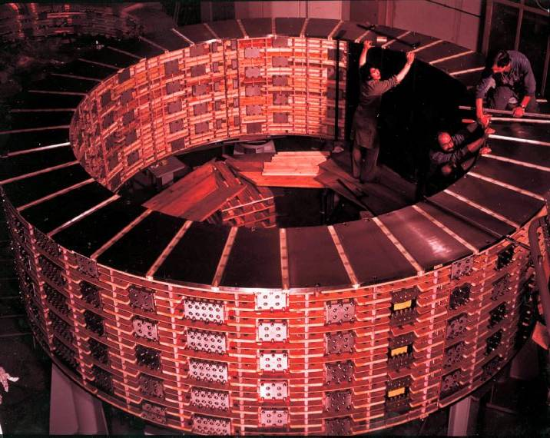
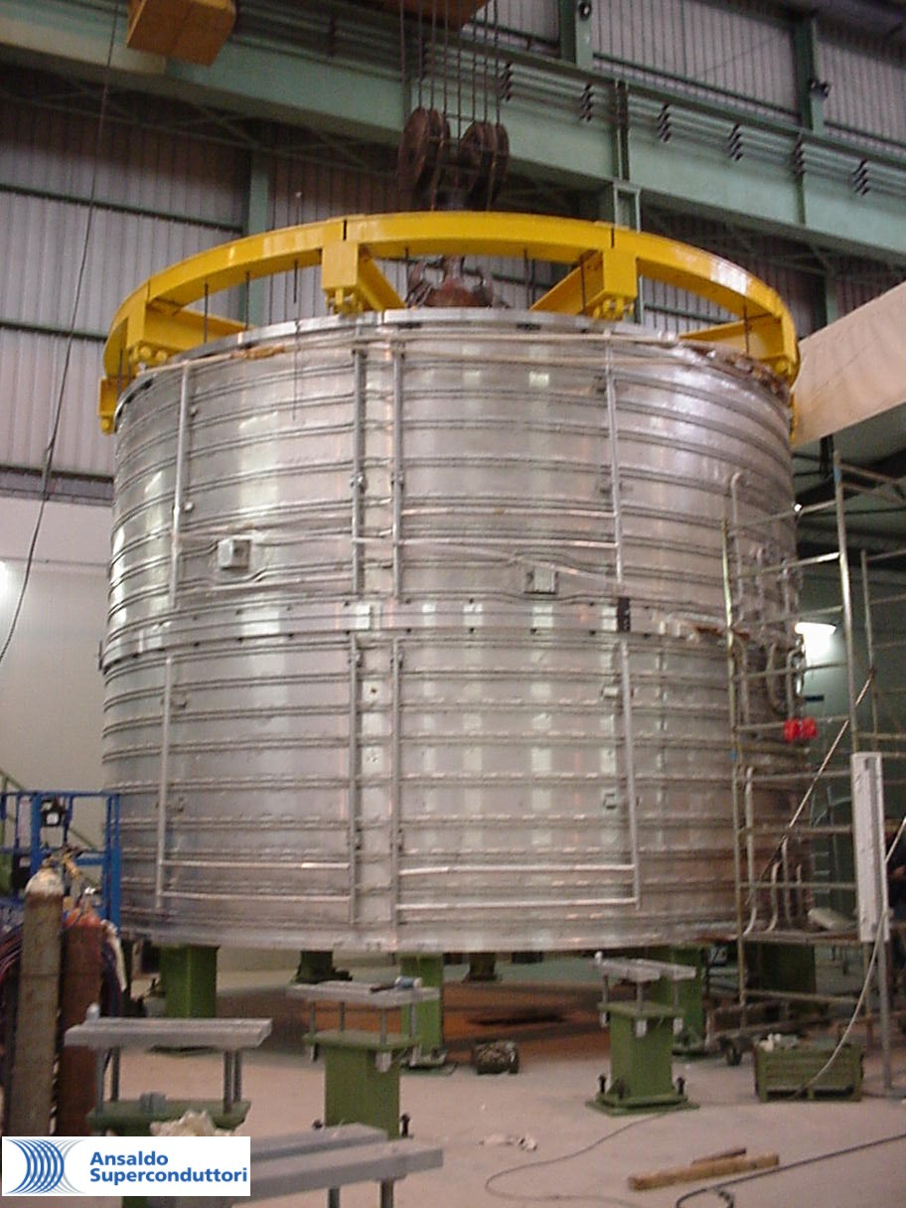
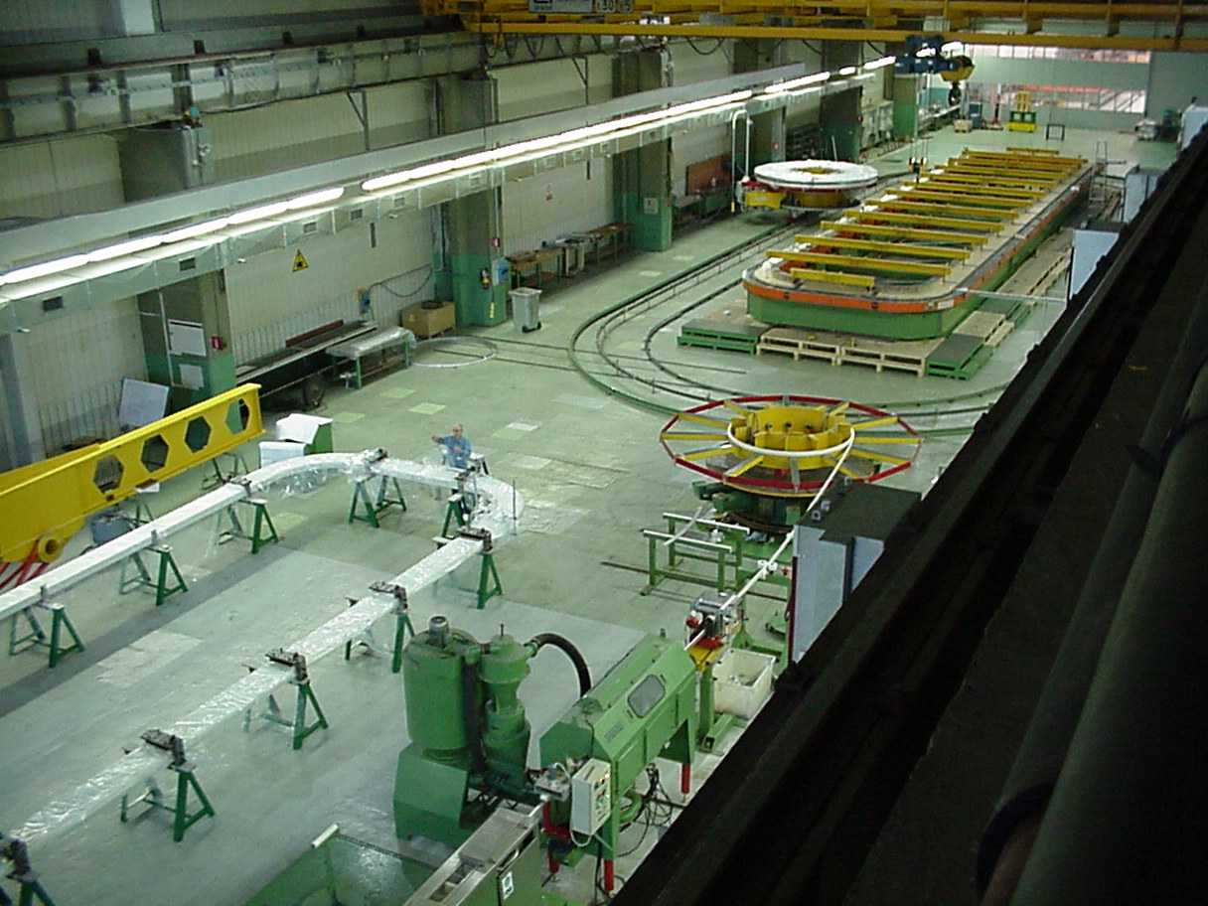
Large Detector Magnets
P.Fabbricatore INFN Genova
Photos taken during the construction of BEBC, CMS and ATLAS magnets

Slide 2
PROLOGUE
The development of Detector Magnets has pushed forward the applications of the superconductivity, specially in the sixties and seventies.
For this reason this lecture is organised according an historical approach starting with the availability of the first superconducting wires (around 1960) and finishing with the very large sc magnet foreseen for future high energy colliders.

Slide 3
Summary
  What we ask to a detector magnet
  The developments of sc wires and cables
  The story of detector magnets
  Design progresses
  Construction technologies
  Future
Some photos were provided by H.Desportes and F.Wittegenstein. I also use slides shown by E.Baynham at MT19 and by A.Yamamoto in presentations available on the web. Other photos from CERN site

Slide 4
Summary
  What we ask to a detector magnet
  The developments of sc wires and cable
  The story of detector magnets
  Design progresses
  Construction technologies
  Future

Slide 6
s
y2
y3
y1
L
ρ
y
θ
x
Superconducting magnets with large dimensions

Slide 7
A very remarkable requirement
for Detector Magnets
(further than high B field in a large volume)
It is strictly required that the magnet has a large safety margin when working at the normal operation. In fact a failure of a magnet component, such as a short to ground, a defective electrical slice or a leaking pipe for LHe circulation etc., can lead to dismount a big part of the detector !!

Slide 8
Summary
  What we ask to a detector magnet
  The developments of sc wires and cables
  The story of detector magnets
  Design progresses
  Construction technologies
  Future

Slide 9
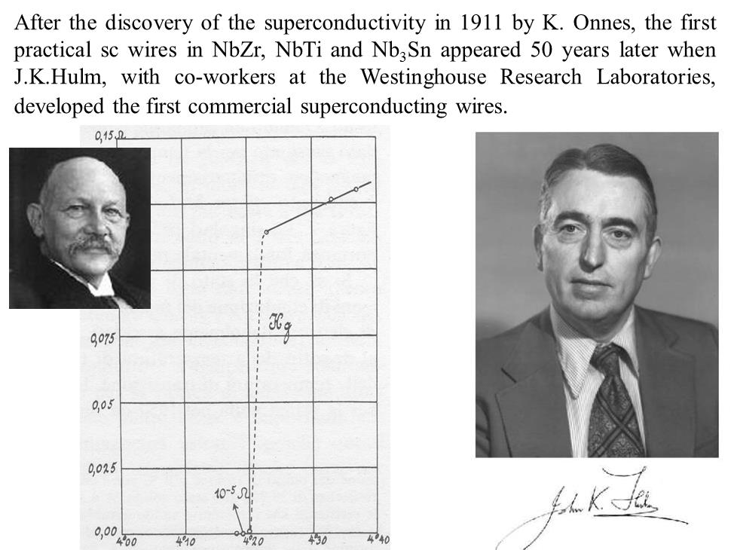

Slide 11
As John Hulm recalled some years later :
“Those tiny, primitive magnets were, of course, terribly unstable and tended to damage themselves on normalization, for reasons that are now well understood. One had to have faith to believe that these erratic toys of the low temperature physicists would ever be of any consequence as large engineered devices”

Slide 12
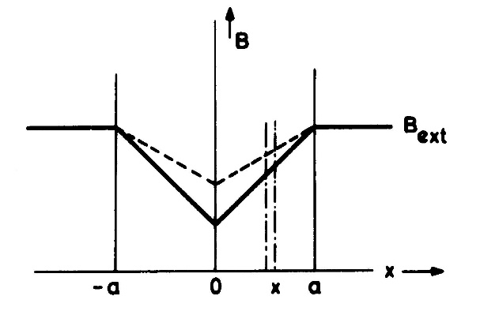
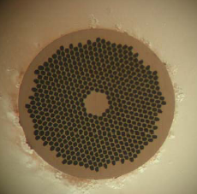
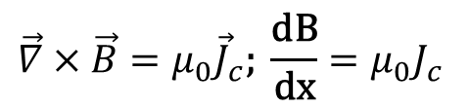
Why 50 years before magnet applications: Steps towards the development of sc wires for application
1- Development of practical material: II type with pinning centers
2- Flux jumps instabilities→ Fine filaments
3- Coupling currents → Twist pitch
$$\vec{∇}×\vec{B}=μ_{0}{\vec{J}}_{c}\text{; }\frac{\text{dB}}{\text{dx}}=μ_{0}J_{c}$$

Slide 13
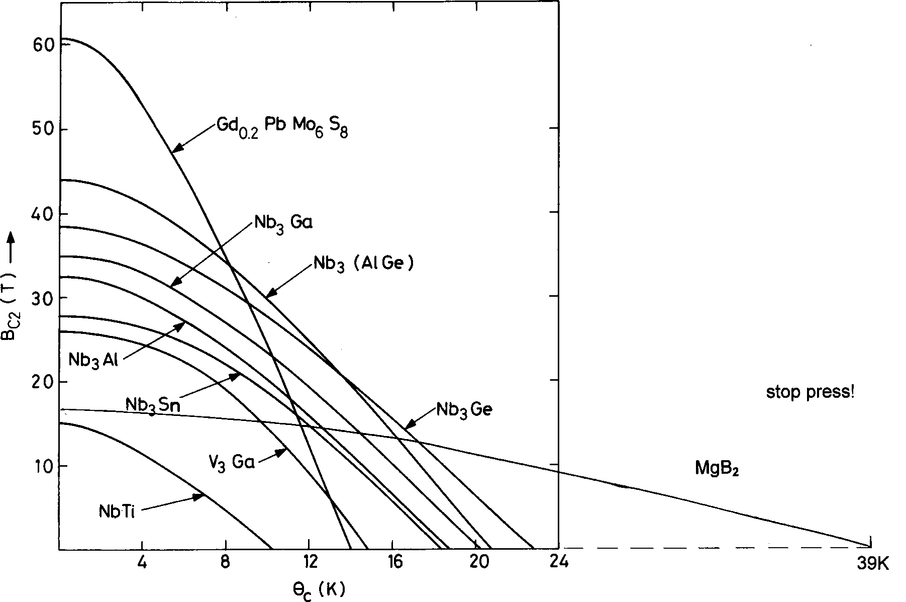
Critical magnetic field and temperature for the low_Tc superconductors
Among all these materials only NbTi and Nb₃Sn have been massively involved in the applications

Slide 14
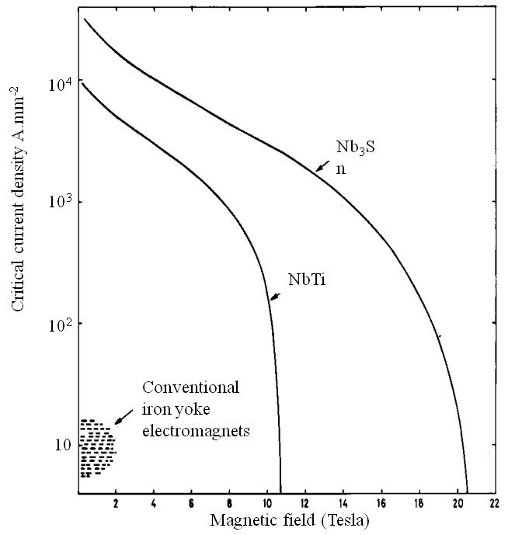
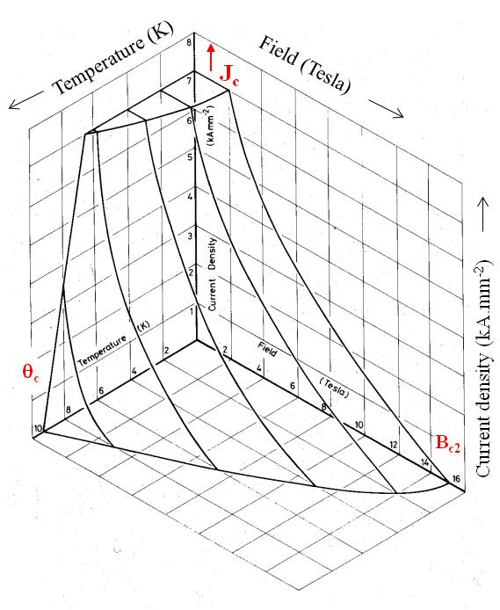
The critical current density Jc vs the magnetic field
Electrical transport properties are determined by impurities or defects in the material, acting as pinning centers for fluxons

Slide 15
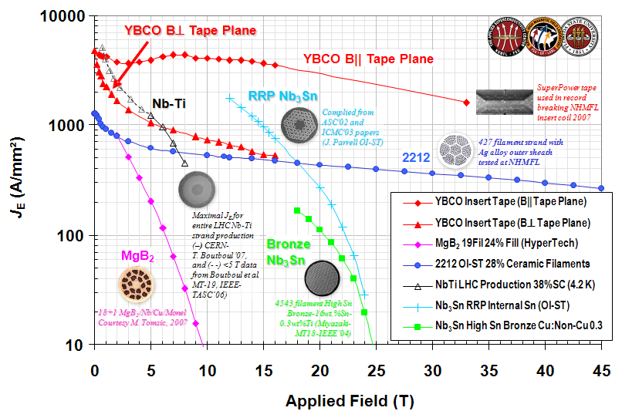
Superconducting materials involved in conductors

Slide 16

Magnetic instability in type-II superconductors with pinning centers
An heat input causes a temperature increases of ΔT. The critical current density decreases of -ΔJ_{c} . Due to the critical state model
Magnetic flux penetrates the sc material
B
$$\frac{\text{dB}}{\text{dx}}=μ_{0}J_{c}$$
B
This flux penetration causes a dissipation
The dissipation causes a furter temperature increase
ΔQ
The process is potentially destructive for the superconductivity, but it could converge to T<Tc in case the conductor is enough thin, i.e. if the radius a is:
Δφ
ΔΤ
-ΔJ_{c}

Slide 17
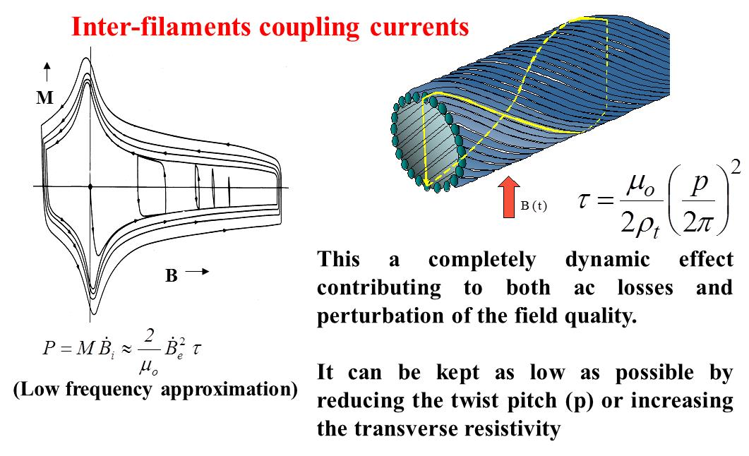

Slide 18
Summary
  What we ask to a detector magnet
  The developments of sc wires and cables
  The story of detector magnets
  Design progresses
  Construction technologies
  Future

Slide 19
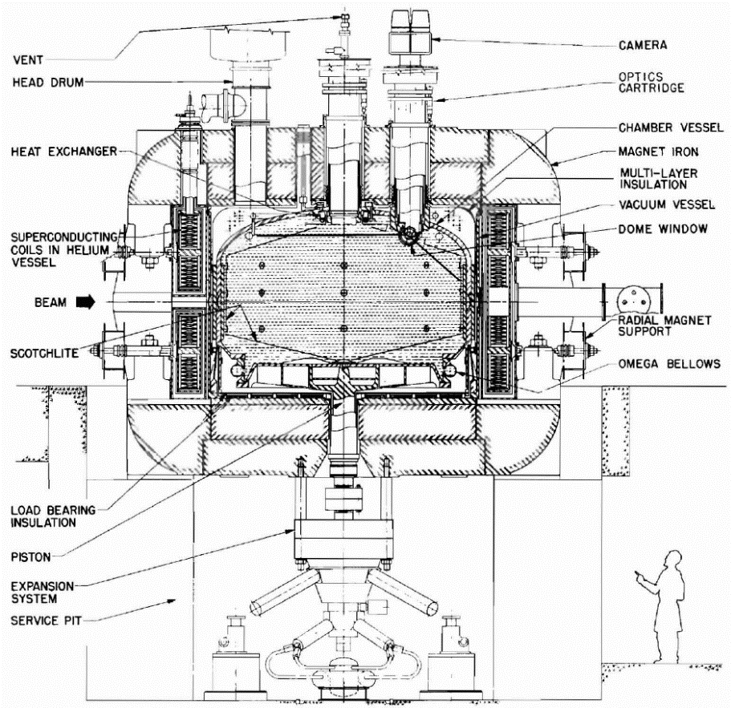
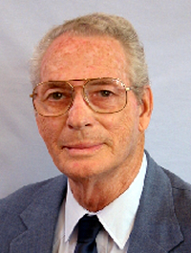
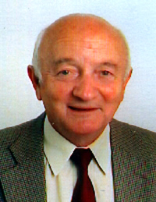
One of the first very large magnets for Particle Physics was developed in the sixtes . At that time the development of first NbTi conductors employing a technology was still far to be mature
The split coil solenoid for the 12-ft bubble chamber built at Argonne (J.Purcell) in the ZGS accelerator (1968) followed by the 15-ft (Purcell -Desportes)
Magnetic field 1.8T in 4.5m diameter and 3m heigth.
Stored Energy 80MJ. Conductor in NbTi (40 km).

Slide 20
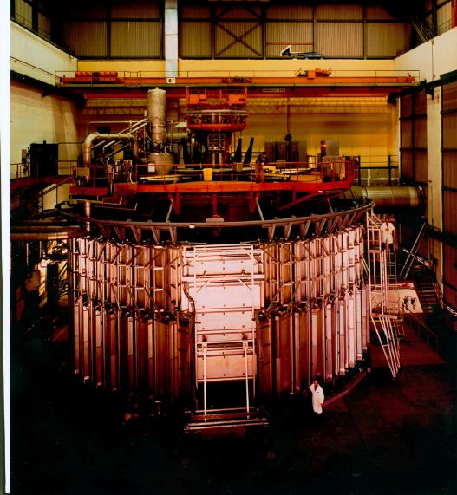
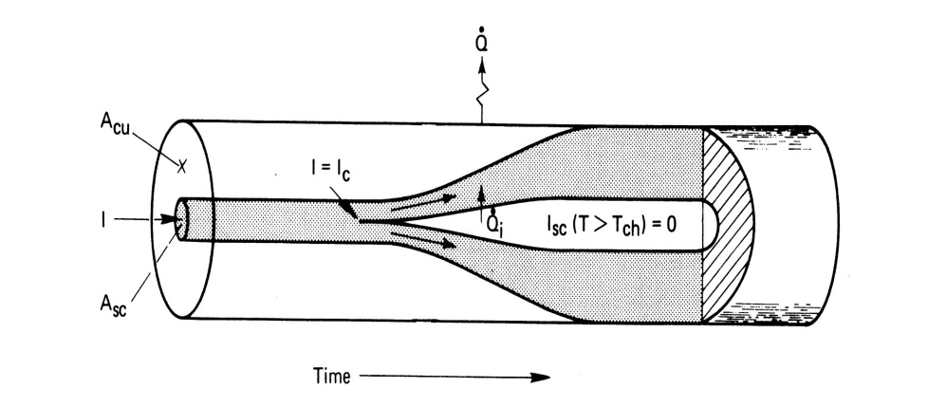
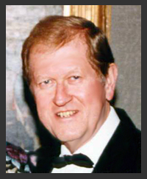
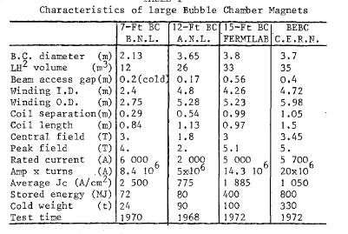
12-ft and successors were pool boiling based on the Stability Stekly criterion (Zdenek J. J. Stekly)

Slide 21
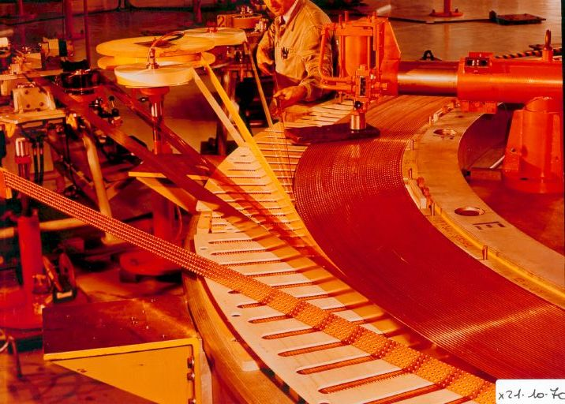

BEBC during the winding
Thanks to
F. Wittgenstein

Slide 22

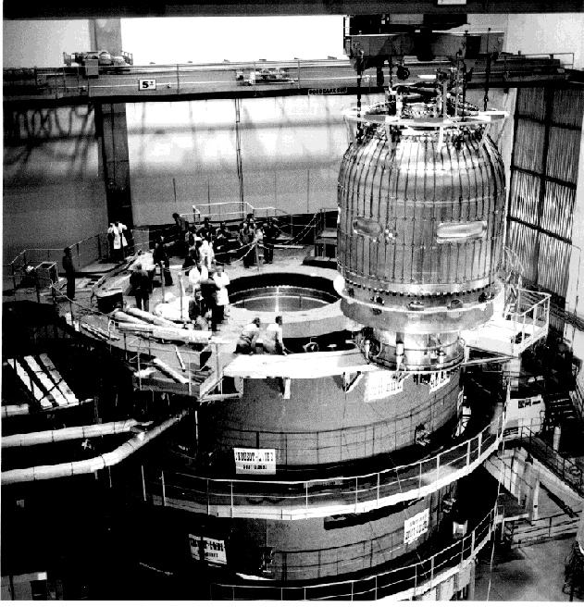
BEBC during the assembly

Slide 23
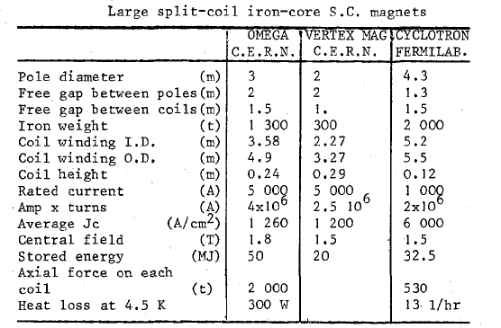
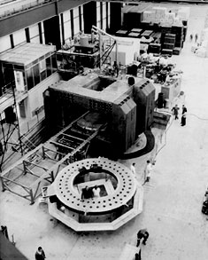
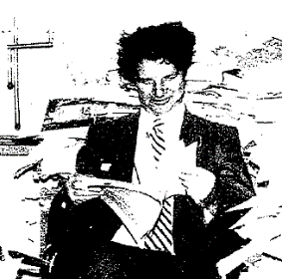
Forced flow magnets : the LHe volume dramatically reduced
An idea of M.Morpurgo
(CERN)

Slide 24
Winding technology in common with power applications

Slide 25
THE ERA OF ALUMINIUM STABILISED MAGNETS
The development of colliding beams demanded for solenoidal magnets (axi-symmetric field) transparent to radiation (calorimeters placed outside).
It was realized that a powerful cooling system was useless for dc magnets, provided that a good stability is guaranteed and the disturbances of mechanical nature limited. → The thin high field solenoids.
The first magnet of this class can be considered CELLO , built at Saclay for Petra Collider at DESY. CELLO was wound with an aluminium stabilized conductor. The cooling was indirect, in the sense that the cooling pipes were connected to the supporting structure, made by aluminium alloy.

Slide 26
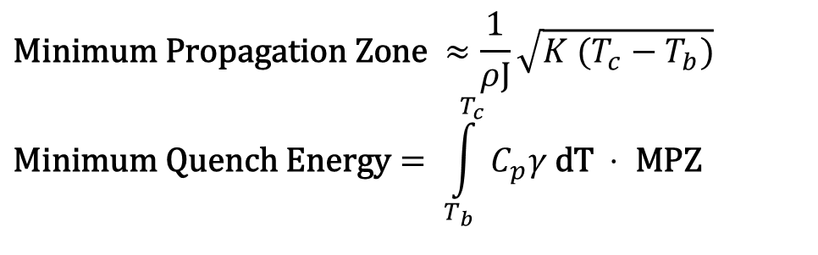
Pure Al stabilised conductors
The idea of using of pure Al directly embedded in the conductors is supported by two main reason.
Good conductor with low mass density (a factor 3 wrt copper)
Higher Minimum Quench Energy wrt copper
$$\text{Minimum} \text{Propagation} \text{Zone} ≈\frac{1}{ρJ}\sqrt{K (T_{c}−T_{b})} \\ \text{Minimum} \text{Quench} \text{Energy}= \int_{T_{b}}^{T_{c}}{C_{p}γ \text{dT} ⋅ \text{MPZ} }$$
Drawback: the pure Al is a very soft material σ_{yield} ~20 MPa.
We need additional mechanical supporting material

Slide 27
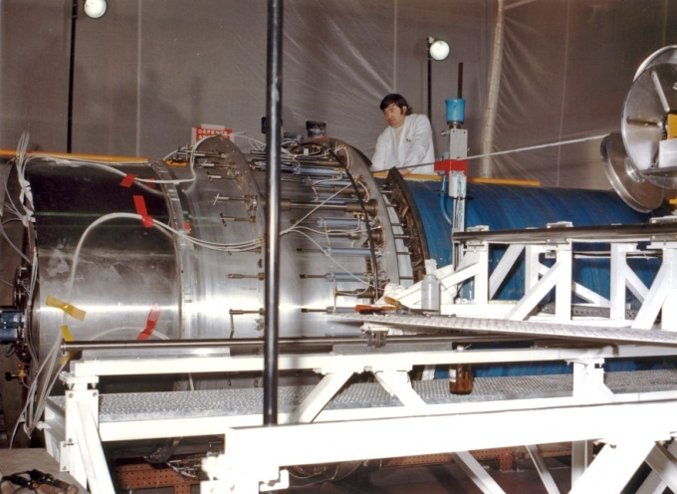
CELLO (1978) – Indirect cooling – Pure Al-stabilised conductor
Basic ideas
Indirect coooling
External support
Monolithic wire soft soldered to Al-pure stabiliser
Al-stabilised conductor
Mandrel
Parameters
Field | 1.5 | T
Coil Radius | 0.85 | m
Length | 3.6 | m
Stored Energy | 5.1 | MJ
Cold mass | 1 | t

Slide 28
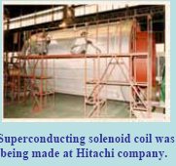
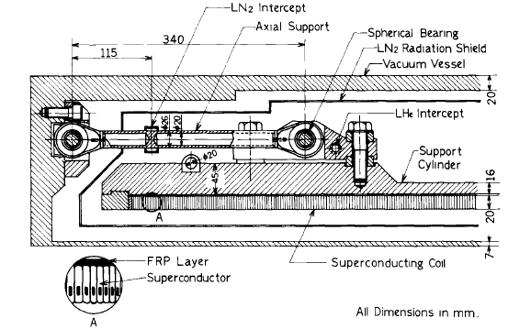
CDF (1984)– First co-extrude conductor – Al-alloy support- Shrink-fit
Parameters
Field | 1.5 | T
Coil Radius | 01.5 | m
Length | 4.8 | m
Sored Energy | 30 | MJ
Cooling pipes directly welded on Al5083 cylinder
After the winding the coil is shrink-fitted inside the outer cylindrical support
Notes:
Note
Shrink fitting high risk operation
Tight tolerances on coil and cylinder dimensions

Slide 29
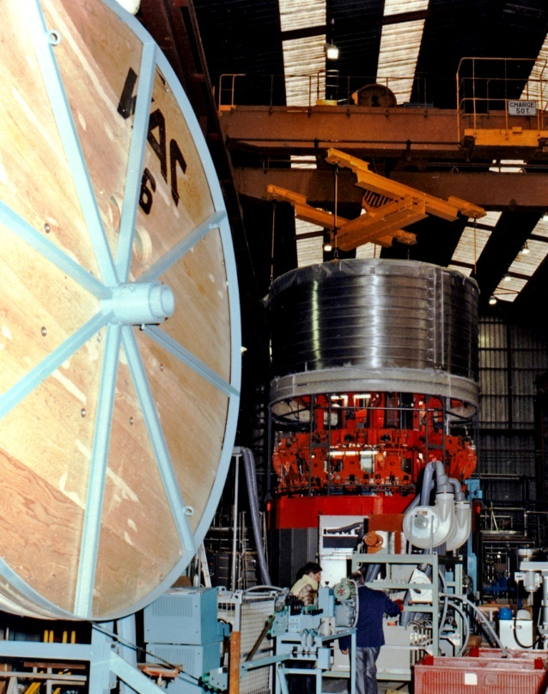
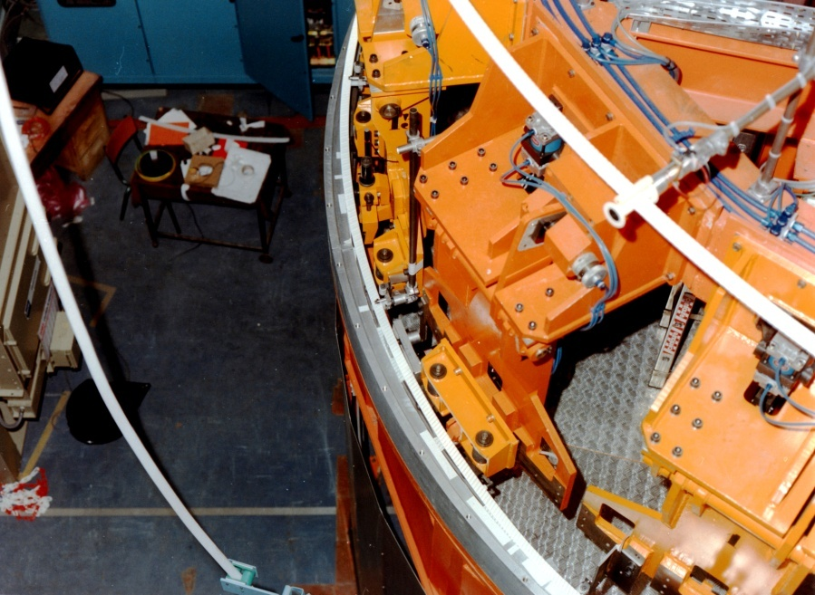
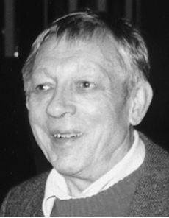
ALEPH (1987)– Rutherford cable- Resin VPI – Thermo-siphon
35mm
Thermo-siphon
Parameters
Field | 1.5 | T
Coil Radius | 2.75 | m
Length | 6.4 | m
Sored Energy | 130 | MJ
J C Lottin

Slide 30
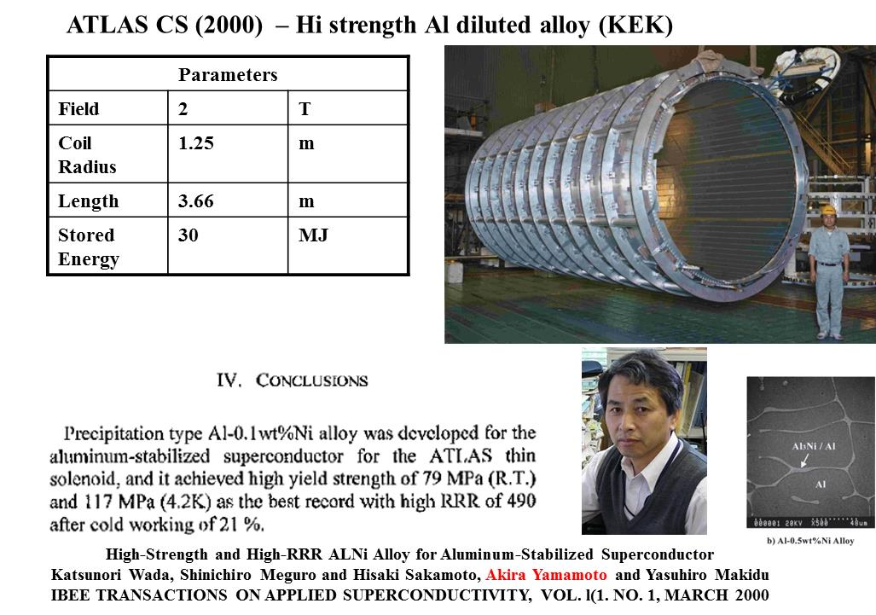

Slide 31
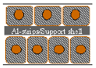
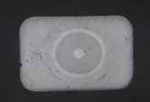
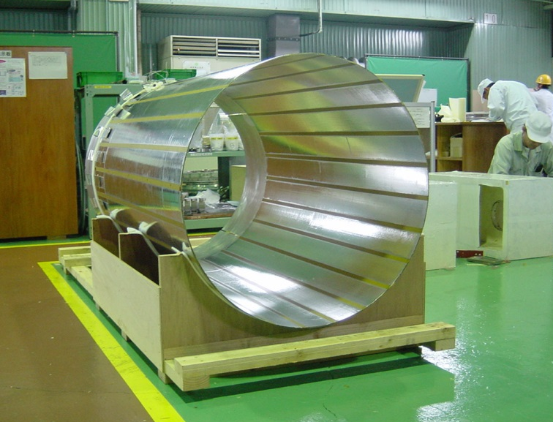
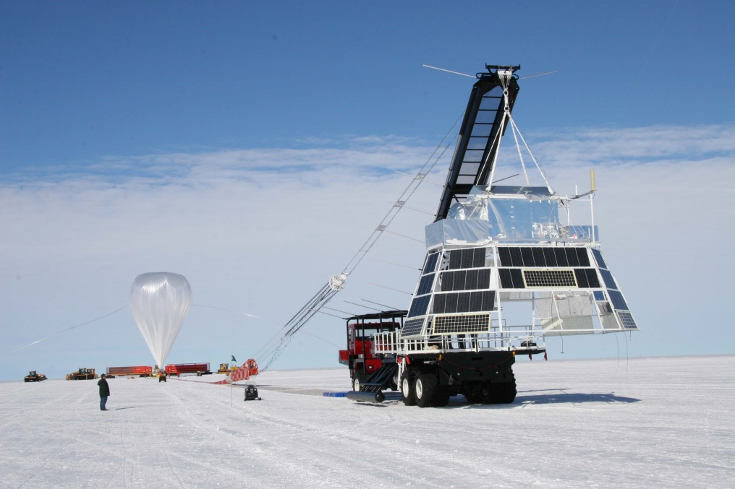
BESS Polar – The thinnest one . No support!!
Diameter 900mm
Length 1000mm
Field 1T
Wall 1gm/cm^2 ~ 0.05X_{o}
3.4mm
NbTi/Cu SC
Al-Ni alloy

Slide 32

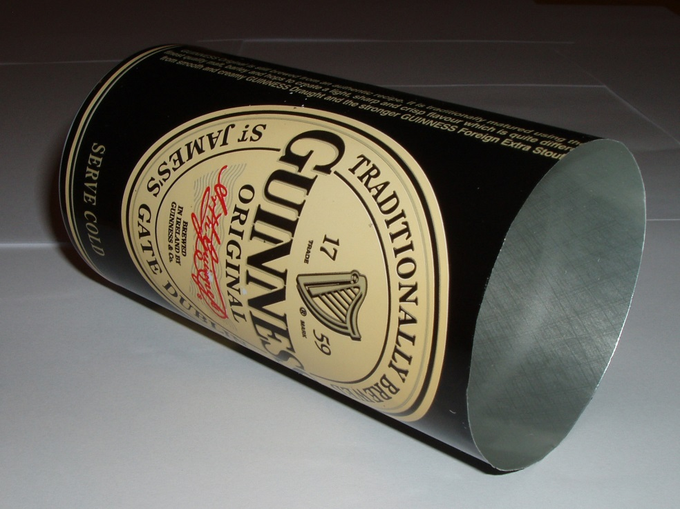
BESS Polar : As thin as a can!!
thickness/diameter ~ 0.2%
Coil thickness/diameter ~ 0.34%

Slide 35
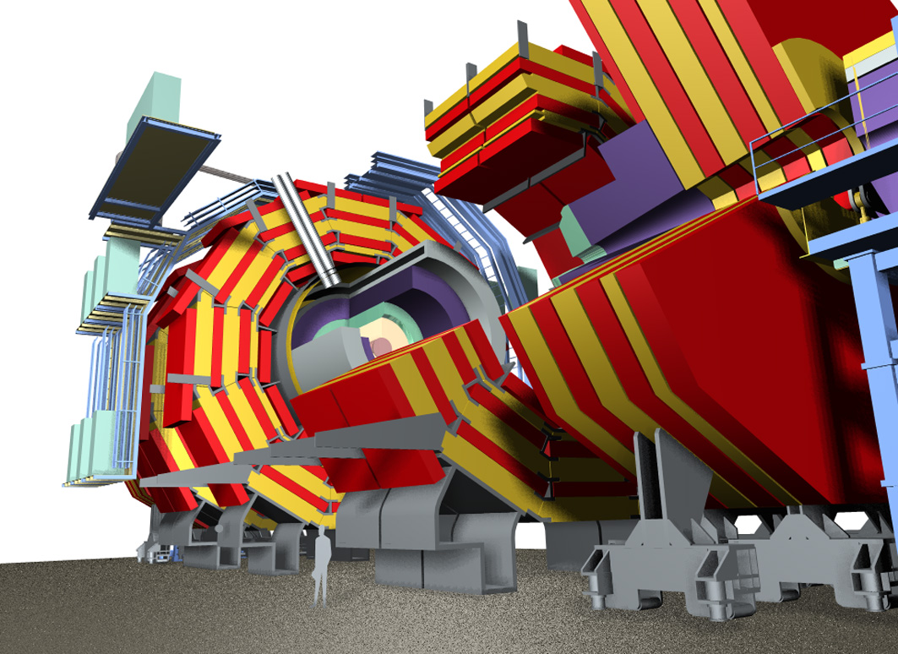
1994- TECHNICAL PROPOSAL of CMS at LHC : The magnets looks to be beyond the technological limits
Magnetic Field 4 T
Current 20000 A
Stored Energy 2520 MJ
Peak field 4.6T
LuMagnet length 12.5 m
Inner Diameter 6320 mm
External diameter 6950 mm
Four layers

Slide 36
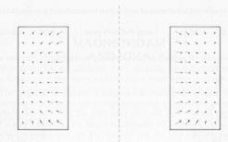
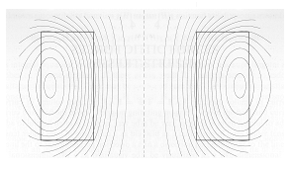
Magnetic forces on solenoids
The radial component of the B field causes an axial compressive force. The axial component a radially outward forces
F_{axial}
F_{radial}
B
A thi solenoid can be seen a vessel with an internal pressure (the magnetic presuure)

Slide 37
A basic parameter for comparing different magnets
The ratio E/M Stored Energy [kJoule])/ Cold Mass [kg]
Where ε is the strain , Y the elastic modulus, δ the density,
α is the fraction of the mechanical resistent material
The ratio E/M gives a direct information of the mechanical deformation. For CMS ε=0.15%
E/M gives also an information of the max temperature in the coil after a quench.

Slide 38
E/M ratio vs E for several detector magnets

Slide 39

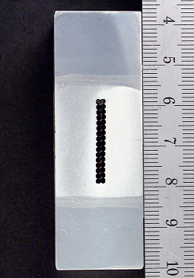
Reinforced Conductor
The basic idea in CMS design was to include the mechanical reinforcement in the conductor. This choice allow to minimize the shear stresses in the winding
186 mm
A (thin ) mandrel is still present for:
Homogenizing the temperature of the coil during cool-down
Protection- Quench back
Supporting the winding during construction
Anchoring the supporting system of the cold mass in the vacuum chamber
127 mm
64.0 mm
21.6 mm

Slide 40
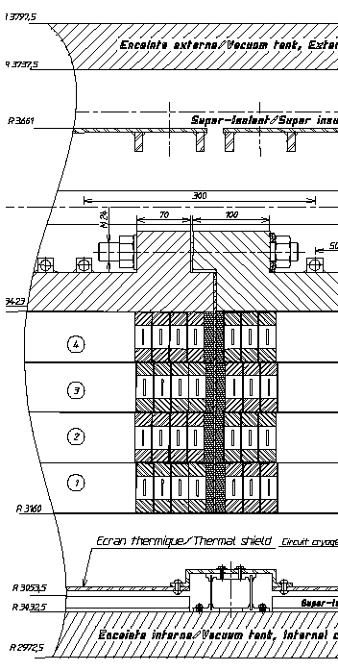
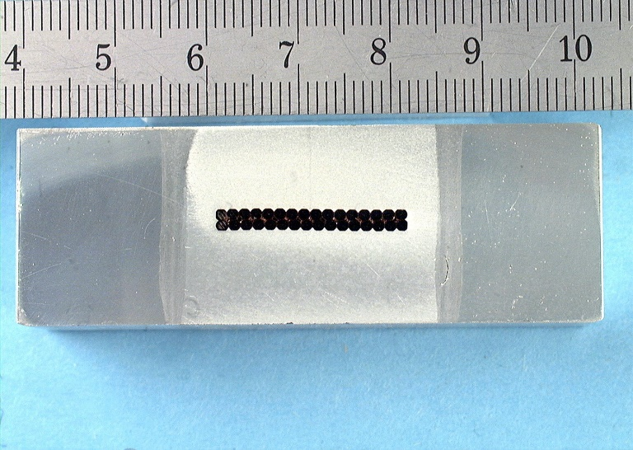
CMS (2006) – The reinforced conductor
CERN CEA ETH-Z INFN
Parameters
Field | 4 | T
Coil Radius | 3.5 | m
Length | 12.5 | m
Stored Energy | 2600 | MJ
A 5 module coil (250 t), requiring R&D developments at industrial level of conductor and winding technologies

Slide 41
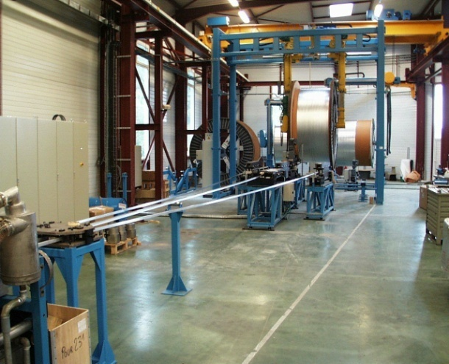
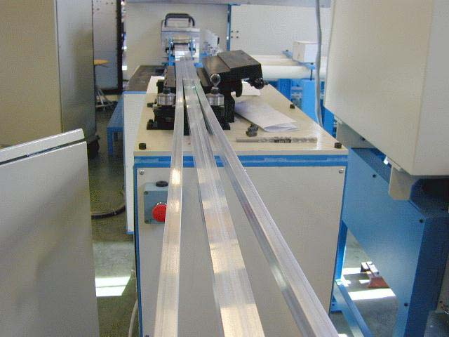
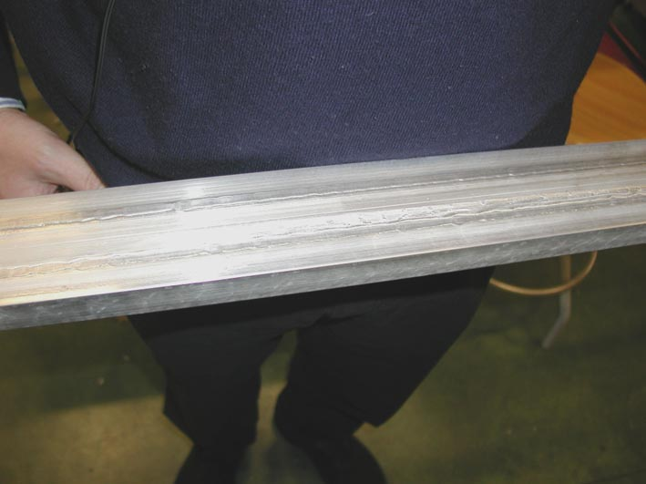
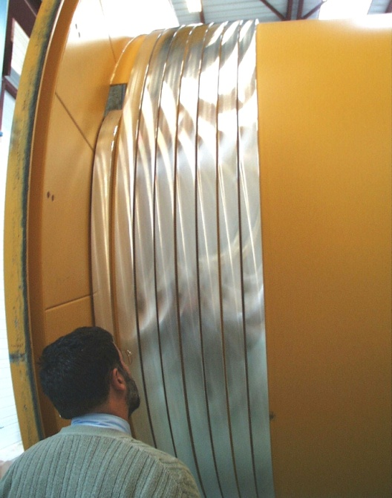
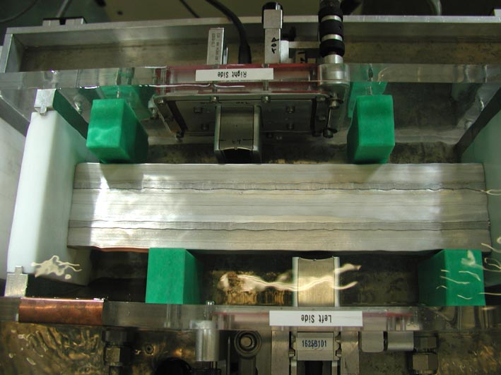
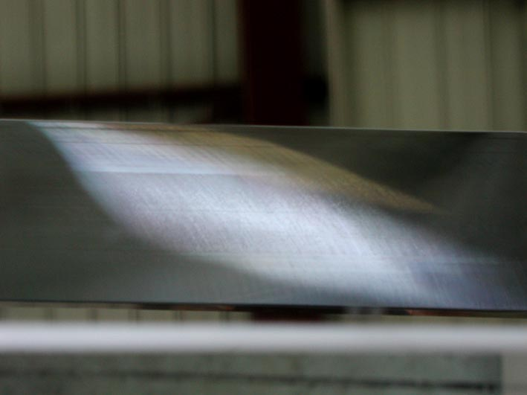
Continuous EB-welding of each 2.5 km length (20 in total)

Slide 42
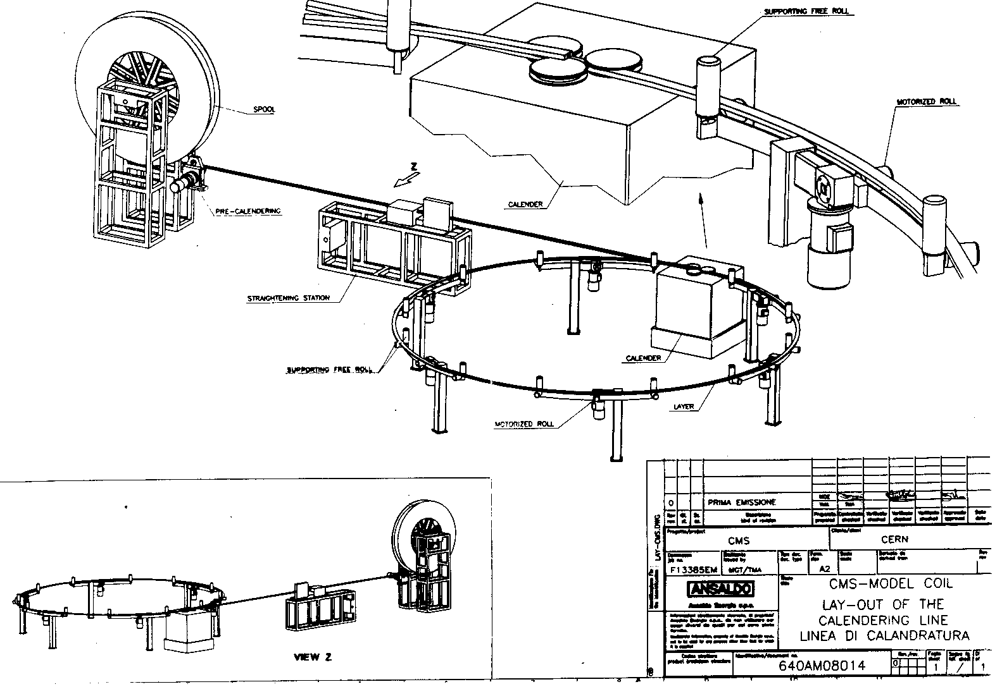
1998-1999 Development in Ansaldo Magneti of an inner winding technology with INFN

Slide 43




1999: Construction of a model → Input for designing a winding line

Slide 44




Developments of the winding techniques for a reinforced conductor
Conductor Bending
Epoxy vacuum impregnation of 50 t modules
Winding

Slide 45



Two step bending
Rollers A,A’ guide the conductor . Rollers B, C’ and D bend it a a radius R₁ (B’ e C not active). Rollers E,F and G bend the conductopr at final radius e R₂ <R₁
Small variation in conductor width (0.1 mm off 64 mm) or 10% variation of mechanical properties are not affecting final radius.

Slide 46

After impregnation le large coil could have excess of epoxy resin at the inner surface. An issue due to potential thermal disturbances causing premature quenching.

Slide 47

Inner machining for removing excess of resin!

Slide 48



Also transportation of these large coils is not trivial!!

Slide 49

7400 mm

Slide 50


Slide 51


Slide 52


Slide 53


Slide 54

ATLAS TOROIDS – largest field volume (7000 m³)

Slide 55

Barrel Toroid: 8 coils in separate cryostats
  20 m diameter
  25 m length
  8200 m³ volume
  118 t superconductor
  370 t cold mass
  830 t total weight
  56 km conductor
  20.5 kA current
  3.85 T peak field
  1 GJ stored energy
  4.8 K indirectely cooled
  Force 1100 t/coil

Slide 56




ATLAS Barrel Toroid
Challenge
Scale of components and integration accuracy
Tolerances << 1 mm in 26m

Slide 57


Slide 58

A challenge for large sc magnets: assembly and handling
Lift down to the cavern of a ATLAS barrel coil
Lift down to the cavern of CMS coil with central yoke module (12000 t)

Slide 59
Summary
  What we ask to a detector magnet
  The story of detector magnets
  Design progresses
  Construction technologies
  Future

Slide 60

What about the future? (Linear Collider or FCC ?)

Slide 61

The load lines in I-B graph and stability margin

Slide 62
Temperature Margin
For NbTi T_{c0} = 9.25 K B_{c20} = 13.9 T.
At B = 4.6 T (Peak field in CMS) T_{c} = 7.35 K
The interesting parameter is the current sharing temperature
Iop =19140 A, I_{c}(T=4.5K ,B= 4.6 T) = 55600 A →T_{g} = 6.35 K.
The temperature margin in CMS is consequently ΔT=6.35-4.5=1.85 K
At 5.2 T central field the margin is lower: 1.4 K (still acceptable considering that CMS worked up to a temperature of 5.4 K ). I personally believe that a margin of 1 K is enough. That means a central field of 6 T (at I/I_{c}=0.33)

Slide 63


Slide 64

Presented by ten Kate at FCC meeting in Rome (April 2016)

Slide 65

It seems that next large detector magnet will still based on NbTi tecnology. Any chances for different materials (HTcS)?

Slide 66
CONCLUSIONS
The detector magnets are evolving since 50+ years, requiring any time developments at the edge of the up-to-date technology.
As the accelerated particle energy increased, the requirement in momentum resolution demanded for new technologies for superconducting cables.
In the sixties and seventies the detector magnet had an important role in pushing the superconducting technology
Next large detector magnet will presumibly still involve LTcS

Slide 67
Additional slides

Slide 68

Notes:
Buttons. Click on any particle type to display the relevant slide with animations. Clicking again will return to this slide.
Recommend putting this slide in the middle of your presentation and putting the other 5 slides at the end.
If you have any difficulties, contact David.Barney@cern.ch

Slide 69



Notes:
Charged hadron: Bends in the magnetic field and leaves signals in the tracker layers; passes through the electromagnetic calorimeter leaving essentially no signal, and is “stopped” by the hadron calorimeter

Slide 70


Notes:
Neutral hadron: Does not bend in the magnetic field and does not leave any signal in the tracker layers; passes through the electromagnetic calorimeter leaving essentially no signal, and is “stopped” by the hadron calorimeter

Slide 71



Notes:
Electron: Bending in the magnetic field, leaving hits in the tracker layers and being “stopped” by the electromagnetic calorimeter

Slide 72



Notes:
Photon: passes through the tracker without bending in the magnetic field or leaving hits, is “stopped” by the electromagnetic calorimeter

Slide 73



Notes:
Muon: passing through CMS, bending in the field (both ways, depending on when it is inside or outside of the solenoid) leaving hits in the Tracker layers and the muon chambers before escaping completely

Slide 74


Slide 75
s
y2
y3
p┴=qBρ
y1
L
ρ
θ
y
x
Superconducting magnets with large dimensions
( N > 10 )

Slide 76


Slide 77
Maddock Criterion
Maddock demonstrated that a less restrictive criterion can be used. It is sufficient that the excess of dissipation is compensated by an excess of heat exchange. The theorem of equal are.

Slide 78


