Slide 1

Large magnets for fusion application
EASI School 3 – Superconductivity and its applications
October 6th, 2020
L. Muzzi / FSN – Superconductivity Division

Slide 2
Outline
Magnetic confinement fusion: the tokamak concept
Magnet system of a tokamak reactor
Cable-in-Conduit conductors (CICCs)
ITER CICCs and optimization margins
Key components of fusion coils: the example of the Italian DTT Project.
Summary and concluding remarks

Slide 3
Outline
Magnetic confinement fusion: the tokamak concept
Magnet system of a tokamak reactor
Cable-in-Conduit conductors (CICCs)
ITER CICCs and optimization margins
Key components of fusion coils: the example of the Italian DTT Project.
Summary and concluding remarks

Slide 4
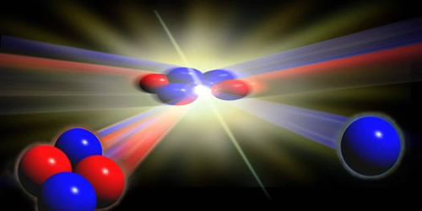
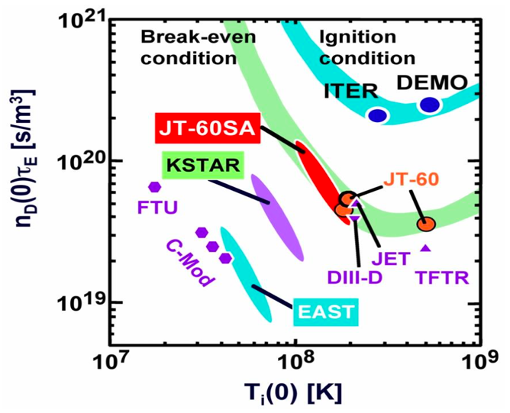
Nuclear fusion principles
Nuclear reaction, where light atoms (Hydrogen) fuse, and form one (Helium), with a net energy release (E=Δm c²)
T
D
He (3.5MeV)
n (14.1MeV)
Lawson’s criterium for D-T fusion:
n τ_{E} T ≥ 1.2 10²¹ m⁻³ keV s
  n: gas density (~ 10²⁰ ions/m³)
  τ_{E}: confinement time (~1 s)
  T: Kinetic energy (T ~ 150・10⁶ °C)

Slide 5
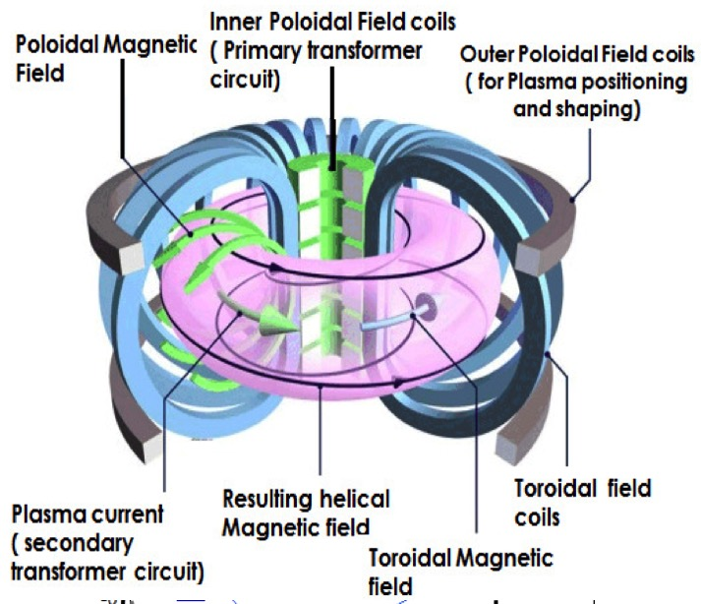
Magnetic Confinement Fusion: the Tokamak
TOKAMAK
toroidal'naya kamera s aksial'nym magnitnym polem (toroidal chamber with an axial magnetic field)
("тороидальная камера в магнитных катушках“)
Torodial Field: for confinement of charged particles in plasma
Poloidal Field: for control of plasma radial position, shaping and vertical stability
Central Solenoid:
Plasma discharge initiation by transformer effect

Slide 6
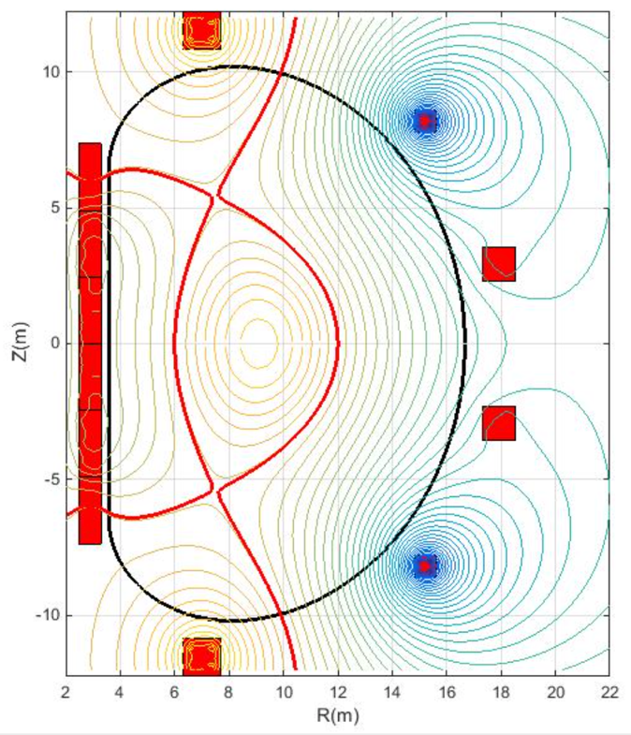
Magnetic Confinement Fusion: the Tokamak
TOKAMAK
toroidal'naya kamera s aksial'nym magnitnym polem (toroidal chamber with an axial magnetic field)
("тороидальная камера в магнитных катушках“)
Torodial Field: for confinement of charged particles in plasma
Poloidal Field: for control of plasma radial position, shaping and vertical stability
Central Solenoid:
Plasma discharge initiation by transformer effect

Slide 7
Magnetic Confinement Fusion: the Tokamak
TOKAMAK
toroidal'naya kamera s aksial'nym magnitnym polem (toroidal chamber with an axial magnetic field)
("тороидальная камера в магнитных катушках“)
Fusion Power:
Stability quantified by the parameter:
Gas Pressure
Magnetic Field Pressure

Slide 8

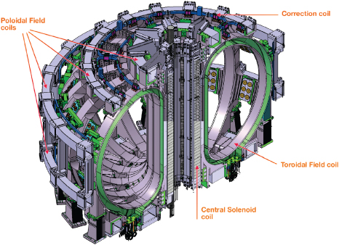
Fusion magnets: the ITER coils
Magnetic confinement fusion: the tokamak concept

Slide 9
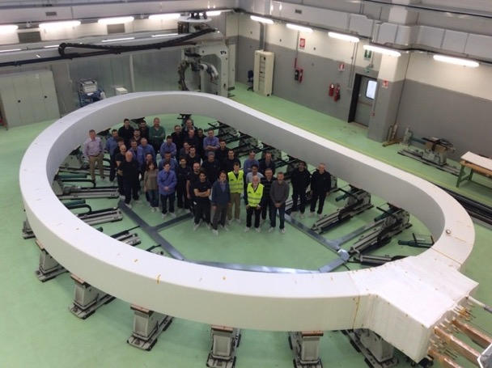
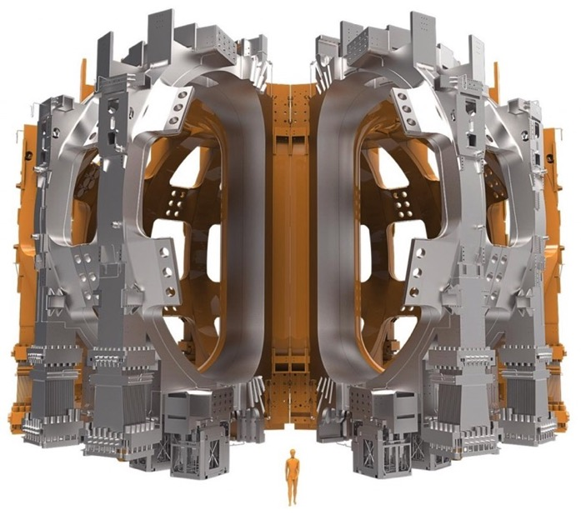
Fusion magnets: the ITER coils
Magnetic confinement fusion: the tokamak concept

Slide 10
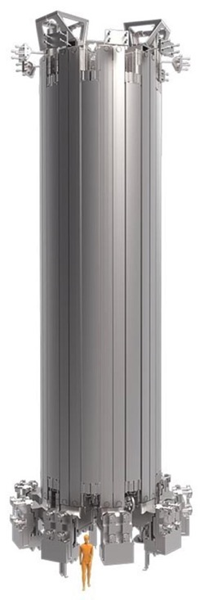
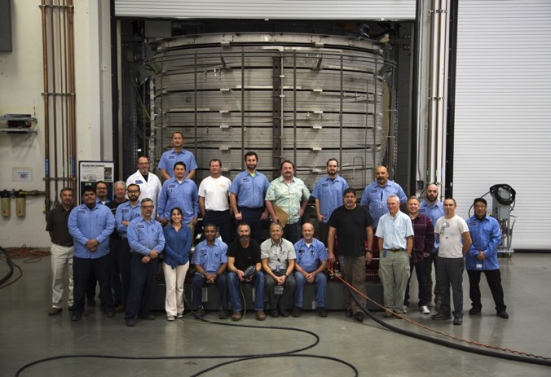
Fusion magnets: the ITER coils
Magnetic confinement fusion: the tokamak concept

Slide 11
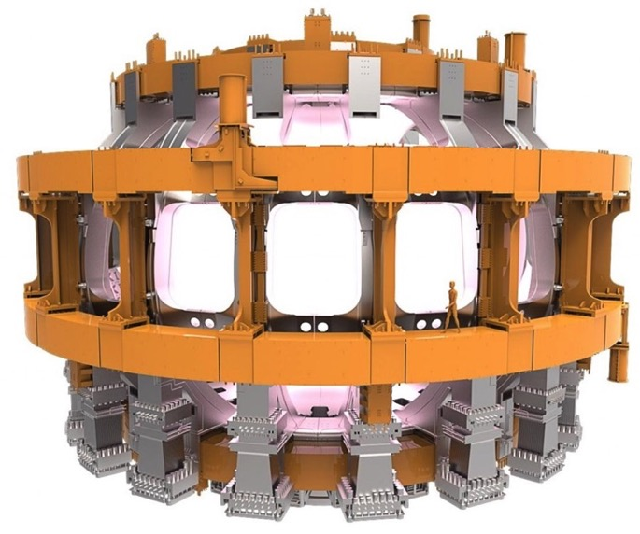
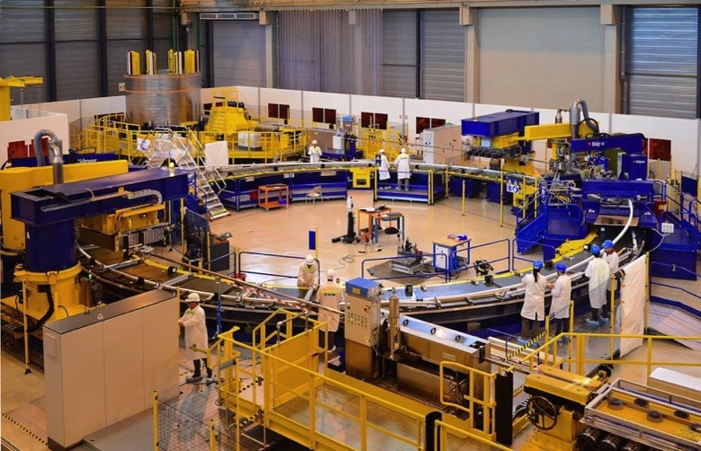
Fusion magnets: the ITER coils
Magnetic confinement fusion: the tokamak concept

Slide 12














D-shaped superconducting tokamaks
JT-60SA
 | B_{toroidal} (T) | I_{plasma} (MA)
JT-60SA | 2.25 | 5.5
ITER | 5.3 | 15.0
DEMO | 5.2 | 17.9
SST-1 | 5.5 | 0.22
EAST | 3.5 | 1.0
KSTAR | 3.5 | 2.0
DTT | 6.0 | 5.5
3.1m
ITER
6.2m
DEMO
1.1m
SST-1
9 m
1.7m
EAST
1.8m
KSTAR
2.1m
DTT

Slide 13
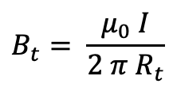
D-shaped superconducting tokamaks
JT-60SA
 | B_{toroidal} (T) | I_{plasma} (MA)
JT-60SA | 2.25 | 5.5
ITER | 5.3 | 15.0
DEMO | 5.2 | 17.9
SST-1 | 5.5 | 0.22
EAST | 3.5 | 1.0
KSTAR | 3.5 | 2.0
DTT | 6.0 | 5.5
3.1m
ITER
6.2m
DEMO
1.1m
SST-1
9 m
Ampere’s law:
$$B_{t}= \frac{μ_{0} I}{{2 π R}_{t}}$$
1.7m
EAST
1.8m
KSTAR
2.1m
DTT

Slide 14




D-shaped superconducting tokamaks
JT-60SA
 | B_{toroidal} (T) | I_{plasma} (MA)
JT-60SA | 2.25 | 5.5
ITER | 5.3 | 15.0
DEMO | 5.2 | 17.9
SST-1 | 5.5 | 0.22
EAST | 3.5 | 1.0
KSTAR | 3.5 | 2.0
DTT | 6.0 | 5.5
3.1m
ITER
6.2m
DEMO
1.1m
SST-1
9 m
Ampere’s law:
$$B_{t}= \frac{μ_{0} I}{{2 π R}_{t}}$$
1.7m
EAST
$$I_{DTT} \sim 60 MA$$
1.8m
KSTAR
Overall TF magnet system current
$$I_{ITER} \sim 150 MA$$
$$I_{DEMO} \sim 250 MA$$
2.1m
DTT
$$I_{JT−60SA} \sim 30 MA$$

Slide 15
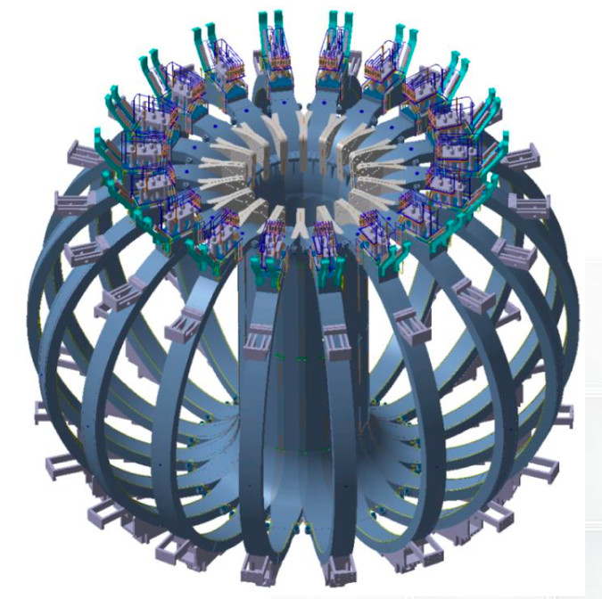
D-shaped superconducting tokamaks
 | B_{toroidal} (T) | I_{plasma} (MA)
JT-60SA | 2.25 | 5.5
ITER | 5.3 | 15.0
DEMO | 5.2 | 17.9
SST-1 | 5.5 | 0.22
EAST | 3.5 | 1.0
KSTAR | 3.5 | 2.0
DTT | 6.0 | 5.5
Ampere’s law:
$$B_{t}= \frac{μ_{0} I}{{2 π R}_{t}}$$
JT-60SA TF Magnet system
Image courtesy of: A. Cucchiaro
$$I_{DTT} \sim 60 MA$$
Overall TF magnet system current
$$I_{ITER} \sim 150 MA$$
$$I_{DEMO} \sim 250 MA$$
$$I_{JT−60SA} \sim 30 MA$$

Slide 16
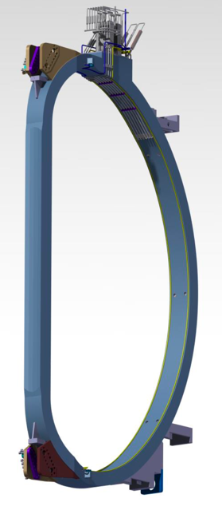




D-shaped superconducting tokamaks
 | B_{toroidal} (T) | I_{plasma} (MA)
JT-60SA | 2.25 | 5.5
ITER | 5.3 | 15.0
DEMO | 5.2 | 17.9
SST-1 | 5.5 | 0.22
EAST | 3.5 | 1.0
KSTAR | 3.5 | 2.0
DTT | 6.0 | 5.5
Ampere’s law:
$$B_{t}= \frac{μ_{0} I}{{2 π R}_{t}}$$
JT-60SA TF coil
Image courtesy of: A. Cucchiaro
$$I_{DTT} \sim 3 MA$$
1 TF coil current
$$I_{ITER} \sim 8 MA$$
$$I_{DEMO} \sim 15 MA$$
$$I_{JT−60SA} \sim 2 MA$$

Slide 17
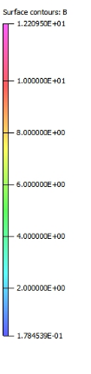
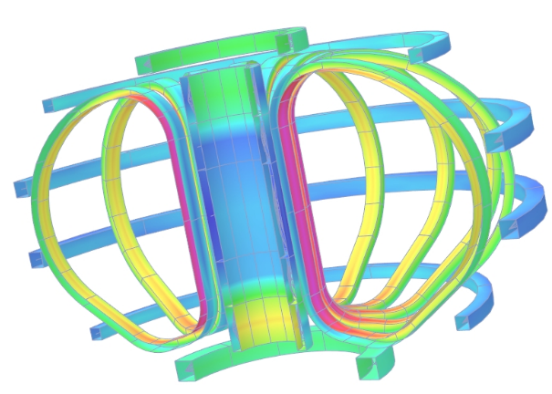
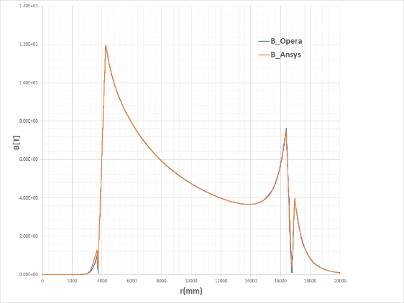
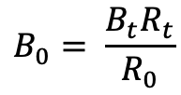

D-shaped superconducting tokamaks
 | B_{toroidal} (T) | I_{plasma} (MA)
JT-60SA | 2.25 | 5.5
ITER | 5.3 | 15.0
DEMO | 5.2 | 17.9
SST-1 | 5.5 | 0.22
EAST | 3.5 | 1.0
KSTAR | 3.5 | 2.0
DTT | 6.0 | 5.5
Ampere’s law:
$$B_{t}= \frac{μ_{0} I}{{2 π R}_{t}}$$
DEMO Magnetic Field Maps
Images courtesy of: S. Turtù
$$B_{0}= \frac{B_{t}R_{t}}{R_{0}}$$
Field on conductor:
In DTT, ITER, DEMO:
$$B_{0} \sim 12 T$$

Slide 18
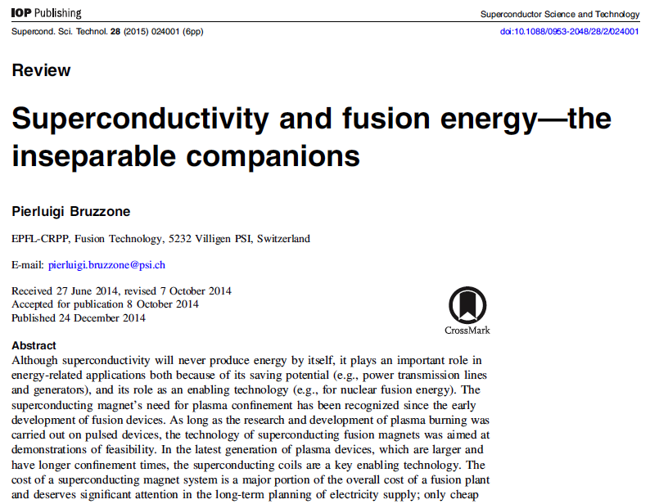
Superconductivity and fusion energy
Superconductivity as Enabling technology

Slide 19
Superconductivity and fusion energy
In the latest generation of plasma devices, which are larger and have longer confinement times, the superconducting coils are a key enabling technology
Superconductivity as Enabling technology

Slide 20
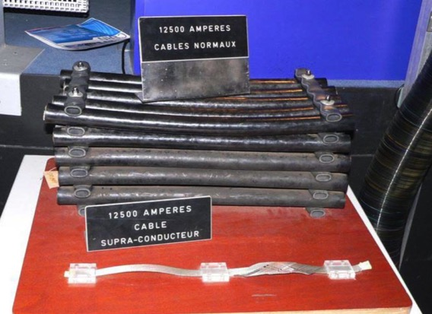
Superconductivity and fusion energy
For: - magnetic field levels (≈10 T)
- magnet size (≈10 m) and stored energy (≈10 GJ)
- pulse duration (≈100 ÷ 1000 sec)
the use of superconducting coils is inevitable
Superconductivity as Enabling technology
Electrical cables at CERN – LEP vs. LHC (Photo by Cockcroft Institute)

Slide 21
Some nomenclature
  in other words …..
  what I would like to show you

Slide 22
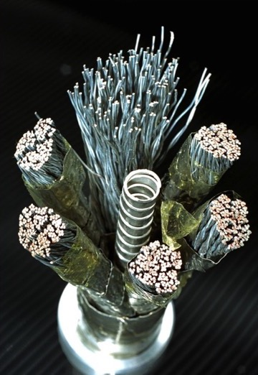
Some nomenclature
Wire (or strand)
  Cable
    Conductor
      Coil

Slide 23
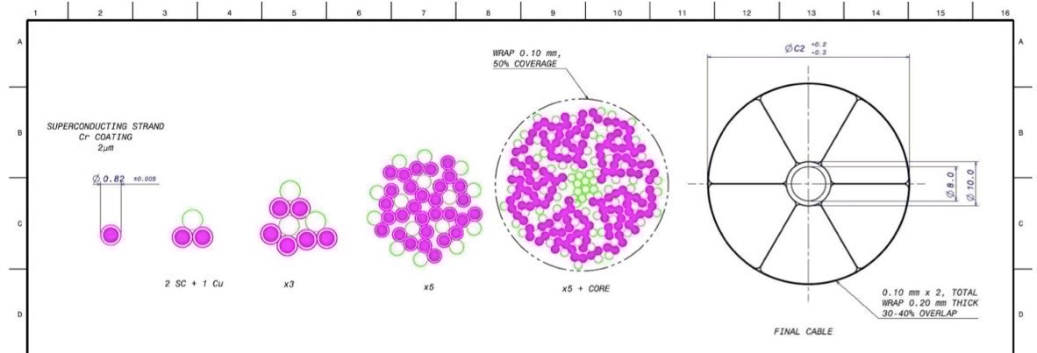
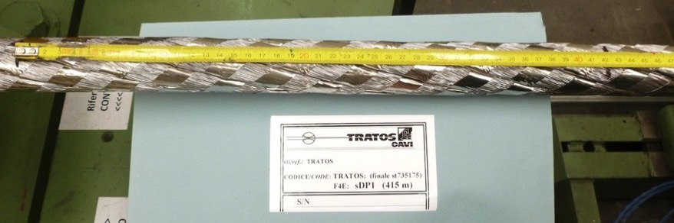
Some nomenclature
Wire (or strand)
  Cable
    Conductor
      Coil

Slide 24
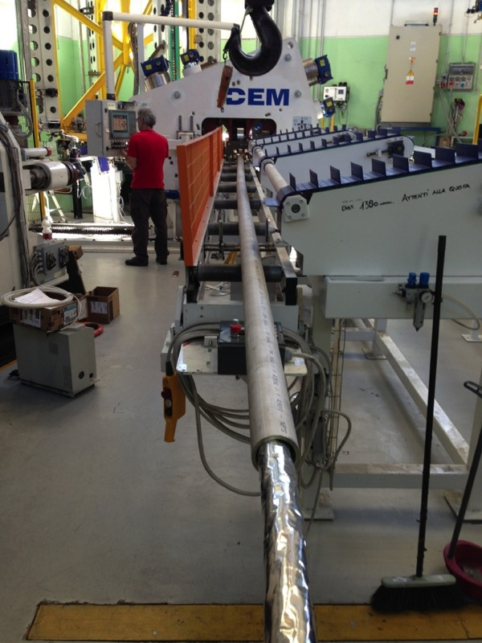
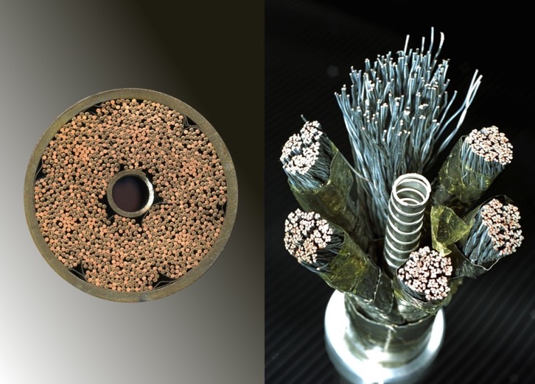
Some nomenclature
Wire (or strand)
  Cable
    Conductor
      Coil

Slide 25
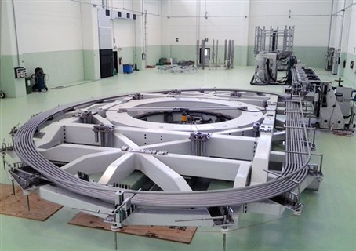
Some nomenclature
Wire (or strand)
  Cable
    Conductor
        Coil

Slide 26
Superconducting wires (strands): stability
In the normal state the superconductor, has high electrical resistivity and low thermal conductivity
2kA(T_{c}-T_{op})/l = J_{c}²ρAl
Cu
Superconductor
It’s thus necessary to couple (stabilize) the material for example with Copper or Aluminum
α = Cu/nonCu ratio

Slide 27
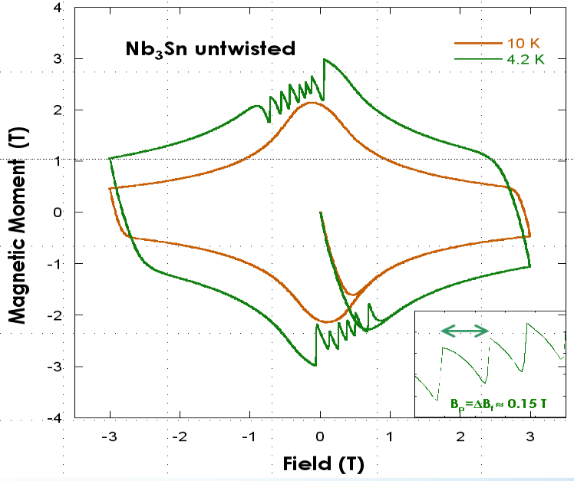
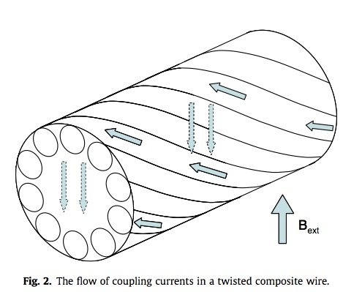
Superconducting wires (strands): stability
AC hysteresis losses + Flux Jumping
AC coupling losses

Slide 28
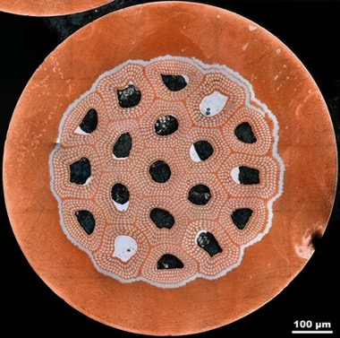
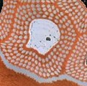
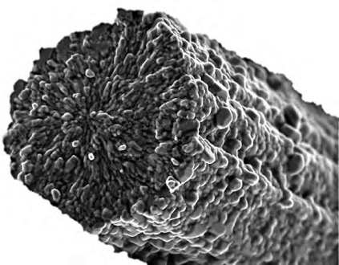
Multi-filamentary superconducting wires
Wire
Copper
Superconductor
Photo courtesy of Peter Lee, FSU
Φ ∼ 50-100 µm
The superconduct. wire is formed of many thin filaments of s.c. materials, twisted within a Cu stabilizing matrix
Φ = 0.81 mm
Bundle
Wire diameter | 0.5÷1 mm
# supecond. filaments | 1000÷10000
Filament diameter | 5÷50 μm
Cu/non Cu | 4/1 ÷ 1/1
Φ ∼ few µm
Filament
Photo courtesy of J. Minervini MIT

Slide 29
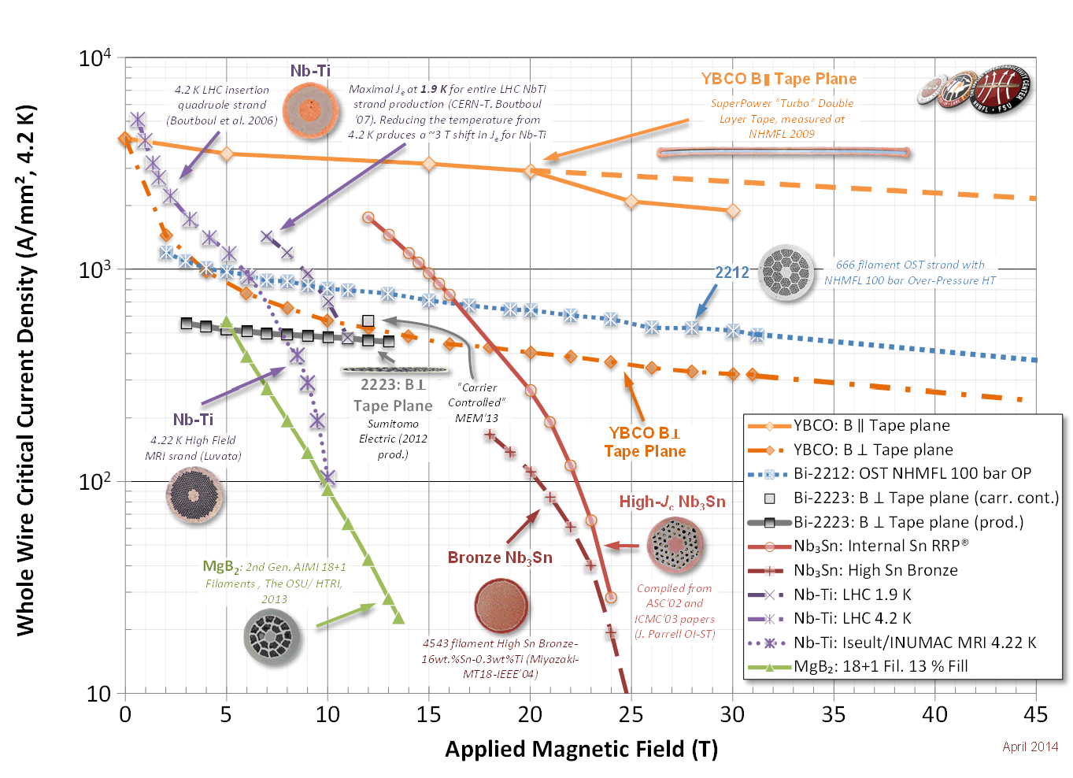
Practical Materials

Slide 30
Practical Materials
Nb₃Sn
NbTi

Slide 31
Practical Materials
 | T_{c}(B=0) | B_{c2}(T=0)
NbTi (type II) | 9.2 K | 15 T | Ductile alloy – bcc structure - cheap
Nb₃Sn (type II) | 18 K | 27 T | Intermetallic compound – brittle – A15 structure – expensive
Nb₃Sn
NbTi

Slide 32
Practical Materials
B_{peak} determines the choice of the s.c. material to be used
ITER PF
ITER TF
Nb₃Sn
NbTi

Slide 33
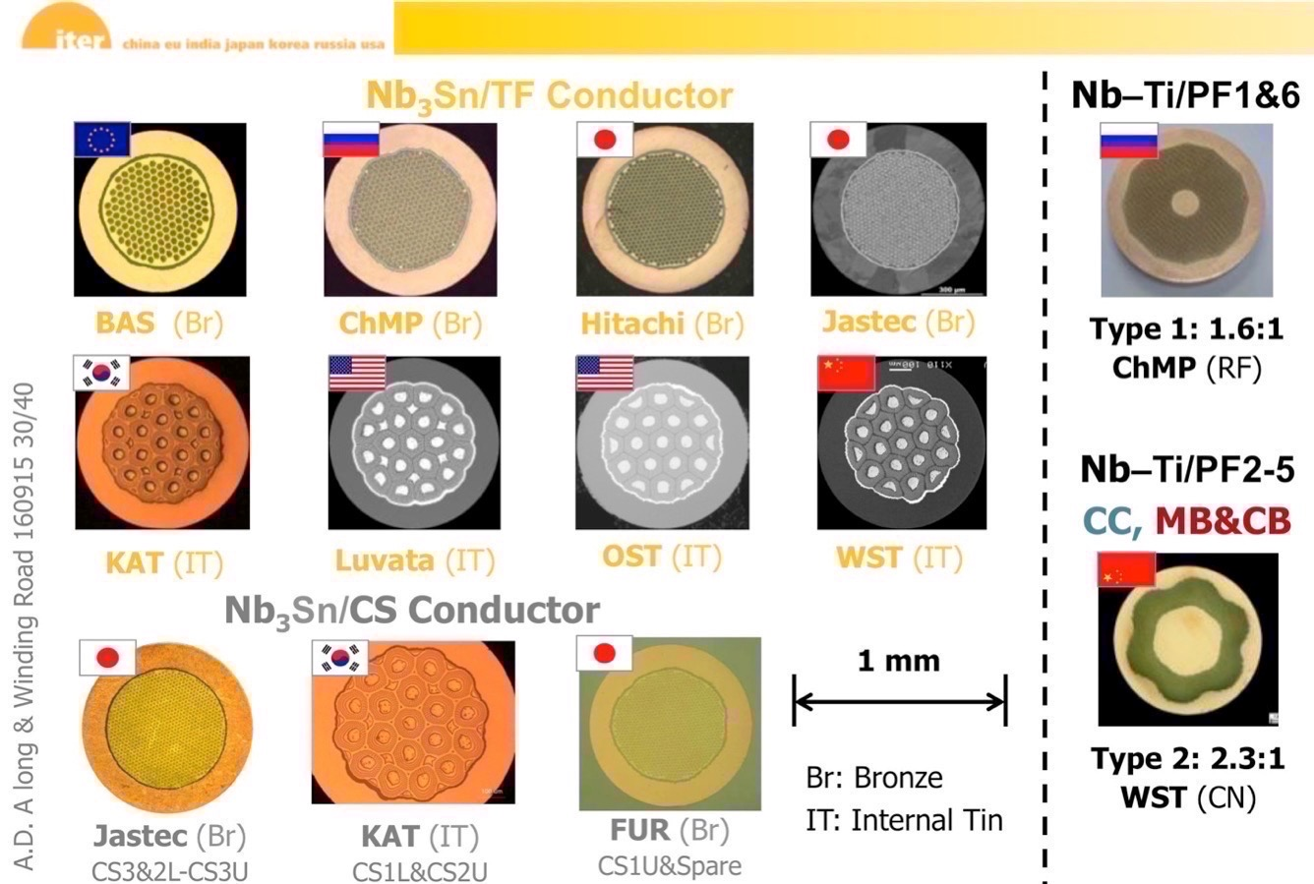
The ITER strands

Slide 34
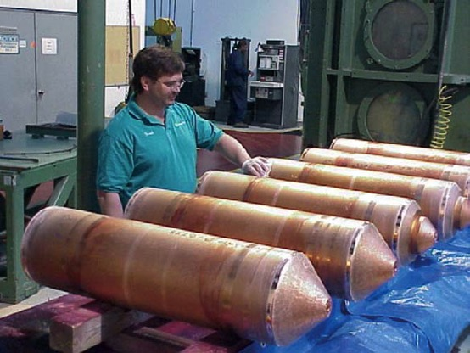
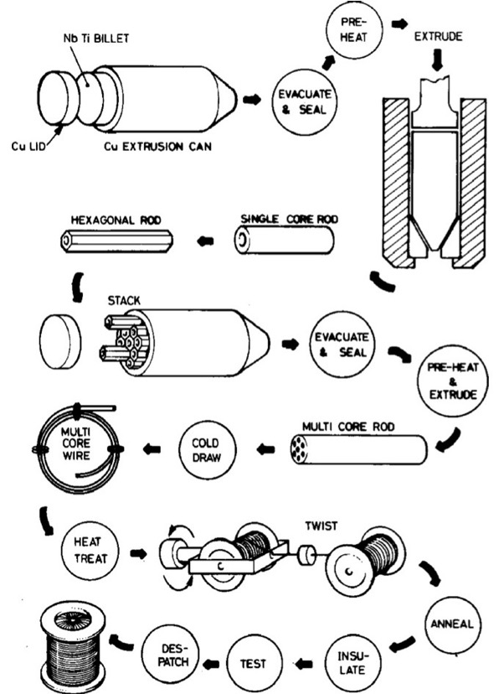
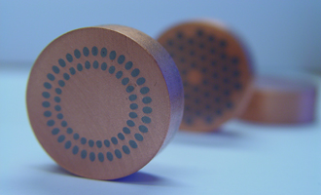
Fabrication of s.c. wires
NbTi

Slide 35
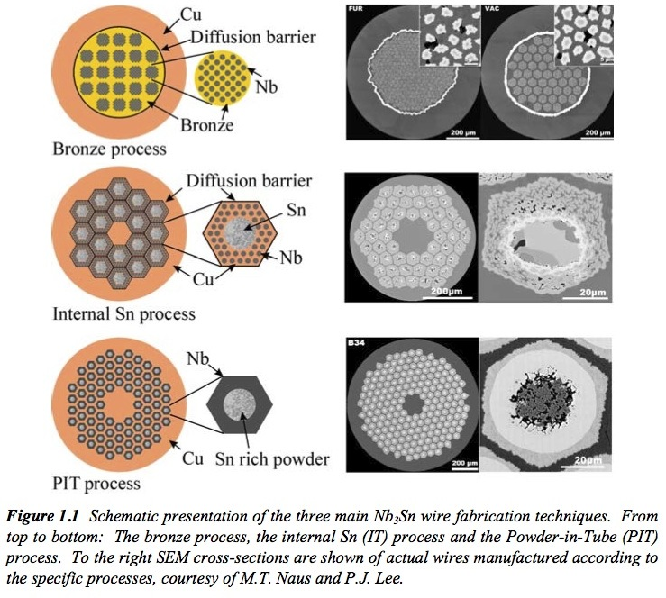
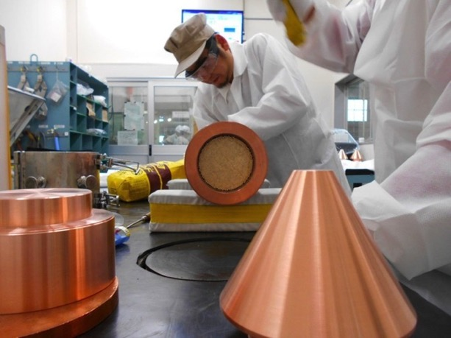
Fabrication of s.c. wires
Nb₃Sn
Courtesy of:
A. Godeke, Performance Boundaries in Nb₃Sn Superconductors (2005)

Slide 36
Fabrication of s.c. wires
Nb₃Sn
Courtesy of:
A. Godeke, Performance Boundaries in Nb₃Sn Superconductors (2005)
It requires a heat treament at 650 °C to form the s.c. phase.
Once formed, it is a brittle material!

Slide 37
Outline
Magnetic confinement fusion: the tokamak concept
Magnet system of a tokamak reactor
Cable-in-Conduit conductors (CICCs)
ITER CICCs and optimization margins
Key components of fusion coils: the example of the Italian DTT Project.
Summary and concluding remarks

Slide 38
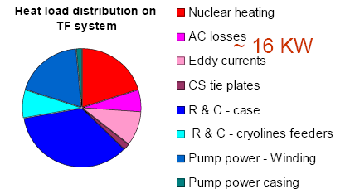
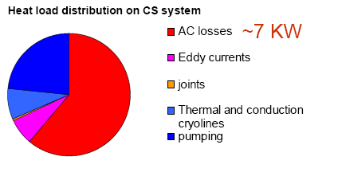
Heat Loads in fusion coils
Source of losses:
Hysteresis
AC
Coupling
Eddy-
Neutrons
Thermal radiation & Conduction
  ITER design experience:
R. Vallcorba_MATEFU School 2009

Slide 39
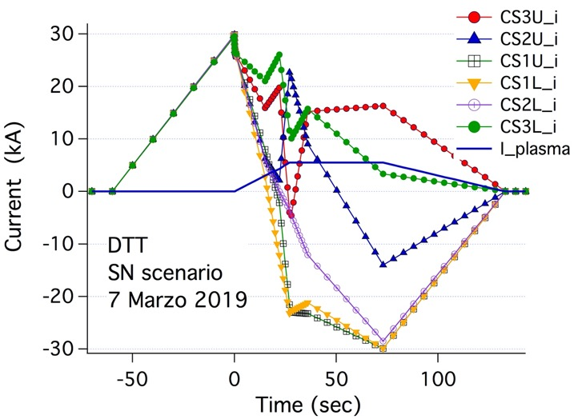
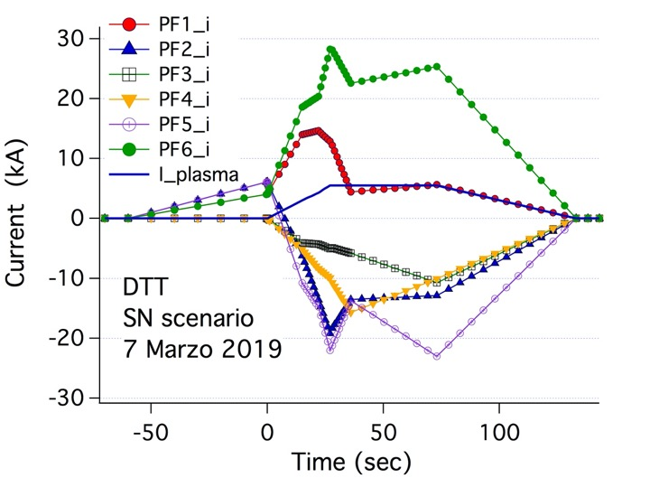
Heat Loads in fusion coils
Source of losses:
Hysteresis
AC
Coupling
Eddy-
Neutrons
Thermal radiation & Conduction
Due to varying field and currents
Specific of CS / PF conductors
; I_{plasma} (MA)
R. Vallcorba_MATEFU School 2009

Slide 40
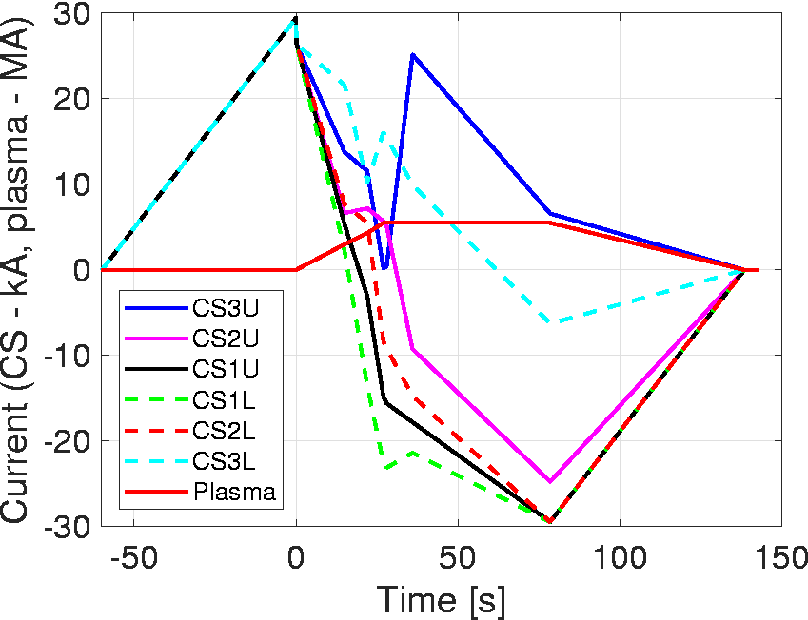
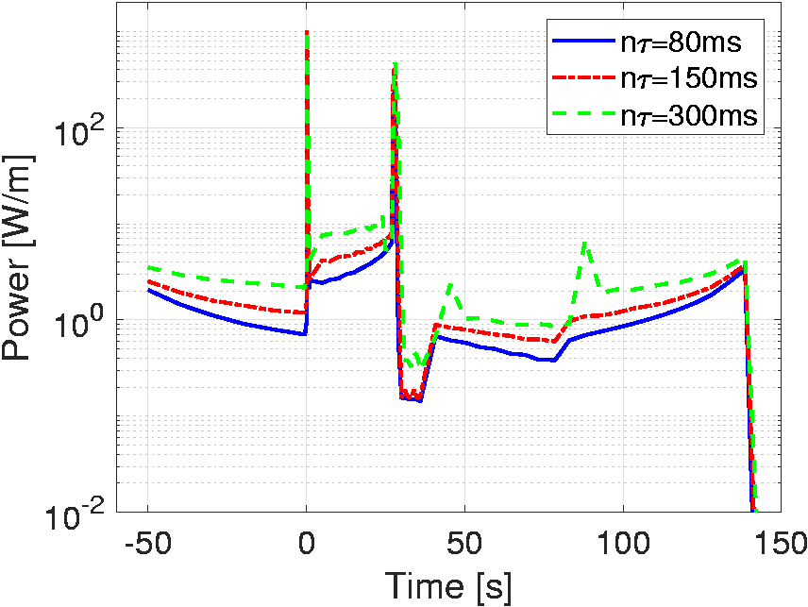
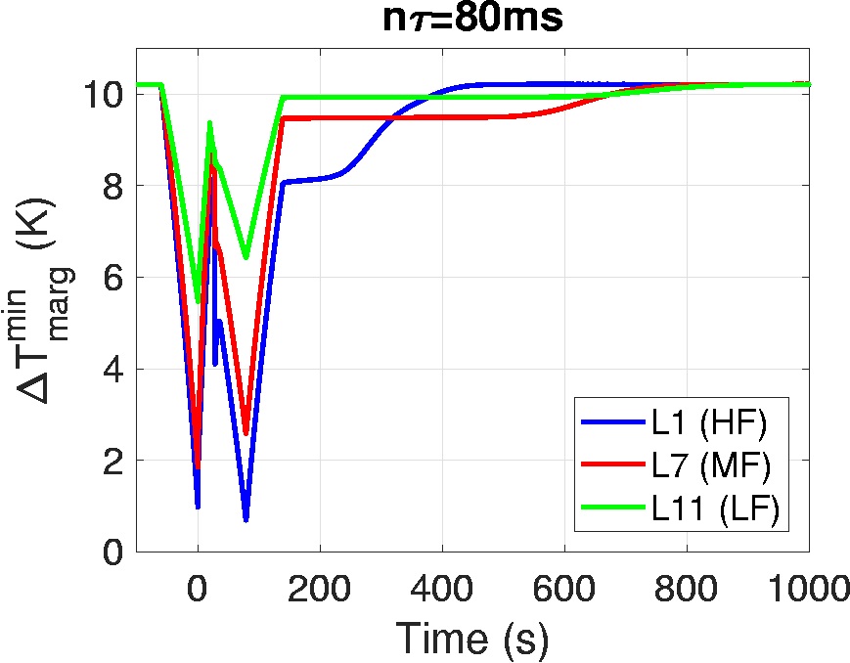
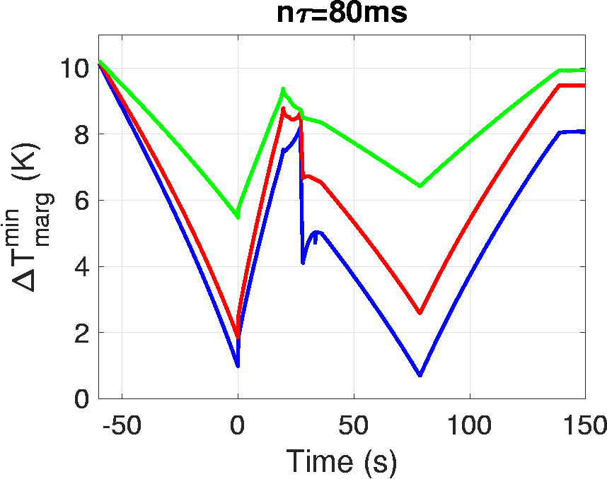
AC losses in DTT CS coil
CS currents
Computed AC losses
L1 (HF)
Temperature margin

Slide 41
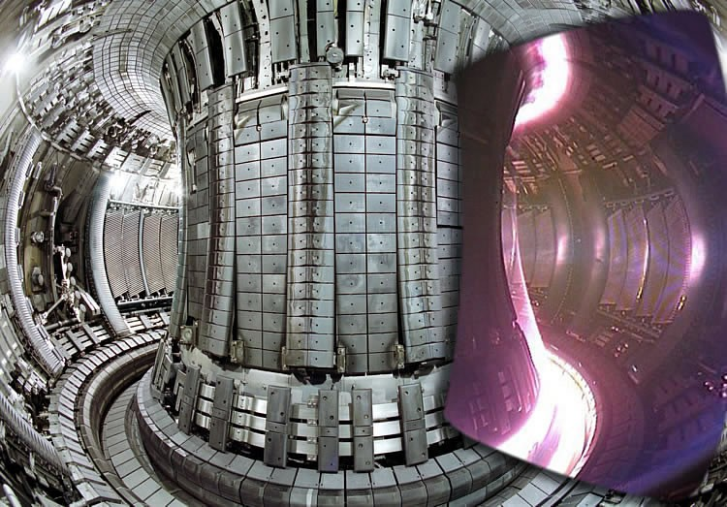
Heat Loads in fusion coils
Source of losses:
Hysteresis
AC
Coupling
Eddy-
Neutrons
Thermal radiation & Conduction
Specific of TF conductors
  ITER design experience:
R. Vallcorba_MATEFU School 2009

Slide 42
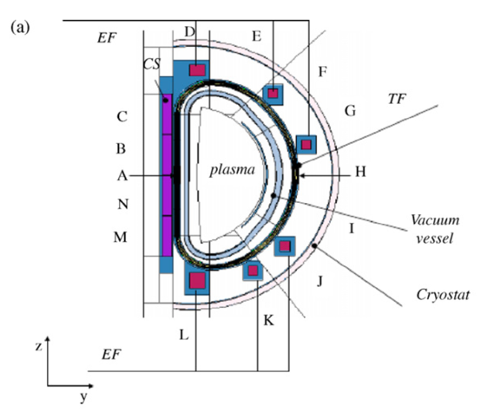
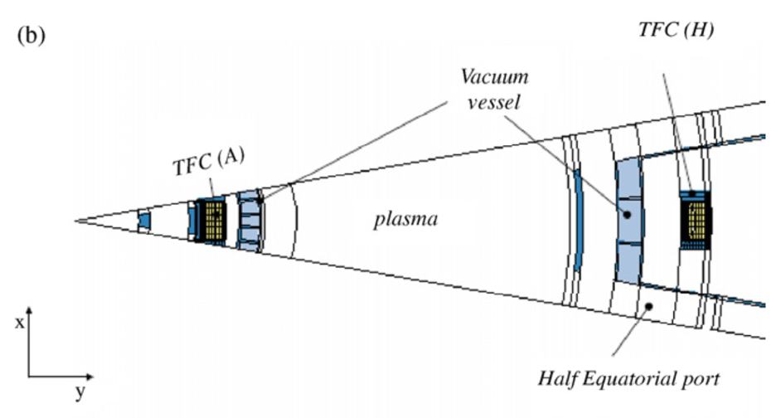
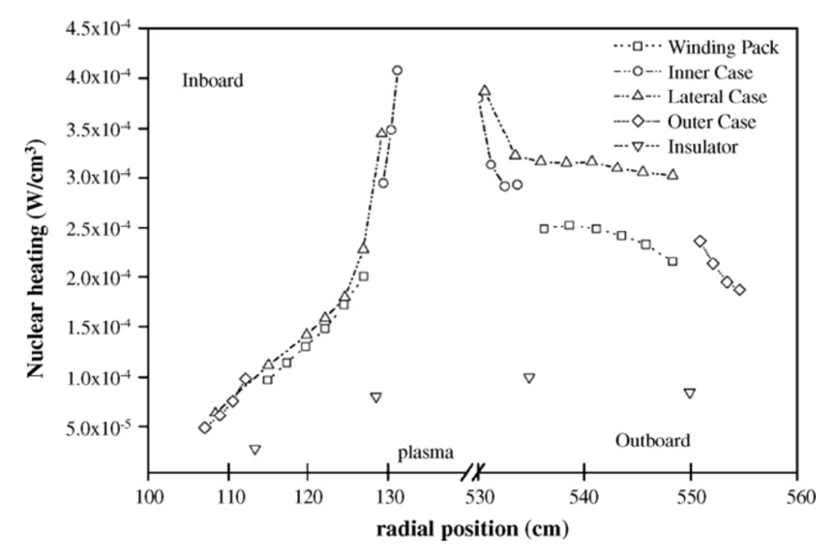
Nuclear heat load (in JT-60SA)
Villari
Fus Eng Des 09

Slide 43
Heat Loads in fusion coils
Source of losses:
Hysteresis
AC
Coupling
Eddy-
Neutrons
Thermal radiation & Conduction
Due to varying field and currents
Specific of CS / PF conductors
Specific of TF conductors
  ITER design experience:
R. Vallcorba_MATEFU School 2009

Slide 44

Cable-in-Conduit Conductors (CICCs)
Hoenig; Montgomery; Iwasa (1975):
high cooling efficiency of single phase (supercritical) He in turbulent flow and in direct contact with a large wetted surface
Empty fraction for forced He circulation
Typically: T ~ 4.5K, P ~ 6 ÷10 bar
Convective heat transfer:
Pressure relief channel
strand
Effective cooling
Mechanically strong
Flexible layout
Effective electrical insulation
1000 ÷ 5000
filaments
Steel
jacket
Strand bundle
BUT: Low J_{ENG}

Slide 45







D-shaped superconducting tokamaks
JT-60SA
JT-60SA
25.7 kA - 5.7 T NbTi
3.1m
ITER
ITER
68.0 kA - 12 T Nb₃Sn
6.2m
1.1m
SST-1
SST-1
10.0 kA - 5.1 T NbTi
1.7m
EAST
14.3 kA - 5.8 T NbTi
EAST
1.8m
KSTAR
KSTAR
35.2 kA - 7.2 T Nb₃Sn
2.1m
DTT
DTT
∼ 42.5 kA – 11.9 T Nb₃Sn

Slide 46

Cable-in-Conduit Conductors

Slide 47
Outline
Magnetic confinement fusion: the tokamak concept
Magnet system of a tokamak reactor
Cable-in-Conduit conductors (CICCs)
ITER CICCs and optimization margins
Key components of fusion coils: the example of the Italian DTT Project.
Summary and concluding remarks

Slide 48




The ITER CICCs: the state-of-the-art
^{TF CICC: 68 kA @ 11.8 T}
^{Φ = 43.7 mm}
^{PF CICC:}
^{52 kA @ 6.4 T}
^{L = 53.8 mm}
^{CS CICC: 46 kA @ 13} ^{T; L = 49 mm}

Slide 49


CICC qualification tests: the SULTAN facility
SULTAN facility at the:

Slide 50


CICC qualification tests: the SULTAN facility
SULTAN facility at the:
Sample configuration: 2 “Legs”, connected by a bottom joint, and fed in series. Full set of instrumentation (Temperature, voltage, pressure sensors acquired)
I (up to 100 kA)
I (up to 100 kA)
B (up to 12T)

Slide 51


CICC qualification tests: T_{cs}
SULTAN facility at the:
Typical Current Sharing Temperature (T_{cs}) test
Breschi_SUST 2012
Repeated after e.m. loading cycles + Warm-up-Cooldown (WUCD) cycles

Slide 52







Degradation issue in Nb₃Sn CICC
SULTAN facility at the:
ITER TF: T_{cs} measurements with cycles
M. Breschi – A. Devred

Slide 53
Strain effects in Nb₃Sn CICCs
Nb₃Sn inside CICC is subject to various strain components:
- mismatch of heat expansion coefficients of different materials, between 650 °C (reaction heat treatment) and 4.2K (operating Temp.):
ε_{axial} ∼ - 0.7% ÷ - 0.4%

Slide 54

Strain effects in Nb₃Sn CICCs
Nb₃Sn inside CICC is subject to various strain components:
- mismatch of heat expansion coefficients of different materials, between 650 °C (reaction heat treatment) and 4.2K (operating Temp.):
ε_{axial} ∼ - 0.7% ÷ - 0.4%
→ only about 50% ÷ 80% of the current carrying capability of the material is actually available
Cheggour_IEEE TAS 2012

Slide 55


Strain effects in Nb₃Sn CICCs
Nb₃Sn inside CICC is subject to various strain components:
- mismatch of heat expansion coefficients of different materials, between 650 °C (reaction heat treatment) and 4.2K (operating Temp.):
ε_{axial} ∼ - 0.7% ÷ - 0.4%
- large e.m. loads together with cable structure and intrinsic presence of voids cause bending at the strand level (+ contact stress, etc.)
ε_{bending} ∼ 0.2% ÷ 0.3%
Nijhuis_SUST 2008

Slide 56




Degradation issue in Nb₃Sn CICC
Post-mortem metallographic studies of tested CICCs
C. Sanabria - NHMFL
Sanabria_SUST 2015

Slide 57
Back to …. strain effects in Nb₃Sn CICCs
Nb₃Sn inside CICC is subject to various strain components:
- mismatch of heat expansion coefficients of different materials, between 650 °C (reaction heat treatment) and 4.2K (operating Temp.):
ε_{axial} ∼ - 0.7% ÷ - 0.4%
- large e.m. loads together with cable structure and intrinsic presence of voids cause bending at the strand level (+ contact stress, etc.)
ε_{bending} ∼ 0.2% ÷ 0.3%
(Reversible or irreversible) degradation is intrinsic in the nature of CICC

Slide 58
Degradation issue in Nb₃Sn CICC
To mitigate the phenomenon down to acceptable levels
(i.e. maintaining sufficient ΔT_{margin}):
→ improve strand support, by:
- reducing the void fraction;
- optimizing cable twist pitches;
- changing conductor aspect ratio.
(BUT trade-off with AC losses and cooling requirements)
The ITER CS example:

Slide 59

Degradation issue in Nb₃Sn CICC
To mitigate the phenomenon down to acceptable levels
(i.e. maintaining sufficient ΔT_{margin}):
→ improve strand support, by:
- reducing the void fraction;
- optimizing cable twist pitches;
- changing conductor aspect ratio.
(BUT trade-off with AC losses and cooling requirements)
The ITER CS example:

Slide 60

The ITER CS development strategy
 | Sample 6 (STP design) | Samples 1, 2, 3 (REF. design) | Sample 4 (REF. design) | Sample 5 (LTP design)
Wire Cu:nonCu | 1 | 1.5 | 1 | 1
Cable layout | (2+1)x3x4x4x6 | 3x3x4x4x6 | (2+1)x3x4x4x6 | (2+1)x3x4x4x6
Twist Pitch sequence (mm) | 20/45/80/150/450 | 45/85/145/250/450 | 45/85/145/250/450 | 110/117/125/132/352
Proposal supported by e.m. and mechanical simulations by A. Nijhuis (Un. Twente)

Slide 61

The ITER CS development strategy
short cable twist pitch cures T_{cs} degradation
Devred_SUST 2014

Slide 62

From ITER to (EU)-DEMO
DEMOnstrate: 500 MW electric power
www.euro-fusion.org/eurofusion/roadmap/
DEMO CAD model (30 April 2014)

Slide 63



From ITER to (EU)-DEMO
since 2011 R&D activities in EU on the magnet system
TF magnet | ITER | July 2013 | April 2015 | July 2018
Major radius (m) | 6.2 | 9 | 9.072 | 9.073
Toroidal field on axis (T) | 5.2 | 6.8 | 5.7 | 5.3
Plasma current (MA) | 9.1 | 14 | 19.6 | 17.9
Number of TF coils | 18 | 16 | 18 | 16
TF magnet I_{TOT} (MA) | 164 | 305.8 | 257.1 | 238.7
Stored energy/TF coil (GJ) | 2.28 | 9.07 | 7.54 | 10.04
2018
2014
16 TF coils
I_{TFcoil}=14.9 MA
16 TF coils
I_{TFcoil}=19.1 MA
B_{peak}=13.3 T
2013
2015
18 TF coils
I_{TFcoil}=14.3 MA
B_{peak}=12.2 T
2014
2015

Slide 64
From ITER to (EU)-DEMO
since 2011 R&D activities in EU on the magnet system
TF magnet | ITER | July 2013 | April 2015 | July 2018
Major radius (m) | 6.2 | 9 | 9.072 | 9.073
Toroidal field on axis (T) | 5.2 | 6.8 | 5.7 | 5.3
Plasma current (MA) | 9.1 | 14 | 19.6 | 17.9
Number of TF coils | 18 | 16 | 18 | 16
TF magnet I_{TOT} (MA) | 164 | 305.8 | 257.1 | 238.7
Stored energy/TF coil (GJ) | 2.28 | 9.07 | 7.54 | 10.04
CICC Operating Current | 68 kA | 70 – 95 kA
CICC Peak Magn. Field | 12 T | 11.5 – 13.5 T
E.m. Load (kN/m) | 816 | 800 – 1200
ΔT_{margin} | 0.7 K | 1.5 – 2 K

Slide 65
From ITER to (EU)-DEMO
since 2011 R&D activities in EU on the magnet system
From ITER to DEMO,
CICC design is required to be:
With optimized performance;
With stable behavior;
Cost-effective!
Quite some effort is being spent on technology development
TF magnet | ITER | July 2013 | April 2015 | July 2018
Major radius (m) | 6.2 | 9 | 9.072 | 9.073
Toroidal field on axis (T) | 5.2 | 6.8 | 5.7 | 5.3
Plasma current (MA) | 9.1 | 14 | 19.6 | 17.9
Number of TF coils | 18 | 16 | 18 | 16
TF magnet I_{TOT} (MA) | 164 | 305.8 | 257.1 | 238.7
Stored energy/TF coil (GJ) | 2.28 | 9.07 | 7.54 | 10.04
CICC Operating Current | 68 kA | 70 – 95 kA
CICC Peak Magn. Field | 12 T | 11.5 – 13.5 T
E.m. Load (kN/m) | 816 | 800 – 1200
ΔT_{margin} | 0.7 K | 1.5 – 2 K

Slide 66
Optimization margins for Nb₃Sn CICCs
Space for optimization of:
Materials: different type of strand, structural material, ….

Slide 67
Optimization margins for Nb₃Sn CICCs
Space for optimization of:
Materials: different type of strand, structural material, ….
CICC layout: cable twist pitches, conductor geometry, manufacturing approach.

Slide 68
Optimization margins for Nb₃Sn CICCs
Space for optimization of:
Materials: different type of strand, structural material, ….
CICC layout: cable twist pitches, conductor geometry, manufacturing approach.
MAIN AIM: improved strain management.

Slide 69

The SPC R&W flat cable CICC

Slide 70


The SPC R&W flat cable CICC
React & Wind (R&W) approach (reduced ε_{thermal} ; more effective use of Nb₃Sn)
Reduced cable size to allow winding with reduced ε _{bending};
Quasi-Monolithic cable (increased cable stiffness).
“Rutherford-like” cable
He channels
Steel jacket
Mixed matrix stabilizer

Slide 71

The SPC R&W flat cable CICC
DC Test results
Nominal operating conditions:
12.2 T ; 63.3 kA
(load: 770 kN/m)
ε_{eff} = -0.27% ; no performance degrad. with cycling

Slide 72
The W&R rectangular CICC

Slide 73



The W&R rectangular CICC
outer dimensions | 38.8 mm x 80.6 mm
measured jacket thickness | 6.9 mm
local VF in cable bundle | 24.6%

Slide 74

The W&R rectangular CICC: DC test results
  T_{cs}(@ 81.7kA and 13T)= 6.95 K ÷ 7.15 K
  with stable performance during cycling.
Muzzi_IEEE TAS 2017

Slide 75





The W&R rectangular CICC: DC test results
Devred_SUST 2014
ITER CS
Very Short Twist Pitch cable
HERE:
Long Twist Pitch cable configuration … BUT
Rectangular geometry AND low void fraction
WR1 DEMO TF

Slide 76
Outline
Magnetic confinement fusion: the tokamak concept
Magnet system of a tokamak reactor
Cable-in-Conduit conductors (CICCs)
ITER CICCs and optimization margins
Key components of fusion coils: the example of the Italian DTT Project.
Summary and concluding remarks

Slide 77

Divertor Tokamak Test (DTT) facility
Construction starting in Frascati:
(strand contract already assigned)
General objective: create a research infrastructure addressed to the solution of the power exhaust issues in view of DEMO.
Test Divertor alternative solutions & improve experimental knowledge in the PEX scientific area
Divertor concept;
Magnetic configurations
Liquid metal plasma facing components
R Martone et al., eds. DTT Divertor Tokamak Test facility Interim Design Report
ENEA (ISBN 978-88-8286-378-4), April 2019

Slide 78
DTT Magnet System
  18 TF coils:
  Nb₃Sn CICC: 42.5 kA – 11.9 T
  providing 6.0 T over plasma major radius (2.19 m)
  6 CS modules (indipendently fed)
  Nb₃Sn CICC: 31.3 kA – 13.6 T
  providing 16.6 Weber magnetic flux for plasma initiation at breakdown
  6 PF coils
  Nb₃Sn (PF1 & PF6) CICC: 28.3 kA – 9.1 T
  NbTi (PF2 to PF5) CICC: 27.1 kA – 4.2 T
  NbTi (PF3 to PF4) CICC: 28.6 kA – 5.3 T
  Identical in pairs to guarantee full top/down symmetry
  + 6 in-vessel Cu axial-symmetric coils
  + 18 in-vessel Cu not-axial-symmetric coils

Slide 79
Main components of fusion coils
TF coils are made of:
- Winding Pack (current carrying element)
- Steel casing
- Structures and supports
PF / CS coils are made of:
- Winding Pack (current carrying element)
- Pre-compression structure

Slide 80
Main components of fusion coils
TF coils are made of:
- Winding Pack (current carrying element)
- Steel casing
- Structures and supports
PF / CS coils are made of:
- Winding Pack (current carrying element)
- Pre-compression structure

Slide 81






The DTT TF Coils
- CICC operating current: 42.5 KA
- B_{peak}: 11.9 T
- 3 rDP; 2 sDP; 84 turns
- Turn insulation: Fiber-glass + resin
Wind→React→Insulate→Impregnate
Overall TF energy: 2 GJ; L (1 TF coil): 48 mH
Volt. at discharge < 1 kV (terminal to terminal)
TF coil height ≈ 6 m; TF coil width ≈ 3.2 m

Slide 82



ITER TF Coil: completed, with casing and structures
337 Tons

Slide 83

Toroidal Field Coils: forces
ITER
ITER
Slide courtesy of A. Portone

Slide 84



Toroidal Field Coils: in-plane loads
Centering force (F_{c}) is reacted by wedging on the casing «nose»
F_{c}
$F_{c} \sim 400 MN / coil$ (ITER)
$\sim 54 MN / coil$ (DTT)
F_{c}

Slide 85

Toroidal Field Coils: in-plane loads
Centering force (F_{c}) is reacted by wedging on the casing «nose»
Bursting force (F_{z}) translates into a Tension along the winding pack
F_{z}
F_{c}
$F_{c} \sim 400 MN / coil$ (ITER)
$\sim 54 MN / coil$ (DTT)
$F_{z} \sim 200 MN / coil$ (ITER)
$\sim 30 MN / coil$ (DTT)
F_{z}

Slide 86

Toroidal Field Coils: out-of-plane loads
Slide courtesy of A. Portone

Slide 87

Toroidal Field Coils: out-of-plane loads

Slide 88




DTT Toroidal Field Coils: out-of-plane loads
Lateral displacement
Stress intensity
≤ 13.0 mm*

Slide 89
DTT Toroidal Field Coils: out-of-plane loads
Out-of-plane loads are sustained by inter-coil structures
Inner Inter-coil structures (IIS) - upper
Outer Inter-coil structures (OIS)
Inner Inter-coil structures (IIS) - lower

Slide 90
Main components of fusion coils
TF coils are made of:
- Winding Pack (current carrying element)
- Steel casing
- Structures and supports
PF / CS coils are made of:
- Winding Pack (current carrying element)
- Pre-compression structure

Slide 91



CS Coil – overview and winding
The flux swing capability of the CS:
$$ΔΨ_{OH}=\frac{π}{3}\left(R_{CS,e }^{2}+R_{CS,i }^{2}+R_{CS,e }^{ }R_{CS,i }^{ }\right)B_{max}$$
To drive the plasma to the desired flat-top value I_{p}:
$$πR_{CS,i}^{2}B_{CS,max}≥2μ_{0}R_{p}I_{p}$$
5.3 m
45 tons
1,5 m

Slide 92


CS Coil – overview and winding
Design choices:
6 identical but independent modules
Layer wound (optimized J_{E} --> Flux > 16.6 Weber
Optimized concepts for inter-grade joints and terminations
G-10 inter-module spacers
High Field Section
810 s.c. wires
4.9 mm jacket
5.3 m
45 tons
Medium Field Section
300 s.c. wires
3.9 mm jacket
Low Field Section
180 s.c. wires
2.0 mm jacket
1,5 m

Slide 93
CS Coil currents and loads
CS and PF turn on the plasma and keep it stable;
CS currents-SN scenario

Slide 94




CS Coil currents and loads
CS and PF turn on the plasma and keep it stable;
A plasma scenario has various stages: induction of plasma current (a) → ovalization (b) → shaping to triangular (c).
CS - SN
a)
c)
b)
b)
c)
PF - SN

Slide 95

CS Coil electromagnetic loads
L. Giannini_IEEE TAS 20
CS currents-SN scenario
SN - IM
DN – Flat-top
SN - EOF
The hoop stress is maximum at the inner radius and it drops as the soleoid gets thicker

Slide 96




CS Coil electromagnetic loads
Electro-magnetic loads
15,29
15.3 MN
-60,4
- 60.4 MN
-19,2
- 19.2 MN
10,2
10.2 MN
57,16
57.2 MN
18
18.0 MN
SN - IM
DN – Flat-top
SN - EOF
SN - IM
SN - EOF

Slide 97
CS Coil electromagnetic loads
Electro-magnetic loads
Essentially reacted internally, through the steel jacket
Require external structures

Slide 98


CS Coil – structures
CS Pre-compression structure

Slide 99
CS Coil – structures
CS Pre-compression structure
Tie plates

Slide 100

CS Coil – structures
CS Pre-compression structure
Centering system
Tie plates

Slide 101

CS Coil – structures
CS Pre-compression structure
Centering system
Tie plates
CS gravity support

Slide 102




PF coils: overview
COIL | PF1/6 | PF2/5 | PF3/4
Bmax (T) | 8.5 | 4.4 | 5.4
I_{op} max (kA) | 28.3 | 27.1 | 28.6
Hydraulic length (m) | 178 | 193 | 381
V_{max} (V) | 2150 | 1350 | 3290
Weight (ton) | 15 | 16 | 28
Delay / discharge const. | 1.5 s / 6 s
CICC dimensions (mm) | 23.4 x 28.3 | 26.4 x 27.7 | 26.4 x 27.7
Jacket thickness (mm) | 3.0 | 3.0 | 3.0
# SC / Cu strands; 0.82 mm | 180 (Nb₃Sn) / 216 | 162 (NbTi) / 324 | 324 (NbTi) / 162
PF Double or Quadri-pancake winding and joint (praying or shaking hands) boxes
DP winding for PF2 to 5

Slide 103
Outline
Magnetic confinement fusion: the tokamak concept
Magnet system of a tokamak reactor
Cable-in-Conduit conductors (CICCs)
ITER CICCs and optimization margins
Key components of fusion coils: the example of the Italian DTT Project.
Mechanics of fusion magnets.
Summary and concluding remarks

Slide 104
Summary
Fusion magnets are wound by Cable-in-Conduit Conductors, i.e. multi-stage cables compacted inside steel jacket, and cooled by forced flow of supercritical Helium.
Empty fraction for forced He circulation
Pressure relief channel
strand
1000 ÷ 5000
filaments
Steel
jacket
Strand bundle

Slide 105

Summary
Fusion magnets are wound by Cable-in-Conduit Conductors, i.e. multi-stage cables compacted inside steel jacket, and are cooled by forced flow of supercritical Helium.
large-size Nb₃Sn CICCs subject to large e.m. loads may exhibit performance degradation with loading cycles.

Slide 106
Summary
ITER CS
Fusion magnets are wound by Cable-in-Conduit Conductors, i.e. multi-stage cables compacted inside steel jacket, and are cooled by forced flow of supercritical Helium.
large-size Nb₃Sn CICCs subject to large e.m. loads may exhibit performance degradation with loading cycles.
The phenomenon is intrinsic in the nature of CICC, but may be mitigated by proper design choices.

Slide 107


Summary
Fusion magnets are wound by Cable-in-Conduit Conductors, i.e. multi-stage cables compacted inside steel jacket, and are cooled by forced flow of supercritical Helium.
large-size Nb₃Sn CICCs subject to large e.m. loads may exhibit performance degradation with loading cycles.
The phenomenon is intrinsic in the nature of CICC, but may be mitigated by proper design choices.
ITER represents the state-of-the-art of CICC technology, but further developments and extension of performance range have been demonstrated e.g. within the DEMO conductor development program.

Slide 108

Summary
Fusion magnets are made of a winding pack (current carrying element) and massive structures to sustain the very high mechanical loads.

Slide 109
Summary
Fusion magnets are made of a winding pack (current carrying element) and massive structures to sustain the very high mechanical loads.
TF coil structures include: casing; inter-coil structures; gravity supports; PF and CS weight supports.

Slide 110
Summary
Fusion magnets are made of a winding pack (current carrying element) and massive structures to sustain the very high mechanical loads.
TF coil structures include: casing; inter-coil structures; gravity supports; PF and CS weight supports.
PF and CS Hoop forces are reacted internally. But pre-compression structures are required, to sustain axial separating forces.

Slide 111

Luigi Muzzi
luigi.muzzi@enea.it

Slide 112
Back-up Slides

Slide 113




ITER TF Coils: winding pack
Conductor is wound in Double-Pancakes
9 m
15 m

Slide 114



ITER TF Coils: winding pack
Radial Plates

Slide 115




ITER CS Coils

Slide 116



DTT Toroidal Field Coils: 2D stress analysis
Stress intensity (MPa)

Slide 117


DTT Toroidal Field Coils: 2D and 3D stress analysis
Stress intensity (MPa)

Slide 118








CS Coil – mechanics: 2D static assessment
Stress Intensity equivalent stress
EOF @ SN scenario
SINT
$$P_{m}=550 MPa<667 MPa$$
$$P_{m}+P_{b}=715 MPa<867 MPa$$
[Pa]

