Slide 1
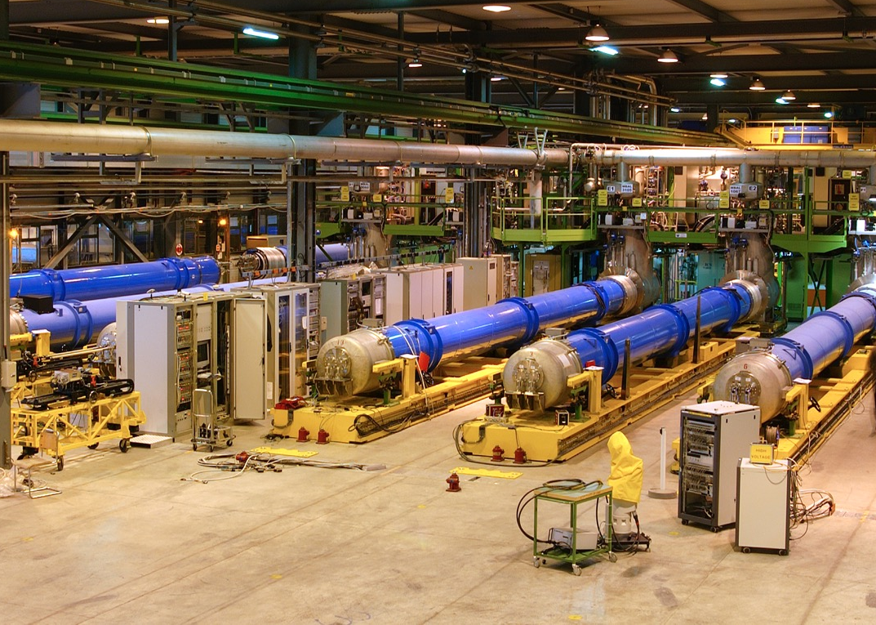

TEST OF LARGE MAGNETS
Marta Bajko
European Organization for Nuclear Research
(CERN TE-MSC-TF)
EASISchool 3 5th October 2020

Slide 2
The MANDATE of the testing team
To QUALIFY
magnets and cold powering equipment in real conditions
To PROVIDE FEED BACK
for superconducting cable and magnet design
OPERATE
in SAFE condition the test stands
MAINTAIN, DEVELOP, BUILD
test stands

Slide 3
The content of may lecture
The life of a magnet in the test stand
Magnet test is = Training ?
… and before going ahead with the test program I will recall some essential concepts used for testing as:
superconductivity : critical parameters
practical superconductors and their main characteristics
quench
    coming back to the testing we will than go trough (quasi) in chronological order of the test steps
Electrical Integrity checks
Connection to the installations
Cooling of large magnet
Measurements of RRR, Strain and Temperature Thresholds and triggers for protection
at this stage I will switch back to concepts as
hot spot temperature, Miits,
minimum propagation zone
quench propagation velocity
quench detection
energy extraction and stored energy
magnet protection
  to explain the way we choose the thresholds before going back to the main subject of
Measurements ( protection efficiency, splices, performance indicators and special measurements, recall Paschen’s law)
finally I will complete this lecture with a
Description of a test stand taking as an example a recent test stand built at CERN

Slide 4
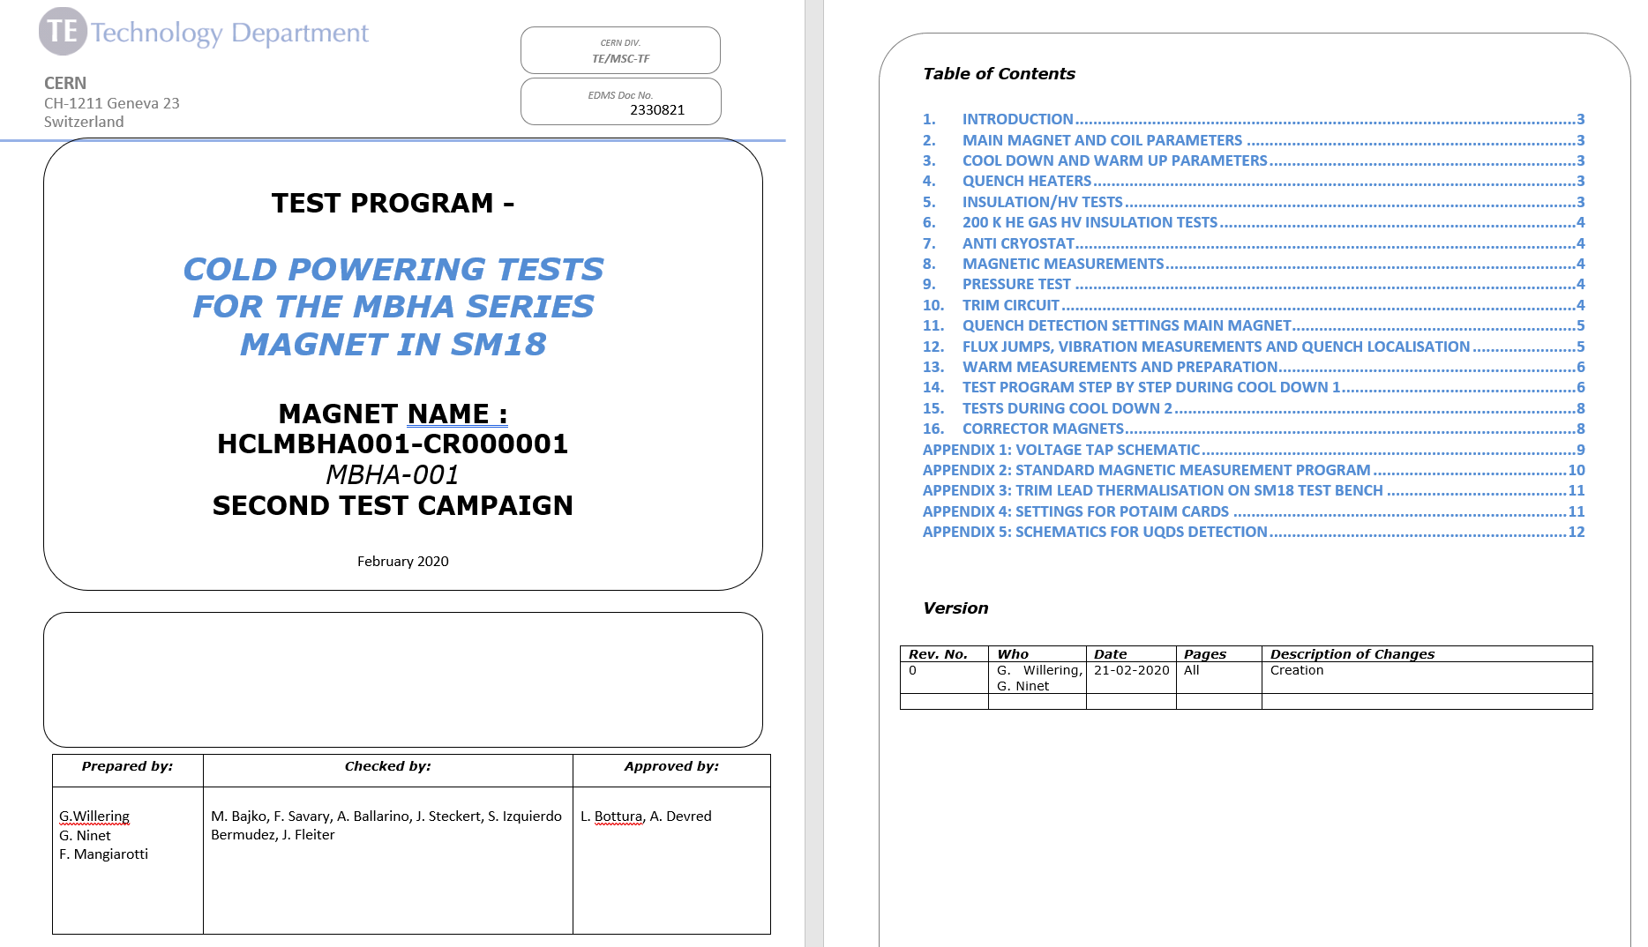
The life of a magnet on the test bench
Electrical integrity test
Electrical and hydraulical interconnections ( magnet to test bench)
Cooling
Electrical integrity test
Cold Powering Tests
check of protection
check of acquisition
check of extraction ( if any)
powering (=training)
Warming
Electrical integrity test

Slide 5
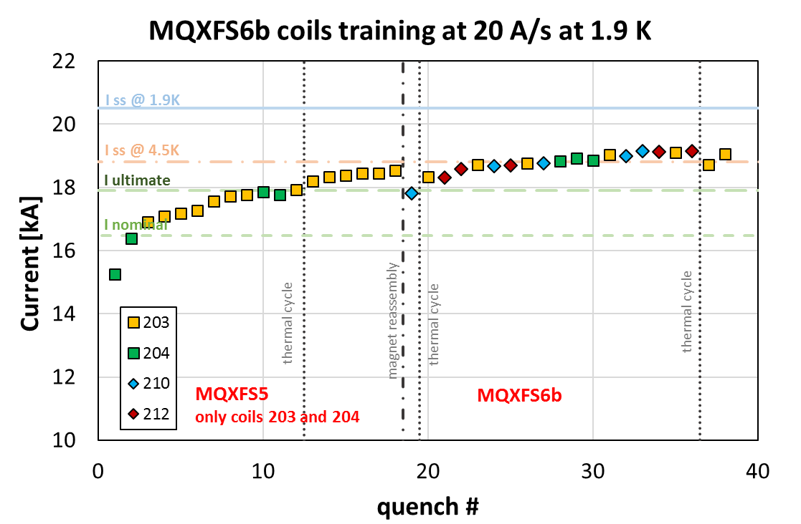
Magnet test = training ?
The final goal of the powering test is to qualify. In the case of the superconducting magnets we used to consider that testing is to make the TRINING of the magnet
Courtesy of G. Willering/ F. Mangiarotti

Slide 6
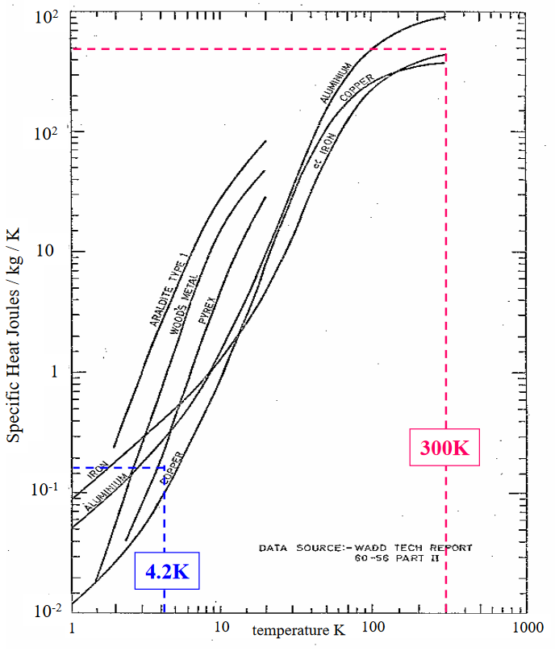
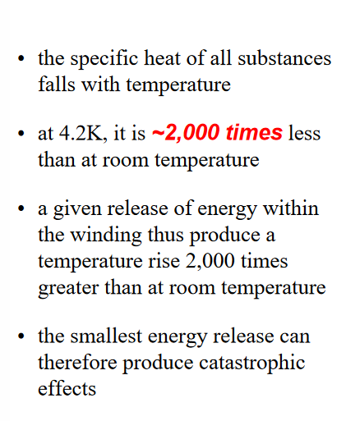
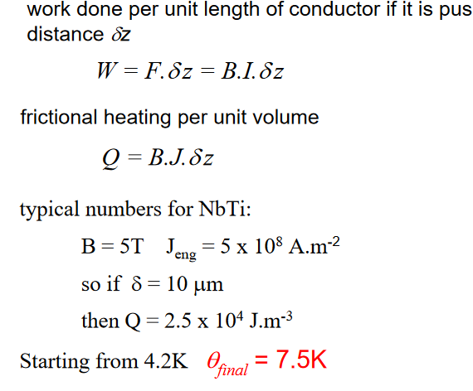
TRAINING
When the current of a magnet is ramped up for the first time, it usually “quenches” at less than the short sample limit .
At the next trial usually it does better.
This sequence of events is called : training
Ex. conductor motion
Courtesy of G. Willering/ F. Mangiarotti
M. N. Wilson

Slide 7
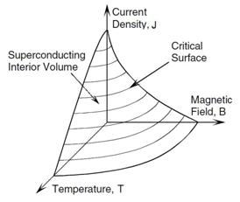
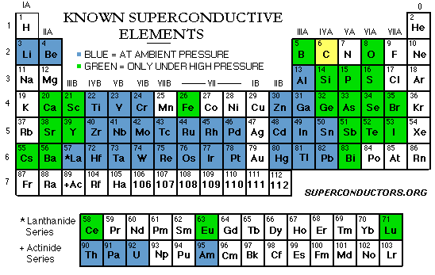
CRITICAL SURFACE
Superconductivity
UNDER CONDITIONS
Superconductivity exists in a 3-dimensional space given by magnetic field, current density and temperature called critical surface

Slide 8
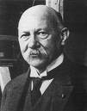

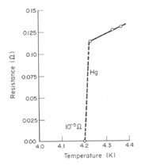
CRITICAL TEMPERATURE
In 1911, Kamerlingh Onnes discovers the superconductivity of mercury
  His team was investigating properties (resistivity, specific heat) of materials at low temperature
  This discovery has been made possible thanks to his efforts to liquefying Helium, a major technological advancement needed for the discovery
  Nobel prize 1913 “for his investigations on the properties of matter at low temperatures which led, inter alia, to the production of liquid helium »
Phenomenology
  Below 4.2 K, mercury has a non measurable electric resistance – not very small, but zero !
  4.2 K is called the critical temperature: below it the material is superconductor
Heinke Kamerlingh Onnes
(18 July 1853 – 4 February 1928)
Nobel prize 1913
E. Todesco - Superconducting magnets

Slide 9
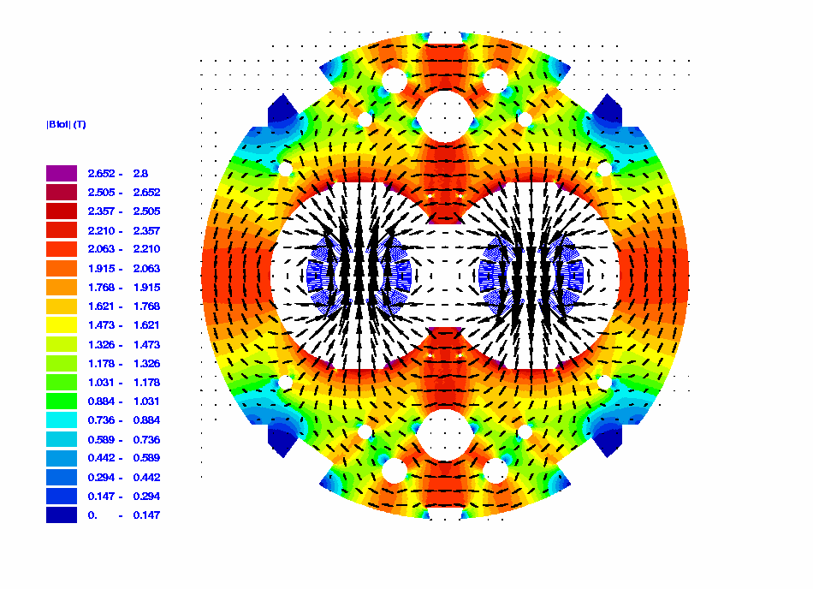
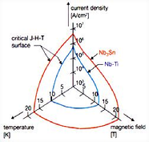
CRITICAL FIELD
J
J
CONDUCTOR limit
Load Line
Load Line
B
B
J
CONDUCTOR limit
When we design a magnet…..
Operating Point
  Ex. of a specification: ~2500 A/mm² at 12 T, 4.2 K, with 15 T short sample
Load Line
B

Slide 10
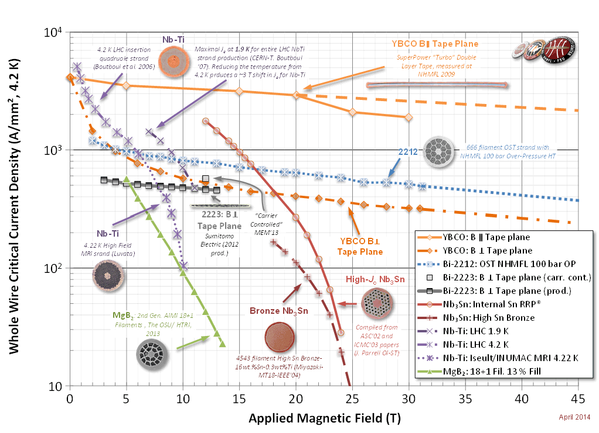
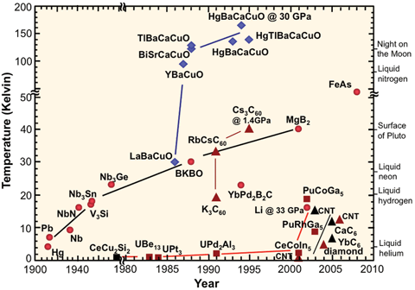
High TEMPERATURE or High FIELD
superconductors
77 K LN₂
Practical coolants ?
4.2 K LHe
In fact, in addition to their superior properties at relatively higher temperatures, HTS materials also come along with significantly expanded magnetic field capabilities.
E. Todesco - Superconducting magnets

Slide 11
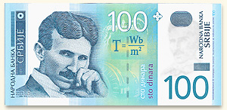
CRITICAL CURRENT DENSITY
the short sample field versus the coil width has an implacable law, that make the last teslas are very expensive
E. Todesco - Superconducting magnets

Slide 12
PRACTICAL SUPERCONDUCTORS @ 4.2 K
Nb-Ti is the workhorse of superconductivity
  Discovered in 1962
  Critical temperature of 10 K, critical field of 15 T
  All superconducting magnets for accelerators are made with Nb-Ti
  LHC pushed this technology to its limit with 8 T magnets
Critical current density in the superconductor versus field for different materials at 4.2 K [P. J. Lee, et al]
https://nationalmaglab.org/images/magnet_development/asc/plots/JeChart041614-1022x741-pal.png

Slide 13
PRACTICAL SUPERCONDUCTORS @ 4.2 K
Nb₃Sn allows doubling the Nb-Ti performance
  Discovered in 1954, before Nb-Ti
  Critical temperature of 18 K, critical field of 30 T
  It is ( unfortunately also) strain dependent
  Must be formed reacting it at 650 C for several days with tight tolerances on temperature
    After formation it is very brittle so coil has to be impregnated
Critical current density in the superconductor versus field for different materials at 4.2 K [P. J. Lee, et al]
https://nationalmaglab.org/images/magnet_development/asc/plots/JeChart041614-1022x741-pal.png

Slide 14
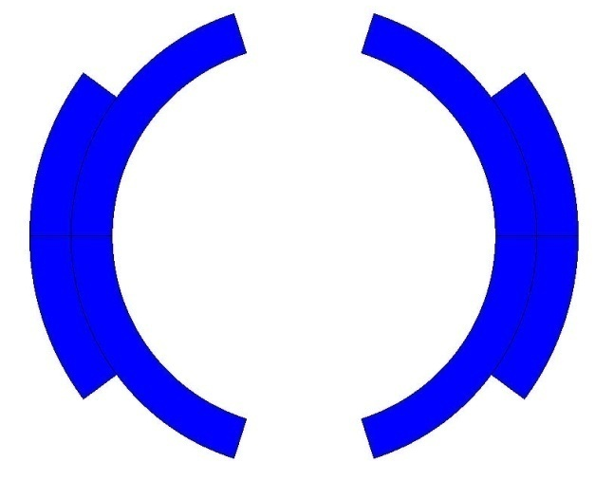
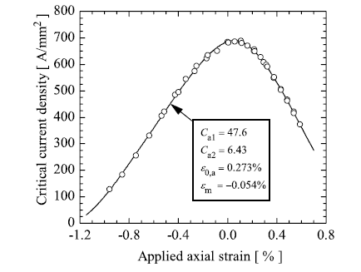
CRITICAL STRAIN
In the presence of a magnetic field B, a conductor element carrying current density j (A/mm²) is subjected to a force density f [N/m³]
The e.m. force acting on a coil is a body force, i.e. a force that acts on all the portions of the coil (like the gravitational force) – compressing the midplane and pushing the coils outward
  Ex. LHC dipole :
  F_{x} = 340 t per meter
A. Godeke et all 2006
So now we have to care ALSO about the mechanics!! And the strain sensitivity

Slide 15
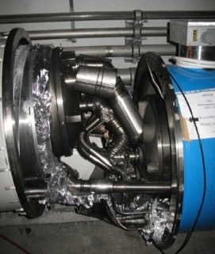
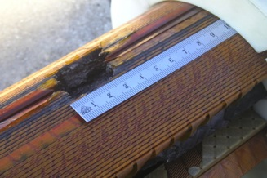
AND WHAT IF WE LOOSE ANY OF THE CRITICAL CONDITIONS?
Superconductivity is DESTROYED when loosing any of the critical conditions: temperature, current density, magnetic field
This is the result of a chain of events triggered by a quench in an LHC bus-bar
This is the result of a quench in the pre series magnet during its qualification test
L. Bottura Wamsdo

Slide 16
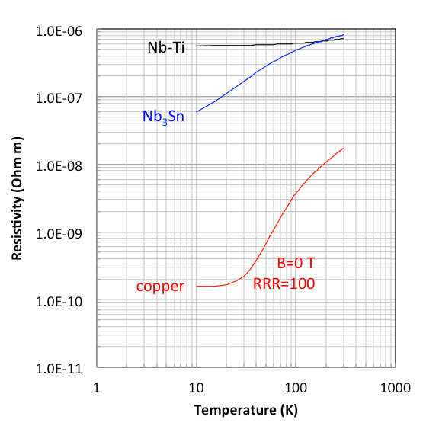
quench
The QUENCH is the result of a resistive transition in a superconducting magnet, leading to appearance of voltage, temperature increase, thermal forces, and cryogen expulsion.
  good superconductors are
  bad normal conductors
Typically, the normal state resistivity of LTS materials is two to four orders of magnitude higher than the typical resistivity of good stabilizer materials
We STABILISE Superconductors with a good conductor as ex. Cu
Superconducting stage
Normal conducting stage
T < T_{cs}
T > T_{c}
Ex of a magnet
R= cons= 0
L
R= variable = f( Iop, B, RRR, T)
R
L. Bottura Wamsdo

Slide 17
Electrical integrity checks: 1
High Voltage withstand level should be compliant with the specifications
During the quench one has
  a. a resistive voltage prop to I (where the magnet is quenched)
  b. an inductive voltage prop to dI/dt (everywhere)
L
R
Courtesy E. Todesco/ H. Felice

Slide 18
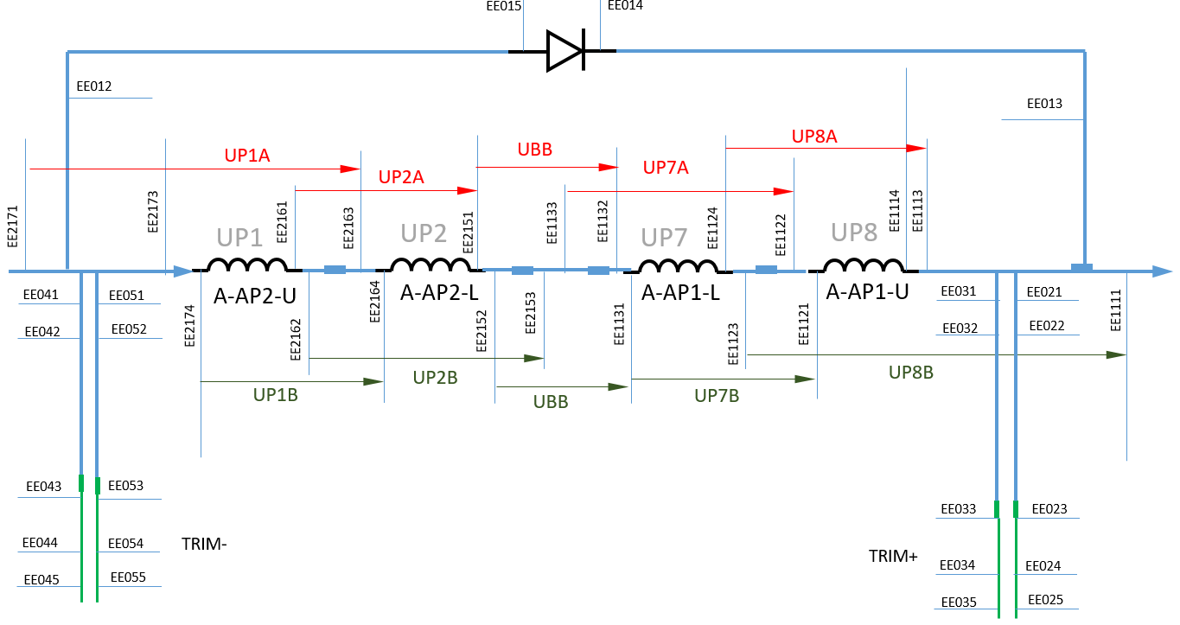
Electrical integrity checks: 2
Instrumentation should allow at least to produce the trigger signal for protection but ideally to give the maximum information on the performance
Typical instrumentation is :
voltage taps ( monitor transitions)
temperature sensors ( monitor cooling)
strain gauges ( monitor effect of forces)
Courtesy R. Denz

Slide 19
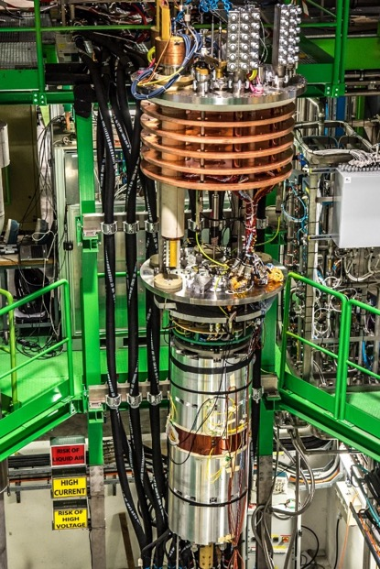
Connection of the magnet to the test stand
The cryostat “insert”
It is a non negligible and precise work!
Do not forget that cryogenic test are long processes ( cool down and warm up are long and therefor no room for mistakes!
… also to be retained that here you have to deal with vacuum and low temperature and high current
Instrumentation is going thought several intermediate connections but they still need to bring the signals CLEAN out from the cryostat to communicate with the magnet
The magnet

Slide 20

COOLING OF LARGE MAGNETS TAKES TIME!
Heat transfer from test stand to magnet
Range 300-80 K
  Exchanged heat Q_{cryo} ≈ 10 kW @ 60g.s⁻¹ & (T_{out}-T_{in})=30K
  Energy stored in 10 tons CM ≈ 800 MJ
  Cooling time aprox 24 h
Range 80 to 4.5 K
  Energy stored in 10 tons CM ≈ 50 MJ
  Q_{cryo}≈ 1.3 kW in average ≡ 4.3 g/s LHe
  Cooling time ≈ 12 h
$Qcryo=\dot{m} Cp (T_{gas out}− T_{gas in}$)
Convective heat transfer of Ghe to magnet
Q_{conv}= A_{tr}.h.(T_{surf}-T_{gas}) = Q_{cryo}
Courtesy Y. Leclerc
Once confined to low-temperature physics laboratories, superfluid HeII has become a technical coolant for advanced superconducting devices, to the point that it is now implemented in industrial-size cryogenic systems, routinely operated with high reliability.
There are two classes of reason that call for the use of superfluid helium as a coolant for superconducting devices namely,
  the lower temperature of operation, and
  the enhanced heat transfer properties
The chapter of cryogenics is far too complex, nice to keep it in few slides! This subject merits and other lecture!

Slide 21
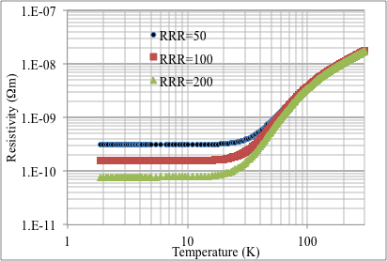
RRR and RESISTIVITY
Recall hot spot temperature:
Copper resistivity is the physical quantity with the most complex dependence
  At low temperatures, the value is dominated by the presence of impurities (measured by the so called RRR, residual resistivity ratio)
This is a measurement you do during cooling, but even better during warming up of the magnet. It gives an idea of a possible degradation if the value is very different from the expected one and allows to estimate the Tmax.
Courtesy E. Todesco

Slide 22
CRITICAL STRAIN
In the presence of a magnetic field B, a conductor element carrying current density j (A/mm²) is subjected to a force density f [N/m³]
The e.m. force acting on a coil is a body force, i.e. a force that acts on all the portions of the coil (like the gravitational force) – compressing the midplane and pushing the coils outward
  Ex. LHC dipole :
  F_{x} = 340 t per meter
A. Godeke et all 2006
So now we have to care ALSO about the mechanics!! And the strain sensitivity

Slide 23
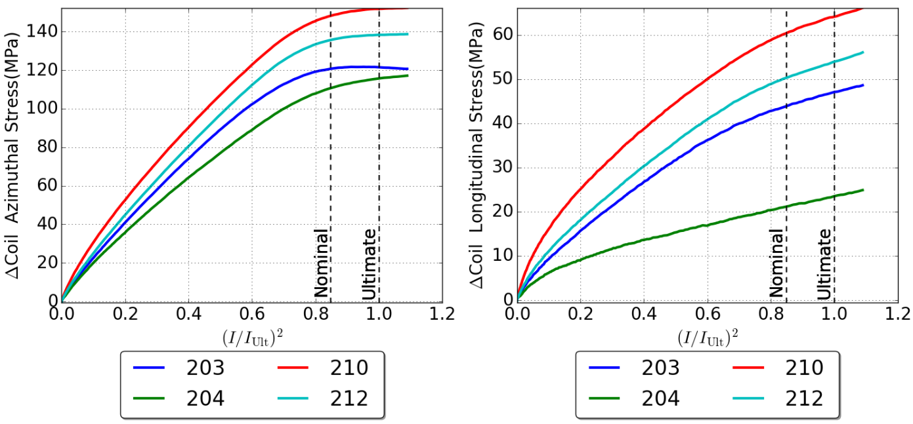
Strain measurements
The prestress paradigm is that coil should never be in tension but always pre-compressed (as reinforced concrete)
The initial reasons for this paradigm were field quality concerns
Later, it was believed that the detachment provokes training – and this is what many of us think still today
Ex. Aluminum shell, bladder and key technology
During cool-down increase in coil/shell stress
  Capability to control final coil and shell stress
See presentation of Susana Izquierdo

Slide 24
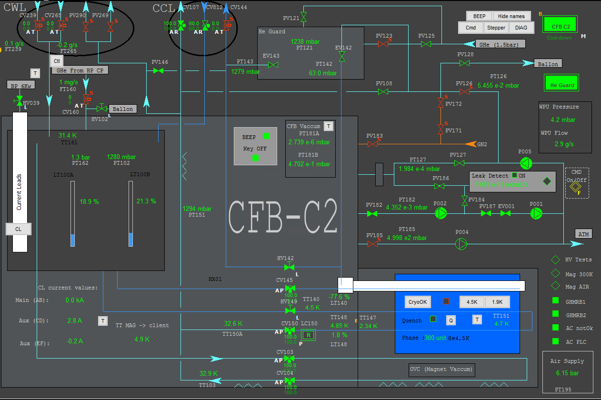
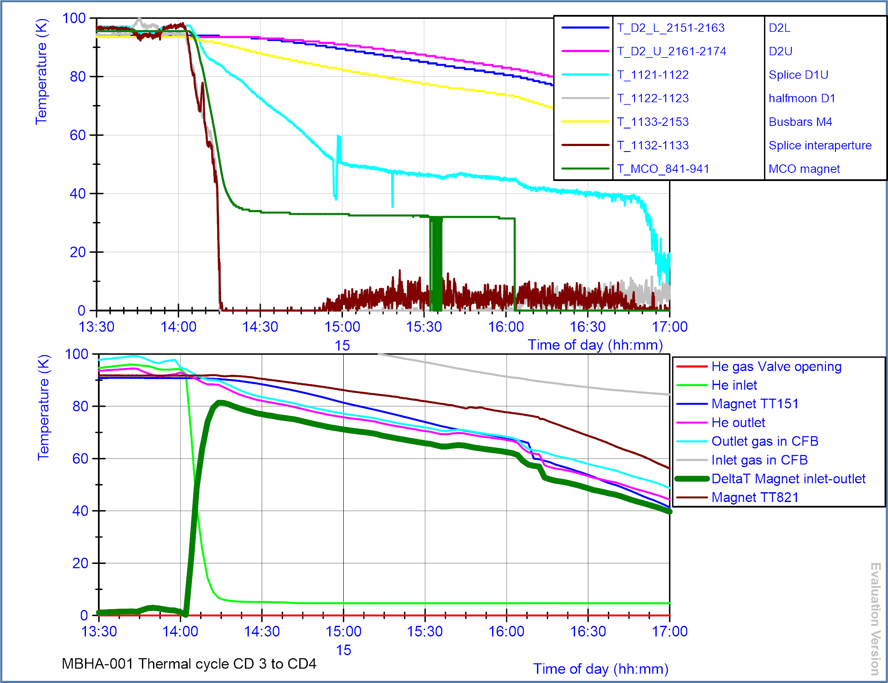
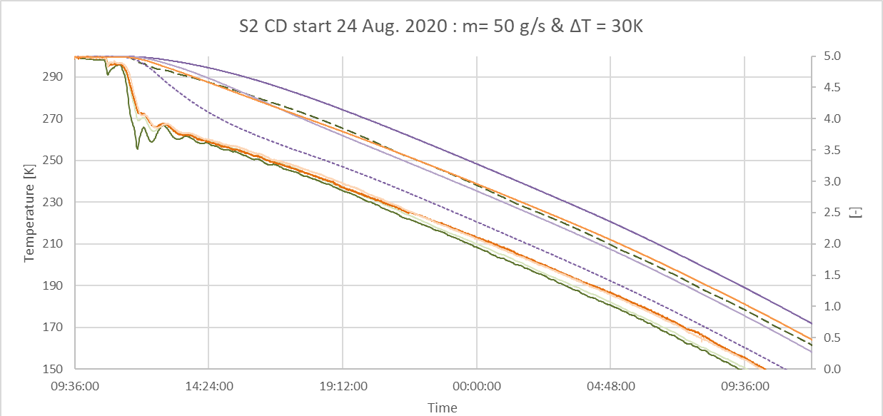
Temperature measurements
Courtesy G. Willering
In general rule we limit the colling speed to a max thermal gradient in the magnet not exceeding 30 K
( on this graph this was up to 80 K!)
Temperature measurements for cooling process control
Temp gradient of the magnet for stress control

Slide 25
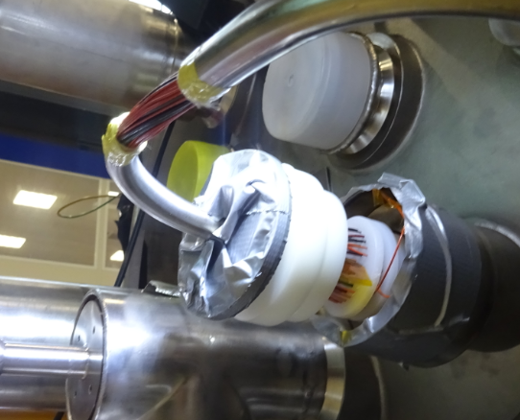
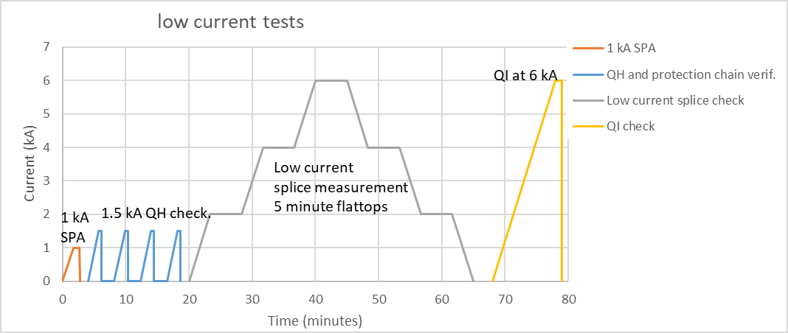
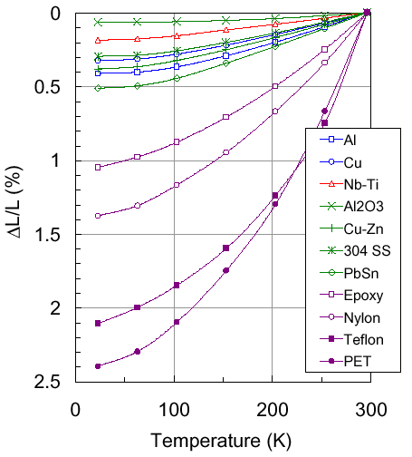
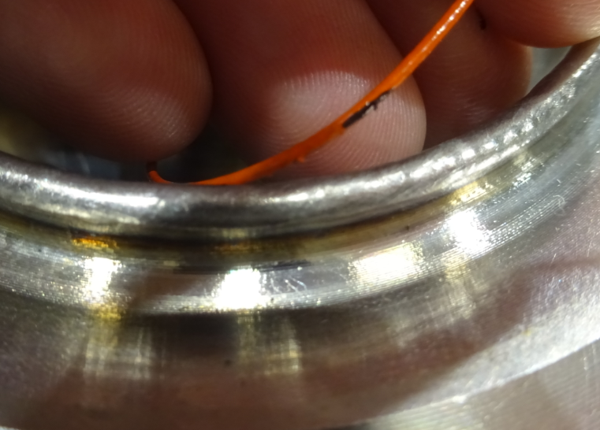
Electrical integrity checks at cold 1
High Voltage withstand level compliant with the specifications (aprox. 3 kV)
Check the good working conditions of the detection, and triggering of protection, extraction
Be sure that thermal contraction does not damaged the insulation
Courtesy G. Willering
Be sure that protection is working and no high resistance connections are present
Courtesy L. Bottura

Slide 26
Thresholds for protection
The SAFETY MATRIX system is using a redundant way of detection based on several signals. Any of the following signals fails it specified threshold values for the given time windows, the system sends a trigger to provokes a FAST POWER ABORT.
V Coil1- VCoil2 50-100 mV for 10 ms
V Coil3- V Coil4 50-100 mV for 10 ms
Vsum 50-100 mV for 10 ms
V_{Splices} 8-10 mV for 8 ms
V _{Leads} 80 mV for 500 ms
..but how we define these schematics and the threshold levels?

Slide 27
COMBINING SIGNALS FOR QUENCH DETECTION
  During the ramp, the magnet has an inductive voltage
    Example of LHC dipole: ramp at 10 A/s, inductance of 100 mH, voltage during ramp is 1 V
  The inductive voltage is removed by subtracting signals from two coils, or from two apertures (if the magnet has two apertures)
    The assumption is that only one coil is quenching, so that subtracting the two voltages the inductive part is removed and the resistive is left
    This is not working in the case of quench developing in the two coils at the same time (symmetric quench), where a second level of control is added
  The inductive part can be also removed by software (based on model) to reduce the voltage taps
L
R
If the signals are well combined,. and the magnet is superconductor , the acquired volatge signals are all indicating 0 V!

Slide 28
Hot spot temperature
the quench starts in a point and propagates with a quench propagation velocity
hot spot temperature: the conductor that has crossed the critical surface (current sharing temperature) and is in normal state is heated by the Joule effect
  where t is time, T is temperature, ρ is resistivity and C_{p} is volumetric specific heat
E. Todesco - Superconducting magnets

Slide 29
Hot spot temperature
hot spot temperature:
T_{max} must be limited to:
  limit thermal stresses (see graph)
  avoid material damage (e.g. resins have typical T_{cure} 100…200 °C)
T_{max} < 300 K for well-supported coils (e.g. accelerator magnets)
T_{max} < 100 K for negligible effect
E. Todesco - Superconducting magnets

Slide 30

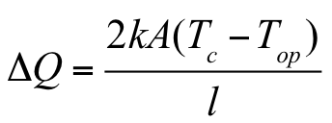
Minimum propagation zone
We now consider a superconductor wire where a length l and section A is above the critical surface (resistive condition)
  Local dissipation is
    ρ: resistivity
    j: current density
    q: dissipated heat density due to Joule effect
  Dissipation over the volume is
  Heat propagation through the surface A is
  T_{c}: critical temperature
  T_{op}: operational temperature
  k: conducibility (W/m/K)
l
A
  So above the length l_{mpz} the quench propagates
E. Todesco - Superconducting magnets

Slide 31
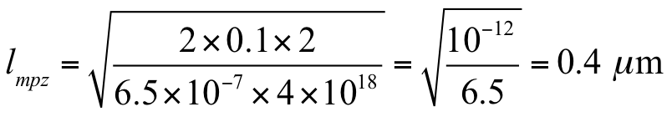
Minimum propagation zone
  Let us estimate this length, with j=2000 A/mm², ρ=6.5×10⁻⁷ Ω m, k=0.1 W/(m K), ΔT=2 K
This is very small
Embedding the filaments of superconductor in a copper matrix one can increase the minimum propagation zone by several orders of magnitude
  Cu resistivity 3×10⁻¹⁰ Ω m (2000 less than Nb-Ti)
  Cu conductivity 350 W/(m K) (3500 more than Nb-Ti)
The gain is of the order of 3000, so the minimum propagation zone increases from fraction of μm to mm, and the energy from nJ to μJ
E. Todesco - Superconducting magnets

Slide 32
QUENCH PROPAGATION VELOCITY
Typical quench velocities (along the cable) of the order 10 m/s
  The equation for quench velocity is
  Parametric dependence:
    proportional to current density in copper
    Inverse proportional to square root of temperature margin
  Can also be written as
    L₀ Lorentz number 2.45×10⁻⁸ W Ω /K²
  Example
    j: 400 A/mm² = 4×10⁸ A/m²
    C_{p}: 5×10³ J/K/m³ (considering at 4 K)
    T_{s}: 4 K T_{op}:2 K
    One finds v_{q}=4×10⁸ / 5×10³ × √(2.5×10⁻⁸× 4/2) = 18 m/s
E. Todesco - Superconducting magnets

Slide 33
QUENCH DETECTION
How to translate the quench velocity in a resistance growth ?
  Equation for resistance growth
  For example, LHC dipole
    I = 12 000 A
    A_{Cu}= 15 mm² = 15×10⁻⁶ m²
    ρ = 5×10⁻¹⁰ Ω m
    Scaling factor from velocity to voltage increase: 5×10⁻¹⁰ / 15×10⁻⁶ × 12000 = 0.4 V/m
    Therefore for a 17 m/s quench velocity, the voltage increase of of the order of 7 V/s
    So for a 100 mV threshold, reached after 15 ms
  The presence of the Cu fasten the resistance growing allowing the detection of a quench and so the extraction of the energy without damaging the coils.
E. Todesco - Superconducting magnets

Slide 34
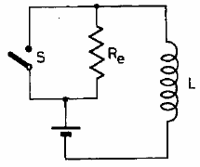
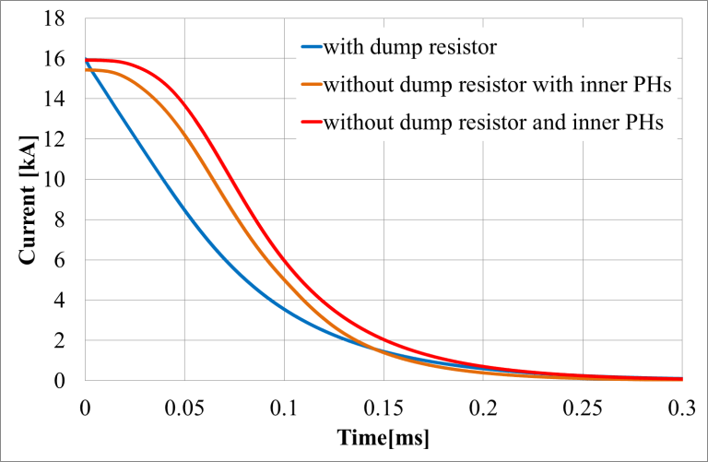
Energy extraction
The higher the resistance, the faster the current dump, the lower hotspot …
For a fast de-excitation in the case of a quench, a magnet can be equipped with external energy extraction systems with circuit breakers and energy-absorbing dump resistors.
The reaction time of the switch is not zero!!
E. Todesco - Superconducting magnets
…..but adding an external dump resistor creates a voltage at the magnet leads, proportional to the dump resistor. So the resistor size is limited by magnet insulation. Moreover for a chain of magnets ( as in the LHC) or long is not efficient ( n x L/R)

Slide 35
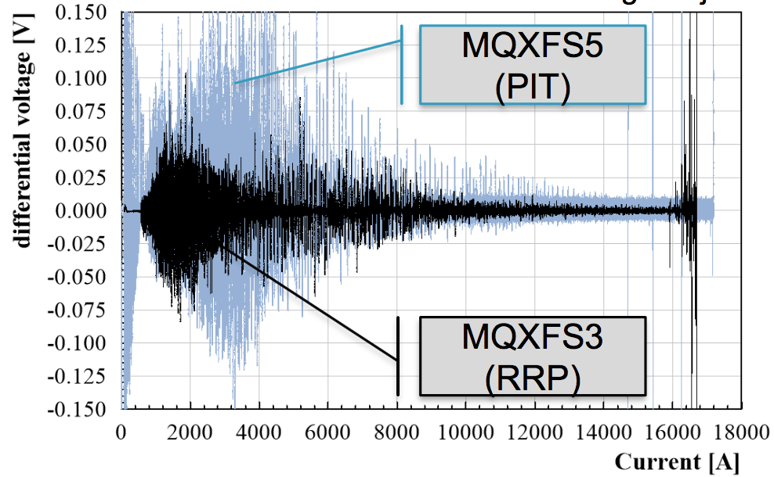
NOISES AND FLUX JUMPS
Flux
jumps
Flux jumps in Nb₃Sn
  In magnets based on Nb₃Sn conductor, at low fields flux jump phenomena provoke spikes in voltages
    These spikes can be much larger than 100 mV, and therefore can be erroneously interpreted as a quench
  Larger thresholds have to be used at lower current
    Protection is not put in danger since at lower current there is more margin
E. Todesco - Superconducting magnets
H. Bajas

Slide 36
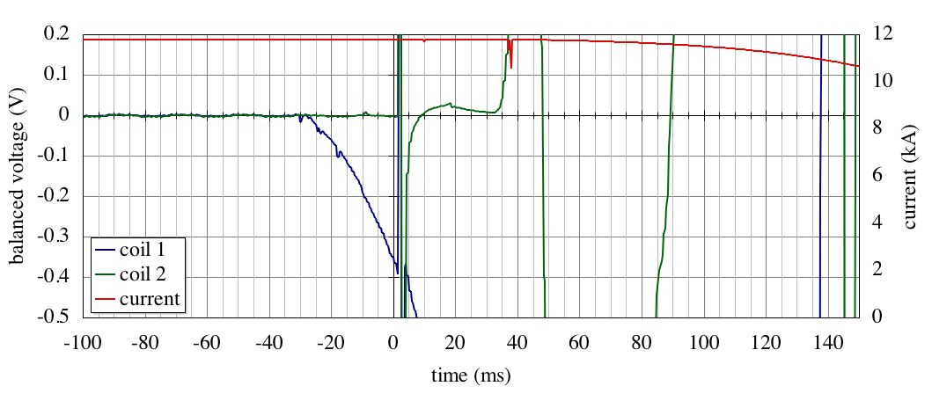
..BUT HOW WE DEFINE THE THRESHOLD?
Example of an LHC dipole magnet training quench
precursor
switch
dump
propagation
detection threshold
detection
fire heaters
trigger (t=0)
t_{detection}
t_{delay}
t_{switch}
t_{dump}
t_{quench} ≈ t_{detection} + t_{delay} + t_{switch} +f t_{dump}
Courtesy L. Bottura Wamsdo

Slide 37
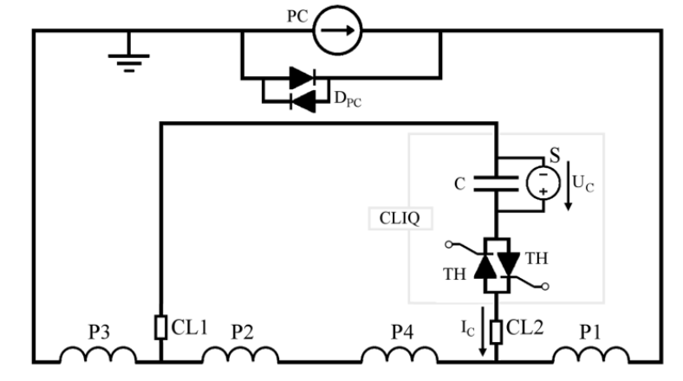
Heat to protect
The best way to get rid of the current is to increase the resistance, transforming the local transition in a global transition to normal conducting state
  This corresponds to rapidly heating the whole coil above the critical surface of the superconductor

Slide 38
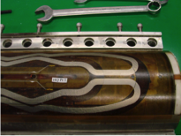
Quench heaters
  Quench heaters are strips of stainless steel where an impulse of current by capacitor discharge is put as soon as the quench is detected.
  Strips heat thanks to Joule heating and give heat power to the coil. The reaction time that can be obtained is of the order of 10-50 ms
  One has to guarantee two conflicting conditions:
    a good electrical insulation between heater and coil
    a good thermal conductivity between heater and coil

Slide 39
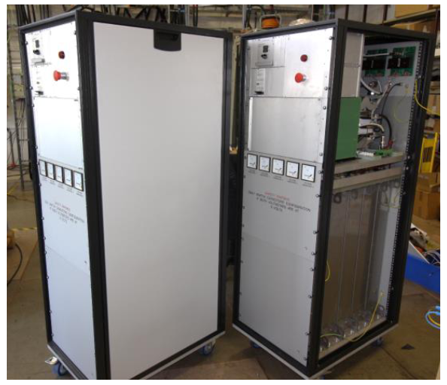
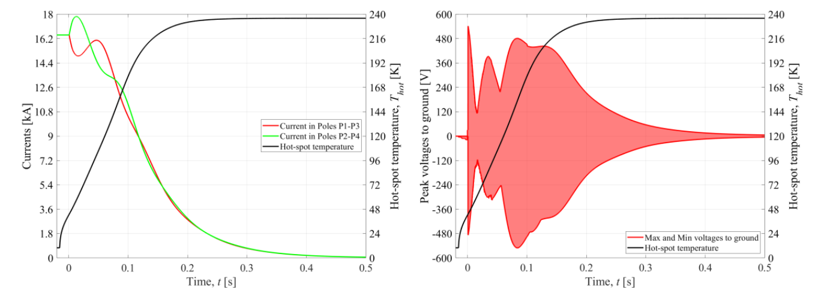
cliq
CLIQ (Coupling Losses Induced Quench)
  This system is based on injecting in the magnet coils two opposite impulses of current via a capacitor.
  The mechanism is the heating due to interfilament coupling losses induced by the variation of the field
It has been developed at CERN and patented in 2014 (EP13174323.9)
D. Wollmann HL-LHC Technical Design Report

Slide 40
Protect with bypass diodes
In case of a resistive transition in the superconducting magnet, the turn-on voltage of the diode is exceeded, and the current commutates from the quenched magnet to the diode during the de-excitation of all magnets in the circuit.
Protection of Hardware: Powering Systems (Power Converter, Normal Conducting, and Superconducting Magnets)
By B. Flora et all

Slide 41
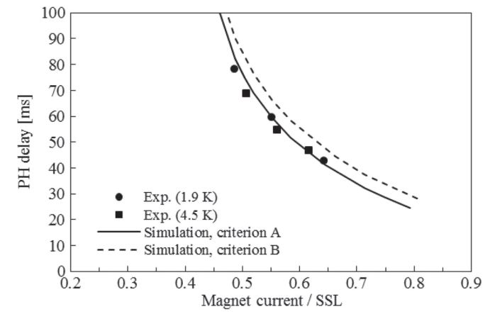
CHECK OF PROTECTION EFFICENCY
Measurement of the time between heater activation and transition to resistive state of the coil are done typically during the R&D phase.
  The quench heater strip is made by stainless steel – ususally 25 mm
  One has to guarantee two conflicting conditions:
    a good electrical insulation between heater and coil
    a good thermal conductivity between heater and coil
  This is achieved with a polyimide strip of 25-75 mm thickness
    The thicker the polyimide, the longer the time to heat the coil
    The thinner the polyimide, the higher the risk of electrical short between heater and coil
Heaters delay measured vs model in HQ, 25 μm polymide (left) and 11 T 75 μm polyimide (right)
[T. Salmi, et al, IEEE TAS 25 (2015) 4004212]

Slide 42
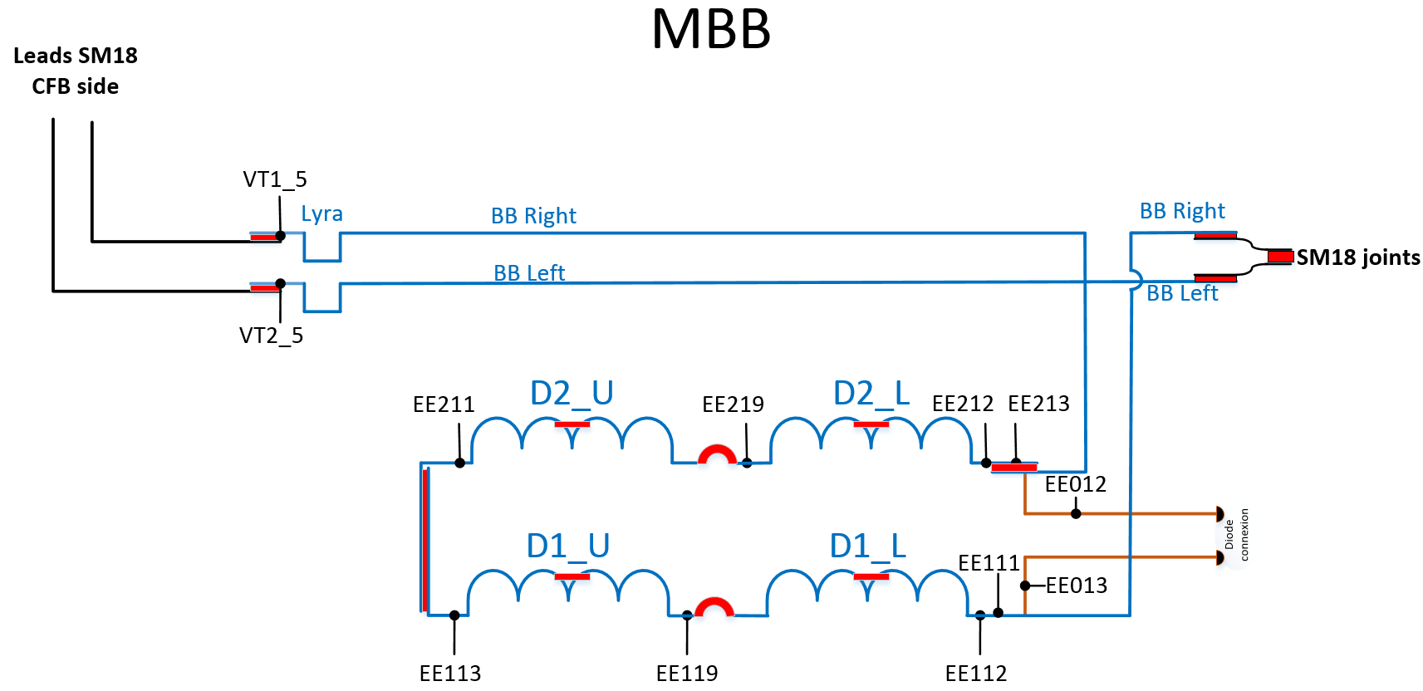
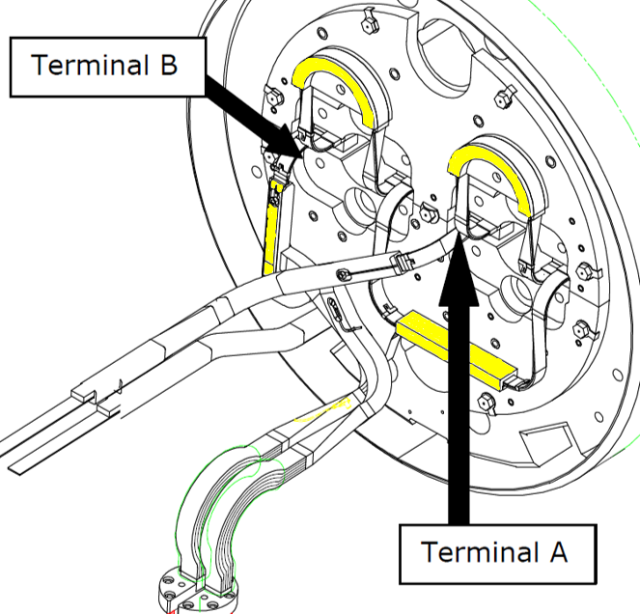
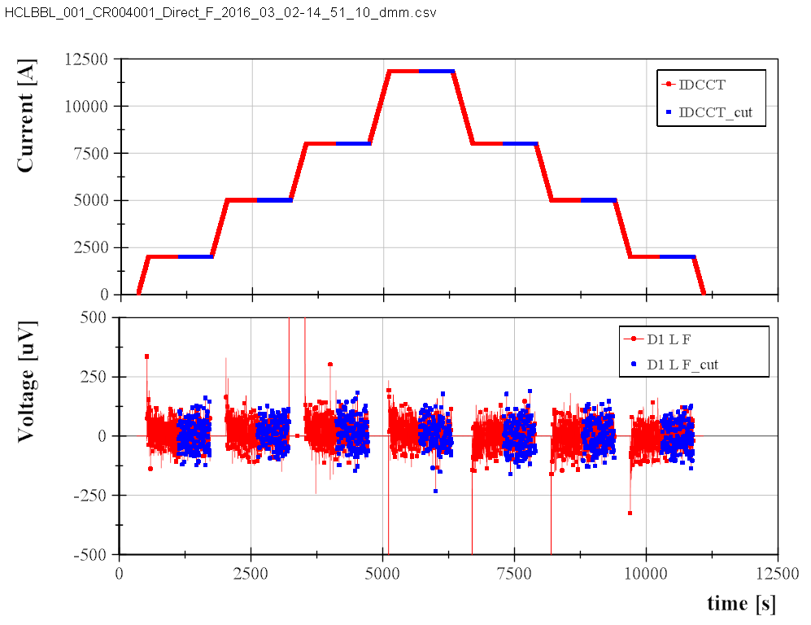
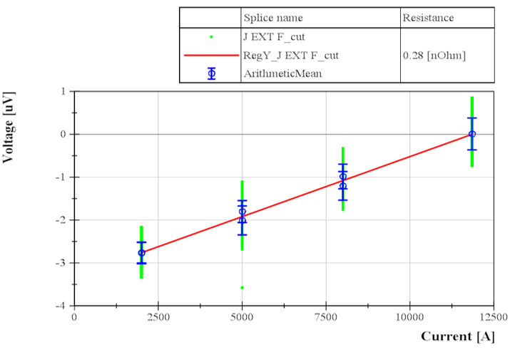
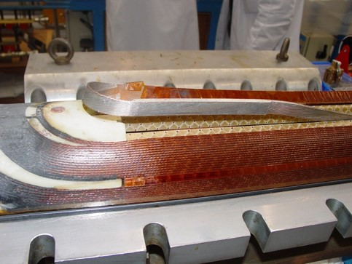
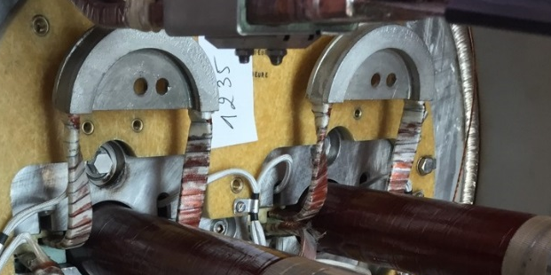
SPLICE MEASUREMENTS
Current cycle from 50 to 11850A with voltage measurements on plateaus (dI/dt=0)
Slope of curve is the resistance (get rid off offset)
U=RI + LdI/dt

Slide 43
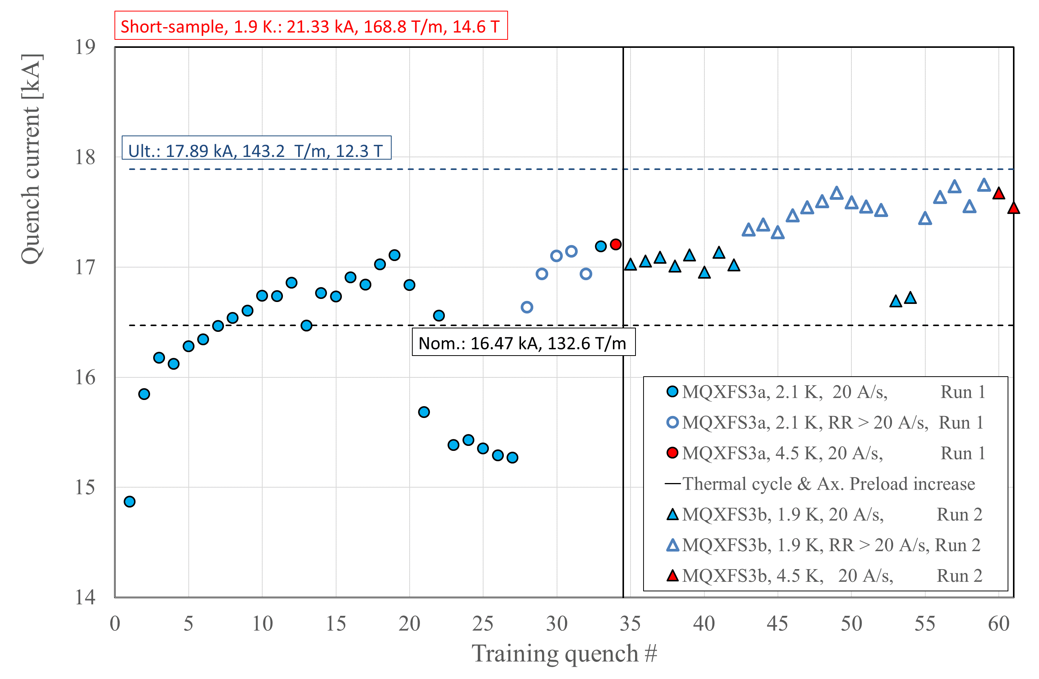
PERFORMANCE INDICATOR: TRAINING, MEMORY
S3a training in many different locations, all coils.
Detraining in coil 7 I3I4
High ramp rate quenches (several locations) allow to overcome c7 I3I4 limitation up to higher level
Axial preload is increased during thermal cycle (S3a→S3b)
S3b quenches at nominal ramp rate in c7 I3I4 and c105 I3I4
High ramp rate allows higher quench current but does not overcome the limitation (4b)
(4)
(5)
(4b)
(1)
(2)
(3)
Courtesy of F. Mangiarotti

Slide 44
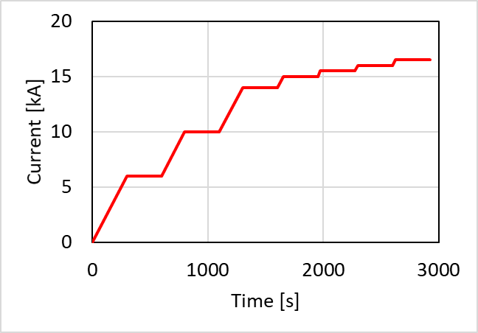


PERFORMANCE INDICATOR: VI measurements
Expected electric field in a degraded conductor.
Simply adding
a reduction factor ($f_{I_{c}}$) for I_{c}
a reduction factor ($f_{n}$) for n
f_{Ic} | 0.62 (38 % reduced) | 0.26 (74 % reduced)
f_{n} | 0.20 (80 % reduced) | 0.12 (88 % reduced)
$$E(I,B)=E_{c}{\left(\frac{I}{f_{I_{c}}I_{c}(B)}\right)}^{\left(f_{n}n(B)\right)}$$
Courtesy of G. Willering

Slide 45

PASCHEN’S LAW
Mean free path of an electron… chain reaction and avalanche breakdown.
p = pressure
d = distance between the electrode
a & b depend on the media
The critical voltage: minimum of the Paschen’s curve
The break voltage:
  decreases with the distance between electrodes
  decreases with the pressure
  decreases with increasing temperature (better at cold)
  in air, increasing humidity decreases the breakdown voltage.
Courtesy of H. Bajas

Slide 46

Electrical integrity checks after Thermal cycle
After a thermal cycle one can not exclude the presence of He gas in the coil which would reduce the breakdown voltage… therefore the final voltage withstand test should consider that and adapt the insulation checks by :
  a. reducing the voltage and so the safety margin ( and taking the risk to not detect a problem)
  b. adapting the conditions: temperature and pressure…
To be noted:
Room temperature GHe is the most critical media.
Pressure helps… temperature does not.
(Hot Spot – Vmax – Pmin ?)
Courtesy of P. Fessia

Slide 47

TEST STANDS
Courtesy of A. Kosmicki

Slide 48








TEST STAND MAIN INGERDIENTS
Test cryostats
Powering circuits
Protection elements
Cooling elements
Handling tools
Cryogenic infrastructures
Data acquisition systems
Safety interlock systems
Analysis software…. ect
…..but before all it is an interdisciplinary, enthusiastic team

Slide 49





TEST CRYOSTATS
They can be very versatile and different from each other; the typical image we have about is a vertical cryostat with a He vessel, a vacuum tank and an insert with or without a lambda plate

Slide 50


A RECENT INSTALLATION AT CERN: CLUSTER D
EE and DUMP on the 2 m LEVEL
POWER CONVERTERS AT GROUND LEVEL
PREPARATION ZONE AT 0 AND -3 m LEVEL
5.5 m
ELECRICAL AND CRYO RACKS NEAR THE CONTROL ROOM
2 m
0 m
TWO ODH ARE IN THE -3 m ZONE ( mostly justified by presence of N₂)
-3 m
CONTROL ROOM NEAR THE CLUSTER
-10 m
COLD He RECOVERY BUFFER - 8 m³ à 5 bar, UNDER THE WORKING AREA IN CONFINED SPACE
NEW OVERHEAD CRANE ALLOWS HADLING 25 t AND AT -3 m LEVEL

Slide 51

CLUSTER D: ELECTRICAL CIRCUIT
EL CIRCUIT PARAMETERS
Maxi stored energy 10 MJ
Short Sample current 21.5 kA
Magnet inductance 8. 27 mH/m
Nominal Ramp Rate 11 – 20 A/s
Max Ramp Rate 200 A/s
Max current 30 kA
Max EE voltage 1 kV
Reaction time : < 10 ms
DESIGN DRIVEN BY: cost reduction and operation optimization implying to use two existing 15 kA power converters for the new circuit

Slide 52





THE ENERGY EXTRACTION OF THE CLUSTER D
DESIGN DRIVEN BY : Reaction time < 10 ms, which implied the use of IGBTs
THE 30 kA SWITCH IS MADE OF 2 UNITS OF 15 kA EACH COMPOSED BY A MODULE OF 7.5 kA
EACH UNIT OF 15 kA IS EQUIPPED WITH A DUMP RESITOR
FOR 5 MJ
DESIGN GOLAS FOR BUS BARS
Equal paths for all currents
Equal impedances
Compact and cold:
(T max 110 °C and 80 °C on junctions)

Slide 53

QUENCH HEATER DISCHARGE SUPPLIES
The Quench Heater Discharge Supplies are the units responsible for energizing the quench heaters strips installed on the magnet coils in order to dissipate the energy stored in the magnet into its full volume, hence limiting the hot-spot temperature at the location of the original quench and preventing damage to the coil.
Ex. A DQHDS for HL-LHC magnets:
a bank of capacitors (7 mF/ 1000 V).
nominal operating voltage of the capacitors will be 450 V and therefore an overall voltage for the capacitor bank of 900 V is expected to
deliver ~ 3.5 kJ to a single quench heater strip
D. Wollmann HL-LHC Technical Design Report

Slide 54



WATER COOLING AND CURRENT LEADS
DESIGN DRIVEN BY Optimization in operation :
Flexible cables
Current lead operation homogenized with the rest of the test stand and minimized flow
CONVENTIONAL GAS COOLED Cu LEADS:
length: 1.7 -2.1 m
top flange d:260-280 mm
Connection : SC cable
Water Cooled Cables
SPECIFIED PARAMETERS
Current: 5 kA DC
Max in. temperature: 28°C.
Pressure in operation: 16 bar.
Maximum delta T: 10°C.
Water speed : <2.5 ms⁻¹
Max. temperature : 50°C.
Operating Voltage: 1 kV
(if fault to ground)
He vapor flow @ 4.2 K:
20 kA lead: 0.87 g/s
30 kA lead: 1.82 g/s
15 kA lead: 0.88 g/s
500 MM²
CABLES SECTION
Current Leads
SPECIFIED PARAMETERS
Main circuit: 20 kA/30 kA
Secondary circuit: 15 kA
Design pressure : 5 bara
Max. Voltage to GRD: 3.5 kV

Slide 55


TEST STANDS : DEMINERALIZED WATER
a need estimated to 1.7 MW (142 m³/h).
….demineralised water station with a thermal capacity of 800 kW limiting the operation to two test stands

Slide 56



CLUSTER D DAQ SYSTEM
Example of HF system
DAQ
SPECIFIED PARAMETERS
Input channels: +/- 10 V analog
Nr of HF channels: 200 differential
HF frequency: 200 kHz
HF,MF,LF resolution: 16 bit resolution
HF,MF,LF accuracy: 1mV
MF frequency: 50 kHz
Nr of LF channels: 144
LF frequency: 1kHz
Timing: GMT synchronization
Data Analysis with DIADEM

Slide 57

TEST STAND : HADLING
To enable insertion of test objects into the HFM cryostat the operating height, must be increased to 6 m (presently 5.3 m).
Cluster D, on the other hand, will be deeper than the existing vertical facilities. To handle the inserts the operation depth between the hook and the top of the cryostat must be increased to 9.3 m.
Heavy and long magnet needs adequate handling systems!

Slide 58
Summary
You Can Only Make As Well As You Can Measure
By. Joseph Withworth

