Slide 2
Commissioning Preparation Coordination Activities – List of tasks 2020

Slide 3
ToDo List - 2020
Tools cluster:
  Performance tracking tools
    WP1 deadline end of March 2020
    WP2 deadline end of May 2020
    WP3 deadline end of August 2020
  NXCALS: feedback for injectors
    When? How (configuration, testing)?
    pytimber or other python API to interface with NXCALS
  Python tools from CO: pjLSA, pyjapc, ….
  Optics measurement tools: what should be operational from day 1?
    Who will write them?
    Status of JMAD models
  Standard optimization framework for online optimisers
  Reference measurement system with new logbook and availability for first beam

Slide 4
ToDo List - 2020
Commissioning preparation cluster:
  HWC check lists preparation: Consistency of structure across machine?
    IST list incorporated
  Readiness of check lists
  General software readiness
  Commissioning preparation analysis per machine
    4 h informal meetings per machine → communicate summary
Commissioning planning cluster:
  POPS, POPSb, Switchyard and LBE run
  Verification of IST planning: BI and BLMs,…
  Experimental Area/AD/ELENA ISTs compatibility with injectors: WIC in east area,…
  When to start piquet services?
  Revisit SPS standalone beam commissioning plan: LHC delay, RF constraints, AWAKE,
  Detailed beam test plan for LBE run 2020
    Aim at MDs

Slide 5
ToDo List - 2020
Commissioning planning cluster - continued:
  Details for ion commissioning in the SPS: FFA, LHC ions (re-phasing), FT ions, slip-stacking
Injector schedule cluster:
  Review Injector schedule September to December 2021
  Xmas shutdown 2020-21: decision on mini ITS
  MD requirements 2021 in injectors
  Finalize DSO test dates (TI 8, TI 2 with LHC,…)

Slide 6
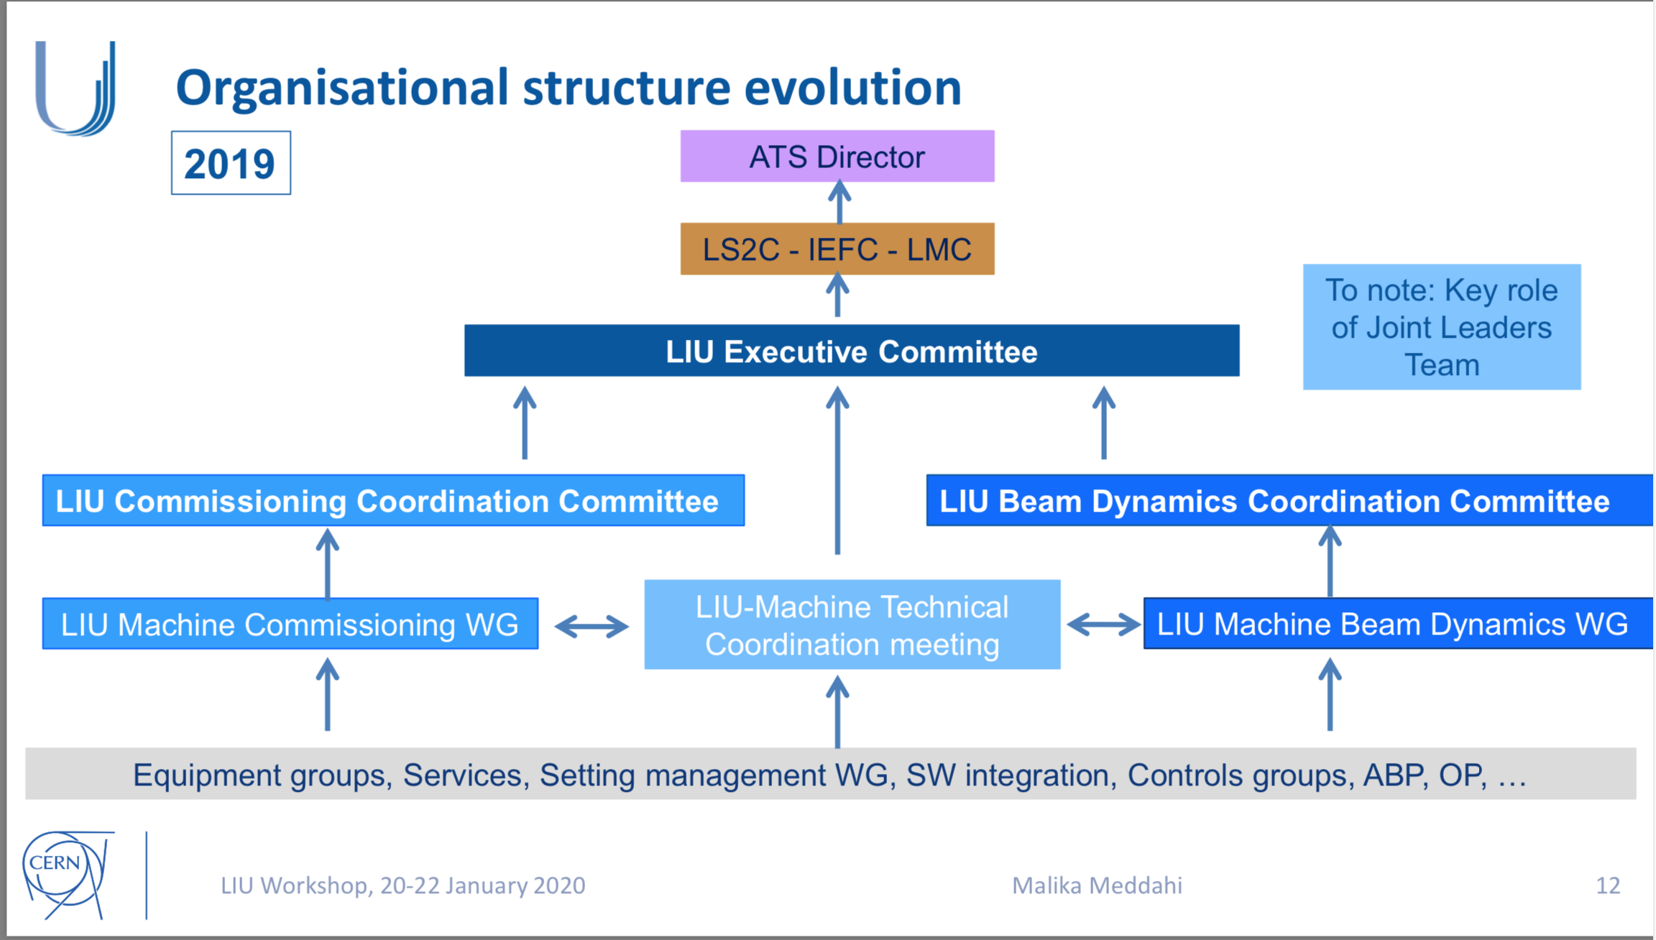
This is the last LIU CCC
The work will however continue → Injector Performance Panel

Slide 7
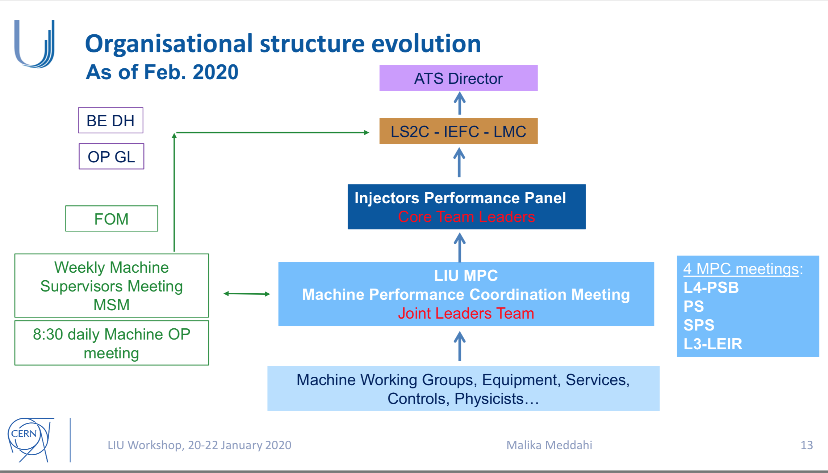
This is the last LIU CCC
The work will however continue → Injector Performance Panel

