Slide 1


The BIS-78 Resistive Plate Chamber Upgrade: Commissioning Software
Alexander Kaipainen
April 9, 2020

Slide 2
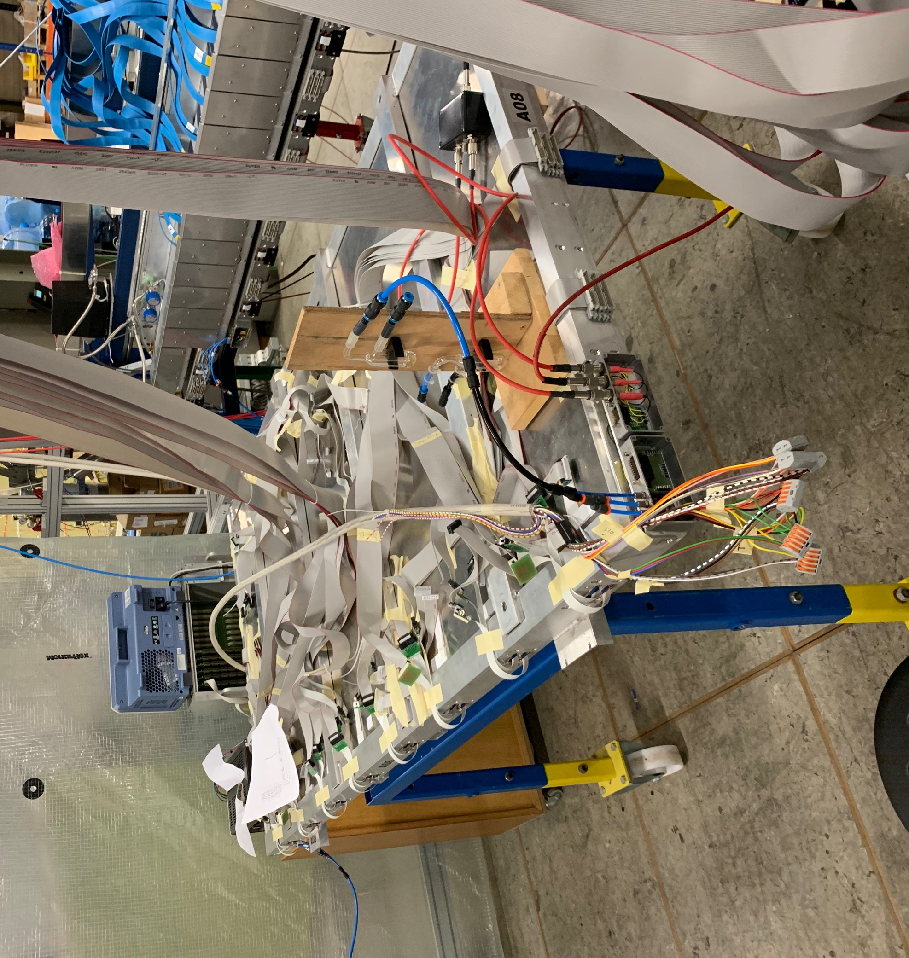
Outline
Quick recap of BIS-78
Commissioning software
  Overview
  Architecture and organization
  Analysis
Current life

Slide 3
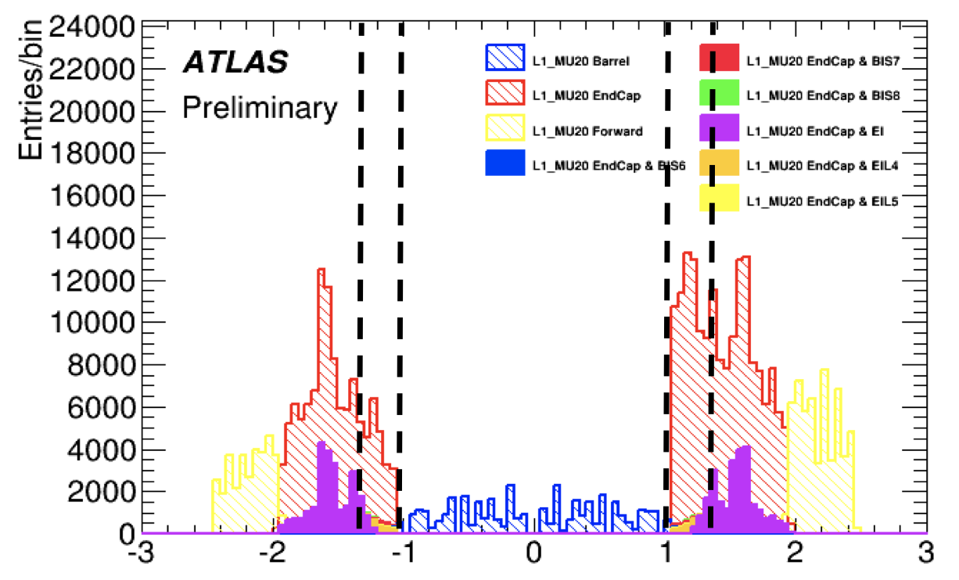
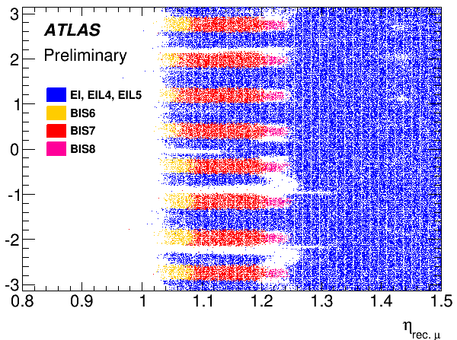
BIS-78 Motivation
High trigger rate in the barrel-endcap transition region (1.0 < | η | < 1.3)
With increasing luminosity, it is very important to reduce the fake rate trigger in the 1.0 < | η | < 1.3 region
Half of the azimuthal region in 1.0 < | η | < 1.3 is covered by existing end cap triggers, so the other half will be covered by the BIS-78 system
Notes:
This is where my project BIS78, comes in
Currently there are a few major problems:
There are holes in the coverage of the muon spectrometer
There is a very high trigger rate in the pseudorapidity 1.0 to 1.3 region (the region inside the dotted lines here.
Yes there are also high trigger rates outside eta=1.3, those will be fixed by the new small wheel ☺ @marius
Lastly, ALTAS is increasing the luminosity, or proton collisions, in the future and the current RPCs are not going to be able to handle the data load
These problems are addressed by BIS78:
The blue in the bottom picture shows the regions covered previously
The red region shows what BIS78 will now cover
Filling these holes will solve the high trigger rate problem and the hole coverage problem
BIS78 is also a pilot program for a new type of RPC called a tRPC which will be able to handle the higher rate of data in future years,
so if this works, there will be a much larger project to install many more tRPCs

Slide 4
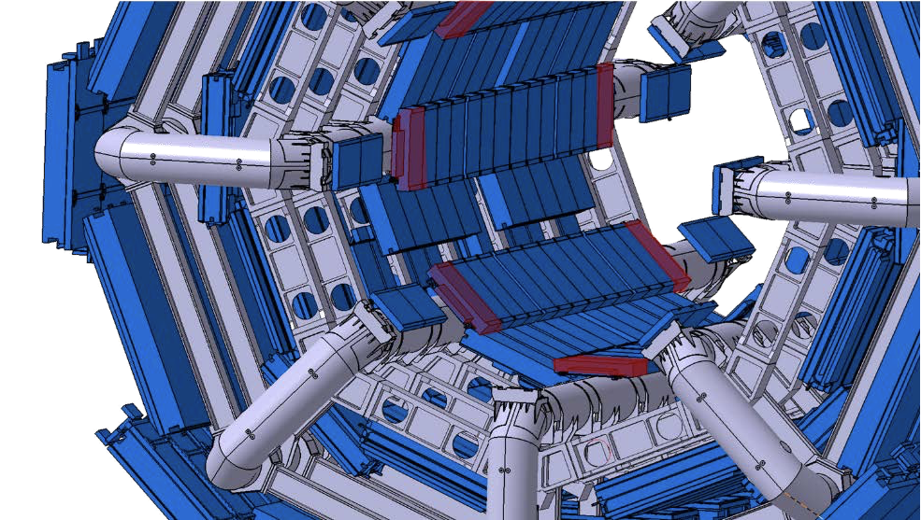










BIS-78 Location
Will be installed in the BI region near the endcap
This is a “small” pilot project for the much larger Full BI layer upgrade in Phase-2 which will install detectors with the same technology to the entire BI region
BIS-78 in phase 1/run 3 2021
Full BI Layer for Phase-2/Run-4 2026
Notes:
Here is a picture of where exactly the BIS78 chambers will go.
As the name suggests: in the Barrel Inner region
The red is BIS78 and the yellow is the future BI installation assuming all goes well here

Slide 5
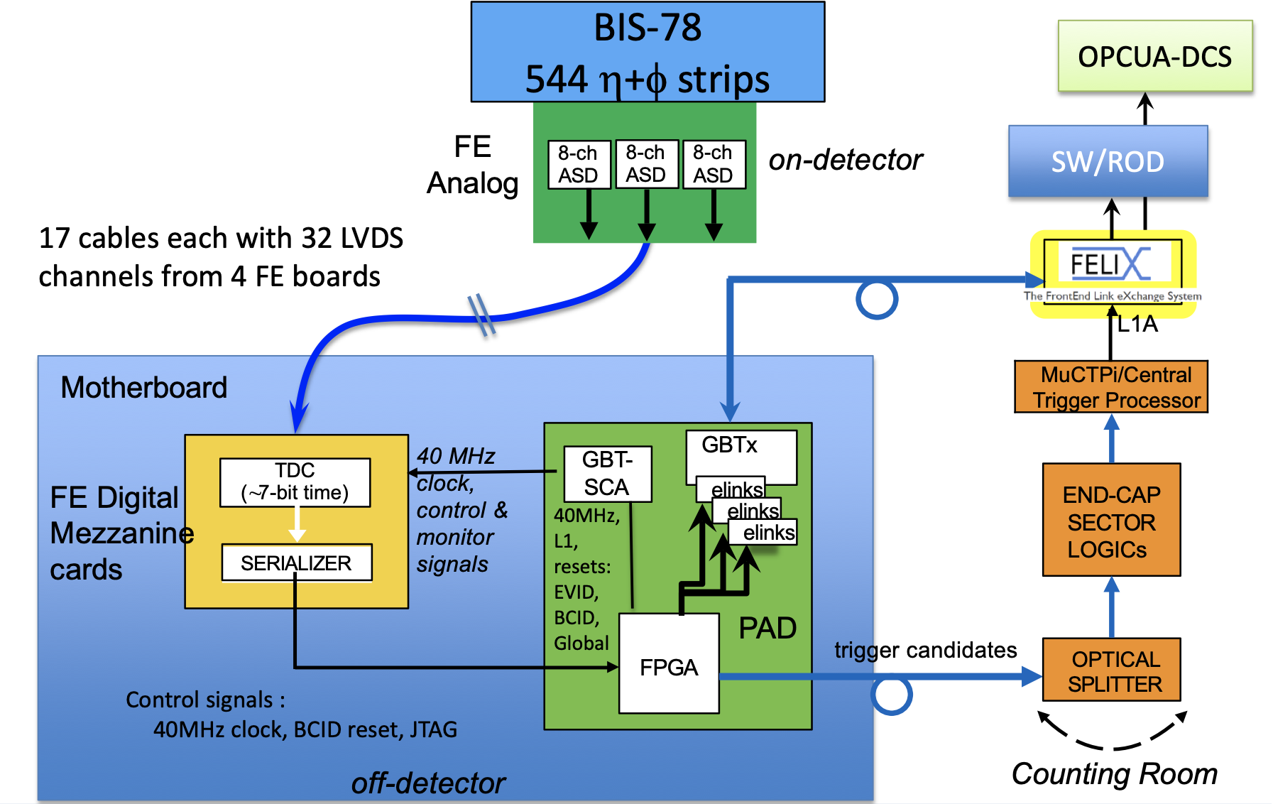
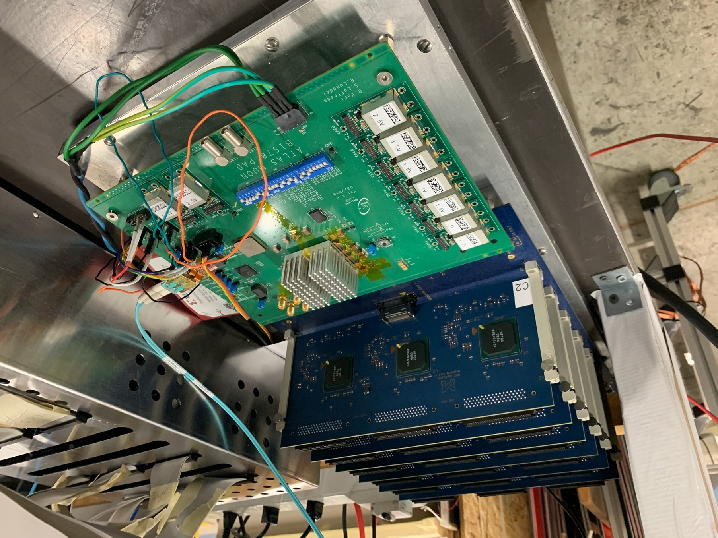
BIS-78 Vertical Slice
This is a data flow map that highlights the key components in the vertical slice
ATLAS Cavern
USA-15
Notes:
Before I talk about the analysis, I wanted to show the data flow of what actually happens
Yada yada yada about how it works.
Here is a picture of the blue rectangle here. The yellow thing is this mezzanine card and the green thing is the PAD board.

Slide 6
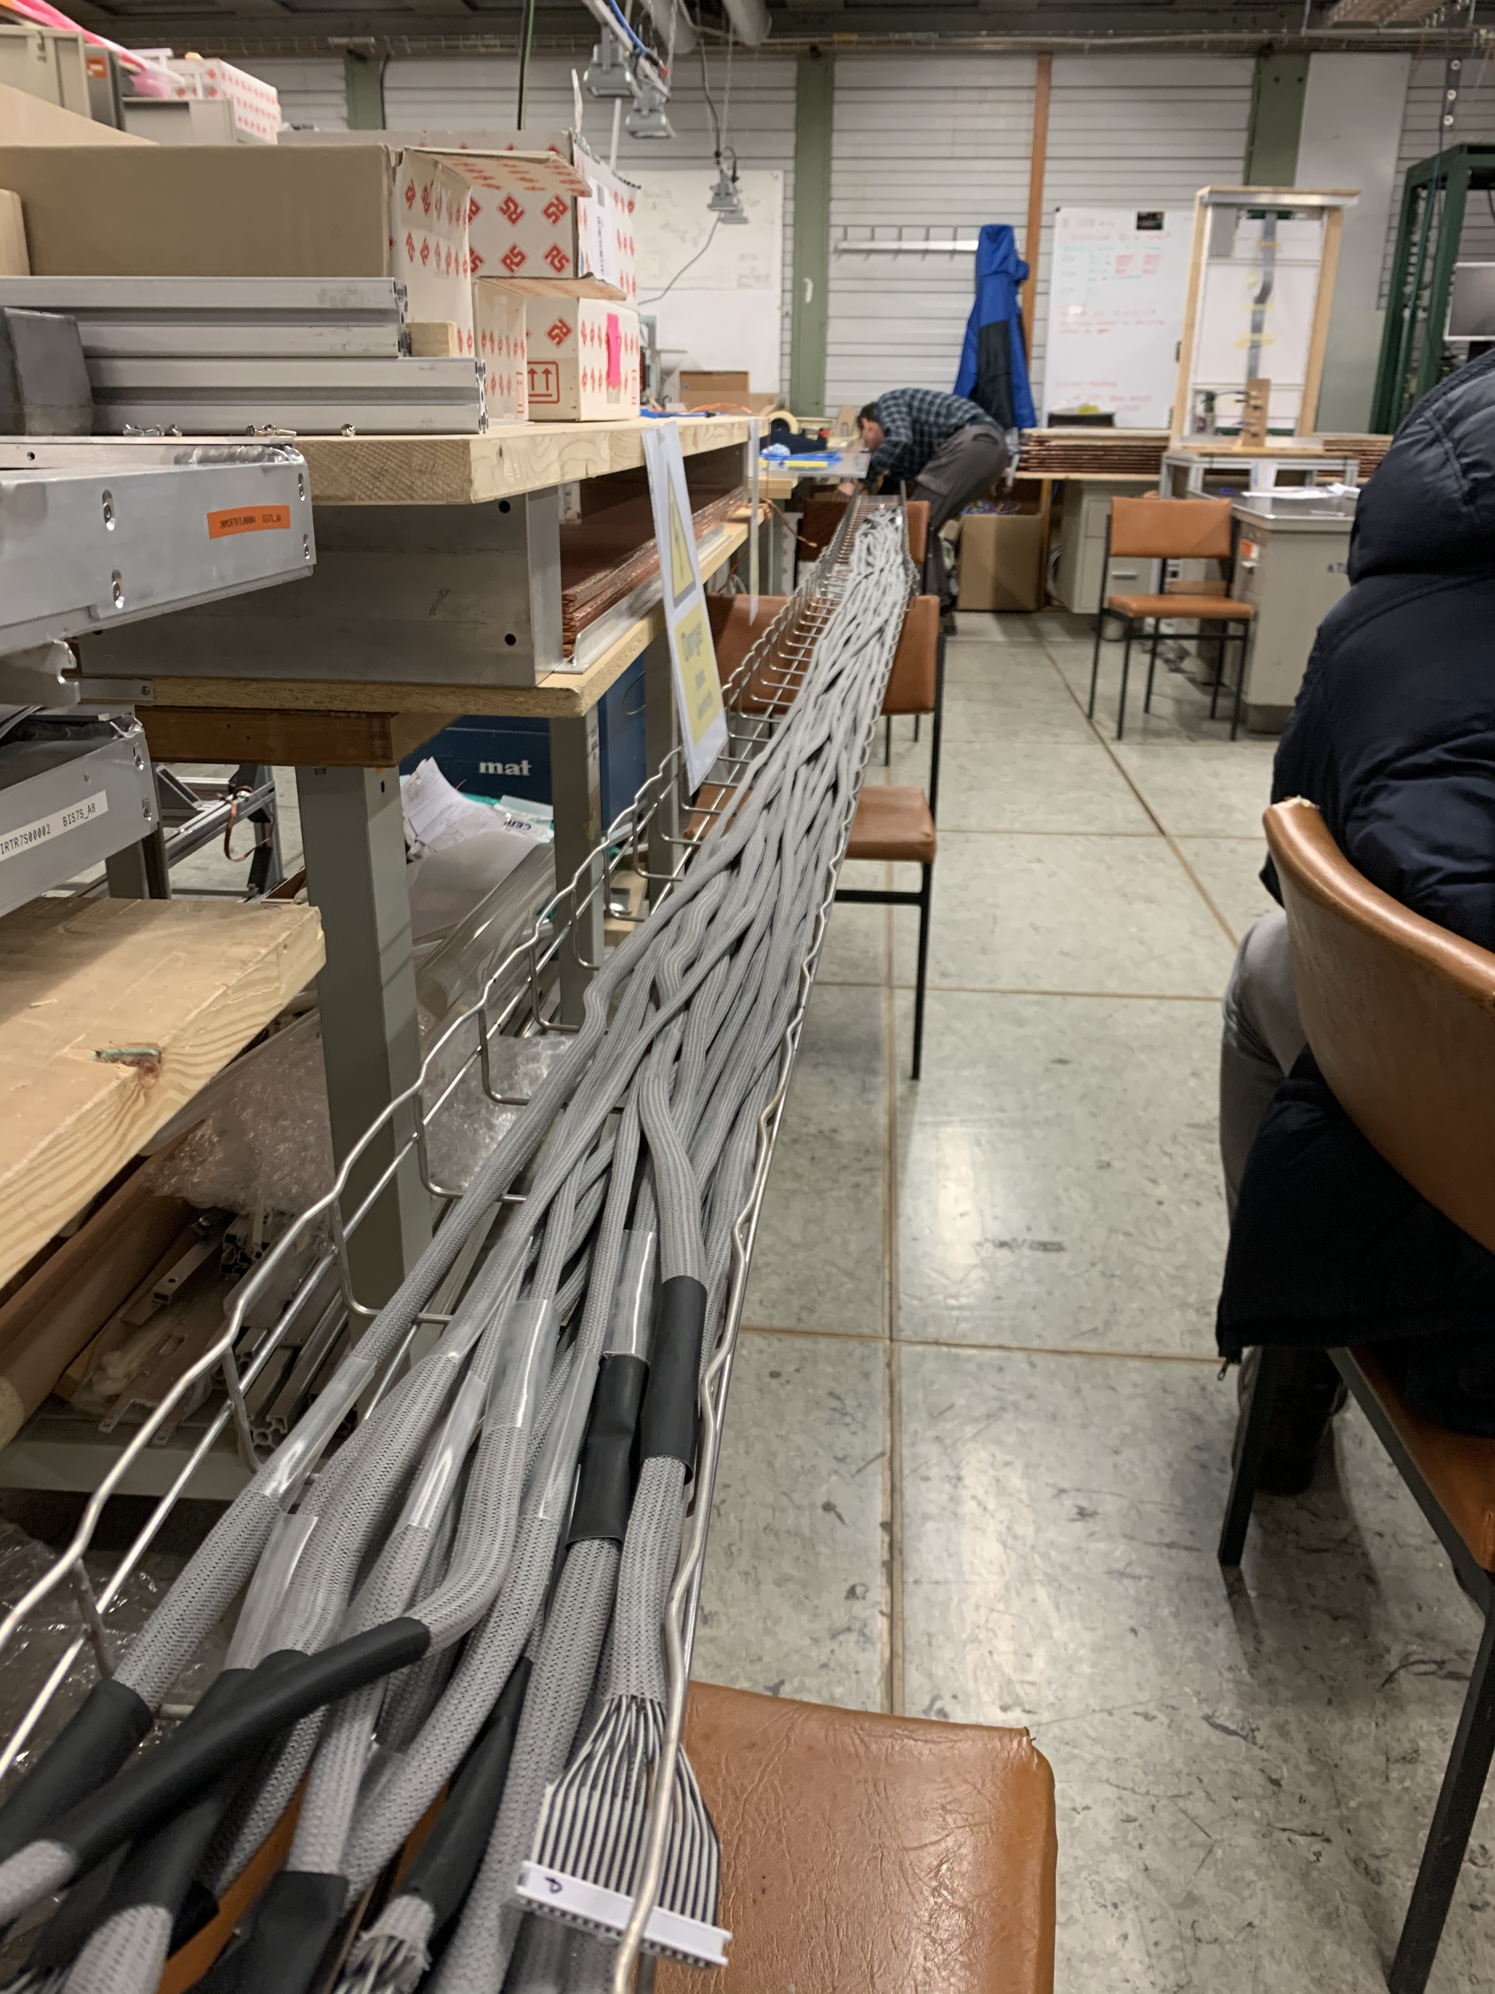
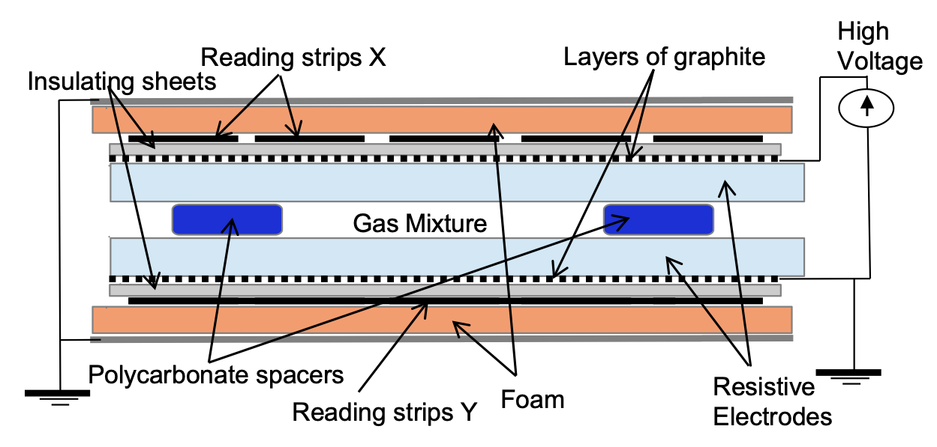
Chamber Strips + Front End Board
Muon ionizes gas inside RPC
Strips detect moving charged particles
Front end board amplifies signal and converts to LVDS signal to pass through 5m cables to TDC

Slide 7

TDC + Motherboard
32 channel LVDS cables run into TDCs with predefined mapping
TDCs assign BCIDs and fine times to incoming signals
32 channel data from TDC gets sent to serializer
TDC

Slide 8

FPGA + PAD Board
Serialized data gets read into queue buffers in the FPGA
FPGA logic chip wait for incoming hits
  If two hits are read within 100ns, create an event window of 1600ns and output all data in this window
  Otherwise, do not send data
Send data to FELIX elinks through fiber cables
FPGA

Slide 9
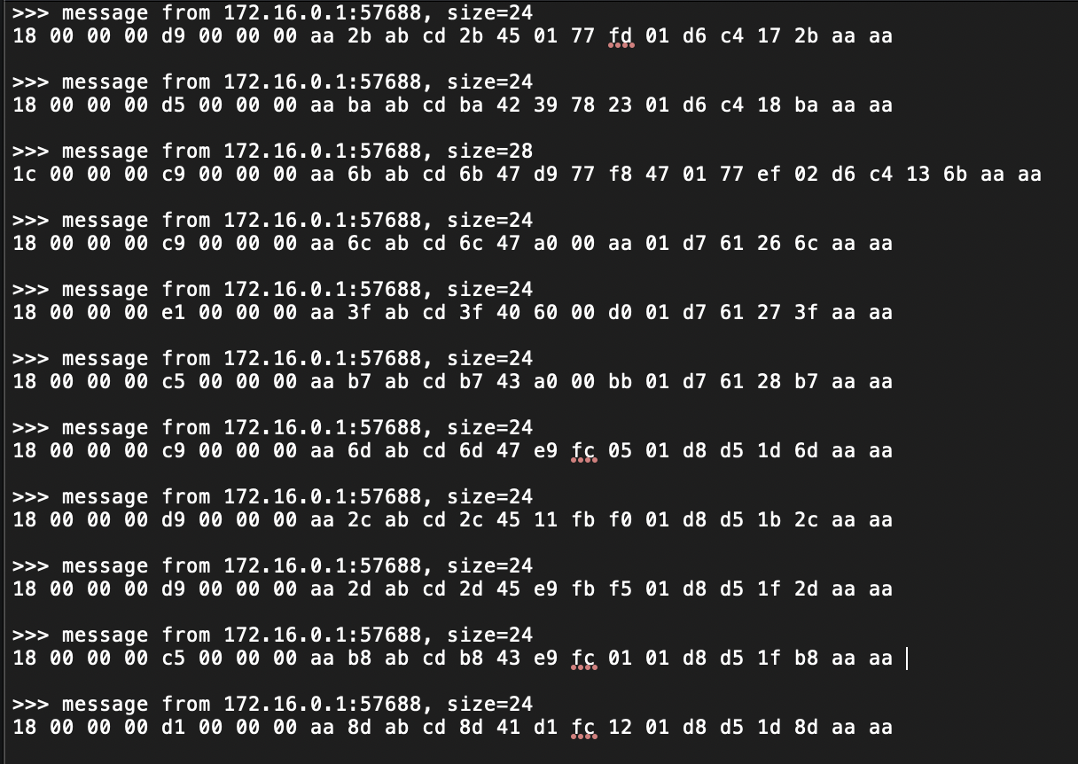
FELIX + Beyond
Data from felix is published via network to address
Use program netiocat to read data
Problem: How to turn raw network packets into useful information?

Slide 10
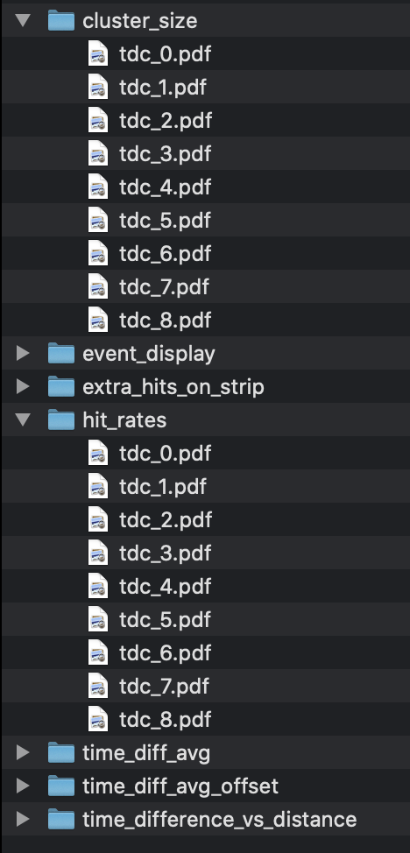
Commissioning Software:
90% Complete
Toolchain to perform quick analysis (<5s)
  Currently need to move around files and run 3 programs
Very easy to add new tasks/histograms
Automatically handles all types of data from electronics
  Leading edge/pair mode
  Trigger/no trigger
  Different cable mappings
Outputs ROOT Tree and pdf files of all histograms
Output files of analysis performed on all TDCs

Slide 11
Architecture and Organization
Commissioning Library output
This project is split into various modules:
  ANALYSIS: Framework for analysis tasks and execution
  BASE: Custom datatypes used by other modules live here (Ex: Cluster, Store)
  MAPPING: Defines detector geometry and parameters (TDC mapping)
  RAW: Handles raw data from .dat files
  RECON: Handles reconstruction pipeline (Data -> Clustering -> Tracking)
  TASK: Defines all custom analysis tasks (most work will be done here)
Commissioning Library
ATLAS Cavern
USA-15

Slide 12
Commissioning Analysis Tasks
Need to ensure every component is functioning properly:
  Detector strips
  FE logic board
  TDCs
  FPGA trigger
  FPGA readout to elinks
Tasks:
  Check muon/noise rates
  Check latency
  Check timing resolution of strips
  Check trigger logic

Slide 13
Event display
Noise
Muon

Slide 14
Muon/Noise Rates
First need to determine which hits are muons and which hits are noise
Perform 3-sigma cut on the time difference of each hit from the average time in an event to make cuts on noise hits
Fixing the TDC
mapping should
solve the final issue
with this plot

Slide 15
Timing of pairs of hits
Pairs of hits should be correlated in both time and space
  Muons would hit strips close together in a short time window
This plot shows us that our mapping is wrong because most likely distance for hit strips is 2 (and increases by 2s)
  It should be 1 (and increasing by 1)

Slide 16
Comparing results with expectations
Experimental results need to be compared and verified with theoretical predictions
For example, we know the muon rate to be around 160Hz/m², so this can be used to verify the muon rates found in the previous plots
Mapping has been a large problem since the beginning, so the streaks found in the previous plot need to be fixed before proceeding to next steps
Why are these strips dead?
The new front-end boards we are using are suspected to drop hits
A connection could be broken or grounded somewhere, disturbing the signal from those strips

Slide 17
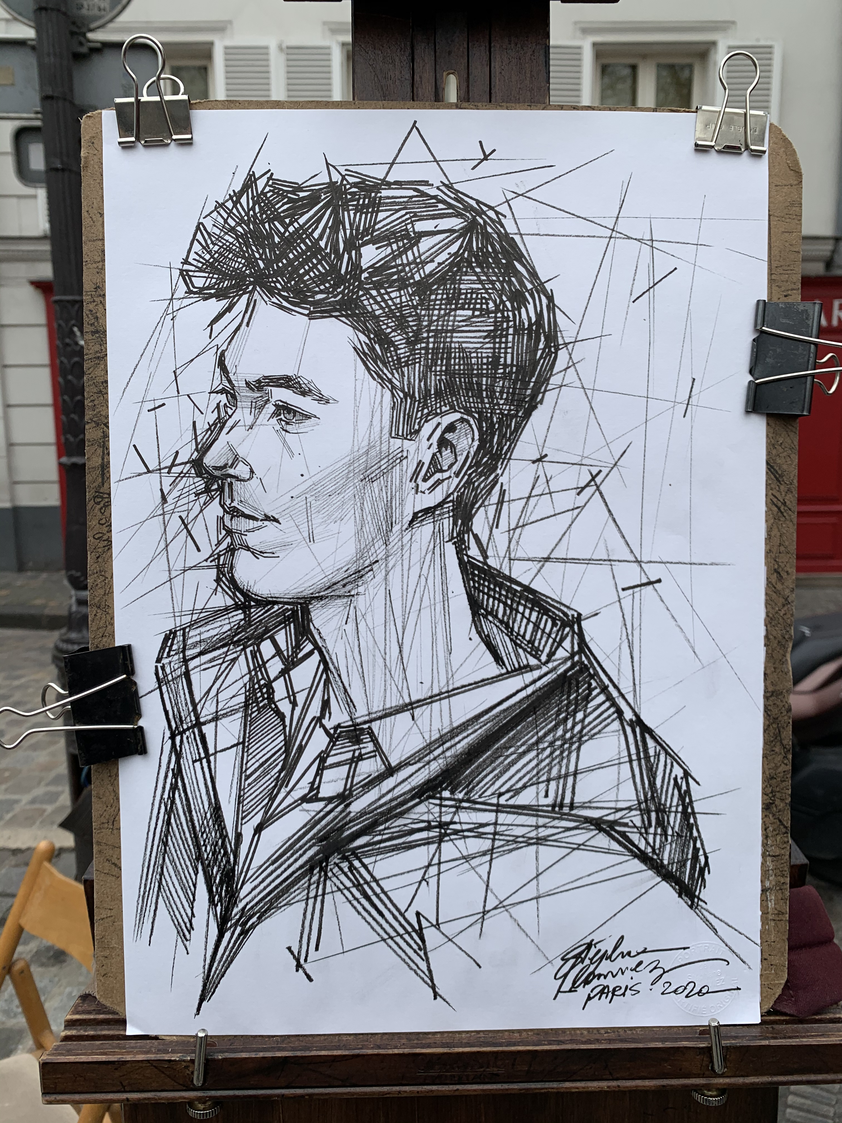

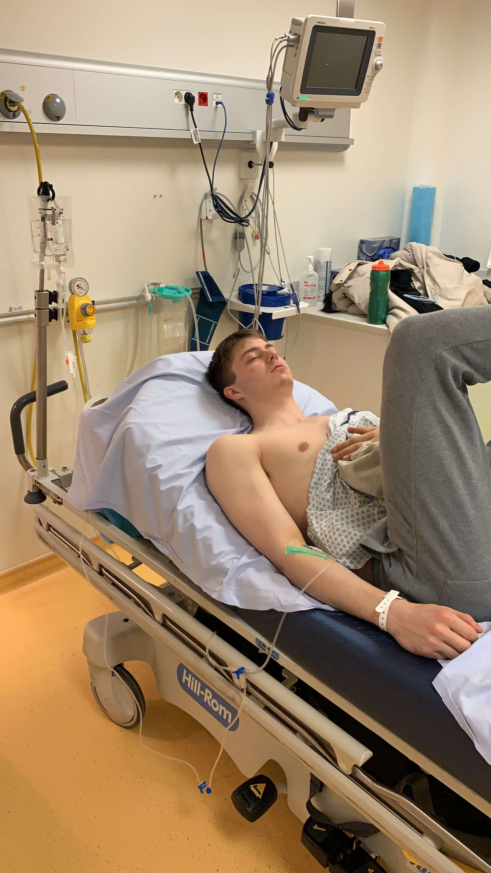

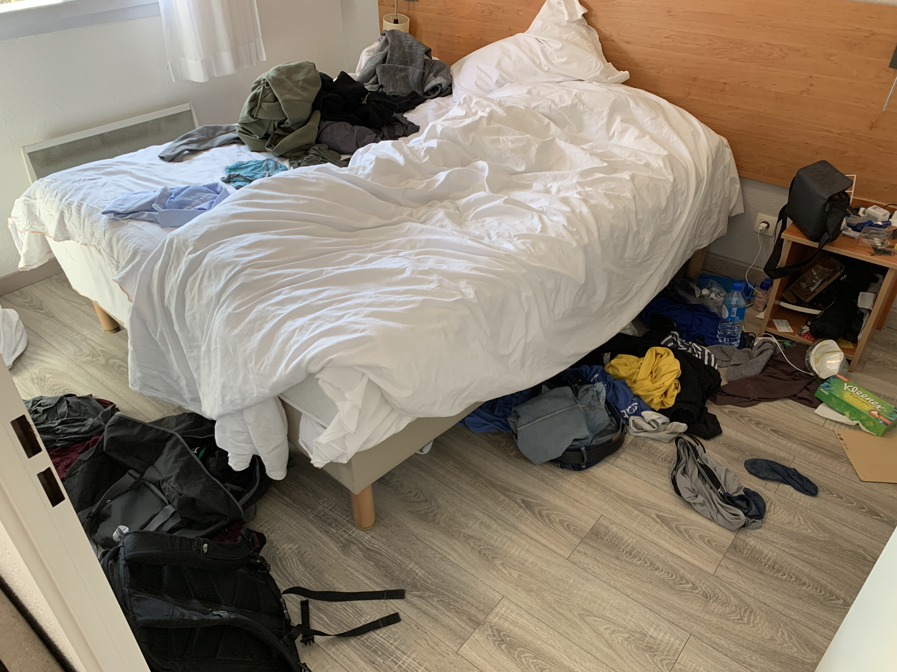
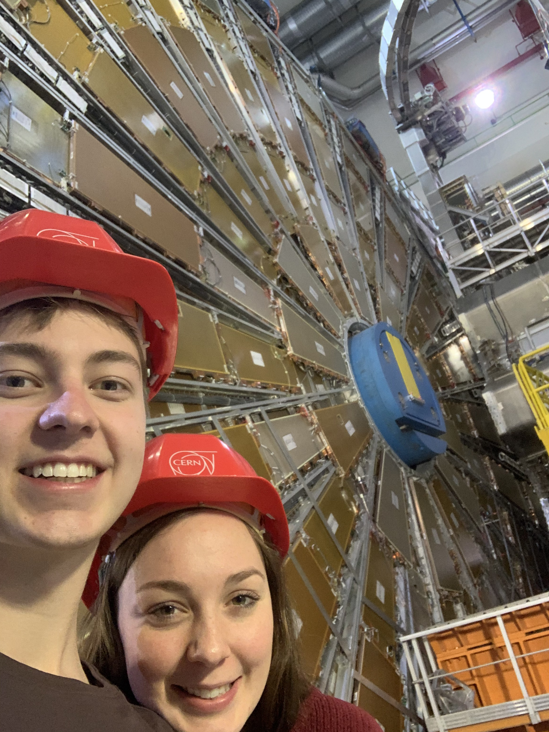
Life since last time
Last picture taken at CERN
Portrait at Montmartre, Paris
Fondue on boat
Hospitalization at Sallanche
Packing up in Saint Genis
ATLAS visit again

