Slide 1

Lectures on
Neutrino Physics (II)
2022.10
Sin Kyu Kang
(Seoul Tech)

Slide 2
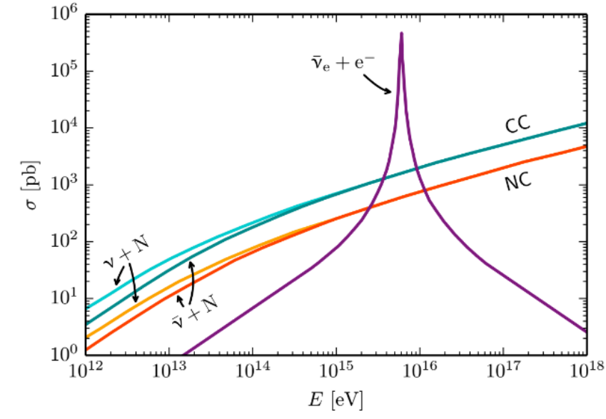
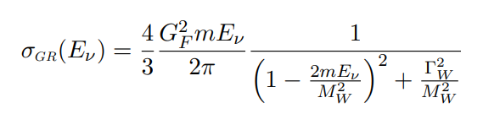



Glashow Resonance
$${\overline{ν}}_{e}+e^{−}→W^{−}→anything$$
on-shell
$E_{{\overline{ν}}_{e}}$=$\frac{M_{W}^{2}−(m_{e}^{2}+m_{ν}^{2})}{2m_{e}}≅\frac{M_{W}^{2}}{2m_{e}}\sim 6.3 PeV$
The threshold $E_{{\overline{ν}}_{e}}$ for this process :
This process is considered for detection of high E cosmic neutrinos
at IceCube
Halzen

Slide 3
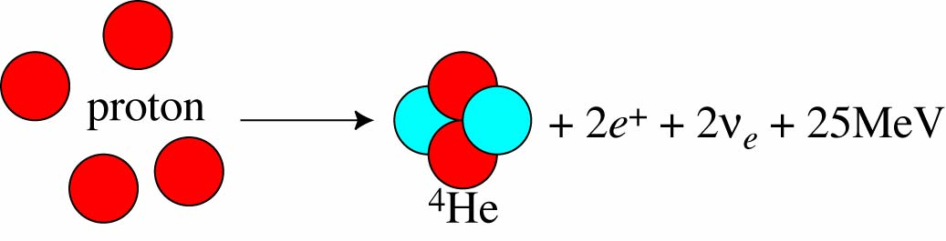
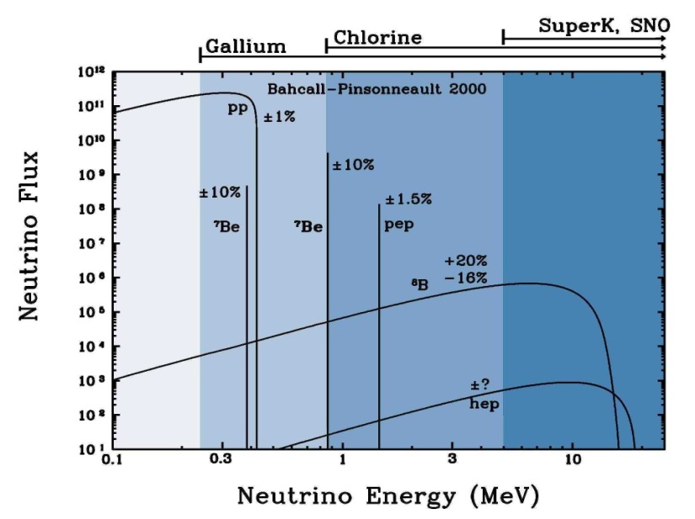

Solar Neutrinos
Nuclear Fusion
Sun burns!!!
Production of ${ ν}_{e}$
J. N. Bahcall, S. Basu and M. Pinsonneault (1998)
Standard Solar Model (Bahcall)

Slide 4
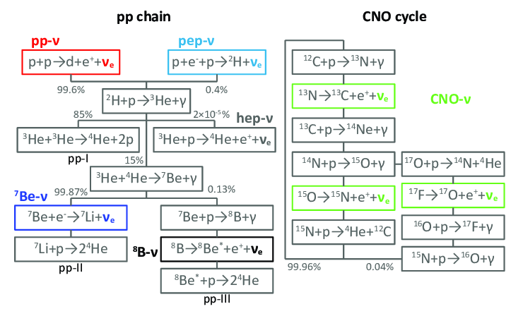
Production of solar neutrinos

Slide 5
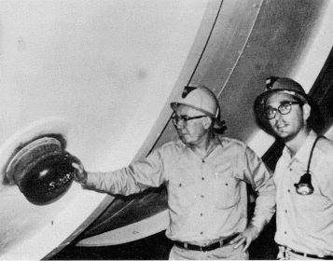

Solar Neutrino Experiment
Homestake
Won Nobel Prize 2002!
First experiment by Davis et al. in 1960’s
Radiochemical Method (Chlorine):
$$ν_{e}+37 Cl→37 Ar+e^{−}$$
found ~ 1/3 of expected rate ! (1968)

Slide 6
Solar Neutrino Experiment

Slide 7
Solar Neutrino Experiment
Using neutrinos from ⁸B
Nucl-ex/0610020
Heavy
water
$$SSM(2004):Φ(^{8}B)=5.26(1±0.23)×10^{6}cm^{−2}s^{−1}$$
Bahcall & Pinsonneault
Supporting neutrino transition as well as verifying SSM

Slide 8
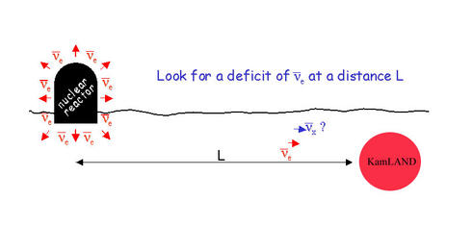

KamLAND results
Reactor long baseline experiment
~180 km
( E_{pr} > 2.6 MeV )
in consistent with the results of solar neutrino oscillation

Slide 9
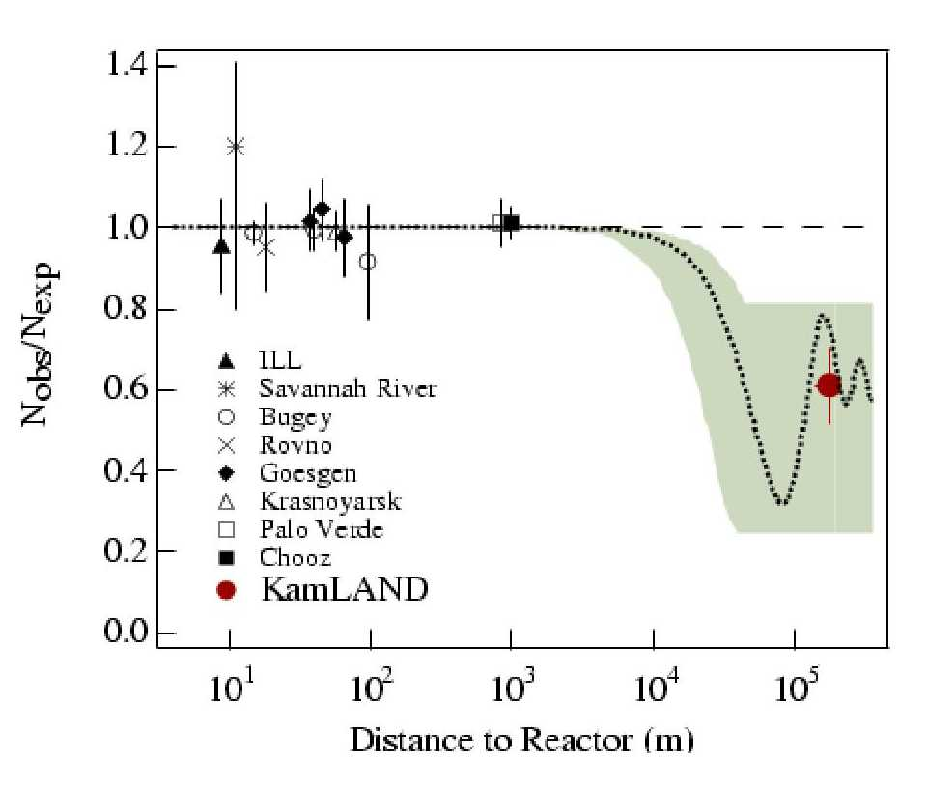
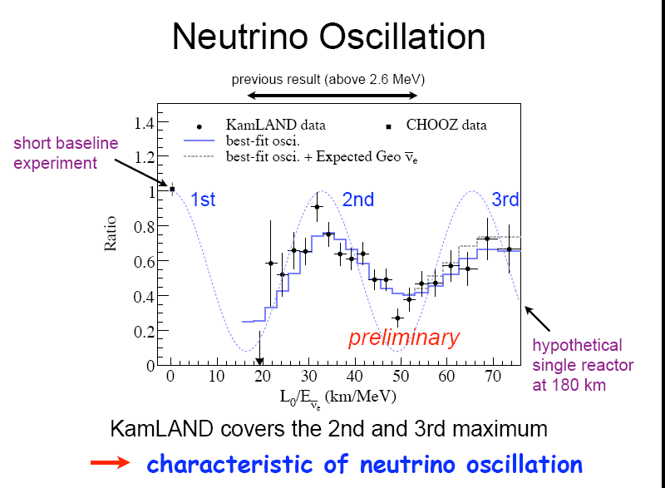
KamLAND results
Testing solar neutrino osc. with reactor experiment
L/E analysis(2008)
[K. Eguchi et al., Phys. Rev. Lett., 90, 021802 (2003)]
A period oscillation
N_{obs}/N_{exp} = 0.611 + 0.094
$$∆m^{2}\sim 7.5×{10}^{−5} {eV}^{2} , \sin^{2}θ\sim 0.32$$

Slide 10
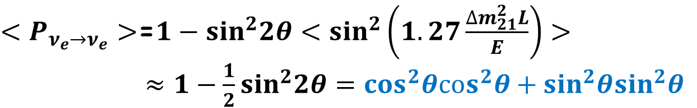
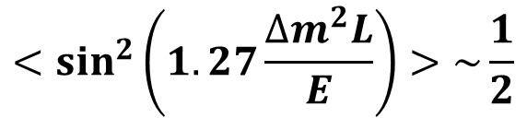
Solar Neutrino Experiment
With
$$∆m^{2}\sim 7.5×{10}^{−5} {eV}^{2} , \sin^{2}θ\sim 0.32$$
For solar neutrinos,
$$1.27\frac{∆m^{2}L}{E}\sim 1.27\frac{(7.5×{10}^{−5} {eV}^{2})(1.5×{10}^{11}m)}{0.1−10 MeB}\sim {10}^{7±1}$$
$$<\sin^{2}\left(1.27\frac{∆m^{2}L}{E}\right)>\sim \frac{1}{2}$$
$<P_{ν_{e}→ν_{e}}>$=$1−\sin^{2}2θ<\sin^{2}\left(1.27\frac{∆m_{21}^{2}L}{E}\right)>$
$≈1−\frac{1}{2}\sin^{2}2θ=\cos^{2}θ\cos^{2}θ+\sin^{2}θ\sin^{2}θ$
Tension : for $8B$, $<P_{ν_{e}→ν_{e}}>≈0.32$, for $pp,7Be:<P_{ν_{e}→ν_{e}}>≈0.6$

Slide 11
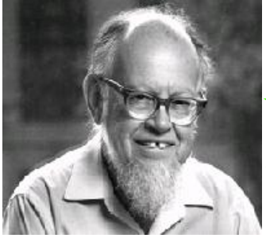
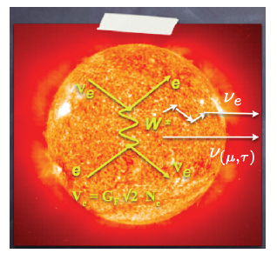
Matter Effect (Wolfestein ‘79)
Matter Effect
When neutrinos travel through a medium, they interact with the background of electron, proton and neutron, and then acquire effective mass.
ν_{e}
e
Elastic forward
scattering
W
ν_{e}
e

Slide 12
Matter Effect
This modifies mixing between flavor states and mass states, and eigenvalues of Hamiltonian, leading to different oscillation probability
$ν_{e}$ has C.C. and N.C. while $ν_{μ}$, $ν_{τ}$ have only N.C.

Slide 13
Matter Effect
The Hamiltonian in matter can be obtained by adding the potential terms
Difference of V plays a crucial role
irrelevant for flavor evolution

Slide 14
Matter Effect
In vacuum, time evolution of neutrino states
In matter,
For antineutrinos, new term has opposite sign

Slide 15
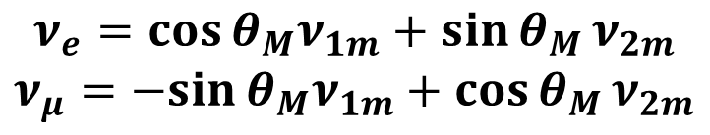
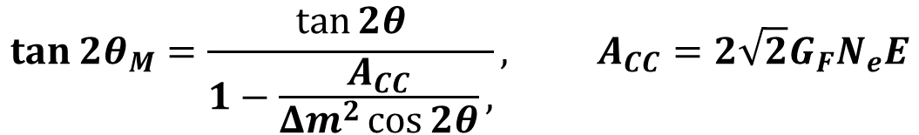
Matter Effect
If $N_{e}$ is constant, diagonalizing the Hamiltonian
$$\tan{2θ_{M}}=\frac{\tan{2θ}}{1−\frac{A_{CC}}{Δm^{2}\cos{2θ}},}, A_{CC}=2\sqrt{2}G_{F}N_{e}E$$
ν₁
ν_{e}
θ
ν_{2m}
$$ν_{e}=\cos{θ_{M}ν_{1m}+\sin{θ_{M}}}ν_{2m}$$
$$ν_{μ}=−sin{θ_{M}ν_{1m}+\cos{θ_{M}}}ν_{2m}$$
ν_{1m}
θ_{m}
ν₂
ν_{μ}

Slide 16
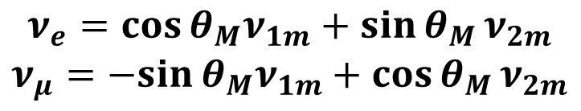
Matter Effect
$$ν_{e}=\cos{θ_{M}ν_{1m}+\sin{θ_{M}}}ν_{2m}$$
$$ν_{μ}=−sin{θ_{M}ν_{1m}+\cos{θ_{M}}}ν_{2m}$$
Level Crossing

Slide 17
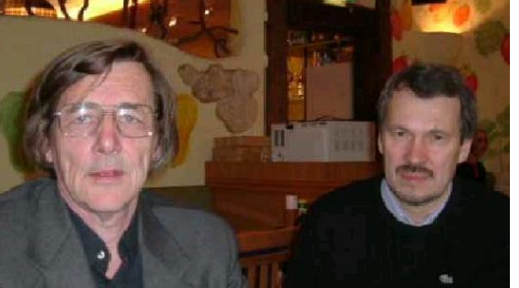

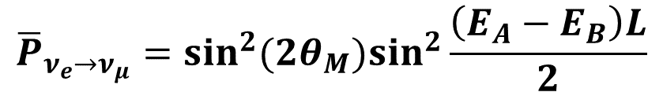

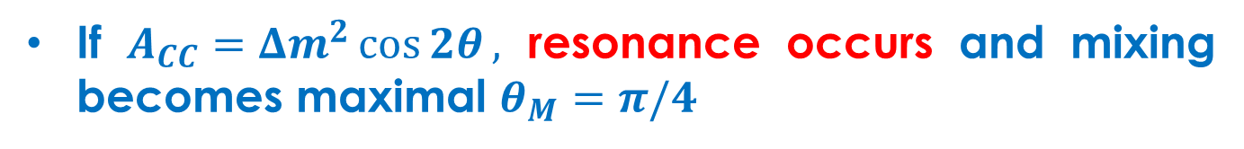
(Mikheyev, Smirnov ‘85)
Matter Effect
If $A_{CC}=Δm^{2}\cos{2θ},$ resonance occurs and mixing becomes maximal $θ_{M}=π/4$
In medium with constant density
- There is no $ν_{1m}↔ν_{2m}$ transitions, $ν_{1m}, ν_{2m}$ are
the eigenstates of propagation
- Oscillation probability in matter looks similar to in vacuum
$${\overline{P}}_{ν_{e}→ν_{μ}}=\sin^{2}(2θ_{M})\sin^{2}\frac{\left(E_{A}−E_{B}\right)L}{2}$$

Slide 18
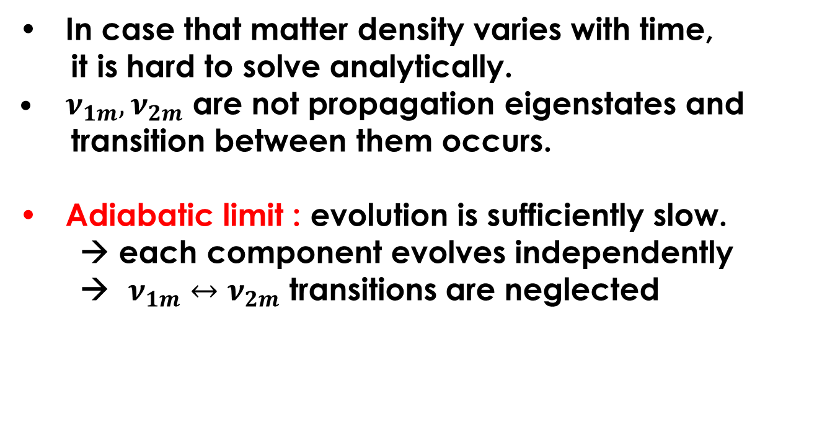
Matter Effect
In case that matter density varies with time,
it is hard to solve analytically.
$ν_{1m}, ν_{2m}$ are not propagation eigenstates and
transition between them occurs.
Adiabatic limit : evolution is sufficiently slow.
→ each component evolves independently
→ $ν_{1m}↔ν_{2m}$ transitions are neglected

Slide 19
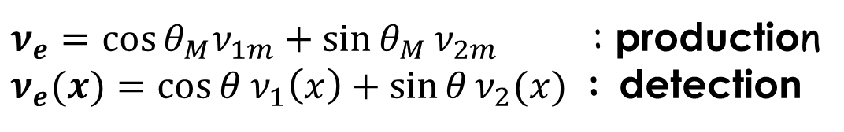
In-Matter Survival Probability
$ν_{e}=\cos{θ_{M}ν_{1m}+\sin{θ_{M}}}ν_{2m}$ : production
$ν_{e}(x)=\cos{θ ν_{1}\left(x\right)+\sin{θ}}ν_{2}(x)$ : detection
Neglecting interference term (averaged over E spectrum)
for non-adiabatic case
(S. Parke, PRL57, ‘86)

Slide 20
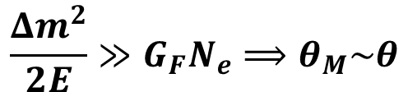



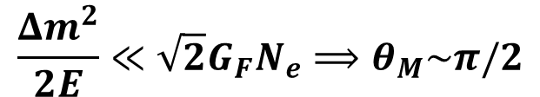
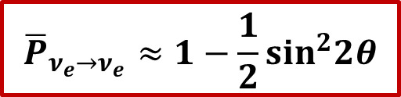
In-Matter Survival Probability
Assuming adiabatic limit
$${\overline{P}}_{ν_{e}→ν_{e}}=\cos^{2}θ\cos^{2}θ_{M}+\sin^{2}θ\sin^{2}θ_{M}$$
two interesting limits
$$\frac{Δm^{2}}{2E}≪\sqrt{2}G_{F}N_{e}⟹θ_{M}\sim π/2$$
Matter dominates :
$${\overline{P}}_{ν_{e}→ν_{e}}≈\sin^{2}θ$$
$$\left(8B :{\overline{P}}_{ν_{e}→ν_{e}}≈0.32\right)$$
(⁸B solar neutrino is pure $ν_{2}$ due to matter effect)
$$\frac{Δm^{2}}{2E}≫G_{F}N_{e}⟹θ_{M}\sim θ$$
Vacuum dominates :
$${\overline{P}}_{ν_{e}→ν_{e}}≈1−\frac{1}{2}\sin^{2}2θ$$
$$\left(pp,7Be:{\overline{P}}_{ν_{e}→ν_{e}}≈0.6\right)$$

Slide 21
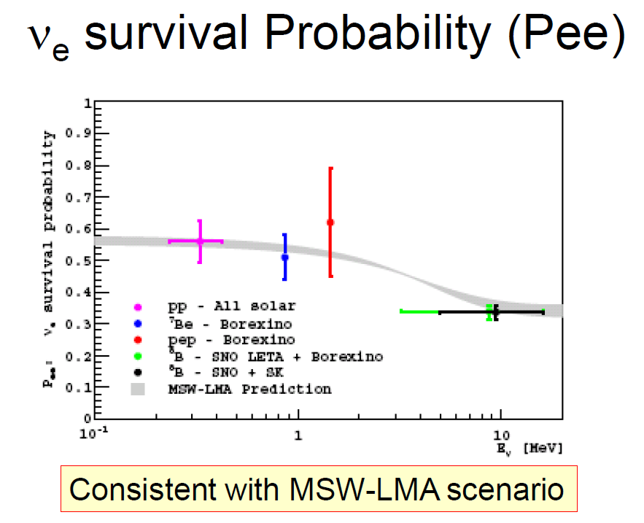
Confirming Matter Effect
Borexino(2011)

Slide 22
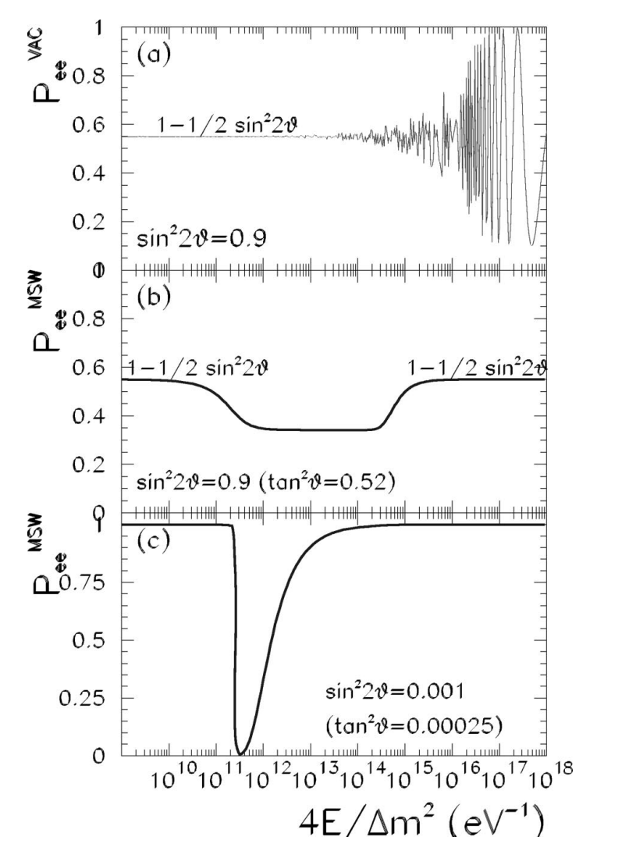
Nature has chosen this

Slide 23
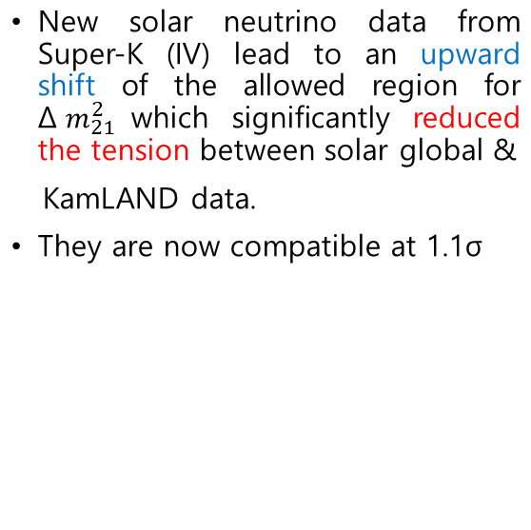
Experimental Results
Solar neutrino experiments and KamLAND
P. Salas, D. Forero, S. Gariazzo,
O. Martinez, O. Mena, C. Ternes,
M. Tortola, J. Valle, JHEP (2021)

Slide 24
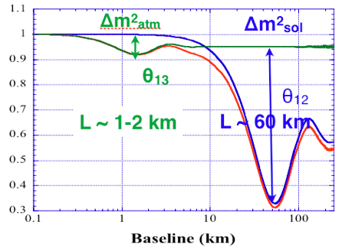
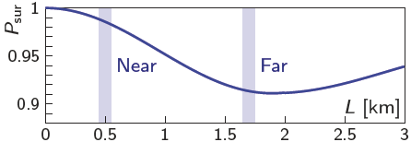
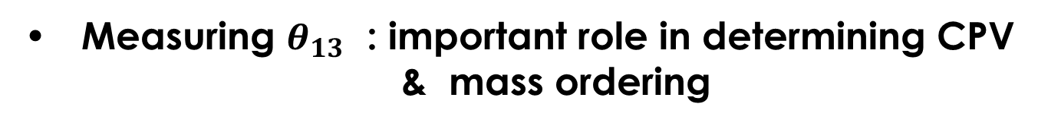

$$θ_{13}$$
Measuring $θ_{13}$ : important role in determining CPV
& mass ordering
Measured from SBL reactor experiments
$$P_{ν_{e}→ν_{e}}≈1−\sin^{2}2θ_{13}\sin^{2}\frac{Δm_{31}^{2}L}{4E} − \cos^{4}θ_{13}{\sin^{2}2θ_{12}sin}^{2}\frac{Δm_{21}^{2}L}{4E}$$
Daya Bay
Double Chooz
RENO

Slide 25
$$θ_{13}$$

Slide 26
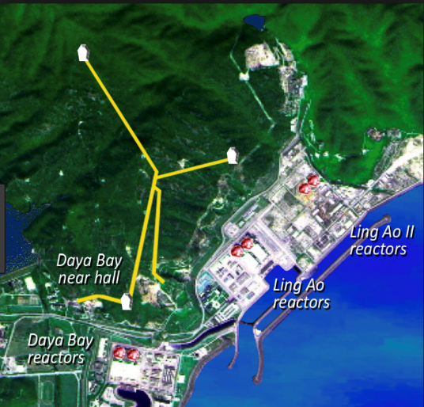
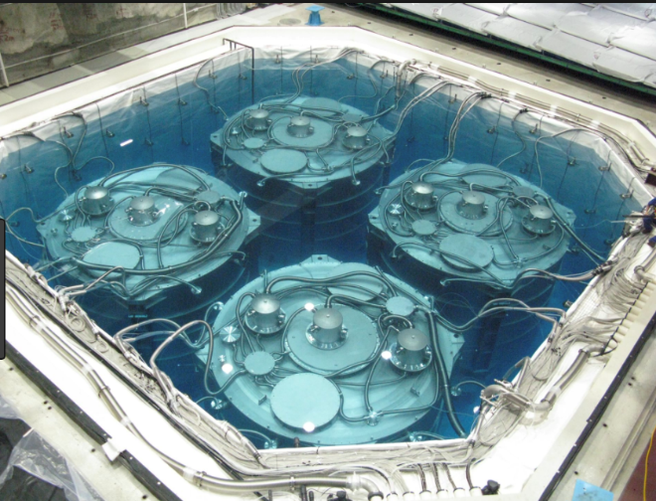
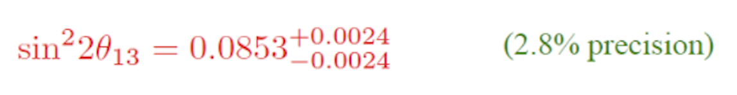
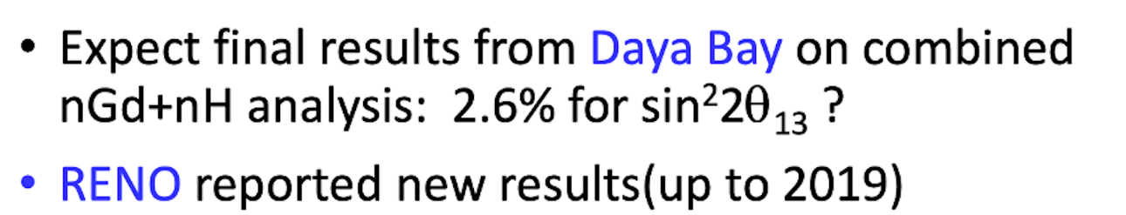
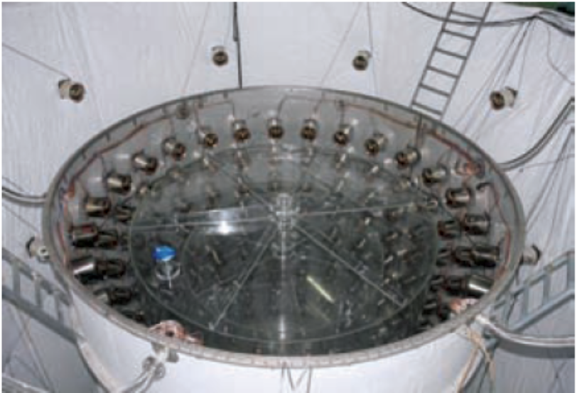
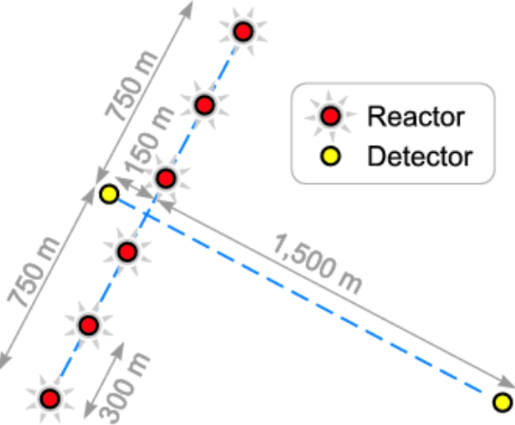
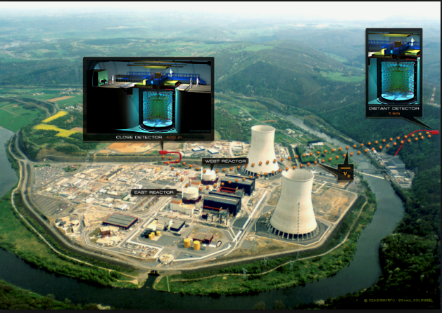
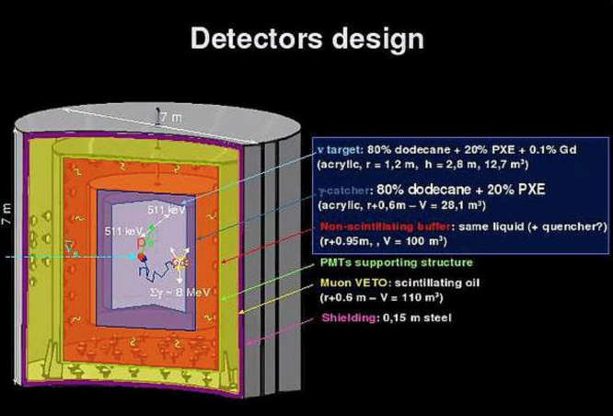
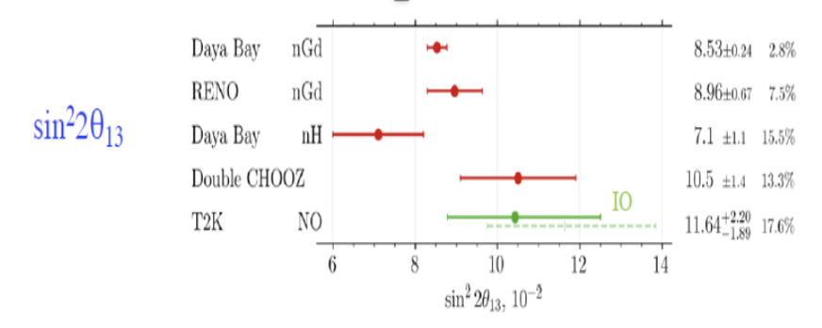

$$θ_{13}$$
Experimental Results

Slide 27
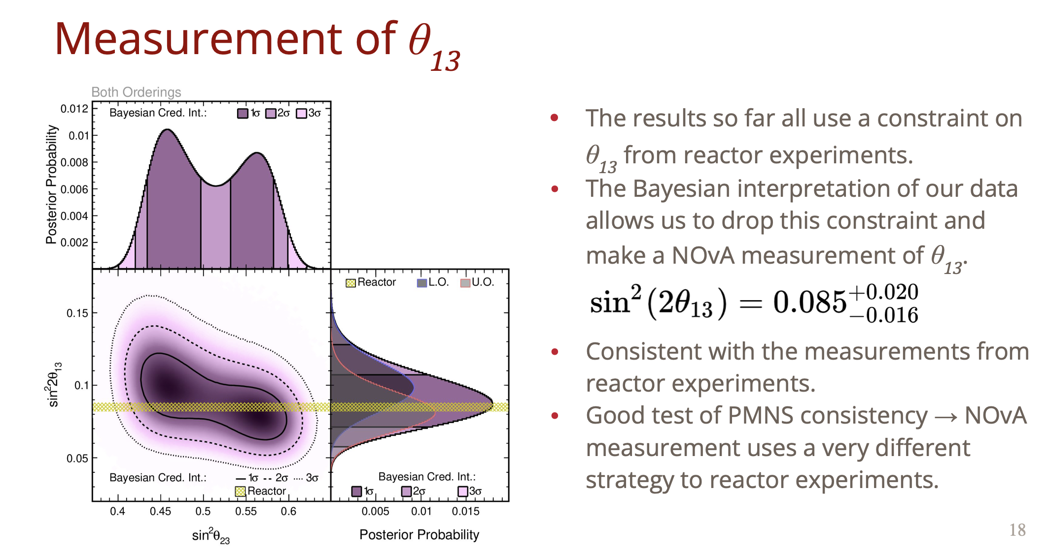
$$θ_{13}$$
from accelerator experiment
NOvA

Slide 28
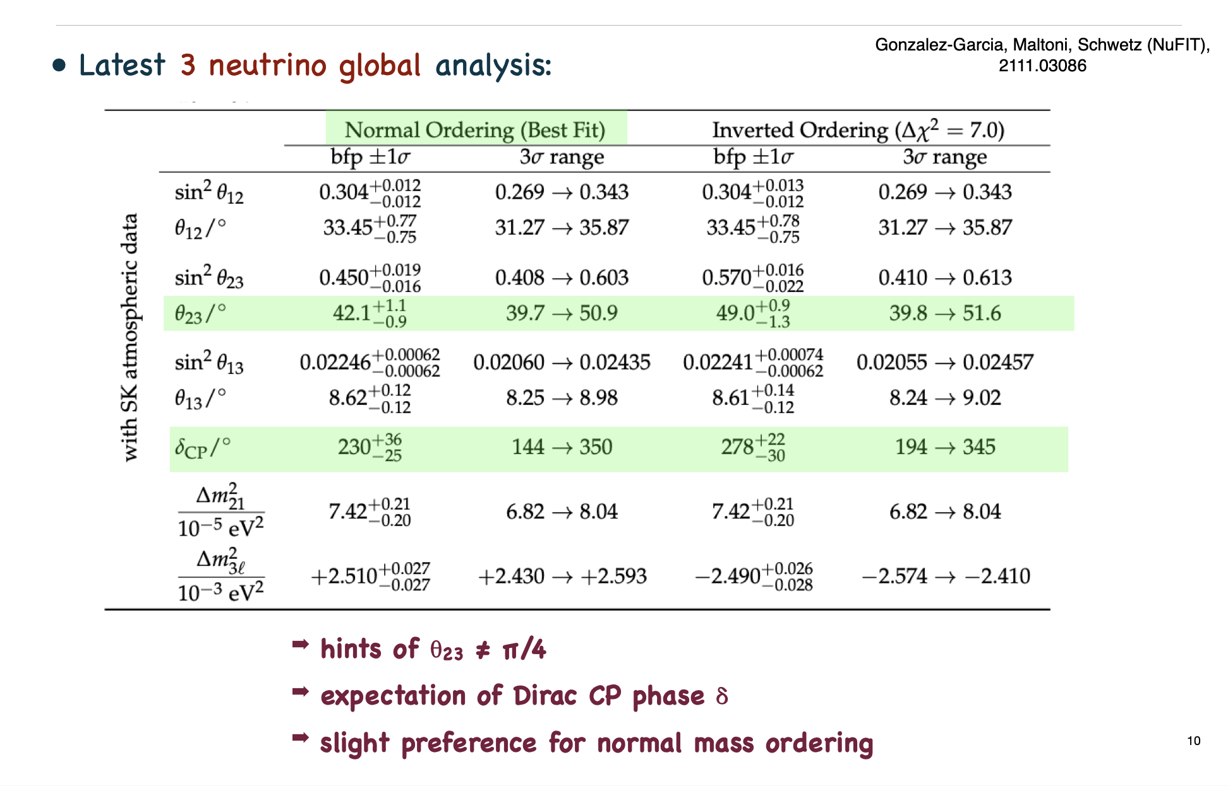
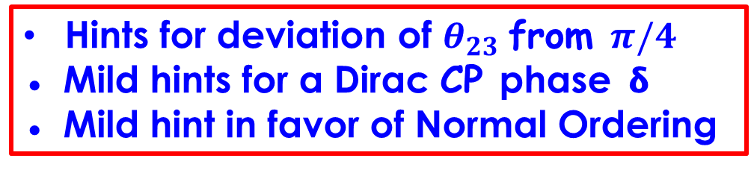
Global Fit
Recent 3-neutrino global analysis
NuFIT5.1
Hints for deviation of $θ_{23}$from $π/4$
● Mild hints for a Dirac CP phase 𝝳
● Mild hint in favor of Normal Ordering

Slide 29
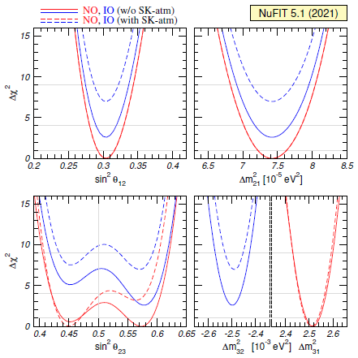
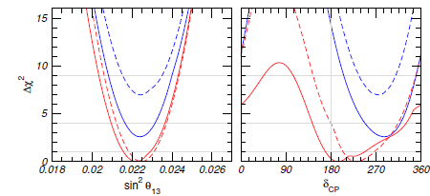

Global Fit
NO is preferred at 2.5$σ$

Slide 30
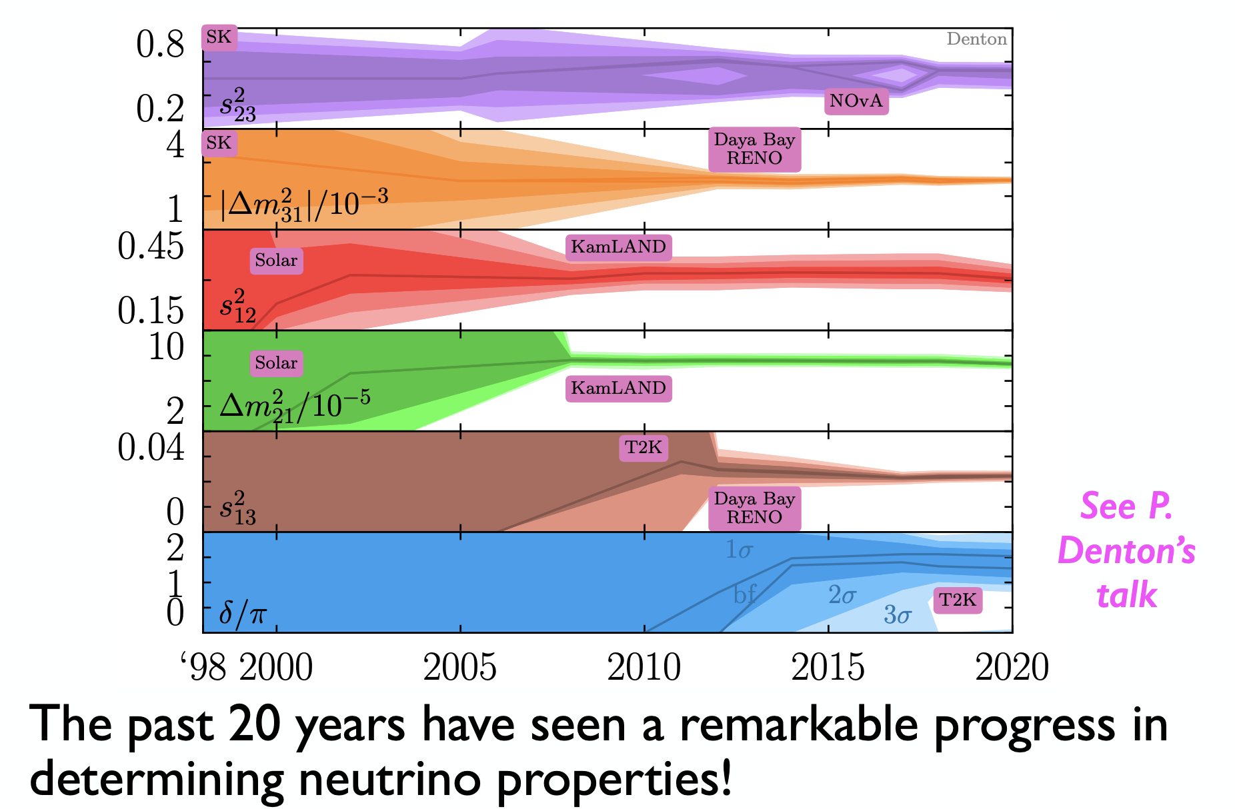
Parameter Precision Evolution
Towards precision physics

Slide 31
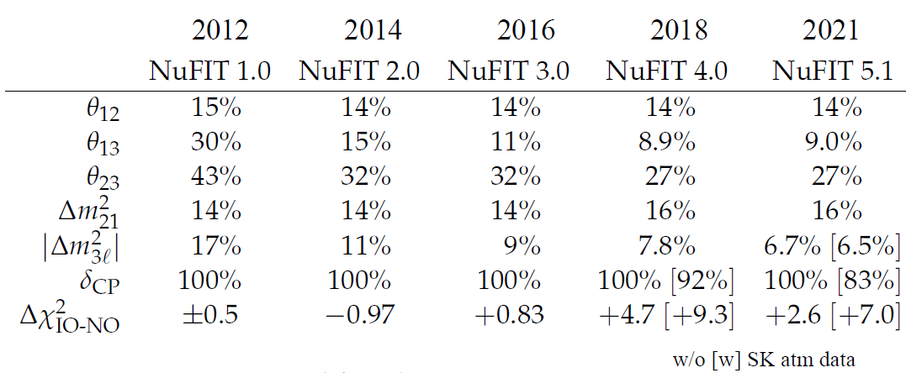
Parameter Precision Evolution
(2111.03086)
4 well-measured parameters : $θ_{13}, θ_{12} , Δm_{21}^{2}, |Δm_{31}^{2}|$
Future exps. such as JUNO,DUNE,Hyper-K will achieve
a few percent precision.

Slide 32
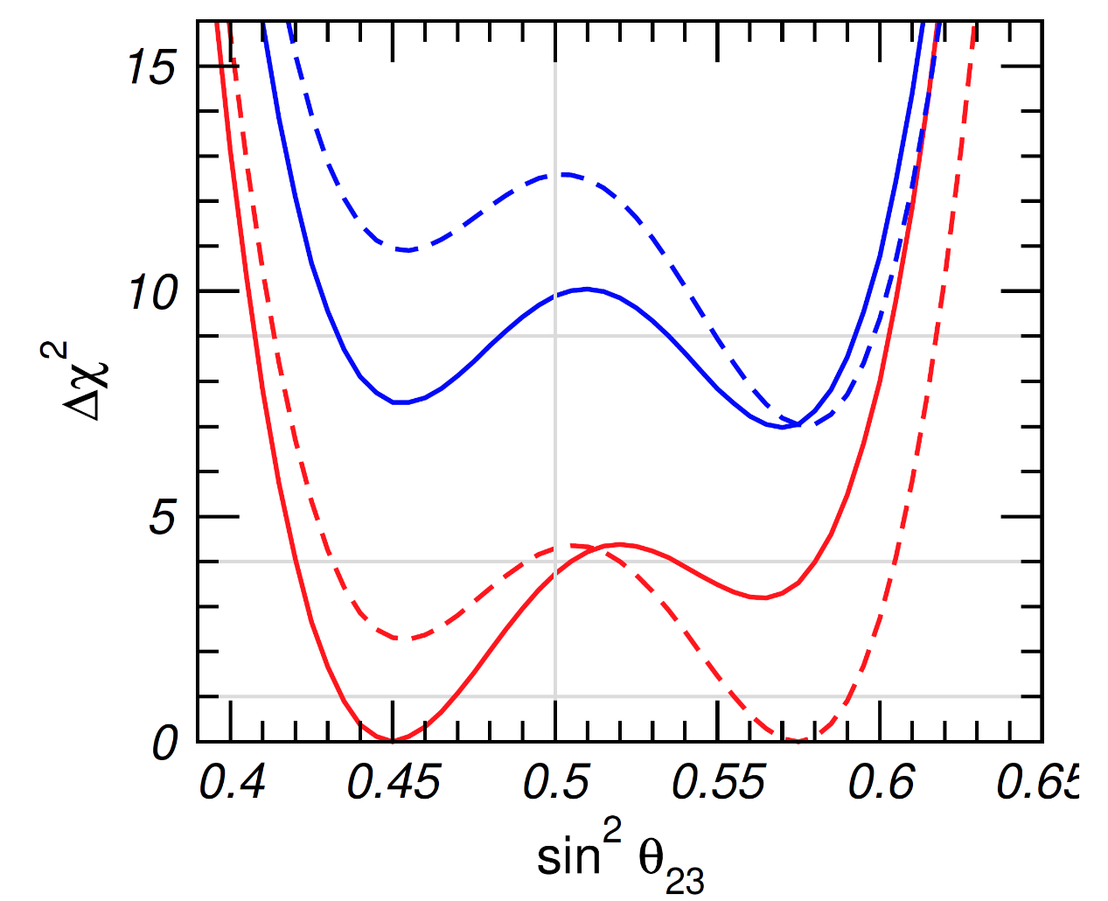

The Unknowns
- Neutrino mass ordering :
(red vs. blue)
NO is preferred at 2.5$σ$
- Octant of
- Leptonic CP violation

Slide 33
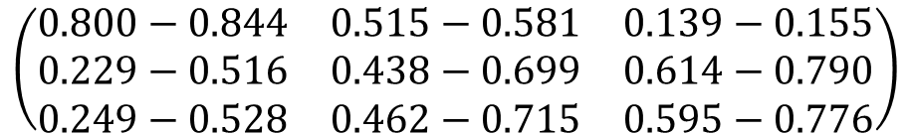

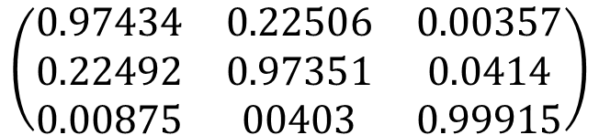

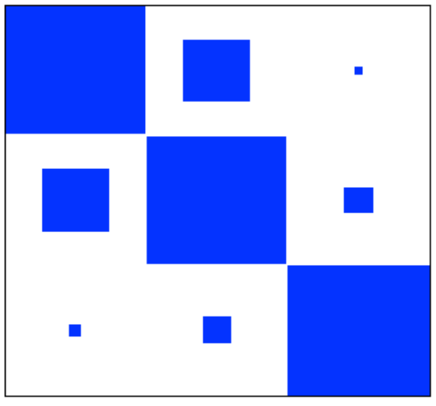
PMNS vs. CKM
From fit to neutrino data in 3-neutrino paradigm
Looks different from quark mixing matrix !!
Image from Mark Messier

Slide 34

Neutrino Masses

Slide 35




Neutrino Mass Scale
Solar neutrino;
$$∆m_{sol}^{2}≈∆m_{21}^{2}\sim {7.5×10}^{−5}{eV}^{2}$$
Atmospheric neutrino;
$$∆m_{atm}^{2}≈|∆m_{31}^{2}|≈|∆m_{32}^{2}|\sim {2.5×10}^{−3}{eV}^{2}$$
Sum of 3 Δm² should be 0;
$$∆m_{12}^{2}+∆m_{23}^{2}+∆m_{31}^{2}=0$$
While we could determine the mass squared difference,
each mass has not been measured .
Assuming hierarchical mass spectrum, $m_{ν_{i}}≤\sqrt{∆m_{atm}^{2}}\sim 0.05$ eV

Slide 36




How small Neutrino Mass ?
How small are neutrino masses?
Cosmological mass limit :
-Under the assumption of ΛCDM
- from Planck CMB + BAO +Planck high-$l$ polar.
+ optical depth to reion.
$m_{ν}$ $≤0.12 (eV)$
(Sunny Vagnozzi, et al. arXiv:1701.08172)
2003 snowmass report

Slide 37

Mass Ordering
Oscillation probability in vacuum is invariant under $∆m^{2}→−∆m^{2}$
Matter effect depends on sign of $∆m^{2}$
Solar neutrino experiments fix $∆m_{21}^{2}>0$
But, we do not determine the sign of $∆m_{31(2)}^{2}$
→ we have 2 options for mass ordering

Slide 38

Mass Ordering
Normal Ordering
Inverted Ordering
(NuFIT group)

Slide 39

How to discriminate between two ?
→ accelerator-based LBL experiments.
Mass Ordering
Disappearance
Appearance
Son Cao et al., symmetry2022

Slide 40

Mass Ordering
Senstivity to MO is marginal in the $ν_{μ}→ν_{μ}$ (or ${\overline{ν}}_{μ}→{\overline{ν}}_{μ}$) modes
The effect of MO is much stronger in the $ν_{μ}→ν_{e}$ (or ${\overline{ν}}_{μ}→{\overline{ν}}_{e}$) modes
The relatively large modification of the oscillation probabilities in the
appearance is due to the coherent scattering of $ν_{e}$ (${\overline{ν}}_{e}$) on the electron
present in the matter.
But, appearance probability is just a few %, limiting the statistics of the
collected data sample.
Moreover, extracting MO effect from the appearance probabilities is non-trivial since the sign of $∆m_{31}^{2}$ is tangled severely with $δ_{CP} \& θ_{23}$ which have been measured with relatively large uncertainty.

Slide 41

Short & medium base line experiments
Mass Ordering
Son Cao etal, symmetry2022

Slide 42

Mass Ordering
For SBL reactor exp., the sensitivity to MO is marginal .
But, for JUNO with a medium-baseline of 50 km, can improve
the sensitivity to MO thanks to the interference between two
oscillation terms driven by $∆m_{21}^{2} \& ∆m_{31}^{2},$respectively.
The most challenging thing is to achieve an excellent resolution of reconstructed neutrino energy for unravelling MO from the
detector response effect (more detail : Abusleme, eta., JHEP2021.2)

Slide 43

Future Experiments for MO
Albert De Roeck (corfu2022)

Slide 44


Neutrino Mass
In SM, neutrinos are massless
All neutrinos left-handed
⇒ massless
SM particle table
Right-handed Neutrinos ?
No observation
Massive neutrinos imply the standard model is incomplete !

Slide 45





Neutrino Mass
(1) Dirac Mass
Some basics for understanding neutrino masses
$$γ^{0}=\left(\begin{matrix}0 & I_{2} \\ I_{2} & 0\end{matrix}\right), γ^{i}=\left(\begin{matrix}0 & σ_{i} \\ {−σ}_{i} & 0\end{matrix}\right)$$
$$γ^{α}γ^{β}+γ^{β}γ^{α}=2g^{αβ}$$
$g^{αβ}$=diag$(1,−1,−1,−1)$
$$γ^{5}=−iγ^{0}γ^{1}γ^{2}γ^{3}$$
$$γ^{5}=\left(\begin{matrix}−I_{2} & 0 \\ 0 & I_{2}\end{matrix}\right)$$
chiral projection operators
$$P_{L}=\frac{1}{2}\left(I−γ^{5}\right)=\left(\begin{matrix}I_{2} & 0 \\ 0 & 0\end{matrix}\right)$$
$$P_{R}=\frac{1}{2}\left(I+γ^{5}\right)=\left(\begin{matrix}0 & 0 \\ 0 & I_{2}\end{matrix}\right)$$
$γ^{0(5)+}=γ^{0(5)}, γ^{i+}={−γ}^{i}$
$$P_{L(R)}^{2}=P_{L(R)} , P_{L}P_{R}=0$$

Slide 46




Neutrino Mass
(1) Dirac Mass
For a Dirac Field $ψ=\left(\begin{matrix}φ \\ χ\end{matrix}\right)$
$$ψ_{L}=P_{L}ψ=\frac{1}{2}\left(1−γ^{5}\right)ψ=\left(\begin{matrix}φ \\ 0\end{matrix}\right),{ ψ}_{R}=P_{R}ψ=\frac{1}{2}\left(1+γ^{5}\right)=\left(\begin{matrix}0 \\ χ\end{matrix}\right)$$
${\overline{ψ}}_{L}={\left(ψ_{L}\right)}^{+}γ^{0}$=${\left(P_{L}ψ\right)}^{+}γ^{0}$
$=ψ^{+}P_{L}γ^{0}=ψ^{+}γ^{0}P_{R}$
$=\overline{ψ}P_{R}$
$${\overline{ψ}}_{R}=\overline{ψ}P_{L}$$
$ψ$=$ψ_{L}$+$ψ_{R}$

Slide 47
Neutrino Mass
(1) Dirac Mass
We can write down Dirac mass term :

Slide 48




Neutrino Mass
(1) Dirac Mass
A fermion mass can be thought of as a $L↔R$ transition
$I_{3}=±\frac{1}{2} : e_{L} | {\overline{e}}_{R}$
$$I_{3}=0 : e_{R} | {\overline{e}}_{L}$$
For electron & positron
Dirac mass
Mass terms (Dirac mass) :
$e_{L}$ $↔$ $e_{R}$, ${\overline{e}}_{R}$ $↔$ ${\overline{e}}_{L}$
$e_{L}$ $↔$ ${\overline{e}}_{R}$ , $e_{R} ↔$ ${\overline{e}}_{L}$
Mass terms : not allowed due to
violation of conservation of electric charge
For neutrino Dirac mass, we need RH neutrino ($I_{3}=0$)

Slide 49

Neutrino Mass
(1) Dirac Mass
Dirac type mass matrix M is in general N $×$ N complex matrix
M is diagonalized by bi-unitary matrices

Slide 50
Neutrino Mass
(1) Dirac Mass
Origin : Yukawa interactions
This shows that weak eigenstates are different from mass eigenstates.

Slide 51


Neutrino Mass
(1) Dirac Mass
Dirac type mass matrix $M$ is invariant under
which implies lepton number $L (=L_{e}+L_{μ}+L_{τ})$ conservation.

Slide 52

Neutrino Mass
(2) Majorana Mass
Some basics for understanding Majorana mass
Charge conjugate :
$$C=iγ^{2}γ^{0}=\left(\begin{matrix}iσ_{2} & 0 \\ 0 & −iσ_{2}\end{matrix}\right)$$
($C^{+}C=1, C^{T}=−C$)
$C{{\left(γ^{μ}\right)}^{T}C}^{−1}=−γ^{μ}$, $C{\left(γ^{5}\right)}^{T}C^{−1}=γ^{5}$

Slide 53
Neutrino Mass
(2) Majorana Mass
Some basics for understanding Majorana mass
Exercise : Prove that

Slide 54



Neutrino Mass
(2) Majorana Mass
Condition for Majorana neutrino : $ψ=ψ^{c}$
Let $ψ_{L}=\left(\begin{matrix}φ \\ 0\end{matrix}\right)$
${\left(ψ_{L}\right)}^{C}$=$Cγ^{0}\left(ψ_{L}^{∗}\right)=iγ^{2}ψ_{L}^{∗}=\left(\begin{matrix}0 \\ −iσ^{2}φ^{∗}\end{matrix}\right)$
We need only $φ$ to describe a Majorana neutrino.
${ ψ}_{M}={ψ_{L}+\left(ψ_{L}\right)}^{C}=\left(\begin{matrix}φ \\ −iσ^{2}φ^{∗}\end{matrix}\right)$=$ψ_{M}^{C}$

Slide 55


Neutrino Mass
(2) Majorana Mass
Note that in the same representation, a Dirac fermion
can be written as
If $φ=χ$, it is a Majorana fermion
For spinors $φ, χ$
For Majorana spinors

Slide 56
Neutrino Mass
(2) Majorana Mass
Using
Then, a Majorana fermion can be written

Slide 57

Neutrino Mass
(2) Majorana Mass
Majorana mass term :
Prove :
$$M=M^{T}$$

Slide 58
Neutrino Mass
(2) Majorana Mass
Majorana mass term is not invariant under
So, lepton number is not conserved.

Slide 59



Neutrino Mass
(2) Majorana Mass
Diagonalization of Majorana mass matrix :
In general,
Since $M=M^{T}$
Therefore
Then, $\left(Y^{T}X\right)$must be digonal
Define $\left(Y^{T}X\right)≡P^{2}$being diagonal, and $XP^{∗}≡U$
$$U^{+}MU^{∗}=M_{D}$$

Slide 60



Adding Right-Handed Neutrino
For $ν$ & $\overline{ν}$
forbidden by weak isospin
$I_{3}=±\frac{1}{2} : ν_{L} | {\overline{ν}}_{R}$
$$I_{3}=0 : ν_{R} | {\overline{ν}}_{L}$$
Dirac mass
allowed but unprotected : Majorana mass
(i.e. can be large : L violation)
Mass term : $ν_{L}$ $↔$ ${\overline{ν}}_{R}$ implies $I_{3}=1, Y=−2$ ,
so we need a new scalar with $I_{3}=1, Y=2$
→ SU(2) triplet scalar

Slide 61








Adding Right-Handed Neutrino
Putting possible mass terms together
$$\overline{(ν_{L},{\overline{ν}}_{R})}\left[\begin{matrix}0 & m_{D} \\ m_{D}^{T} & M\end{matrix}\right]\left(\begin{matrix}ν_{R} \\ {\overline{ν}}_{L}\end{matrix}\right)$$
Assuming $M≫m_{D}$, diagonalization of the mass matrix →
$$−\frac{m_{D}^{2}}{M}$$
$$M$$
Type-I Seesaw Mechanism
tiny neutrino mass : -$m_{D}M^{−1}m_{D}^{T}$

Slide 62


Type –I Seesaw Mechanism
Scales : no guide, but
- $m_{D}$ : electroweak scale
- $M$ : L violation scale $↔$ embedding into GUT
To obtain $m_{ν}\sim \sqrt{∆m_{atm}^{2}}$, $m_{D}\sim 100 GeV$, we need $M$~10¹⁵ GeV → GUT scale !
This seesaw idea was originally mentioned in a paper’s footnote : PLB59 (1975) 256 by Fritzsch, Gell-Mann & Minkowski

Slide 63
Type –I Seesaw Mechanism
This idea was clearly elaborated by Minkowski in his paper,
PLB67 (1977) 421
But, today, the following papers are mostly cited :
Minkowski (1977), Yanagida (1979),
Gell-Mann, Ramond & Slanski (1979)
Glashow (1979), Mohapatra & Senjanovic (1980), ….

Slide 64





Type –II Seesaw Mechanism
(Higgs Triplet Mechanism)
Konetschny, Kummer PLB70(1977), Magg PLB94(1980), Schechter, Valle PRD22(1980), Mohapatra, Senjanovic PRL44(1981), Lazzarides,Shafi, Wetterich NPB181(1981)
No RH neutrinos
Higgs triplet:
EW precision measurements:
< Δ⁰ > / < H > < 0.03
$$m_{ν}=Y_{Δ}<Δ>$$
$$μ_{∆}$$
$$\left\langle Δ\right\rangle =μ_{Δ}\frac{v_{H_{u}}^{2}}{M_{∆}^{2}}$$
Breaking of B-L

Slide 65



Type –III Seesaw Mechanism
(Fermion Triplet Mechanism)
LR. Foot, H. Lew, X.-G. He and G.C. Joshi, Z. Phys. C44 (1989)
SU(2) fermion triplet with Y=0
$$L=Y_{ν}\overline{L}\vec{σ}H_{u}\vec{T}+M\vec{T}∙\vec{T}+h.c.$$
$$m_{ν}=−Y_{ν}^{2}\frac{v_{H_{u}}^{2}}{M}$$
same formular as in type-I seesaw

Slide 66




Radiative Generation
1-loop generation of light neutrino masses (Zee, 1980)
- SM be extended to include ${ h}^{−}$(SU(2) singlet) & 2nd scalar
doublet ($φ^{0}$, $φ^{−}$)
2-loop generation of light neutrino masses (Zee, 1986; Babu, 1988)
- SM be extended to include $h^{+}$(SU(2) singlet)&$k^{++}$(SU(2) singlet)

Slide 67





Radiative Generation
1-loop generation of light neutrino masses (“scotogenic model”)
- SM be extended to include 3ν_{R}
& 2nd scalar doublet (η⁺, η⁰) :
→ odd under Z₂ (E.Ma,2006)
In the flavor basis where the charged lepton mass matrix
is real and diagonal, neutrino mass matrix becomes

Slide 68



Determination of neutrino mass
Determination of Neutrino Mass
Direct measurement
Neutrino mass can be measured from decay kinematics.
The simplest case is 2-body at-rest-decay kinematics of $π→μν_{μ}$
Using $m_{ν}^{2}$= $m_{π}^{2}+m_{μ}^{2}−\sqrt{4m_{π}^{2}({\left|{\overset{⃑}{p}}_{μ}\right|}^{2}+m_{μ}^{2})}$, we can obtain $m_{ν}$
But, it would hard to extract it from this method due to
uncertainties in measuring ${m_{π}, m}_{μ}$ and measurement of $\left|{\overset{⃑}{p}}_{μ}\right|$.

Slide 69




Determination of neutrino mass
Determination of Neutrino Mass
Direct measurement
Using $E^{2}$=$p^{2}c^{2}+m^{2}c^{4}$ , $m^{2}(ν)$ can be extracted by endpoint spectrum of β-decay
$$m^{2}\left(ν_{e}\right)=\sum{\left|U_{ei}^{2}\right|m^{2}(ν_{i})}$$
Tritium β-decay : ³$H→ {3He}^{+}+e^{−}+{\overline{ν}}_{e}$($E_{0}$=18.6 keV)
To observe modification
of endpoint spectrum,
we need
very high E resolution
very high luminosity
Very low background
(KATRIN Design Report 2004)

Slide 70



Determination of neutrino mass
Determination of Neutrino Mass
KATRIN experiment
Aim : achieving $m\left(ν_{e}\right)$sensitivity of 0.2 eV
(current upper limit : 0.7 eV (2021) )

Slide 71



Determination of neutrino mass
Determination of Neutrino Mass
Final Results from phase II
Mainz Neutrino Mass Experiment

Slide 72



Determination of neutrino mass
Determination of Neutrino Mass
Troitsk Neutrino Mass Experiment

Slide 73

Determination of neutrino mass
Determination of Neutrino Mass
Project -8 experiment :
Sensitivity of 0.04 eV

Slide 74



Donna Padian
CP Violation
CP violation
/ symmetry magazine Sandbox Studio, Chicago

Slide 75

CP violation in neutrino Oscillation
C : charge conjugate
P: parity

Slide 76

CP violation in neutrino Oscillation
Under CP transformation
Leptonic Jarskog invariant:
Under CP transformation :
$$U→U^{∗}$$
$$J→−J$$

Slide 77





CP violation in neutrino Oscillation
Oscillation probability
$$P_{ν_{α}→ν_{β}}=\sum_{i=1}^{3}{{\left|U_{αi}^{∗}U_{βi}\right|}^{2}+2\sum_{i<j}^{3}{Re\left(U_{αi}^{∗}U_{βi}U_{αj}U_{βj}^{∗}\right)}\cos{\frac{Δm_{ji}^{2}L}{2E}}−2\sum_{i<j}^{3}{Im\left(U_{αi}^{∗}U_{βi}U_{αj}U_{βj}^{∗}\right)}\sin{\frac{Δm_{ji}^{2}L}{2E}}}$$
$$P_{ν_{α}→ν_{β}}={\left|\sum_{i=1}^{3}{U_{αi}^{∗}U_{βi}}\right|}^{2}−4\sum_{i<j}^{3}{Re\left(U_{αi}U_{βi}U_{αj}^{∗}U_{βj}^{∗}\right)}\sin^{2}{\frac{Δm_{ji}^{2}L}{2E}}+2\sum_{i<j}^{3}{Im\left(U_{αi}U_{βi}U_{αj}^{∗}U_{βj}^{∗}\right)}\sin{\frac{Δm_{ji}^{2}L}{2E}}$$
$δ_{αβ}$
$=J\sum_{γ,k}{ε_{αβγ}ε_{ijk}}$:
${\text{CP} \text{conserving} \text{part}\text{ :}P}_{ν_{α}→ν_{β}}^{CPC}$ :
$P_{ν_{α}→ν_{β}}=P_{ν_{α}→ν_{β}}^{CPC}$+$P_{ν_{α}→ν_{β}}^{CPV}$
$$P_{ν_{α}→ν_{β}}^{CPV}=8J\sum_{γ}{ε_{αβγ}}\sin{\frac{Δm_{21}^{2}L}{4E}}\sin{\frac{Δm_{31}^{2}L}{4E}}\sin{\frac{Δm_{32}^{2}L}{4E}}$$
→ vanishing for α=β

Slide 78






CP violation in neutrino Oscillation
CP transformation of oscillation probability:
$$P_{ν_{α}→ν_{β}}→P_{{\overline{ν}}_{α}→{\overline{ν}}_{β}}$$
$P_{{\overline{ν}}_{α}→{\overline{ν}}_{β}}$=$P_{ν_{α}→ν_{β}}^{CPC}−P_{ν_{α}→ν_{β}}^{CPV}$
CPT invariance :
$$P_{ν_{α}→ν_{β}}=P_{{\overline{ν}}_{β}→{\overline{ν}}_{α}}$$
CP violation shows up a difference between $P_{ν_{α}→ν_{β}}$ and $P_{{\overline{ν}}_{α}→{\overline{ν}}_{β}}$
$$A_{αβ}^{CP}=\frac{P_{ν_{α}→ν_{β}}−P_{{\overline{ν}}_{α}→{\overline{ν}}_{β}}}{P_{ν_{α}→ν_{β}}+P_{{\overline{ν}}_{α}→{\overline{ν}}_{β}}}=\frac{P_{ν_{α}→ν_{β}}^{CPV}}{P_{ν_{α}→ν_{β}}^{CPC}}$$
$$(α≠β)$$

Slide 79


CP violation in neutrino Oscillation
CP asymmetry
$$A_{αβ}^{CP}=\frac{2\sin{2θ_{12}}\sin{\frac{Δm_{21}^{2}L}{4E}}\sin{2θ_{23}}sin2{\frac{Δm_{31}^{2}L}{4E}\sin{2θ_{13}c_{13}}}sin{δ}}{P_{ν_{α}→ν_{β}}^{CPC}}$$
$A_{μτ}^{CP}$~ $\sin{2θ_{13}}$ $\frac{Δm_{21}^{2}L}{E}$ : suppessed ( $P_{ν_{μ}→ν_{τ}}^{CPC}$~$c_{13}^{4}$ $\sin^{2}{2θ_{23}}\sin^{2}{\frac{Δm_{31}^{2}L}{4E}}$ )
Detections of $ν_{e}$ and $ν_{μ}$ are far easier than $ν_{τ}$, so the golden channel for CP asymmetry is ${ A}_{μe}^{CP}$
$A_{eτ}^{CP}$~$\frac{\sin{2θ_{13}}}{Δm_{21}^{2}L/E}$ or $\frac{Δm_{21}^{2}L/E}{\sin{2θ_{13}}}$ ( $P_{ν_{e}→ν_{τ}}^{CPC}$~ $\sin^{2}{2θ_{12}}\sin^{2}{\frac{Δm_{21}^{2}L}{4E}}$ )

Slide 80

CP violation in neutrino Oscillation
Golden Channel for CP asymmetry
$P_{ν_{μ}→ν_{e}}=\sin^{2}θ_{23}$ $\sin^{2}{2θ}_{13}\sin^{2}\frac{∆_{31}}{2}$
$$+c_{13}^{2}\left(c_{23}^{2}\sin^{2}{2θ}_{12}+4s_{13}^{2}s_{23}^{2}s_{12}^{4}−2s_{13}s_{12}^{2}sin{2θ}_{12}sin{2θ}_{23}\cos{δ}\right)\sin^{2}\frac{∆_{21}}{2}$$
$+c_{13}^{2}\left(s_{13}sin{2θ}_{12}sin{2θ}_{23}\cos{δ}−4s_{13}^{2}s_{12}^{2}s_{23}^{2}\right) sin2\frac{∆_{31}}{2}sin\frac{∆_{21}}{2}$
+8 $\hat{J} sin\frac{∆_{31}}{2}sin\frac{∆_{21}}{2}sin\frac{∆_{32}}{2}\sin{δ}$
($\hat{J}$=$\cos{θ_{13}}$ $\sin{2θ_{13}}$ $\sin{2θ_{23}}$ $\sin{2θ_{12}\sim 0.039}$, $∆_{ij}≡∆m_{ij}^{2}L/2E$ , $c_{ij}=\cos{θ_{ij}}$)

Slide 81


CP violation in neutrino Oscillation
Golden Channel for CP asymmetry
- To leading order in $∆_{21}$
$A_{μe}^{CP}\sim \frac{4\hat{J}sin∆_{21}\sin{δ}}{\sin^{2}θ_{23} \sin^{2}{2θ}_{13}}≅\frac{c_{23}sin{2θ}_{12}}{s_{12}s_{13}}\left(\frac{∆m_{21}^{2}}{∆m_{31}^{2}}\right)\frac{∆m_{31}^{2}L}{4E}$+$O\left(∆_{21}^{2}\right)$ ~ 0.26$\left(\frac{∆m_{31}^{2}L}{4E}\right)$
The asymmetry grows linearly with L, but for fixed detector size and neutrino energy, the flux of neutrinos decreases as ∼ 1/L² .
First oscillation maximum :
$L_{0}=\frac{2πE}{∆m_{31}^{2}}≈495\left(\frac{E}{GeV}\right)\left(\frac{2.5×{10}^{−3}}{∆m_{31}^{2}}\right)$km
e.g.) T2K: 295 km → 0.6 GeV,

Slide 82




CP violation in neutrino Oscillation
Golden Channel for CP asymmetry
$$For E=500 MeV, θ_{3}=8^{o} , δ={90}^{o}$$
$$P_{ν_{μ}→ν_{τ}} vs. P_{{\overline{ν}}_{μ}→{\overline{ν}}_{τ}}$$
$$P_{ν_{μ}→ν_{e}} vs. { P}_{{\overline{ν}}_{μ}→{\overline{ν}}_{e}}$$

Slide 83


CP violation in neutrino Oscillation
Matter Effects
$P_{ν_{μ}→ν_{e}}\sim \sin^{2}θ_{23}$ $\sin^{2}{2θ}_{13}\sin^{2}\frac{∆_{31}}{2}$ $\left(1−\frac{8a}{∆m_{31}^{2}}\cos{2θ_{13}}\right)$
$$+c_{13}^{2}\left(c_{23}^{2}\sin^{2}{2θ}_{12}+4s_{13}^{2}s_{23}^{2}s_{12}^{4}−2s_{13}s_{12}^{2}sin{2θ}_{12}sin{2θ}_{23}\cos{δ}\right)\sin^{2}\frac{∆_{21}}{2}$$
$+c_{13}^{2}\left(s_{13}sin{2θ}_{12}sin{2θ}_{23}\cos{δ}−4s_{13}^{2}s_{12}^{2}s_{23}^{2}\right) sin2\frac{∆_{31}}{2}sin\frac{∆_{21}}{2}$
+8 $\hat{J} sin\frac{∆_{31}}{2}sin\frac{∆_{21}}{2}sin\frac{∆_{32}}{2}\sin{δ}$
$+2\cos{2θ_{13}}sin2{2θ_{13}}s_{23}^{2}\left(\frac{aL}{4E}\right)sin\frac{∆_{31}}{2}cos\frac{∆_{32}}{2}$
($a\left[{eV}^{2}\right]=2\sqrt{2}G_{F}n_{e}E=7.6×{10}^{−3}ρ\left[g/cm3\right]E[GeV]$ (earth crust: $ρ$=2.76)
$P_{{\overline{ν}}_{μ}→{\overline{ν}}_{e}}$ ➔$a→−a \left(fake CPV \right), δ→−δ$

Slide 84


CP violation in neutrino Oscillation
T2K
NOvA

Slide 85

Wide Beam
CPV can be observed by measuring $P_{ν_{μ}→ν_{e}}$ ${\text{\&} P}_{{\overline{ν}}_{μ}→{\overline{ν}}_{e}}$
at 1st and 2nd oscillation maxima, which are covered by
wide $ν$ ($\overline{ν}$) beam
P(ν_{μ} → ν_{e}) for sin²2θ₁₃=0.1

Slide 86




T2K
Narrow Beam
$ν$and $\overline{ν }$narrow beams tuned to
2nd oscillation max.
significantly less affected by syst. Uncertainties
compared to the
1st osc. max.
For this observation next generation very high intensive $ν$ beams are needed. (ESSnuSB)

Slide 87





CP violation in neutrino Oscillation
Separating fake matter effects
Genuine CPV & the matter effect both lead to a difference between ν and $\overline{ν}$ oscillation.
(Minakata & Nunokawa 2001)
trajectory in matter is shifted to 2 different directions, according to sign(∆$m_{31}^{2})$
Octan of $θ_{23}$ can be distinguishable
To disentangle them, one may make oscillation measurements at different L and/or E.

Slide 88

CP violation in neutrino Oscillation
Jeff Hartnell, SSP 2018

Slide 89


CP Violation: T2K Result
CP Violation : T2K result
Nature : April 16/4/2020
and arXiv:: 1910.03887
Determination of 𝞭_{CP} from
appearance of 𝝼_{e} events
- The gray region is disfavored by 99.7% (3𝝈) CL
- The values 0 and 180 degrees are disfavoured at 95% CL

Slide 90



CP Violation: T2K Result
CP Violation : NOvA result
Determination of 𝞭_{CP} from
appearance of 𝝼_{e} events
Most Probable
Excluded

Slide 91

CP Violation : NOvA result
NOvA/T2K will continue to take data till 2026/2027
-> double the statistics of present analyses, reduce systematics

Slide 92

CP Violation :Future Experiments

Slide 93

DUNE Sensitivity
Anatael Cabrera, IMFP-2021

Slide 94


Majorana vs. Dirac
DESY, Science Communication Lab

Slide 95


Dirac vs. Majorana
If massive neutrinos are Majorana, it implies L number is not conserved.
- L number violating phenomena :
Neutrinoless $ββ$ decay : $\left(Z,A\right)→\left(Z±2,A\right)+2e^{±}$ $\left(T_{1/2}^{136Xe}/T_{1/2}^{total136Xe}\sim {10}^{−5}\right)$
Muon conversion : $μ^{−}+\left(Z,A\right)→e^{+}+\left(Z−2,A\right)$ $:(Br\sim {10}^{−12})$
Rare Kaon decays : $K^{+}→π^{−}μ^{+}μ^{+}$ $:(Br\sim {10}^{−9})$
0$νββ$ decay dominates by a huge margin. That is so because many mols of the target can be studied for a long time, and the Avogadro number is much larger than typical beam flux.
(Vogel, 2017)

Slide 96


Dirac vs. Majorana
How difficult to test Majorana property
If massive neutrinos are Majorana, the following process is allowed
$$m_{ν}{\overline{ν}}_{L}{\left(ν^{c}\right)}_{R}$$
But, even rate $∝{\left(\frac{{m }_{ν}}{E}\right)}^{2}\sim {10}^{−20}$ suppressed.

Slide 97




Dirac vs. Majorana
Neutrinoless double beta decay (0νββ)
If neutrinos are Majorana, two outgoing neutrino lines in the double β-decay diagram can be connected.
Amplitude of 0νββ $∝\left\langle m_{ββ}\right\rangle ≡\left|\sum{m_{ν_{i}}U_{ei}^{2}}\right|$
=$\left|m_{ν_{1}}c_{12}^{2}c_{13}^{2}+m_{ν_{2}}s_{12}^{2}c_{13}^{2}e^{2iα}+m_{ν_{3}}s_{13}^{2}e^{2i(β−δ)}\right|$
Nuclear Matrix Elements
Phase space factor

Slide 98

Dirac vs. Majorana
There is large uncertainty in the calculation of nuclear matrix elements

Slide 99


Dirac vs. Majorana
Neutrinoless double beta decay (0νββ)
Why observation of 0νββ may indicate that neutrinos are Majorana ?
0νββ is the process $dd→uu+e^{−}e^{−}$
Implies the amplitude for $e^{+}\overline{u}d→e^{−}u\overline{d}$ is not vanishing
Amplitude for the chain ${\overline{ν}}_{R}→e^{+}W^{−}$ $→$ $e^{+}\overline{u}d→e^{−}u\overline{d}$ $→e^{−}W^{+}$ $→ ν_{L}$
is not vanishing
This chain results in ${\overline{ν}}_{R}→ν_{L}$ which is the effect of Majorana mass

Slide 100


Dirac vs. Majorana
What is Observable signature of 0$νββ$ ?
Observable is the 0$νββ$ event rate (equivalently a half lifetime $T_{1/2}$)

Slide 101

Experiments
Several candidates of nuclei are being considered in experiments
Jonathan Link, (TAU2016)

Slide 102

Experiments
Heidelberg-Moscow collab. (⁷⁶ Ge in Gran Sasso)
- 2001, they claimed to have found an evidence for 0νββ
(Klapdor-Kleingrothaus et al, MPLA16 ) .
This was ruled out by the results
from GERDA exp. (arXiv:1411.4791)

Slide 103



Experiments
CUORE (¹³⁰ Te).
KamLAND-Zen (¹³⁶ Xe).
AMORE (¹⁰⁰ Mo).

Slide 104



Experiments
KamLAND-Zen
¹³⁶ Xe(91% enriched) loaded LS
Reached IO region for the first time.
Improvement of KamLAND-Zen800 over
KamLAND-Zen400
m_{𝝱𝝱} <

Slide 105


Sensitivity
Neutrinoless double beta decay (0νββ)
AMORE sensitivity
AMORE sensitivity

Slide 106

Dirac vs. Majorana
The question is still unanswered:
Many experiments operating, planned or in R&D:
LEGEND, SNO+, NEXT, CUPID, THEIA…GERDAPhaseII, Majorana, SuperNEMO, CUORE, and nEXO

Slide 107

Conclusion & Outlook
Firmly established that neutrinos are massive particles and leptons mix.
Determined three mixing angles and two mass-squared differences from various experiments.
Made great effort on understanding neutrino properties.
What we don’t know yet
- Leptonic CP Violation
- Origin of Neutrino Mass (ordering)
- Octant of $θ_{23}$
- Majorana vs. Dirac
- Sterile Neutrinos ?
- Non-unitarity of $U$ ?
New opportunity through neutrinos.

