Slide 1
Full day excursion
1. PyeongChang
9:00 am Departure
2. Goseong
2. Goseong
11:00 ~ 12:00 DMZ museum
12:00 ~ 13:00 Unification Observatory
13:30 ~ 14:30 Lunch (화진포박포수가든)
3. Gangneung
1. PyeongChang
3. Gangneung
14:30 ~ 16:30 Moving to Gangneung
16:30 ~ 18:20 Coffee street&Anmok Beach (free time)
18:30 ~ 20:00 Dinner at Tofu restaurant(소나무집초당순두부)

Slide 2
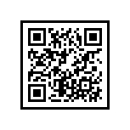
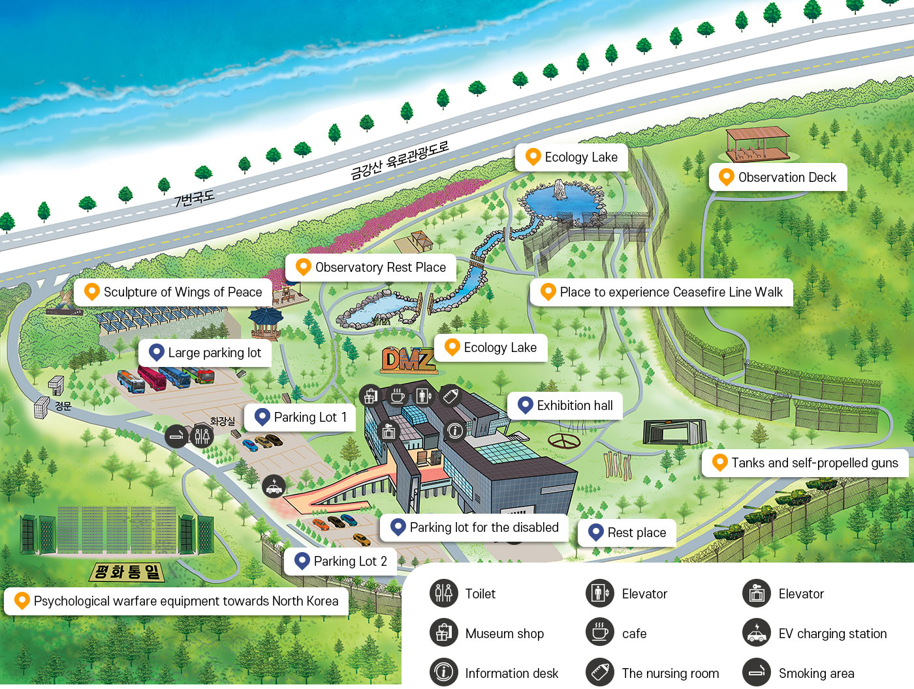
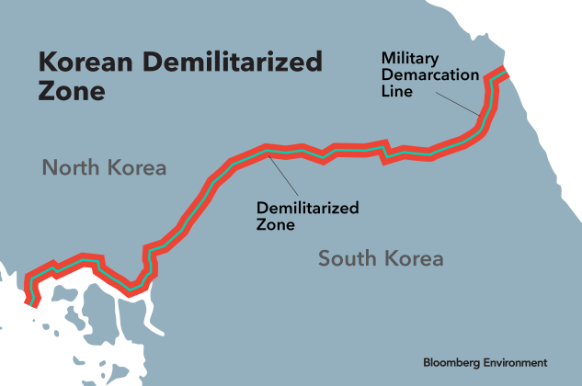

Goseong – DMZ museum
DMZ
: Demilitarized Zone
Meeting Point at 12:00

Slide 3
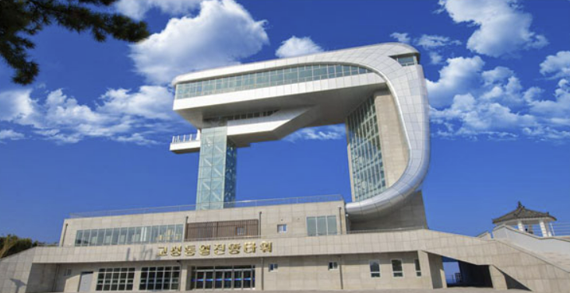
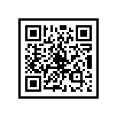

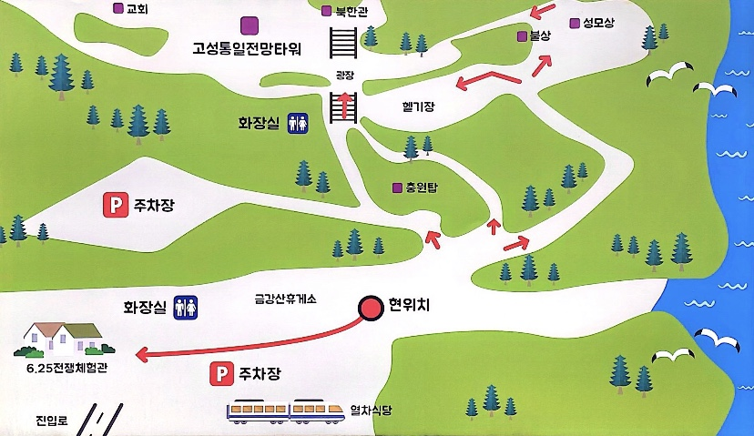

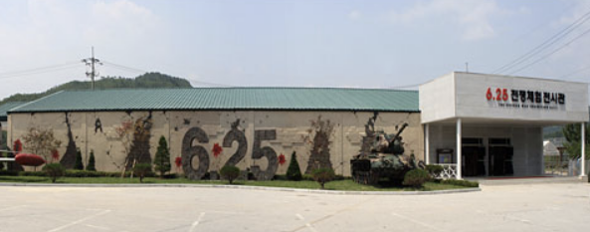

Goseong - Unification Observatory
Unification Observatory Tower
The Korean War Exhibition Hall
Unification Observatory Tower
An observatory where you can see Mt. Geumgang & Haegeum river in North Korea at a glance.
The Korean War Exhibition Hall
You can experience the Korean war to learn from the tragedy of the war and desire for peaceful unification.
Meeting Point at 13:00

Slide 4
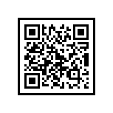
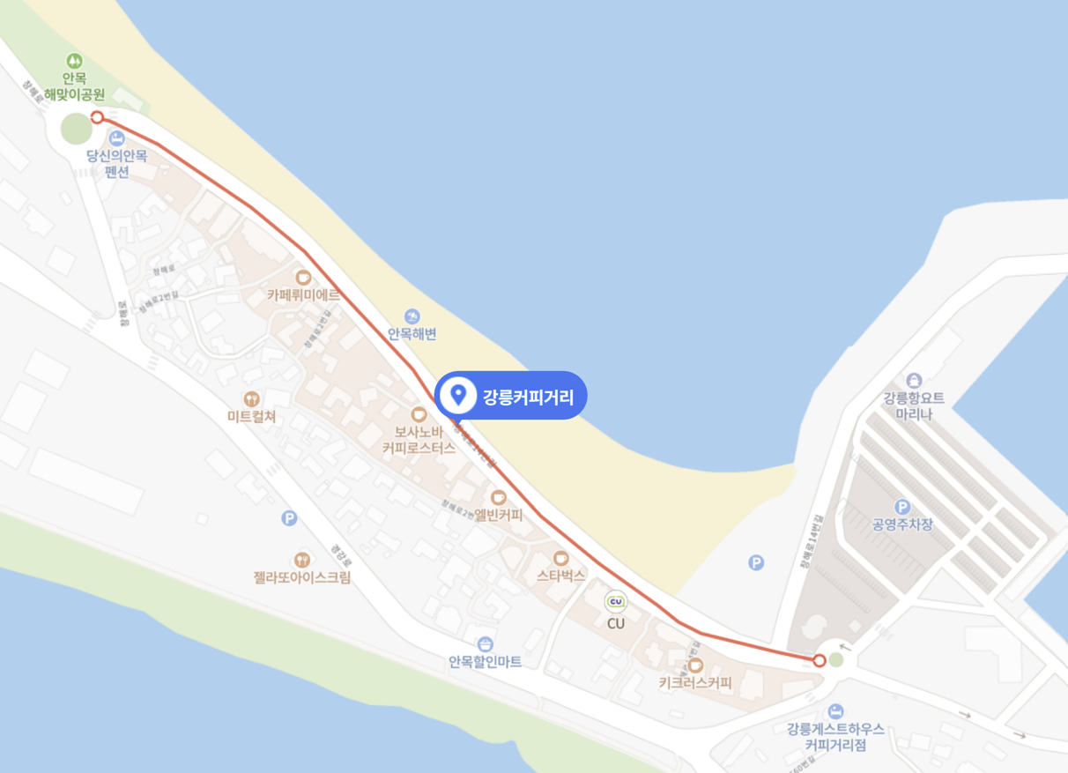


Gangneung
Gangneung coffee street
Anmok Beach
Anmokbeach
Gangneung coffee street
Anmok beach
커피콩빵
Gangneung coffee street
Bread representing Gangneung province
The shape of the bread is like coffee bean
Meeting Point at 18:20

Slide 5



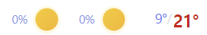


Notice
Excursion is a part of the AEPSHEP program
On excursion day, there will be no lunch and dinner at the hotel
If you don’t come to excursion, please let Kate know
Goseong
Gangneung
Lunch (화진포박포수가든) +82 (0)33-682-4856
Dinner (소나무집 초당순두부) +82 (0)33-653-4488
Kate +41-75-411-5943
Taejeong Kim +82-(0)10-3024-7470

