Slide 1
Ensuring Data Durability in EOS Systems
Notes:
In this presentation I am going to talk about how to improve the data durability in EOS systems.

Slide 2

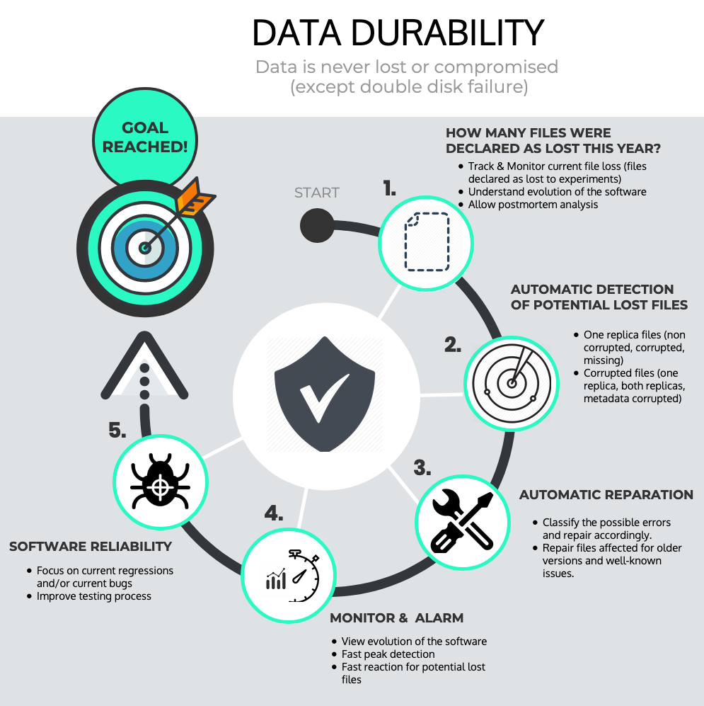

EOSPHYSICS: minimal fraction of files may be lost “by design” in certain situations (e.g. double disk failure) — this is a deliberate choice due to the sheer size of the system (100s PBs) and it is trade-off between the cost of storage and required reliability.
EOSUSER: we guarantee better reliability (and we don’t expect the file loss at all) by increasing the cost of the service. This may be done in several ways (e.g. higher replication, additional backup, …).
EOS Workshop 2020 - Maria Arsuaga-Rios
1
Notes:
Here you can see the graph that summarize the Data Durability process. The goal is that data is never lost or compromised (except double disk failure). We are going to go through all these steps during the presentation.

Slide 3
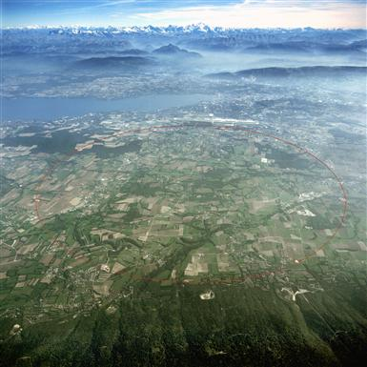

Flashback: March 2019
Operations support
Wigner draining
How many files are we missing?
Is there any tool to allow us post-mortem/historical analysis?
2
Notes:
One year ago I joined the EOS team, being part of the operations support and the Wigner draining project.
It was at that moment when, as the rest of the team, I noticed the lost of files during the draining processes and I wondered myself, how many files are we missing? Is there any tool to allow us a post-mortem and historical analysis? No, there was not, and that was my motivation to implemente it!

Slide 4
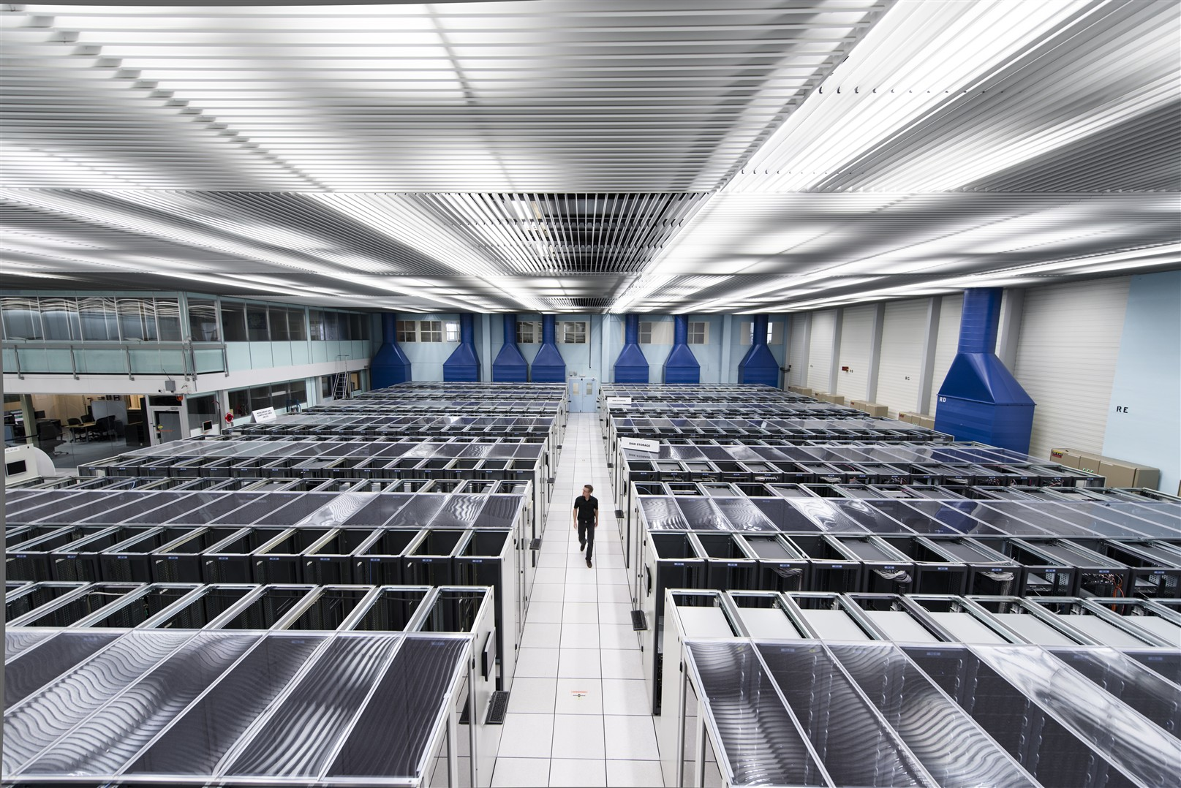





Missing files tracking
Track and monitor files declared as lost
Understand evolution of the software
Allow post-mortem analysis
Monitoring
Lost files
Metadata
(eos-ops-lostfiles)
Data discovery
eos-ops-lostfiles -f file -d 2020-02-04 -r "bootfailure_with_other_replica_0_size" -e ALICE --send
EOS Workshop 2020 - Maria Arsuaga-Rios
3

Slide 5
Missing files tracking
send_data_to_es(data, index, _id, es):
requestBody = ""
requestBody+='{"index":{"_id": "'+_id+'"}}\n'
requestBody+= json.dumps(data) +"\n”
try:
out = es.bulk(index='eosmon_'+index+'-'+str(datetime.datetime.now().year), doc_type=index, body=requestBody)
print out
except TransportError as e:
print e.info
except Exception as er:
print er
get_es_connexion():
USER_ES = 'eosmon'
PASSWORD_ES = lalala
certpath = "/etc/pki/tls/certs/ca-bundle.trust.crt"
es = Elasticsearch(
'https://'+USER_ES+':'+PASSWORD_ES+'@es-eosmon.cern.ch/es',
# turn on SSL
use_ssl=True,
# make sure we verify SSL certificates (off by default)
verify_certs=True,
ca_certs=certpath)
return es
Monitoring
Lost files
Metadata
(eos-ops-lostfiles)
Data discovery
EOS Workshop 2020 - Maria Arsuaga-Rios
3

Slide 6
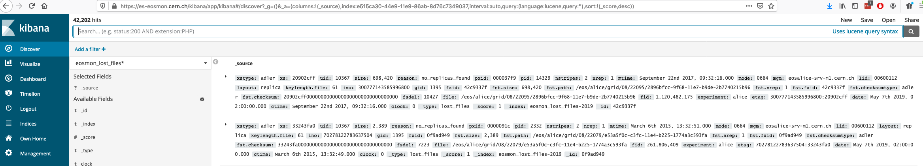
Missing files tracking
Monitoring
Lost files
Metadata
(eos-ops-lostfiles)
Data discovery
EOS Workshop 2020 - Maria Arsuaga-Rios
3

Slide 7
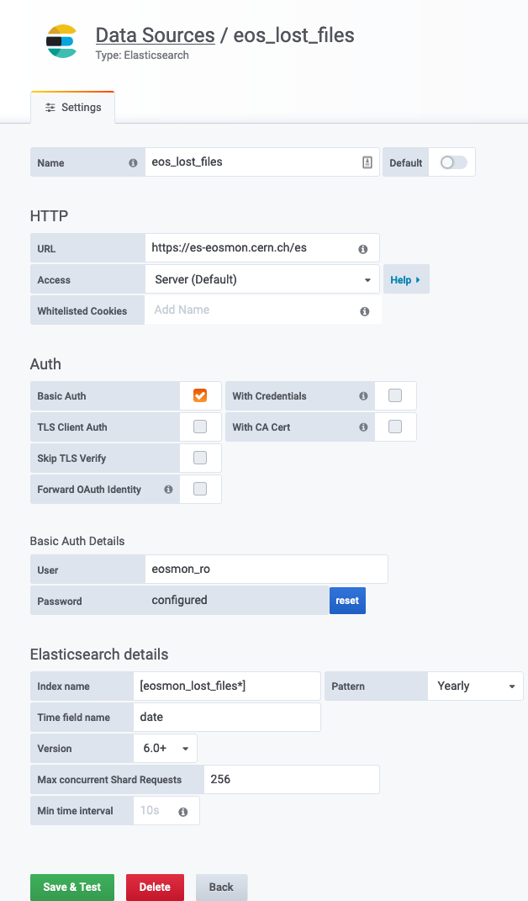
Missing files tracking
Monitoring
Lost files
Metadata
(eos-ops-lostfiles)
Data discovery
EOS Workshop 2020 - Maria Arsuaga-Rios
3

Slide 8
7th May 2019 - we discovered 32K* missing files when draining ALICE
How we communicate these information to our users?
  How many condition data base files are missing?
    (5 replicas expected)
  Which is the distribution over mtime?
  Is there a correlation with an incident, ticket or known bug?
*: 0.0046% files stored
EOS Workshop 2020 - Maria Arsuaga-Rios
4

Slide 9
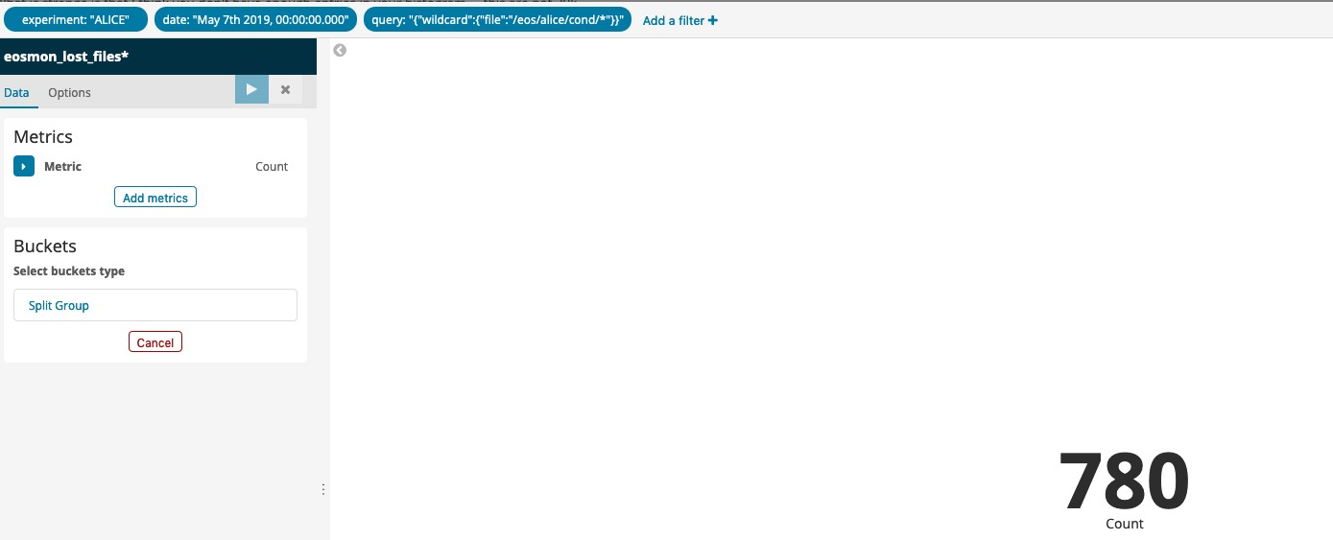
7th May 2019 - we discovered 32K missing files when draining ALICE
  How many condition data base files are missing?
    (5 replicas expected)
EOS Workshop 2020 - Maria Arsuaga-Rios
5

Slide 10
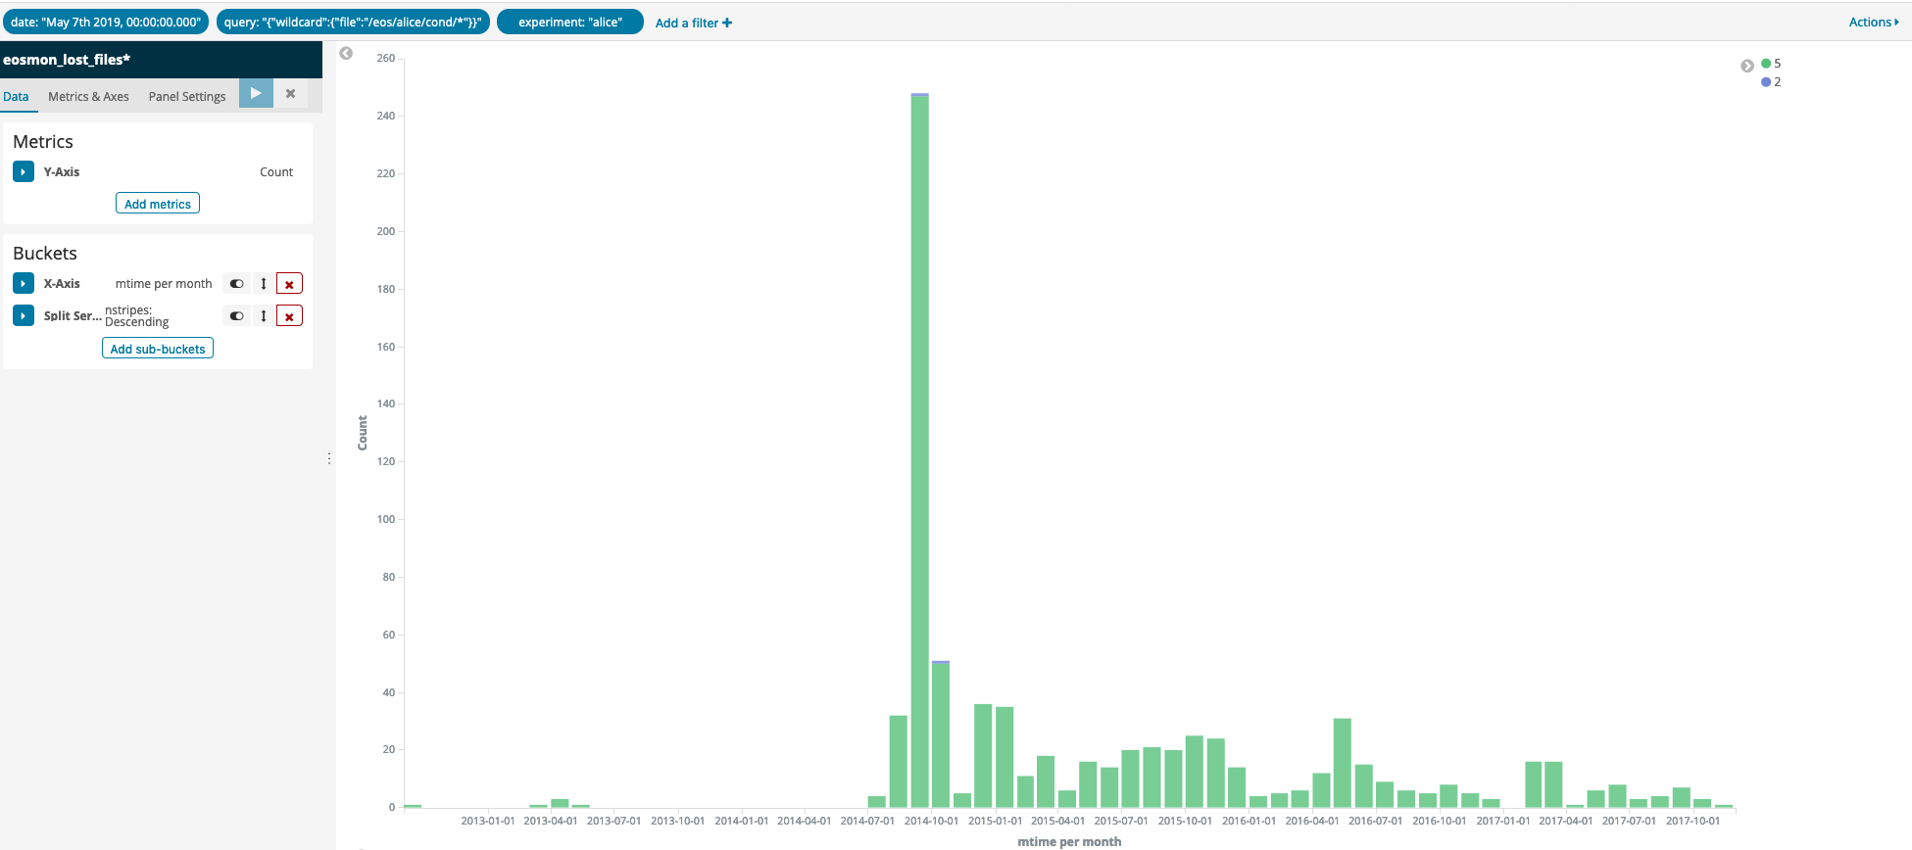
  Which is the distribution over mtime?
    2013 to 2017
EOS Workshop 2020 - Maria Arsuaga-Rios
6

Slide 11
7th May 2019 - we discovered 32K missing files when draining ALICE
  Is there a correlation with an incident, ticket or known bug?
    10/11/2017 Incident: “Root cause: Crash caused the namespace to be corrupted” OTG0040840
    10/11/2017 to 14/12/2017 GGUS Ticket:”eosalice manual restore, missing condition files” GGUS ticket
EOS Workshop 2020 - Maria Arsuaga-Rios
7

Slide 12
Automatic detection of high risk files
Detection is the first step, make it visible!
  Detect one replica files (non corrupted, corrupted, missing, …)
  Detect mismatching checksums and sizes (one replica, both replicas, metadata corrupted, …)
EOS Workshop 2020 - Maria Arsuaga-Rios
8

Slide 13
Automatic detection of high risk files
One replica files (one replica layouts included):
  Automatic and daily full scan in all EOS quarkDB instances
    stripediff option requested to Georgios for the eos-ns-inpect-tool
Draining failures
  Automatic and daily full scan in all file systems marked as drained failure (which have problematic files that prevent the completion of the draining process)
Backup errors
  Automatic and daily detection of files that couldn’t be backup
EOS Workshop 2020 - Maria Arsuaga-Rios
9

Slide 14
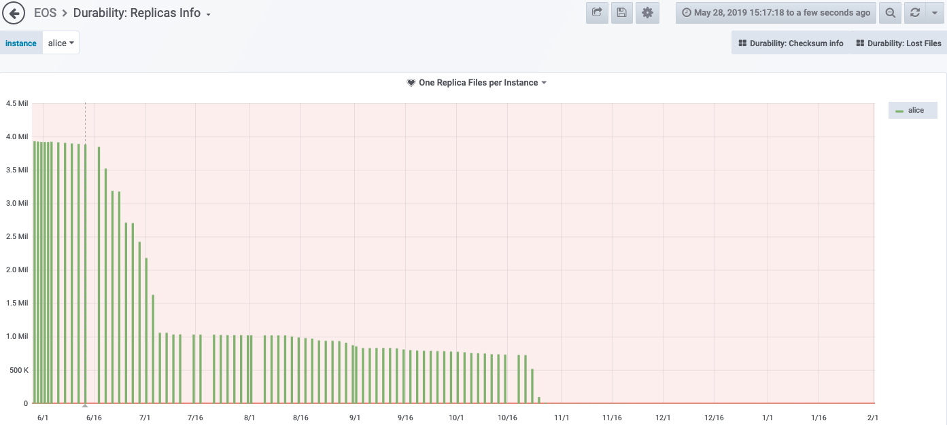
Automatic detection of high risk files
29th May 2019 – Alice: 3.93M* with only one replica registered in the namespace
*: 0.58% of the files stored
eos-ops-collect-stripediff-files --instance "$i" –send
EOS Workshop 2020 - Maria Arsuaga-Rios
10

Slide 15
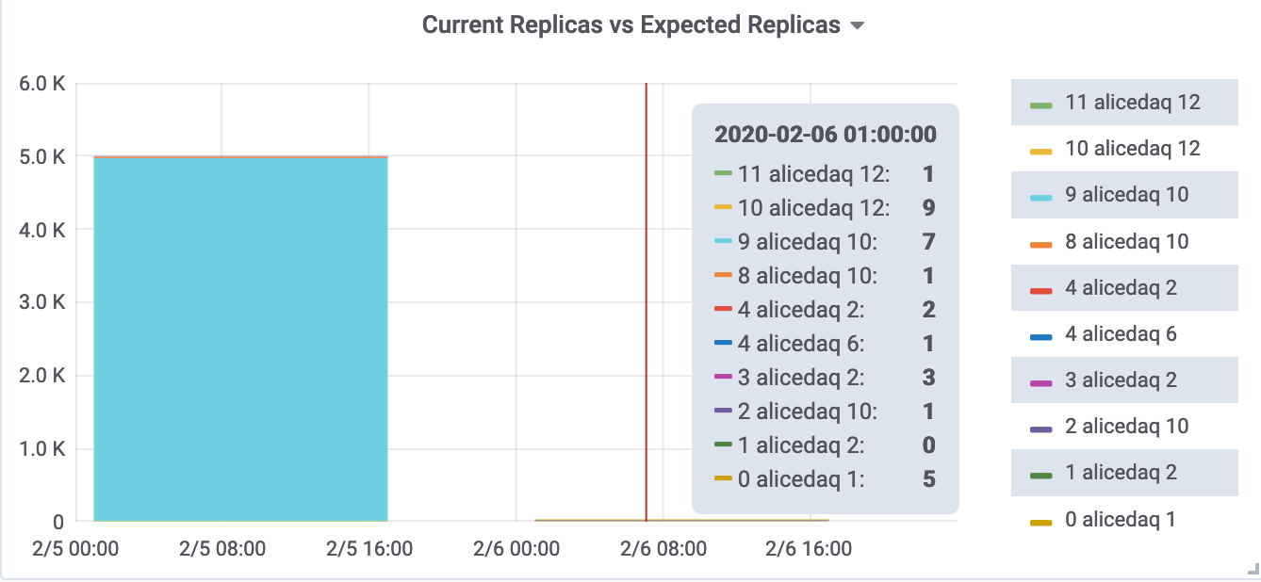
Automatic detection of high risk files
Under-replication of Rain files in Alicedaq
*: 0.47% of the files stored
eos-ops-collect-stripediff-files --instance "$i" –send
EOS Workshop 2020 - Maria Arsuaga-Rios
10

Slide 16
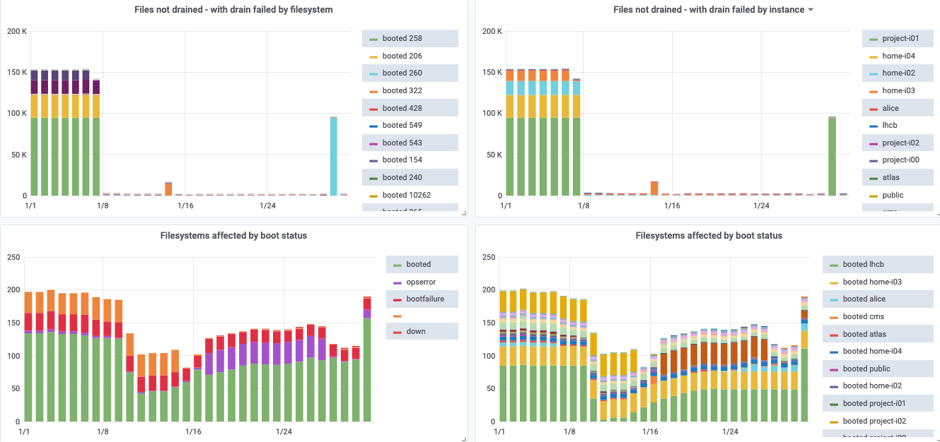
Automatic detection of high risk files
Draining failures – last month (January 2020)
eos-ops-collect-drain-failed -i $instance --repair --send
EOS Workshop 2020 - Maria Arsuaga-Rios
11

Slide 17


Automatic reparation
Namespace full scan is not enough
  We need to go deeper and get the storage nodes information
Classify the possible errors and repair accordingly
  Divide & Conquer: 14 categories for one replica files out of 21 categories in total
Repair files affected for older versions and well-known issues/cases
One replica and size and checksum
match the namespace
One replica with checksum 0 in namespace
One replica with size and checksum
mismatch with namespace
Missing replica
EOS Workshop 2020 - Maria Arsuaga-Rios
12

Slide 18
Automatic reparation
Namespace full scan is not enough
  We need to go deeper and get the storage nodes information
Classify the possible errors and repair accordingly
  Divide & Conquer: 14 categories for one replica files out of 21 categories in total
Repair files affected for older versions and well-known issues/cases
One replica and size and checksum
match the namespace
One replica with checksum 0 in namespace
One replica with size and checksum
mismatch with namespace
Missing replica
EOS Workshop 2020 - Maria Arsuaga-Rios
12

Slide 19
Automatic reparation
21 + 1 categories
NOT EXPECTED PLAIN LAYOUT
MISSING
CONTAINER
GHOST FILES
NON-PURGED
ATOMIC FILES
ONE REP
NS XS 0 OR 1
ONE REP
CORRUPTED
REP EXCEEDED
ONE OK
ALL REP OK
ALL REP CORRUPTED
MATCH XS AND SIZE
MULTIPLE REP
NS XS 0 OR 1
ONE REP OK
Repaired automatically
Corner
cases
NO_REP
ALL REP CORRUPTED
AT LEAST
ONE REP OK
ALL REP CORRUPTED
MATCH XS NO SIZE
Possible
loss
Other filters
Nothing to repair
REMOVED FILE
FILE NOT EXIST
ZERO FILE SIZE
LOST&FOUND
BIG FILE (>3m timeout)
EOS Workshop 2020 - Maria Arsuaga-Rios
12

Slide 20
Automatic reparation
21 + 1 categories
NOT EXPECTED PLAIN LAYOUT
MISSING
CONTAINER
GHOST FILES
NON-PURGED
ATOMIC FILES
Possible loss categories can have a chance!:
Retrieve finding replicas in other storage nodes (recycle bin, orphan files, lost&found)
Retrieve from versions
Retrieve from backup (eosbackup)
Retrieve from restic (independent system backup)
Retrieve from sync client
ONE REP
NS XS 0 OR 1
ONE REP
CORRUPTED
REP EXCEEDED
ONE OK
ALL REP OK
ALL REP CORRUPTED
MATCH XS AND SIZE
MULTIPLE REP
NS XS 0 OR 1
ONE REP OK
Repaired automatically
Corner
cases
NO_REP
ALL REP CORRUPTED
AT LEAST
ONE REP OK
ALL REP CORRUPTED
MATCH XS NO SIZE
Possible
loss
Other filters
Nothing to repair
REMOVED FILE
FILE NOT EXIST
ZERO FILE SIZE
LOST&FOUND
BIG FILE (>3m timeout)
EOS Workshop 2020 - Maria Arsuaga-Rios
12

Slide 21
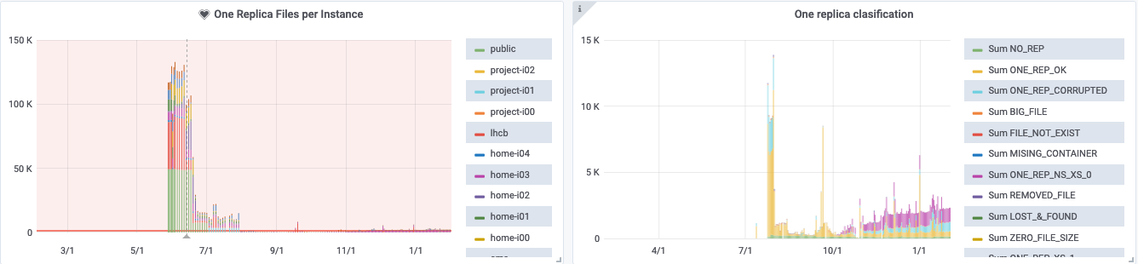
Automatic reparation
All instances (Alice excluded): One replica files classification and reparation
  First big reparation because of a massive adjustreplica performed without classification
eos-ops-repair -f "$i"_one_replica_$(date +%Y-%m-%d -d "yesterday").txt --id_type dec -i "$i" -l DEBUG --rundeck --one_rep --repair --send
EOS Workshop 2020 - Maria Arsuaga-Rios
13

Slide 22
Automatic reparation
All instances (Alice excluded): One replica files classification and reparation
How it works:
1. Classify the files per problem by providing the list of fids or pathnames.
2. Each category will contain one file with the list of fids affected
3. --repair: Repair by category and run the corresponding repairing method
4. --send: Send the data to ES (the data is always sent to Cernbox)
  First big reparation because of a massive adjustreplica performed without classification
eos-ops-repair -f "$i"_one_replica_$(date +%Y-%m-%d -d "yesterday").txt --id_type dec -i "$i" -l DEBUG --rundeck --one_rep --repair --send
EOS Workshop 2020 - Maria Arsuaga-Rios
13

Slide 23
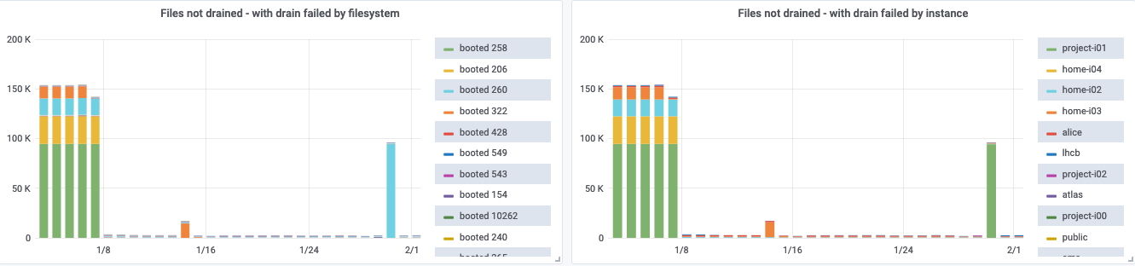
Automatic reparation
Automatic reparation for draining failures:
  Every day at 3pm: “Detect + Classify + Repair + Drain” = Less human effort
eos-ops-collect-drain-failed -i $instance --repair --send
EOS Workshop 2020 - Maria Arsuaga-Rios
14

Slide 24
eos-ops-durability toolkit
Code & automatic rpm creation:
  Gitlab: https://gitlab.cern.ch/eos/eos-ops-durability
  EOS repo: http://storage-ci.web.cern.ch/storage-ci/eos-ops-durability
Installed via puppet in all MGMs (AliceDaq excluded)
Running in MGMs / rundeck
Output sent to:
  Cernbox: https://cernbox.cern.ch/index.php/apps/files/?dir=/__myprojects/eos/Durability&
  Data source – Elasticsearch + Data Discovery - Kibana: https://es-eosmon.cern.ch/kibana/app/kibana#/discover
  Monitoring - Grafana: https://filer-carbon.cern.ch/grafana/d/JzDQWU7Zz/durability-classification
EOS Workshop 2020 - Maria Arsuaga-Rios
15

Slide 25
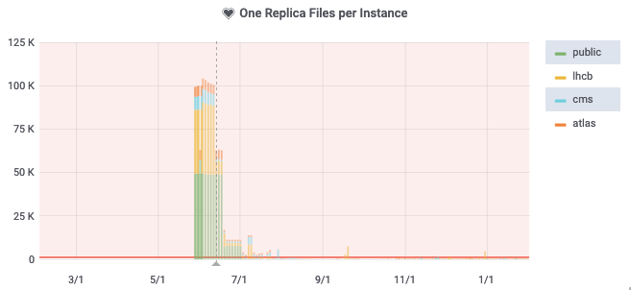
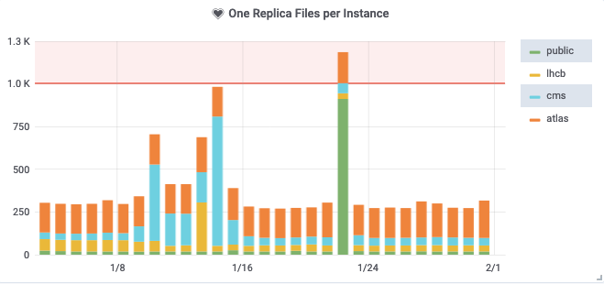
Monitor & Alarm
Allow us to monitor the software evolution
Fast peak detection and fast reaction
EOS Workshop 2020 - Maria Arsuaga-Rios
16

Slide 26
Software reliability
Focused on current regressions and/or bugs
Improve testing process
  Eg. Helping the testing of the new generation of fsck
EOS Workshop 2020 - Maria Arsuaga-Rios
17

Slide 27

Future work
Top 4 objectives for next round
Automatic missing files retrieval from backup and restic in home instances
Evaluate the new generation of fsck and complement its actions
Provide external configuration for elasticsearch data sources and eos directories
Include data durability checks for erasure coding – AliceDaq (complementing fsck)
18

Slide 28
Conclusions
Software evolution monitoring
Better communication and better incidents understanding
Less human effort in operations support (rota) and draining processes
Faster peak detection and reaction
Focus on current regressions/bugs, avoiding noise from the past
Testing processes improvement
19

