Slide 1

WP17.3 – VENTILATION OF THE LHC TUNNEL DURING THE CORES DRILLING WORKS AT POINT 1 AND POINT 5
(ref. EDMS 2322242)
P. Pepinster – T.Otto – Ch. Gaignant
Cores meeting – 10.02.2020

Slide 2
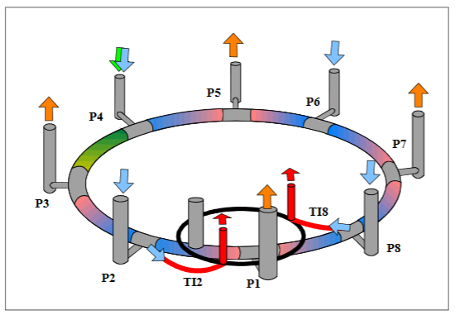
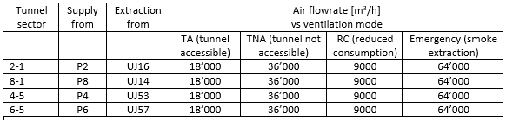
LHC VENTILATION

Slide 3
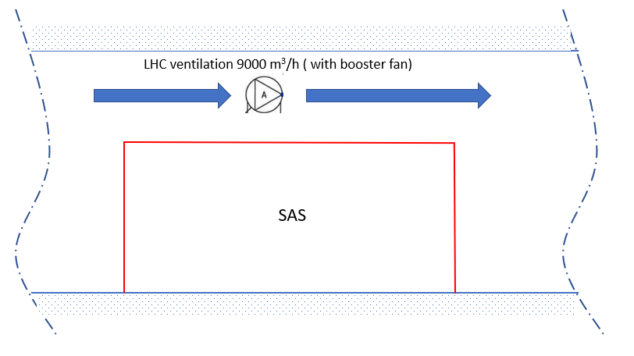
Technical Requirements: LHC Tunnel Ventilation
Isolation SAS (airlock) for CE works will obstruct a large part of the tunnel section
Minimum ventilation must remain active to provide air renewal and limit humidity (at least 9000m³/h – RC mode)
Maintain ventilation passage, no pressure drop can be added by a restriction of the section otherwise can be compensated with a booster fan
Applies to UA13, UL13, UA17, UL17, UA53 and UA57
Exceptions: UL53 and UL57.

Slide 4
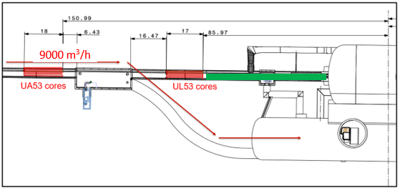
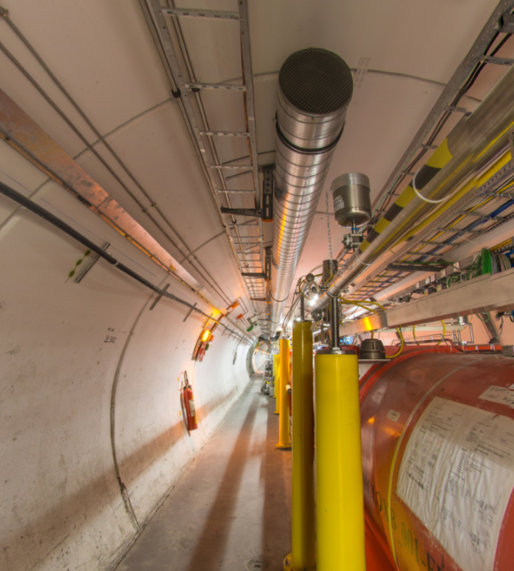
Technical Requirements: LHC Tunnel Ventilation
Particular case of UL53: forbid access to R54 or maintain ventilation?

Slide 5
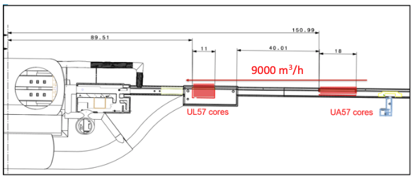
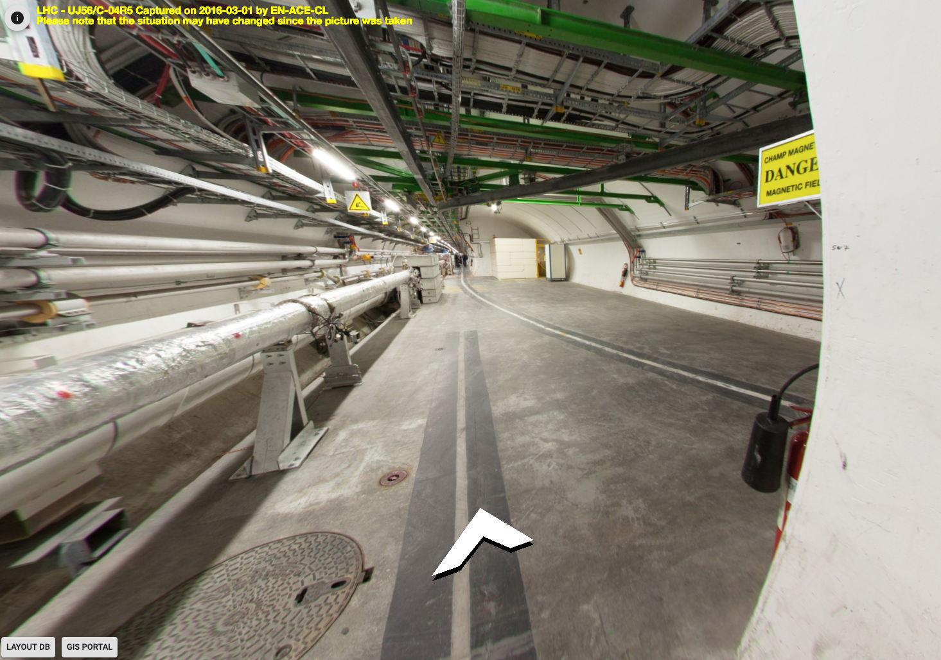
Technical Requirements: LHC Tunnel Ventilation
Particular case of UL57: SAS located in UJ57 with tunnel cross section large enough.

Slide 6
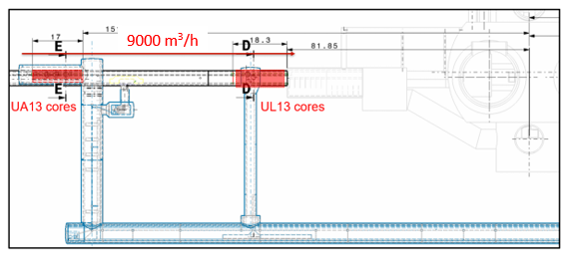
Safety Requirements: Evacuation
SAS should be built such as to leave a personnel evacuation passage of 80 cm width on the floor and 2 metres height.
Example of UA13: evacuation from LHC sector 8-1 to HL by UPR13

Slide 7
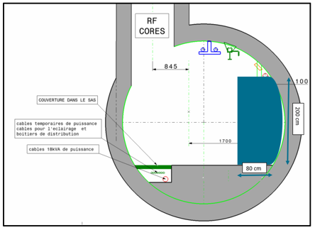
Safety Requirements: Evacuation
Sector | Passage by CC cores | Continue evacuation to | Exit by
8-1 (P1 left) | UA 13 cores partition: Personnel passage | UPR 13 – HL-LHC at Point 1 | HL-LHC shaft
4-5 (P5 left) | UA 53 cores partition : Personnel passage | UJ 53- UL55 | PX54 or PM 56

Slide 8
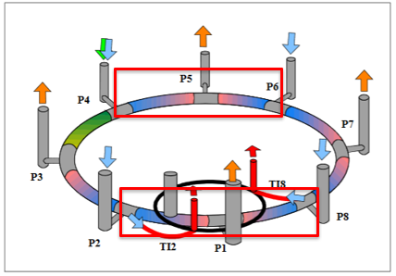
Safety Requirements: Work in affected sectors
The limited possibilities for ventilation and evacuation during the 4-month period of core engineering impose restrictions for work in the affected sectors.
In order to reduce the risk of igniting a fire, all “hot” work is forbidden. This includes welding, brazing, soldering, flame cutting, and grinding.
Electrical tests employing high voltage or high current, which are able to ignite a fire either by sparks or by resistive heating, are forbidden.
The use of chemicals which emanate noxious or toxic vapours in large quantities is forbidden.

Slide 9
Technical Requirements: SAS Ventilation
Class of filtration shall be ePM1 70-85% / ISO16890 (equivalent to F8 / ISO779.2012);
Air renewal flowrate in the SAS shall comply with rules applicable to civil engineering worksites;
Redundancy of the fan is not requested, being understood that in case of failure, works shall stop until restoration of required ventilation conditions;
Differential pressure between SAS and tunnel shall be monitored;
Loss of underpressure shall be visually signalled by flashing lights (need of alarm to CCC to be confirmed or not).

Slide 10
Thank you

