Slide 1
Summary
Many thanks for the latest model, SOTON and CERN now agree on the deployment of x4 (12 mm rods), their locations, and simplified fixation by bolts and nuts
Friction contacts between the stainless rib and invar rods through fastening of invar nuts on invar thread eliminate the thermal stress in all cases (A1-A9) seen previously in bonded contacts
The access port in the side wall of the vacuum elbow section has been removed
The final assembly sequence for the rods remains an open point
  SOTON understand the reasoning behind the CERN proposal to pre-install the four rods to the vacuum flange and then to simultaneously aligned with the four locations in the ribs as the vacuum flange is moved forwards and closed. However, aligning four “dangling” rods simultaneously during installation seems challenging and quite impractical
  SOTON present in the following slides (Slides 2-12) an alternative to install the Invar rods one-by-one from “behind” through the large flange for vacuum pumps on the opposite side of the elbow section
  The main obstacle for the proposal is the limited space for tightening the rods to the warm vacuum flange even with the corresponding vacuum section displaced – See Slide 7
  SOTON propose to adapt the warm vacuum flange section to make install of the rods easier and at the same time create smaller, lighter sub-sections to handle during assembly
    Introduce an intermediate O-ring in the vacuum section to provide the access required – See Slide 13
    Introduce a floating flange arrangement to enable this section to slide for full access – See Slide 14

Slide 2
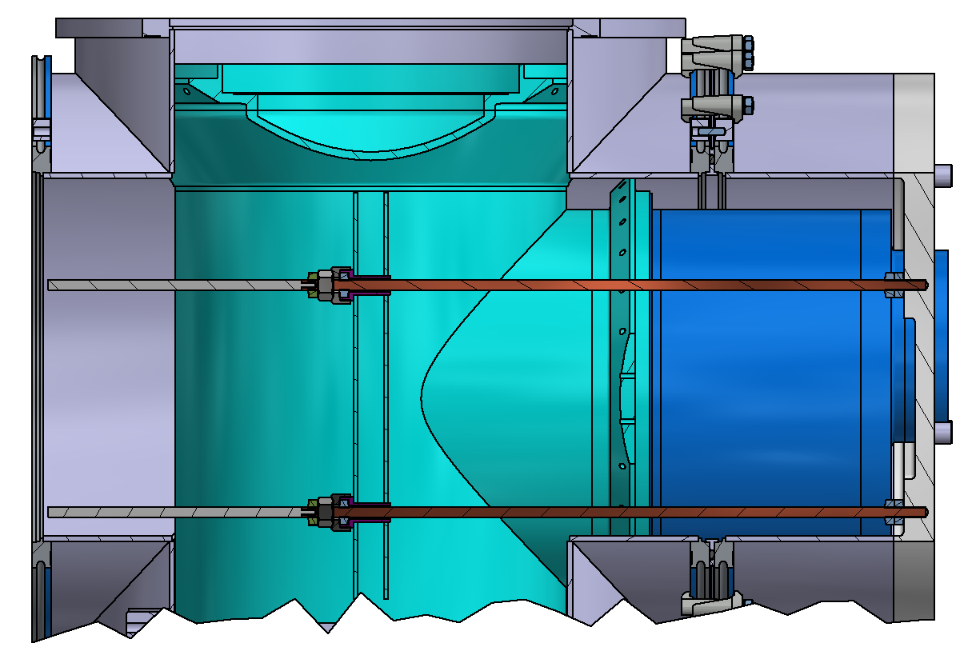
SOTON option for fixing to vertical rib
2-D overview of design
12mm extender rod to aid insertion and assembly at the warm flange end
12mm Invar rod
(final length)
Red arrows show the direction of insertion of the Invar rods
Threaded connection to vacuum flange with double nut locking as proposed by CERN team

Slide 3
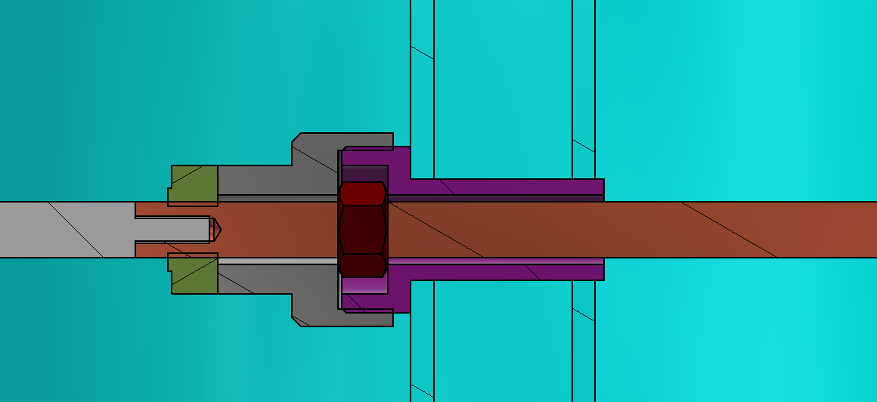
2-D zoomed in view of SOTON option for fixing to vertical rib
Retaining cap with M20 socket drive (all one piece)
Captive M12 nut
Welded insert
12mm Invar bar
Cap locking nut
12mm extender bar
Vertical rib attached to elbow

Slide 4
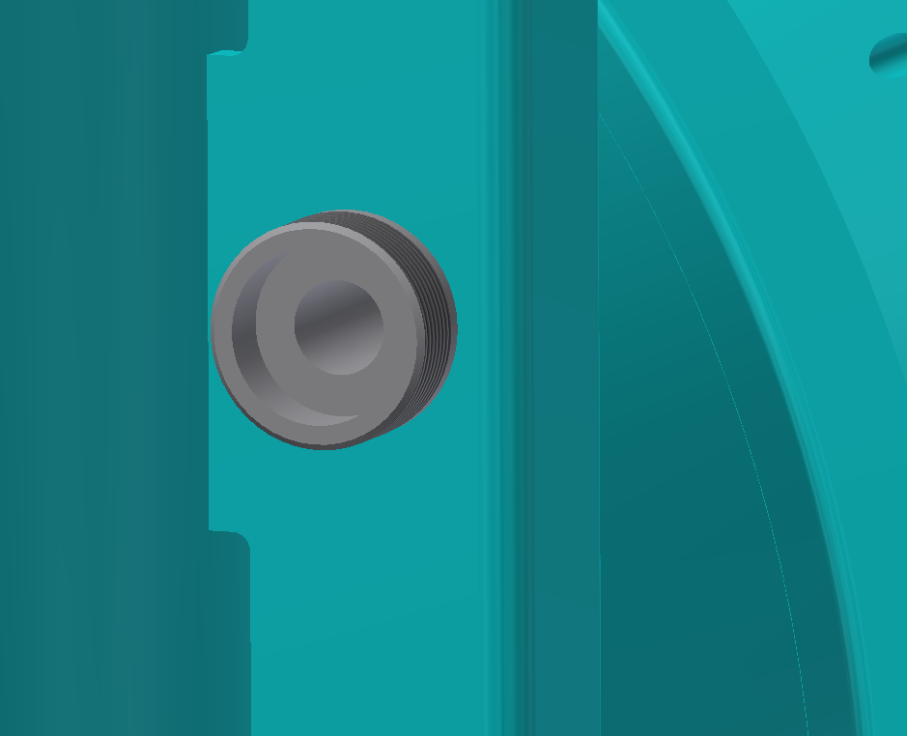
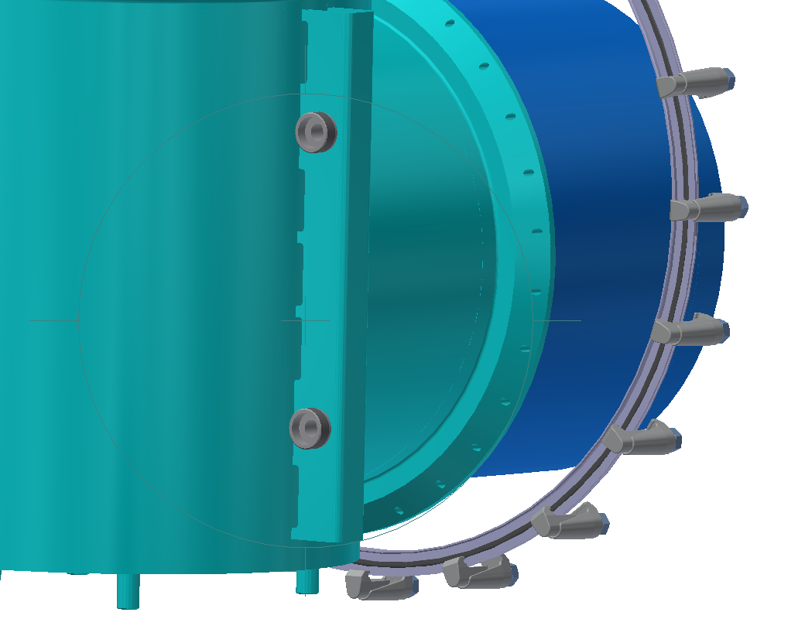
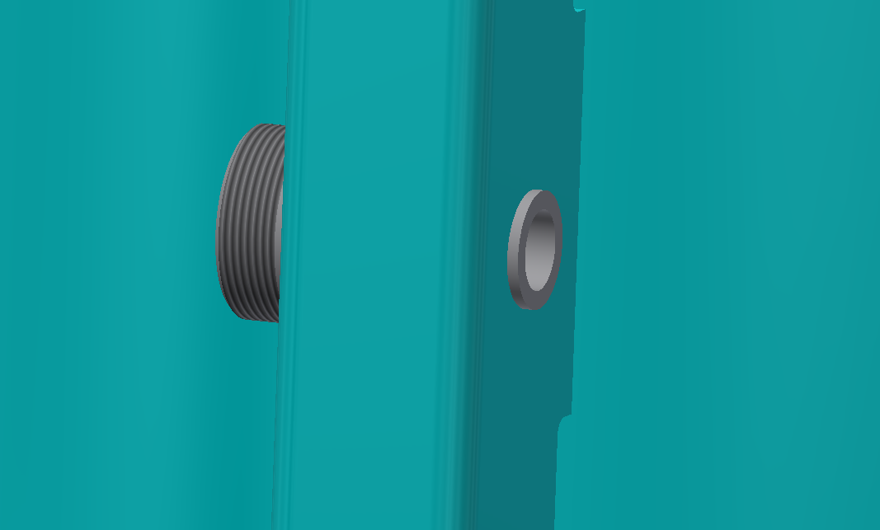
3-D view show insert welded in ribs
Insert entry face
Can add a circumferential weld here
Insert rear lip for welding to rib
Rear view of elbow section

Slide 5
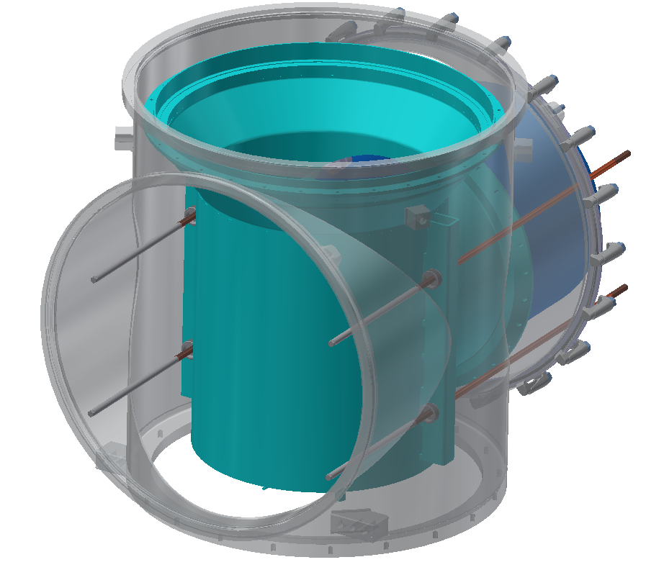
Assembly sequence
STEP 1:
Attached the extended rods to the Invar rods and insert into socket

Slide 6
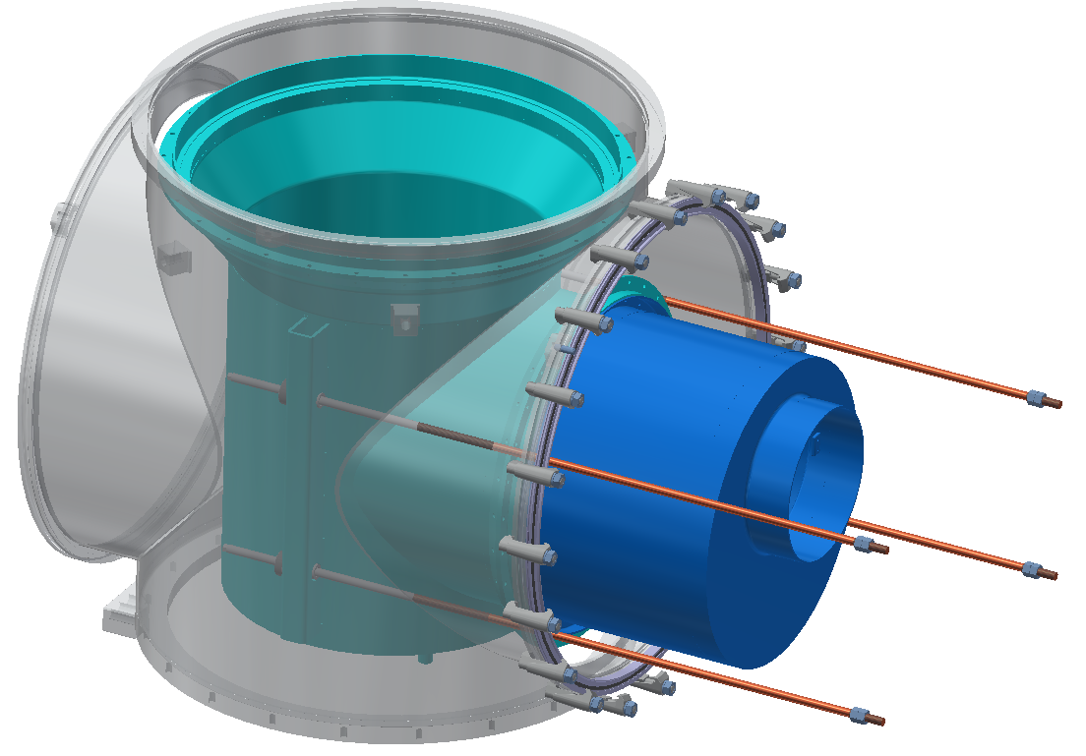
STEP 2:
Long rods are pushed through socket fitting but still remain supported
Double nuts added to Invar rod
450 mm gain for access

Slide 7
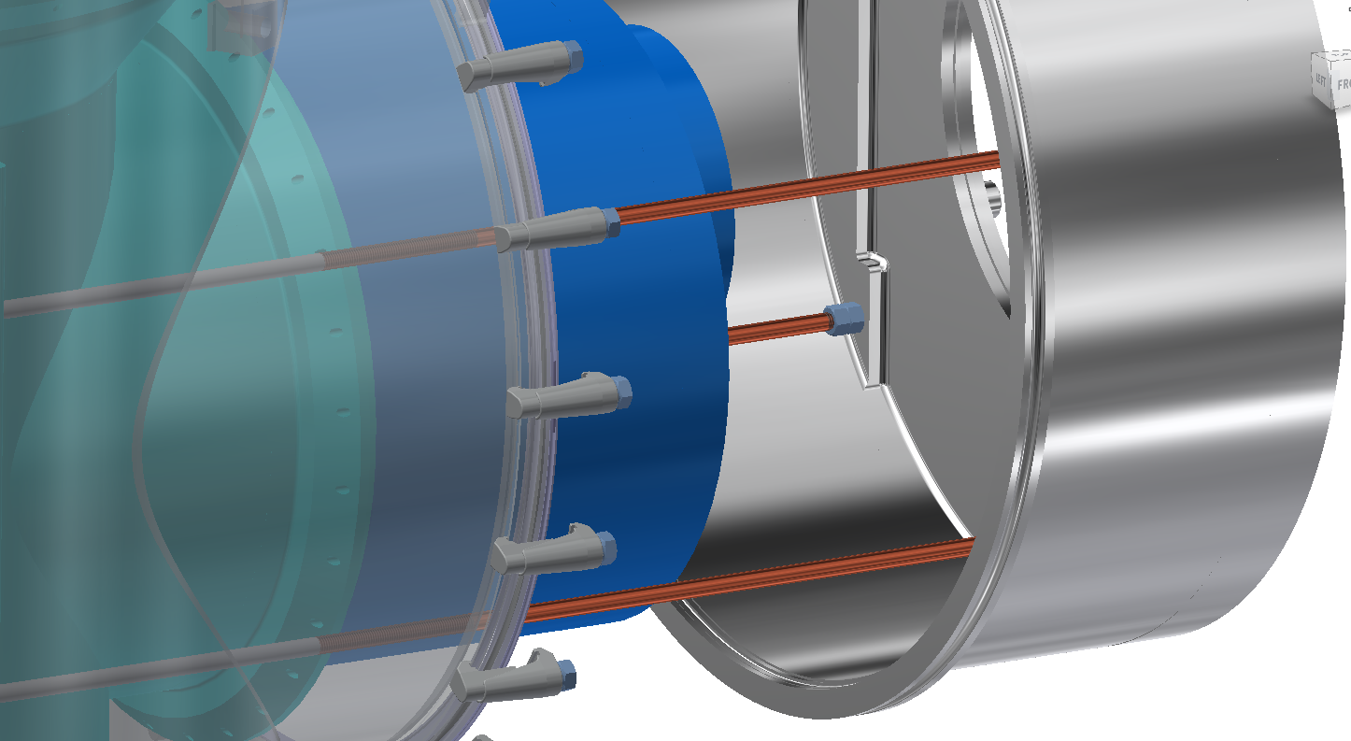
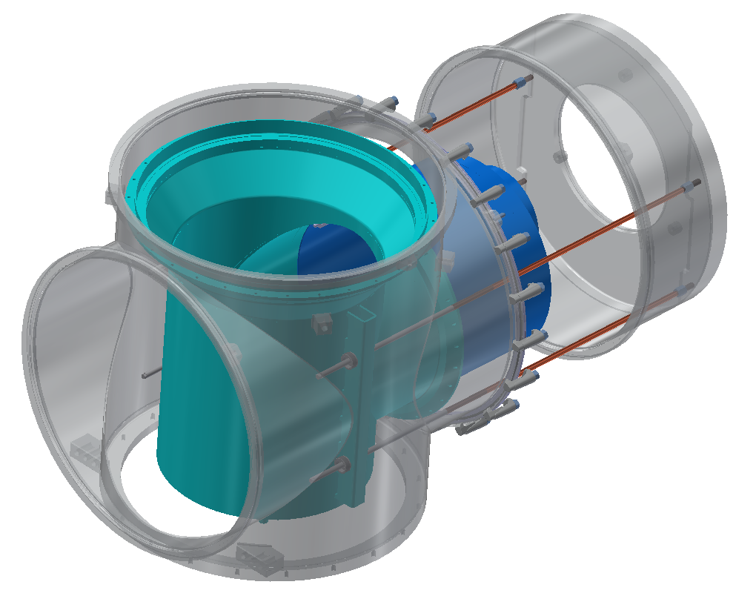
STEP 3:
Prepare vacuum flange by aligning and support in front of main assembly. Leave sufficient space for access to see and tightened each bar independently with tooling
Due to the reduction on the helium vessel in this section, there appears to space to tighten Invar rods against the flange and tighten nuts
There is the option to put a set of flats in the invar rods at a the mid point to help drive the rods home.

Slide 8
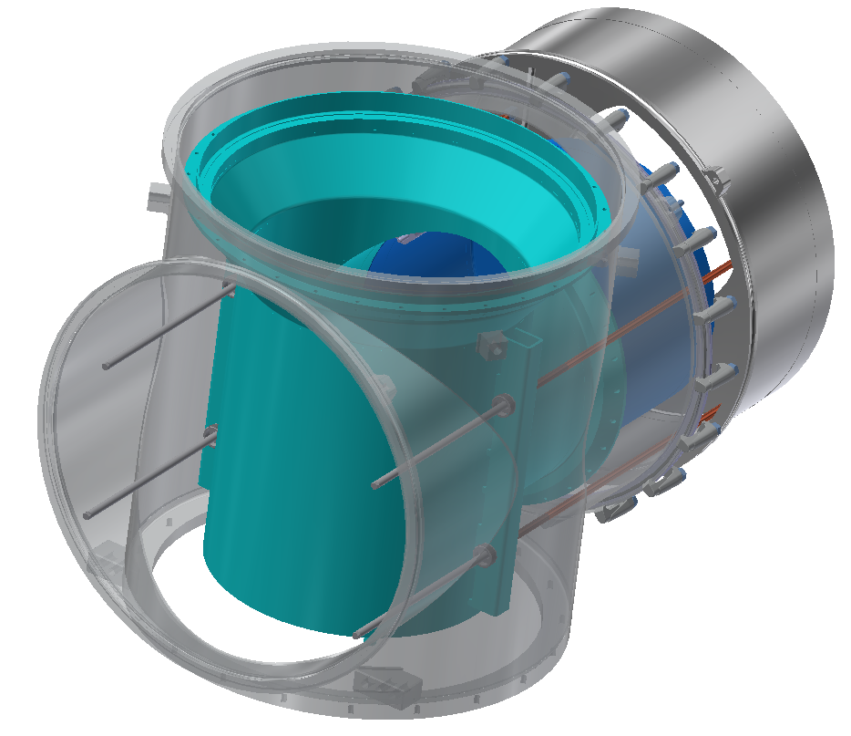
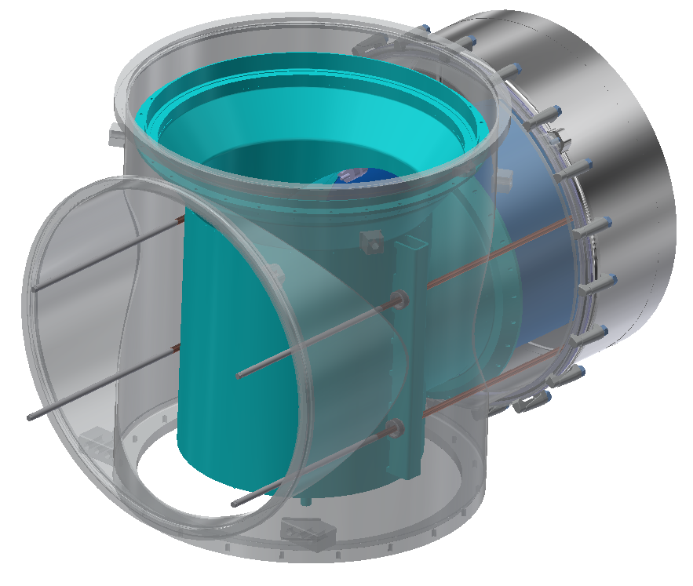
STEP 4:
Begin closing the vacuum vessel once the bars are fixed. The bars should have sufficient clearance at the vertical rib end to avoid snagging as the extended rod retreats.

Slide 9
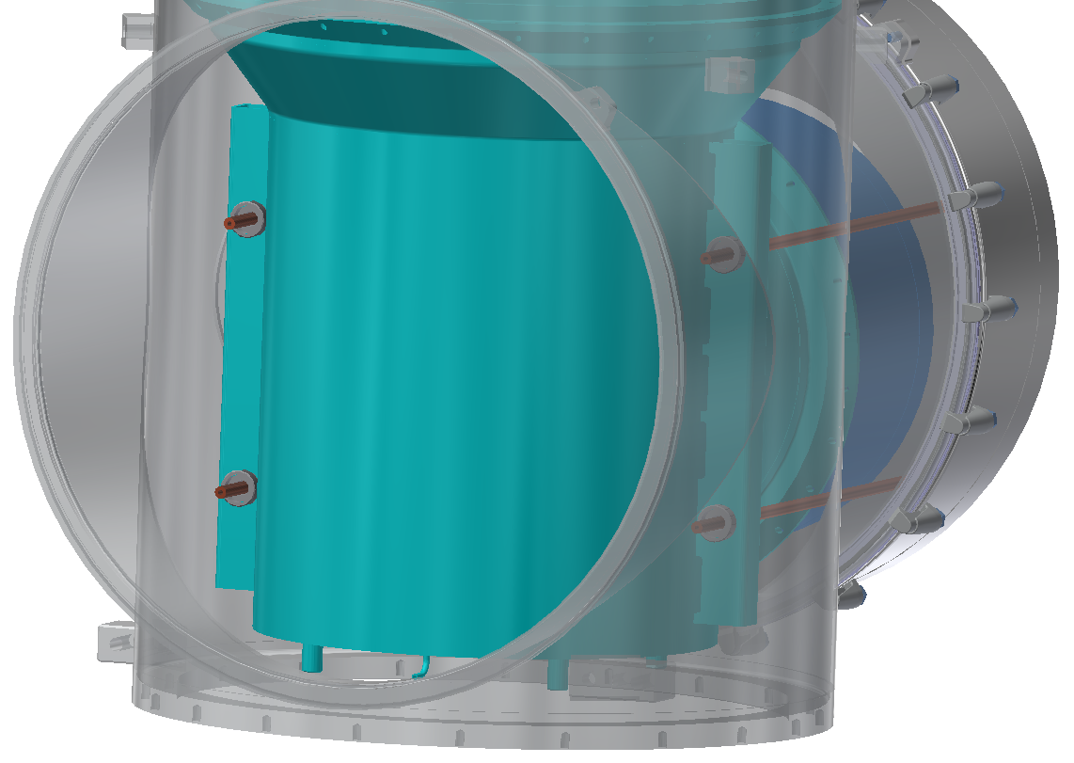
STEP 5:
Once the vacuum flange is clamped. Remove the extender rods

Slide 10
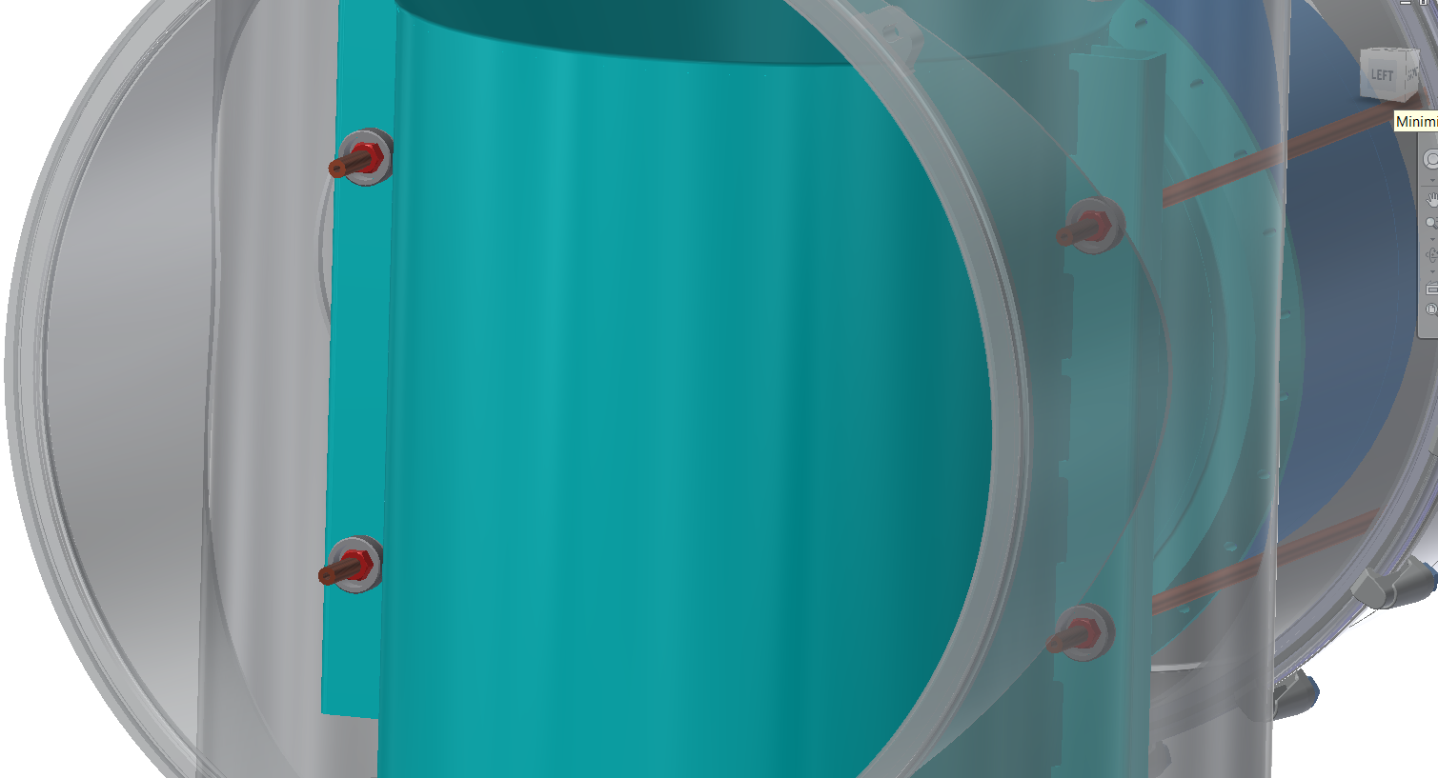
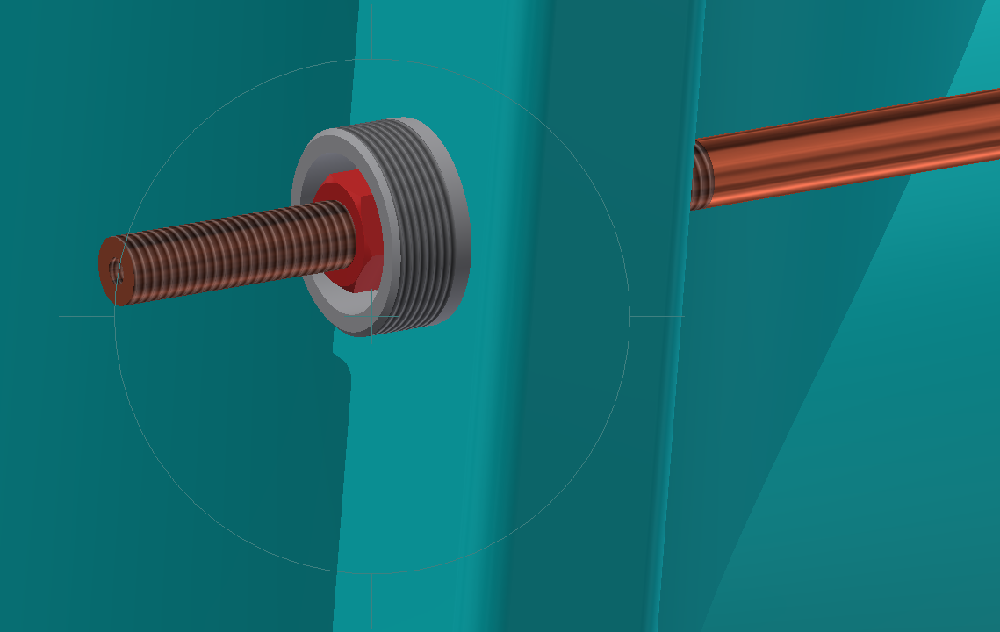
STEP 6:
Installed M12 Invar nut (red) and use a socket set drive with extension to tighten nut inside weld insert

Slide 11
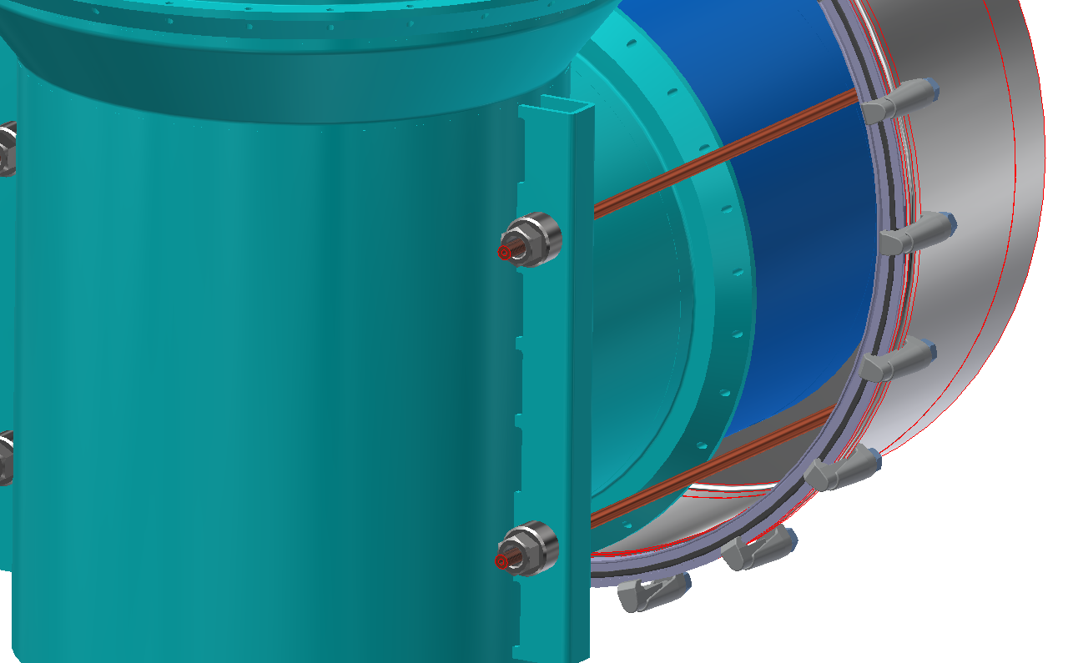
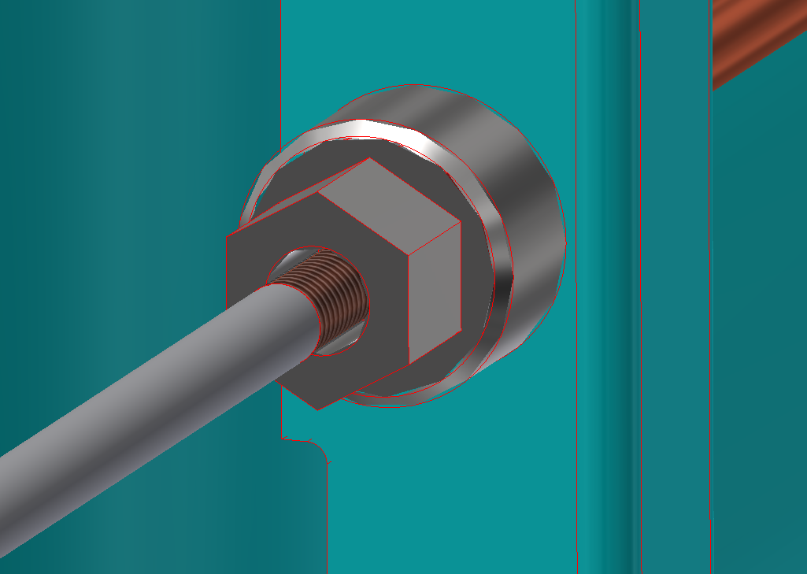
STEP 7:
Installed retaining nut (currently M36) with 20 mm hex drive front end for driving. Retaining nut will keep the M12 Invar nut captive and cope with movements in the z-plane in both directions

Slide 12
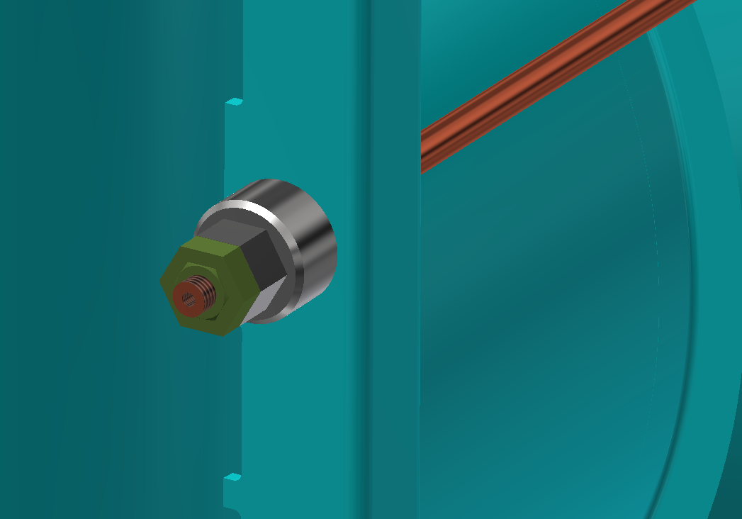
STEP 8:
Installed the cap locking nut to avoid the cap loosening

Slide 13
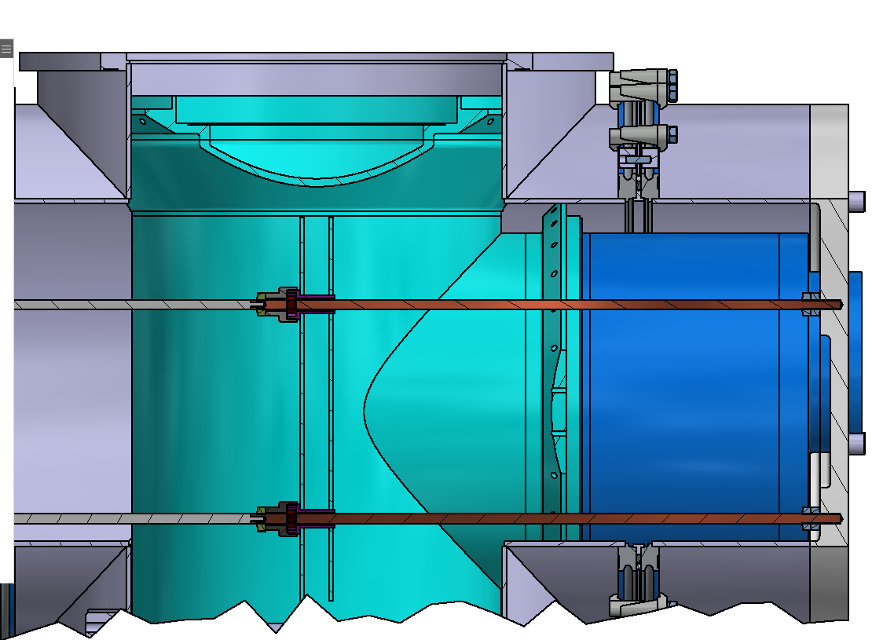
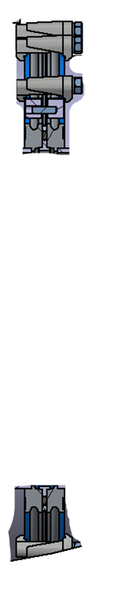
Option:
i) Install an additional O-ring joint to break the vacuum section into two
The displacement of flange without the tubular section attached will create the space to tighten the rods

Slide 14
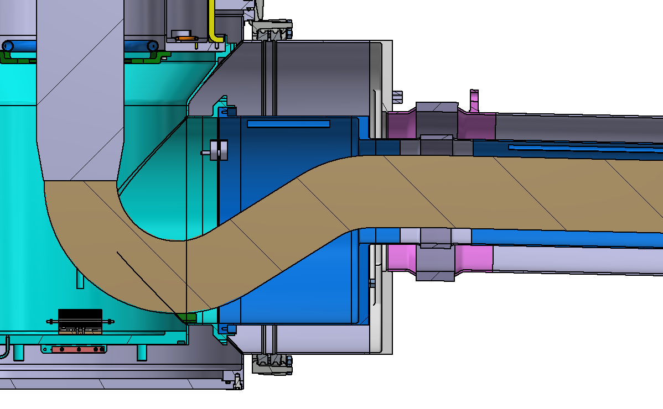
Option:
ii) Introduce a floating flange arrangement
The sliding section creates full peripheral access to installed the rods
Adding the yellow flange to the bellows will create two shorter sub-section for easier handling and installation

