Slide 1
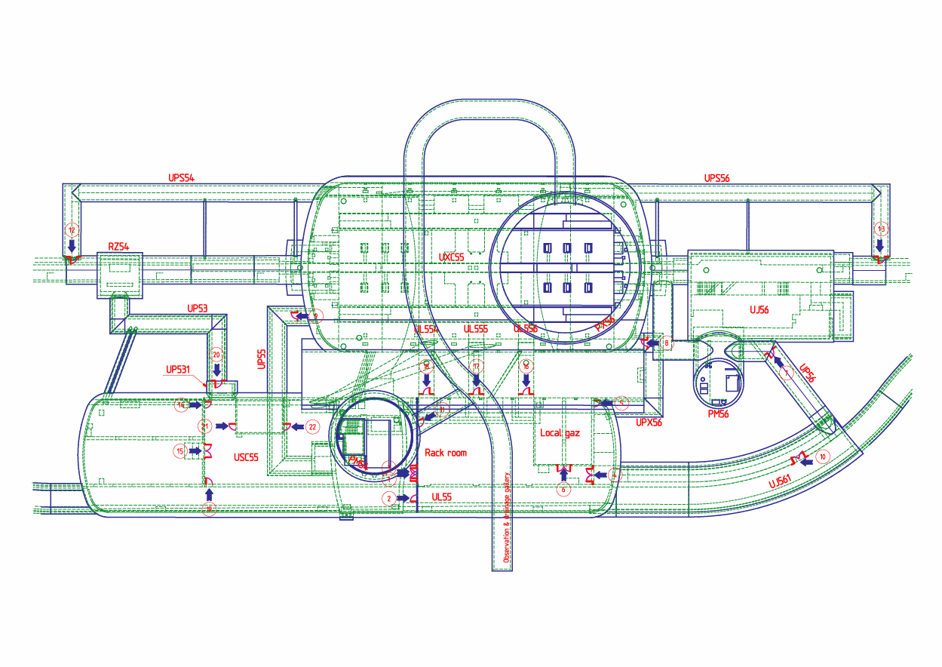


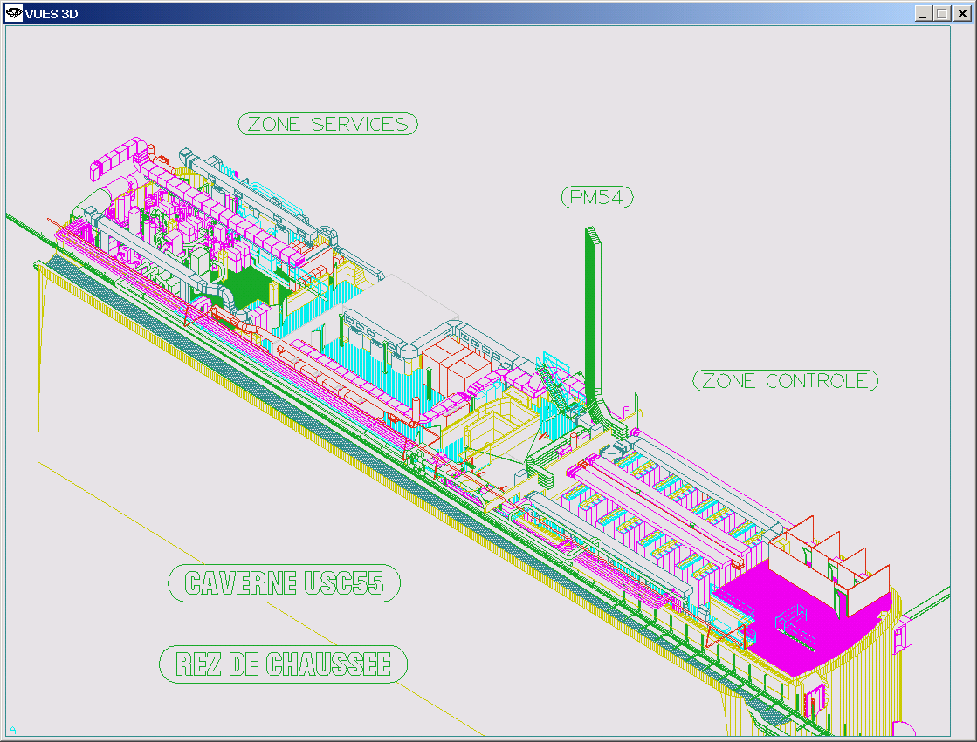
R2E @ Pt5 - RadWG meeting
Presenting a concept
Prepared by M Gastal & S Maridor

Slide 2
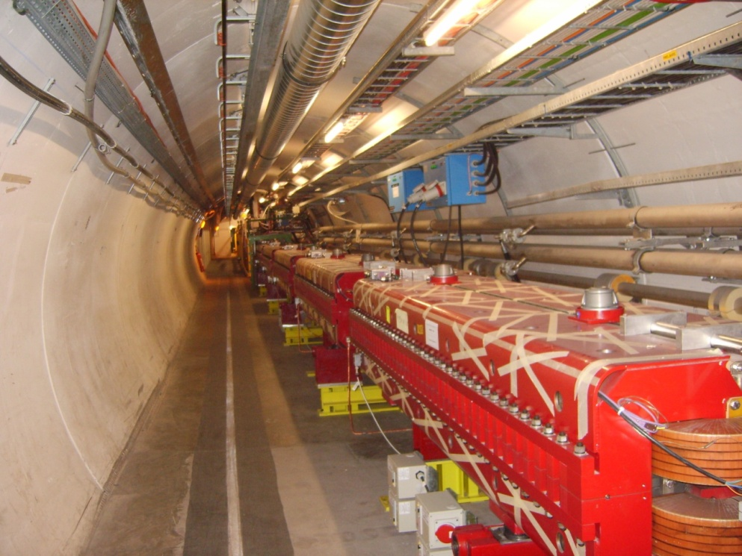
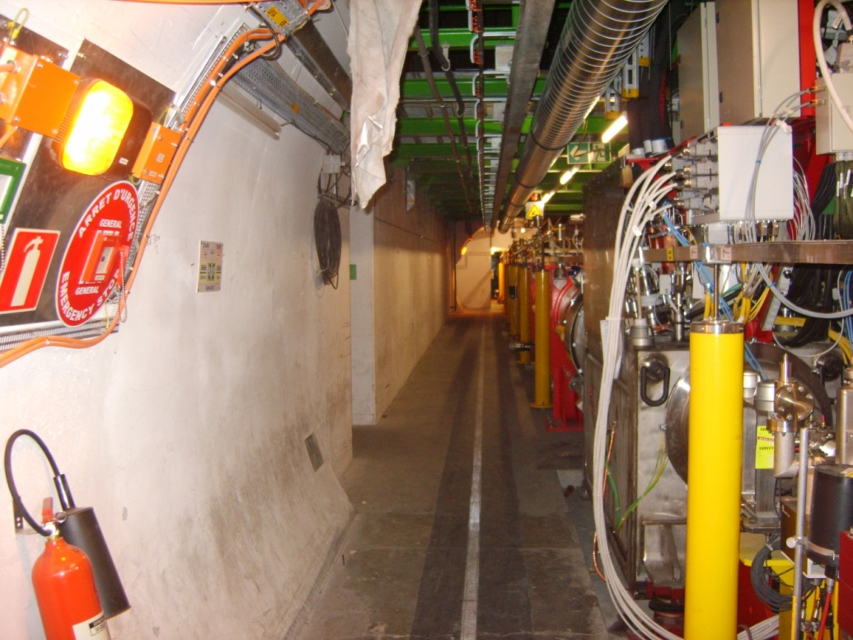
UJ56 Shielding Option
R562
UJ56
VERS UJ56
F. DELSAUX
1500
ENVIRON 18 M
HT LIBRE 2600 mm
CHICANE
VERS UJ57

Slide 3
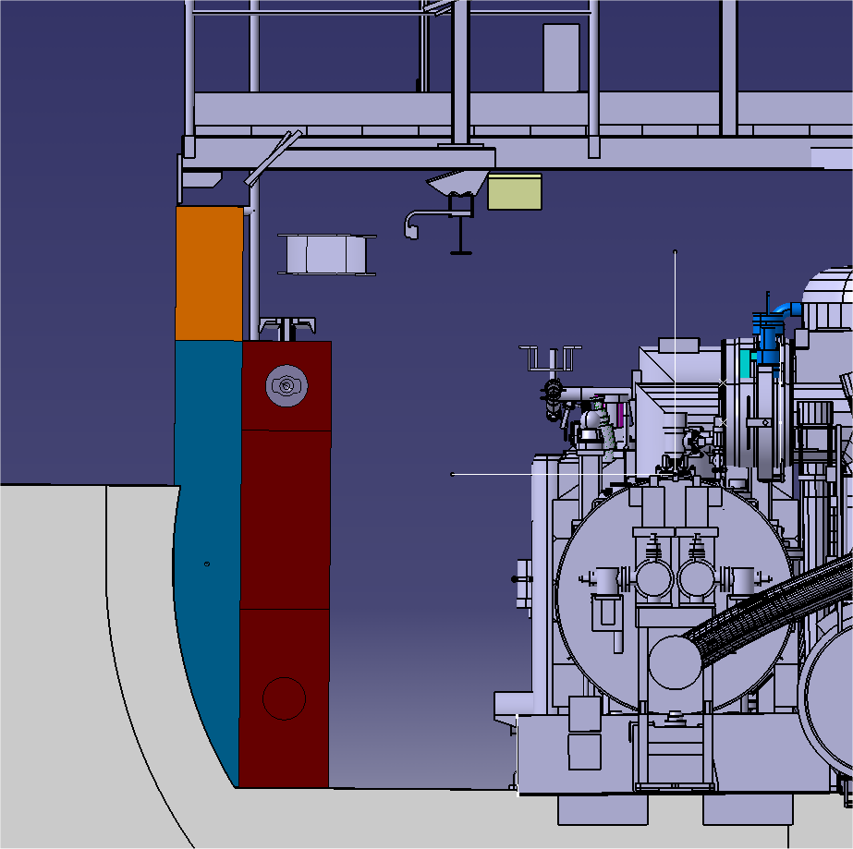
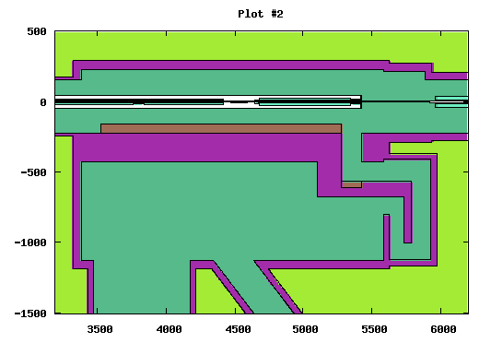
UJ56 Shielding Option
BLINDAGE UJ56
COMPLEMENT
BRIQUETTES ACIER
HAUTEUR 600mm
MONORAIL
300mm
RAIL DE MANUTENTION
DES BLOCS DE BLINDAGE
MUR FIXE ACIER
HAUTEUR 2000mm
300mm
xz view
400mm
BLINDAGE ACIER
DEMONTABLE
EP. 400mm
HAUTEUR 2000mm
800mm
F. DELSAUX

Slide 4
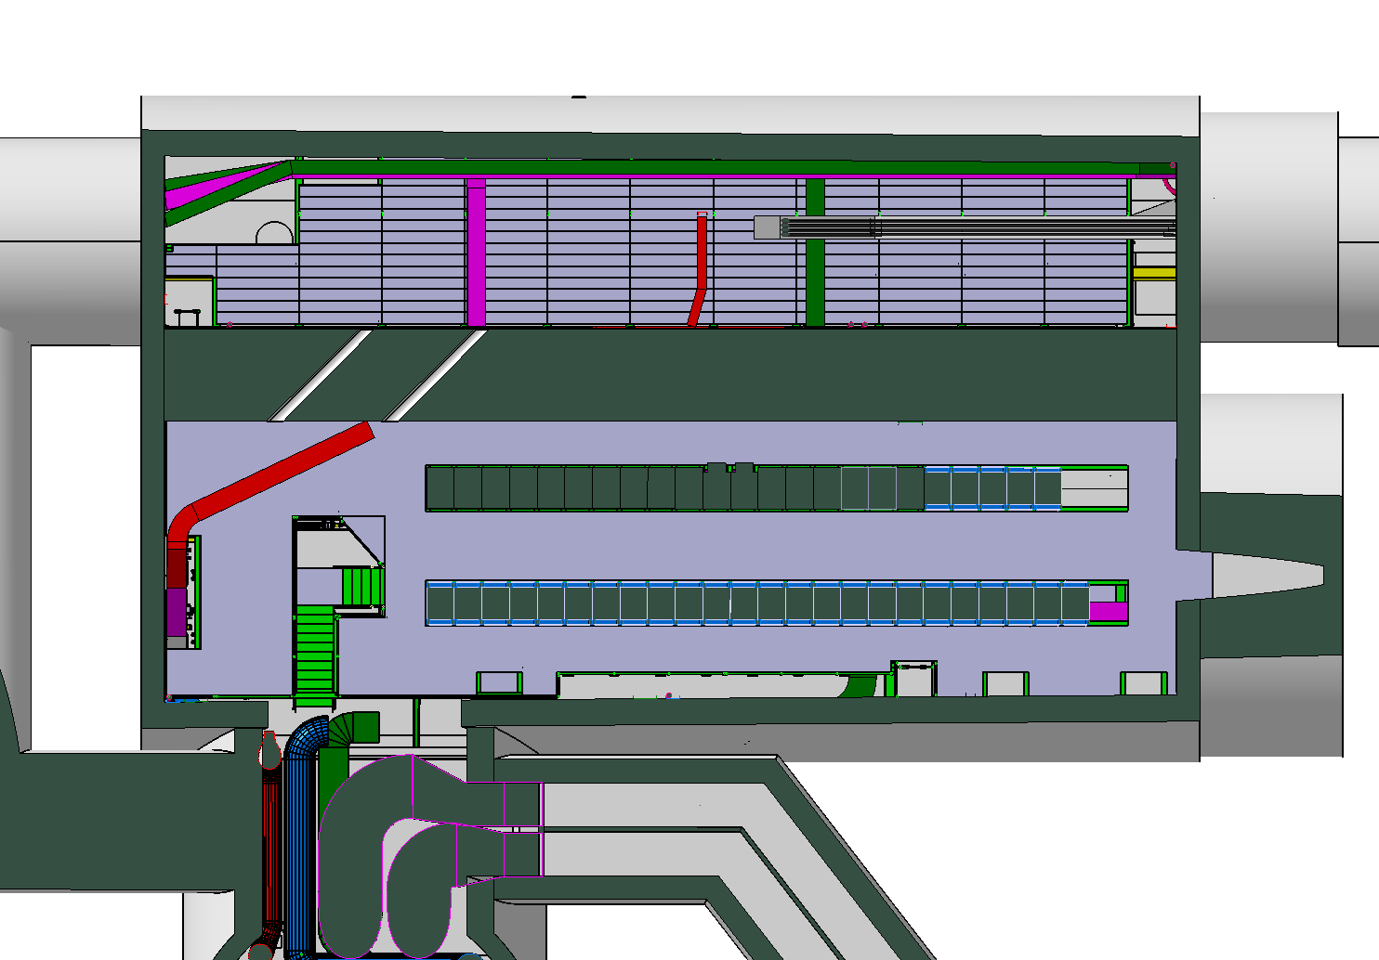
UJ56 1st floor
Compensators
24 racks

Slide 5
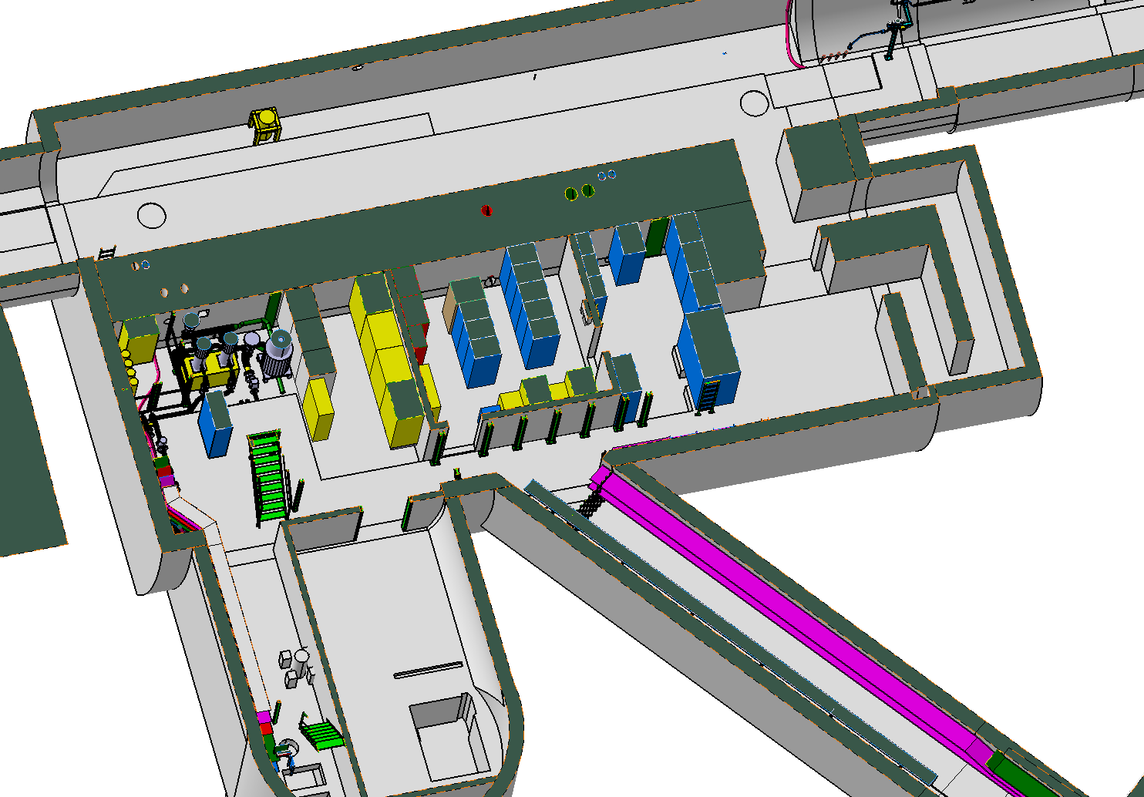
UJ56 Gnd Floor

Slide 6
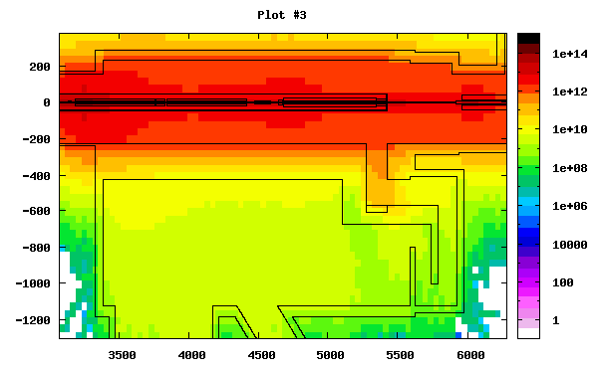
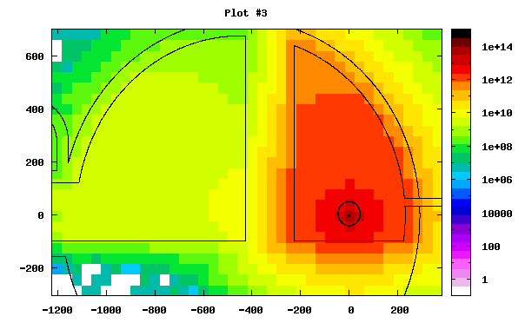
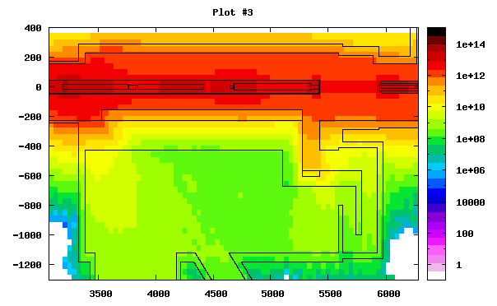
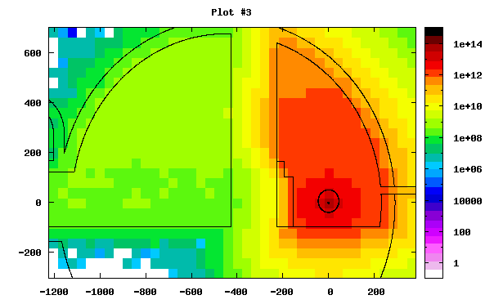
Issues in the UJ56
Shielding effectiveness GND Floor ~10
Shielding effectiveness 1st Floor ~2

Slide 7
Issues in the UJ56
Shielding effectiveness GND Floor ~10
Shielding effectiveness 1st Floor ~2

Slide 8
Goal and initial idea
Goal: Find a permanent solution to relocate the electronics in the UJ56
Limitation: For some equipment the cable length is critical (compensators)
Idea: Find some room in the USC55 if not detrimental to CMS

Slide 9
Very first draft proposal
Move all or part of the EL safe room on the ground floor of the UJ56 into the USC55
Lower the power converters from the 1st floor of the UJ56 to the ground floor and build adequate shielding
Move all remaining racks from the 1st floor of the UJ56 into the USC55 (Cryogenics, WIC, Timing, Remote-Reset, UPS, Access Control, Network, AUG control, Electrical Distribution (Control), GSM, Fire/ODH)

Slide 10
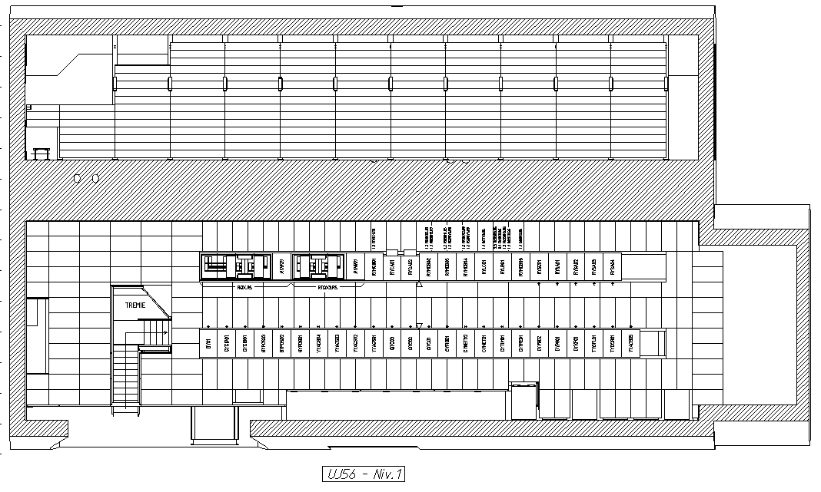
39racks

Slide 11
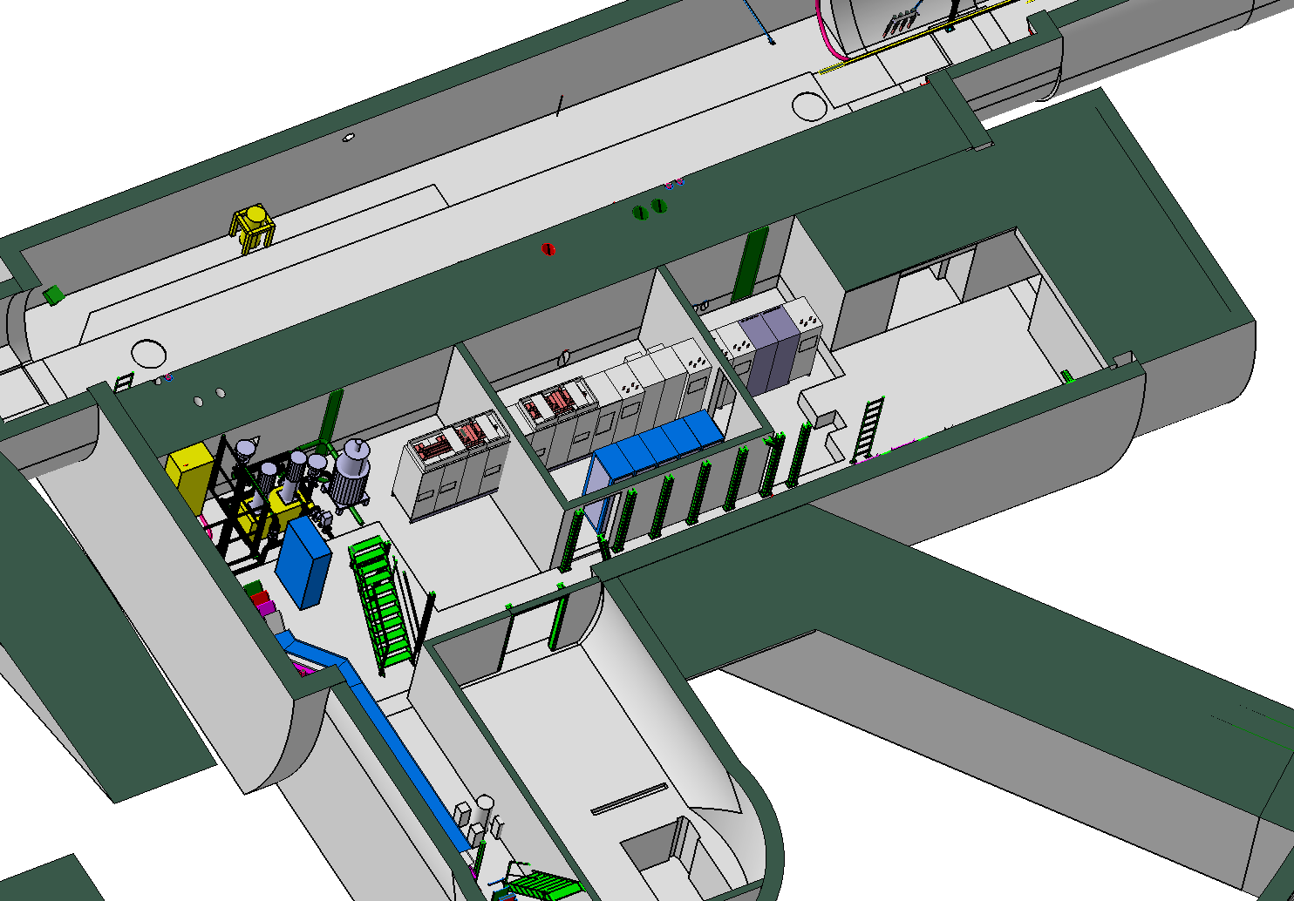
UJ56 Gnd Floor
Area taken by power convertors
→ integration to be studied
Shilding

Slide 12
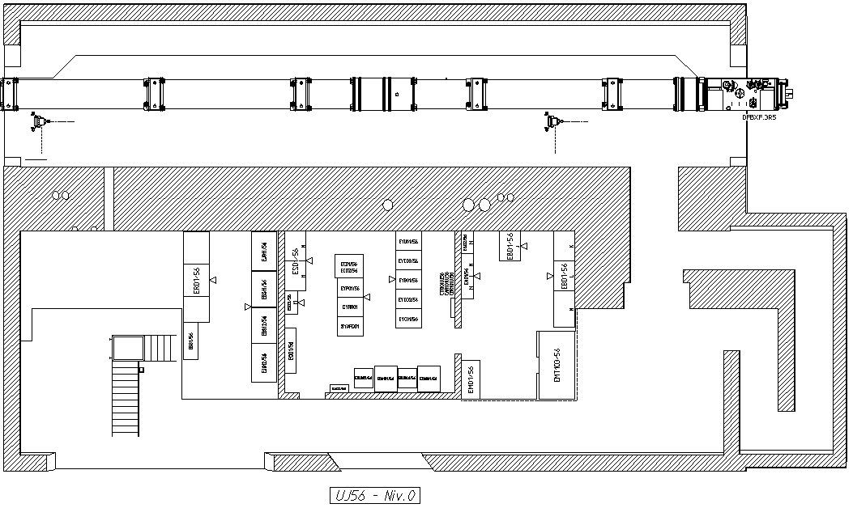

Slide 13
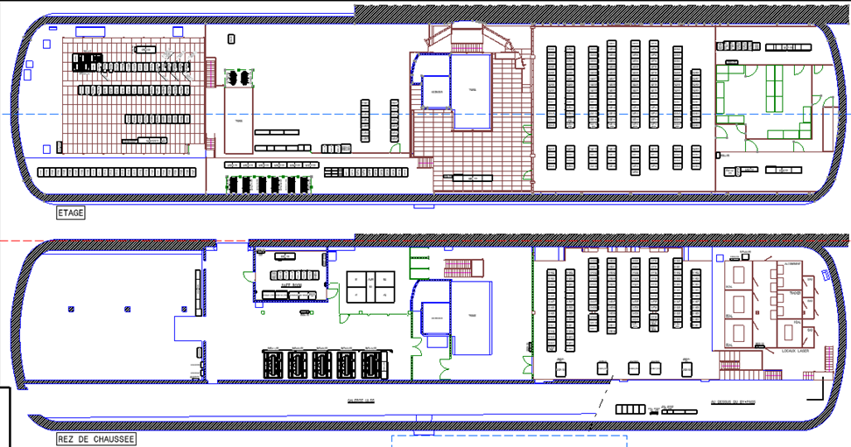
5 transformers could be brought up and housed in a surface building together with other CMS electrical equipment (eg 3 MVA UPS)
All or part of the UJ56 safe room could be relocated in the freed area

Slide 14
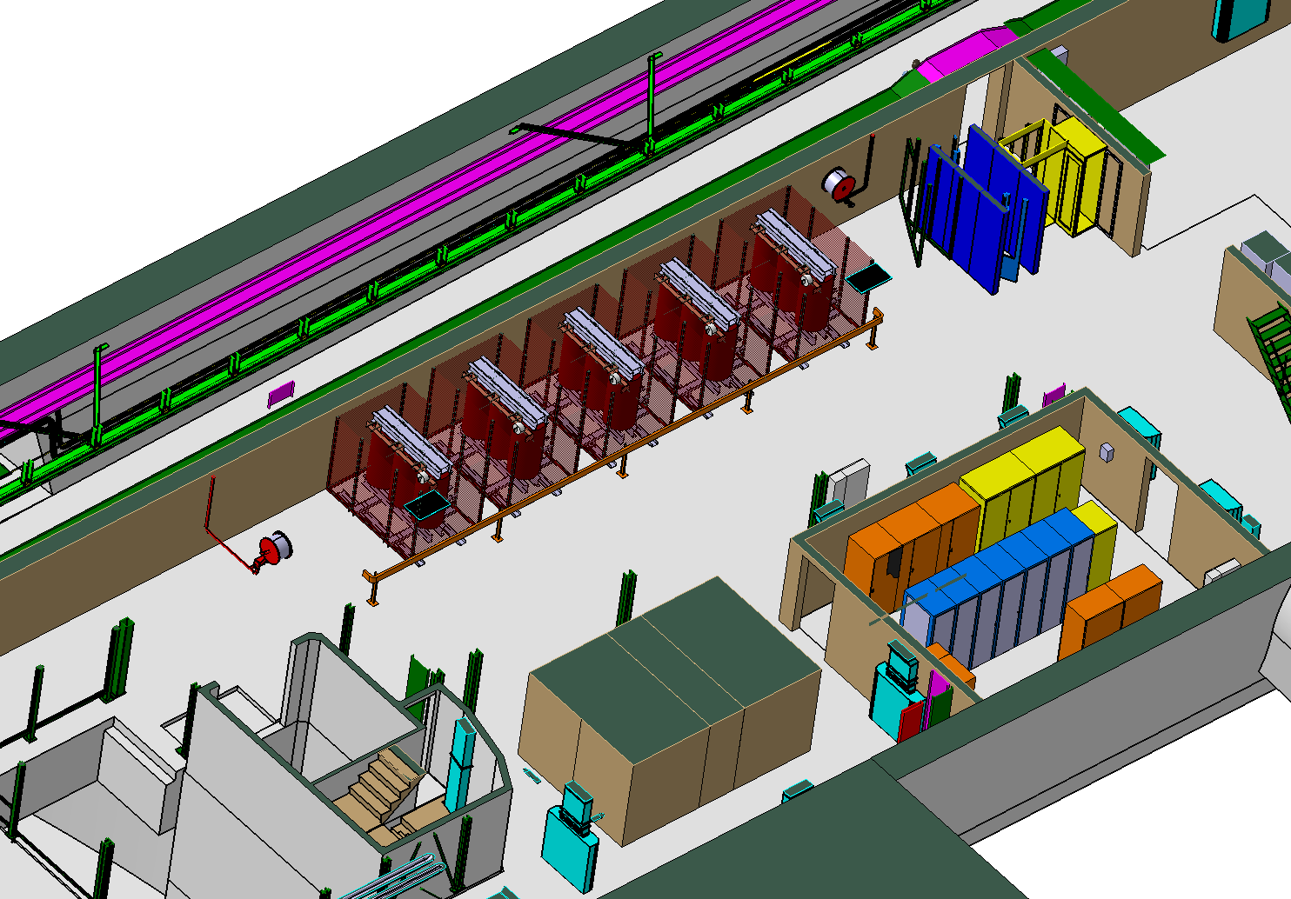
USC55
Service Area L-2
5 x 2MVA transformer to be
Relocated on the surface

Slide 15
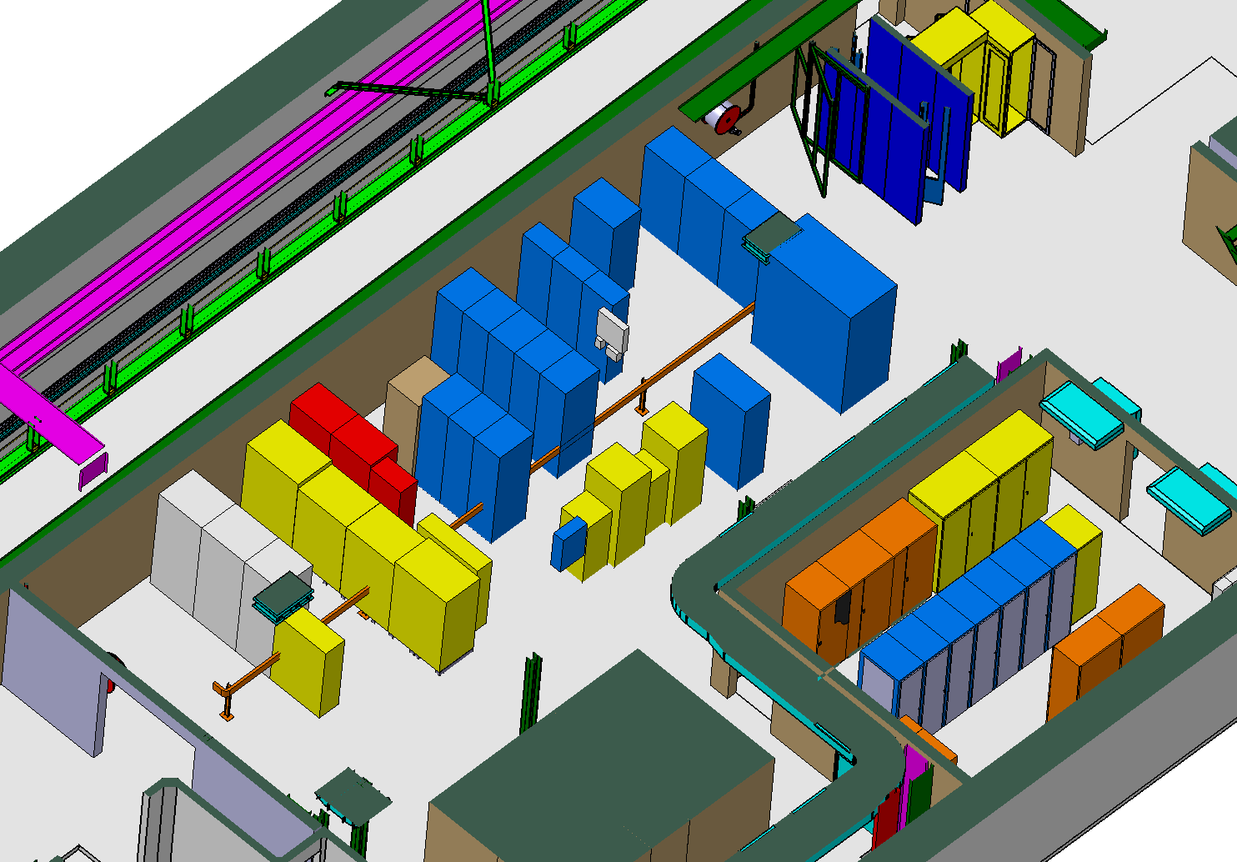
USC55
Service area L-2
Footprint of the UJ56 safe room
→ Intergration to be studied

Slide 16
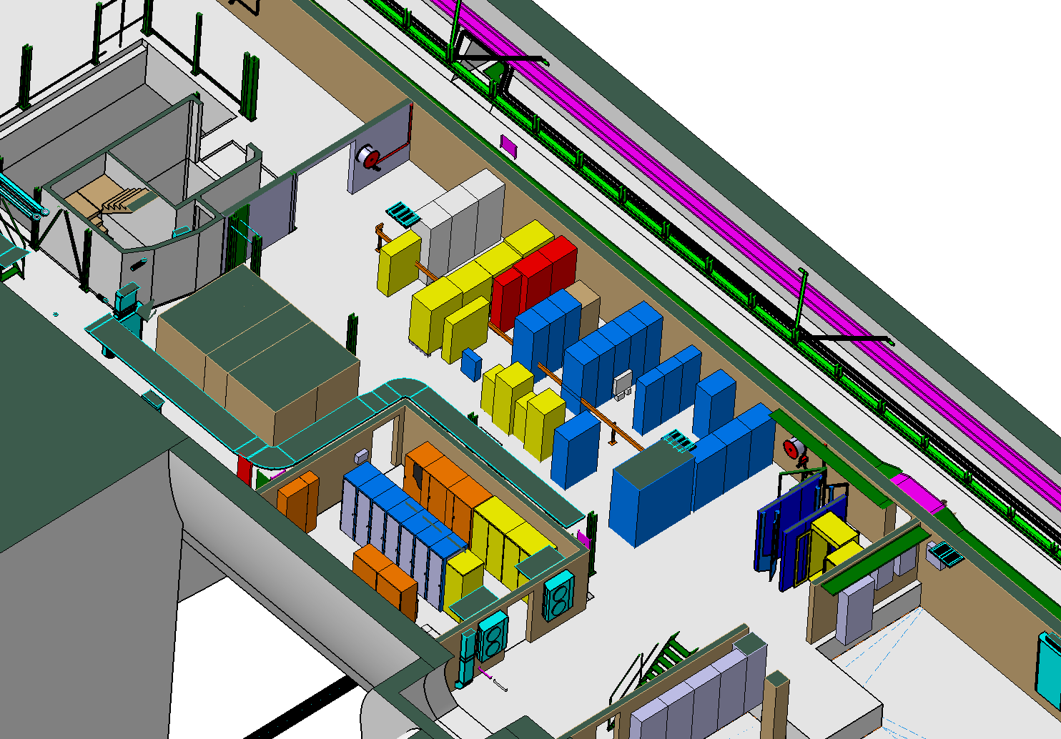
USC55
Footprint of the UJ56 safe room
→ Intergration to be studied
Service area L-2

Slide 17
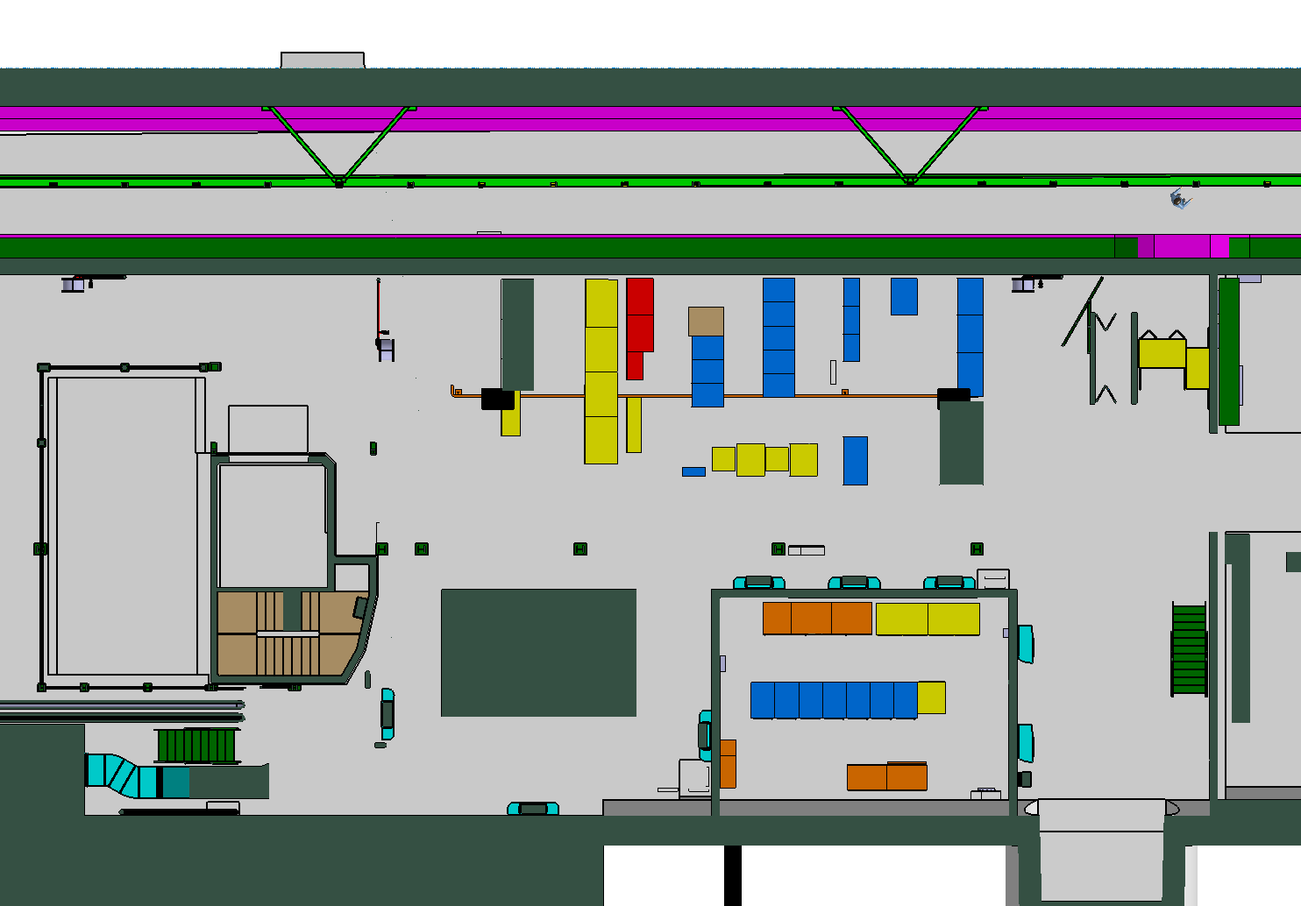
USC55
Footprint of the UJ56 safe room
→ Intergration to be studied
Service area L-2

Slide 18
2 candidate areas to relocate the 24 racks from UJ56
  Preferred option: Top of CV room
  Back up: part of underground control room

Slide 19
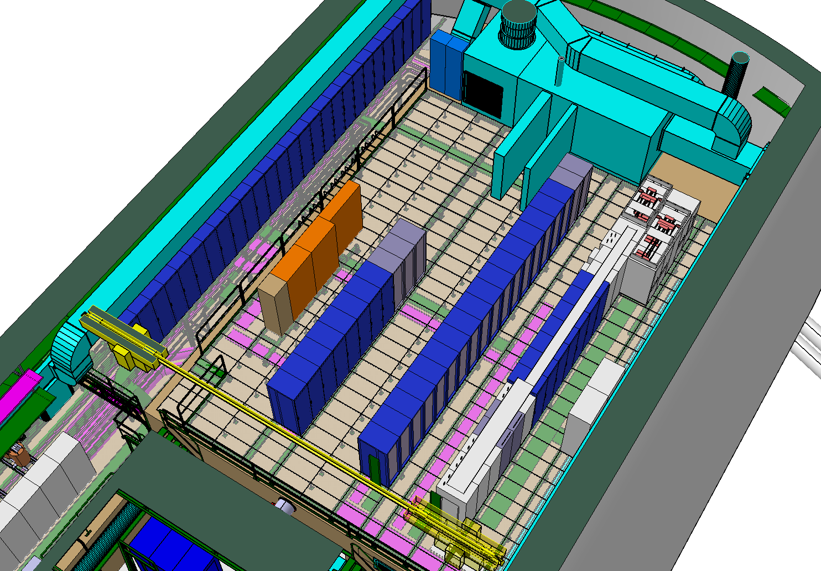
USC55
Area available for UJ56 racks
Top Of CV room

Slide 20
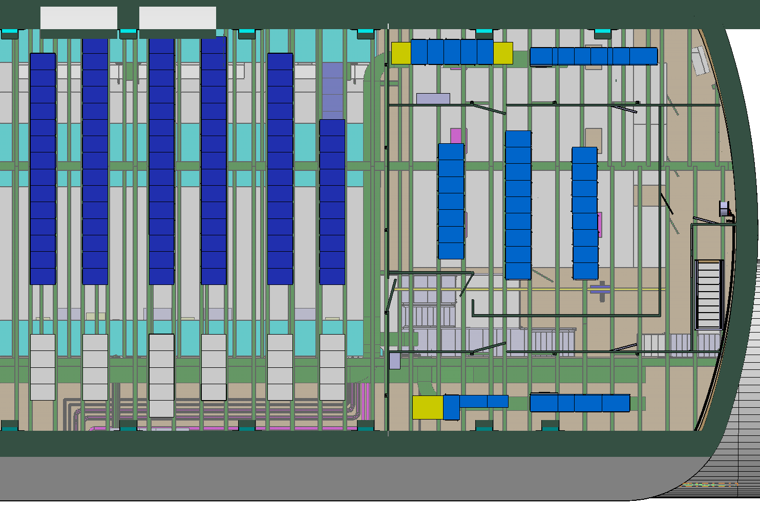
USC55
24 racks (uj56 du 1er )
→ Integration to be studied
Underground Ctrl room

Slide 21
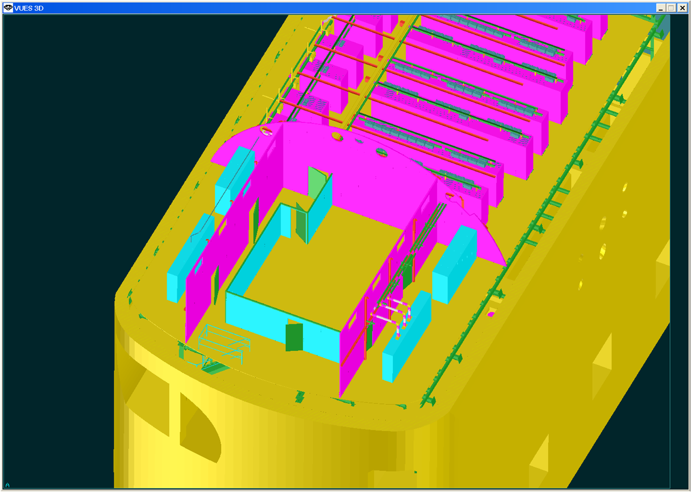
Relocate UJ56 racks in USC55 control area
  Existing floor beams already suitable
If need be, build a second floor to house a control room

