Slide 1
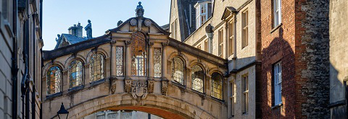
Co-creation of CERN
OpenData projects with UK school students
Alan Barr, University of Oxford
Notes:
Welcome
About me
Thanks to the team

Slide 2
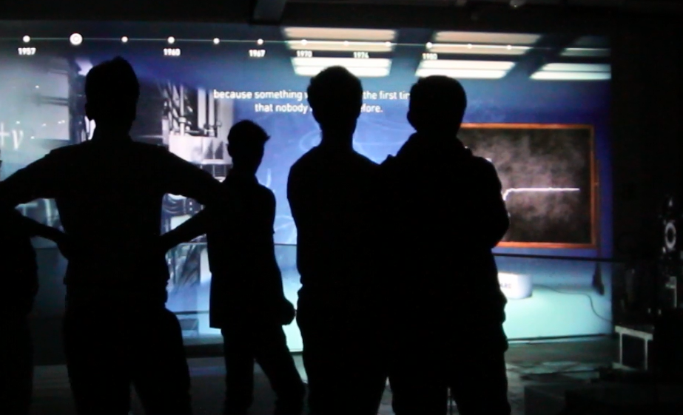
School students can do impressive research
Schools working on HiggsHunters
produced some impressive results
Topics included:
- machine learning
- pattern recognition & edge detections
- us of SQL databases
- biases and human errors
Proceedings: ATL-OREACH-PROC-2019-002
UK school students presented their research based on the HiggsHunter dataset at CERN in October 2019 [photo IRIS]

Slide 3
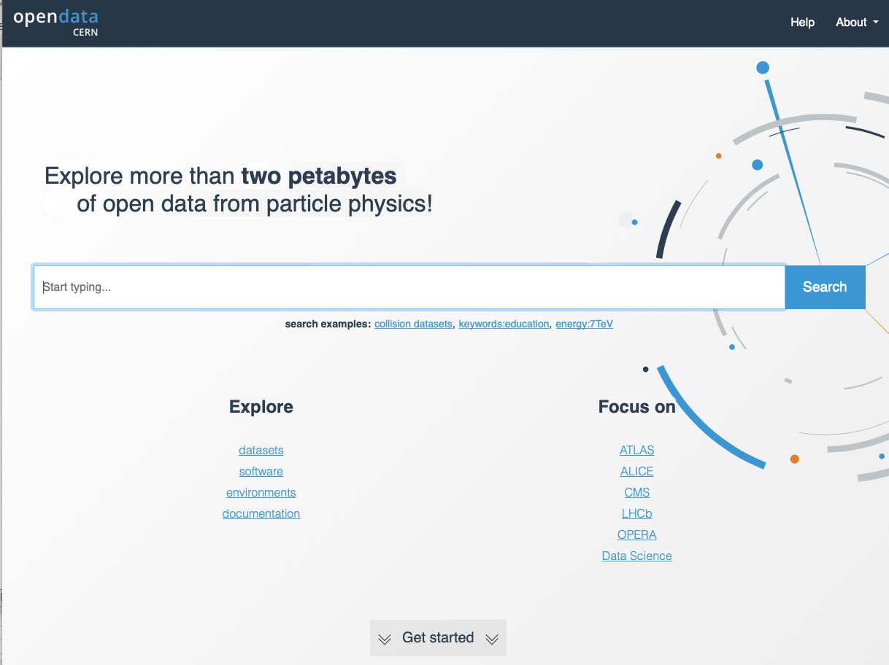
CERN has provided a wealth of data for education
Much investment & effort
not least by people present today
Real research data
Incredible resource

Slide 4
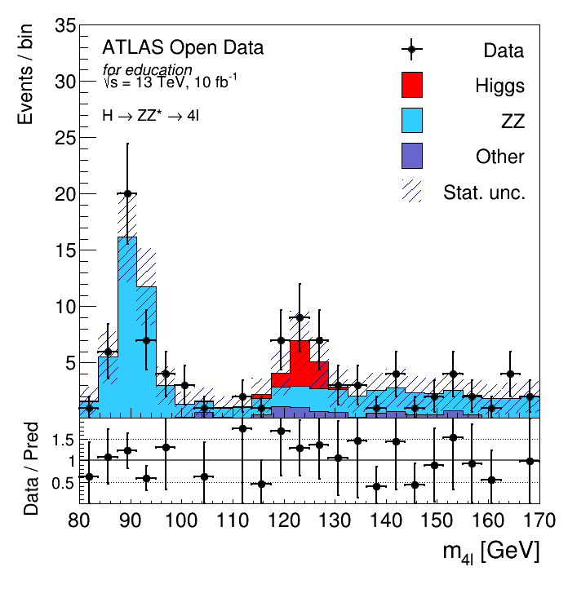
Examples:
Make your own
Higgs boson discovery at home
Created on Monday with tools available to the public
What might students want to do?
Co-creation of research?

Slide 5
Objectives
Share experience & best practice with existing use CERN OpenData within the target age range
Identify any barriers to wide(r) participation
Discuss conditions needed for larger programme
  Evaluation of pilots
  Partnerships
  Funding & resources
  Timing

Slide 6
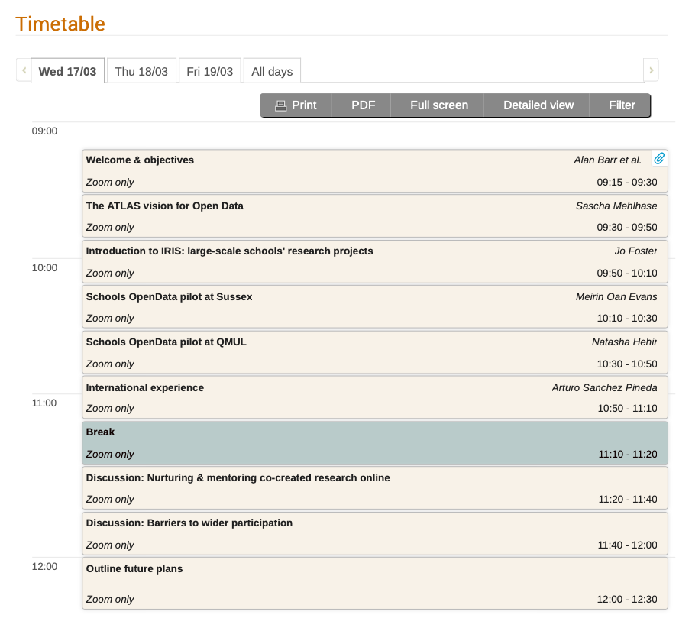


Running events & pilots
Discussion, suggestions & next steps
Notes:
Working meeting
Please keep to time
Leave space for discussion
We may use break-out rooms for discussion

