Slide 1
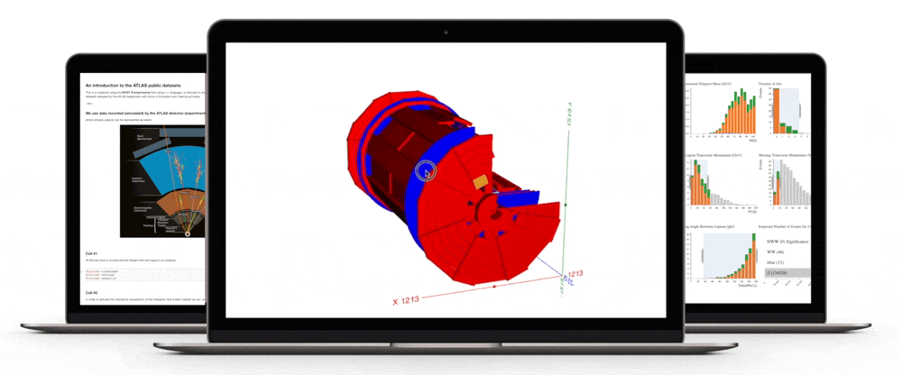
Co-creation between US & school students
Meirin, on behalf of Sussex ATLAS group

Slide 2
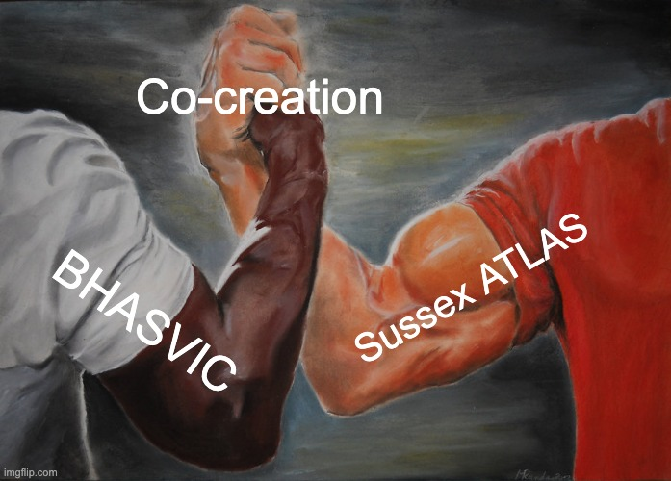
Motivation
Open Data: a crucial part of science
Enables public understanding
Promotes citizen science
Economic growth
Easier access to research
Increases trust in scientists

Slide 3

now
Dec 2020

Slide 4
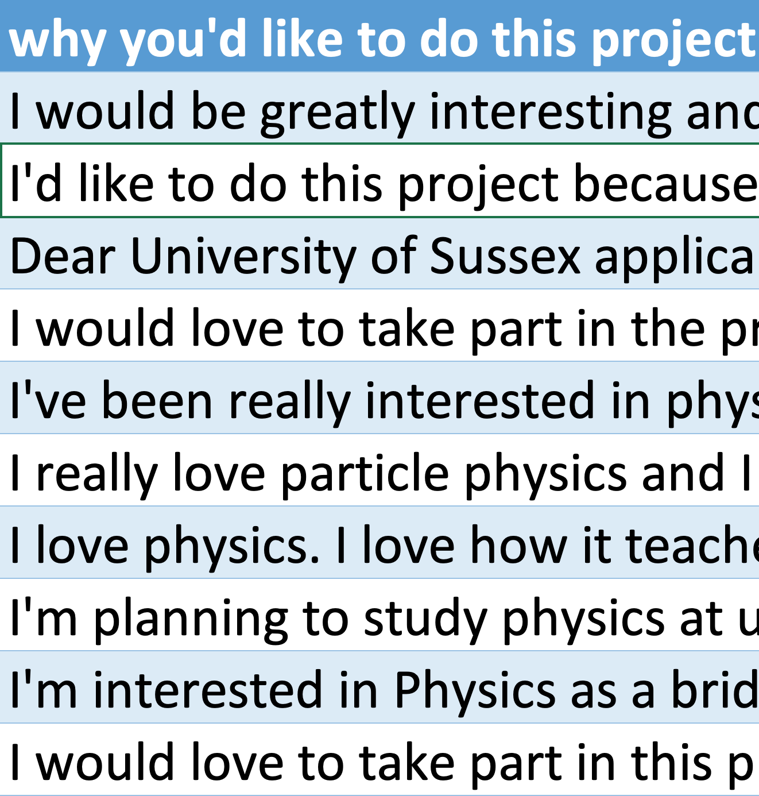
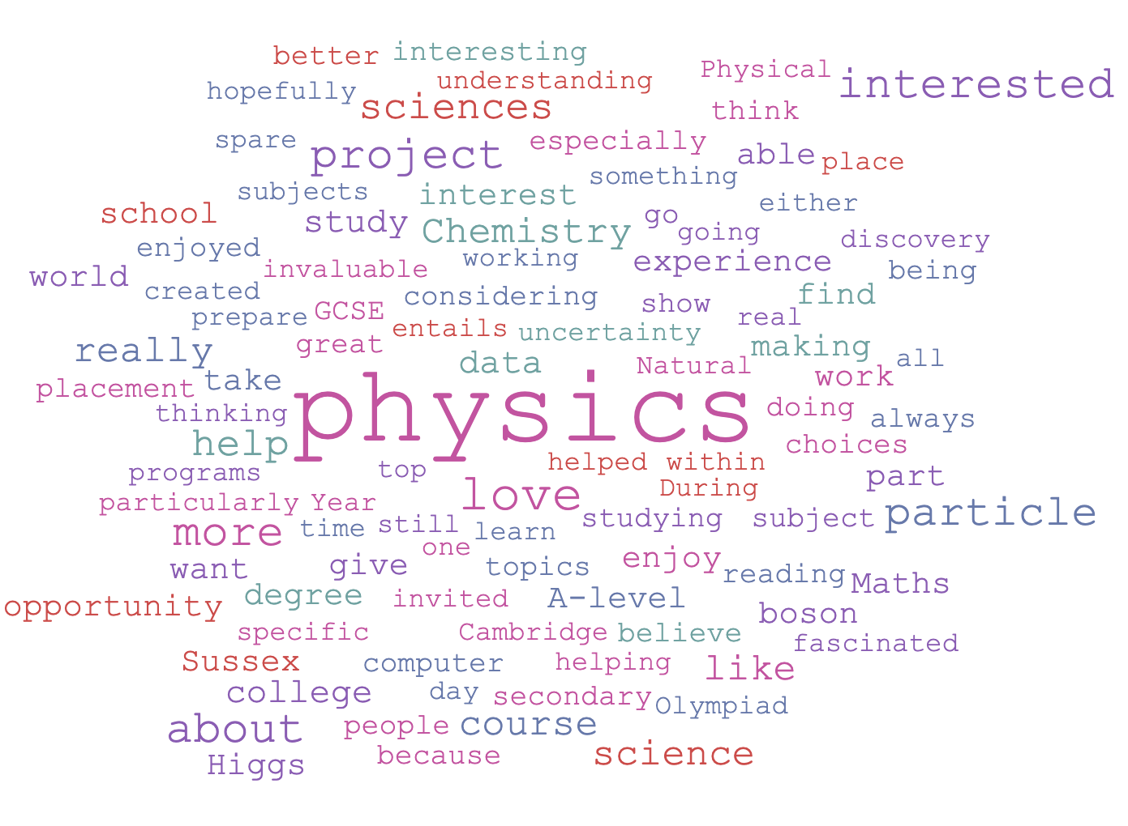
Discussion points
What pre-requisites did we require?
…none!

Slide 5



Discussion points
What technologies are we using?
What technologies are we using? – Microsoft Teams
All in 1 (meetings, chat, files)
Only teacher can control breakouts
Can’t move between breakouts
Advice: Use what the school uses
If multiple schools with different platforms, use your fave

Slide 6

Discussion points
What technologies are we using? - HYPATIA
Successful with masterclasses
Old software
Problems with operating system, versions, java…
Has anyone used HYPATIA web?
Are Open Data tools accessible w/o masterclass-type intro?

Slide 7
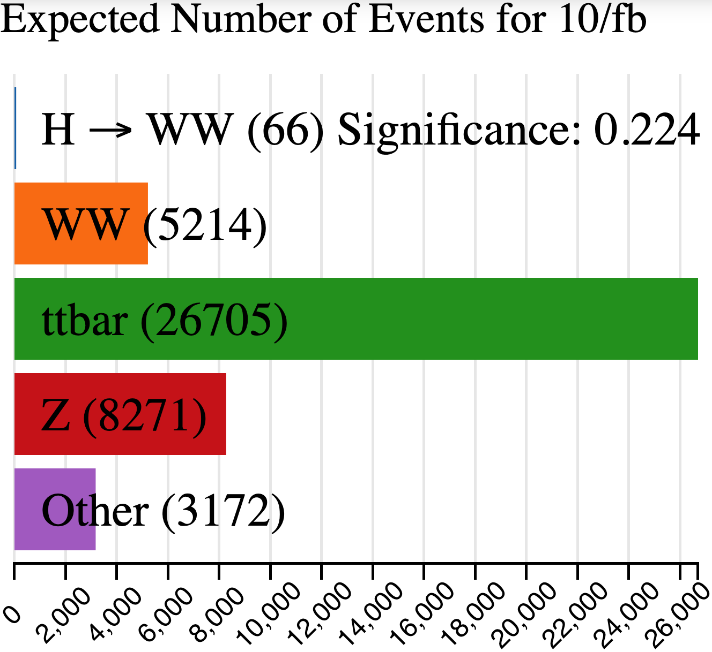
Discussion points
What technologies are we using? – Histogram Analyser
Encourages interactive exploration
Documentation aimed at uni students
Can this be made fully accessible to school students?
Can this be school students’ intro to particle physics?

Slide 8
Discussion points
How are we mentoring students?
Live
1 hour per week
Live
Live
1 hour per week
Mix of main room & breakouts
1 researcher & 2/3 students per breakout
Live | Independent work
1 hour per week
Mix of main room & breakouts
1 researcher & 2/3 students per breakout
Live | Independent work
1 hour per week | ~1 hour per week
Mix of main room & breakouts
1 researcher & 2/3 students per breakout
Live | Independent work
1 hour per week | ~1 hour per week
Mix of main room & breakouts | Groups to discuss independent work
1 researcher & 2/3 students per breakout | Available over chat to answer questions
Live | Independent work
1 hour per week | ~1 hour per week
Mix of main room & breakouts | Groups to discuss independent work
1 researcher & 2/3 students per breakout
Live
1 hour per week
Mix of main room & breakouts

Slide 9
Discussion points
What barriers to participation have we found?
2 students stopped after 1st session
Cameras remain off
Student might miss the odd week
1 student needs to leave halfway through each session
Schools flipping between face2face & online

Slide 10
Discussion points
How much co-creation has been possible?
Less than hoped for ☹
Student asked “why us rather than Y13/teachers?”
Students may come up with a few ideas
  but most work still has to be done by you
Best to evaluate where students aren’t clear
  then you generate ideas on what needs improving

Slide 11
Discussion points
What hasn’t gone well?
Slides >10mins go over their head
Not much discussion in main room
Last minute attempts to involve researchers
Students don’t always do independent work
Not sure if they always discuss in their groups
Not many questions on independent work

Slide 12
Discussion points
What’s gone well?
Breakout rooms
Links to school curriculum (particles, energy, EM…)
Teacher Continuing Professional Development (CPD)
Low-threat-high-challenge through offline research & groups
Students given opportunity and responsibility
Paying PhD students through outreach budget
Submitted a paper to an education conference

Slide 13
SUmmary
Future challenges
How to ensure our tools and resources are accessible without guidance from physicists?
How to incorporate our tools into more schools?
How can we spread our tools into wider use? e.g. platforms that teach machine learning, Kaggle...
How can we teach more than just particle physics – skills in computing, analysis, data science, machine learning...?
How can we reach more students that need it?

Slide 14
SUmmary
For the future
Lessons learnt from co-creation with 10 school students:
  Remove all pre-requisites
  Understand the technologies you’re using
  Support students live and offline
  You will encounter barriers along the way
  Co-creation is difficult and takes time
  No matter what, make sure the students have fun

Slide 15
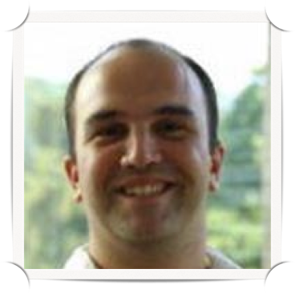

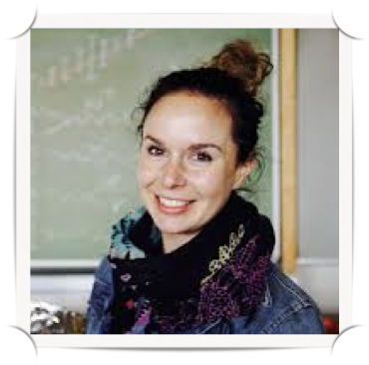
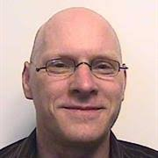
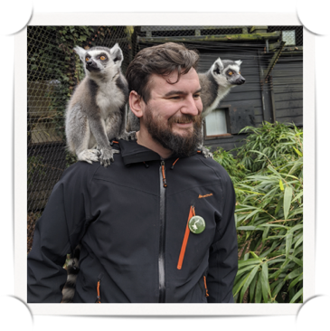
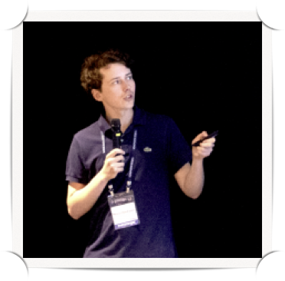
Thanks!
Diolch!
*also to everybody at BHASVIC

