Slide 1

International Day of
Women and Girls in Science
11 February

Slide 2
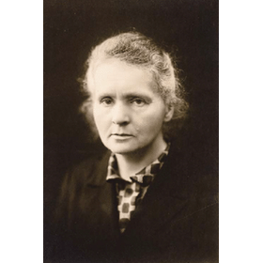
Women in Physics
Marie Skłodowska-Curie
1867-1934
Polish and naturalized-French physicist and chemist
Conducted pioneering research on radioactivity
First woman to win a Nobel Prize
The only person to win twice in multiple sciences
1903: Physics
1911: Chemistry

Slide 3
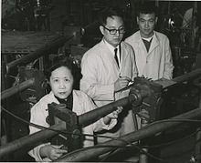
Women in Physics
Chien-Shiung Wu
1912-1997
Chinese American experimental physicist
Worked on the Manhattan Project, where she helped develop the process for separating uranium metal into the uranium-235 and uranium-238 isotopes by gaseous diffusion
Wu experiment, which contradicted the law of conservation of parity
2 colleagues from theory received 1957 Nobel Prize for Physics

Slide 4
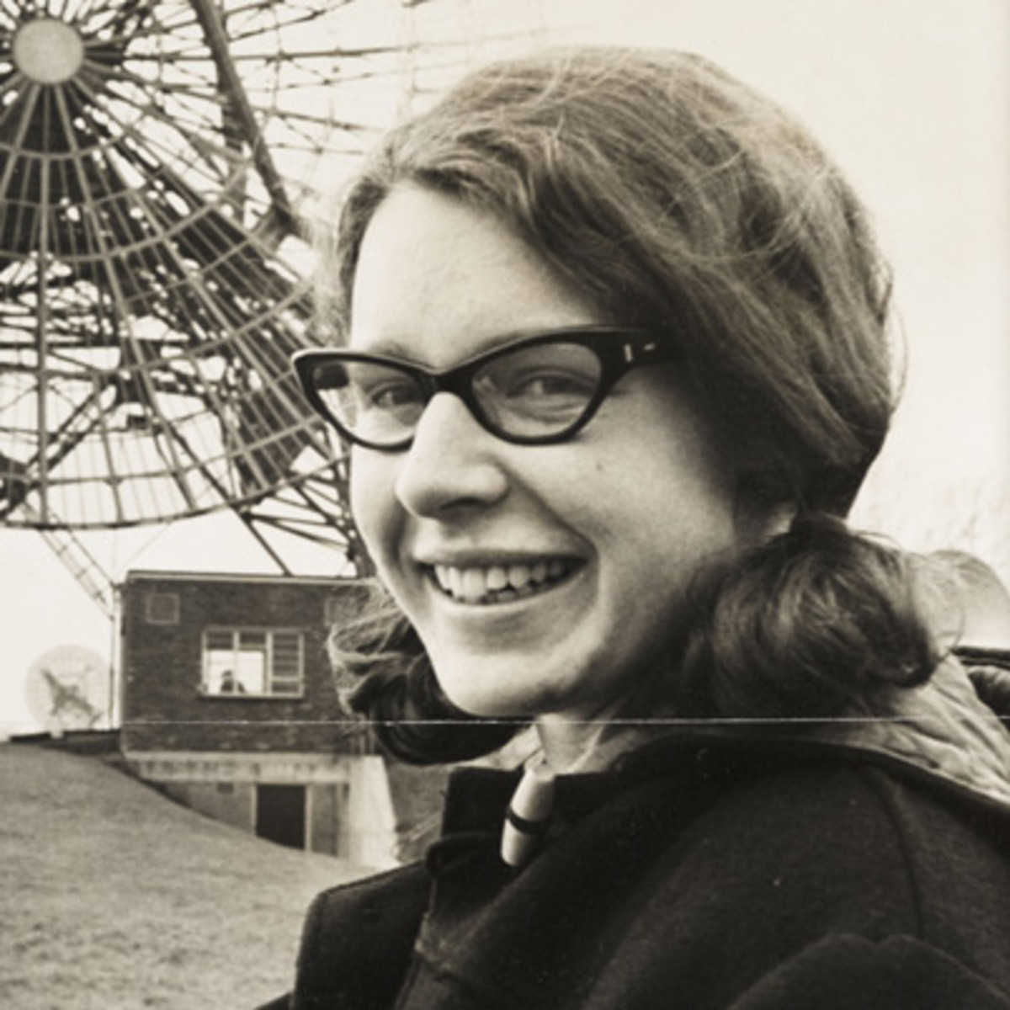
Women in Physics
Jocelyn Bell-Burnell
Born 1943
astrophysicist from Northern Ireland
discovered the first radio pulsars in 1967 as a postgraduate student
discovery was recognized by the award of the 1974 Nobel Prize for Physics to her thesis supervisor Antony Hewish and to the astronomer Martin Ryle

Slide 5
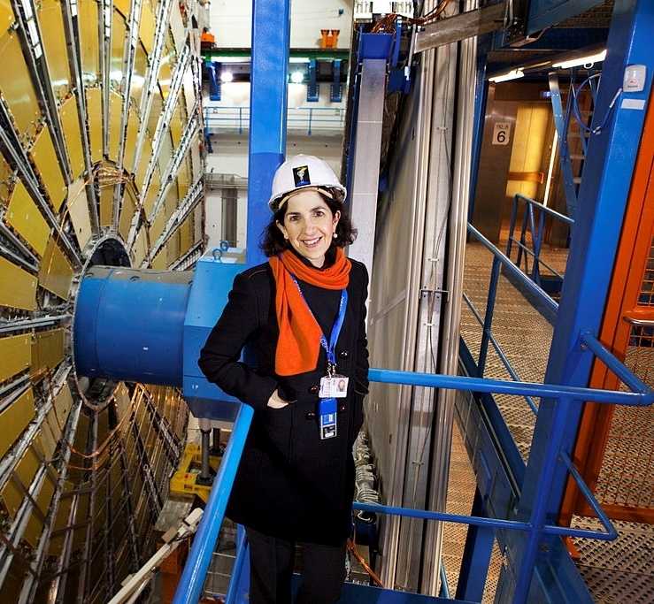
Women in Physics
Fabiola Gianotti
Born 1960
Italian particle physicist
Studied arts and philosophy, then physics
Elected as the project leader and spokesperson of ATLAS in 2009
Announced the discovery of the Higgs boson in 2012
First female DG at CERN

Slide 6
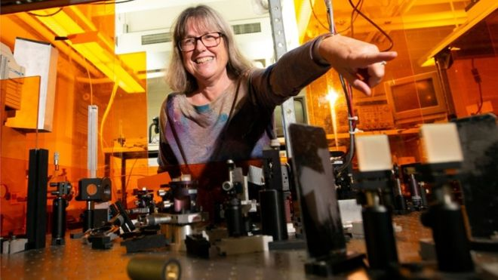
Women in Physics
Donna Strickland
Born 1959
Canadian physicist
Nobel Prize for Physics 2018, together with Gérard Mourou, for the invention of chirped pulse amplification

Slide 7
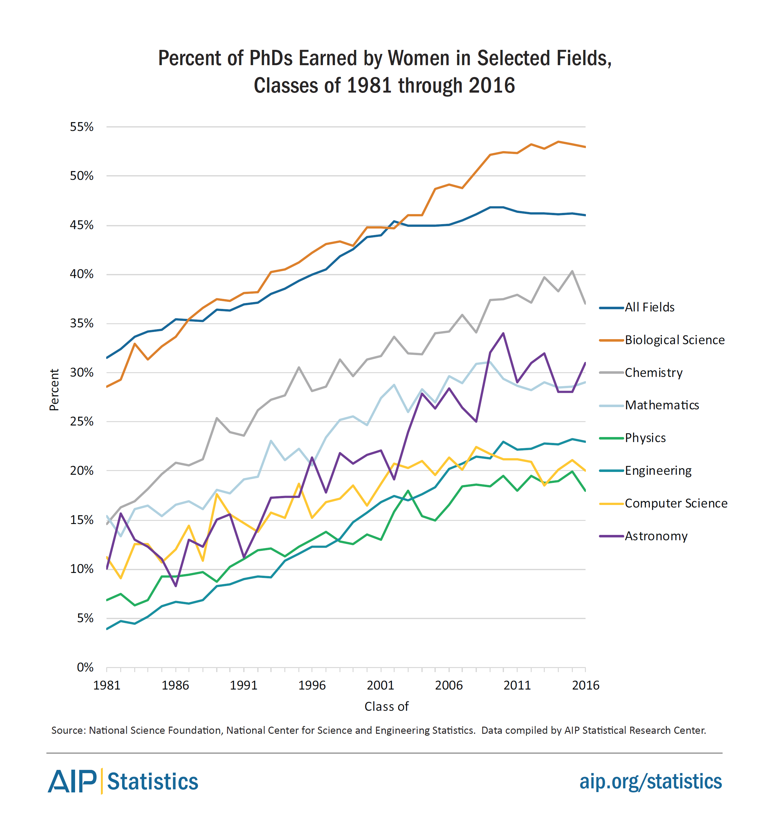
STEM Statistics

Slide 8
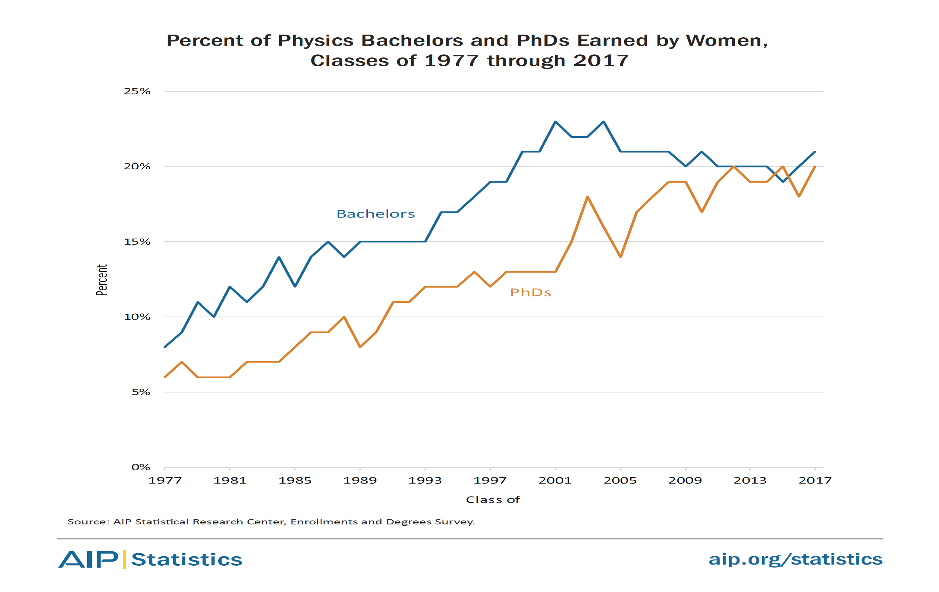
Physics Statistics

Slide 9
CERN Personnel Statistics 2018
Notes:
Users: 12.569
Staff members: 2.667
Fellows: 839
Students (technical and doctoral students): 1.457 were selected over the last 5 years

Slide 10
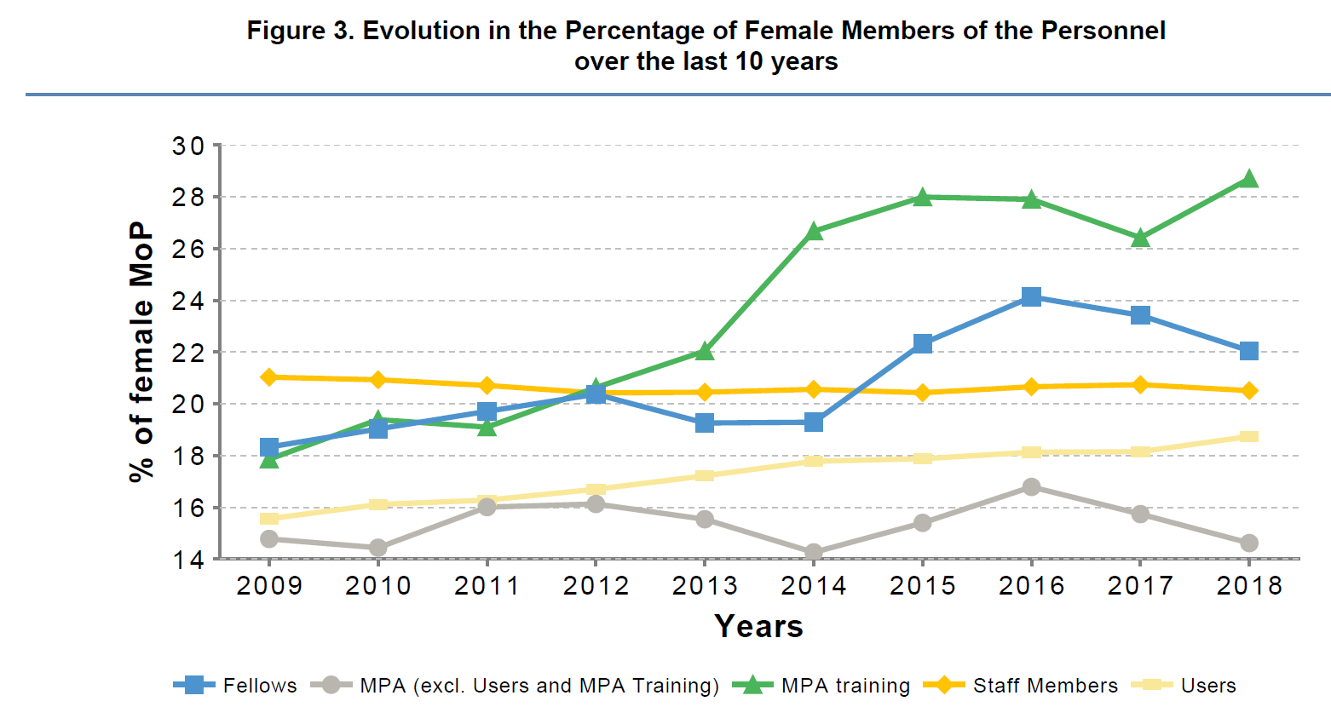
Evolution over the last 10 years
Notes:
MPA: Associated members of the personnel

Slide 11
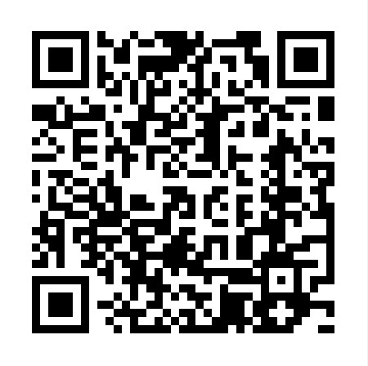
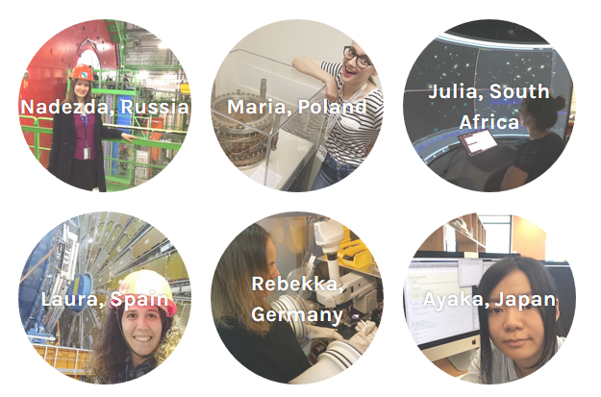
Young Women in Physics
Get more inspiration on https://womeninresearchblog.wordpress.com/

