Slide 1
Atlas

Slide 2

ATLAS
The ATLAS detector
Located just across the street at P1
One of the four major detectors on the LHC

Slide 3
ATLAS
ATLAS – multi-purpose particle detector
> 40 m long, > 25 m tall (the largest one here!)
Forward-backward symmetric

Slide 4
ATLAS
Main sub-detectors
Muon spectrometer
Hadronic calorimeters
EM calorimeters
Inner detector

Slide 5
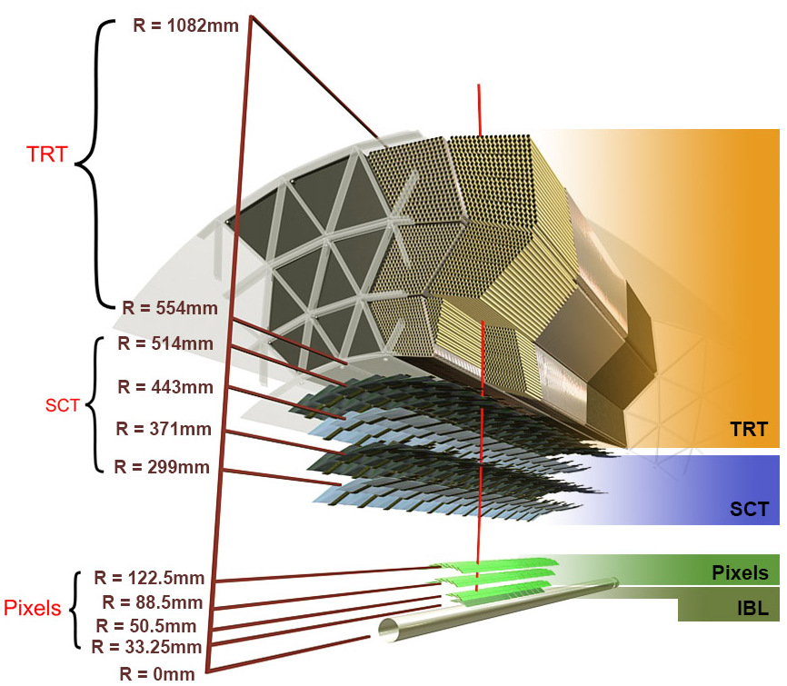
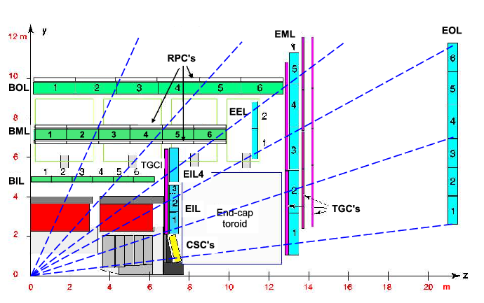
ATLAS sub-detectors
ID
Inner detector (ID) |z| < ~ 3m
Precision tracking
Pixel – 4 barrel layers, 3 endcap layers (each side)
SCT – 4 barrel layers, 9 endcap layers each side
TRT – straw tubes, give 2-coordinates
Calorimeters
ECal – measuring energy deposits from charged particles
HCal – measuring energy deposits from hadrons
MS
Muon spectrometer (MS)
MDT – barrel + endcaps, precision measurement
CSC – forward region in endcap, precision measurement
RPC – triggering chambers in the barrel
TGC – triggering chambers in the endcap

Slide 6
Shifting
Every institution needs to contribute to the ATLAS experiment
One way to contribute is by providing people who spend time on shift in the ATLAS Control Room (ACR)
While the detector is on, the control room is typically equipped with 8 shifters
The muon spectrometer
Trigger
Run control
Data quality
Shift leader
SLIMOS (shift leader in matters of safety)
The calorimeters and forward detectors
The inner detector

Slide 7
SHIFTING
While I was a student, I was a shifter on the Muon desk in the ACR for three years (totaling approximately 90 shifts)
Each shift is 8 hours long, either 7h00 – 15h00, 15h00 – 23h00, or 23h00 – 7h00
I watched for alarms, checked data quality, worked with the shift leader and run control, fixed minor problems, and called in experts for major problems (I’ve woken up a lot of people between midnight and 5h00)
Not me, but the view from my desk was similar

Slide 8
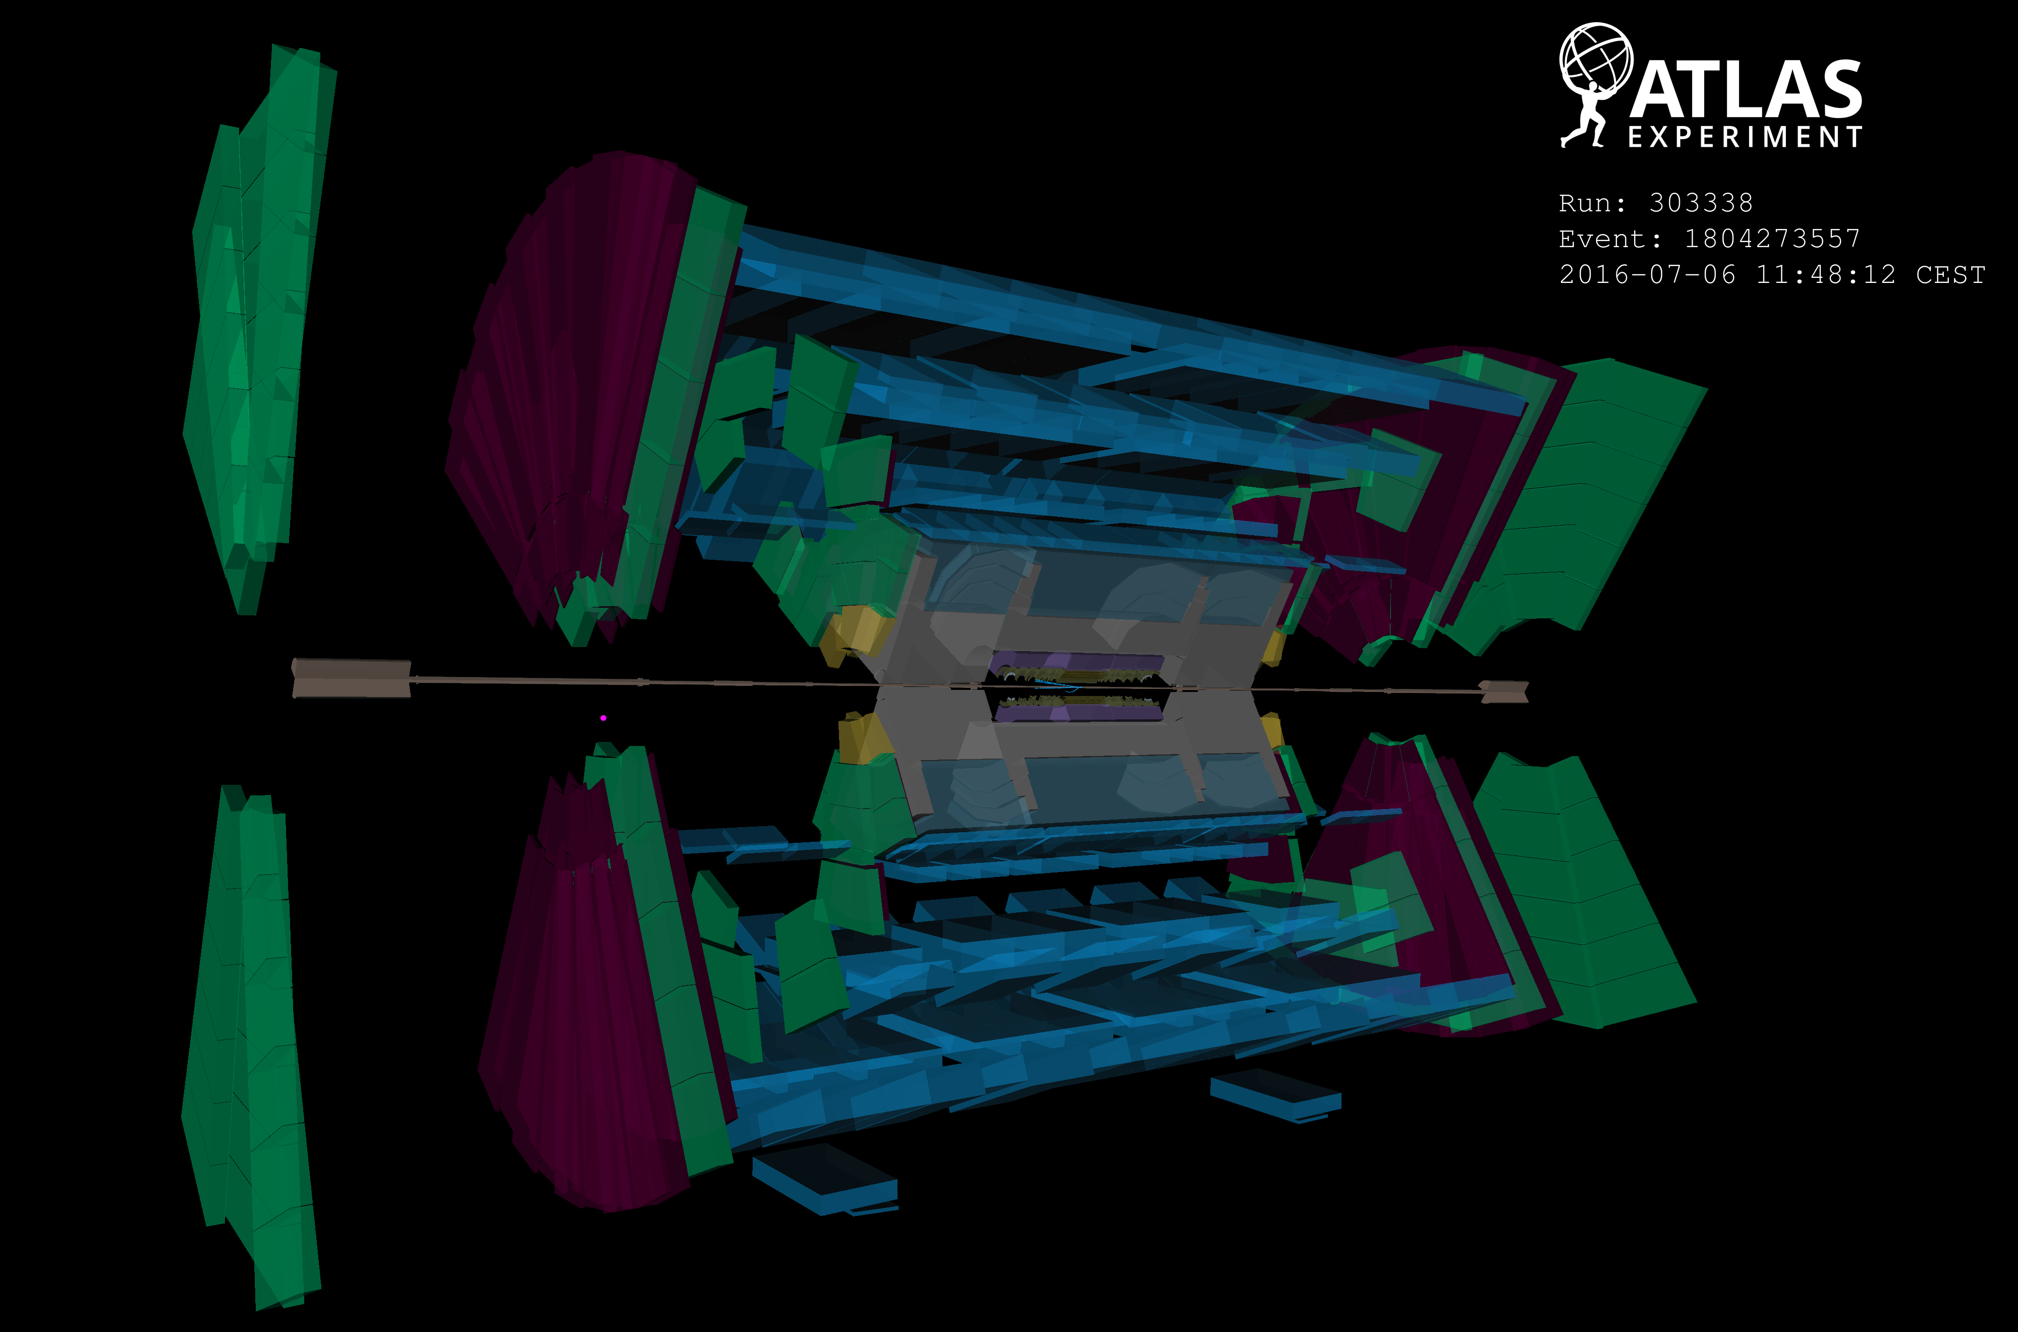

Slide 9
The ATLAS new small wheel project

Slide 11
The NSW upgrade project
The New Small Wheel Upgrade aims at replacing the present Small Wheel (CSC + MDT/TGC EIL/EIS1,2) to address high fake single muon trigger rate and rate limitations at HL-LHC luminosities
The NSW basic layout is the same as the one of the present Small Wheel: 16 sectors, 8 small and 8 large ones per side

Slide 12
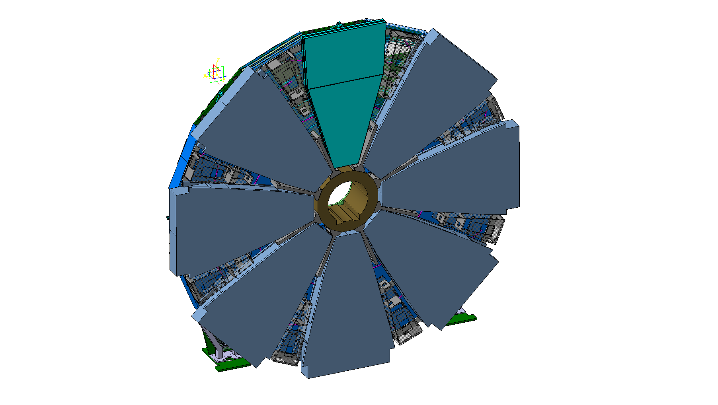
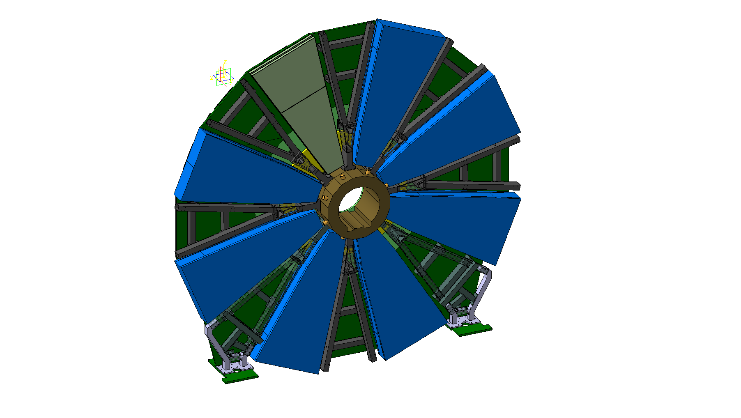
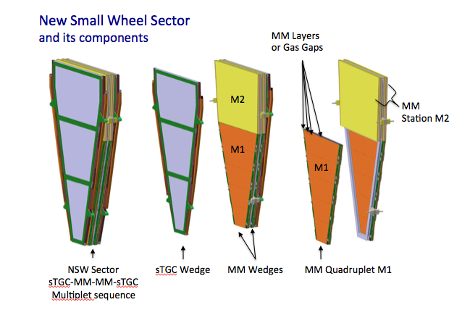
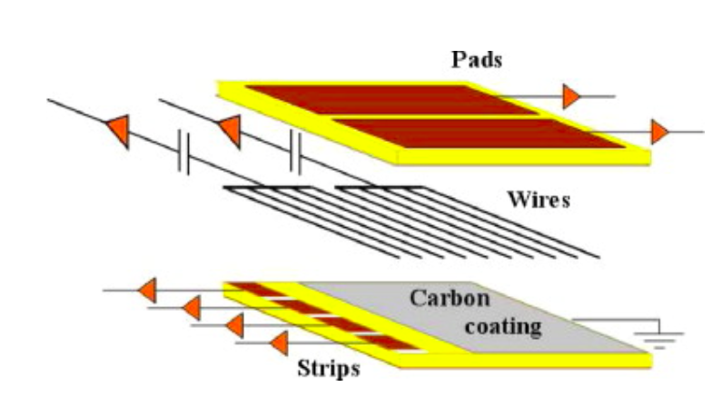
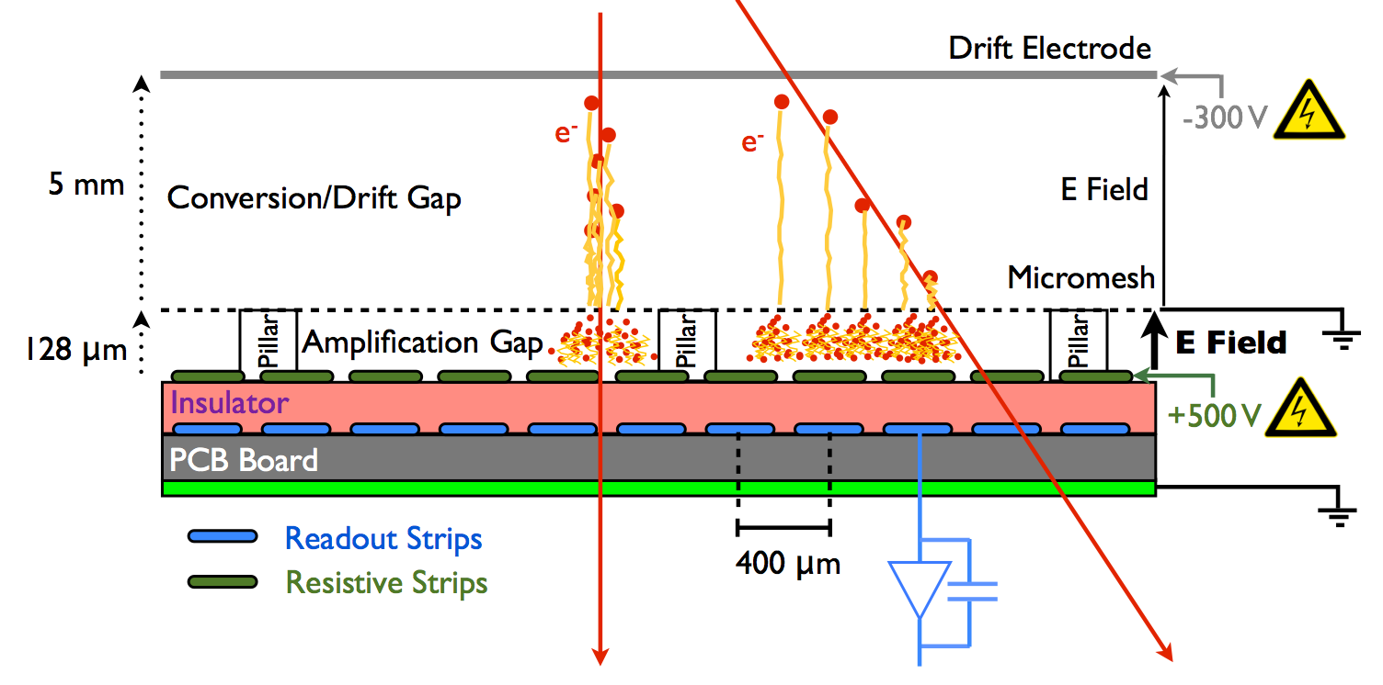
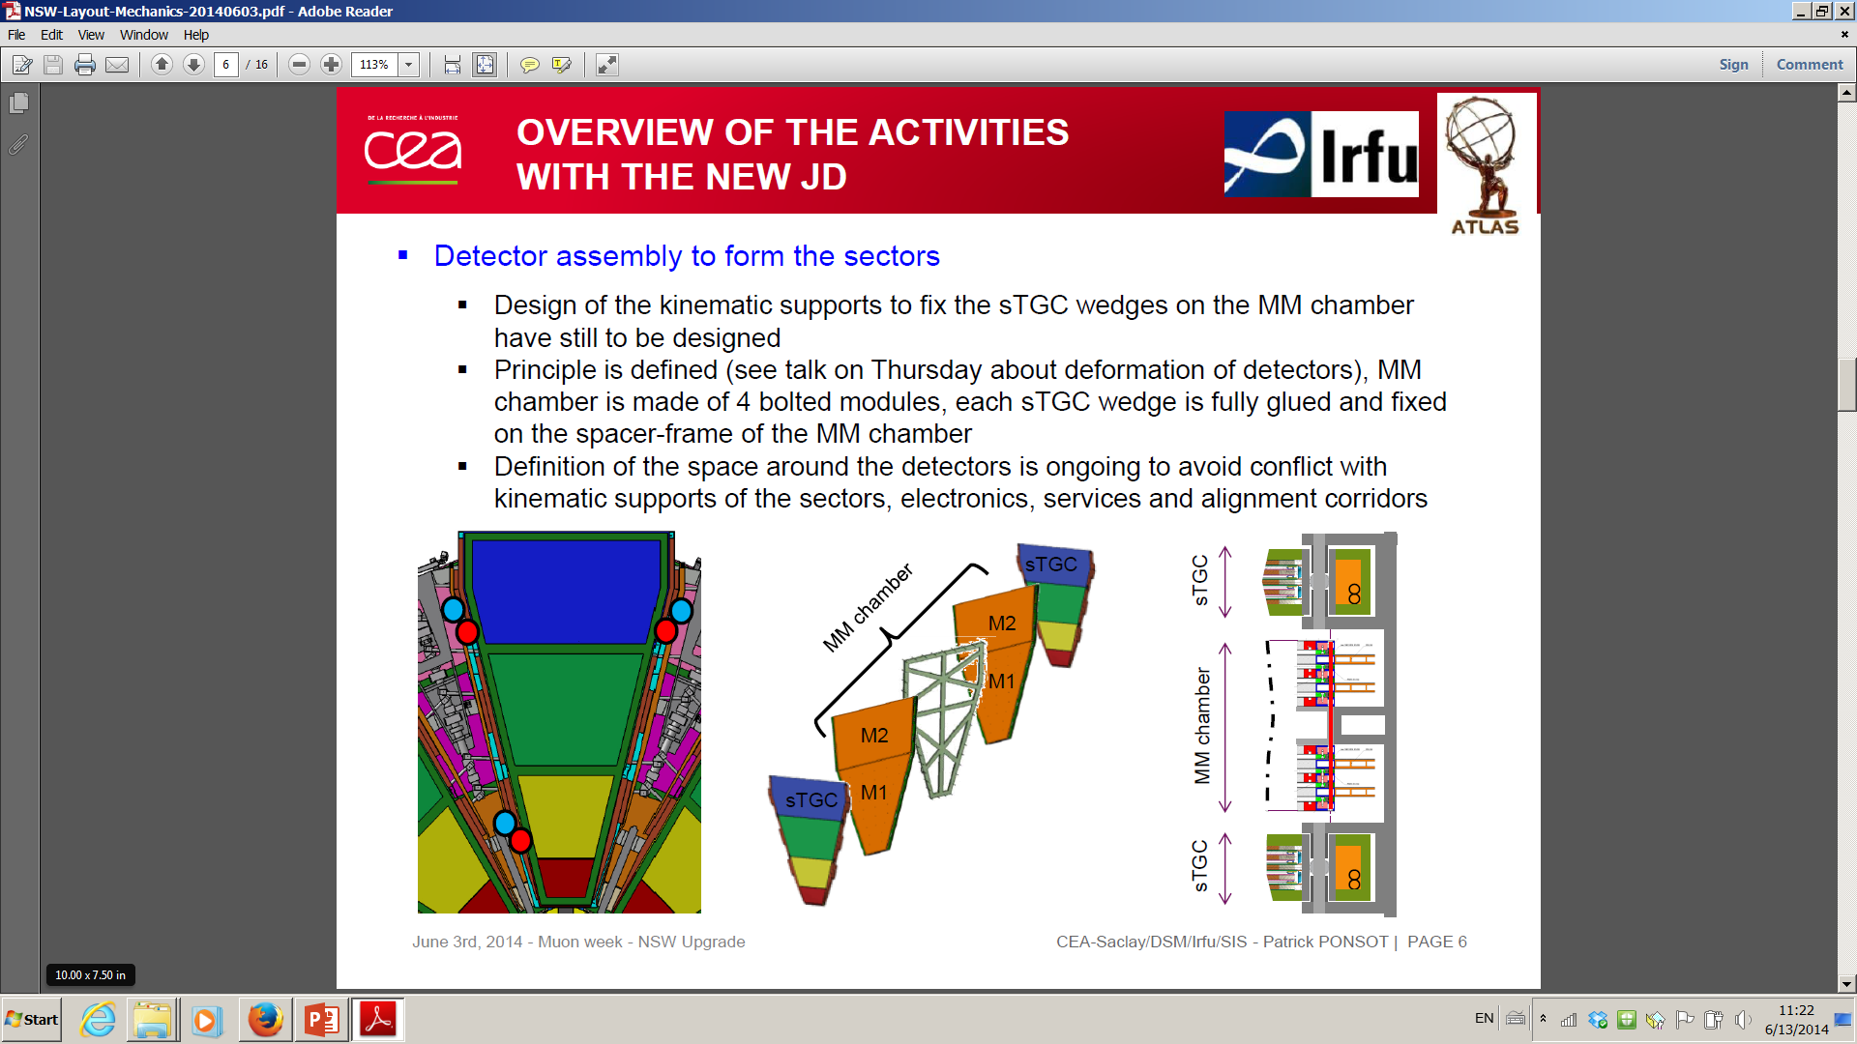
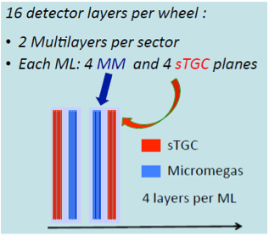
The Layout of the NSW
16 Sectors:
8 Small
8 Large
Large Sector Small Sector
Micro-Mesh Gaseous detectors (Micromegas): primary precision tracker
Space resolution < 100 μm independent of track incidence angle
Good track separation due to small 0.5 mm readout granularity (strips)
Excellent high rate capability due to small gas amplification region and small space charge effects
Non-IP side:
Large sectors,
covering area from
r = 92 cm to 465 cm
IP side:
Small sectors,
covering area from
r = 90 cm to 445 cm
sTGCs: primary trigger detector
Bunch ID with good timing resolution – additional suppression of fakes
Good space resolution providing track vectors with < 1 mrad angular resolution
Based on proven TGC technology; Pads & strips, instead of only strips as in current detector
~10 m
Sectors: Package of sTGC and MicroMegas “wedges” + central spacer frame

Slide 13
MicroMegas : construction repartition
Small sector modules
Large sector modules
SM2
LM2
Germany
cluster
Dubna
Tessaloniki
CERN
Italy
cluster
Saclay
SM1
LM1

Slide 14
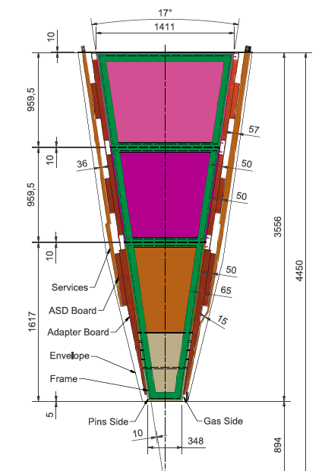
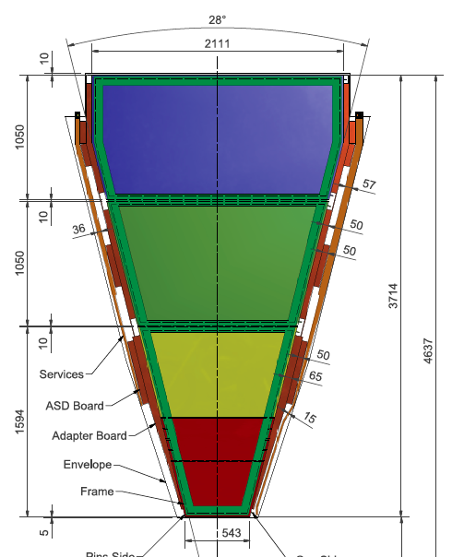
sTGC : construction repartition
Small sector modules
Large sector modules
CANADA
ISRAEL
RUSSIA
CHINA
CANADA
RUSSIA
CHILE
ISRAEL

Slide 15
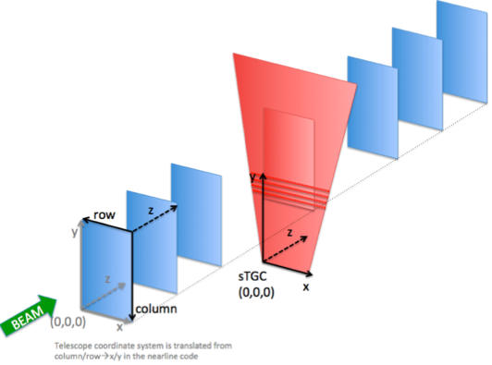
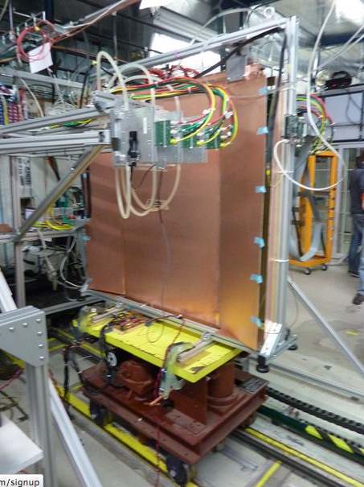
TGC test beam at Fermilab : position resolution
Excluding R323, we observe:
Consistency across runs (different sTGC positions)
Consistency across sTGC layers
Wire support
y
47μm
x

Slide 16
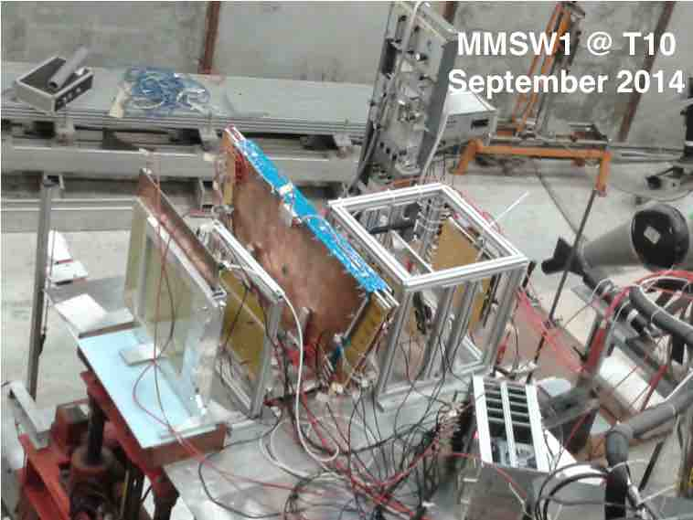
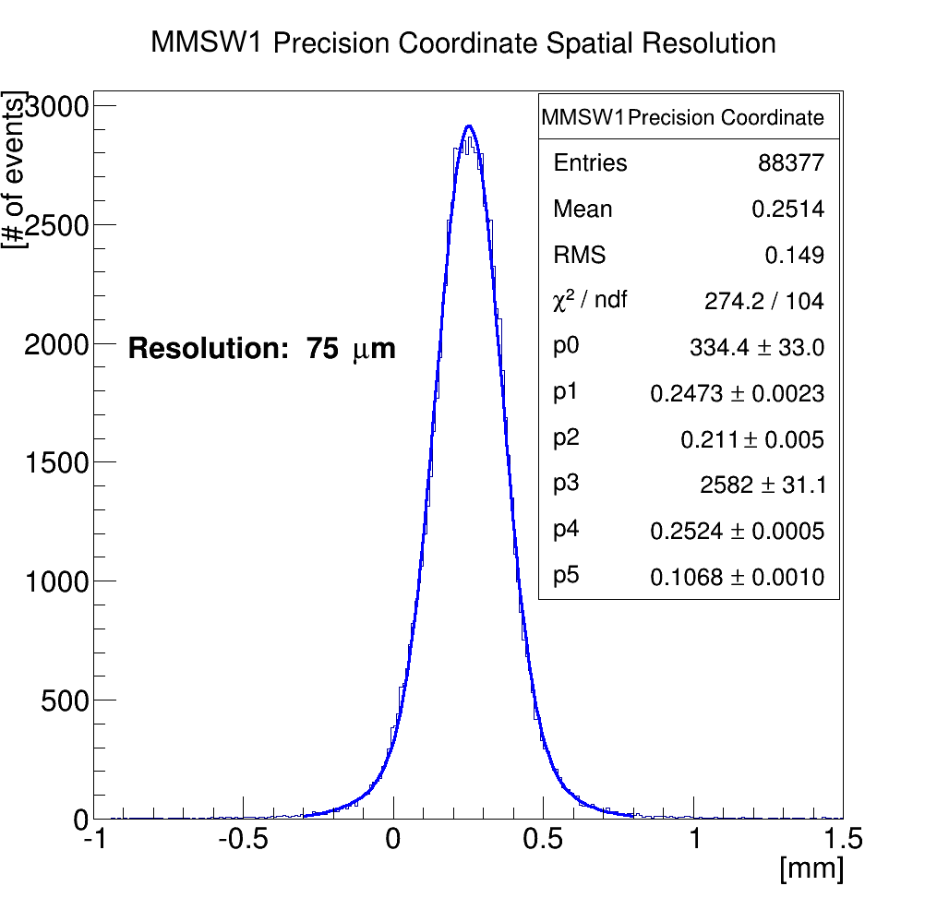
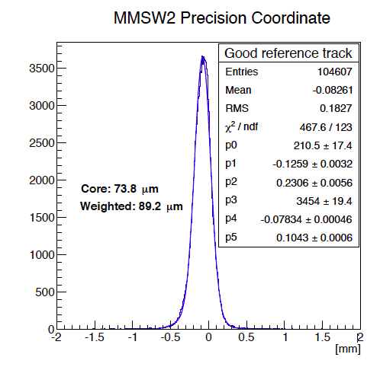
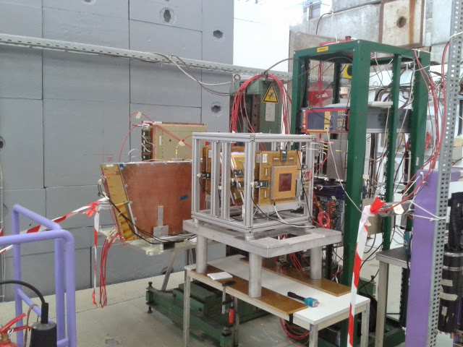
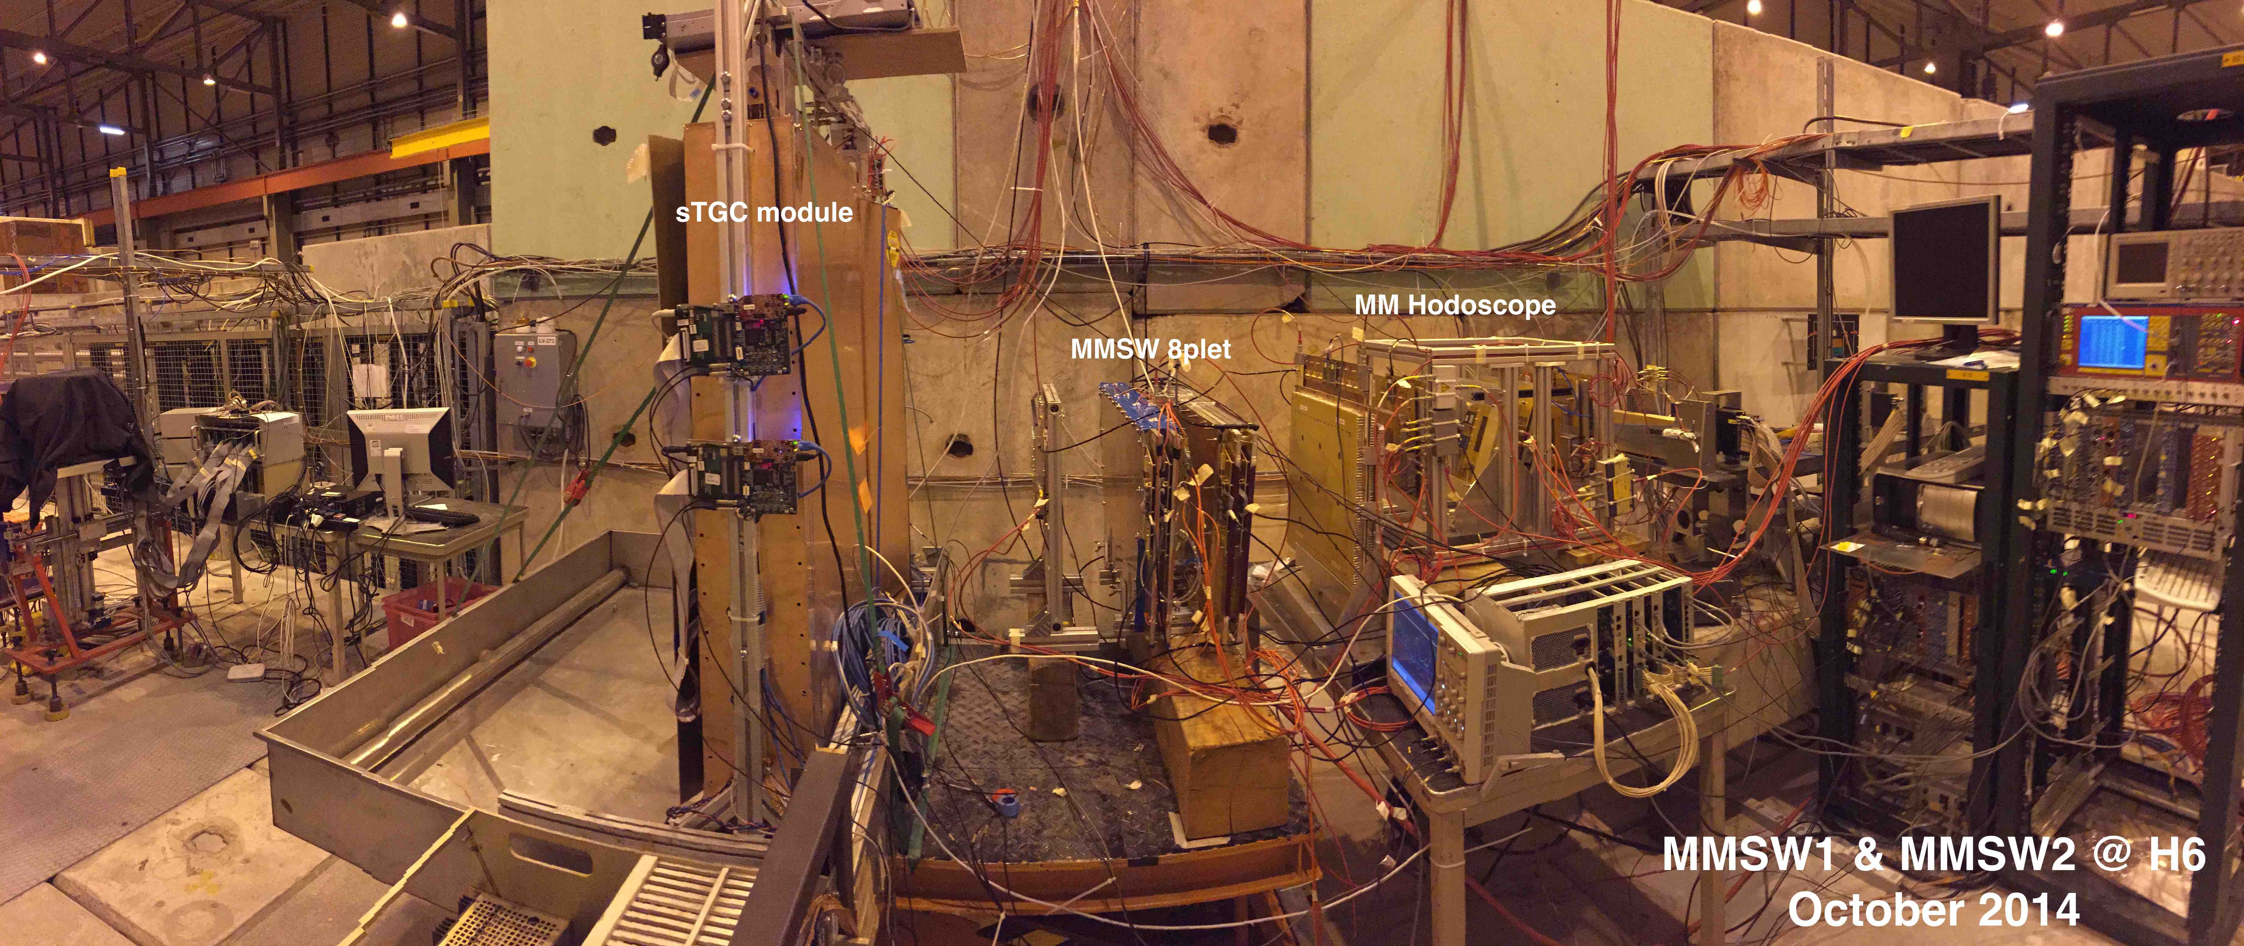
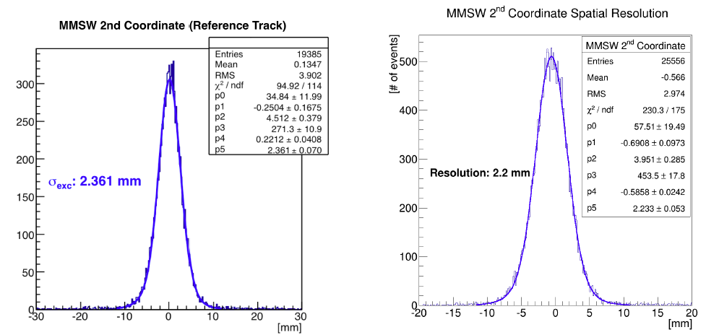
MM : MSW position resolution
MMSW1@T10
September 2014

Slide 17
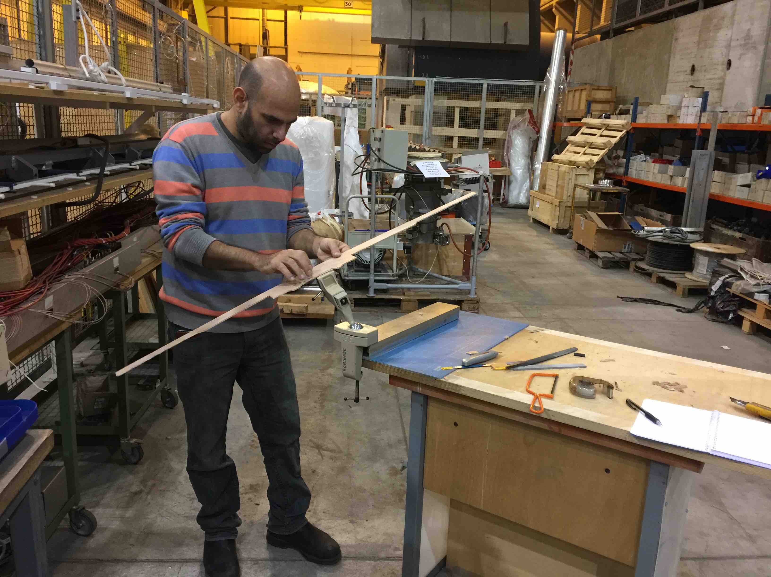
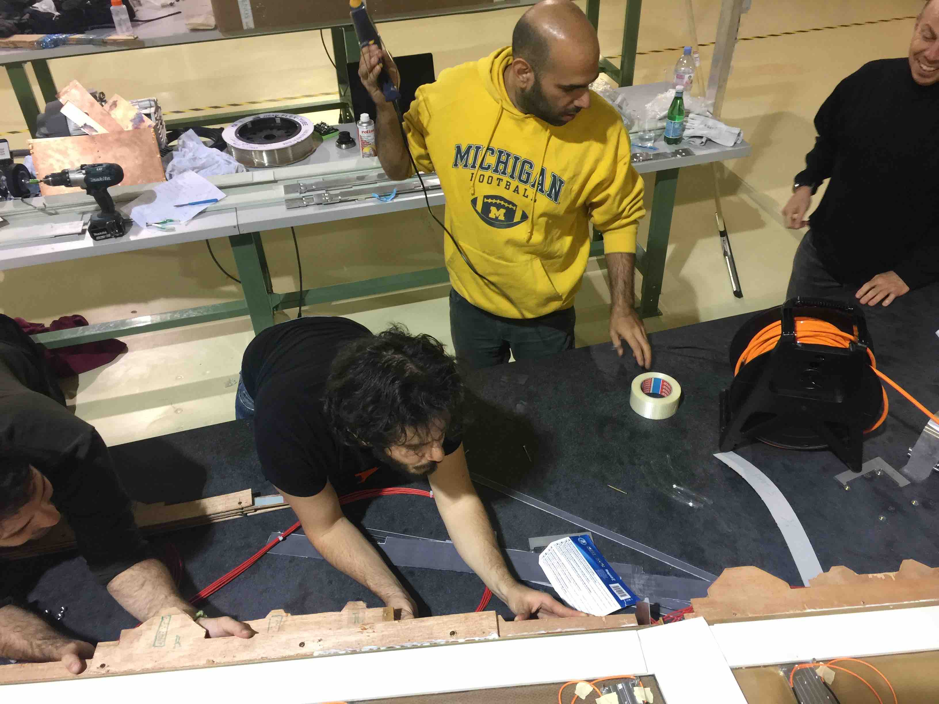
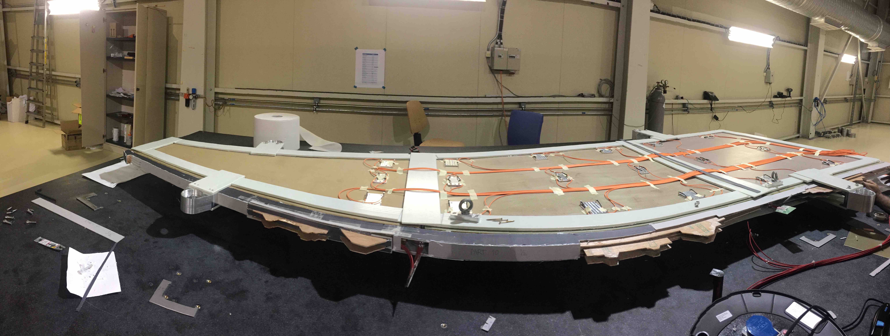
sTGC : fake wedge
CANADA
CHINA
CANADA
RUSSIA
CHILE
ISRAEL

Slide 18
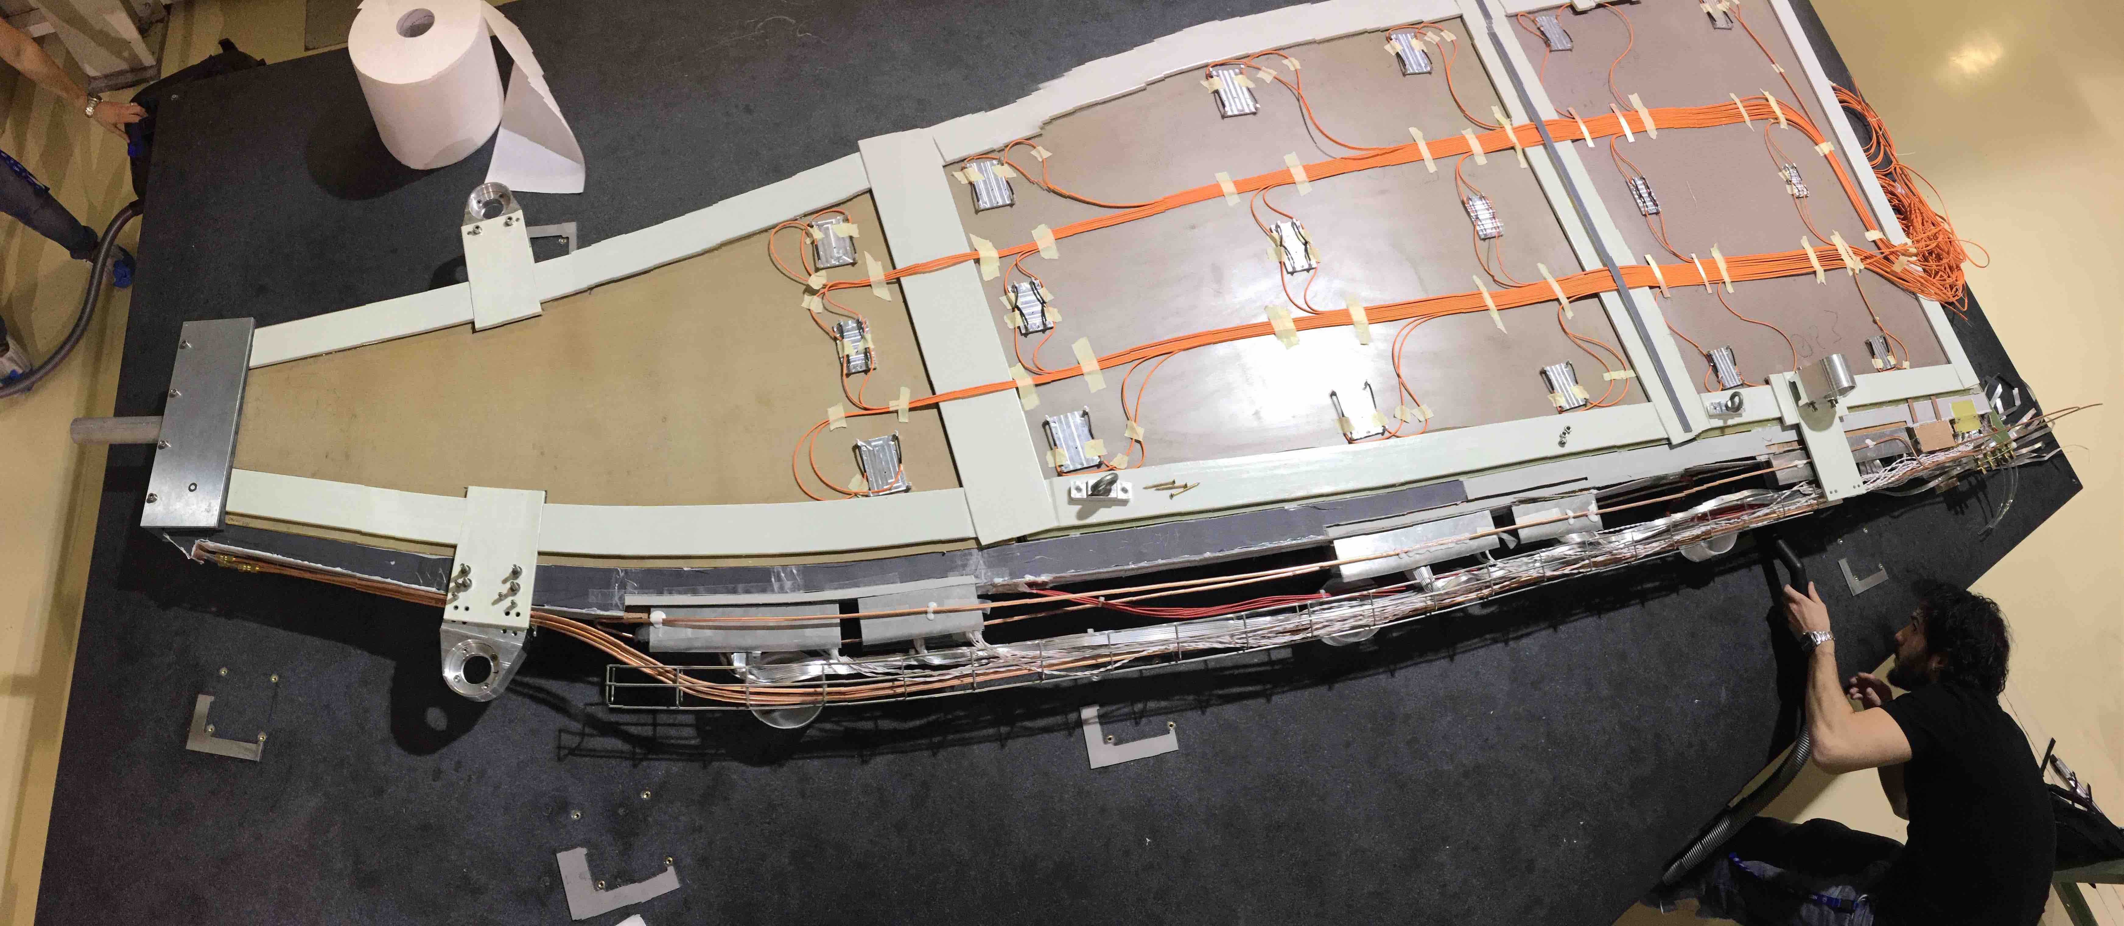
sTGC : fake wedge
CANADA
CHINA
CANADA
RUSSIA
CHILE
ISRAEL

Slide 19
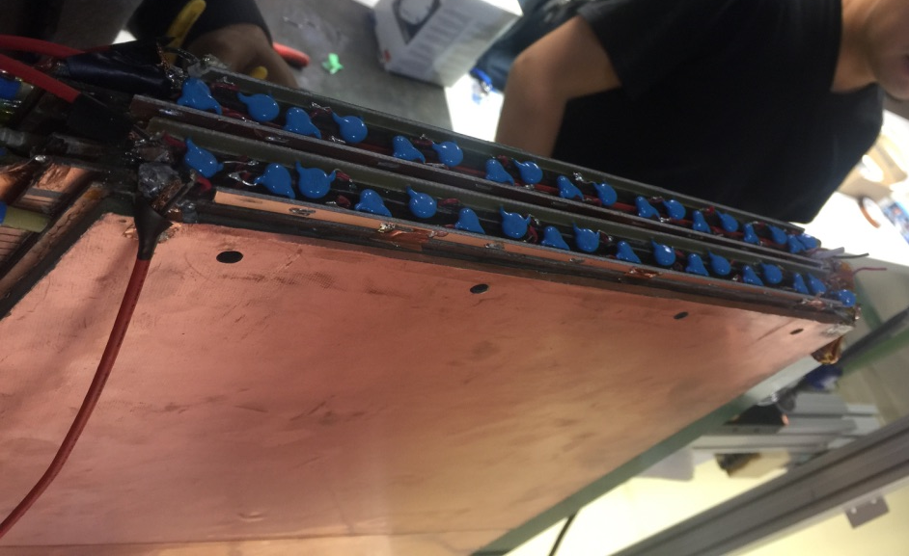
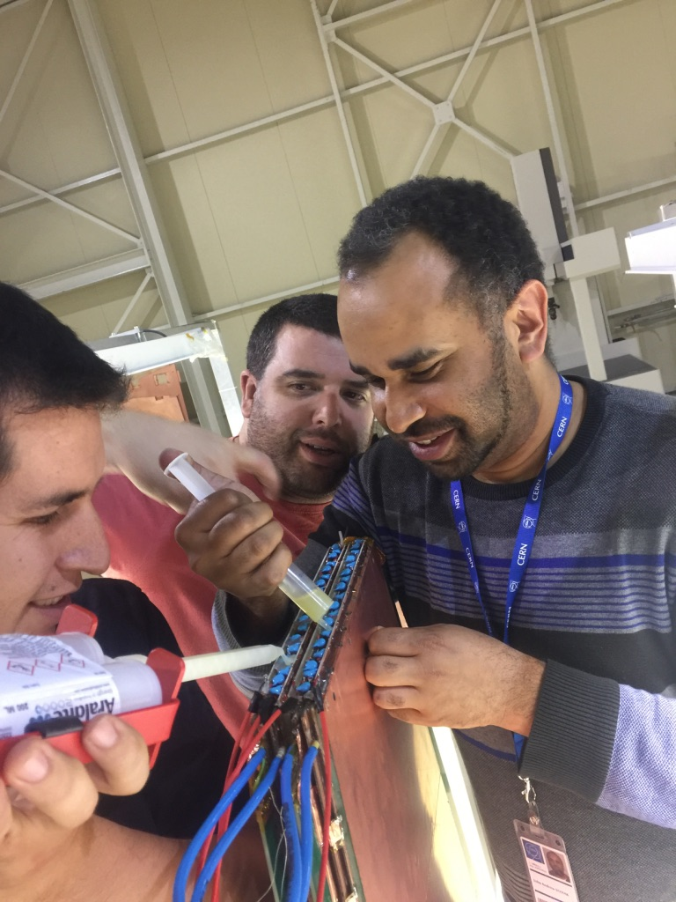
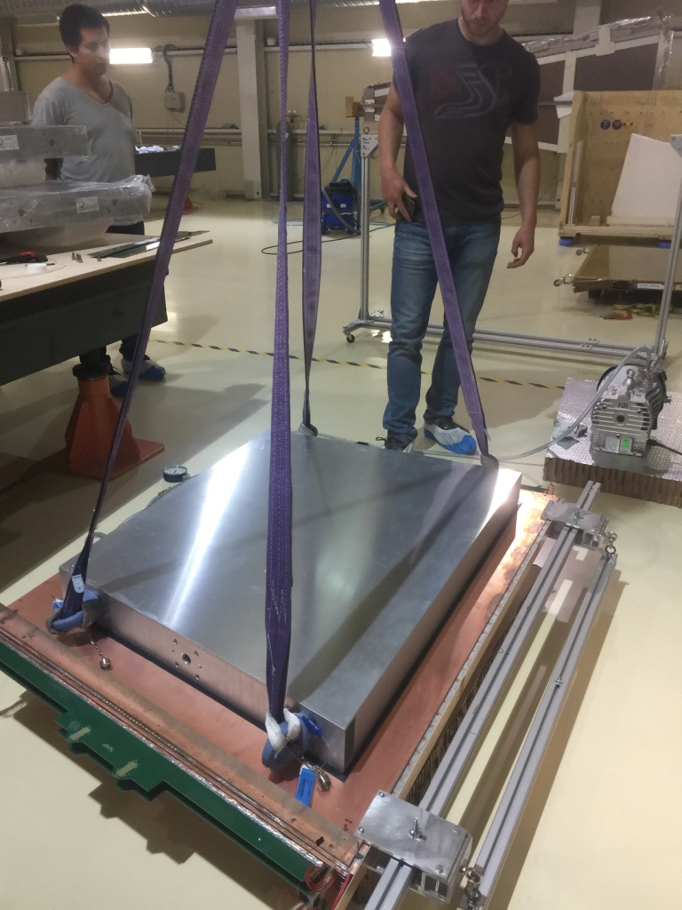
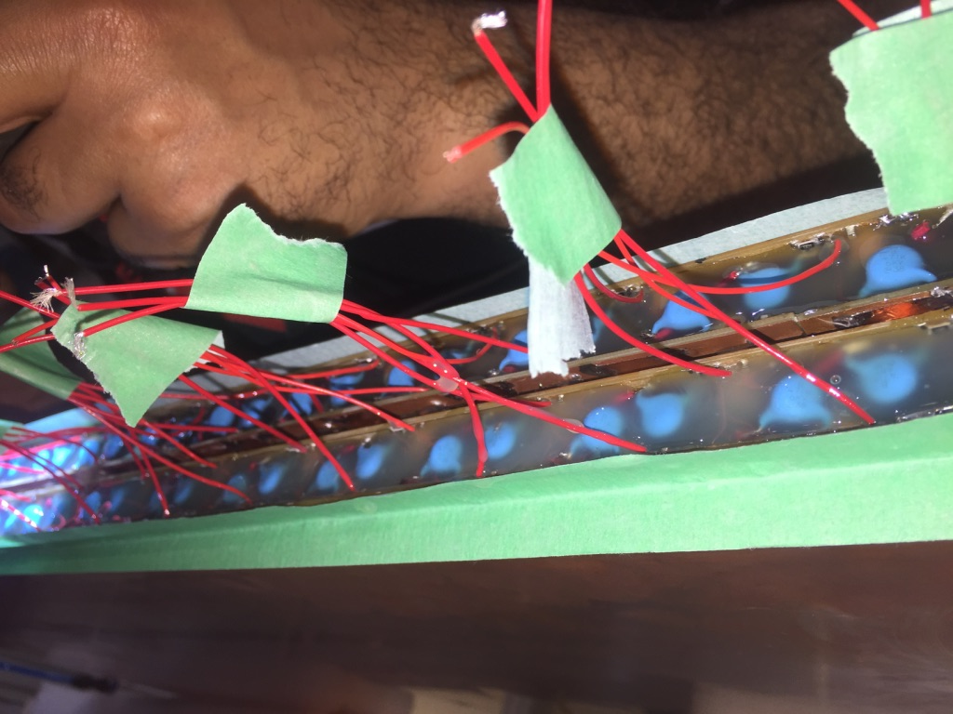
sTGC : first wedge
Chamber preparation
Installation of one of the detectors on the table
CANADA
ISRAEL
RUSSIA
CHINA
CANADA
RUSSIA
CHILE
ISRAEL

Slide 20
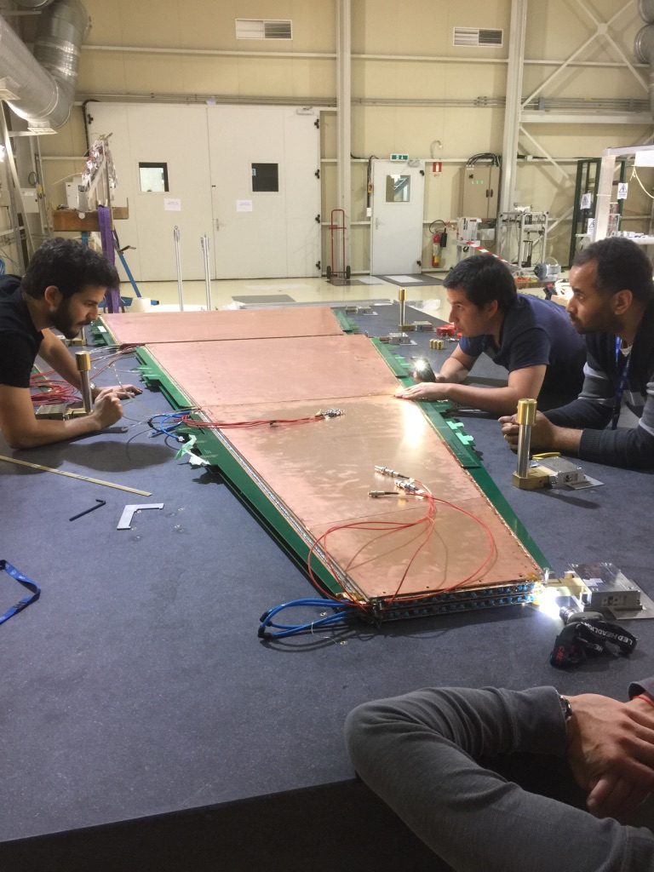
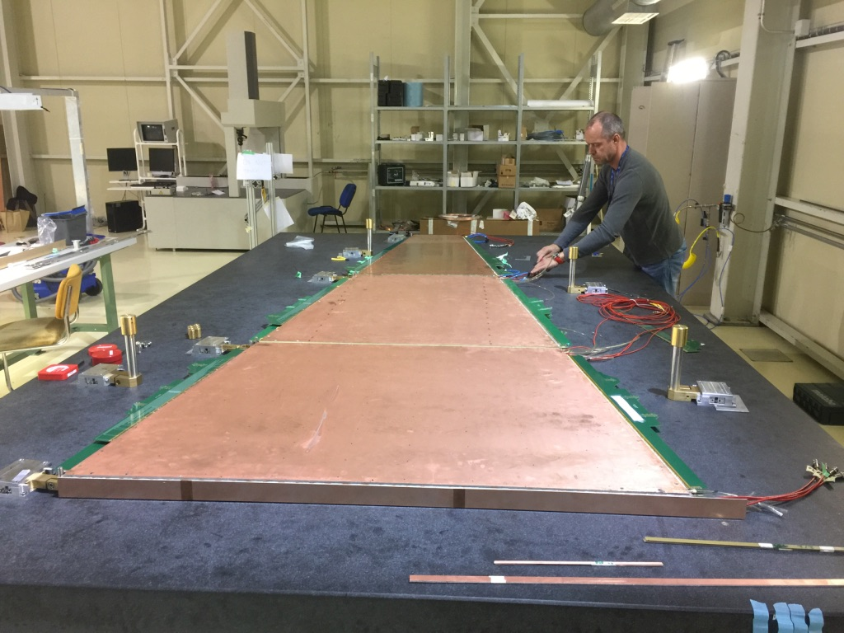
sTGC : installation of the chambers on the table
CANADA
ISRAEL
RUSSIA
CHINA
CANADA
RUSSIA
CHILE
ISRAEL

Slide 21
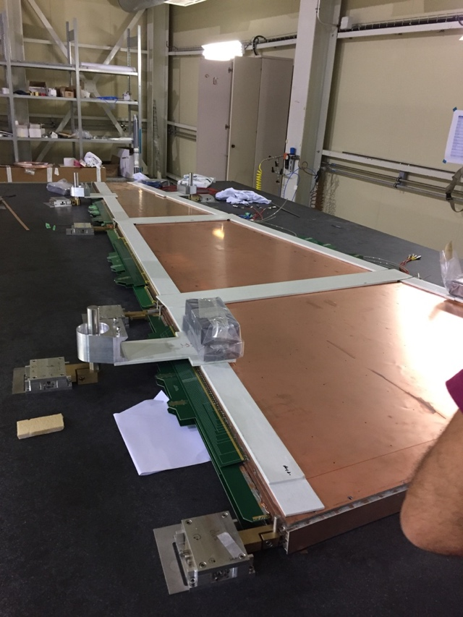
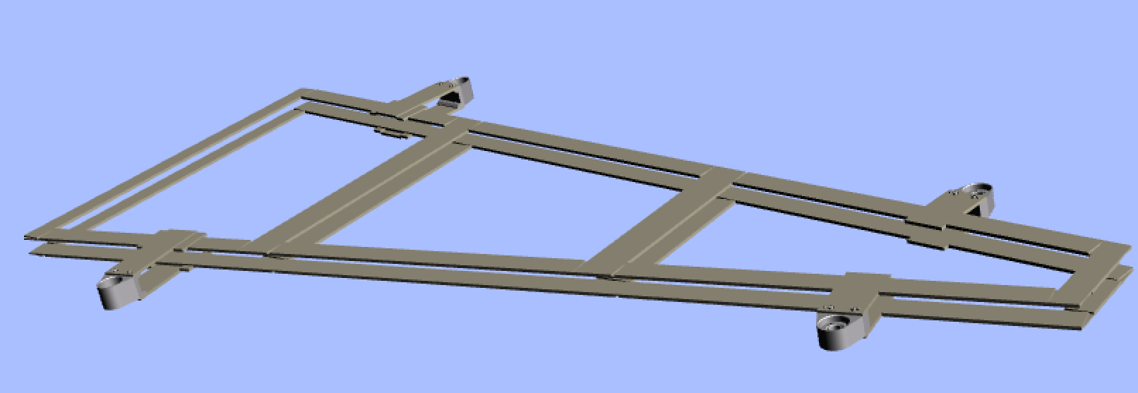
sTGC : gluing of the frame
CANADA
ISRAEL
RUSSIA
CHINA
CANADA
RUSSIA
CHILE
ISRAEL

Slide 22
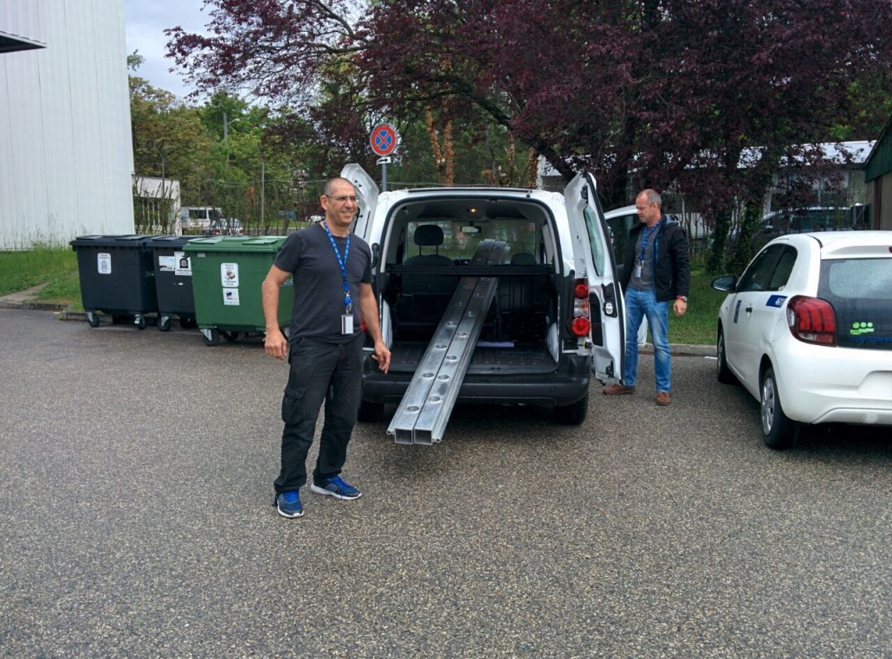
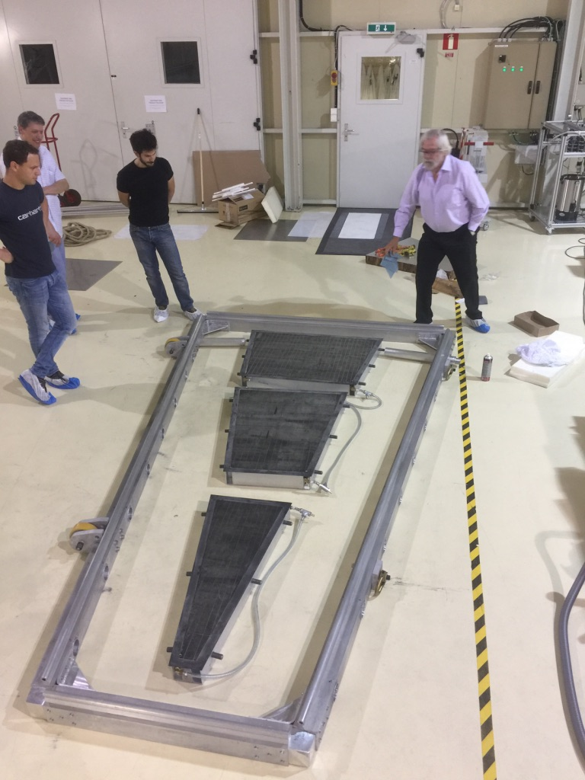
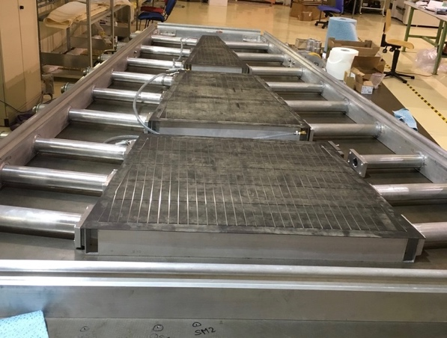
sTGC : turning the wedge
CANADA
ISRAEL
RUSSIA
CHINA
CANADA
RUSSIA
CHILE
ISRAEL

Slide 23
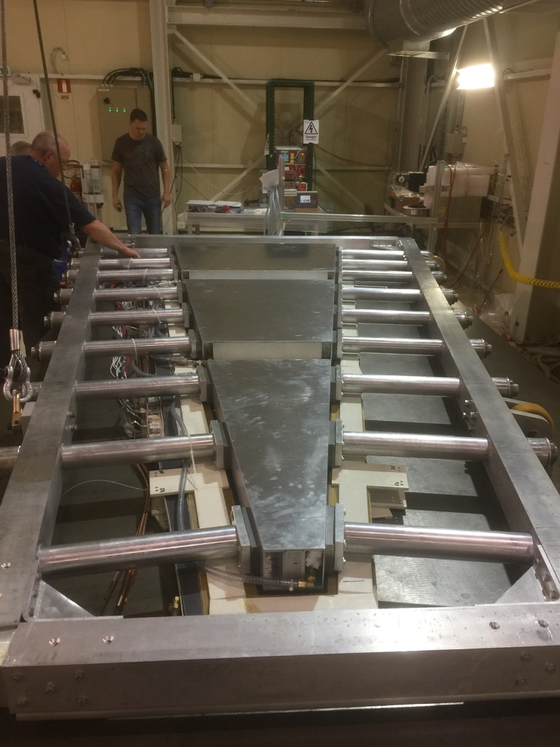
sTGC : Turning the wedge
CANADA
ISRAEL
RUSSIA
CHINA
CANADA
RUSSIA
CHILE
ISRAEL

Slide 24
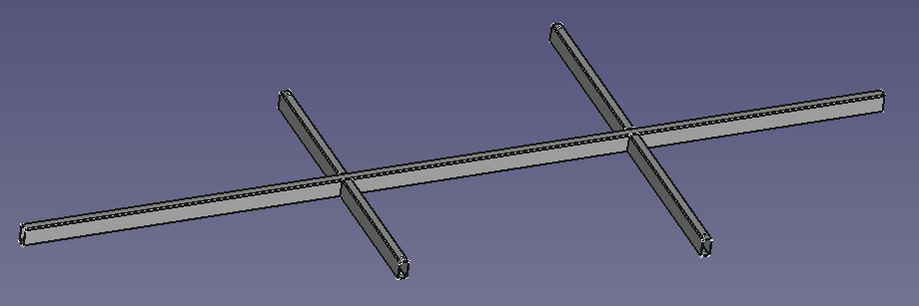
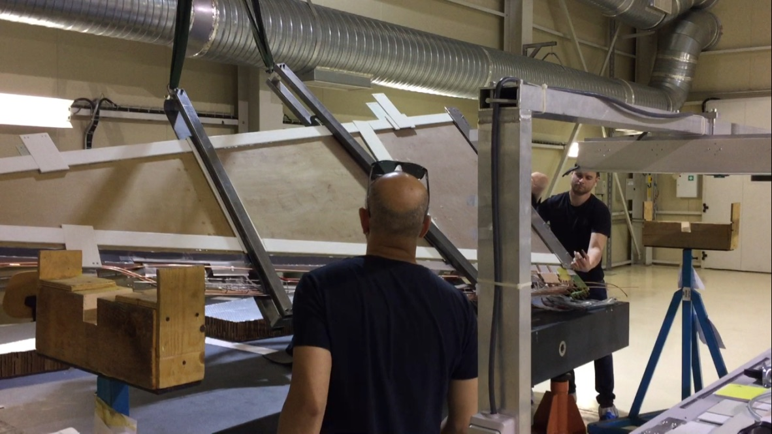
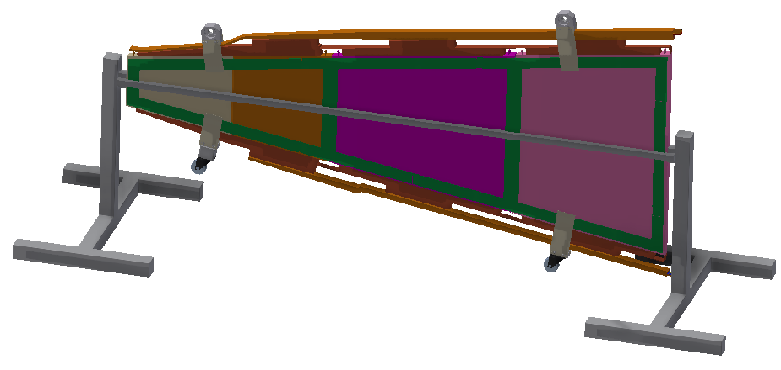
sTGC : Moving the wedge to rotating stand
CANADA
ISRAEL
RUSSIA
CHINA
CANADA
RUSSIA
CHILE
ISRAEL

Slide 25
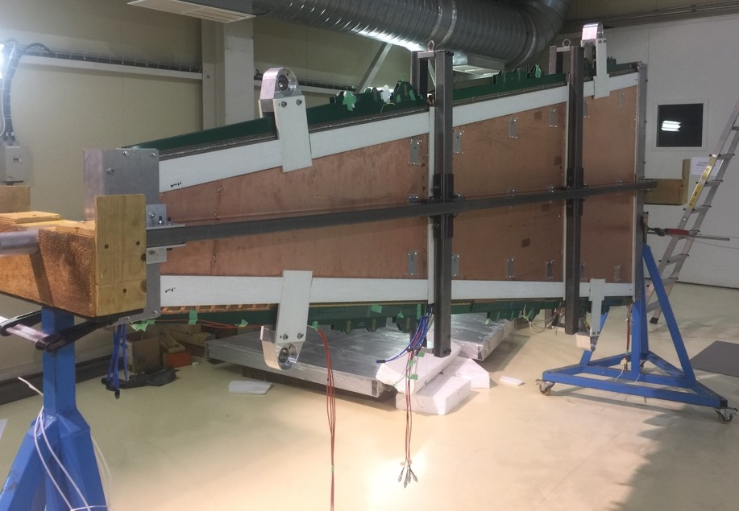
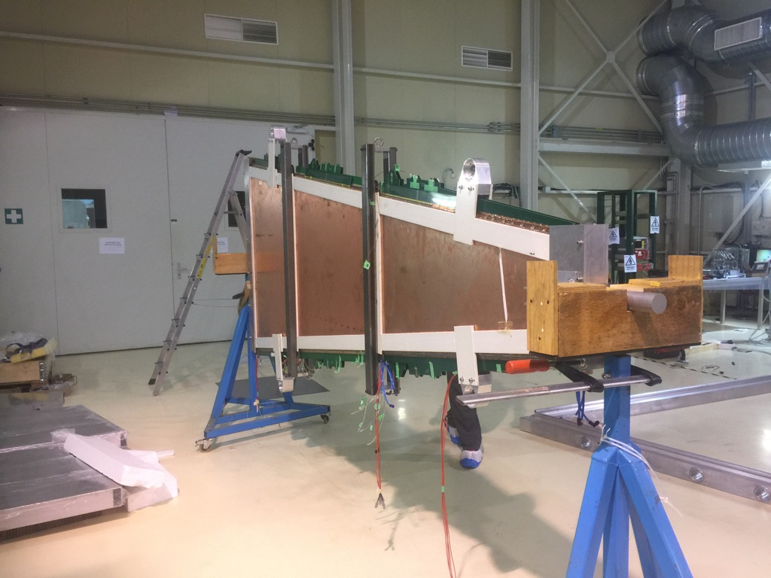
sTGC : rotating stand
CANADA
ISRAEL
RUSSIA
CHINA
CANADA
RUSSIA
CHILE
ISRAEL

Slide 26
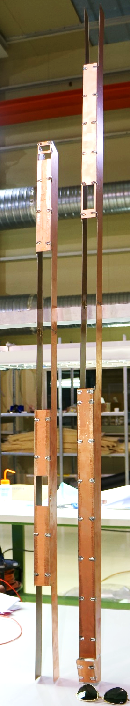
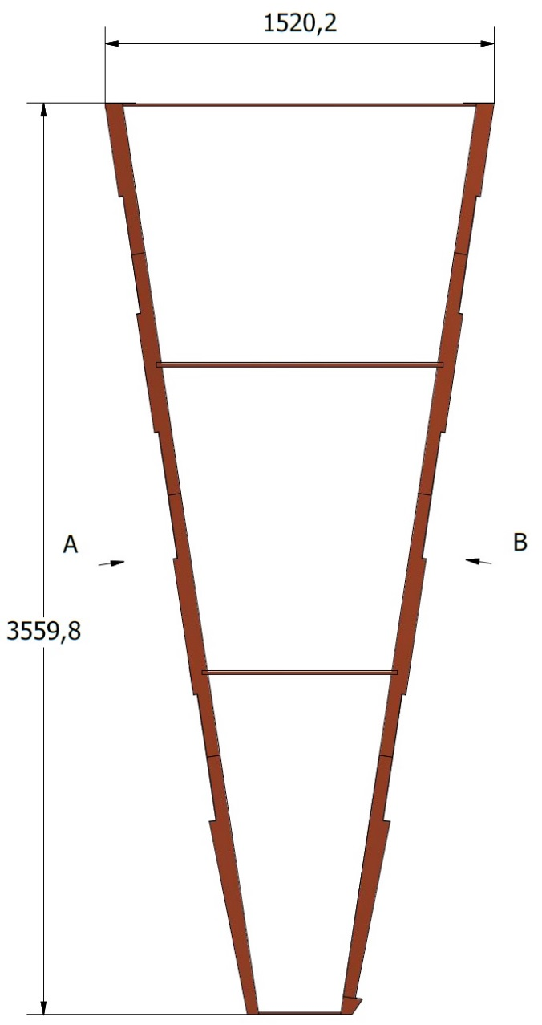
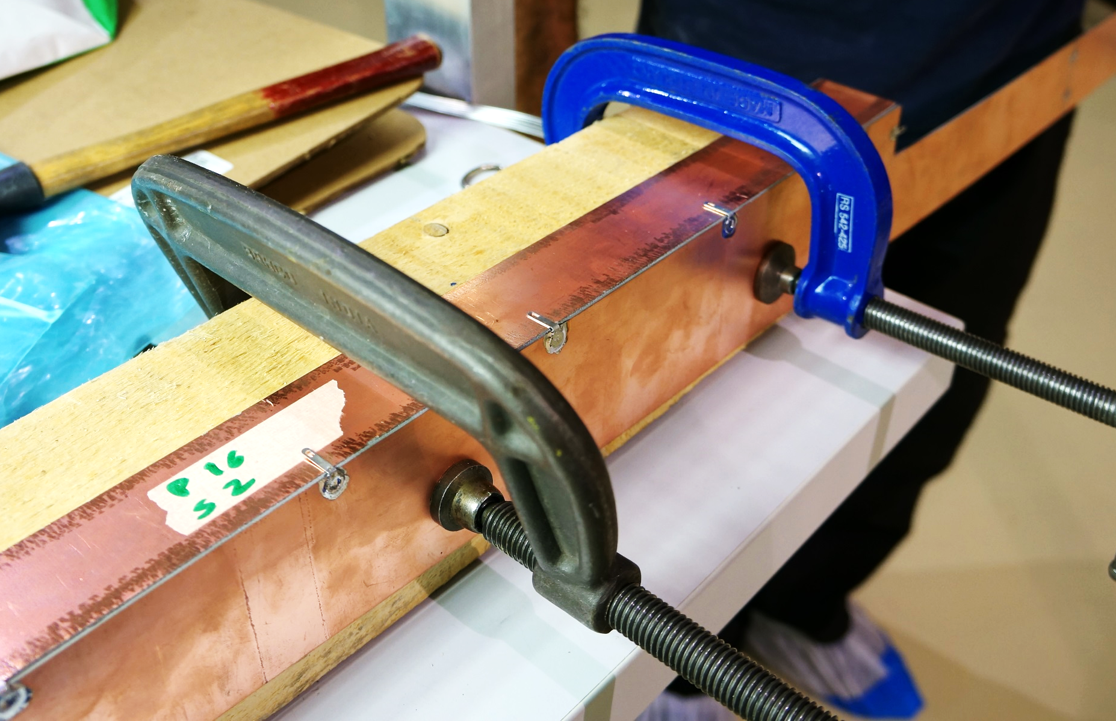
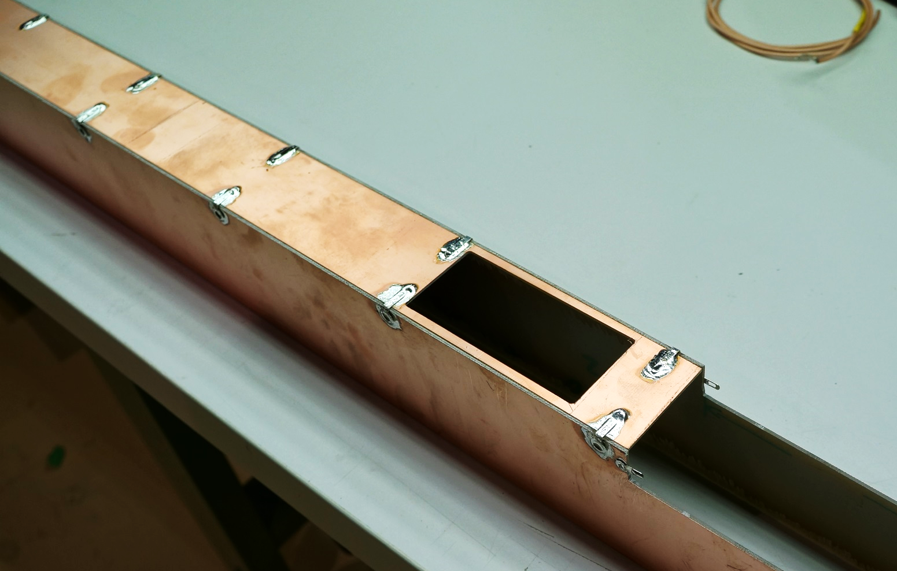
sTGC : installation of the faraday cage
CANADA
ISRAEL
RUSSIA
CHINA
CANADA
RUSSIA
CHILE
ISRAEL

Slide 27
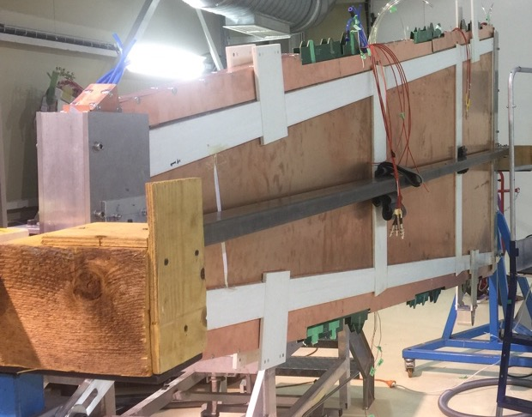
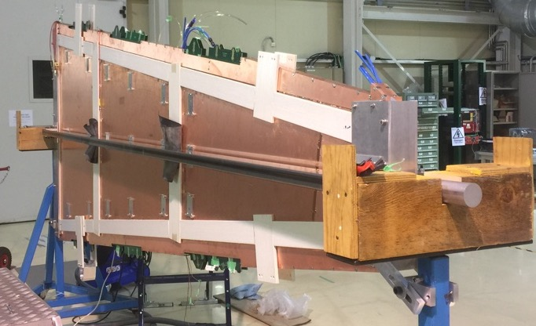
sTGC : faraday cage
CANADA
ISRAEL
RUSSIA
CHINA
CANADA
RUSSIA
CHILE
ISRAEL

Slide 28
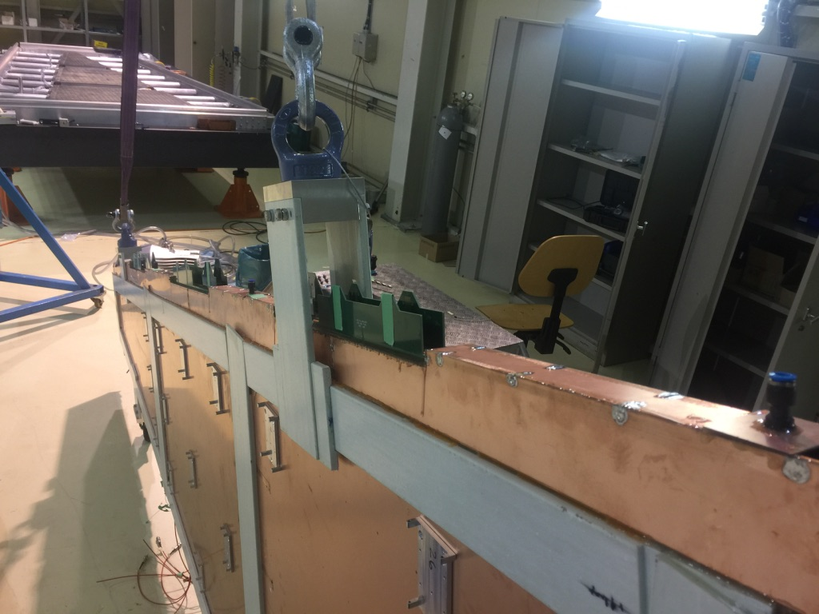
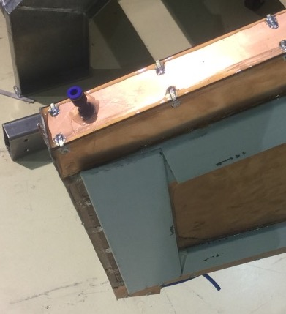
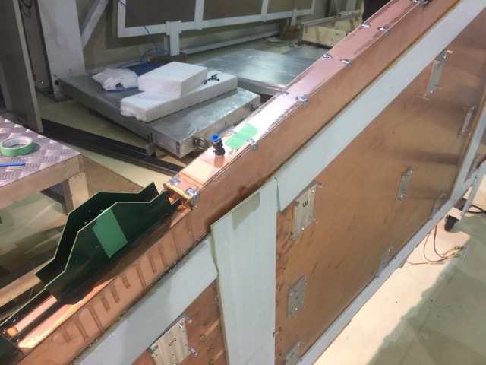
sTGC : faraday cage and gas
CANADA
ISRAEL
RUSSIA
CHINA
CANADA
RUSSIA
CHILE
ISRAEL

Slide 29


