Slide 1
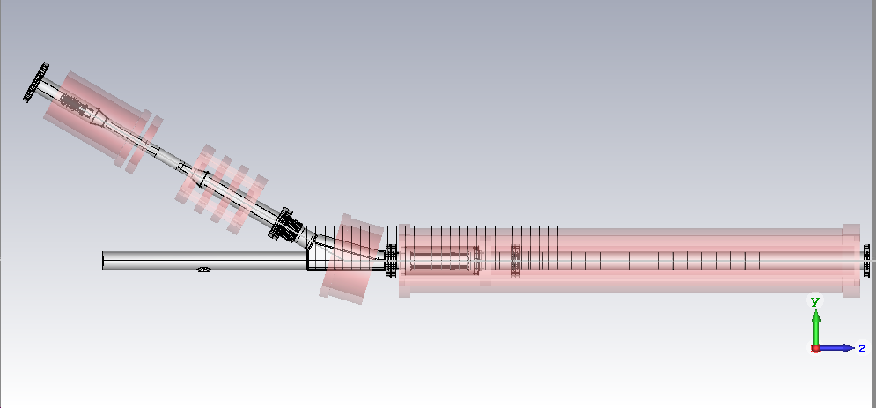
CST simulations of electron beam trajectory in the Hollow Electron Lens to find configuration without ‘bump’ at the inlet of the main solenoid
A. Rossi, S. Sadovich
Tracking with magnetostatic evaluation only
3mm mesh (will be refined after narrowing down spectrum of study)

Slide 2
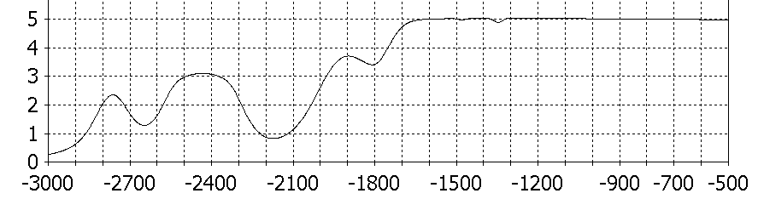
HEL magnetic field at flat top
valve

Slide 3
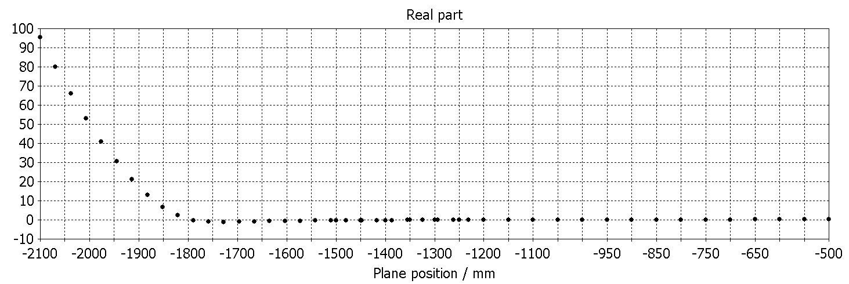
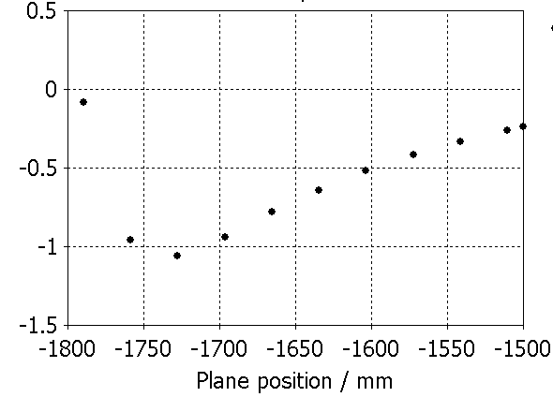
Current mechanical design: 30 deg angle of injection, bend solenoid tilt 16.7 deg

Slide 4
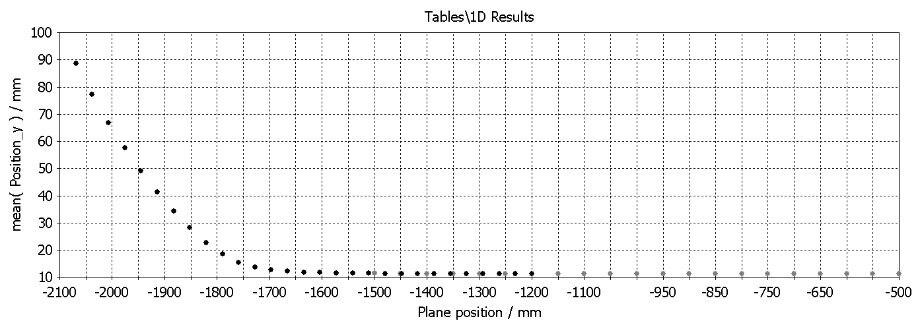
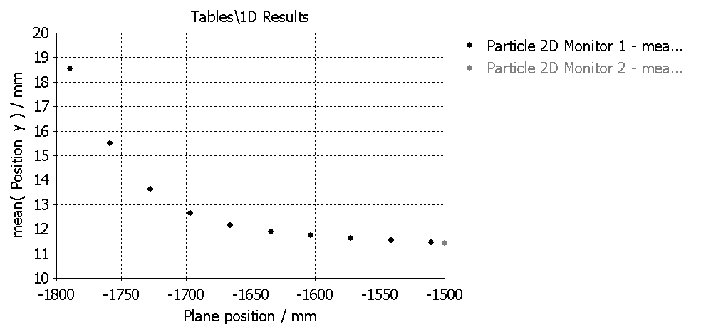
Trajectory without bending magnet

Slide 5
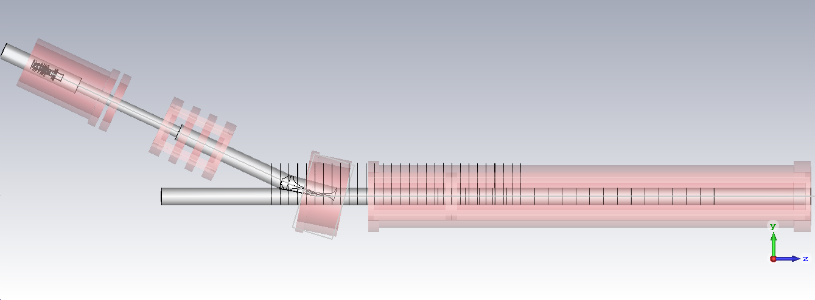
Vary angle and position of bending magnet, go to 25 deg injection
Tracking with magnetostatic evaluation only
3mm mesh (will be refined after narrowing down spectrum of study)

Slide 6
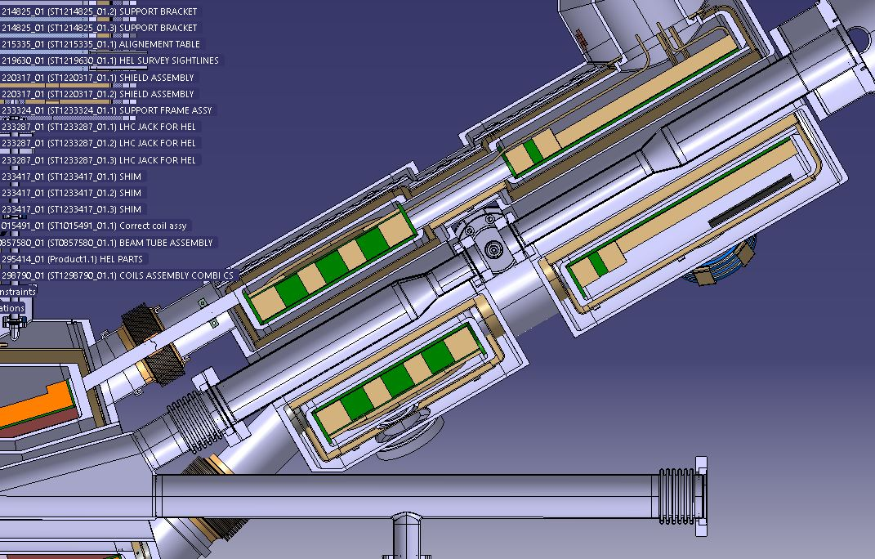


Mechanical design
In blue the coil. Around the He tank. In red the local cut to create space for the vacuum pipe (in red)
Diego Perini and Antti Kolehmainen

Slide 7
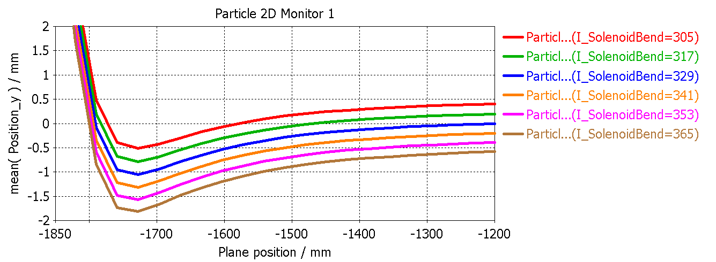
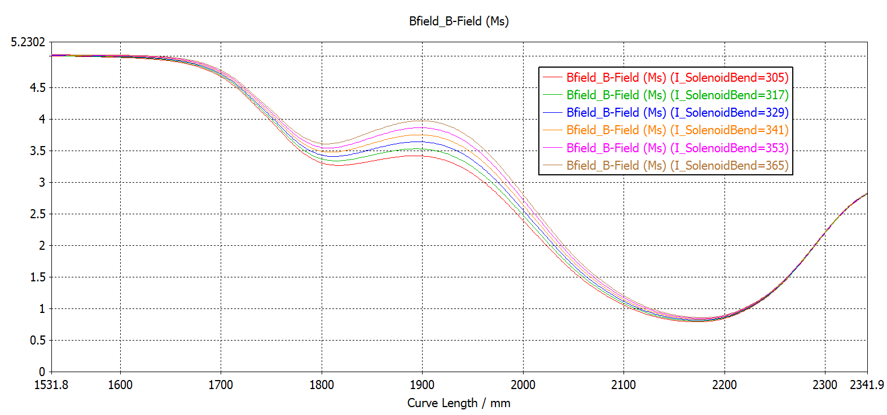
Bend solenoid current scan

Slide 8
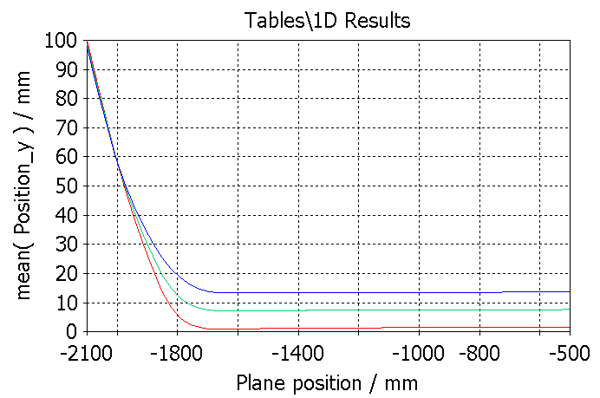
Bend solenoid tilt scan:
(1) 16.7 deg
(2) 16.7 – 3
(3) 16.7 - 6

Slide 9
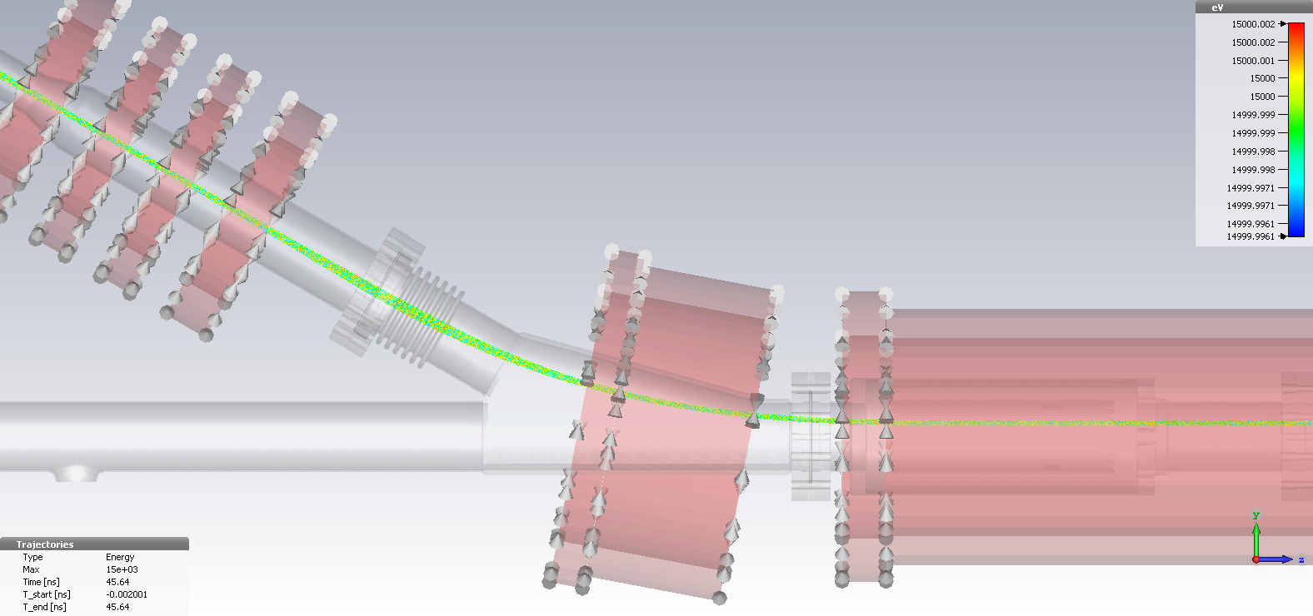
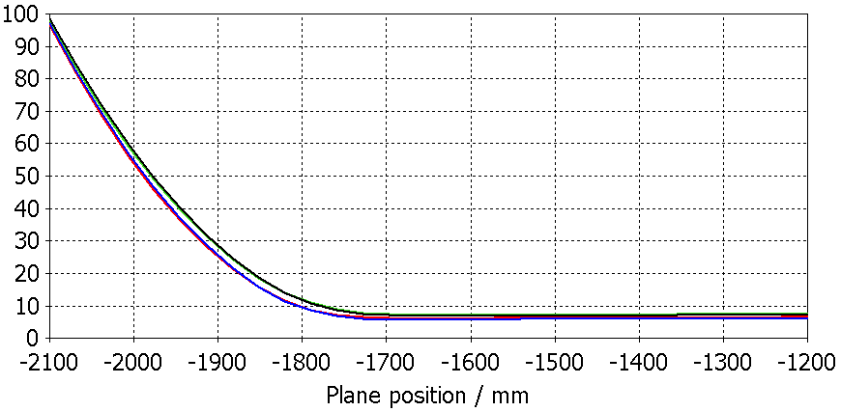
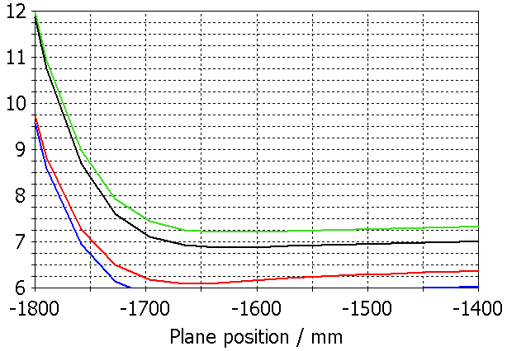
Bend solenoid Y-Z position scan:
Tilt= 16.7-3 degrees
Y+5, Z+5 mm
Y+10, Z+5
Y+5, Z+10
Y+10, Z+10
HEL_GunSide_v02_with2D - bendParam - v3

Slide 10
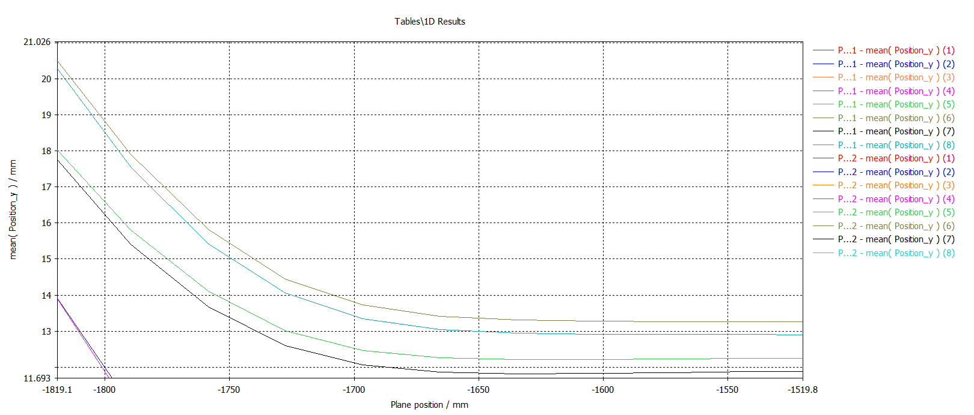
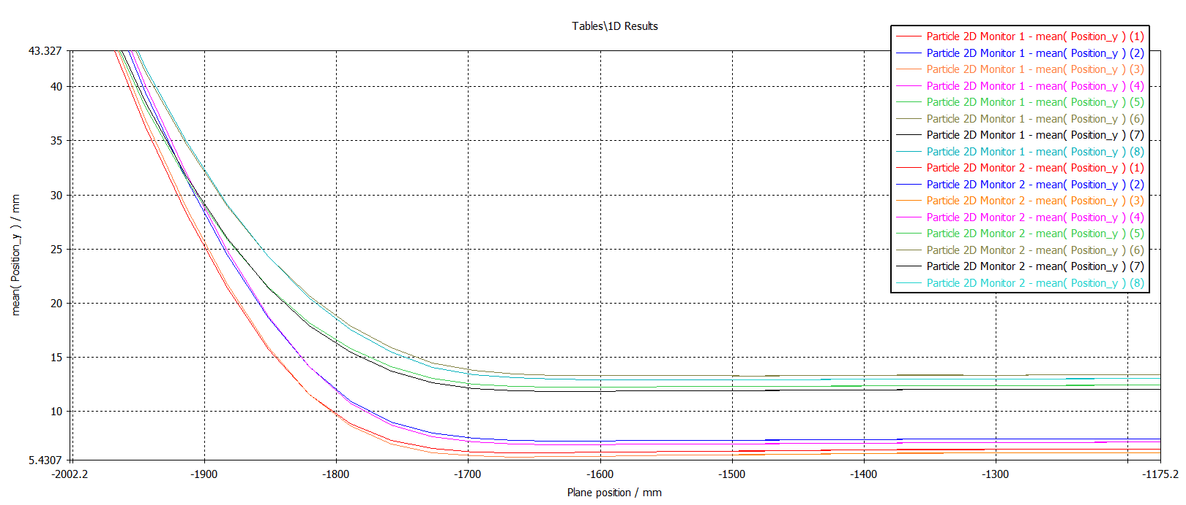
HEL_GunSide_v02_with2D - bendParam - v3
Bend solenoid Y-Z position scan:
Y+5, Z+5 mm, tilt= 16.7-3 deg
Y+10, Z+5
Y+5, Z+10
Y+10, Z+10
Y+5, Z+5 mm, tilt=16.7-6 deg
Y+10, Z+5
Y+5, Z+10
Y+10, Z+10

Slide 11
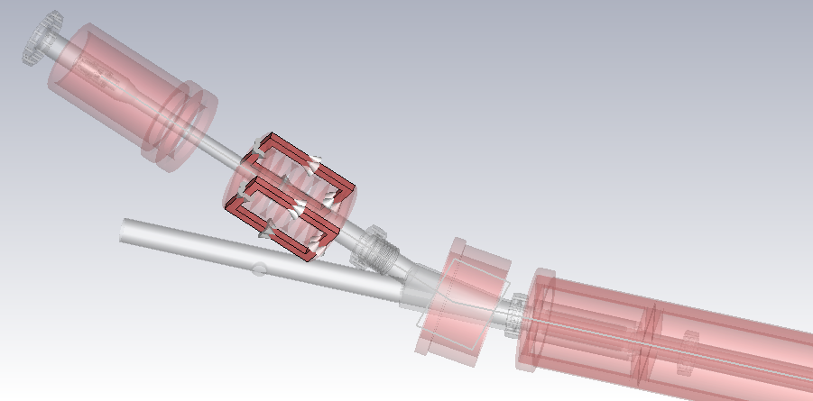
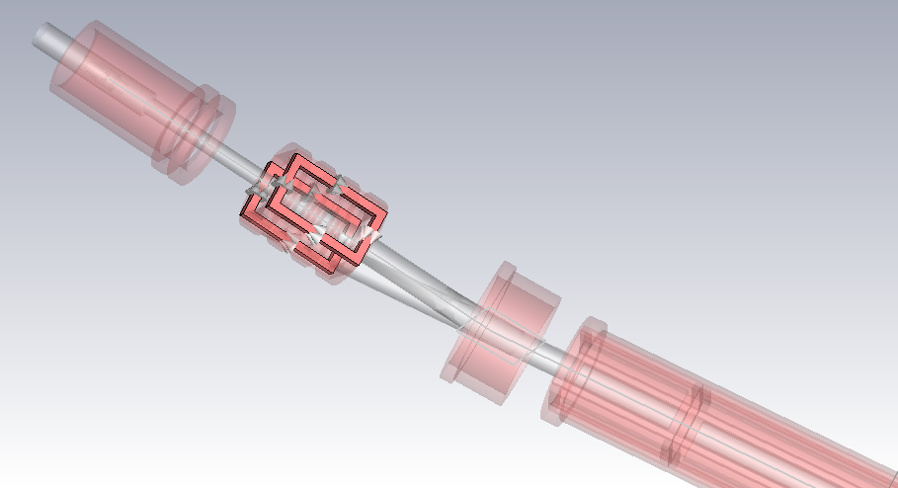
Corrector dipole magnets, V and H installed on the second gun solenoid, and along the main solenoid
Dipole approximated with 2 opposite windings, not yet realistic in shape or size
V
H

Slide 12
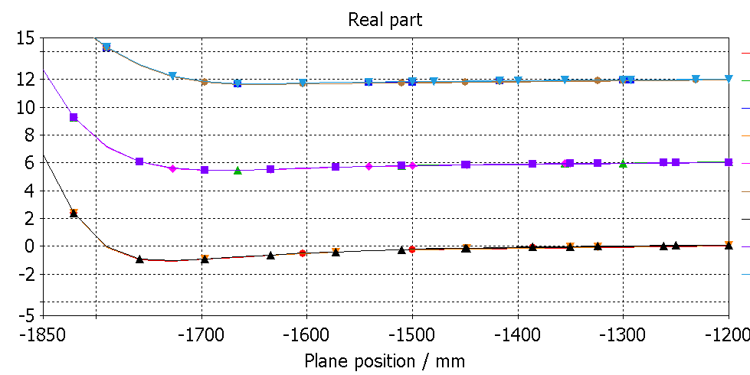
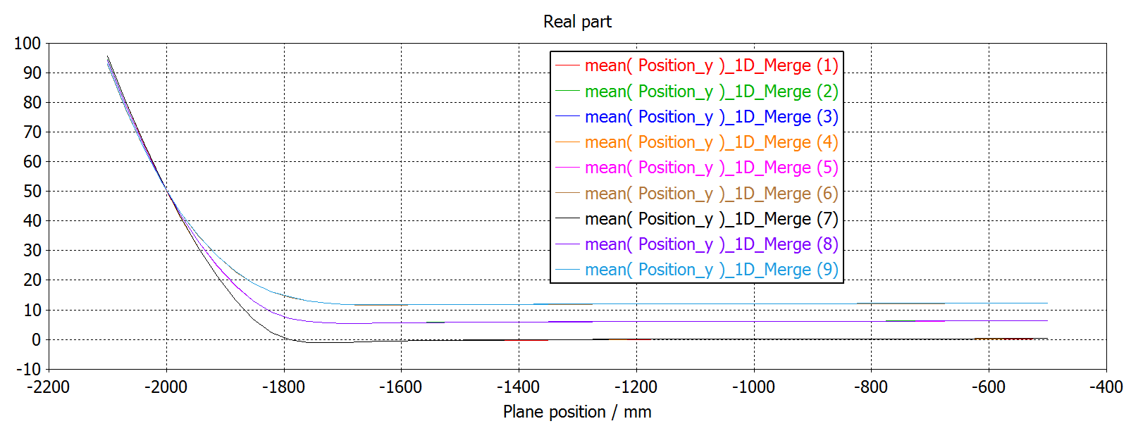
Bend solenoid tilt scan Gun corrector V current :
Tilt = 16.7 – 0 deg, Iv = 0 A
Tilt – 3, Iv = 0
Tilt – 6, Iv = 0
Tilt – 0, Iv = – 50
Tilt – 3, Iv = – 50
Tilt – 6, Iv = – 50
Tilt – 0, Iv = – 100
Tilt – 3, Iv = – 100
Tilt – 6, Iv = – 100

Slide 13
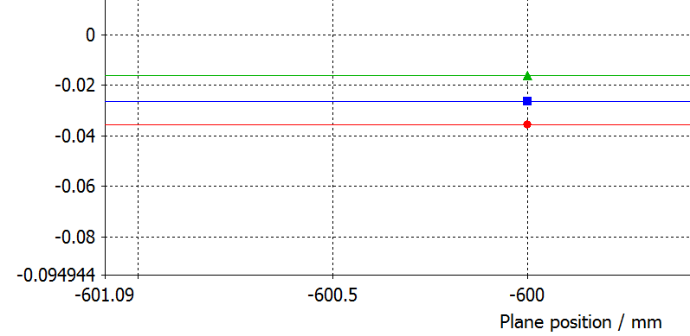
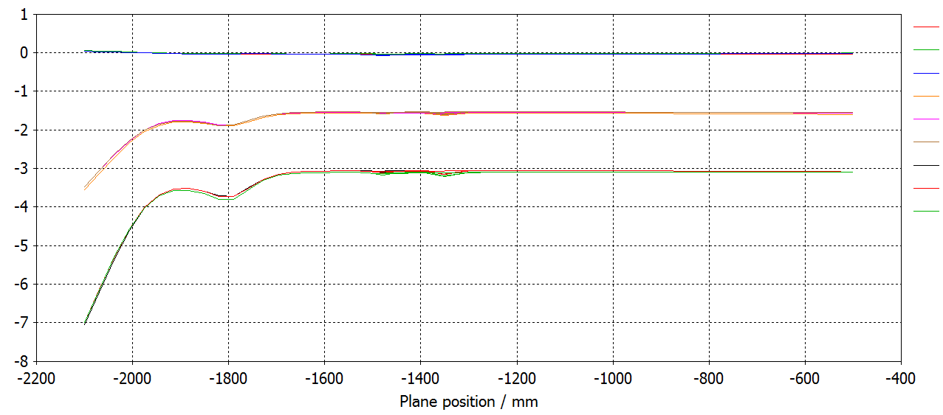
Bend solenoid tilt scan Gun corrector V current :
Tilt = 16.7 – 0 deg, Iv = 0 A
Tilt – 3, Iv = 0
Tilt – 6, Iv = 0
Tilt – 0, Iv = – 50
Tilt – 3, Iv = – 50
Tilt – 6, Iv = – 50
Tilt – 0, Iv = – 100
Tilt – 3, Iv = – 100
Tilt – 6, Iv = – 100

Slide 14
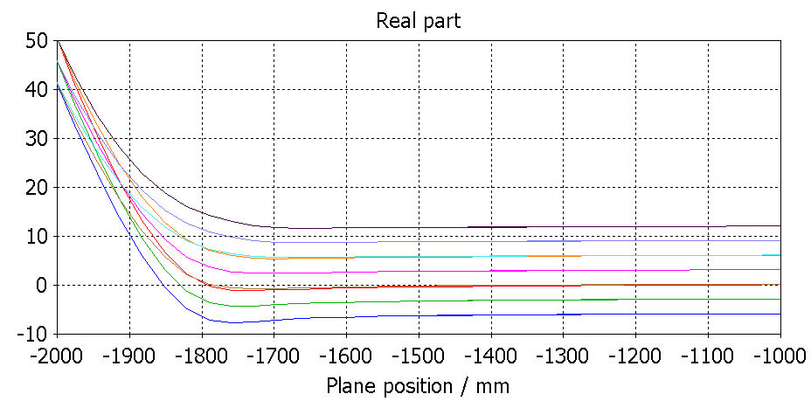
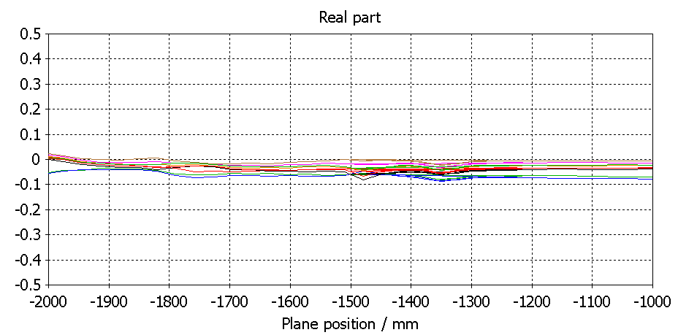
Bend solenoid tilt scan Gun corrector H current :
Tilt = 16.7 – 0 deg, IH = 0 A
Tilt 0, IH = -100
Tilt 0, IH = -200
Tilt = 16.7 – 3 deg, IH = 0 A
Tilt – 3, IH = -100
Tilt – 3, IH = -200
Tilt = 16.7 – 6 deg, IH = 0 A
Tilt – 6, IH = -100
Tilt – 6, IH = -200
HEL_GunSide_v02_with2D - bendParam - v6

Slide 15
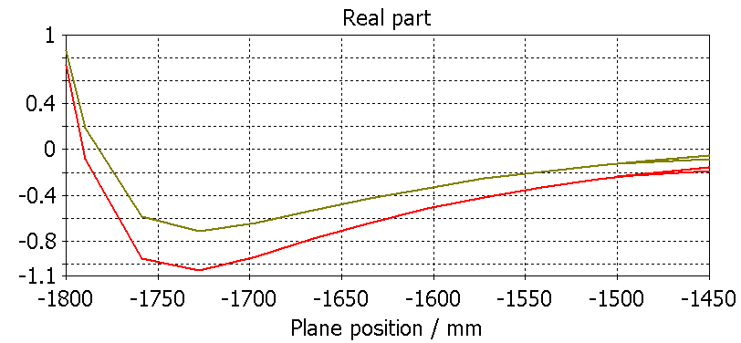
Bend solenoid tilt scan Gun corrector V current :
----- Tilt = 16.7 – 0 deg, IH = 0 A
----- Tilt = 16.7 – 3 deg, IH = -200
HEL_GunSide_v02_with2D - bendParam - v6

Slide 16
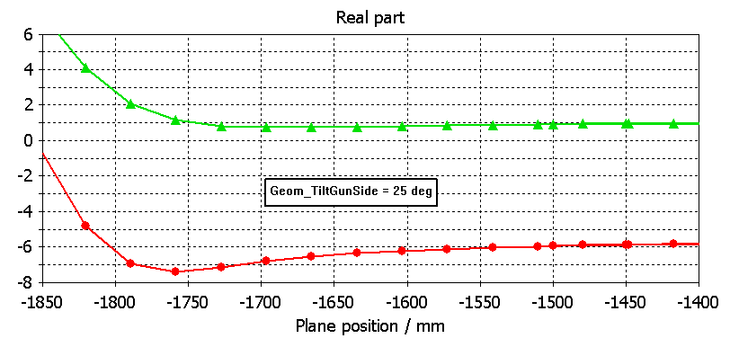
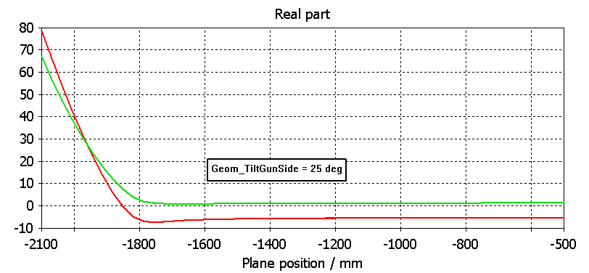
Injection angle reduced to 25 deg
----- No other variation from ref design
----- Bending magnet straightened by 5 deg, shifted 5mm up and H gun corrector at -150A
0.25mm bump

