Slide 1

Operational experience with LHC feedbacks
J. Wenninger BE-OP-LHC
Orbit & Tune FB team:
BE-BI: D. Louro Alves, L. Grech, S. Jackson
BE-OP: A. Calia, M. Hostettler, D. Jacquet, J. Wenninger

Slide 2
History – how we got here
During its entire lifecycle, LEP suffered from unstable orbits due to temperature driven movements of low-beta quadrupoles, coupled with the absence of real-time orbit control.
  Majority of lost ramps due to poor orbit control, affected ~10-20% of the ramps.
To avoid a similar fate to the LHC beams, work on real-time feedbacks in OP, implementation by R. Steinhagen (Tech & Doct in OP, Fell & Staff in BI) between 2003 and 2013.
  Support for FESA class by G. Sivatsky (PA in CO/BI).
  J. Wenninger & K. Fuchsberger from OP for design and high level CCC tools.
  Major consolidation during LS1 by S. Jackson and D. Louro Alves (BE-BI) for FESA, the OP team for JAVA, settings and sequencing (up to 2016).
The current architecture is the result of:
  Little support by CO – rely on ‘standard’ tools and HW and BI+OP manpower,
  No dedicated communication hardware,
  Rise of Gigabit Ethernet as reliable communication channel in 2000++.
    Performance adequate given the limitations of LHC circuits.

Slide 3
Feedback architecture
A central FB Controller (OFC) is running in the control room where all data is concentrated, processed and corrections are dispatched.
  Around 2004-2005 this was a highly innovative approach compared to light sources !
  Possible because the data rate was only 25 Hz (design up to 50Hz).
The position monitors and power converters (PC) are distributed around the LHC ring.
  The sensor data is obtained from ~70 Front End Computers (FECs).
  The actuators data is dispatched to ~40 FGC gateways.
  The system also handles the tune feedback.
The data is transmitted over the accelerator technical network as UDP data packets.
  UDP: throw it at the client, no handshake, no confirmation of reception.
  Option of QA on FB packets (priority at switch level) is available, but it was never used.
~2000 position readings
BPM data
Typical collection time < 3 ms
Orbit sampling rate 25 Hz
OFC
PC data
~1100 orbit correctors PCs

Slide 4
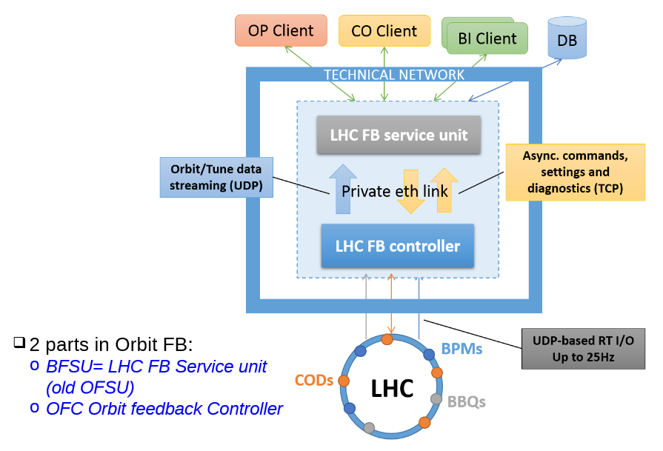
Feedback architecture
The Run 1 + 2 feedback was implemented in two C++ servers for data collection and control loop (‘controller’ → critical for FB operation) and for interfacing to the accelerator control system (‘service unit’).
  The service Unit is implemented within the FESA framework (but on Linux server).
    Standard controls device.
    “Protects” the controller from clients (proxy).
  The controller is a custom build C++ server based on the CERN root framework.
Both servers are running on HP ProLiants (2 x Intel Xeon CPU, 12 cores, 32 Gb RAM) with a private Ethernet Gb connection between the two machines.
  Standard CO machines, new generation will appear in Run 3.

Slide 5
BPM data
The orbit data is published in RT by the BPM FECs and send at 25 Hz as UDP packets to the OFC server.
  Typical data latencies < 1 ms, max. ~ 3 ms.
The OFC server concentrates the data and builds the orbit with ~ 2000 readings.
  Free running or synchronized trigger mode to define the window for orbit data collection by the FB controller.
    FEC publication synchronized by BST.
    During Run 2 the controller operated in synchronized mode (BST orbit trigger).
The orbit data is compared to a reference (→ correction on the difference) to define the error signal for orbit and radial position (→ feedback on radial position).
Since Run 2 the orbit references are handled as functions in LSA (~2000 functions !).
  Composed of a base orbit (i.e. best flat reference) with a superposition of bumps.

Slide 6
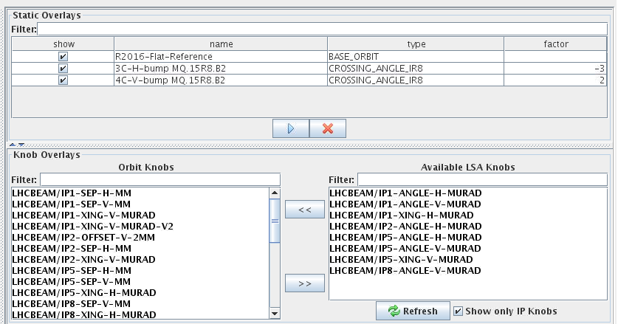
Reference orbits
The reference orbits are constructed as (sometimes exception for stable beams reference ⇔ measured orbit):
  Base orbit + overlays (xing, separation, ULO etc bump).
  The base orbit is the same for all references of a given hypercycle → the same across the cycle.
    Since 2016 a single reference is used for all pp hypercycles of one year (same for ions by diff. reference).
A OFB reference application is used to define which ‘knobs’ are added to the orbit. The references are then generated (using the settings generation application) from base plus the calculated effect of all knobs.
Some experts options to deal with special cases..
Base orbit
Knob overlays

Slide 7
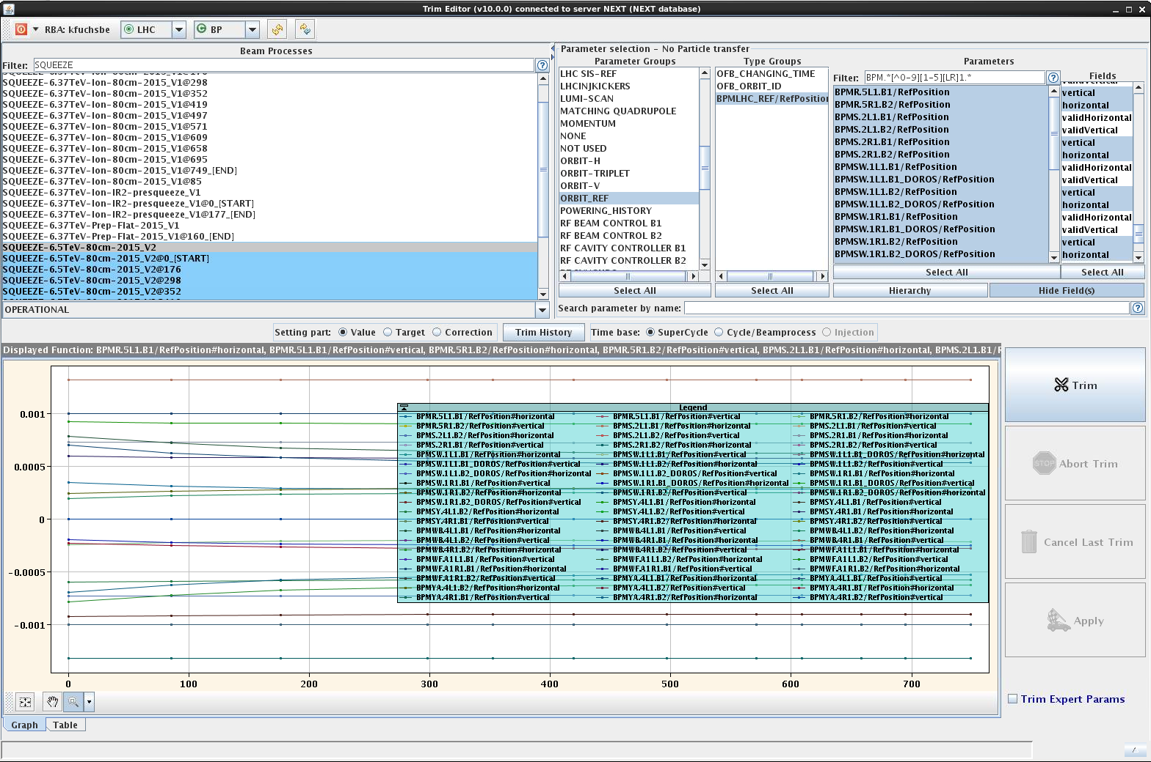
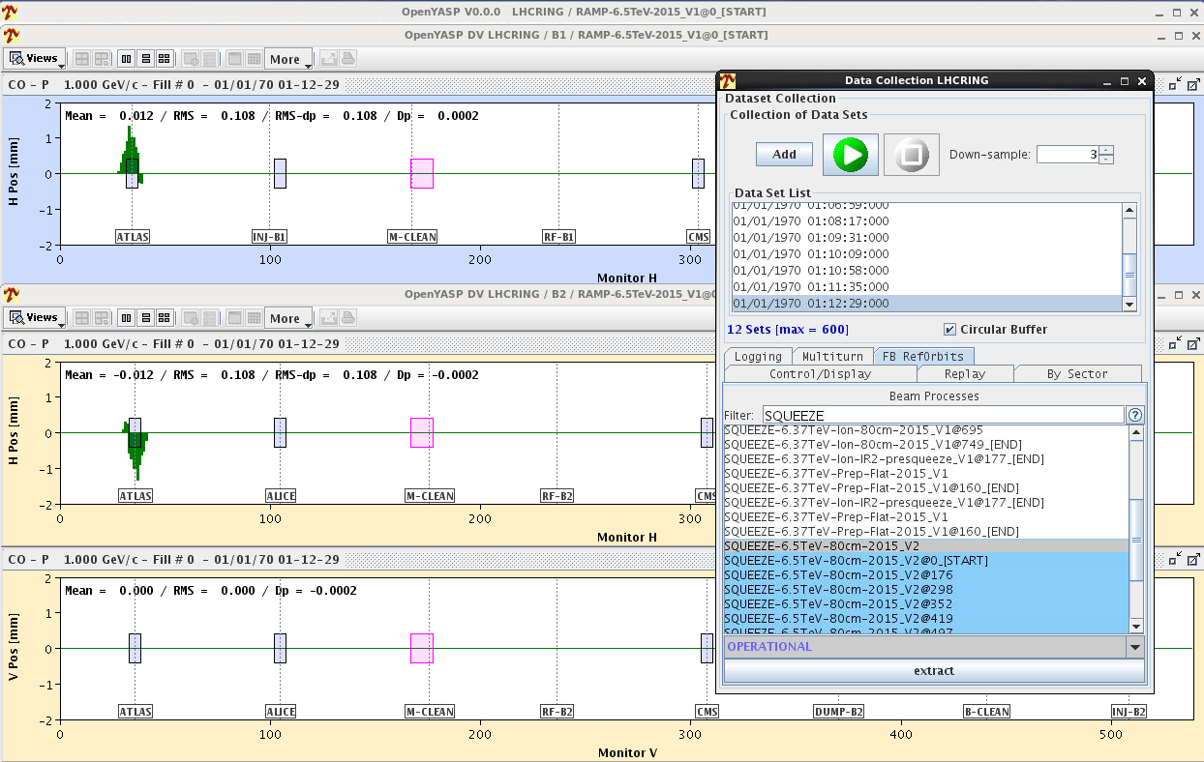
Reference orbits
After generation, the BPM functions are part of the settings of a beam process – they can be inspected in the trim application or visualized as orbits with the steering application.
  There are only values at the matched points, linear interpolation between points.

Slide 8
Tune
Tune values are obtained from the 4 BBQ devices (high sensitivity and gated for B1 & B2), the QFB can be configured dynamically to switch devices.
  The data rate can be configured, for Run 2 it was at 7.5 Hz for 2k turn FFTs.
For high intensity beams (i.e. ADT active) the performance of the tune feedback is always limited by the quality of the tune signals.
  The situation improved considerably in Run 2 with the signal gating on tune measurement bunches for which the ADT gain could be lowered (bucket range 1-450).
  Nevertheless even after FFT de-spiking (50 Hz...), the Q peaks remain broad and with 2k turns the peak positions are noisy (~0.001-0.003) for HI beams.
Tune reference system is rather crude and tricky to handle, therefore Q references are generally held constant (except during Q change beam process).

Slide 9
Power converters - FGCs
The power converters are controlled by a FGC (Function Generator Controller) with a digital control loop.
Each converter has a ramp rate (dI/dt) and acceleration rate (d²I/dt₂) limit.
  Limits are imposed by the PC and/or the Quench Protection System (QPS).
The FGC ensures that the ramp rate and acceleration limits are respected. The current changes will be clamped at the maximum rate in case of requests exceeding the limit.
  But QPS may trigger on a fake quench signal before…
The FGC has two inputs for current reference: function/setting input and a real time input. For every period it will combine the two sources and use the sum as new PC reference.
  While the FGC can pre-check a function for out of rate points (dI/di or accel.) this is not possible once RT data is superposed → clamp !
RT input
+
PC reference
Function input

Slide 10
Actuation – power converter control layer
Local gateways (by LHC point) receive control inputs (functions, state commands, RT inputs) through the accelerator technical network.
Data is exchanged between gateways and PC units over a RT Worldfip bus operated at 50 Hz.
The PC control loop is normally implemented in the FGC, but for Radiation resistant FGCs (FGClite) the loop is in the gateway (→ slower, more fragile).
  The 60A arc COD that moved to FGClite are now more fragile – one can trip the PC on noisy OFB input which was not the case before.
For orbit correctors the PC digital loop period is 80 milliseconds (12.5 Hz).
A design ‘error’ – should have been 20 ms!
WorldFIP bus

Slide 11
Circuits and QPS
All single beam orbit correctors (MCB, MCBC, MCBY, MCBW ...) are self-protected and have no QPS protection.
  The limits on ramp and acceleration rates are due to / enforced by the PC.
The common MCBX triplet correctors (600 A – on paper) are protected by a ,vintage‘ QPS system which cannot take into account PC induced voltage changes.
  Very sensitive to acceleration changes above injection energy (threshold from 2 V to 0.1/0.2 V @ 50 A).
  MPE does not want to touch / update the system.
  The MCBX are deactivated in the FB, all tests > 450 GeV ended with circuit trips (QPS triggers).
    MD note CERN-ACC-Note-2017-0015.
The MQT circuits are also protected by a QPS system which is also not able to subtract PC induced voltage changes.
  Many trips in Run 1 due to aggressive QFB gains (noise on Q signals → acceleration → QPS triggers).
  No more issues in Run 2 thanks to tune noise reduction (lower frequency, more turns in FFT, gated BBQ) and lower gain.
Developments in TE-MPE to improve such cases by including an independent current rate measurement into the QPS logic, should improve the situation for HL.

Slide 12
Orbit feedback loops
There are 3 loops in the OFB which can be operated independently:
  Orbit correction based on SVD algorithm – Orbit FB
  Horizontal orbit corrector strength stabilization (average ~ 0) – Energy FB
  Radial position stabilization – Radial FB
The radial FB acts on the B1 RF frequency (B2 frequency locked to B1) using RF FGCs.
  Technically the same mechanism of data transmission to the FGC than for orbit correctors.
  This loop is also handing the RF frequency modulation (Q‘ measurements).
    Due to the 25 Hz packet rate, too fast modulation frequencies lead to signal distortions !
  This loop is not used:
    At injection due to the SPS-LHC RF frequency coupling (rephasing).
      At injection the RF frequency is trimmed manually (ok !).
    In p-ion mode with unlocked RF frequencies (injection and ramp).
The ‚energy FB‘ is a loop that prevents a run-away of the horizontal orbit corrector strength – does not make sense to operate on its own.
  With many eigenvalues there can be a run-away of the corrector strengths if the radial error is not perfectly subtracted. Observed occasionaly at the LHC.

Slide 13
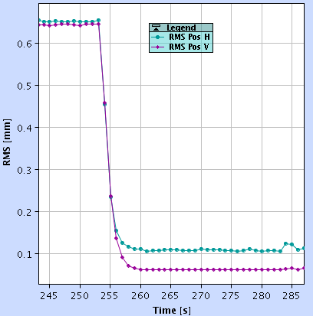
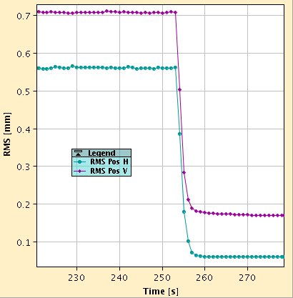
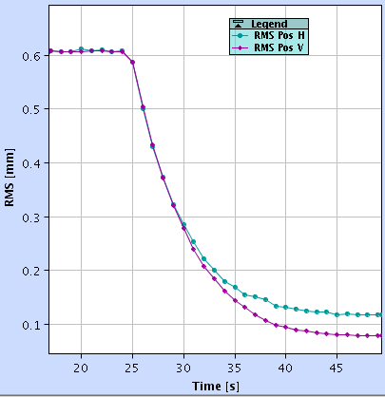
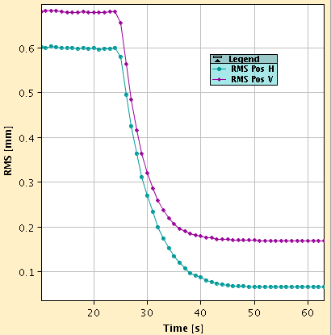
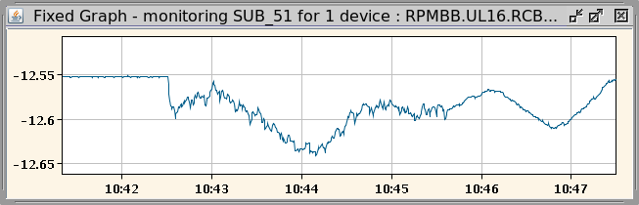
Feedback damping
Examples of steady state orbit error corrections.
  Gain scaling = 1 corresponds to the ‚default‘ gain.
Typical settings:
  1 : injection
  2-4 : ramp, squeeze
  0.2 : stable beams
  > 10-15: loop may become unstable...
Gain scaling = 4
Damping ~4 s
Impact of the OFB gain on the current ripple on MCBX @ injection → BPM / orbit noise (here one bunch)
Gain scaling = 2
Gain scaling = 1
Gain scaling = 1
10 mA
Damping ~15 s

Slide 14


Feedback usage in the cycle
Triggered by timing event
Settings loading
Triggered by hand/sequencer
QFB
OFF
ON
ON
OFF
Ref.
Injection tunes
Collisions tunes
OFB
OFF
ON
OFF
ON
ON
ON
OFF
Ref.
Injection
Xing/sep
Optics
Injection optics
Injection optics
Energy
Preparation
(no beam)
Injection
pilot
Injection
nominal
Ramp
FT
Squeeze
Collisions

Slide 15
Operational experience in Run 2
The experience with the OFB during Run 2 was excellent, no major issues. Small control bugs could be quickly fixed in 2015-2016 (thanks in part to the OP testbed).
  The performance in terms of stability is limited by the BPM reading quality.
  Some technical issues detected by OP and BI (not commonly know).
    Optics consistency, data transfer latencies for reference orbits → see Run 3 outlook.
  The absence of MCBX had no real negative impact.
In stable beams the performance of the OFB was limited by:
  BPM quality → limits how agressive one can correct, limited number of eigenvalues to 40 in SB (versus 300-400 for the ramp / squeeze).
  Speed of reference orbit update: luminosity or vdm scans had to be made without reference change at every step, implying either OFB off or small number of eigenvalues.
    But impact of OFB on scans can be easily reconstructed/corrected offline.

Slide 16
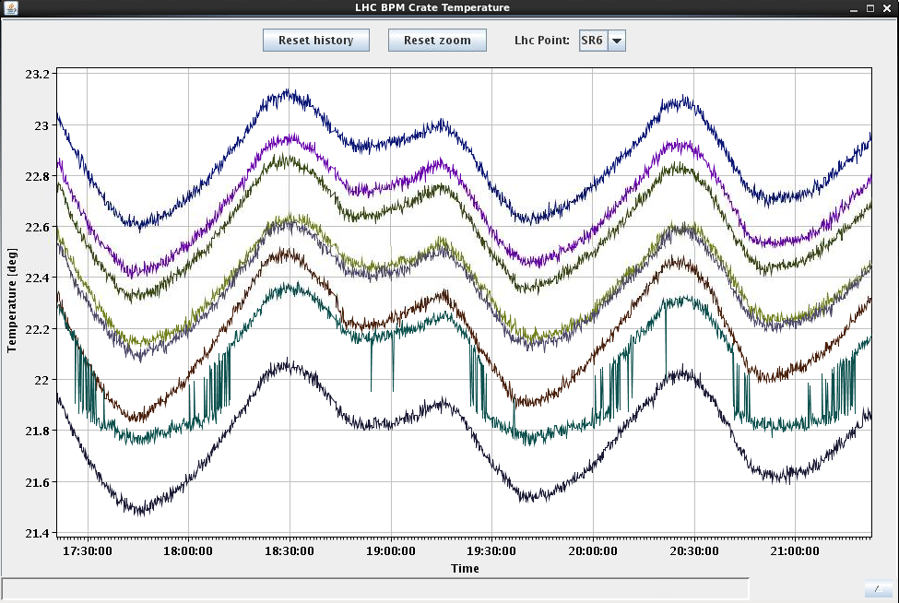
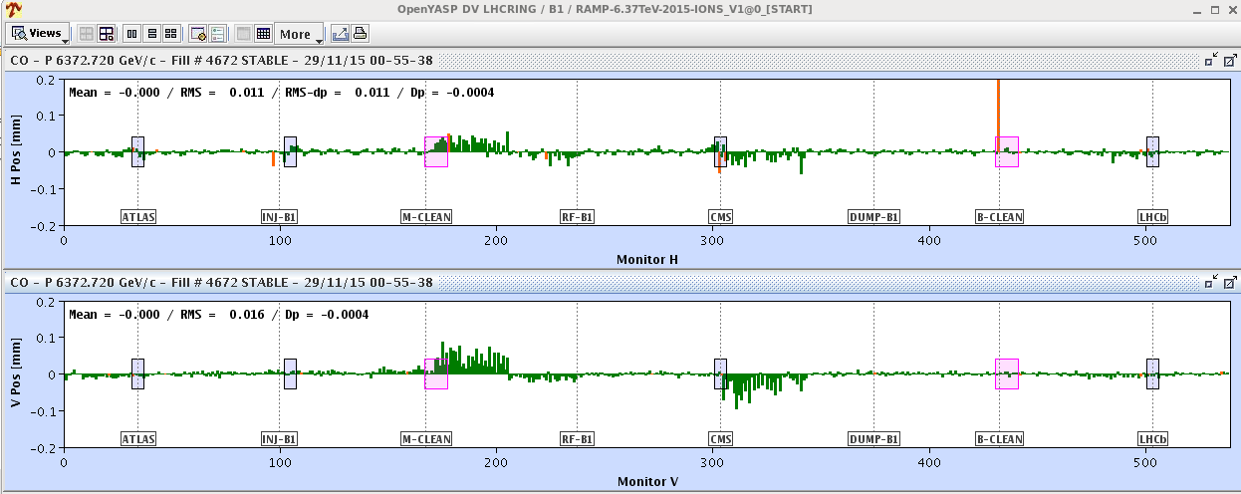
Limitations – BPM quality
Residual temperature variations of the temperature stabilized BPM electronics racks (most likely) generate systematic reading errors of the BPMs.
  Aggressive steering will transfer those offsets to the actual beam orbit.
  One of the reasons to apply only very gentle corrections during stable beams.
Residual temp oscillations cause introduce small fake orbit structures

Slide 17
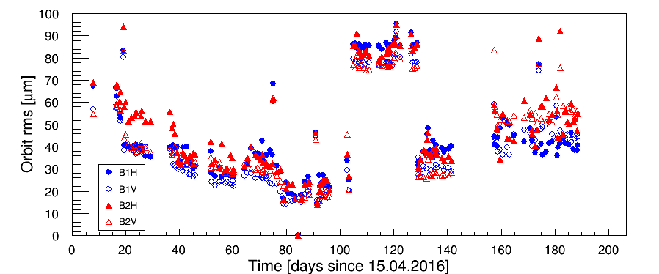
Global orbit
The orbit reproducibility (excluding the experimental IRs) over a run:
  Short term reproducibility ~20 μm,
  Long term reproducibility ~40-60 μm.
  Incorrect BPM calibrations have a significant impact !
Evolution of the orbit rms in 2016
orbit RMS evolution wrt reference on 14.07.2016 for 25 ns beam fills
BPM calibration !

Slide 18
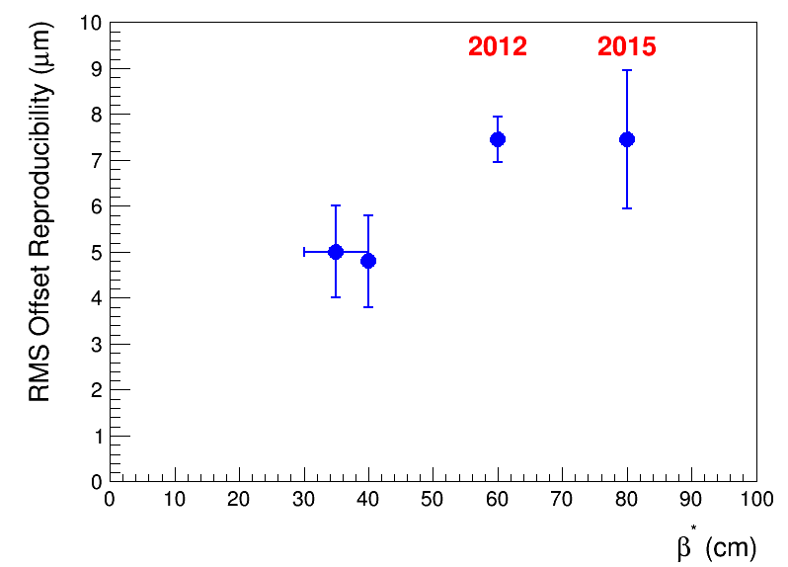
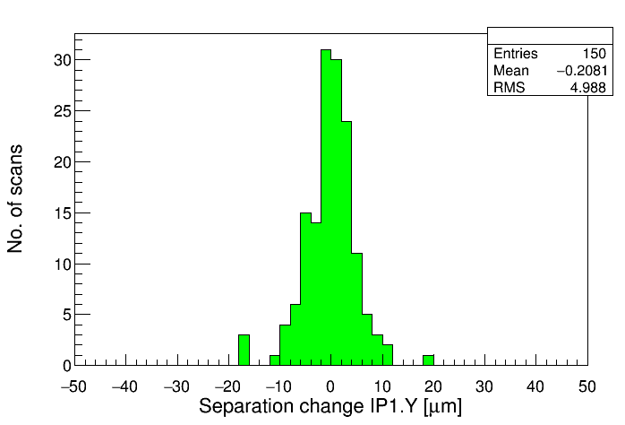
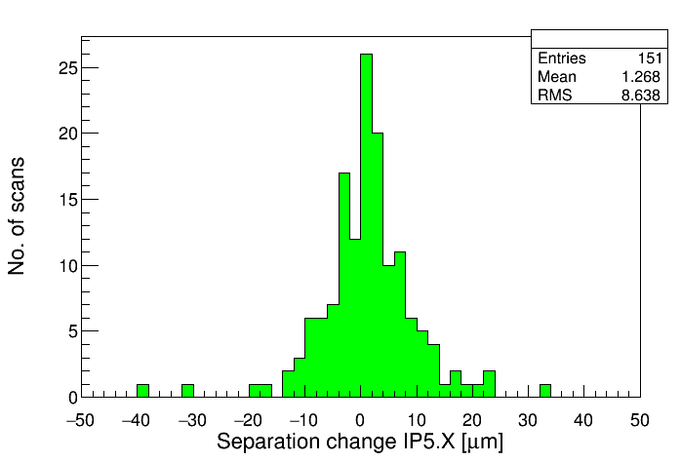
IP reproducibility
The fill-to-fill IP reproducibility, obtained from the corrections applied to steer the beams head-on, is typically around ½ σ.
  No degradation @ lower β*
Examples of Fill-to-fill IP separation changes in 2016, rms ~ ½ σ
IP1V
IP5H

Slide 19
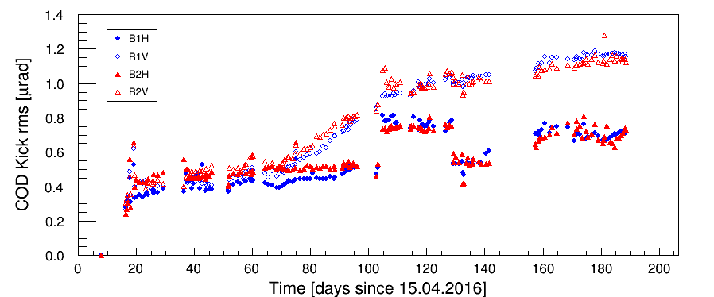
RT trim amplitudes
Over a typical year, machine drifts eat up no more than 1 μrad of kick strength (rms value) in the arcs (max kick of a magnet ~ 80 μrad).
  Rms kick strength needed to correct the orbit (flat): ~10-15 μrad
Evolution of the RT trim strengths in 2016
Arc corrector kick RMS evolution for 25 ns beam fills
BPM calibration issue

Slide 20
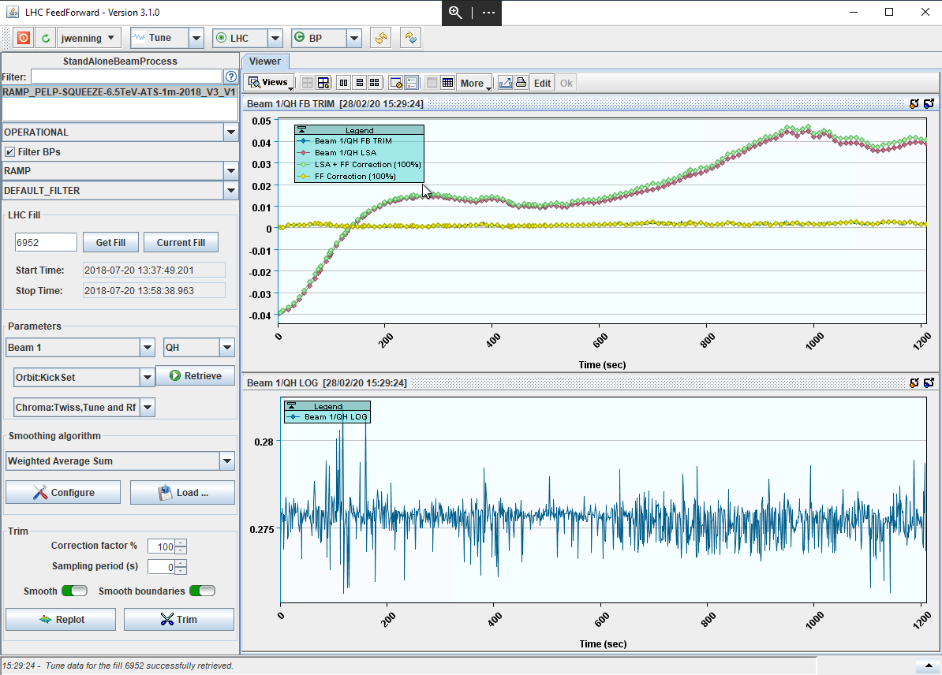
Operational aspects – Feed-forward
A feed-forward (FF) application to maintain the RT trims of the FBs as small as possible is used by OP.
  FF of logged RT trims to the PC functions.
  Minimizes issues of FB outages (QFB off due to poor Q signal quality !).
  For tunes: a single FF per run and cycle – ultra-stable above ~1 TeV.
    Below 1 TeV some fill-to-fill changes due to imperfect Q decay / snapback modelling.
  For orbit: one initial FF (in a couple of iterations) and one FF per technical stop are sufficient.
    FF in TS not even strictly needed.

Slide 21
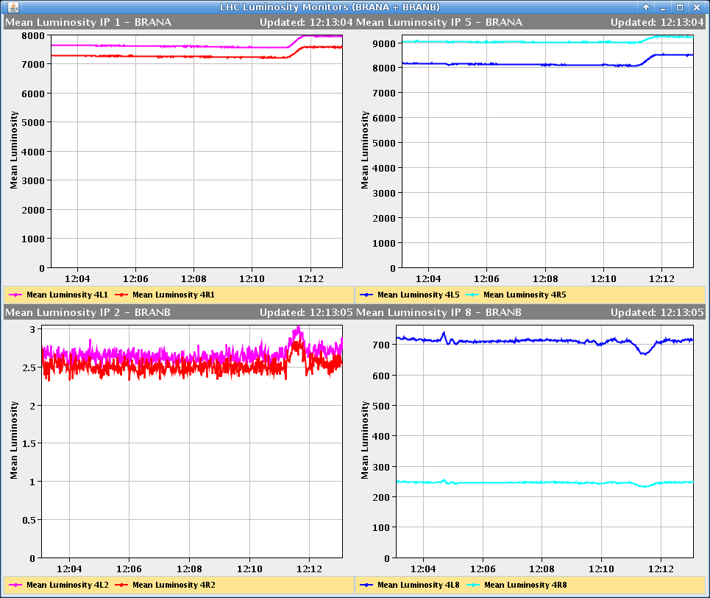
Operational experience in Run 2
The OFB performed similarly well for β* levelling.
  Complex mechanism involving many control system components in synchronism.
  Levelling trim preparation was slowed down by data transfer between the two FB servers.
    Not a real issue.
  This levelling type is more tricky for levelled experiments (luminosity slope), in part due to the ATS optics in TELE mode.
    Very strict protocol was required to maintain luminosity transients < 5-10% (mostly ALICE, should be OK for upgraded detector in Run 3).
    Z shifts appeared in LHCb due to coupling of H offsets due to β* levelling and Xing angle.
      Fixed with feed-forward trims.
IP1
IP5
IP2
IP8
β* levelling
(a ‘bad’ example)

Slide 22
Run 3 prospects - orbit
A major re-design of the feedback server by BE-BI is in progress during LS2, with support by BE-OP to define the functionality and to set up testing and high level control.
The two servers will be merged into a single FESA3 server with complete overhaul of the properties and cleaned up functionality.
  Better property structure for accessing the server,
  Much improved handling of optics and references,
    Could potentially update references during luminosity/vdm scans.
  Much more diagnostics for debugging and testing,
  Removal of the intra-server communication (was a bottleneck for settings updates),
  Deployment of local instances for testing.
Work on the server is in full swing, the first ~ complete functionality should be available in the coming 1-2 months.
As this server is super-critical for operation, BE-OP is upgrading the test environment including the possibility to close the loop (but not at 25 Hz).

Slide 23
Run 3 prospects - tune
The re-design of the feedback server will eventually also apply to the QFB (not started).
  Overall clean-up (same than for orbit),
  Proper tune functions.
The BBQ front-ends will be upgraded to FESA3 and partially redesigned (try to keep some continuity wherever possible).
  FFT will be moved out of the firmware to FEC → option to implement more easily noise reducton filters and other goodies.
  Proper functions for the tune windows for peak search are required to make use of QFB tune functions. In negotiation with BI-SW.

Slide 24
Run 3 prospects - performance
Except for the controls aspect, there are no major changes for Run 3 (BPM, COD, QPS systems unchanged): expect similar performance than in Run 2 – smooth !
  β* levelling was already demonstrated, should be ‚faster‘ in terms of preparation time.
  With more frequent β* levelling and over a wider range, more opportunities to fine tune the process.
    Levelling in TELE mode is very easy in ATLAS & CMS since no settings change in those IRs, more tricky in ALICE and LHCb.
The only ‚missing item‘ remains at the level of the MCBX – do not really expect a change.
  Risk of loosing a fill without real gain seems to high.
  But continue testing as this reveals many features (minor hickups) in the systems (QPS, PC, FB).
The Run 3 system is ready for HL – I see no issues (IT CODs included or not).

