Slide 1




CLIC-Module Meeting
Week 09 – 2020
A. Castilla
a.castilla@cern.ch

Slide 2
XBOX3 – Lines A&B Functional Diagram

Slide 3
XBOX3 – Lines A&B Functional Diagram (zoom)
LOAD
Flow meter
CHILLER

Slide 4
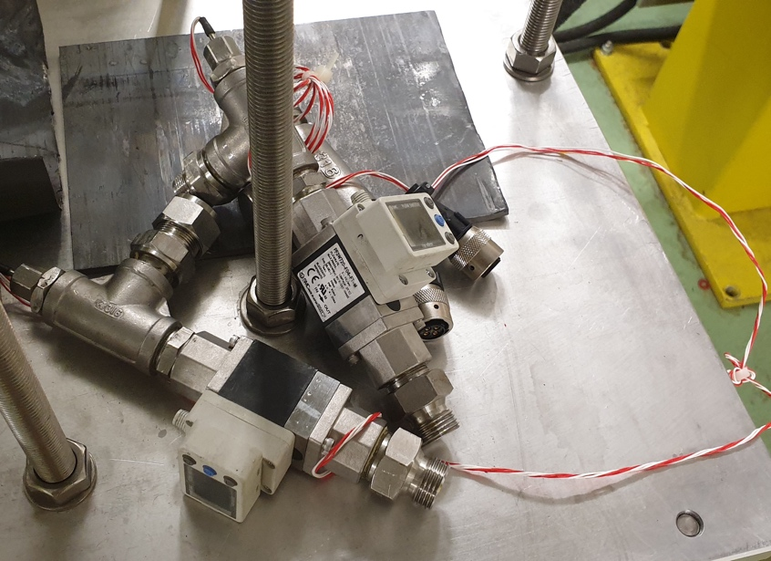
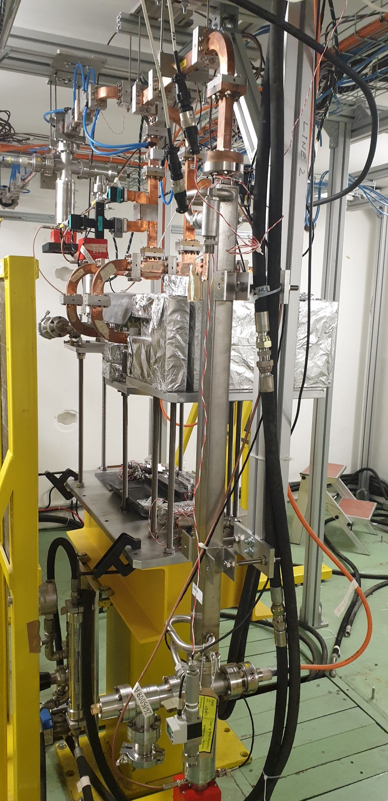
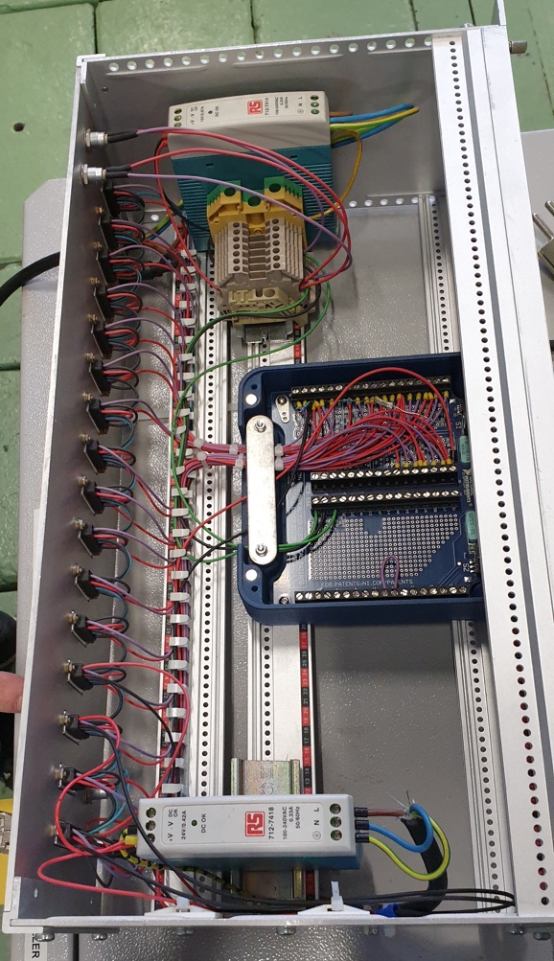
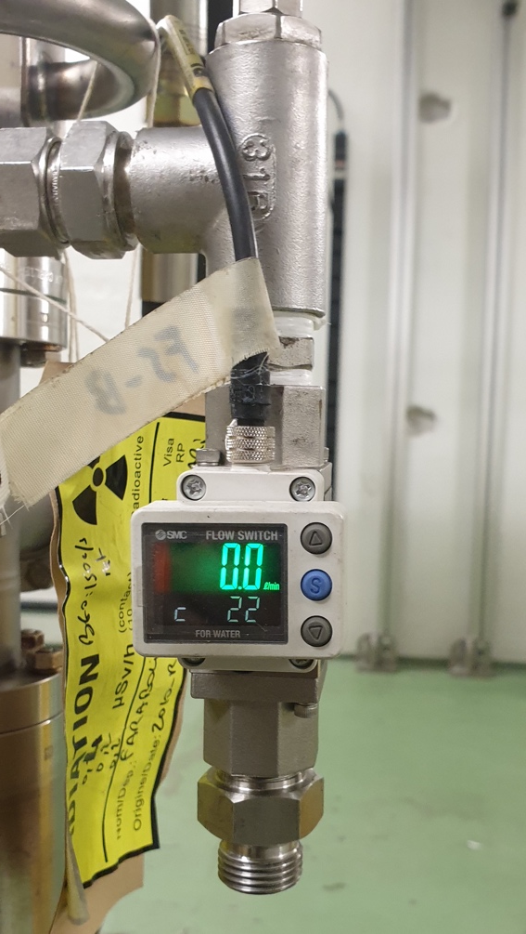
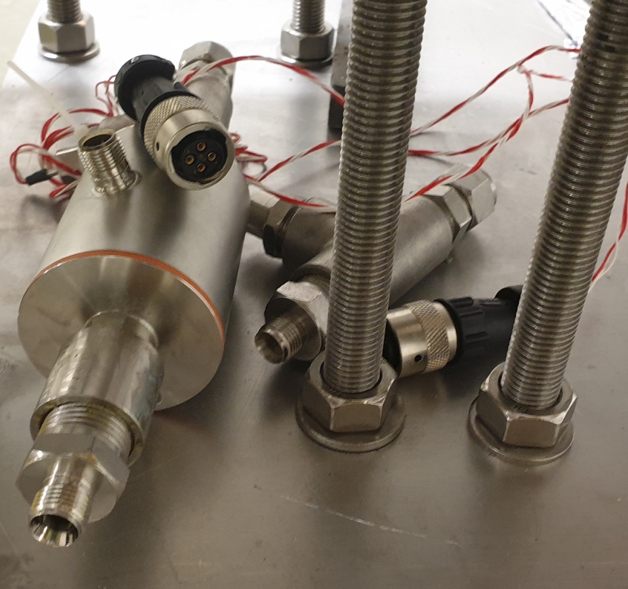
Flow meters – XB3
Flow meters and switches available.
Vacuum channels available.

Slide 5
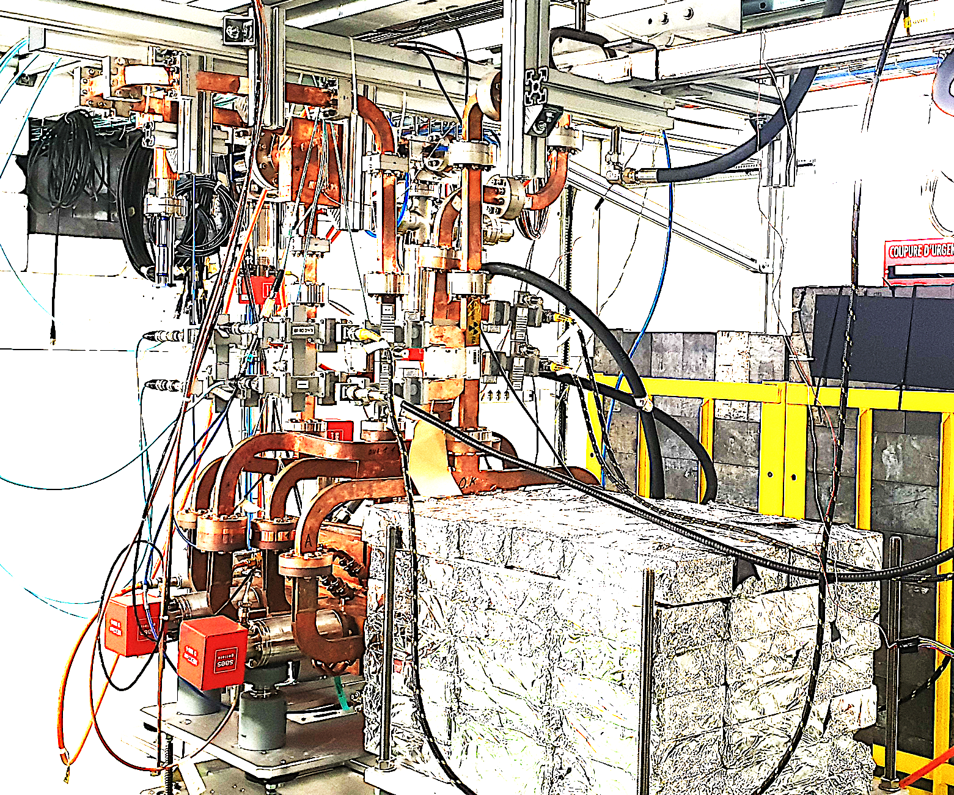
XBox2 – SS

Slide 6
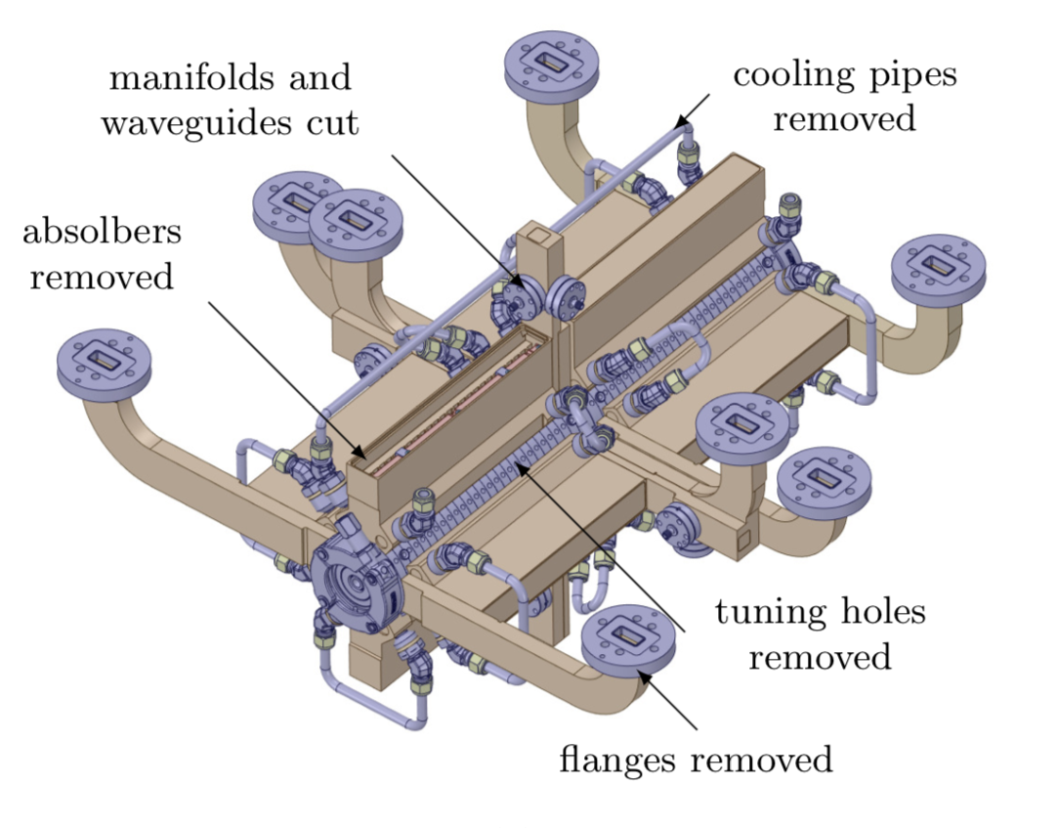
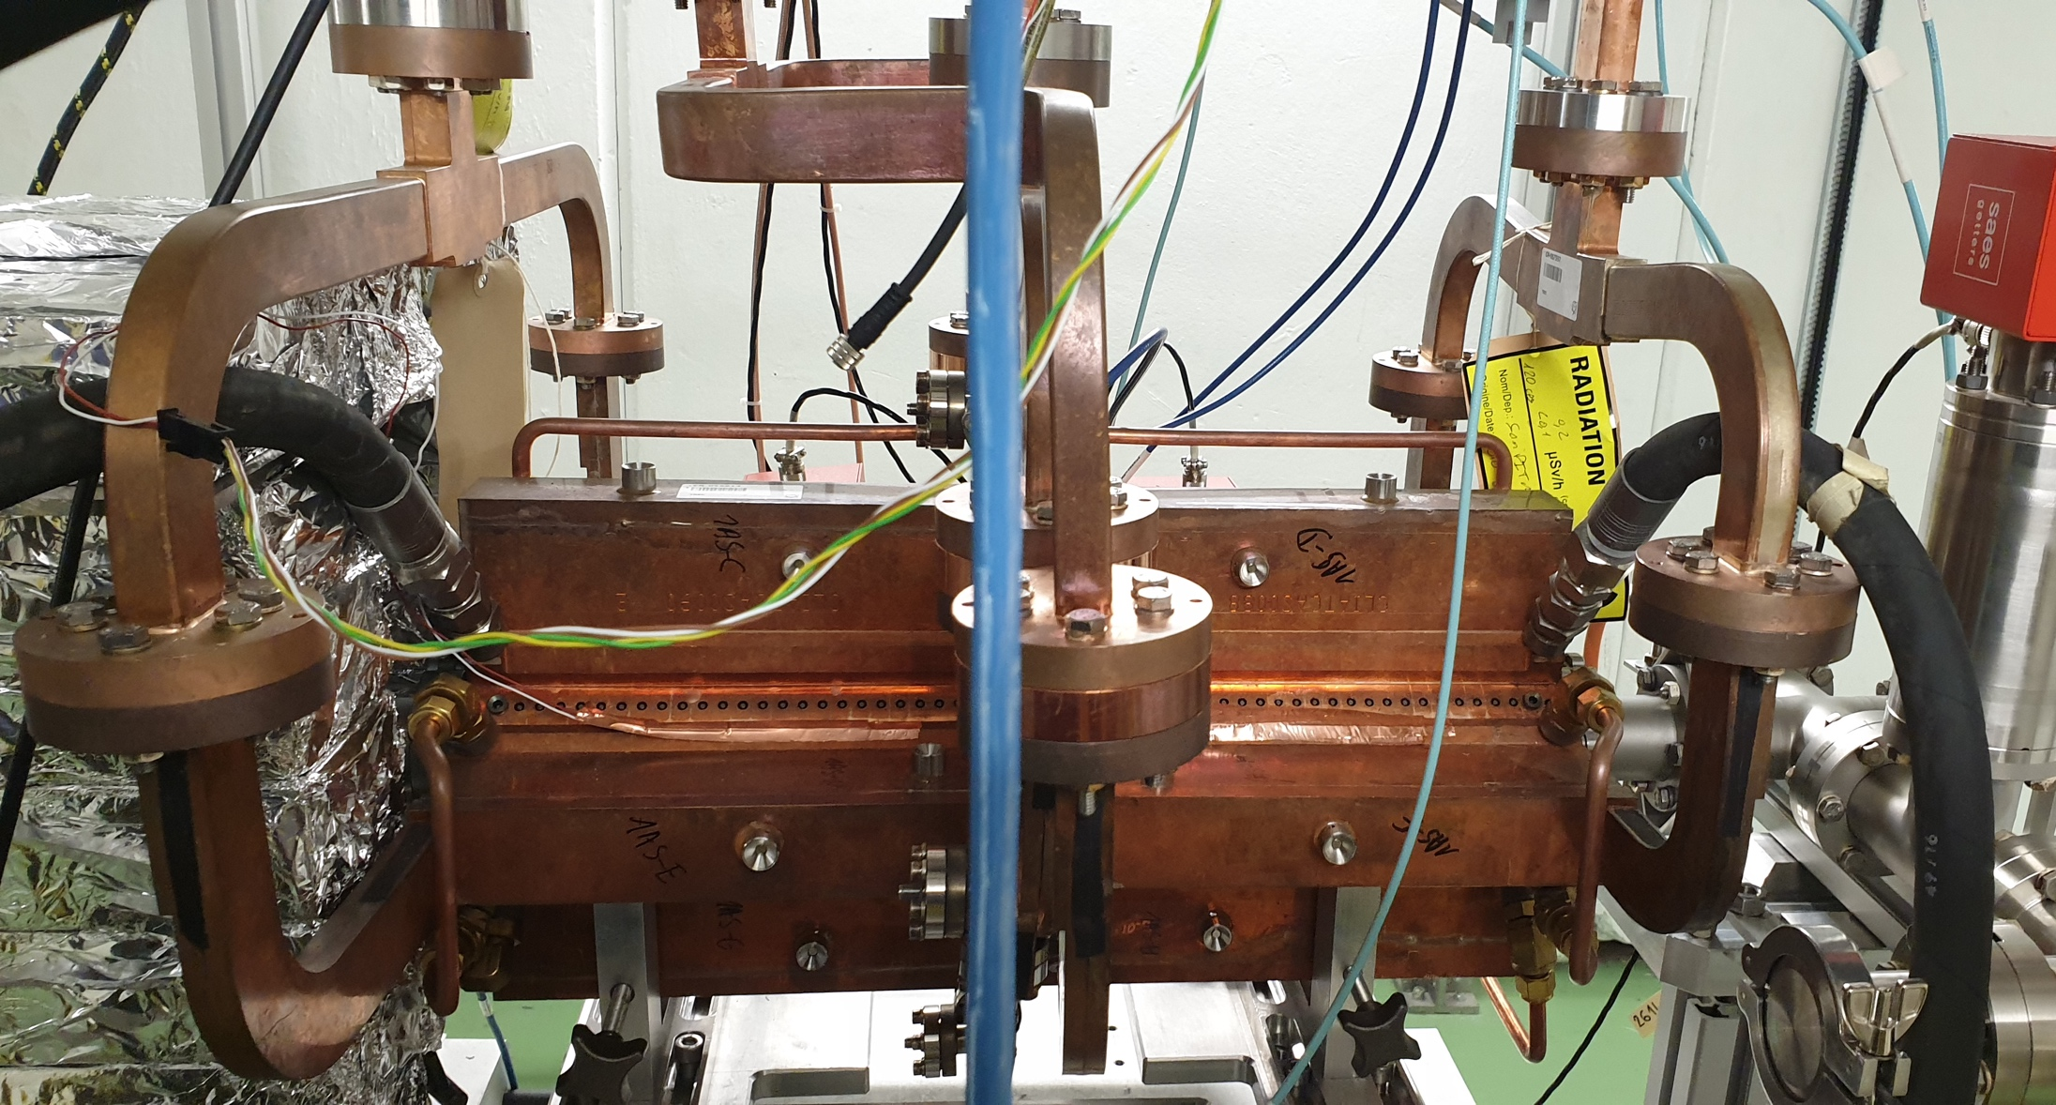
Cooling Circuit - Series

Slide 7
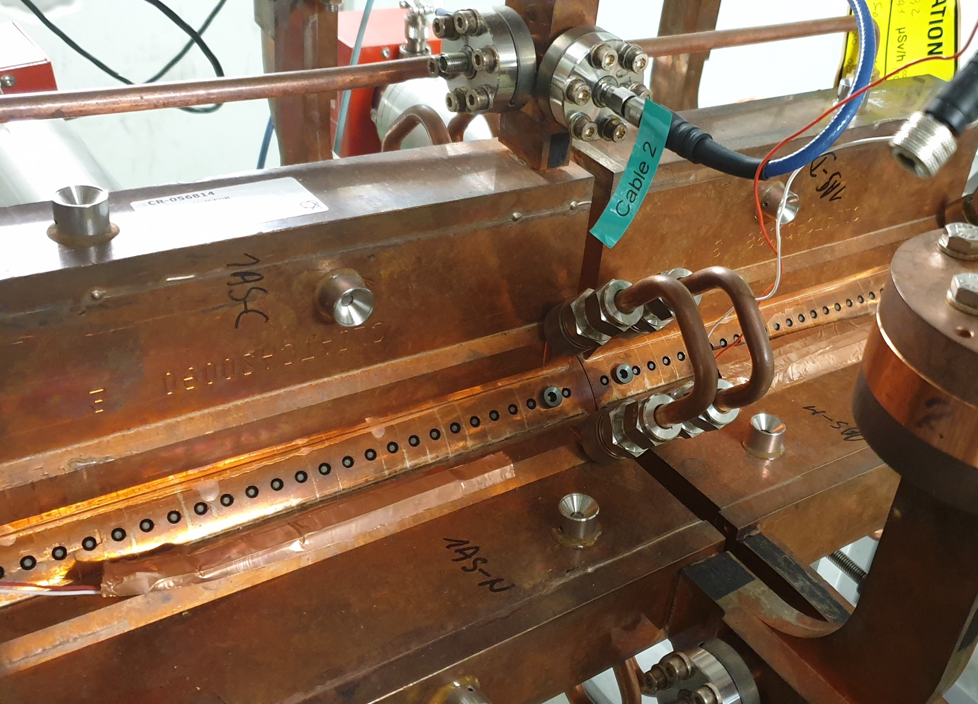
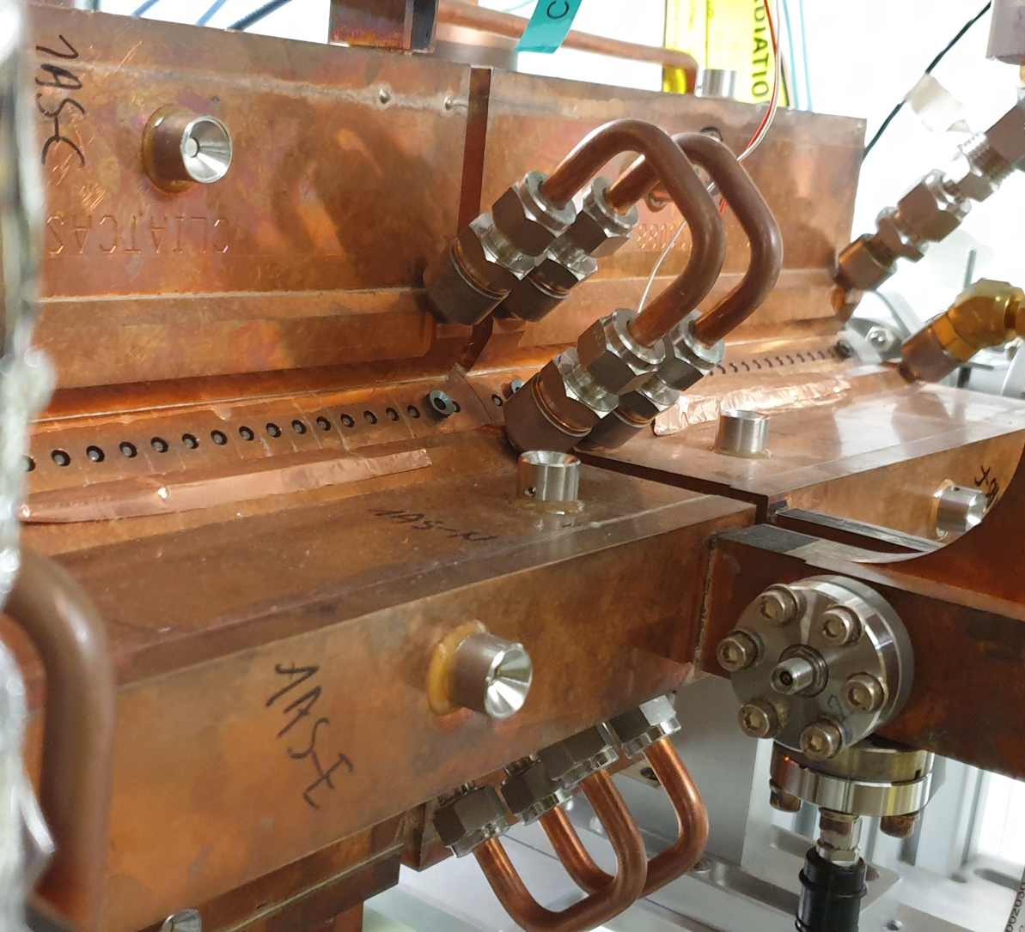
Temperature Sensors
Measure external temperature of the structure, depends on the contact.

Slide 8
Wrap up
Flow meters available.
Resolution need to be checked.
Xbox 3 has a semi-easy way to add the channels.
Xbox 3 has envisioned high repetition tests (>400 Hz).
Xbox 2 holds the super structure.
Xbox 2 acquisition system is different and may prove harder to incorporate.
Structure powers well acquired in all the Xboxes.
Structure temperature measured by contact on the outside of its walls.

